Slide 1
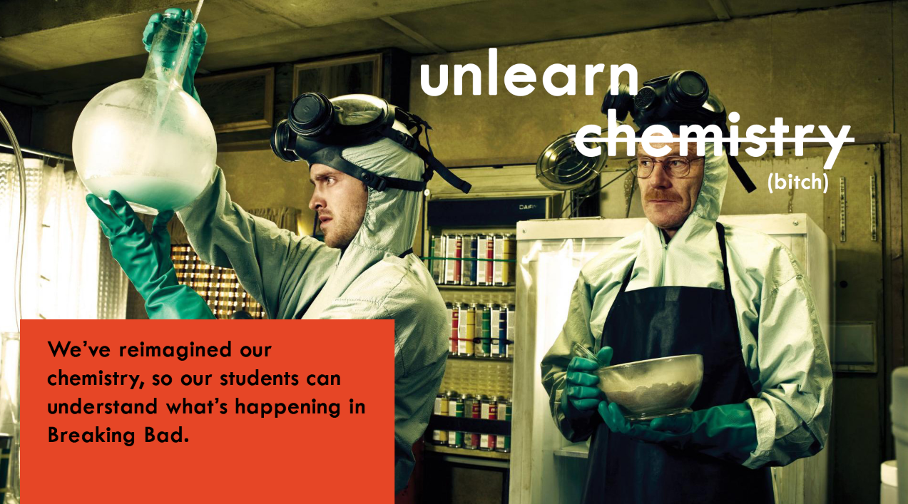
Weber Liu

Slide 2
Contents
Acidic and basic salts
Titration and shit
Layout
The concept
The calculations
The example
The past paper questions

Slide 3
ACIDIC AND BASIC SALTS: The concept
When a salt dissolves in water, it forms the anion and cation
The cation can either
react with the water (if it is a weak acid/base with a weak conjugate)
not react with the water (if it a very weak acid/base with a strong conjugate, or is a metal ion)
The anion can also either
react with water (if it is a weak acid/base with a weak conjugate)
not react with the water (if it is a very weak acid/base with a strong conjugate)

Slide 4
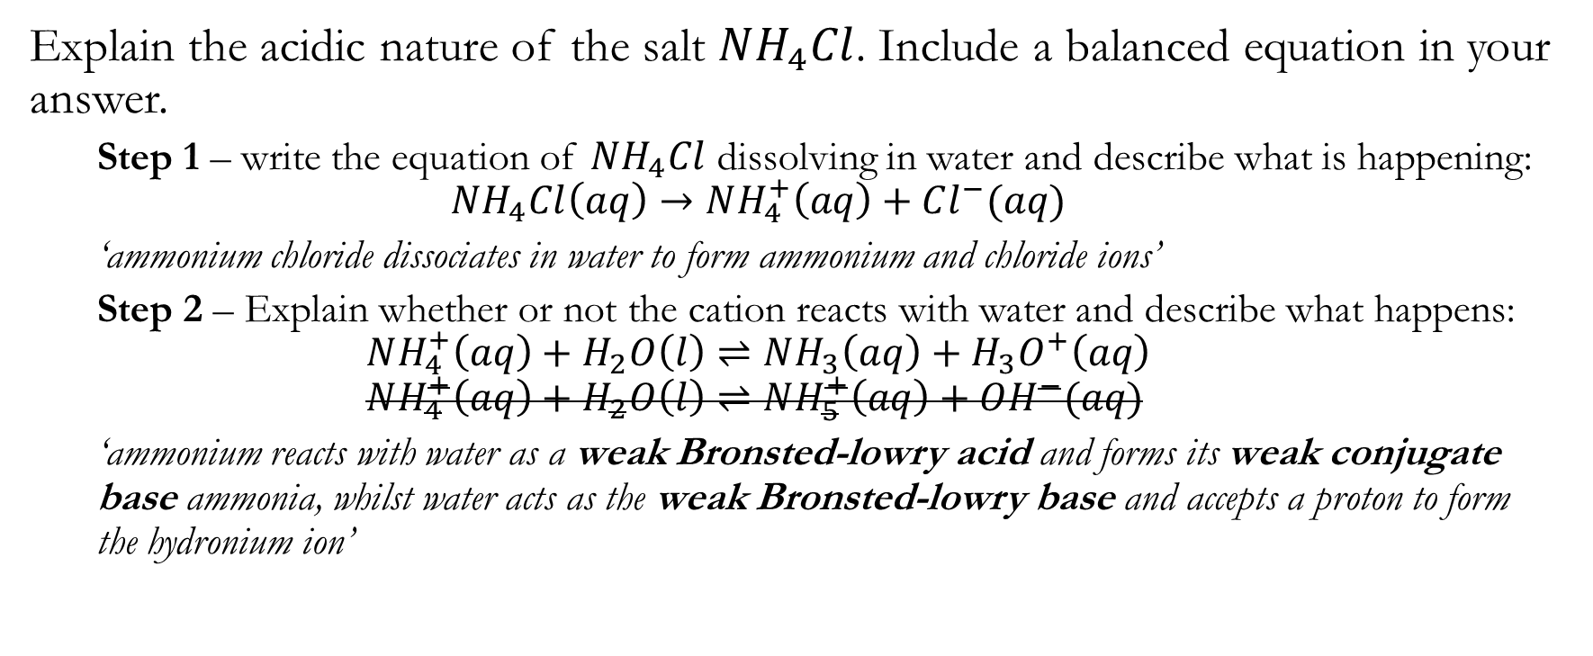
ACIDIC AND BASIC SALTS: The calculation/ formula and example
Explain the acidic nature of the salt $NH_{4}Cl$. Include a balanced equation in your answer.
Step 1 – write the equation of $NH_{4}Cl$ dissolving in water and describe what is happening:
$$NH_{4}Cl\left(aq\right)→NH_{4}^{+}\left(aq\right)+Cl^{−}(aq)$$
‘ammonium chloride dissociates in water to form ammonium and chloride ions’
Step 2 – Explain whether or not the cation reacts with water and describe what happens:
$$NH_{4}^{+}\left(aq\right)+H_{2}O\left(l\right)⇌NH_{3}\left(aq\right)+H_{3}O^{+}\left(aq\right) \\ NH_{4}^{+}\left(aq\right)+H_{2}O\left(l\right)⇌NH_{5}^{+}\left(aq\right)+OH^{−}(aq)$$
‘ammonium reacts with water as a weak Bronsted-lowry acid and forms its weak conjugate base ammonia, whilst water acts as the weak Bronsted-lowry base and accepts a proton to form the hydronium ion’

Slide 5
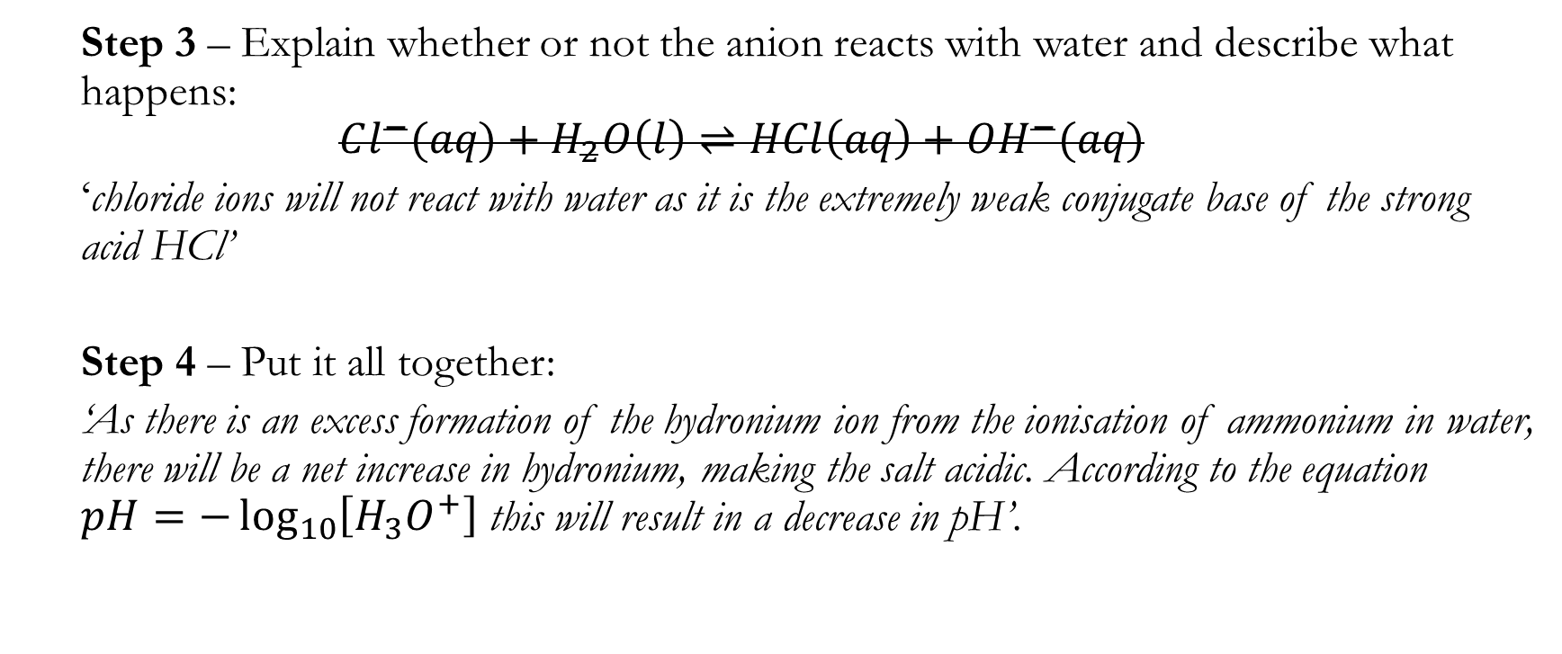
ACIDIC AND BASIC SALTS: The calculation/ formula and example
Step 3 – Explain whether or not the anion reacts with water and describe what happens:
$$Cl^{−}(aq)+H_{2}O\left(l\right)⇌HCl\left(aq\right)+OH^{−}(aq)$$
‘chloride ions will not react with water as it is the extremely weak conjugate base of the strong acid HCl’
Step 4 – Put it all together:
‘As there is an excess formation of the hydronium ion from the ionisation of ammonium in water, there will be a net increase in hydronium, making the salt acidic. According to the equation $pH=−\log_{10}\left[H_{3}O^{+}\right]$ this will result in a decrease in pH’.

Slide 6
ACIDIC AND BASIC SALTS: The past paper question
Question:
Explain why the salt, sodium acetate, forms a basic solution when dissolved in water. Include an equation in your answer.
(HSC 2015 Q24(a))
Remember:
Dissolution
Ionisation of acid/base (+ Bronsted-Lowry Conjugate acid/base)
Put it together

Slide 7
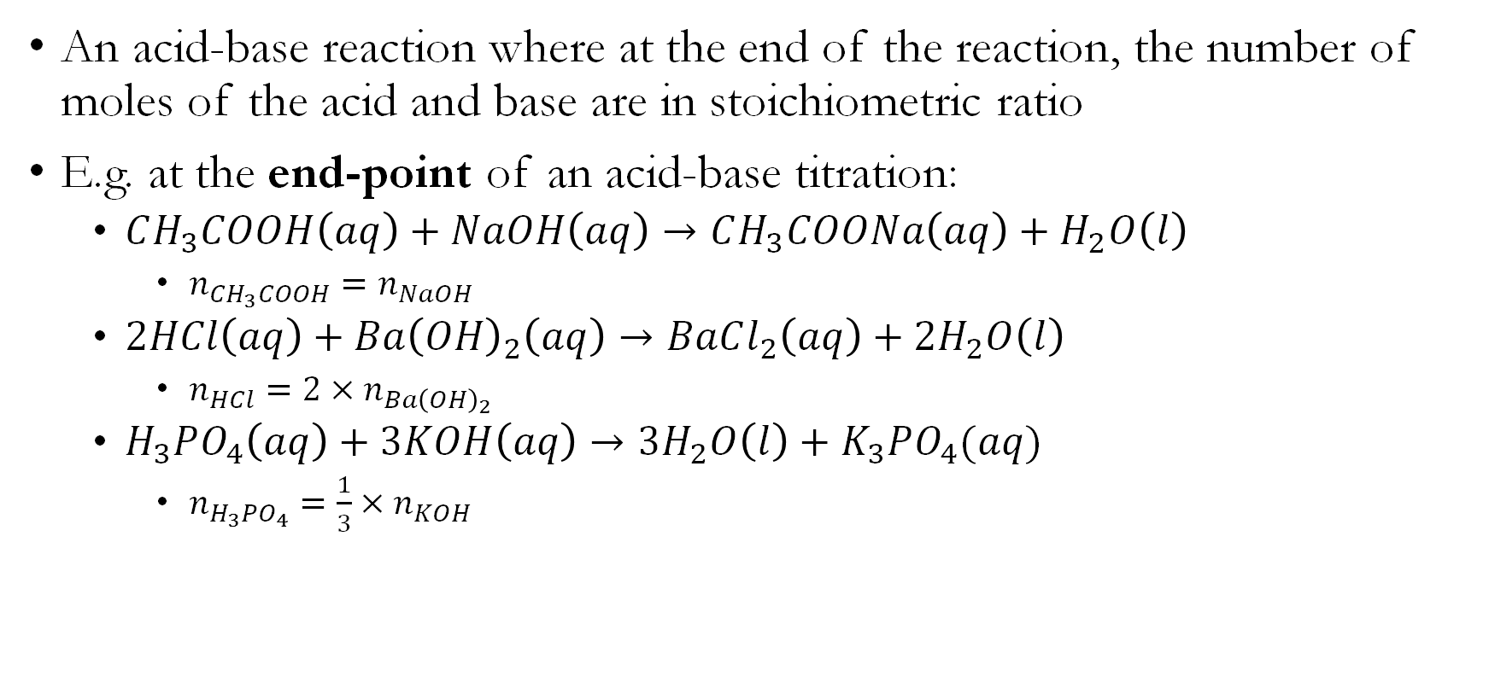
TITRATION: The concept
An acid-base reaction where at the end of the reaction, the number of moles of the acid and base are in stoichiometric ratio
E.g. at the end-point of an acid-base titration:
$CH_{3}COOH\left(aq\right)+NaOH\left(aq\right)→CH_{3}COONa\left(aq\right)+H_{2}O\left(l\right)$
$n_{CH_{3}COOH}=n_{NaOH}$
$2HCl\left(aq\right)+Ba{\left(OH\right)}_{2}\left(aq\right)→BaCl_{2}\left(aq\right)+2H_{2}O\left(l\right)$
$n_{HCl}=2×n_{Ba{\left(OH\right)}_{2}}$
$H_{3}PO_{4}\left(aq\right)+3KOH\left(aq\right)→3H_{2}O\left(l\right)+K_{3}PO_{4}(aq)$
$n_{H_{3}PO_{4}}=\frac{1}{3}×n_{KOH}$

Slide 8

TITRATION: The example
A 25mL aliquot of $HCl$ of unknown concentration was titrated again a 0.1005M solution of $NaOH$. The average titre volume was 16.73mL. Determine the concentration of $HCl$.

Slide 9

TITRATION: The example ( stepping it up)
A 25mL of $H_{2}SO_{4}$ of an unknown concentration was diluted to 500mL in a volumetric flask. 25mL of the diluted solution was then titrated again a 0.670M solution of $KOH$. The titre volumes were as follows:
Determine the original concentration of $H_{2}SO_{4}$.
Titration volume #1 | 23.6 mL
Titration volume #2 | 21.62 mL
Titration volume #2 | 21.65mL
Titration volume #2 | 22.60mL
Titration volume #2 | 21.58mL

Slide 10
TITRATION: The even harder example ( hit me up with the back titration fam)
Seashells contain a mixture of carbonate compounds. The standardised hydrochloric acid (c = 0.200M) was used to determine the percentage by mass of carbonate in a seashell using the following procedure.
A 0.145 g sample of the seashell was placed in a conical flask.
50.0 mL of the standardised hydrochloric acid was added to the conical flask.
At the completion of the reaction, the mixture in the conical flask was titrated with 0.250M sodium hydroxide.
The volume of sodium hydroxide used in the titration was 29.5 mL. Calculate the percentage by mass of carbonate in the sample of the seashell. (HSC 2016 Q29(b))

Slide 11
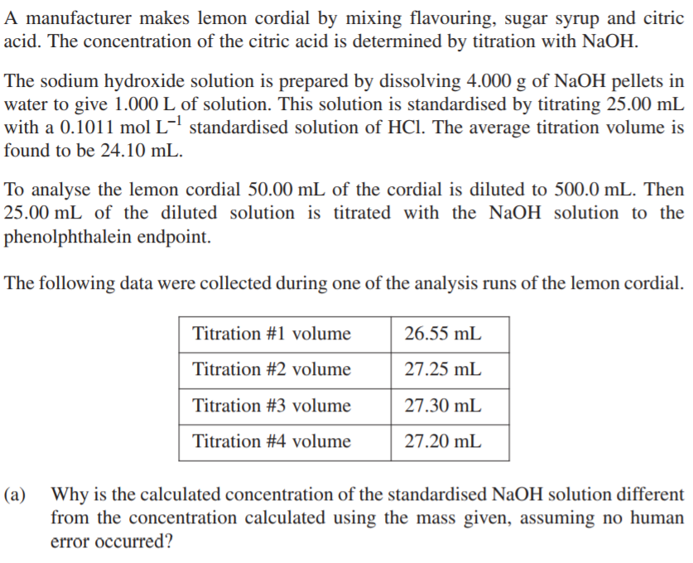
TITRATION: The calculation
Remember:
Figure out the story
Write out the formula
Write out the mathematical equation
Substitute values into the equation
Calculate and write the final answer with correct S.F. and units

