Slide 1
Neural Networks
Medical Image Analysis
Koen Van Leemput
Fall 2023

Slide 2
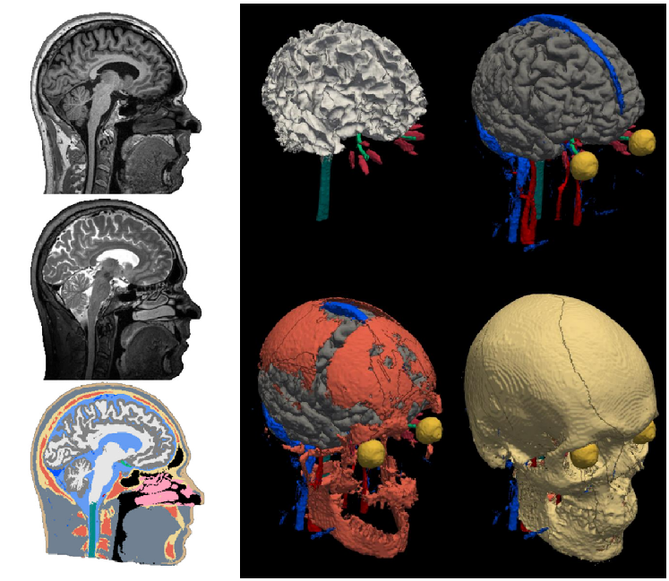
Focus: automatic segmentation
images
segmentation

Slide 3






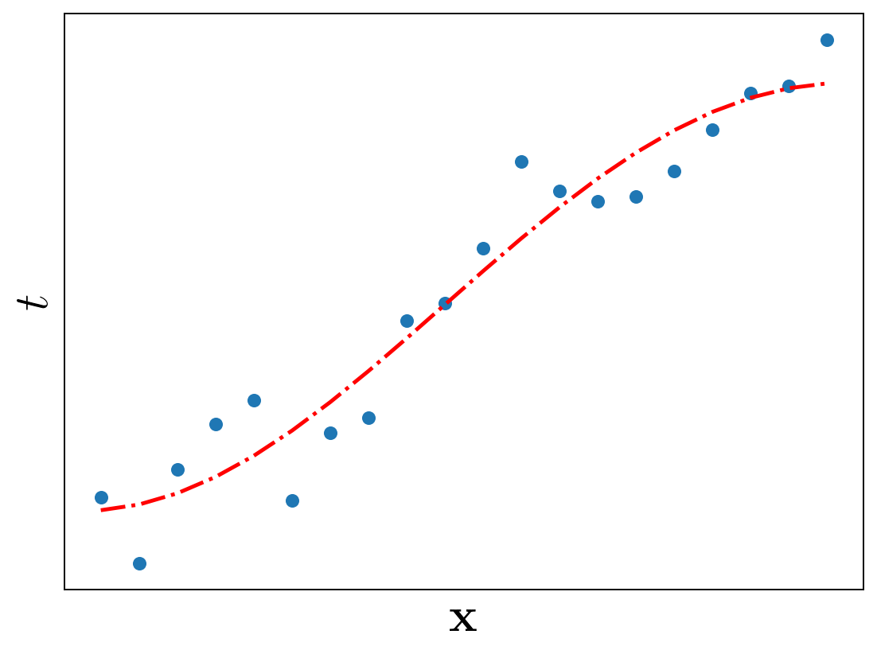
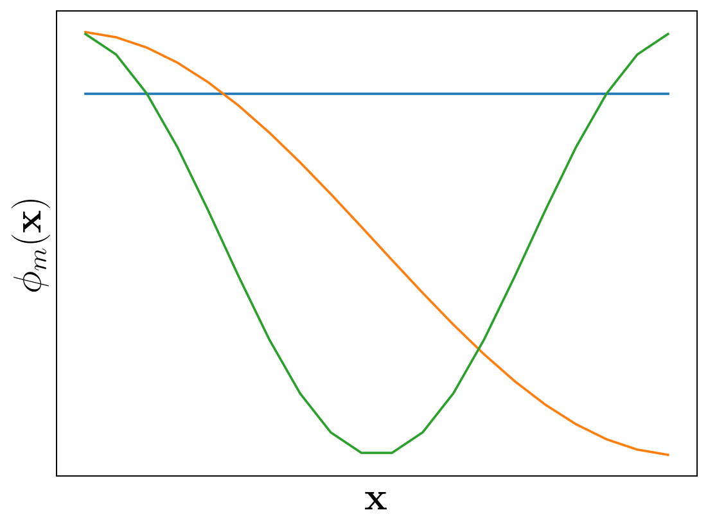
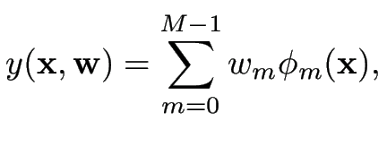
Remember linear regression?
  Let denote an input vector in a -dimensional space
  Given measurements at inputs , what is at a new input ?
nonlinear basis functions
tunable weights

Slide 4
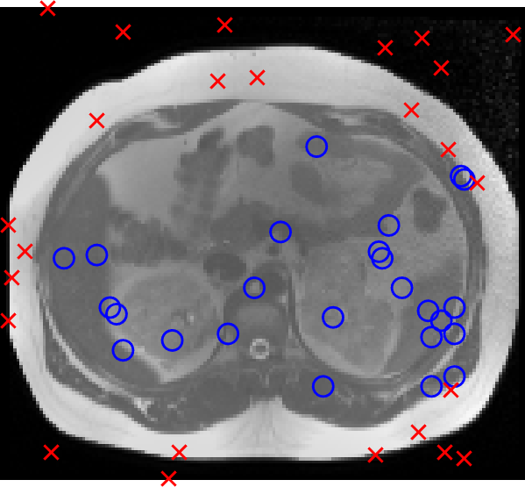
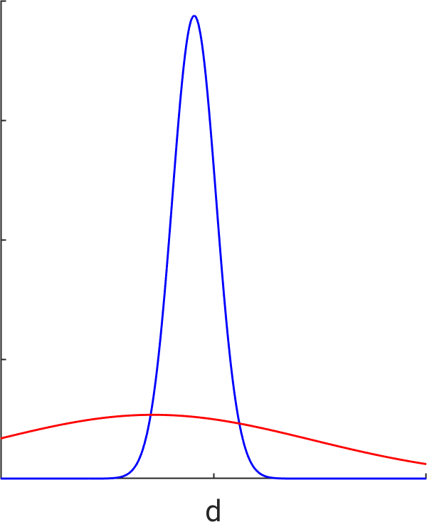
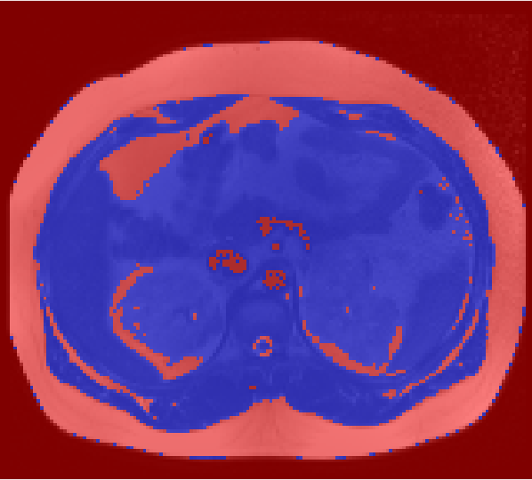

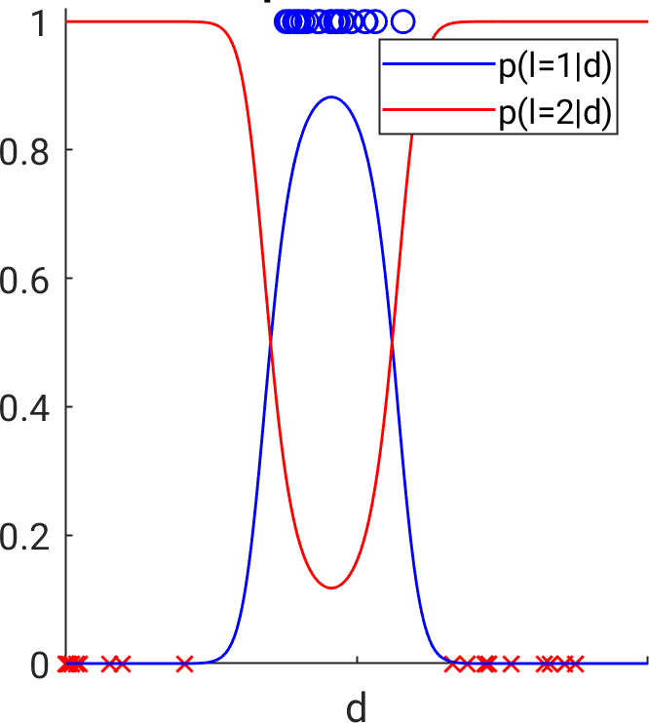

Remember the Gaussian mixture model?
  Posterior using Bayes’ rule:

Slide 5
Remember the Gaussian mixture model?
new notation/terminology:
- “training samples”
- “t=1” if l=1
- “t=0” if l=2
  Posterior using Bayes’ rule:

Slide 6


Remember the Gaussian mixture model?
This lecture: can we get a “classifier”
directly
without a model?
new notation/terminology:
- “training samples”
- “t=1” if l=1
- “t=0” if l=2
  Posterior using Bayes’ rule:

Slide 7
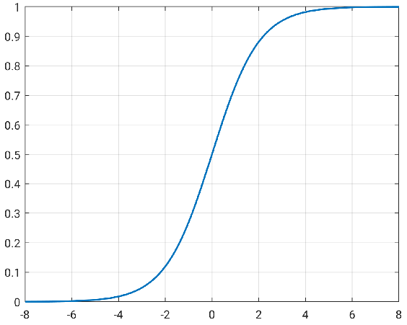

Logistic regression
  Logistic function as a “squashing” function

Slide 8

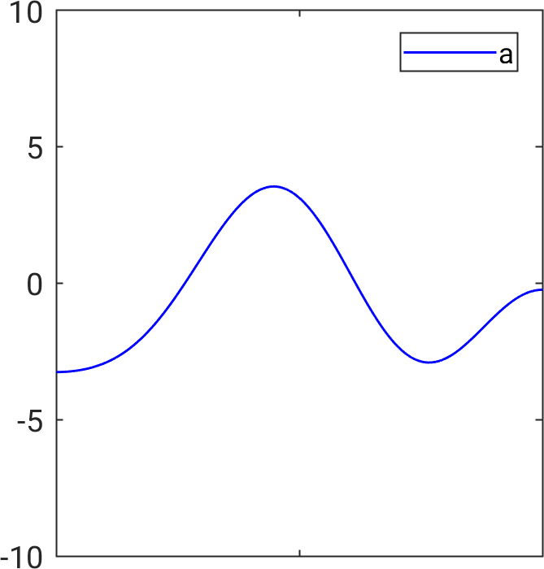
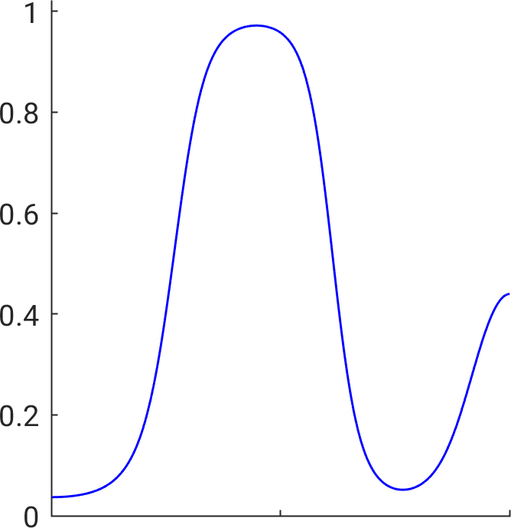
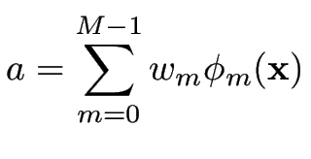
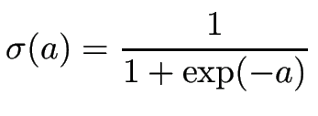
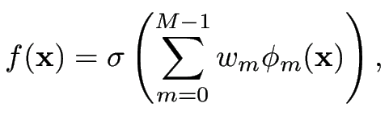

Logistic regression
  where
  Of course:

Slide 9




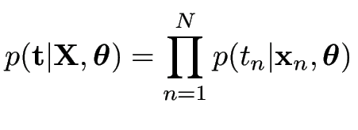

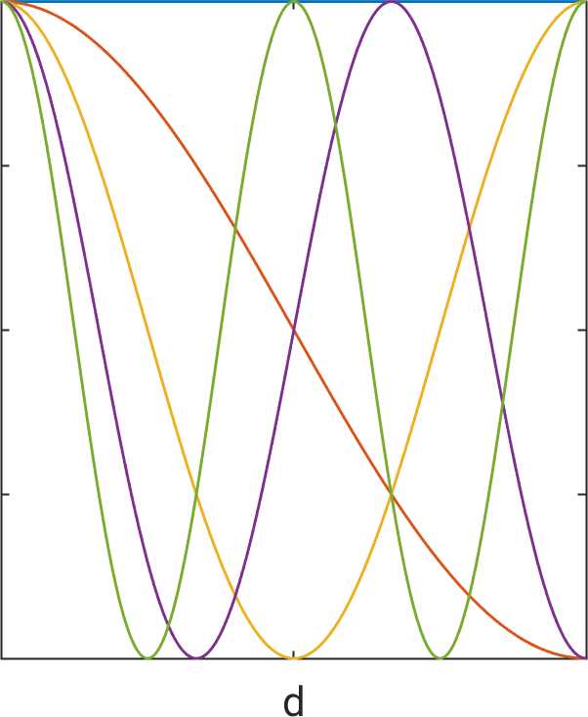
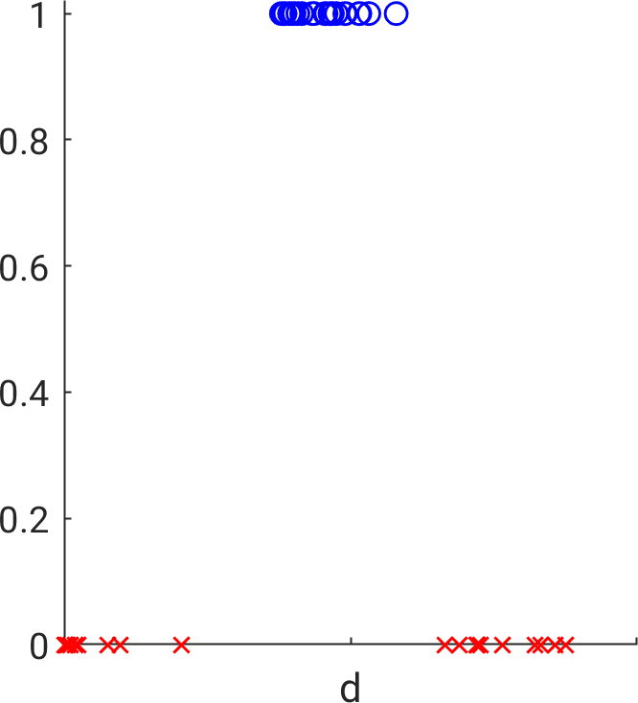
Voxel-based classifier
  Training data with (i.e., ) and
  Estimate parameters by maximizing the likelihood

Slide 10
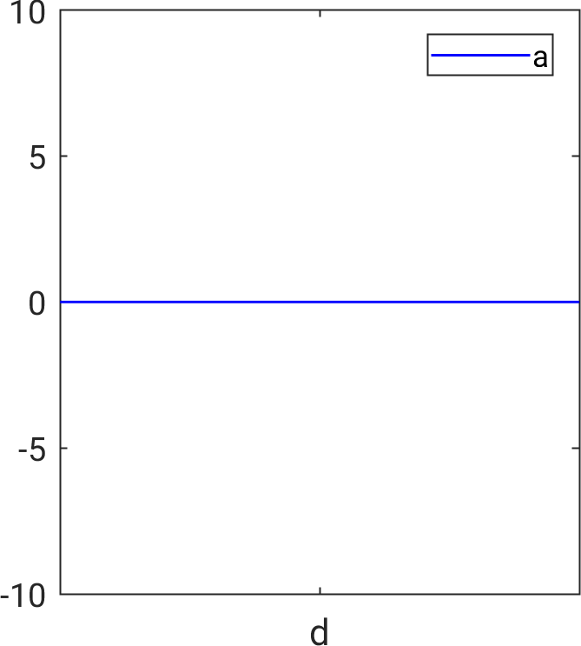
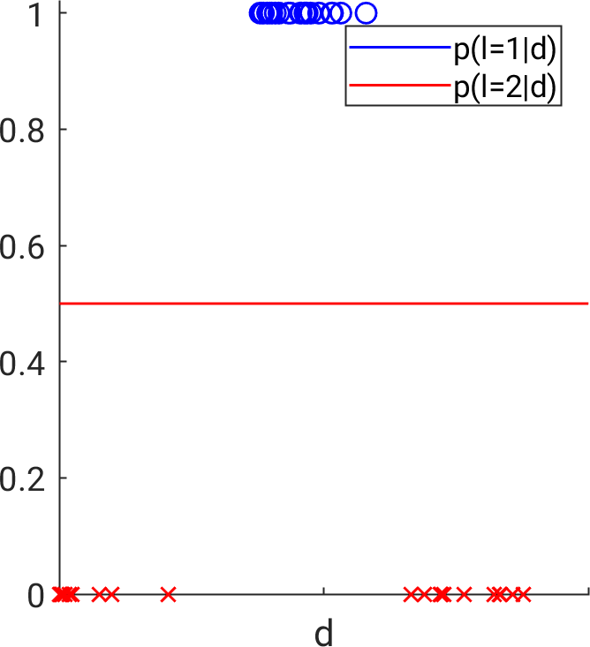
Voxel-based classifier
  Training data with (i.e., ) and
  Estimate parameters by maximizing the likelihood

Slide 11
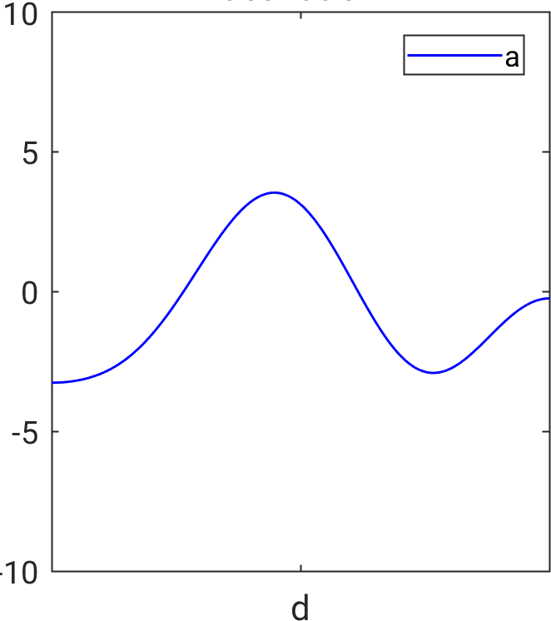
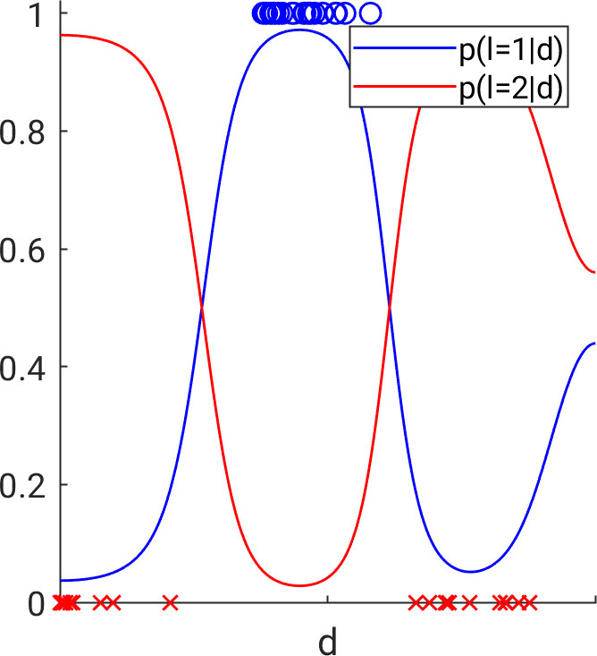
Voxel-based classifier
  Training data with (i.e., ) and
  Estimate parameters by maximizing the likelihood

Slide 12
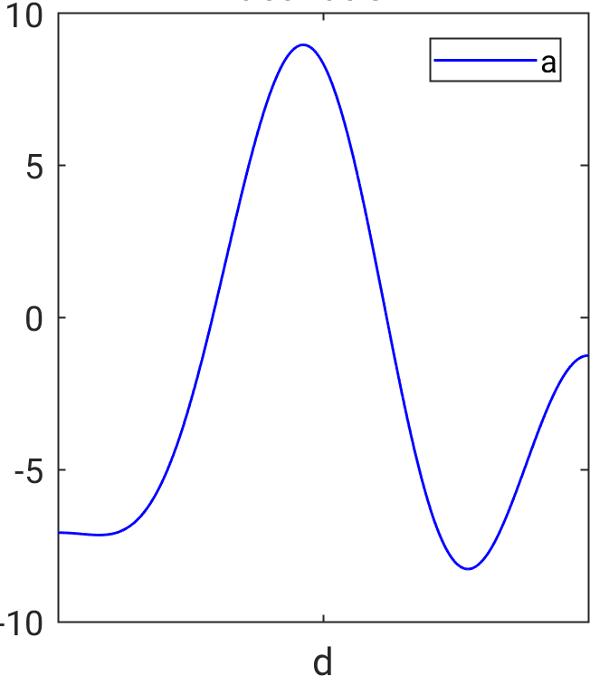
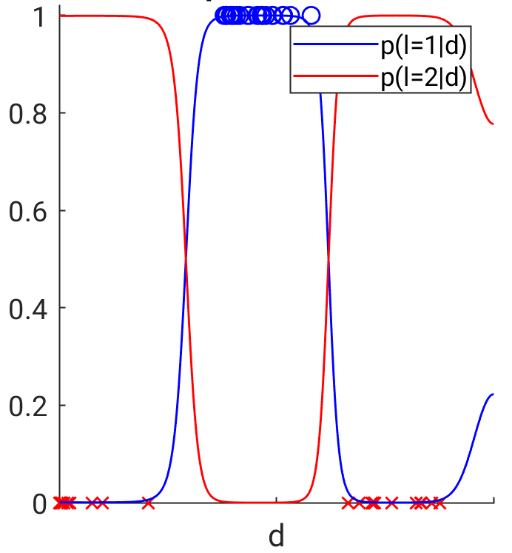
Voxel-based classifier
  Training data with (i.e., ) and
  Estimate parameters by maximizing the likelihood

Slide 13

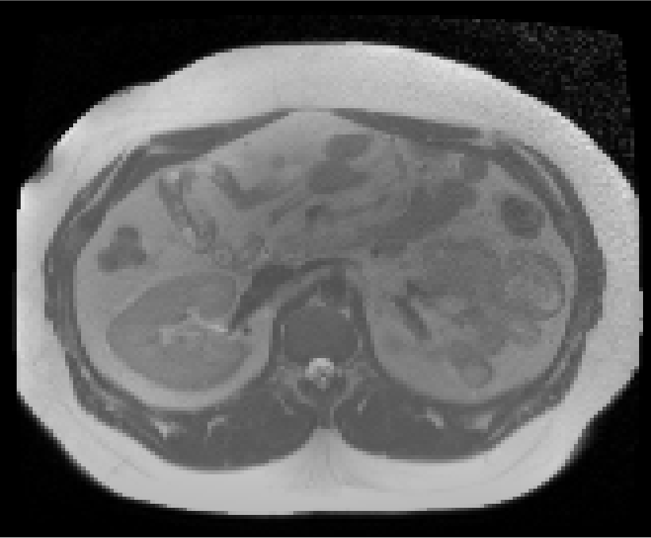
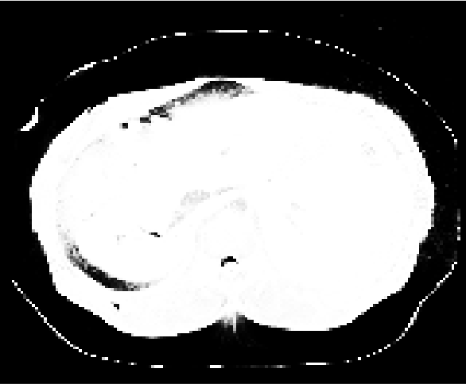
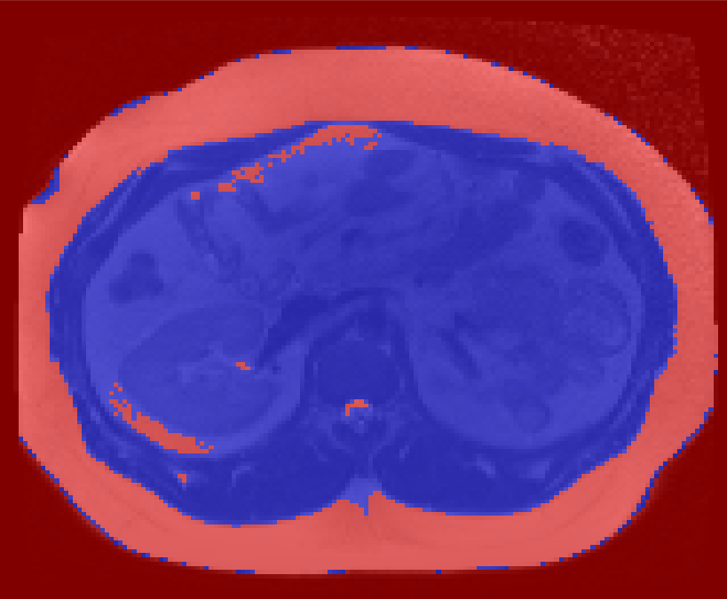


Voxel-based classifier
  Once trained keep the classifier
  Simply apply it to new data

Slide 14




Optimization algorithm for training
  Maximizing the likelihood function is equivalent to minimizing
  Gradient descent: with gradient
  Stochastic gradient descent: use only randomly sampled training points, and approximate:
step size (user-specified)

Slide 15
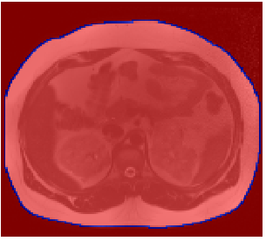

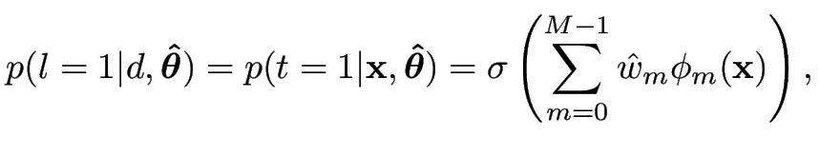

More fun: patch-based classifier
  Classify 3x3 image “patches”: intensity of the pixel to be classified + intensities of 8 neighboring pixels
  is now a 9-dimensional vector ( ), but otherwise everything is the same:
  But how to choose basis functions in a 9-dimensional space?

Slide 16
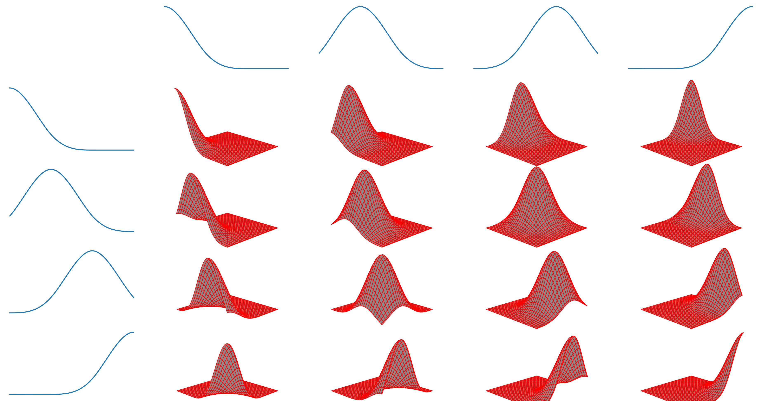
Basis functions in high dimensions?
  Idea: remember the “separable basis functions” trick?
Question:
does this work in 9D?
“making” sixteen 2D basis functions
out of two sets of four 1D basis functions

Slide 17
Basis functions in high dimensions?
  Idea: remember the “separable basis functions” trick?
Question:
does this work in 9D?
No!
4^9 = 262144
basis functions!
“making” sixteen 2D basis functions
out of two sets of four 1D basis functions

Slide 18
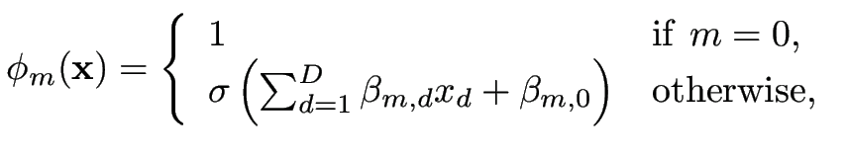


Adaptive basis functions
  Introduce extra parameters that alter the form of a limited set of basis functions
  Prototypical example:
  All parameters ( and ) are optimized together during training
  (stochastic gradient descent)
extra parameters

Slide 19
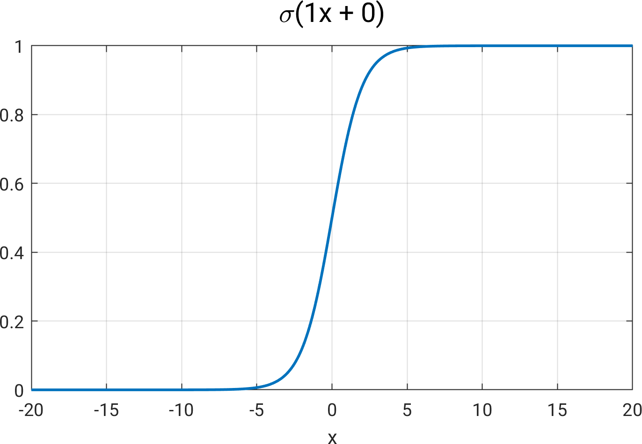
Adaptive basis functions (D=1)

Slide 20
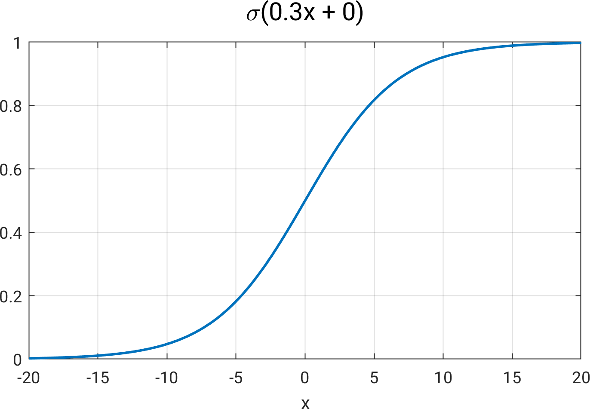
Adaptive basis functions (D=1)

Slide 21
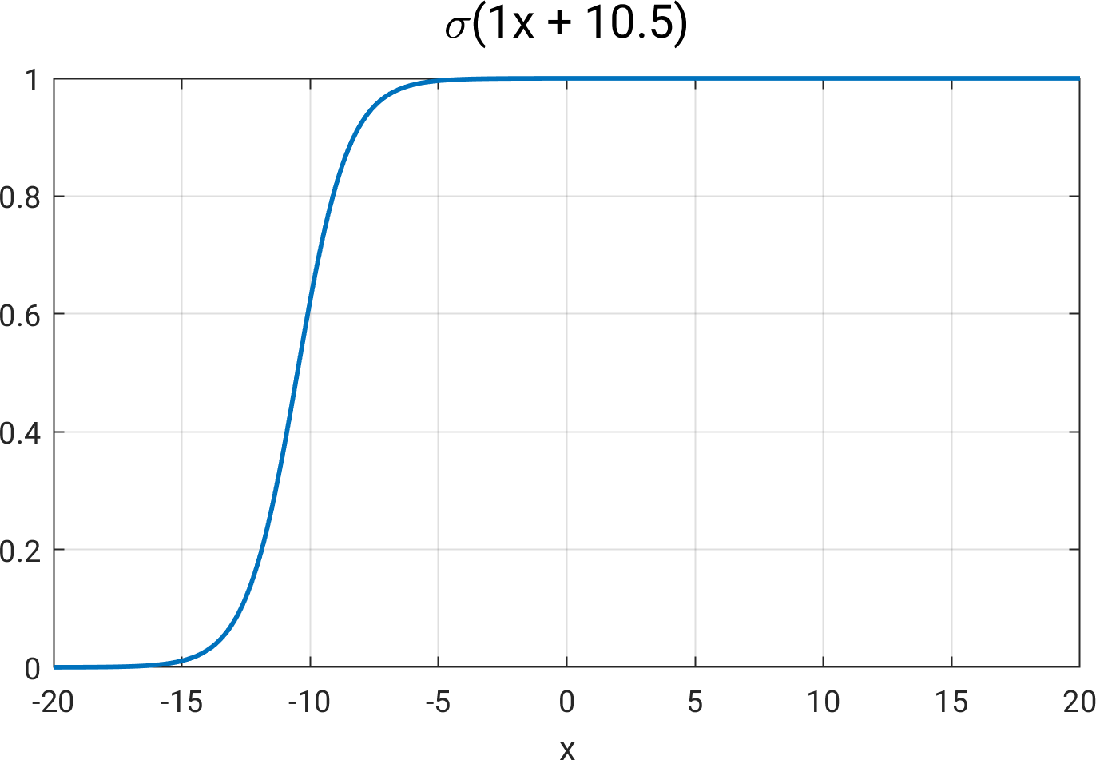
Adaptive basis functions (D=1)

Slide 22
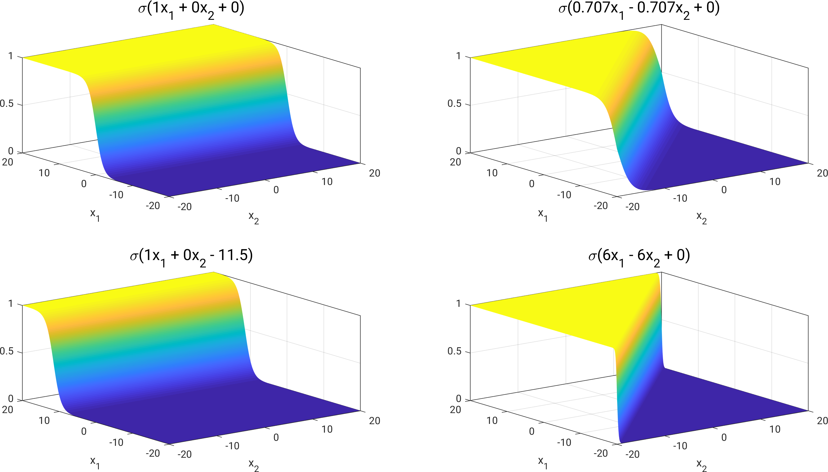
Adaptive basis functions (D=2)

Slide 23
Feed-forward neural network
  So the model is:
  with basis functions
parameters

Slide 24
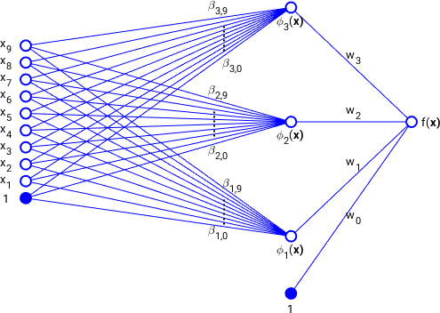
Feed-forward neural network
  Graphical representation of our 3x3 patch-based classifier (D=9 and M=4):
  Can insert more than one “hidden” layer (“deep learning”)
“hidden units”
flow of information

Slide 25
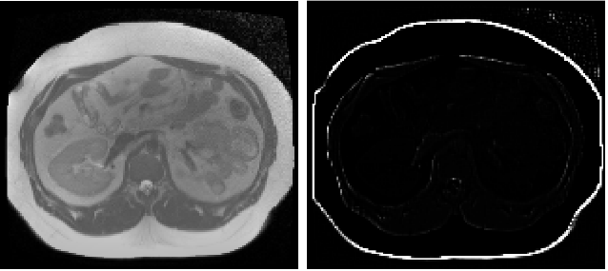

XX
  Applying the trained classifier on new data:

Slide 26
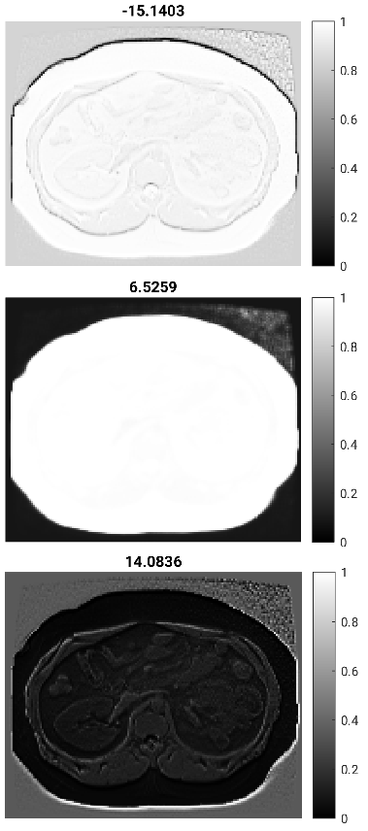
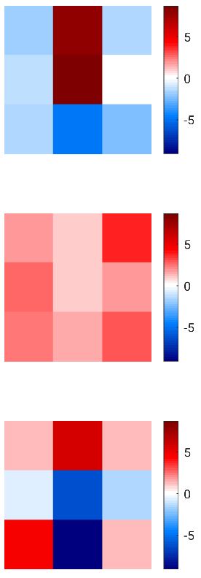






XX
  Applying the trained classifier on new data:
filter
filter
filter

Slide 27
XX
  Applying the trained classifier on new data:
Filtering operations can be implemented using convolutions
=> “convolutional neural network”
filter
filter
filter

Slide 28


Neural networks = ultimate solution?
  No model, only training data:
    - No domain expertise needed
    - Very easy to train and deploy
    - Super fast (GPUs)
    - Training data often very hard to get in medical imaging!
    - Scanning hardware/software/protocol changes routinely!

