Slide 1
Intensity-based
Registration
Medical Image Analysis
Koen Van Leemput
Fall 2023

Slide 2

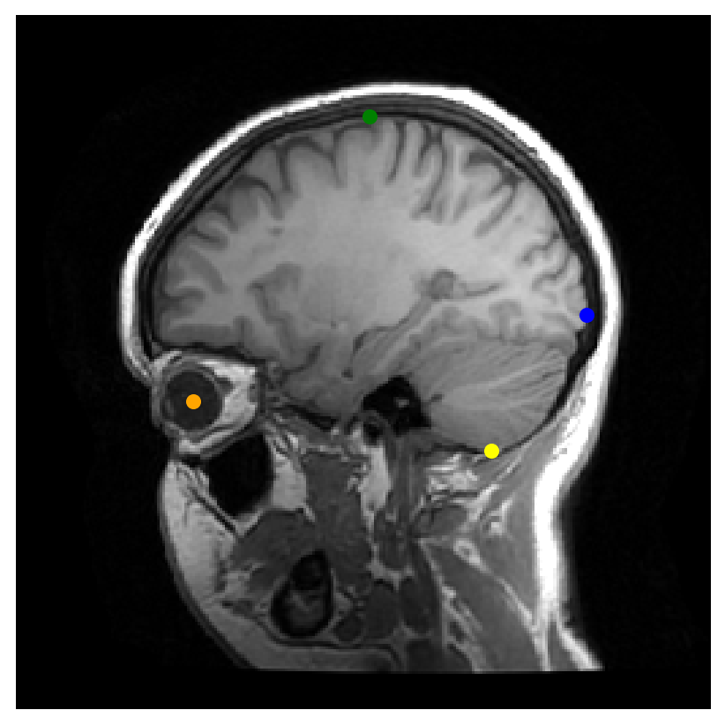
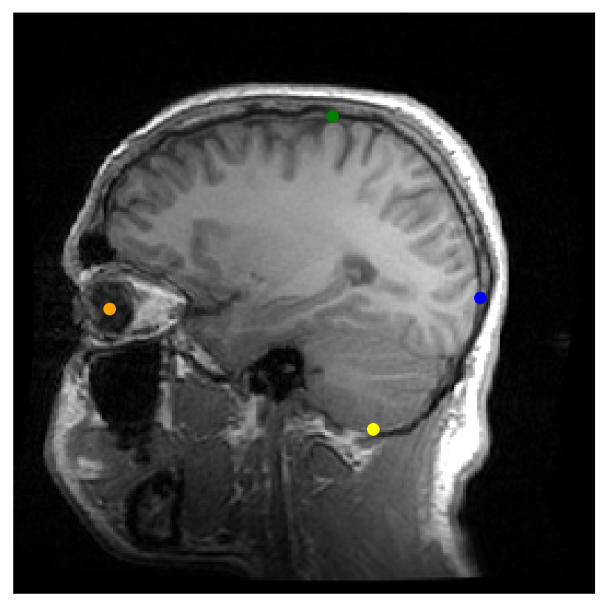


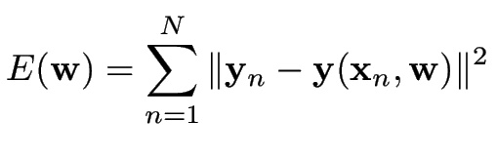
Recall landmark-based registration
Manually annotate corresponding points in two images:
Register the images by minimizing the distance between matching point pairs:
fixed image
moving image
Spatial transformation model

Slide 3

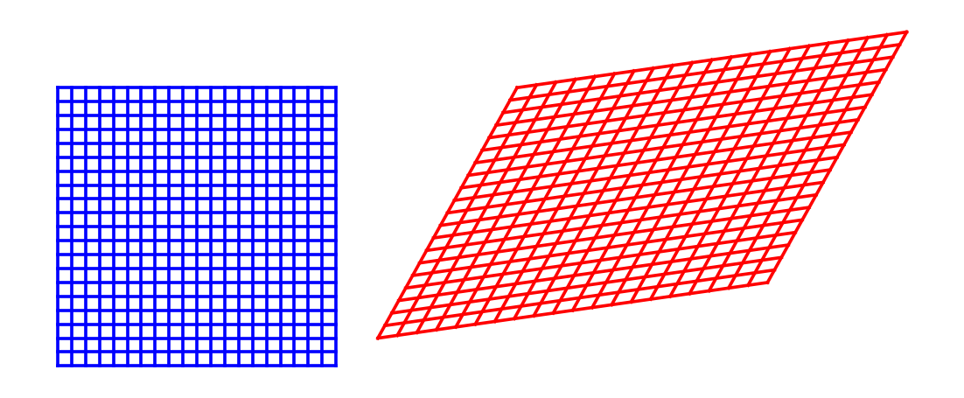
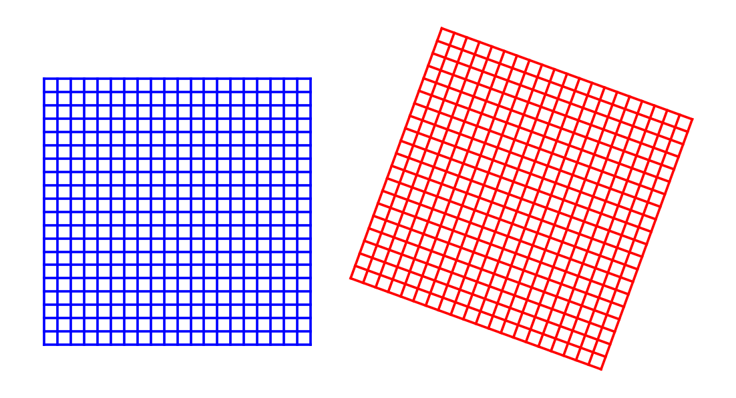
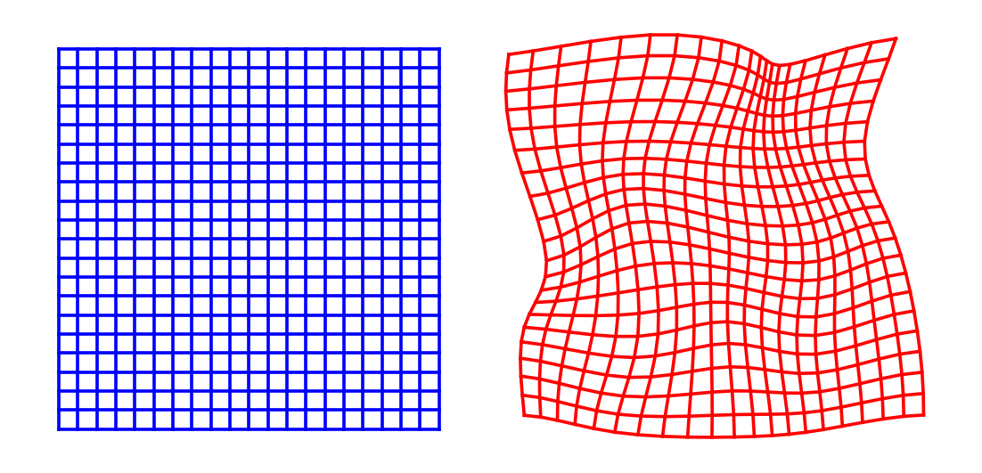
Spatial transformation models
Spatial transformation :
maps world positions in the fixed image to world positions in the moving image
controlled by parameters
affine
rigid
nonlinear

Slide 4
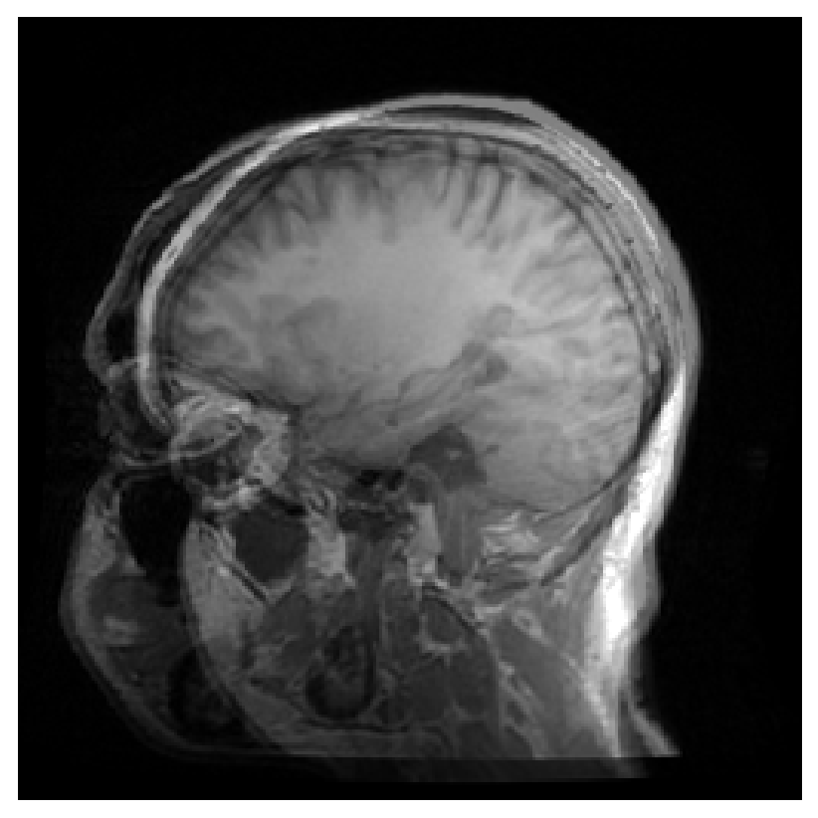


Landmark-based registration
fixed image
moving image
fixed + moving
Before registration

Slide 5
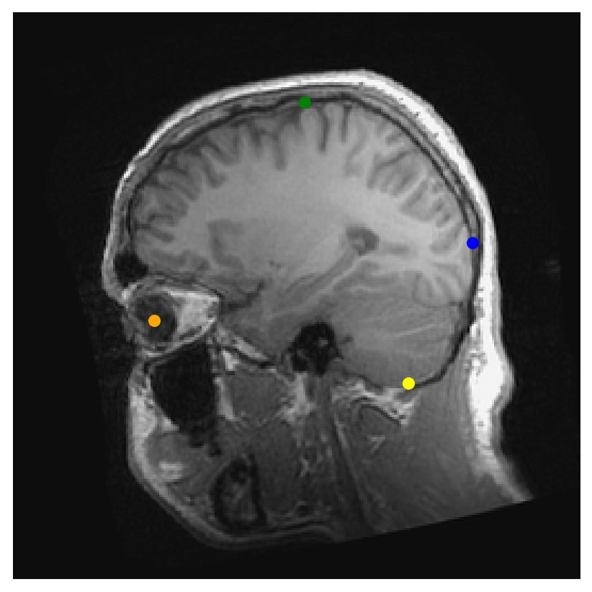
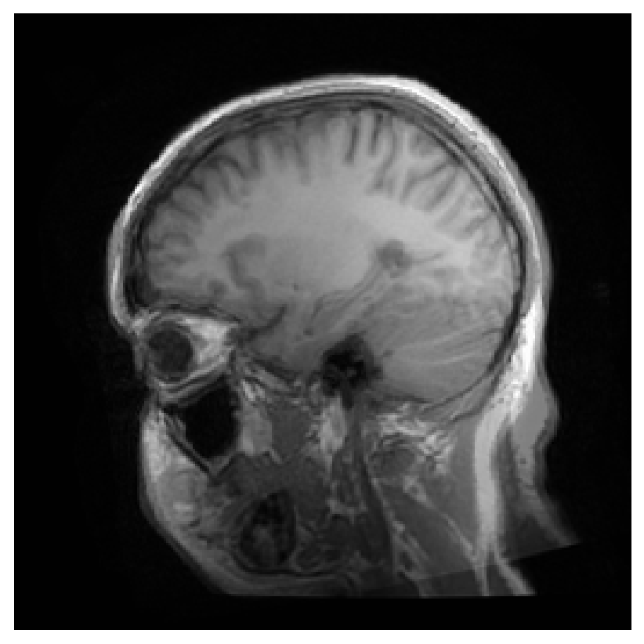

Landmark-based registration
fixed image
interpolated moving image
fixed +
interpolated moving
After registration

Slide 6
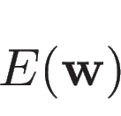
Landmark-based registration
This lecture:
define energy
without landmarks
fixed image
interpolated moving image
fixed +
interpolated moving
After registration

Slide 7
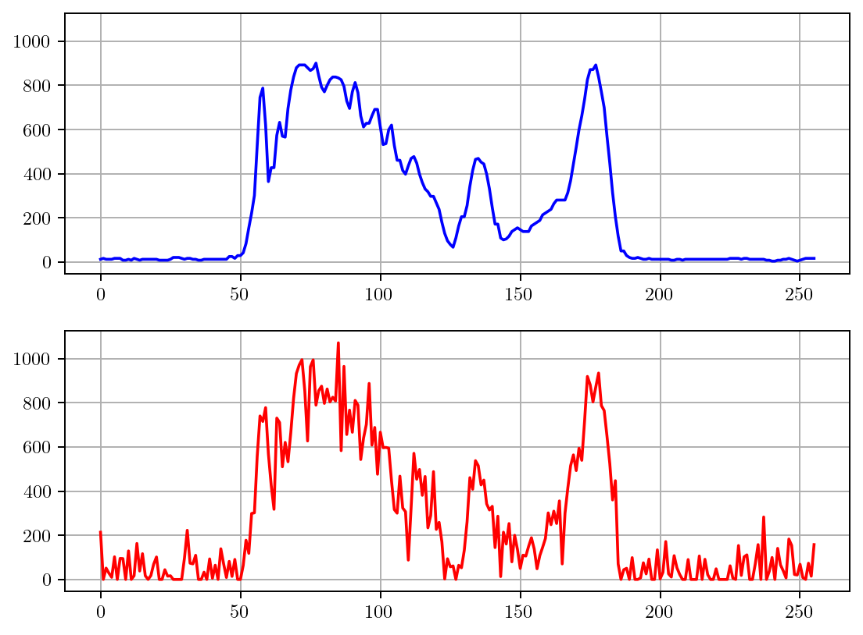
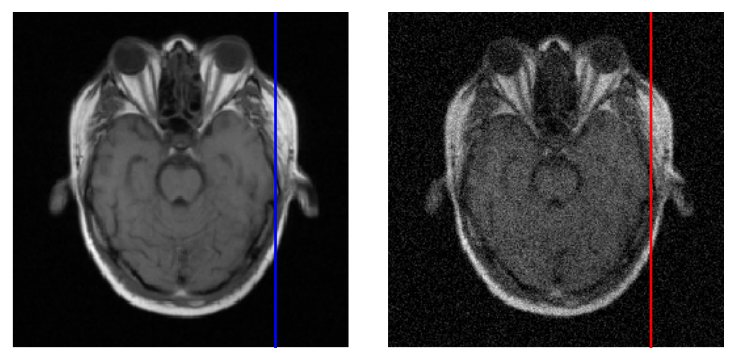

Intra-modal registration
Images have similar intensity characteristics
Task: what’s a good energy function ?

Slide 8
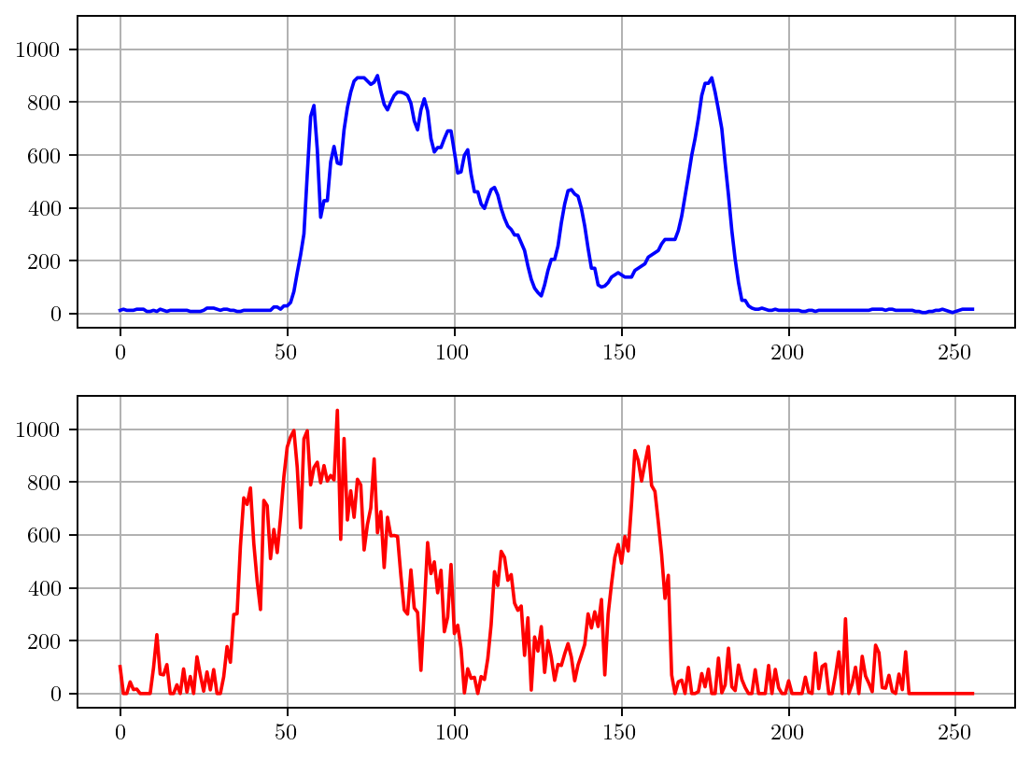
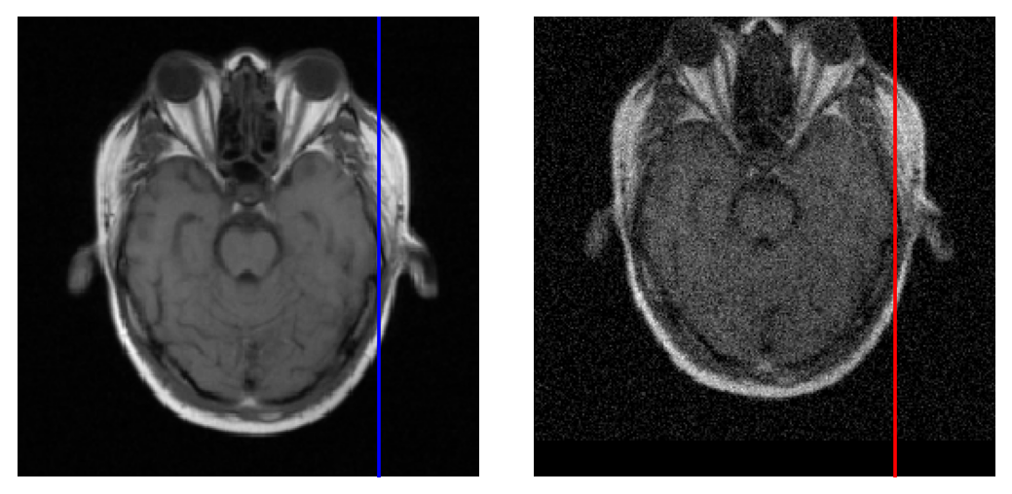
Intra-modal registration
Images have similar intensity characteristics
Task: what’s a good energy function ?

Slide 9
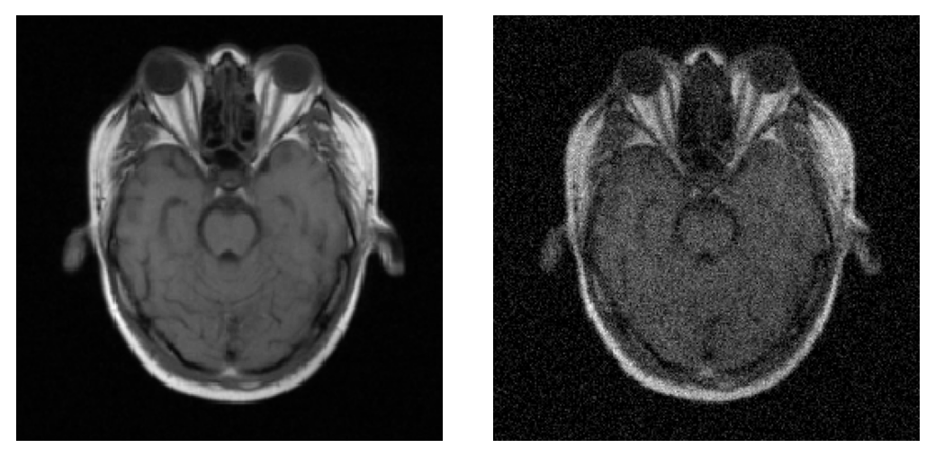


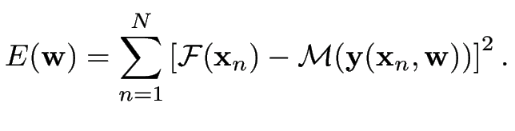
Intra-modal registration
Images have similar intensity characteristics
sum over all voxels

Slide 10
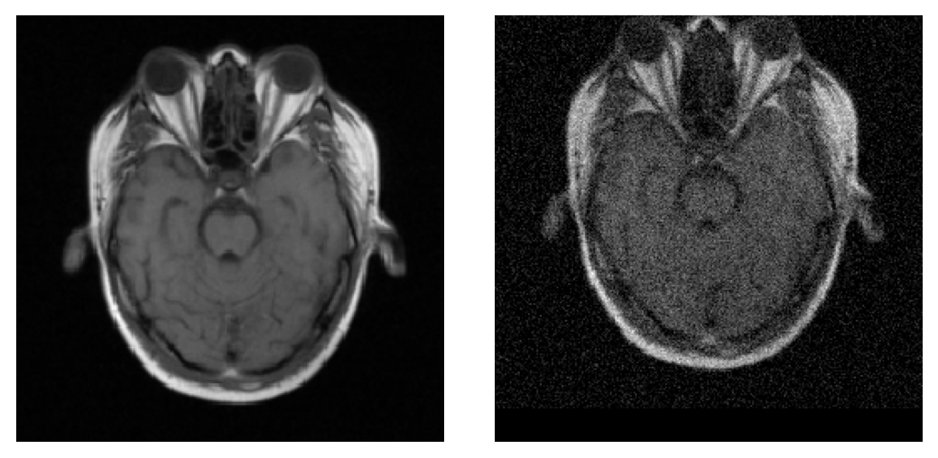
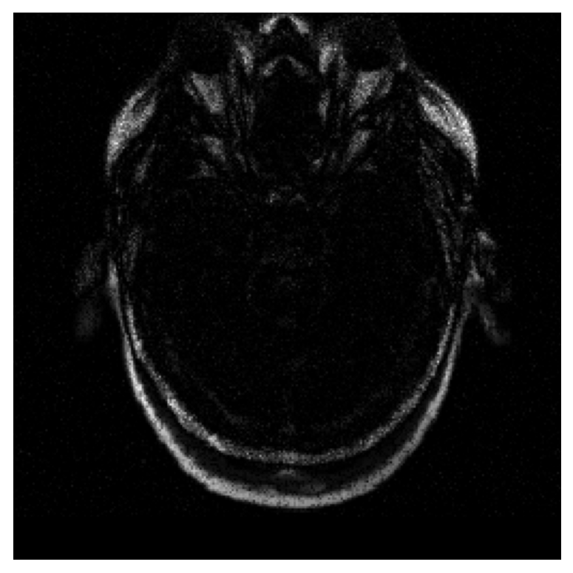
Intra-modal registration
Images have similar intensity characteristics
sum over all voxels

Slide 11
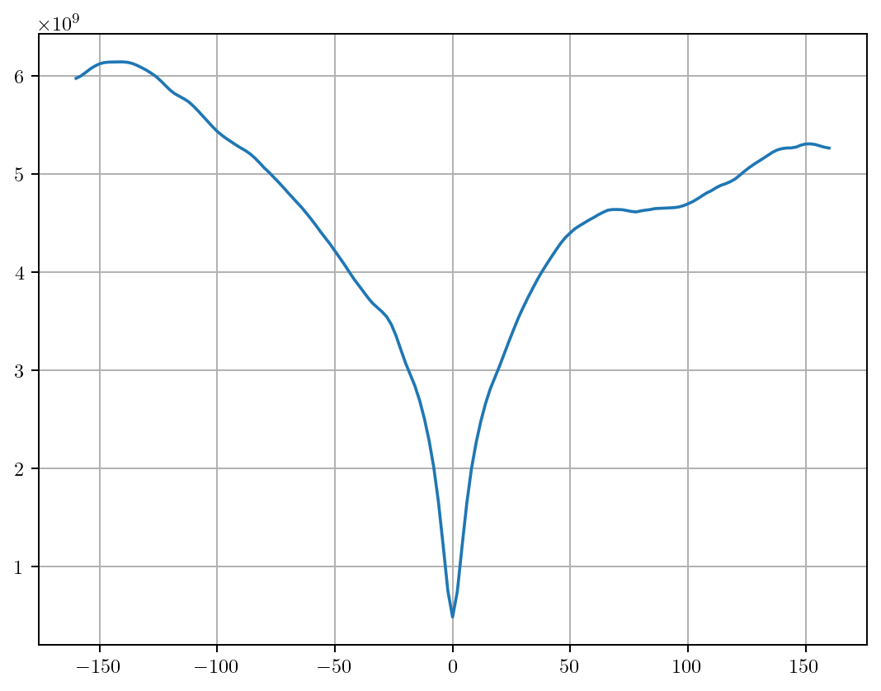
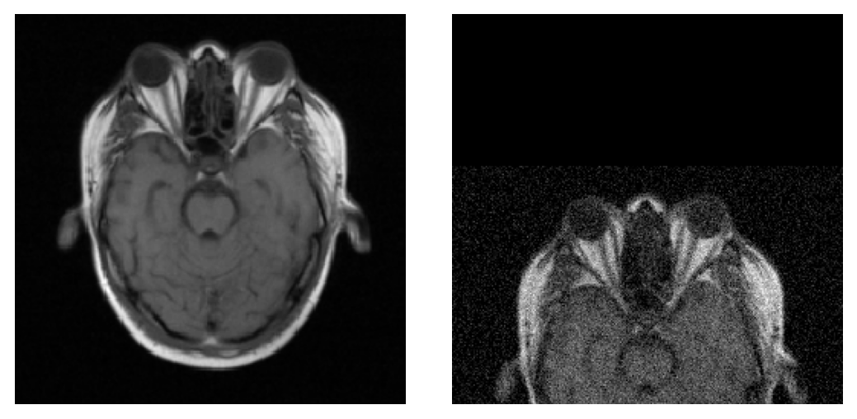
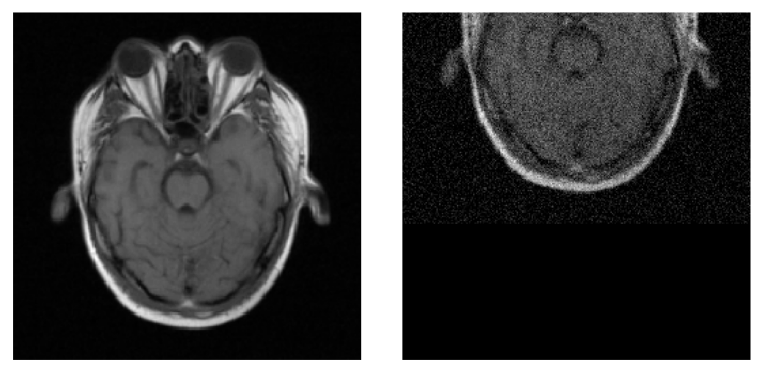

Slide 12
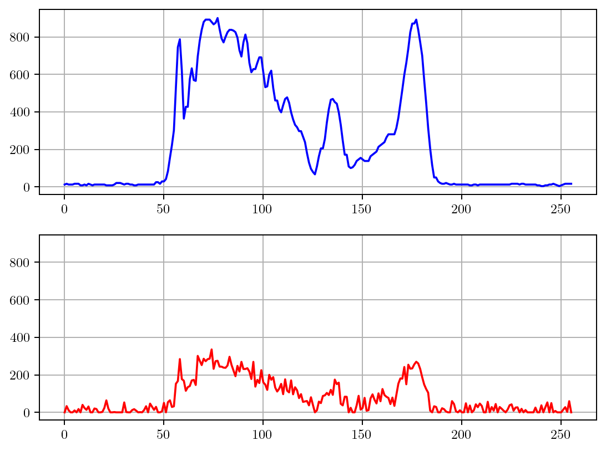
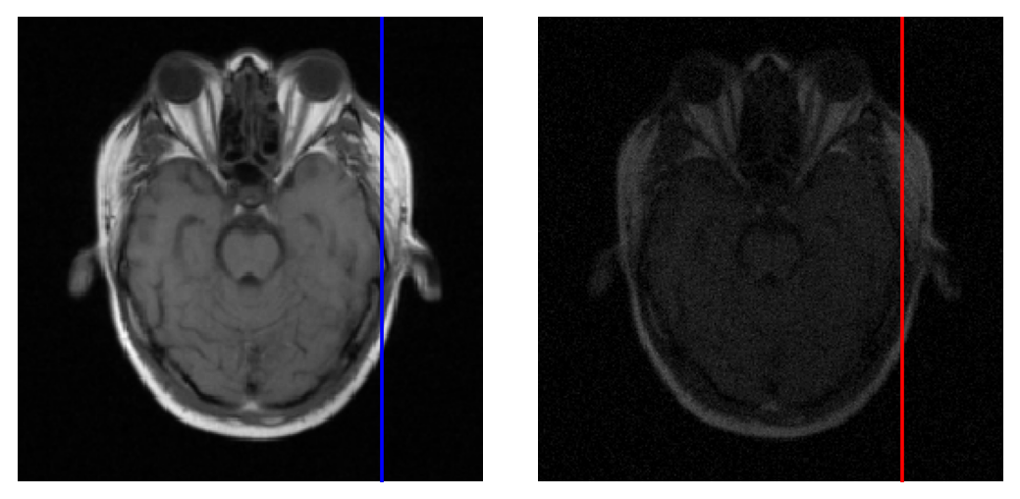
Intra-modal registration
Same but images are scaled differently
Task: what’s a good energy function ?

Slide 13
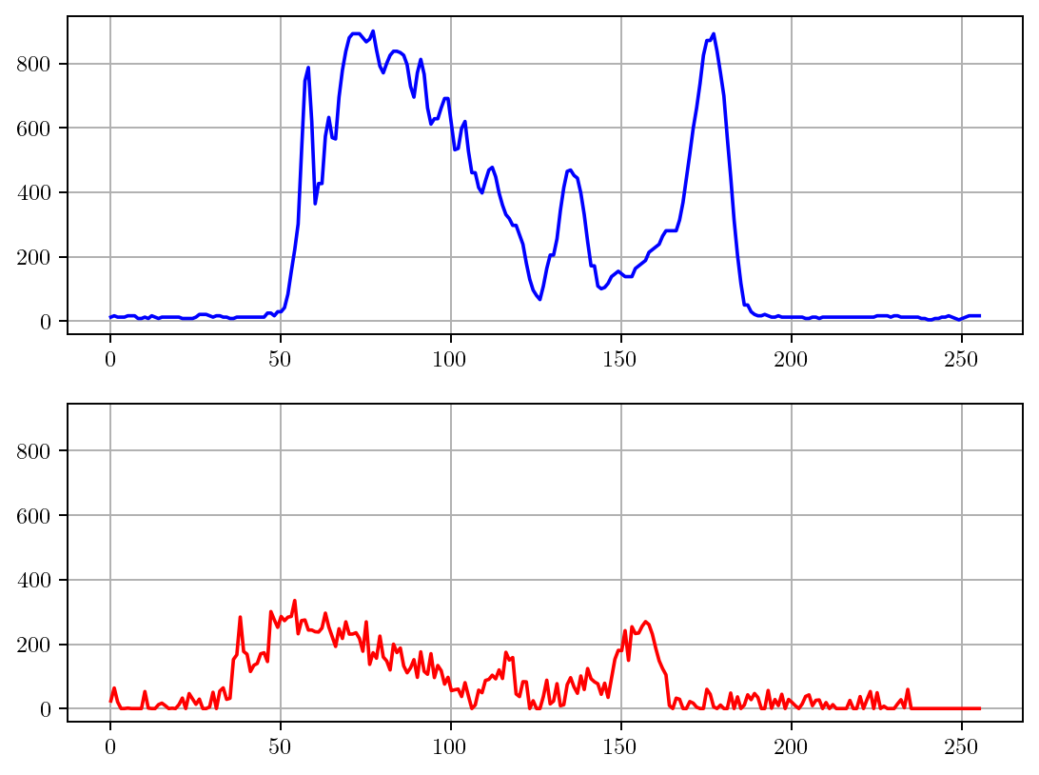
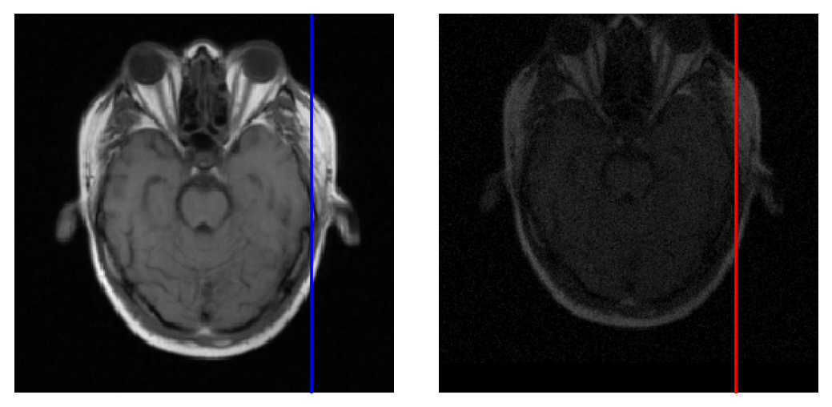
Intra-modal registration
Same but images are scaled differently
Task: what’s a good energy function ?

Slide 14
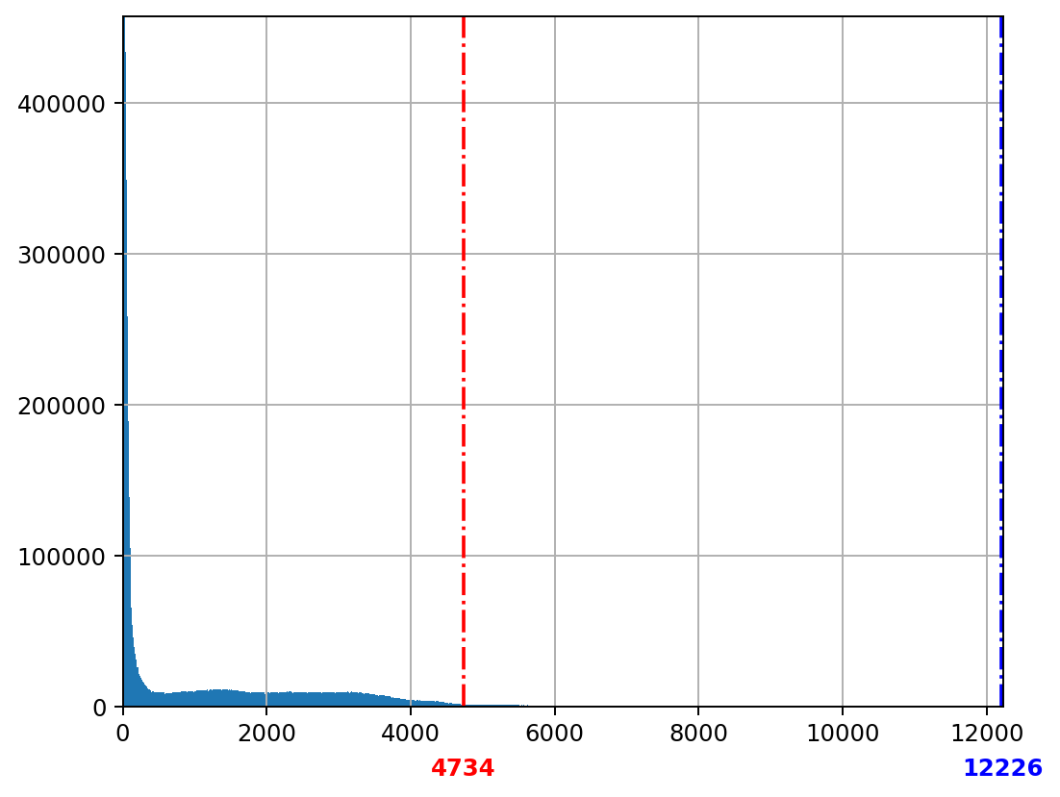
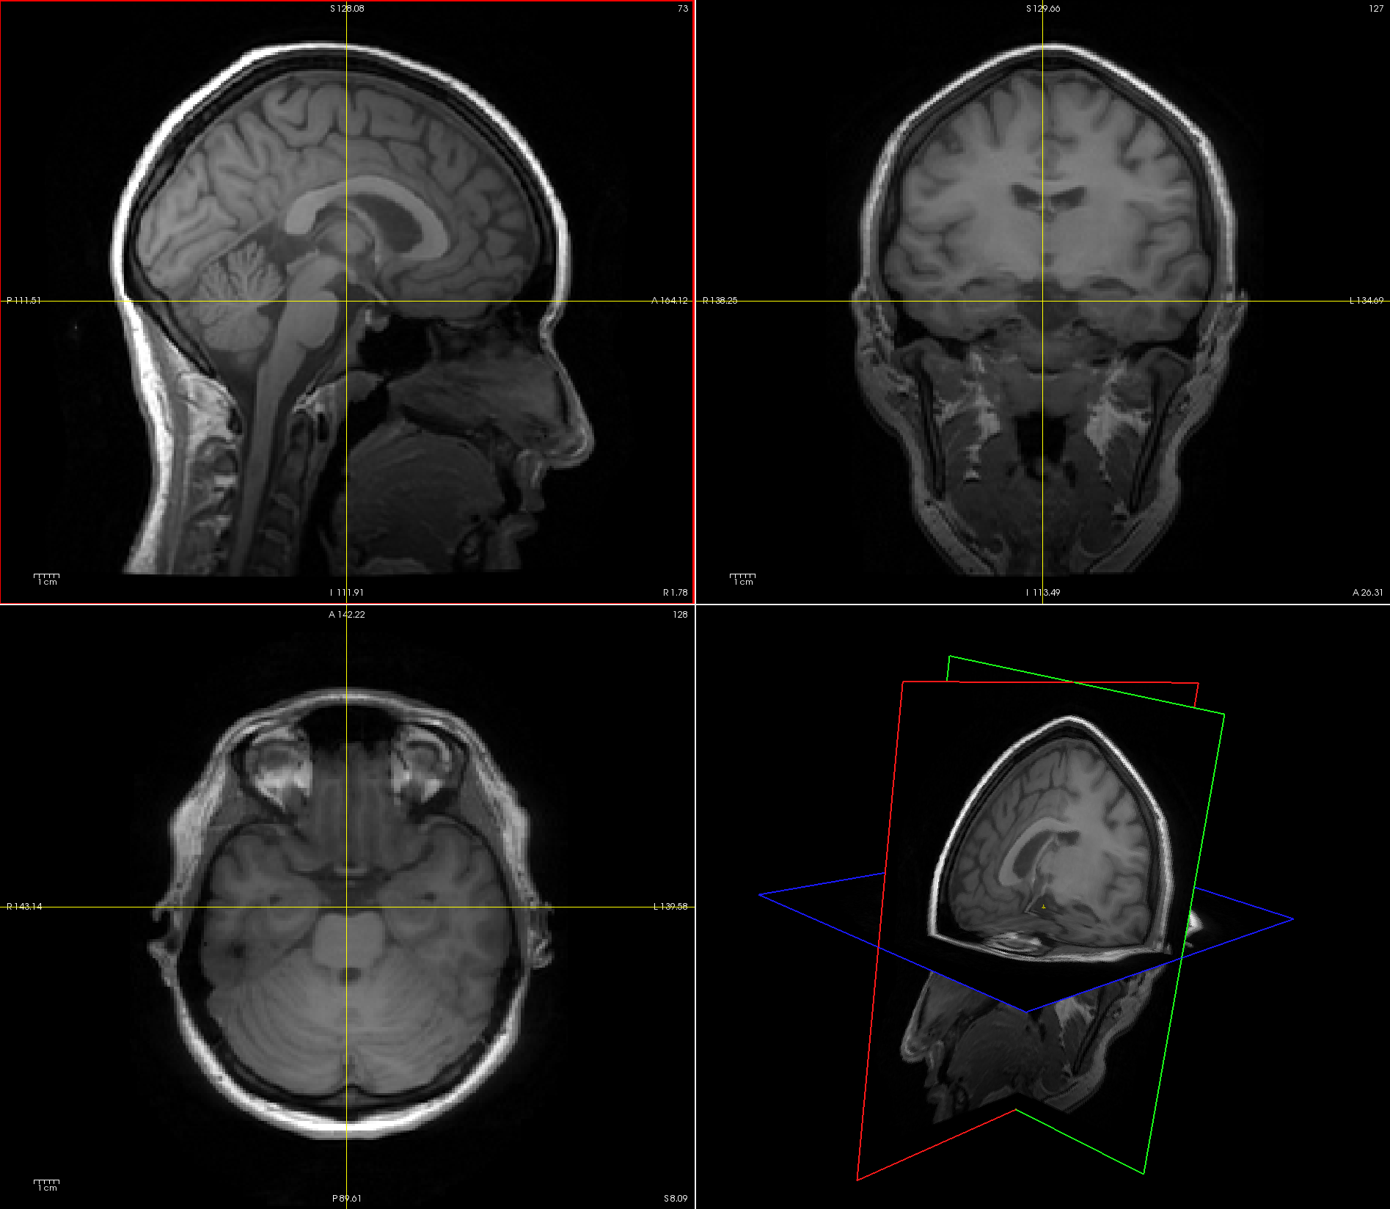
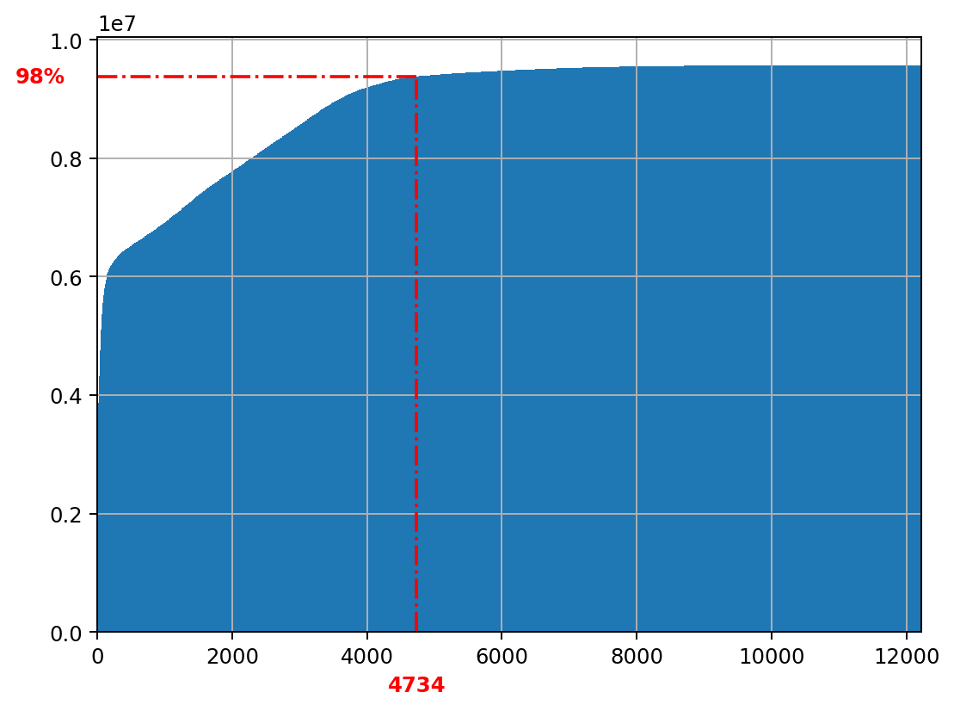
histogram
“Maximum” intensity
max
robust max
cumulative
histogram

Slide 15
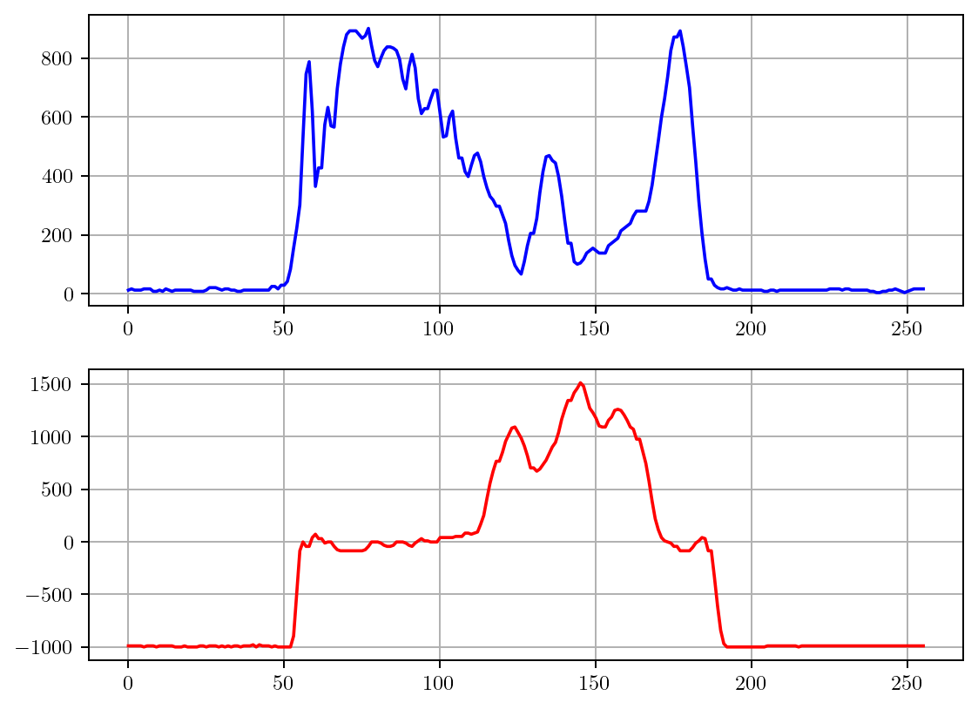
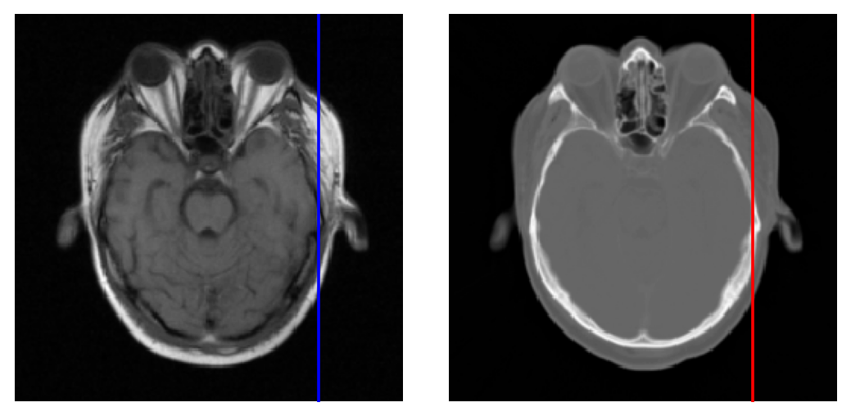
Inter-modal registration
Images have different intensity characteristics
Task: what’s a good energy function ?

Slide 16
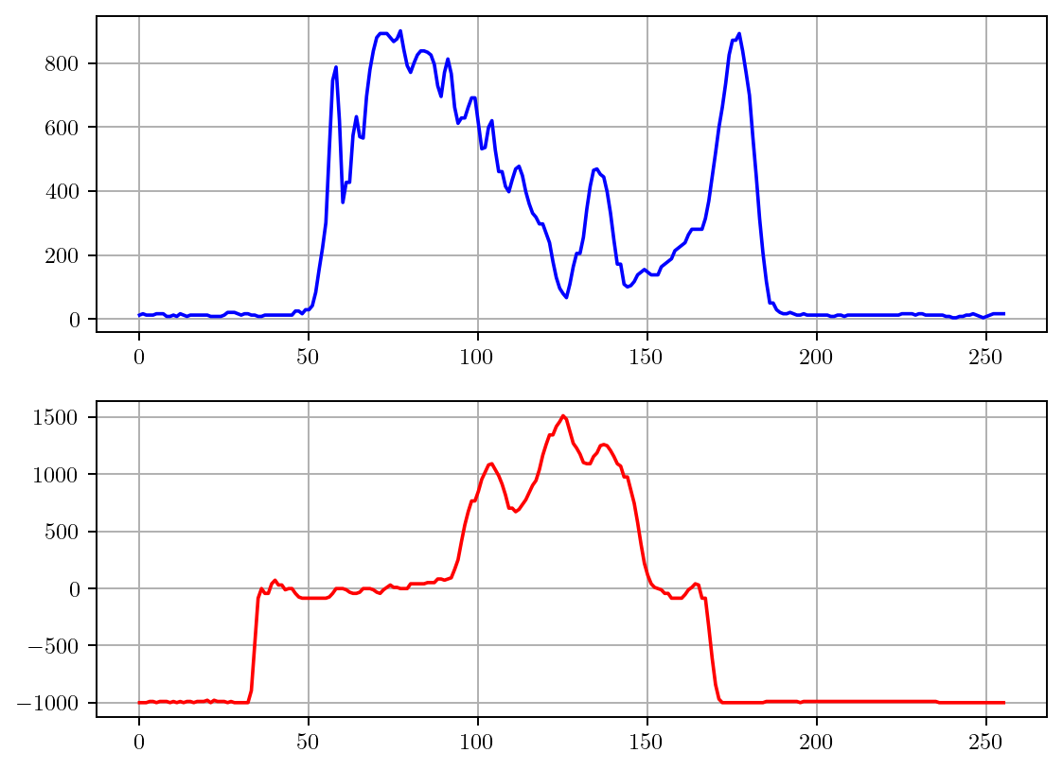
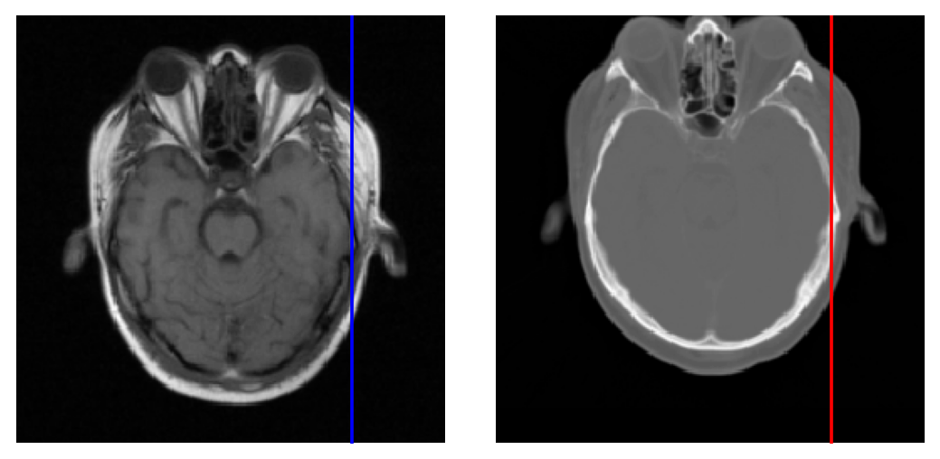
Inter-modal registration
Images have different intensity characteristics
Task: what’s a good energy function ?

Slide 17
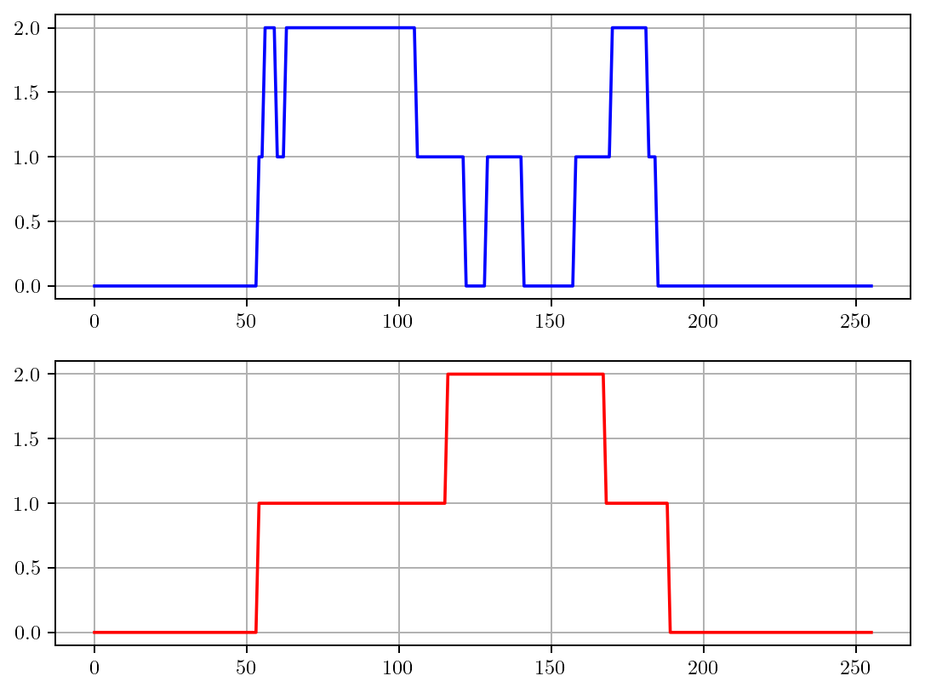
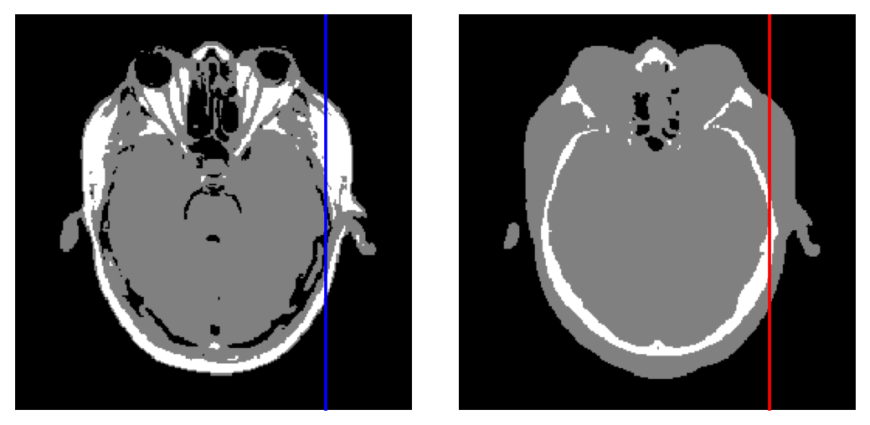
Inter-modal registration
Images have different intensity characteristics
Easier task: what’s a good energy function now?

Slide 18
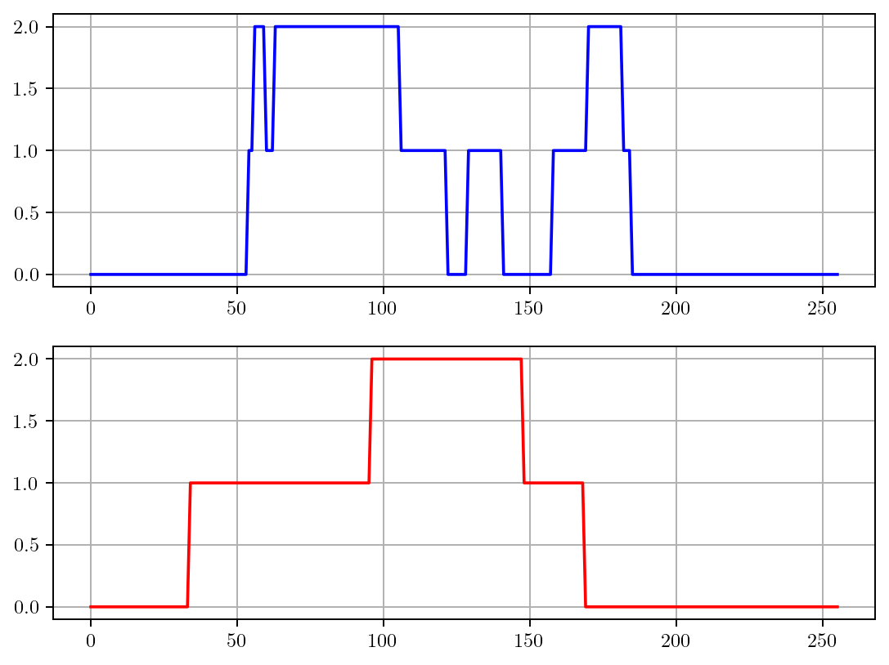
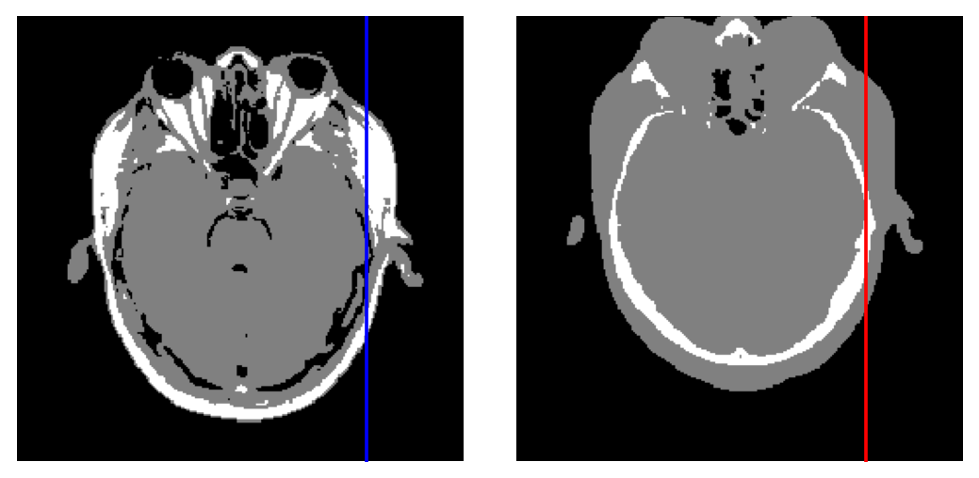
Inter-modal registration
Images have different intensity characteristics
Easier task: what’s a good energy function now?

Slide 19
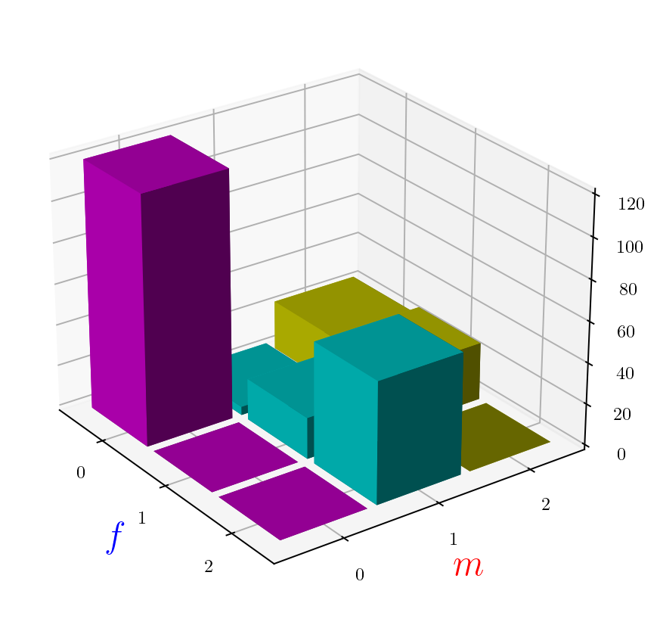
Inter-modal registration
Images have different intensity characteristics
joint histogram
intensity in moving image
intensity in fixed image

Slide 20
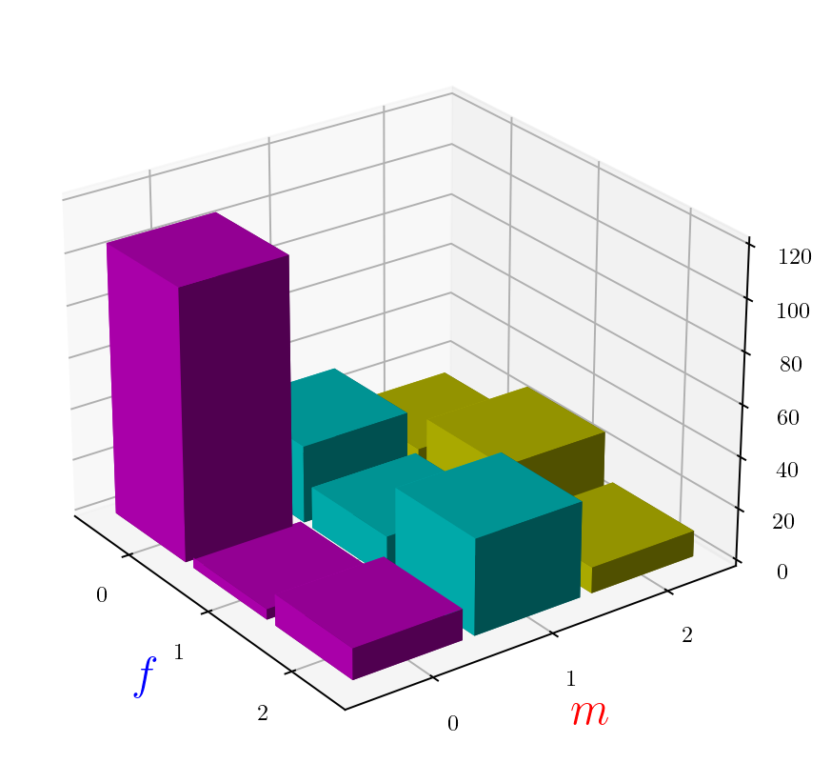
Inter-modal registration
Images have different intensity characteristics
joint histogram
intensity in moving image
intensity in fixed image

Slide 21
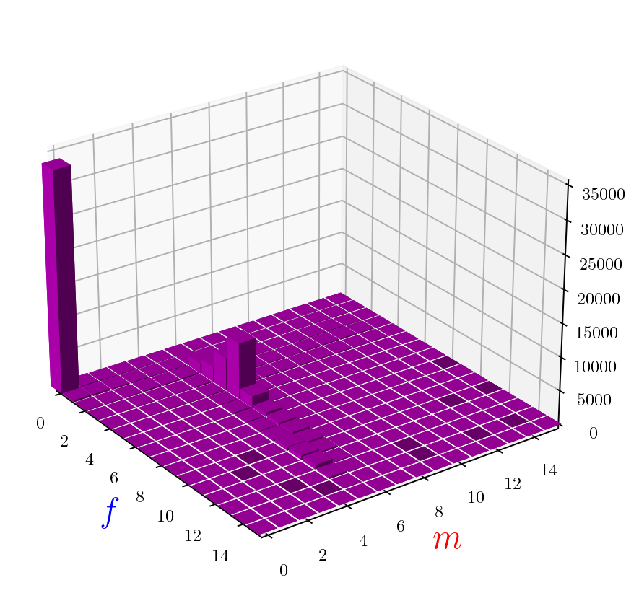
Inter-modal registration
Images have different intensity characteristics
joint histogram
intensity in moving image
intensity in fixed image

Slide 22
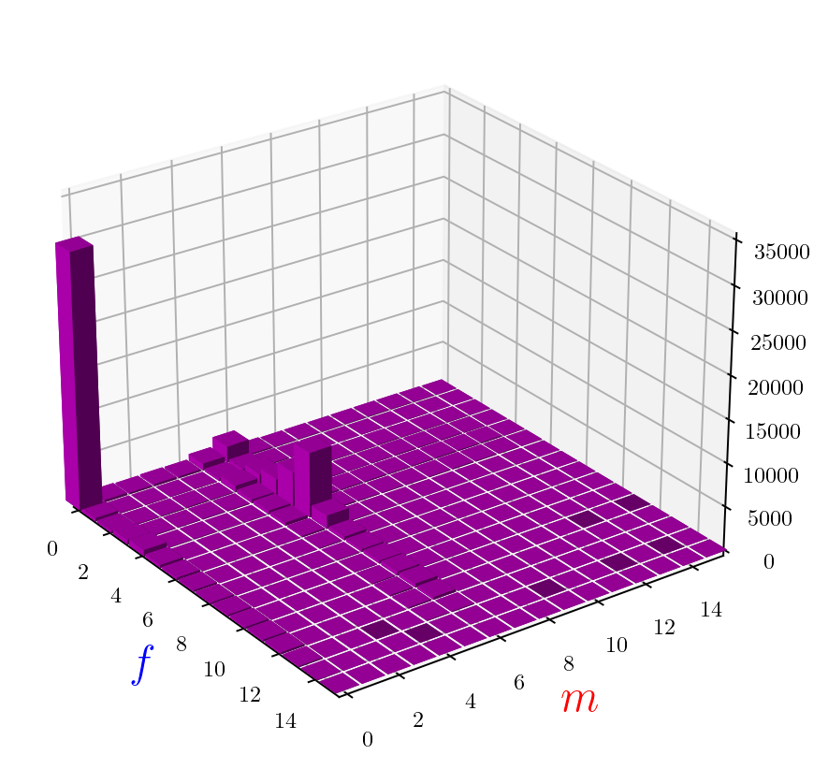
Inter-modal registration
Images have different intensity characteristics
joint histogram
intensity in moving image
intensity in fixed image

Slide 23


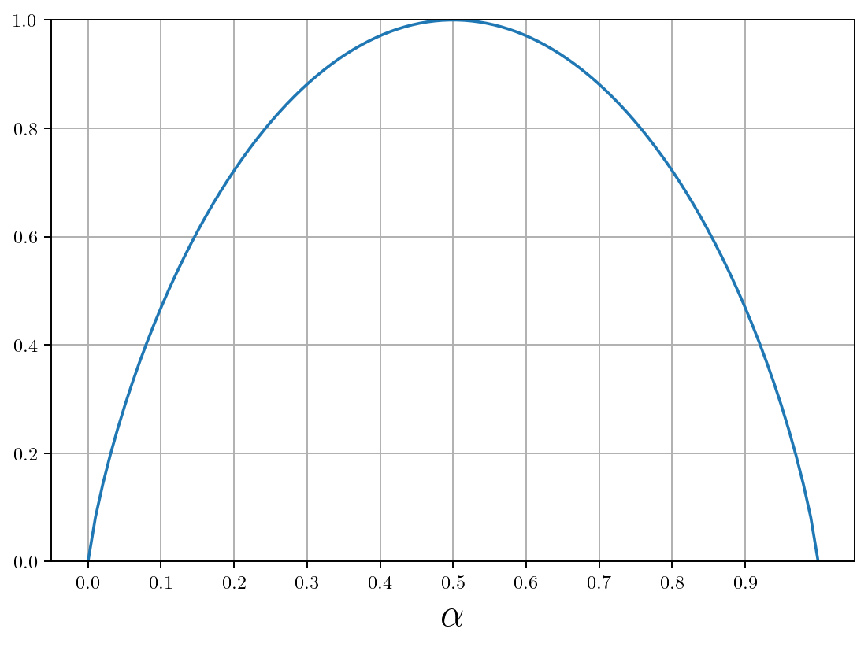
A bit of information theory...
Imagine that a coin is “rigged”:
lands on heads with probability
I toss it many times, and the result is 11010001011111011101000101111101101000101...1
The minimum number of bits required to store/communicate this result is (per toss):
“heads”
“tails”
“entropy”

Slide 24
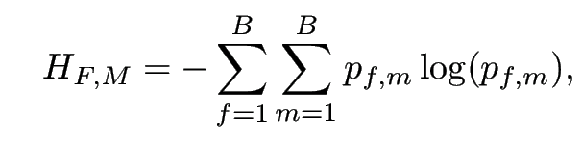

Inter-modal registration
joint histogram
Images have different intensity characteristics
where
normalized histogram counts

Slide 25
Inter-modal registration
joint histogram
Images have different intensity characteristics
where
normalized histogram counts

Slide 26
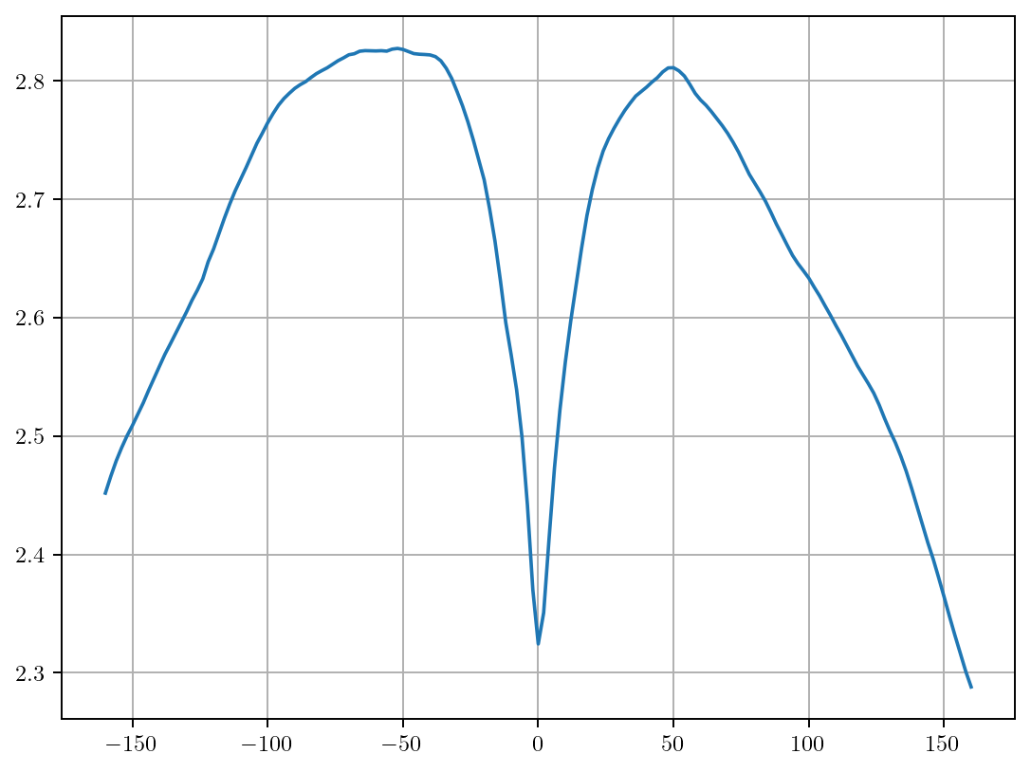
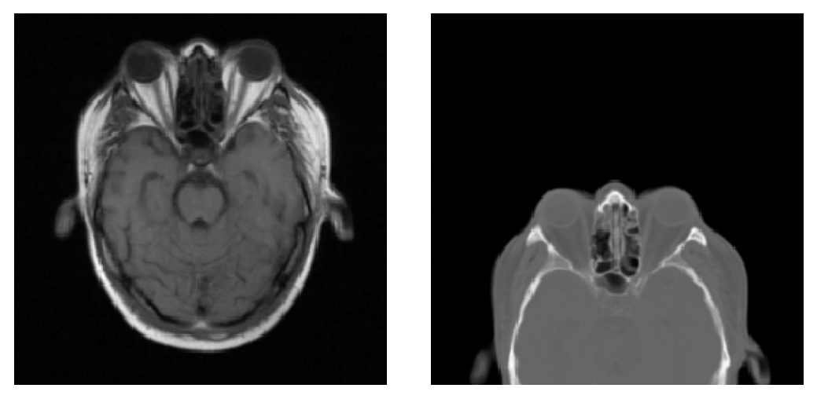
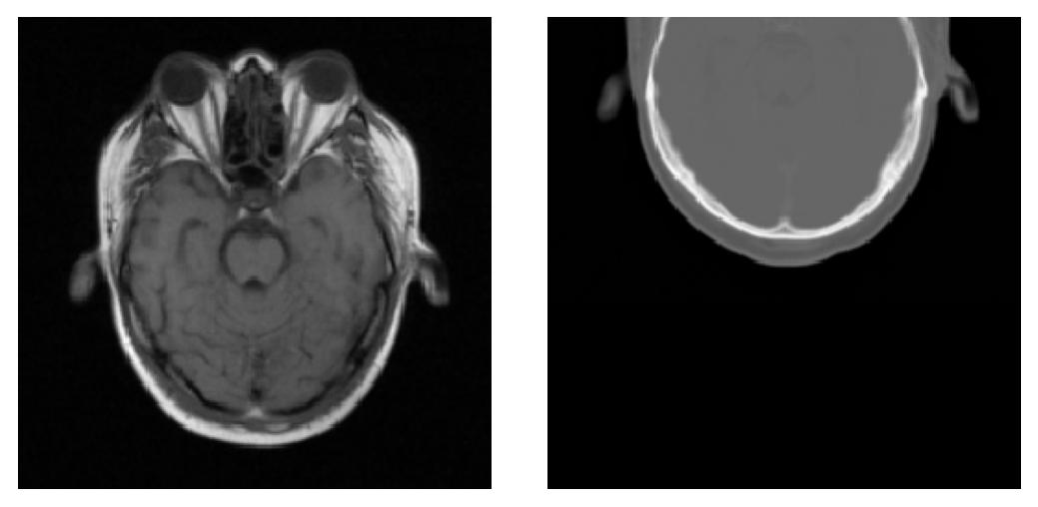
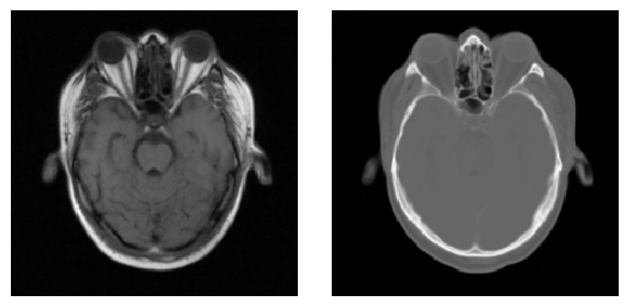

Slide 27
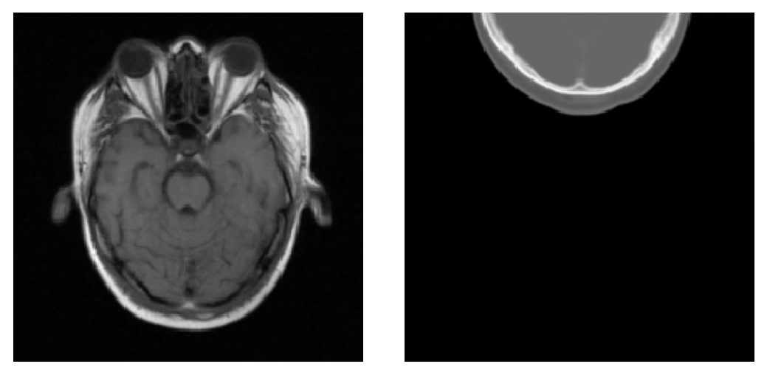
Diagnosing the problem
Question: which image pair takes more bits to encode?
A
B

Slide 28
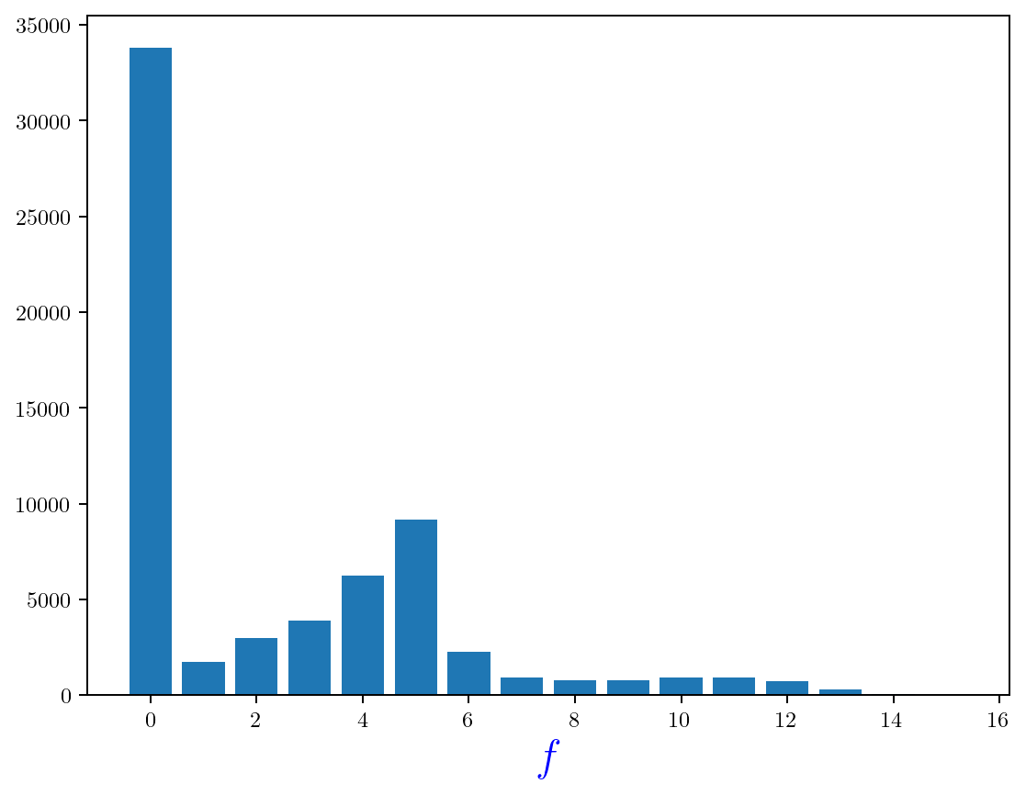
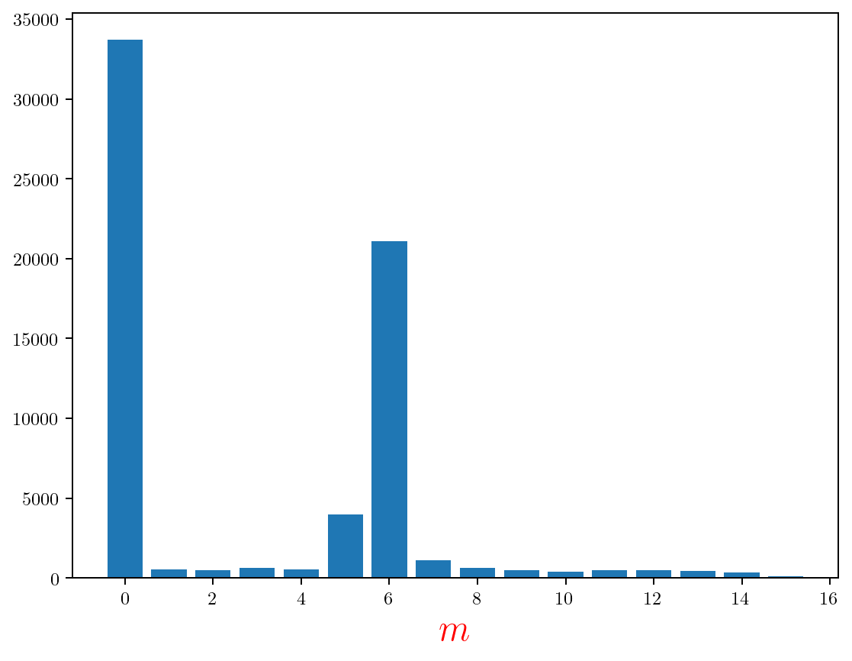
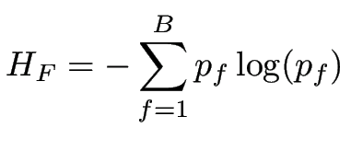


Solution
histogram fixed image
joint histogram
histogram moving image
(negative “mutual information”)

Slide 29


Slide 30

Numerical optimization
Find transformation parameters that minimize

