Slide 1
Smoothing
and
Interpolation​
Medical Image Analysis
Koen Van Leemput
Fall 2023

Slide 2
TODO: Intro
Xxx
Xxx

Slide 3






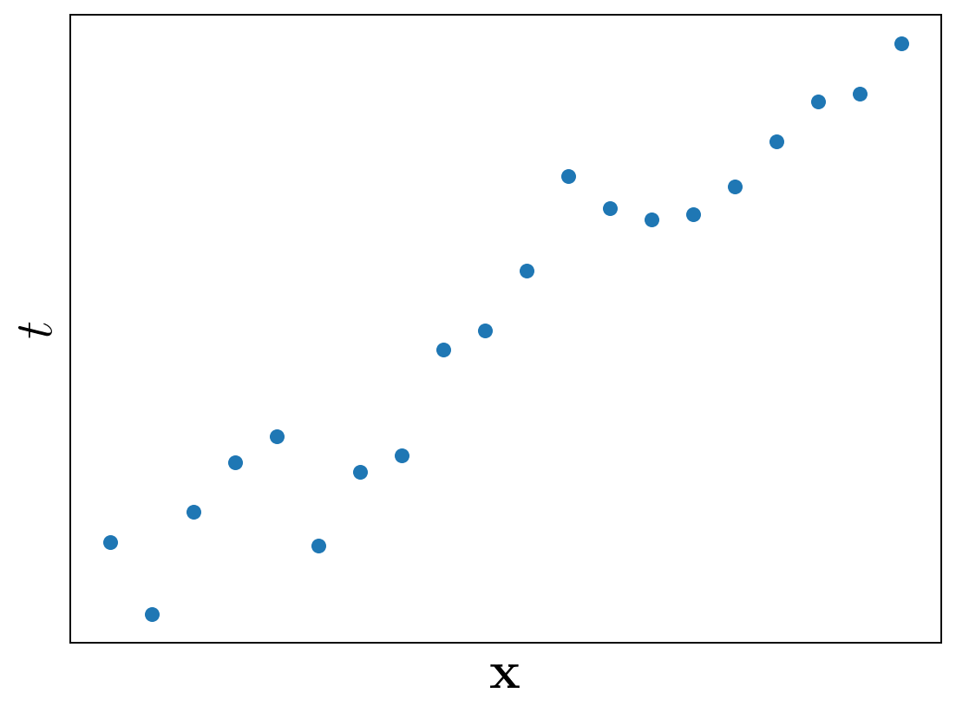
Linear regression
Let denote a spatial position in a -dimensional space
Given measurements at locations , what is at a new location ?

Slide 4
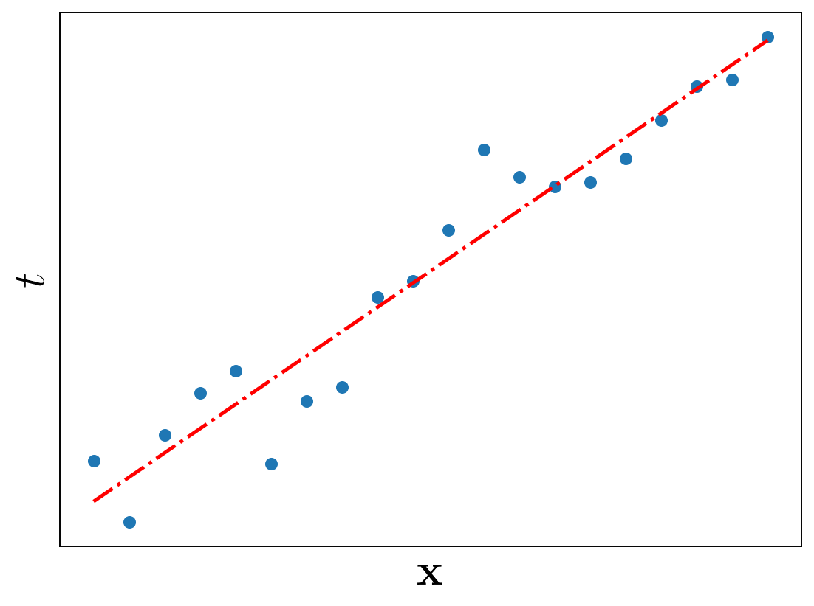

Linear regression
Let denote a spatial position in a -dimensional space
Given measurements at locations , what is at a new location ?
tunable weights

Slide 5
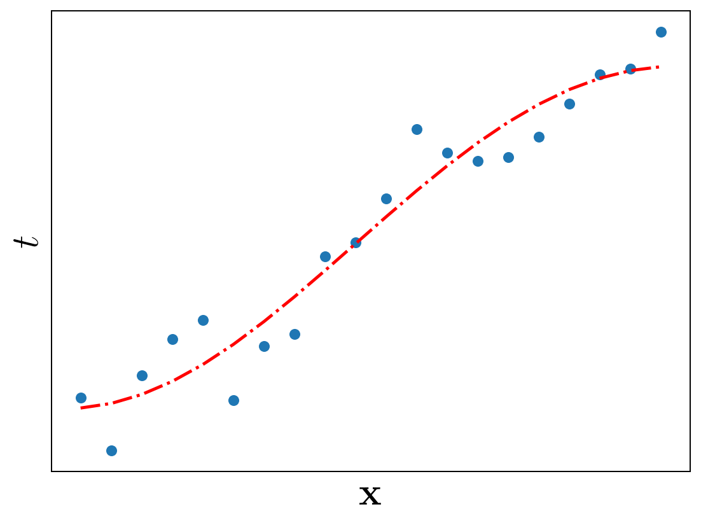
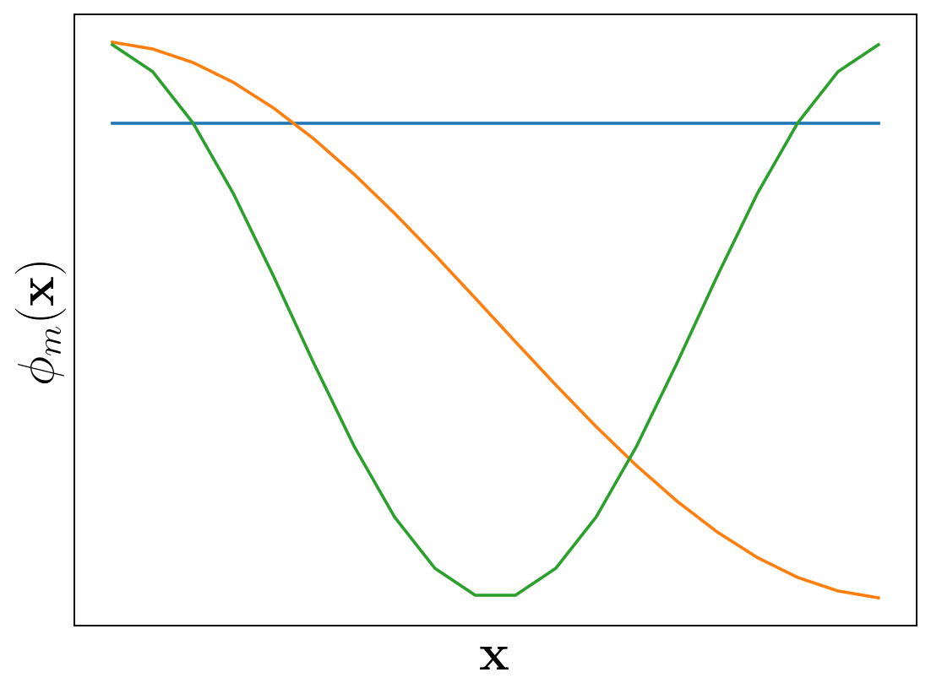
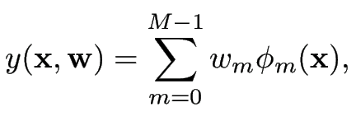
Linear regression
Let denote a spatial position in a -dimensional space
Given measurements at locations , what is at a new location ?
nonlinear basis functions
tunable weights

Slide 6

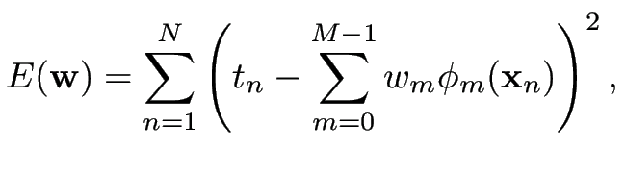
Linear regression
What are “suitable” values for the weights ?
Minimize the energy

Slide 7

Linear regression
What are “suitable” values for the weights ?
Minimize the energy
Task: find that minimizes

Slide 8
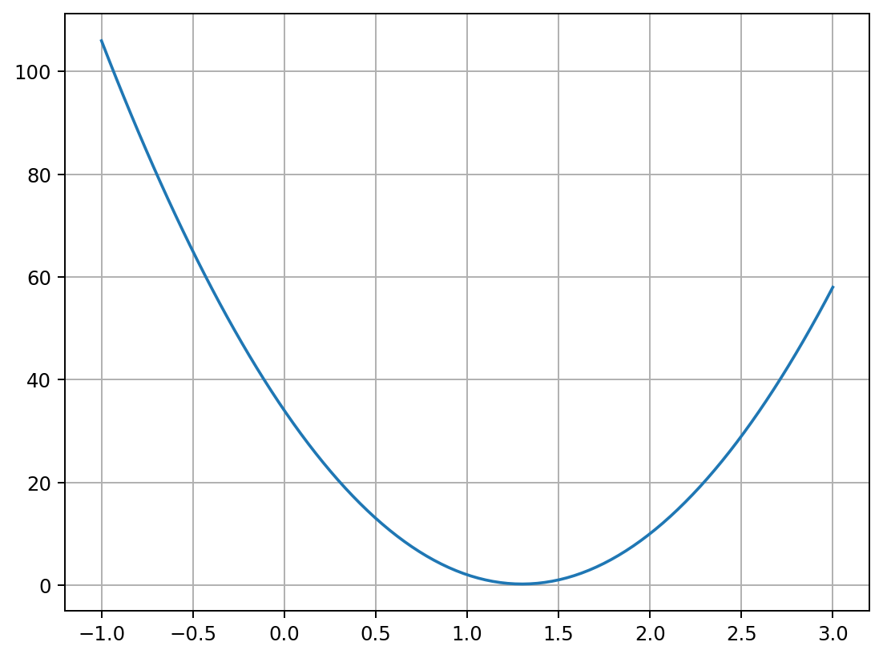
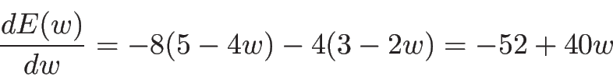
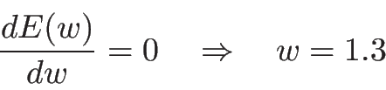
Linear regression
What are “suitable” values for the weights ?
Minimize the energy
Task: find that minimizes

Slide 9
Linear regression
What are “suitable” values for the weights ?
Minimize the energy

Slide 10
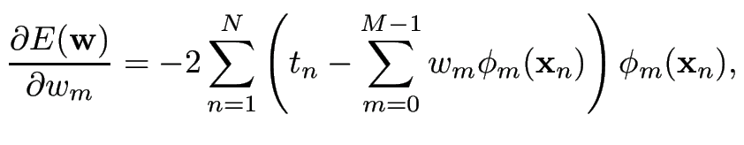
Linear regression
What are “suitable” values for the weights ?
Minimize the energy

Slide 11
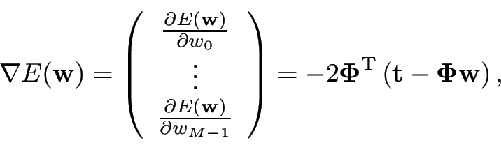
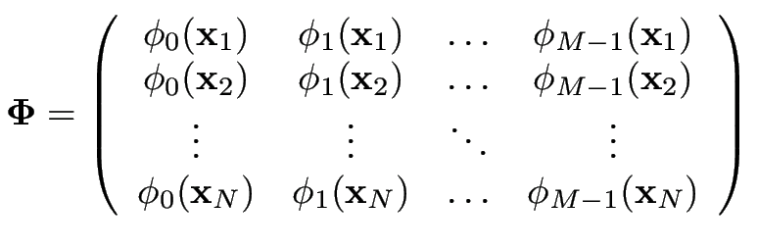

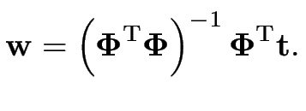
Linear regression
What are “suitable” values for the weights ?
Minimize the energy

Slide 12
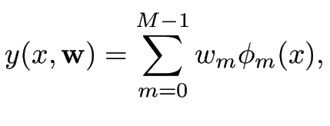


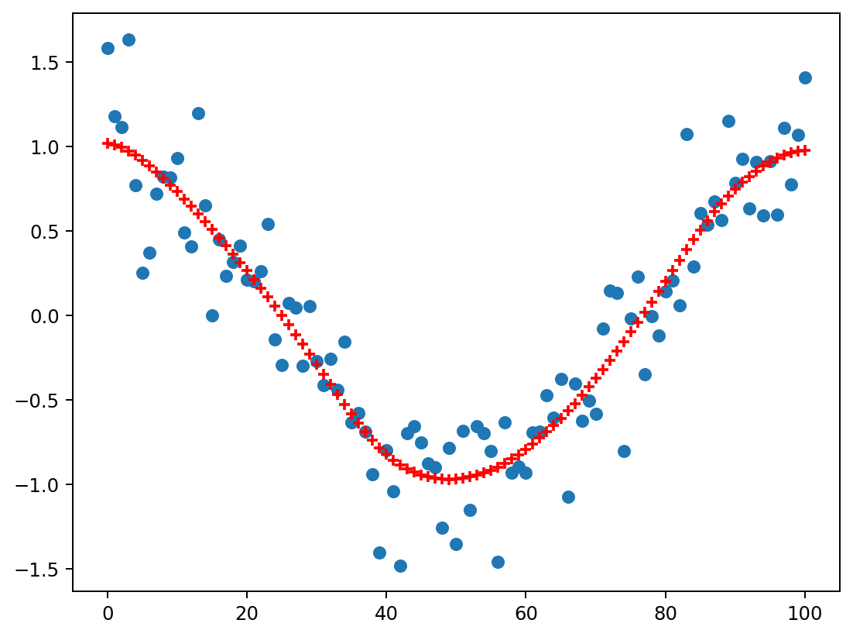



Smoothing
Let’s concentrate on one-dimensional (1D) “images”:
Functions of the form where the location is a scalar
Measurement points are defined on a regular grid:
“Denoising”:
The measurements are noisy observations
Recover the underlying signal at the locations

Slide 13



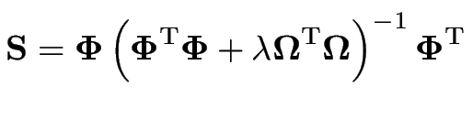
Smoothing
We aim to recover from
Since and :
with

Slide 14
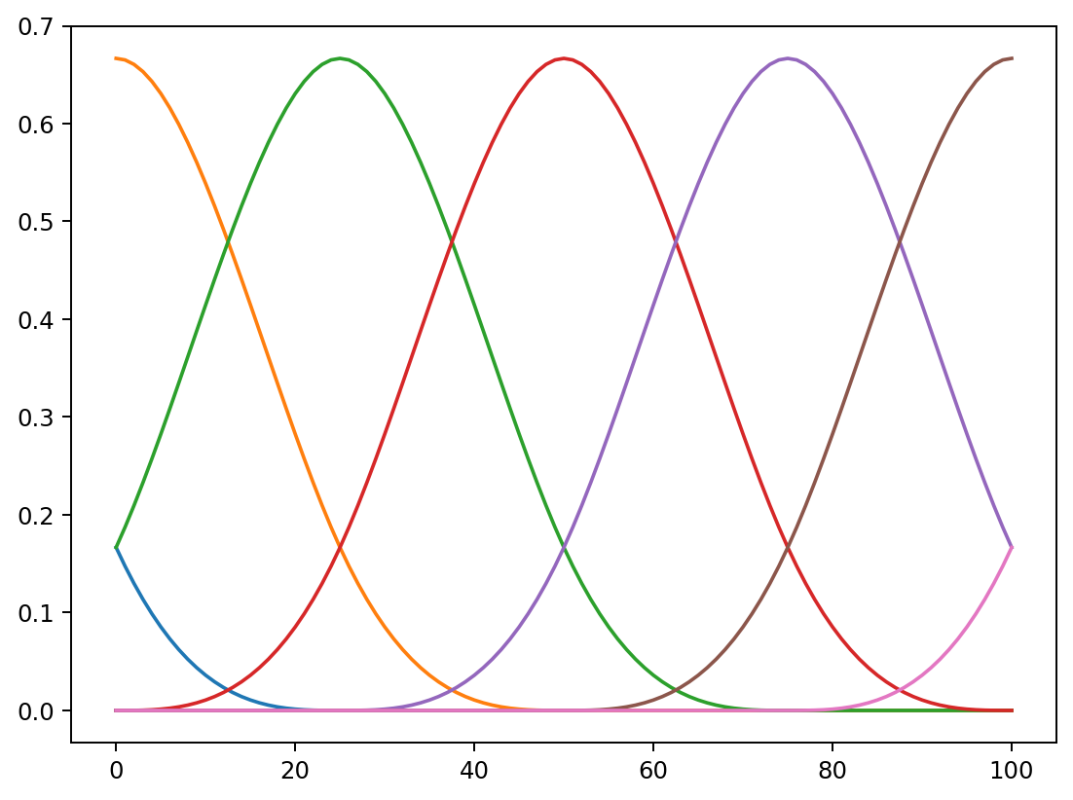
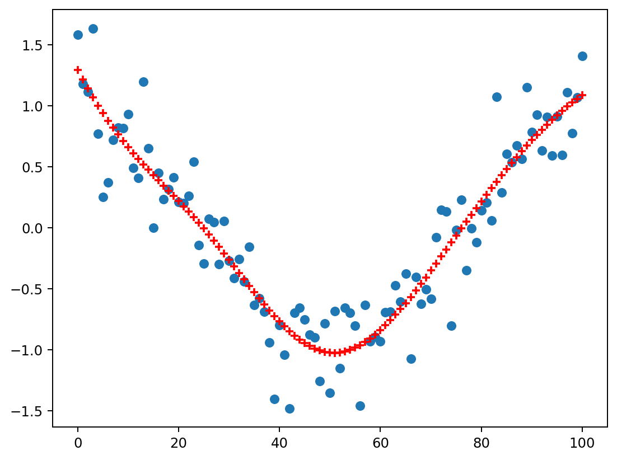
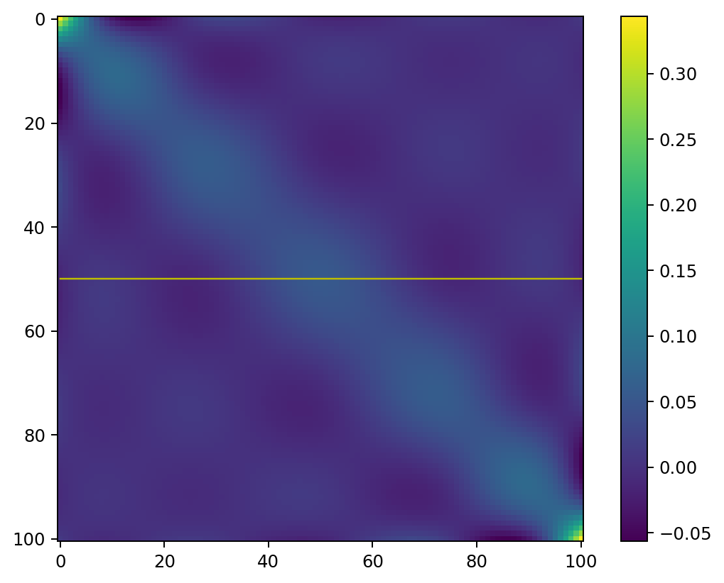
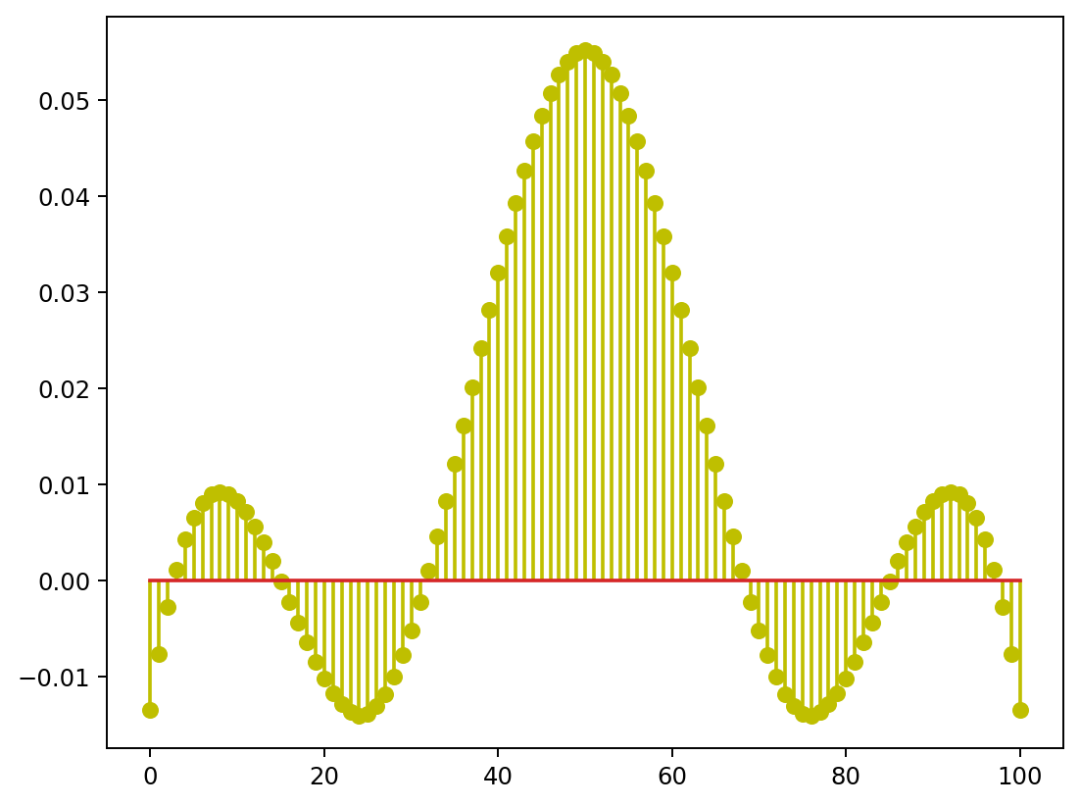

Example
M=7 basis functions

Slide 15
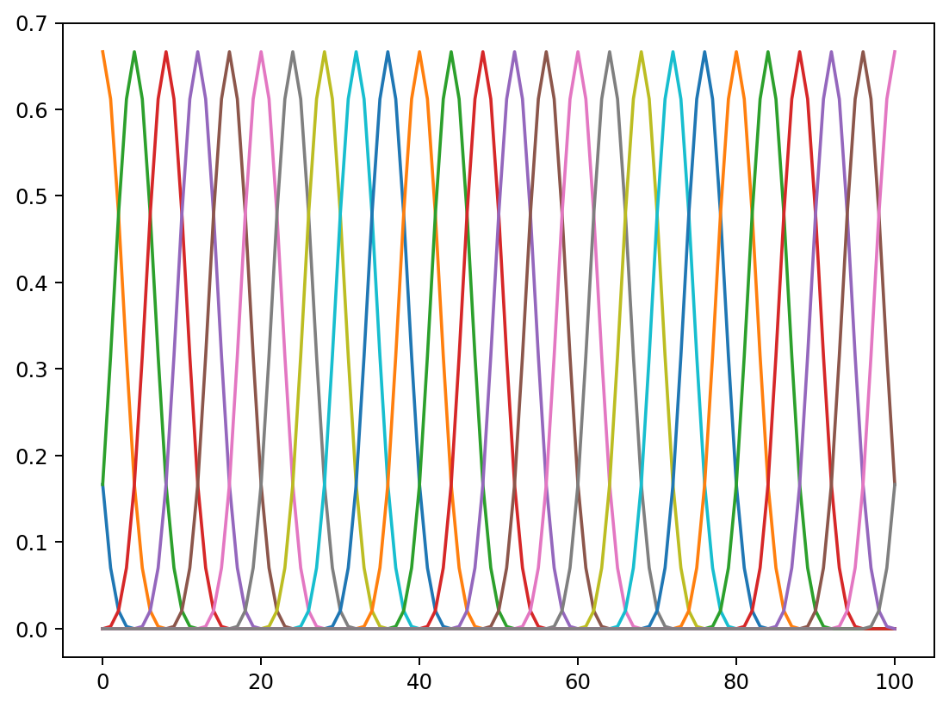
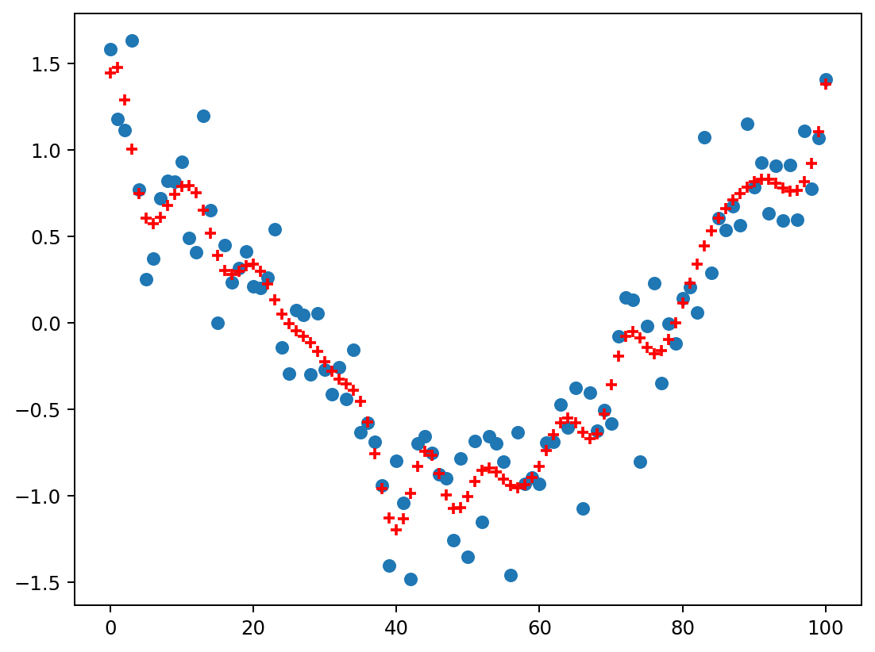
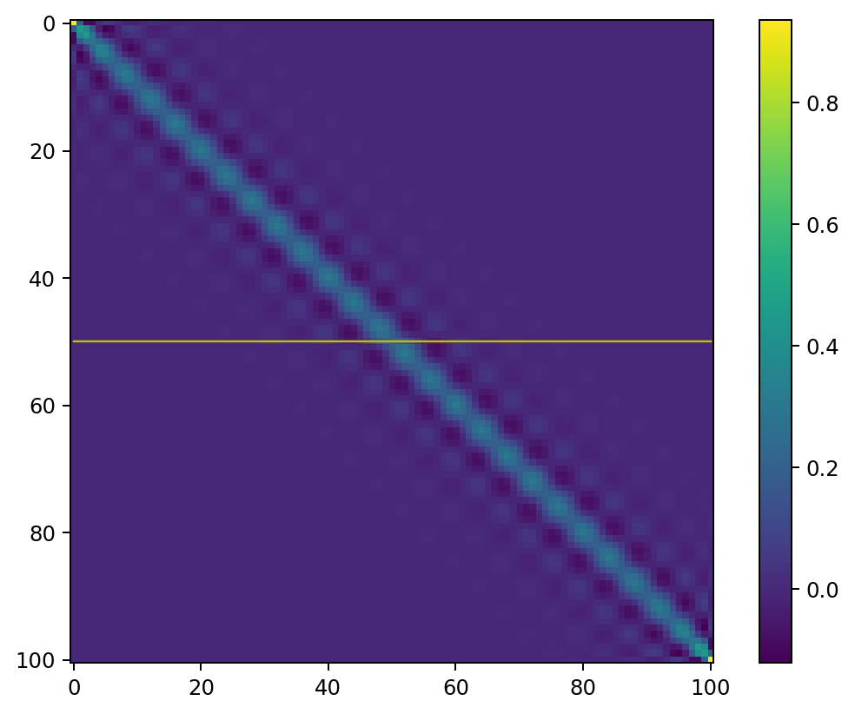
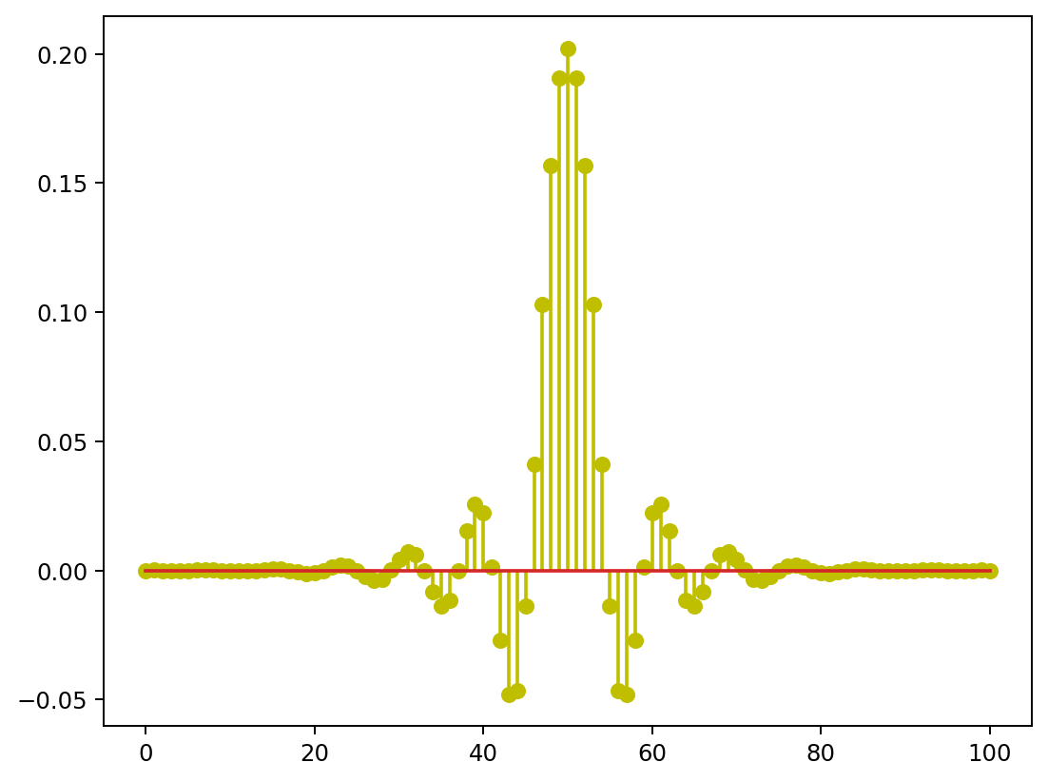
Example
M=28 basis functions

Slide 16
Example
What happens when M=N?
M=28 basis functions

Slide 17


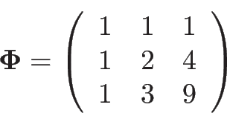
Discuss with your neighbor
Consider the case and
Task 1: what is ?
Task 2: what are and ?
Can you explain (e.g., draw) what’s happening?
Task 3: same as task 2 but when

Slide 18
Discuss with your neighbor
Consider the case and
Task 1: what is ?
Task 2: what are and ?
Can you explain (e.g., draw) what’s happening?
Task 3: same as task 2 but when

Slide 19

Discuss with your neighbor
Consider the case and
Task 1: what is ?
Task 2: what are and ?
Can you explain (e.g., draw) what’s happening?
Task 3: same as task 2 but when

Slide 20
Discuss with your neighbor
Consider the case and
Task 1: what is ?
Task 2: what are and ?
Can you explain (e.g., draw) what’s happening?
Task 3: same as task 2 but when

Slide 21
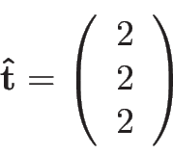
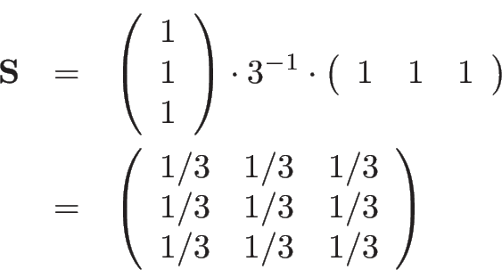
Discuss with your neighbor
Consider the case and
Task 1: what is ?
Task 2: what are and ?
Can you explain (e.g., draw) what’s happening?
Task 3: same as task 2 but when

Slide 22
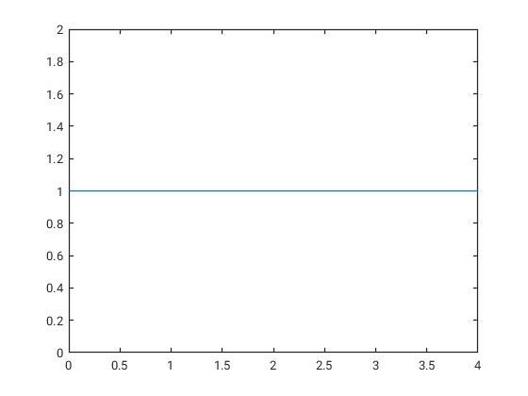
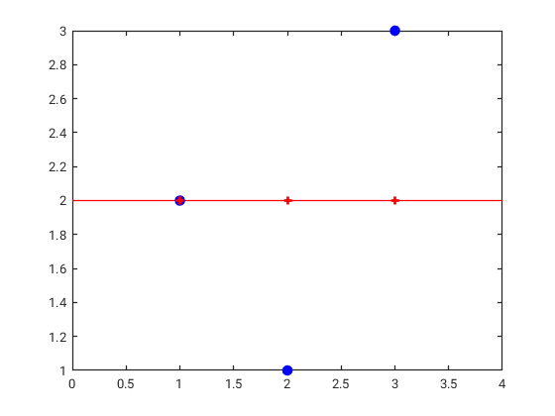
Discuss with your neighbor
Consider the case and
Task 1: what is ?
Task 2: what are and ?
Can you explain (e.g., draw) what’s happening?
Task 3: same as task 2 but when

Slide 23
Discuss with your neighbor
Consider the case and
Task 1: what is ?
Task 2: what are and ?
Can you explain (e.g., draw) what’s happening?
Task 3: same as task 2 but when

Slide 24
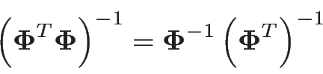
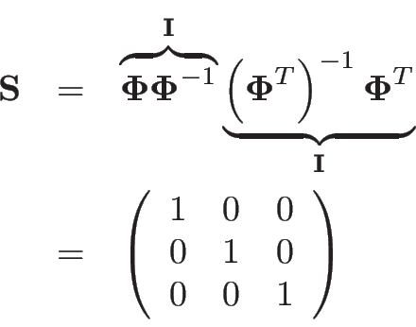
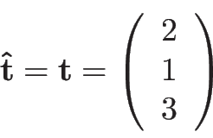
Discuss with your neighbor
Consider the case and
Task 1: what is ?
Task 2: what are and ?
Can you explain (e.g., draw) what’s happening?
Task 3: same as task 2 but when

Slide 25
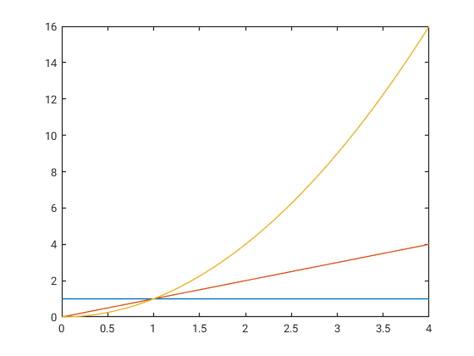
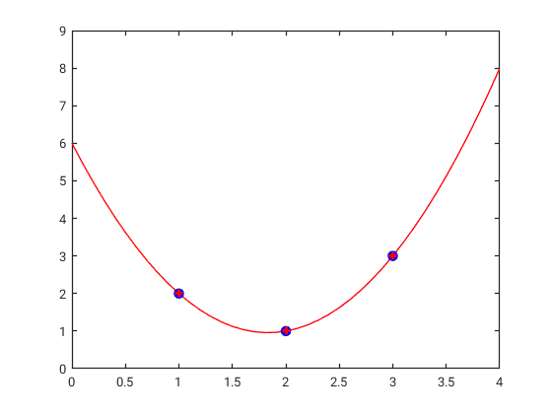
Discuss with your neighbor
Consider the case and
Task 1: what is ?
Task 2: what are and ?
Can you explain (e.g., draw) what’s happening?
Task 3: same as task 2 but when
When M=N,
no smoothing is applied!

Slide 26
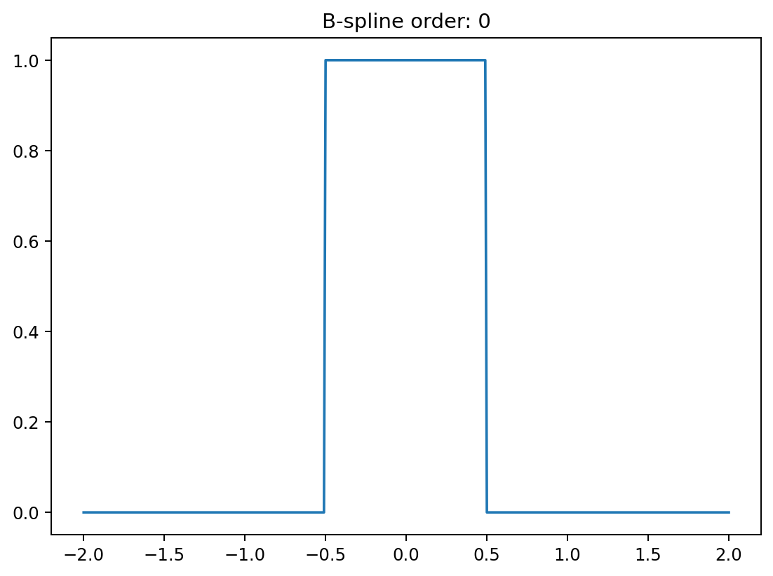
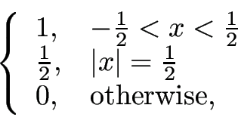


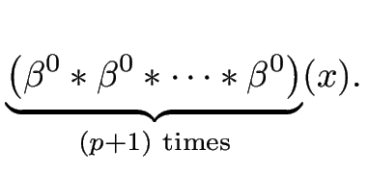
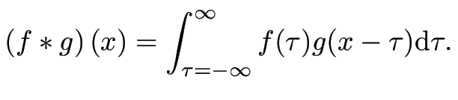

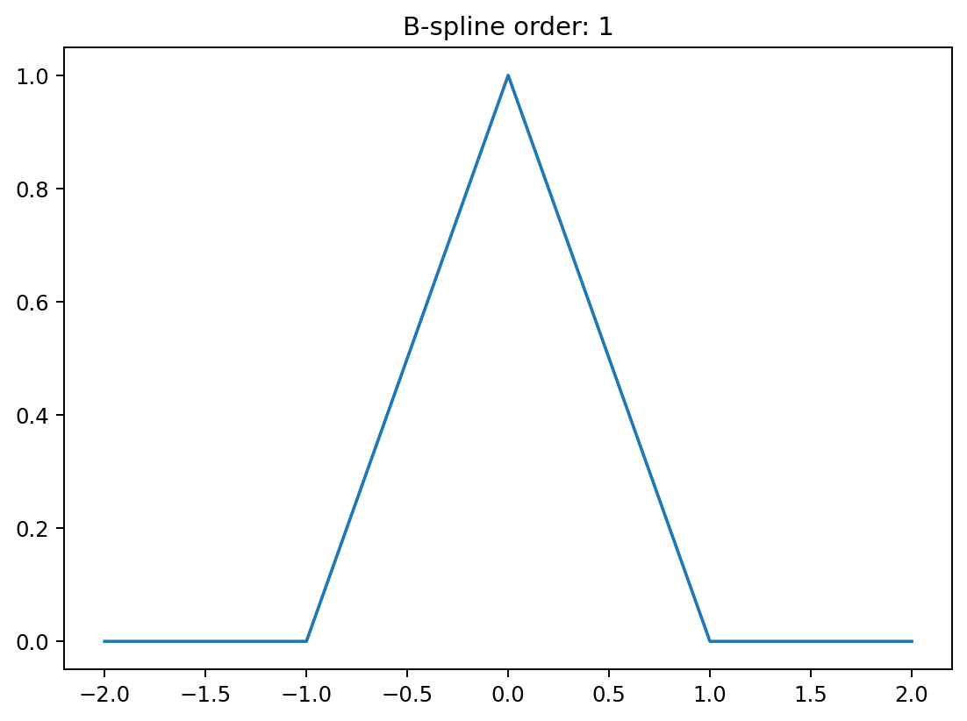
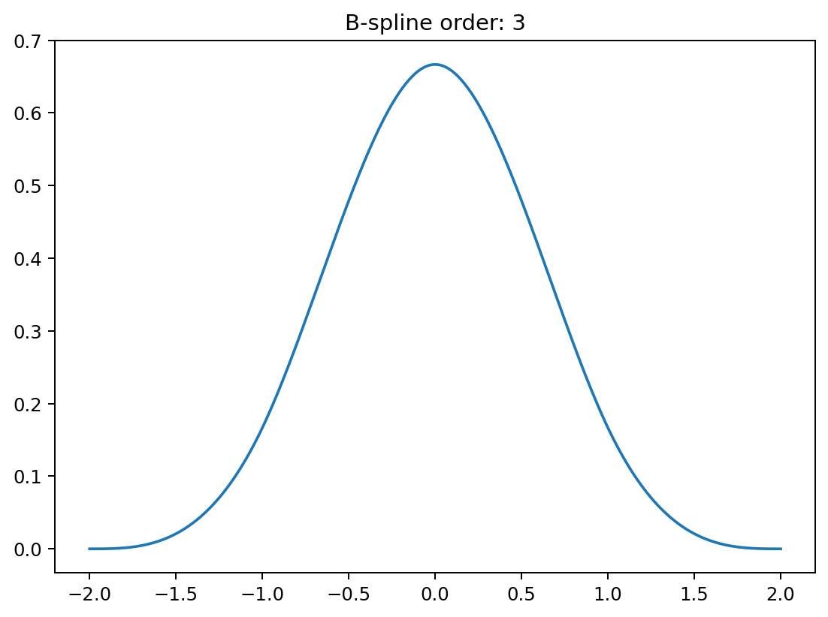
Interpolation
Meet the B-spline family:
where
“order”

Slide 27



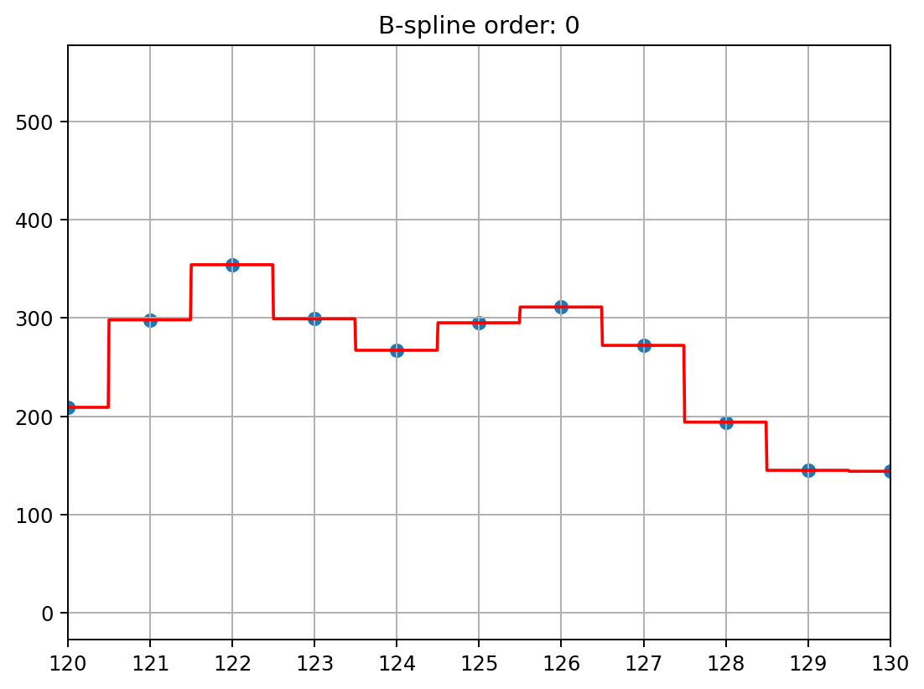
Interpolation
Use basis functions:
will pass exactly through at the integer locations
Order 0: “nearest neighbor” interpolation
(almost)

Slide 28
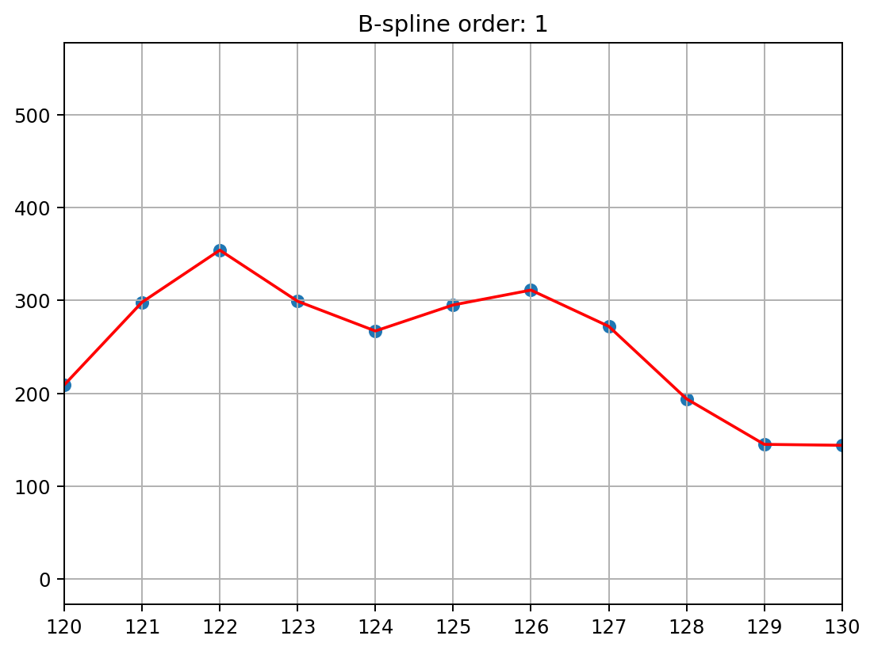
Interpolation
Use basis functions:
will pass exactly through at the integer locations
Order 1: “linear” interpolation

Slide 29
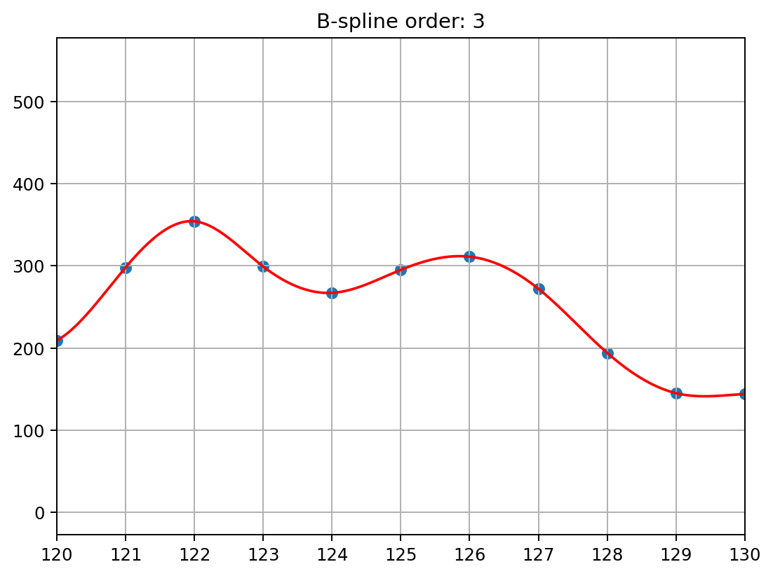
Interpolation
Use basis functions:
will pass exactly through at the integer locations
Order 3: “linear” interpolation

Slide 30


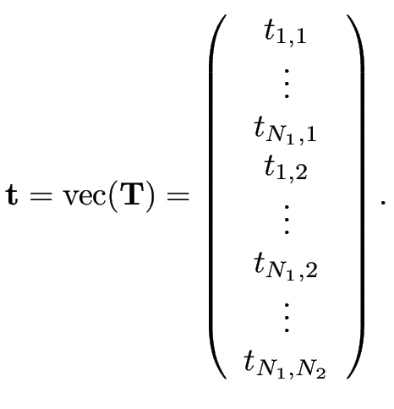
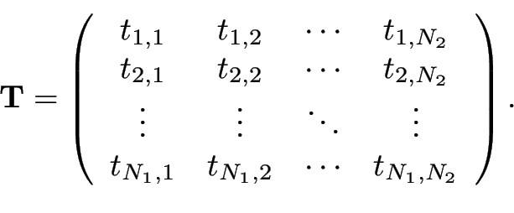
Going to higher dimensions
Re-arrange pixels in 2D images of size into 1D signals of length
Vectorize the image to be smoothed or interpolated
Also vectorize each of the 2D basis functions
Solve the resulting 1D problem as before

Slide 31
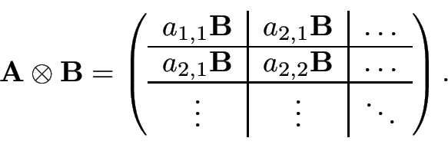



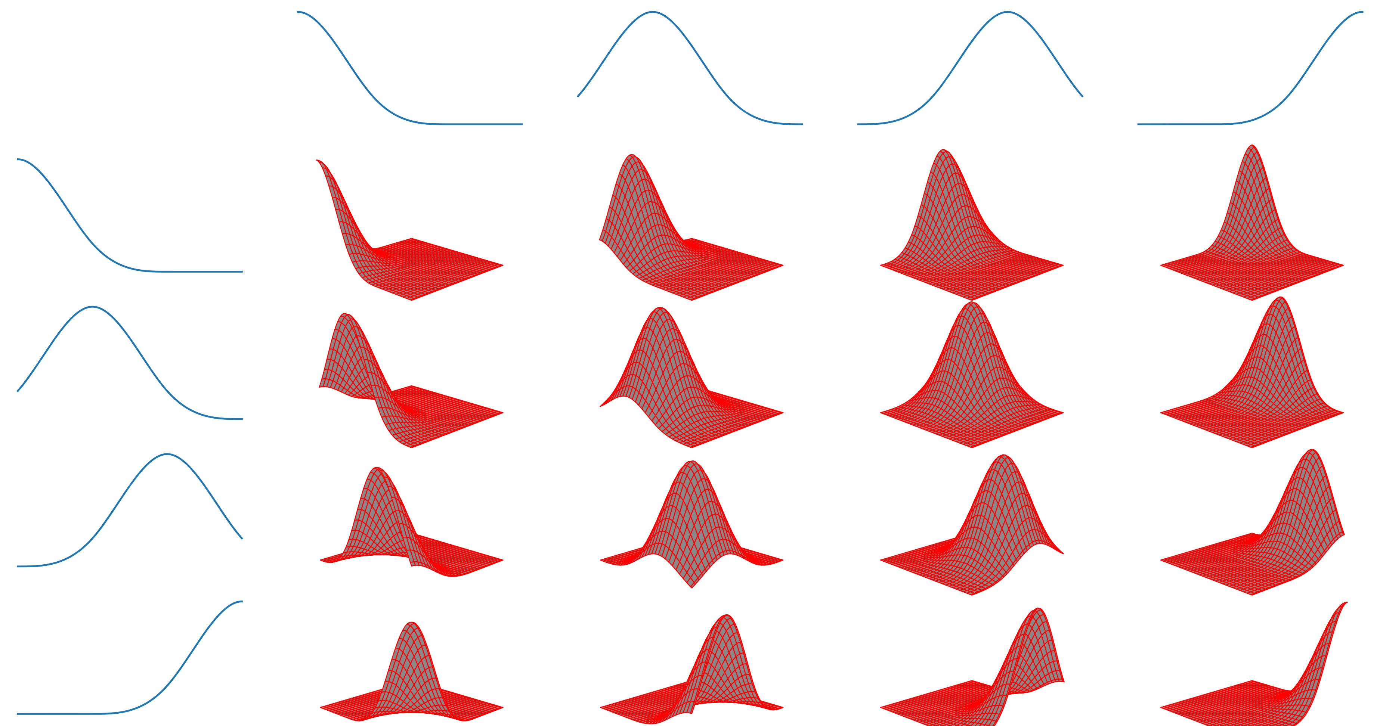
Separable basis functions
Create 2D basis functions from two sets of 1D basis functions
Kronecker product: , where
Column in contains a vectorized version of

Slide 32
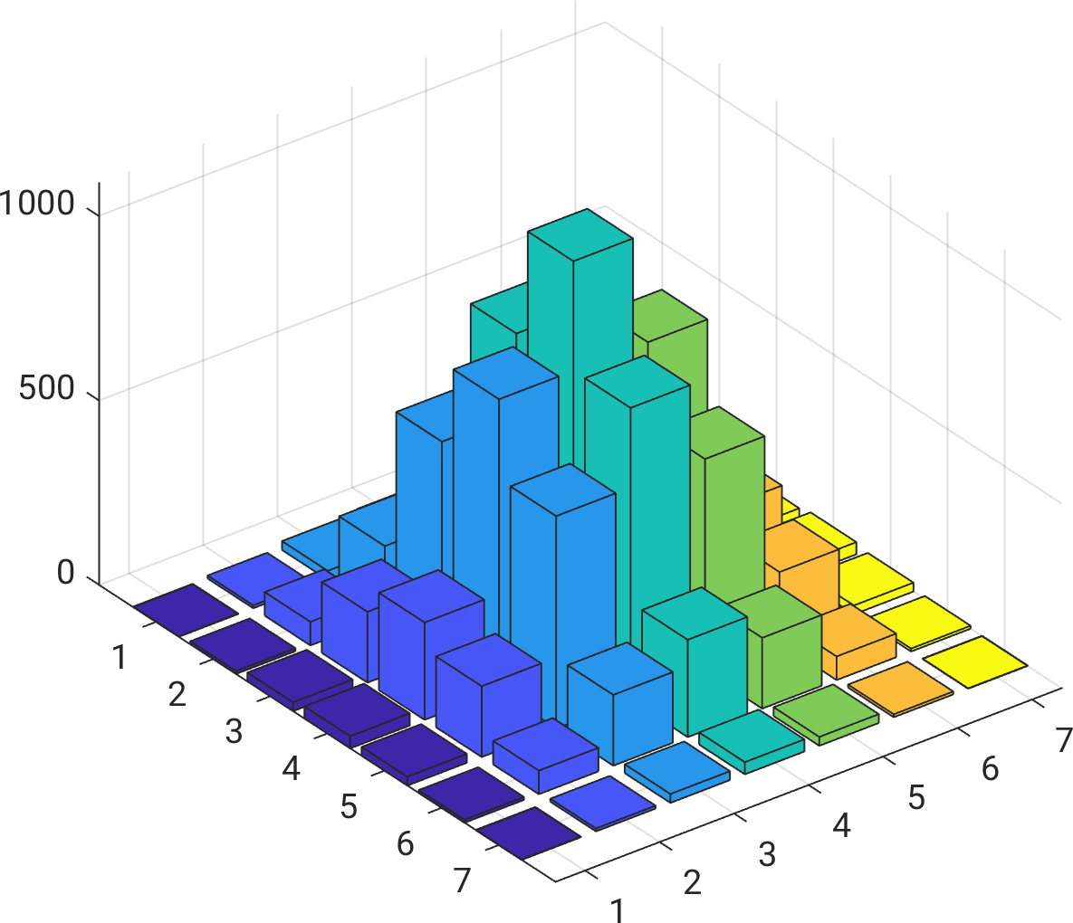
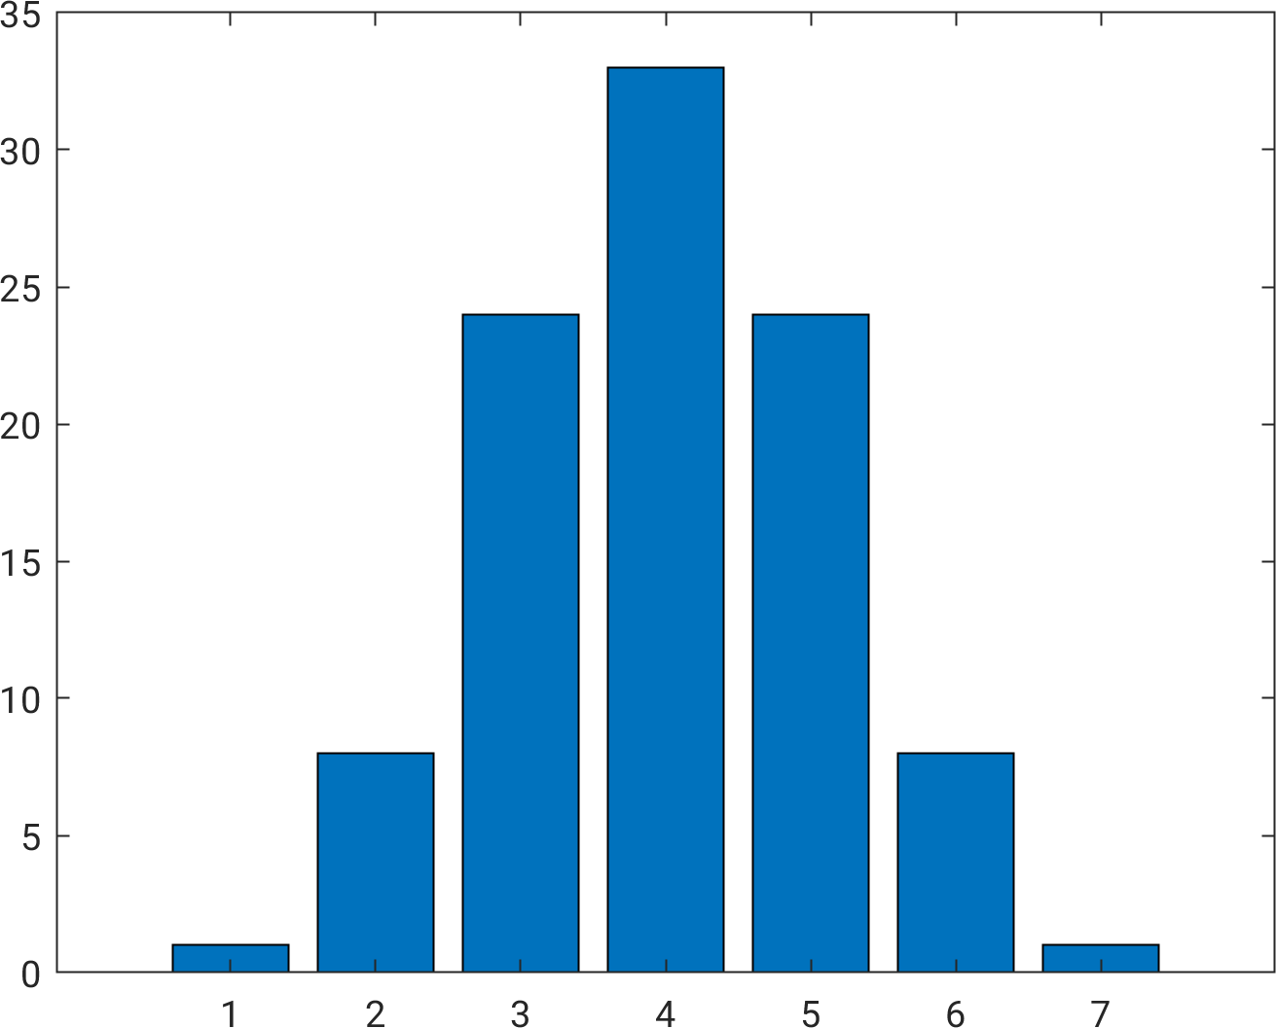
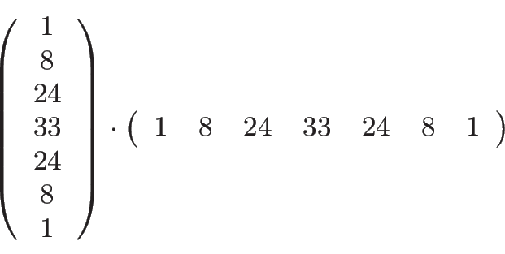

Separable basis functions
x
=

Slide 33





Exploiting separability
When , we can compute faster as follows:
where
As a result, we can also compute as:
where

Slide 34
Exploiting separability
When , we can compute faster as follows:
where
As a result, we can also compute as:
where
Example: naively interpolating a 256x256 image (M = 256*256 = 65,536 basis functions in 2D!)
Storing takes 32 GB, vs. 1MB to store both and
Inverting is almost 10 million times slower than inverting both and

Slide 35






Smoothing in 2D
smoothing in the
column-direction
smoothing in the row-direction

Slide 36




Interpolation in 2D
“nearest neighbor”
“linear”
“cubic”

