Slide 1
Model-based Segmentation:
Part I
Medical Image Analysis
Koen Van Leemput
Fall 2023

Slide 2
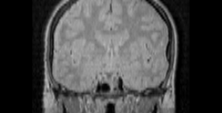
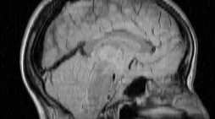
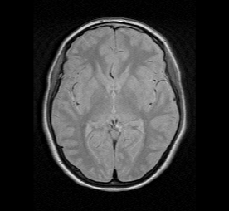
Voxel-based segmentation
“voxel”
Determine to which anatomical structure each voxel in the image belongs:
  - Think “LEGO bricks”
  - Outer surfaces can easily be extracted if needed

Slide 3
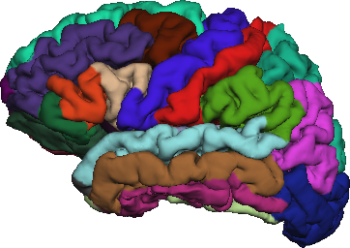
Voxel-based segmentation
Automated computational methods

Slide 4
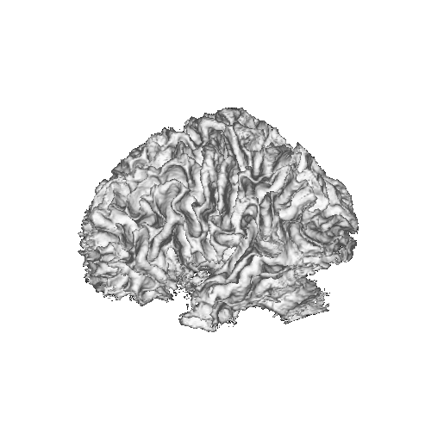
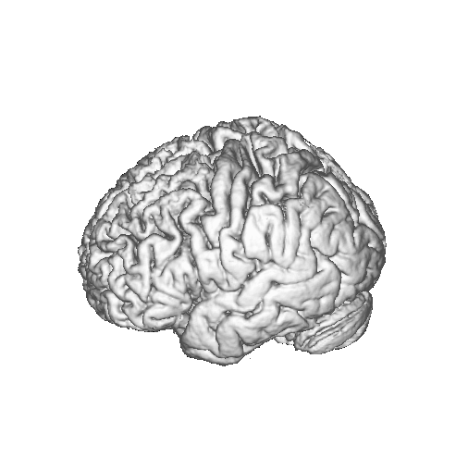
This and next lecture
Automated computational methods

Slide 5
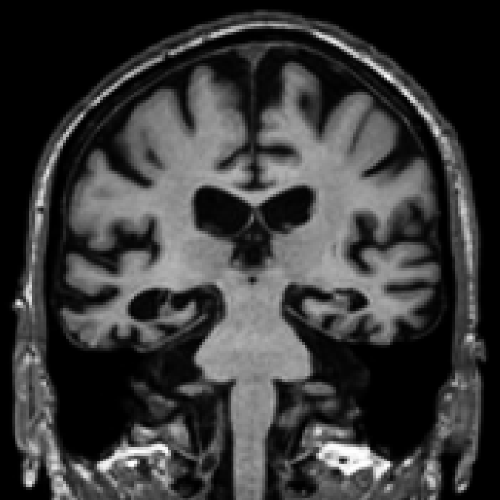





The problem to be solved
MRI image
voxels
: intensity in voxel

Slide 6
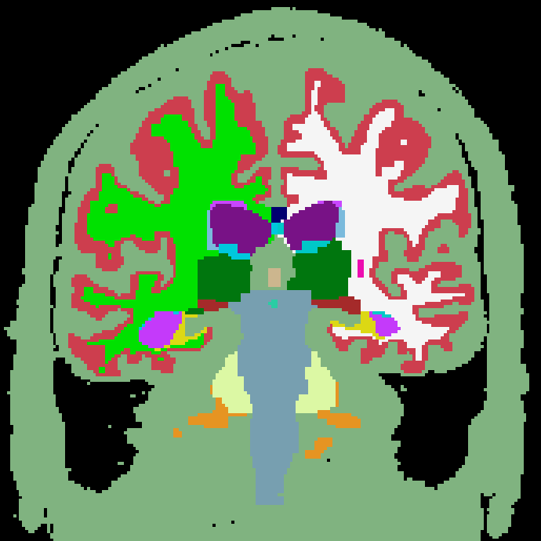





The problem to be solved
MRI image
Label image
: number of classes

Slide 7



One solution: generative modeling
  Formulate a statistical model of how a medical image is formed
  The model depends on some parameters
  Appropriate values are assumed to be known for now...
“labeling model”
“imaging model”
Label image
MRI image

Slide 8

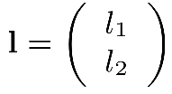



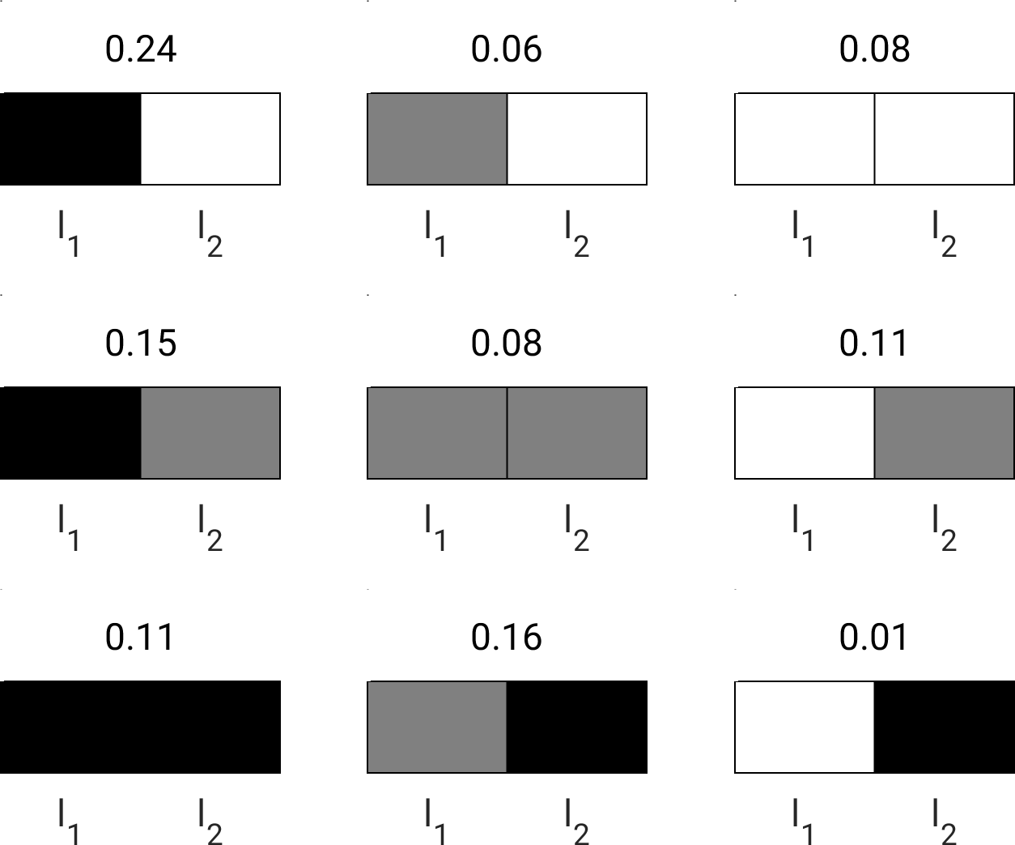
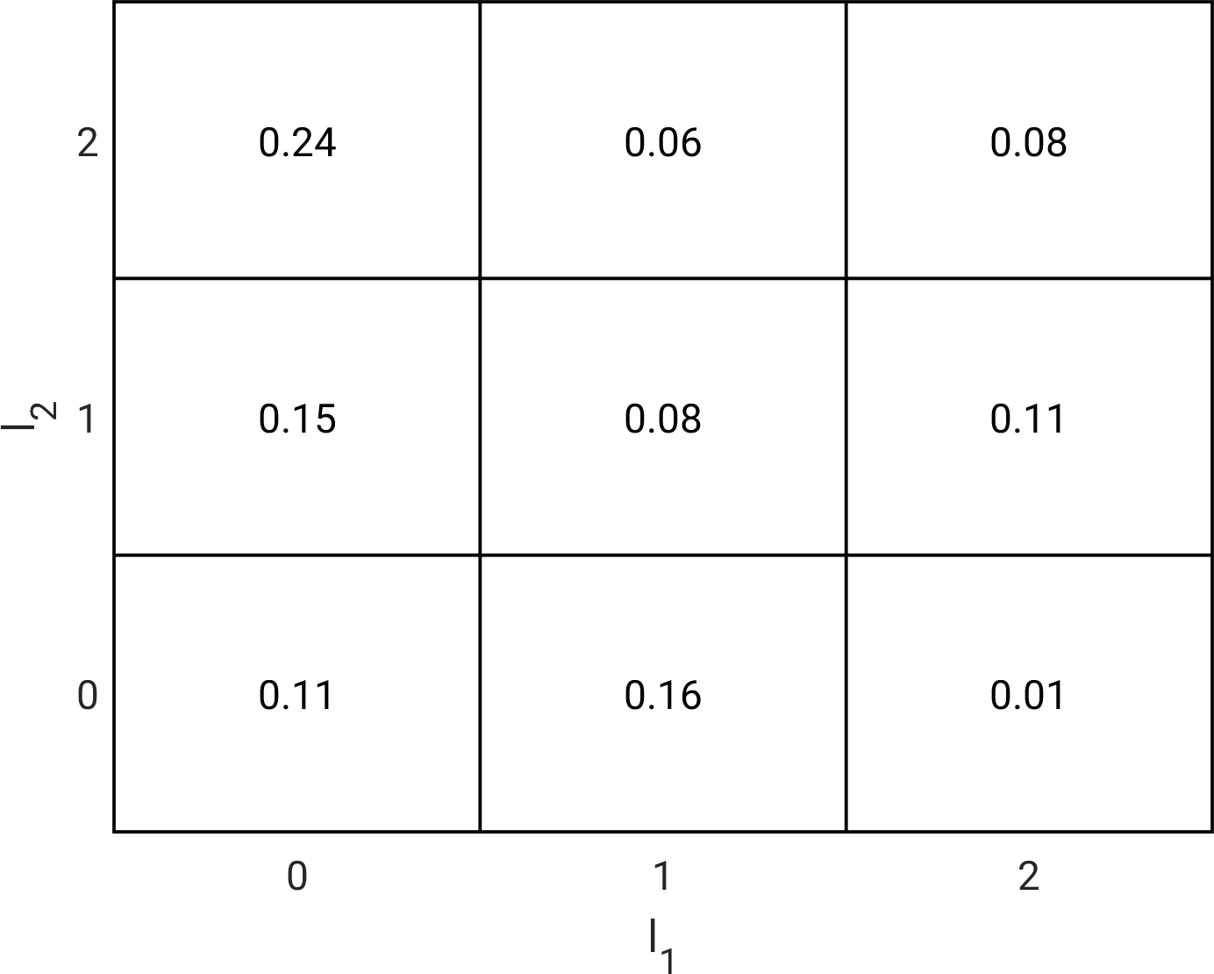
Toy example
voxels
classes

Slide 9
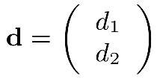


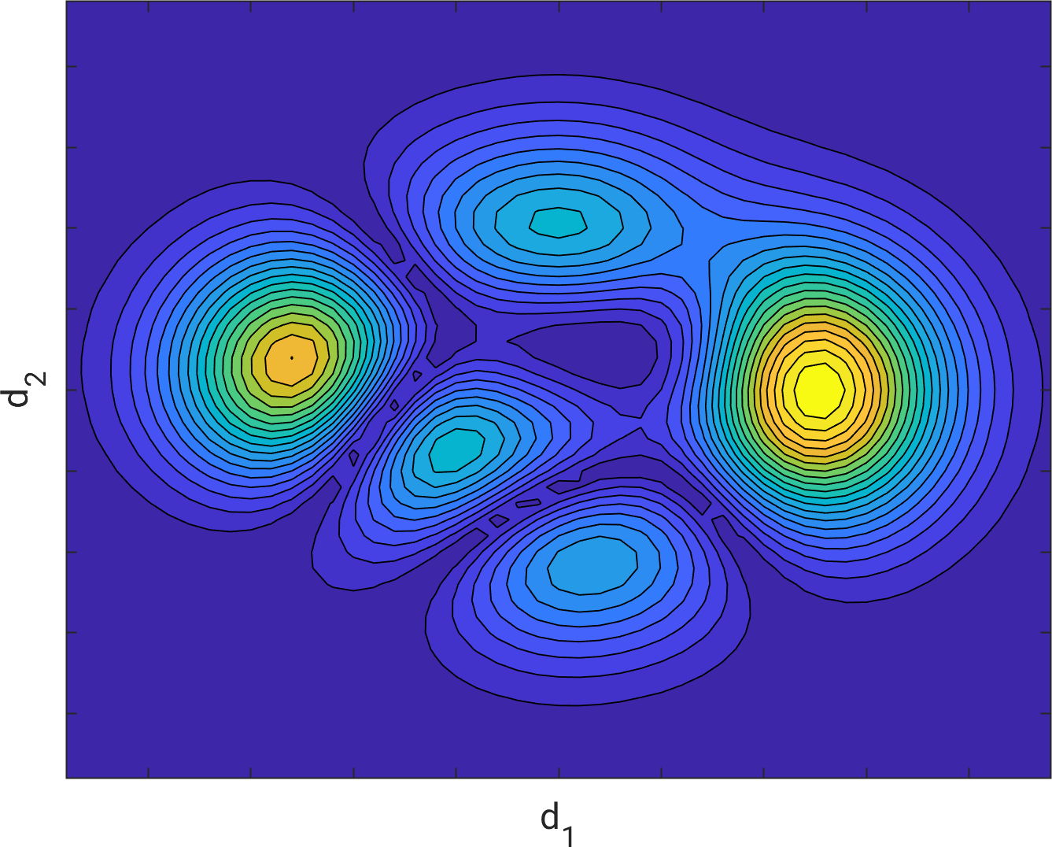
Toy example
voxels
classes

Slide 10
One solution: generative modeling
  Formulate a statistical model of how a medical image is formed
  The model depends on some parameters
  Appropriate values are assumed to be known for now...
“labeling model”
“imaging model”
Label image
MRI image

Slide 11
Segmentation = inverse problem
MRI image
Label image

Slide 12




Segmentation = inverse problem
MRI image
Label image
The posterior distribution is given by Bayes rule:

Slide 13
Segmentation = inverse problem
MRI image
Label image
The posterior distribution is given by Bayes rule:
labeling model

Slide 14
Segmentation = inverse problem
MRI image
Label image
The posterior distribution is given by Bayes rule:
imaging model

Slide 15

Segmentation = inverse problem
MRI image
Label image
The posterior distribution is given by Bayes rule:
(but not
needed)

Slide 16




Gaussian mixture model
“labeling model”
“imaging model”
Label image
MRI image
  Assign a label to each voxel independently
  Probability of assigning label is

Slide 17

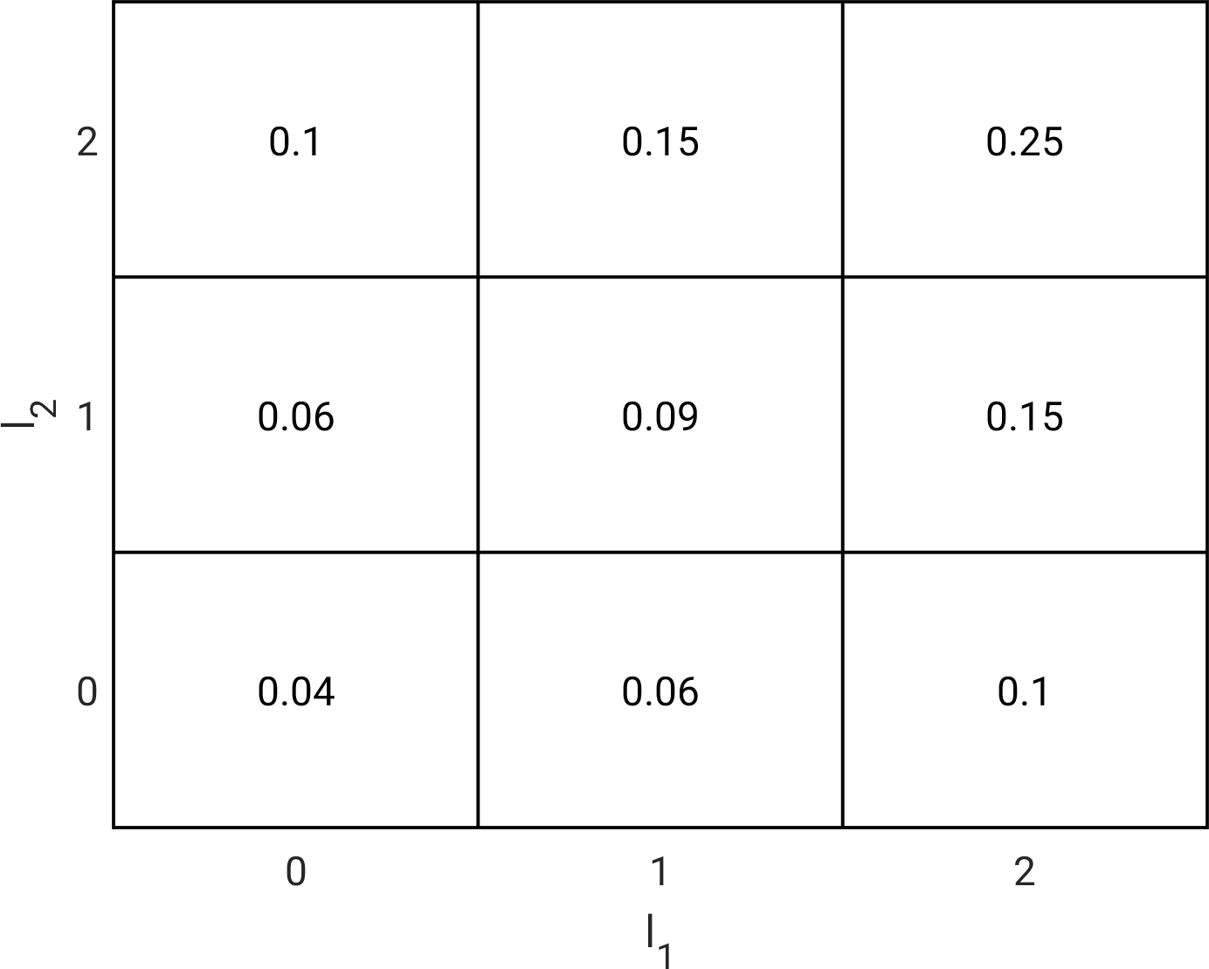
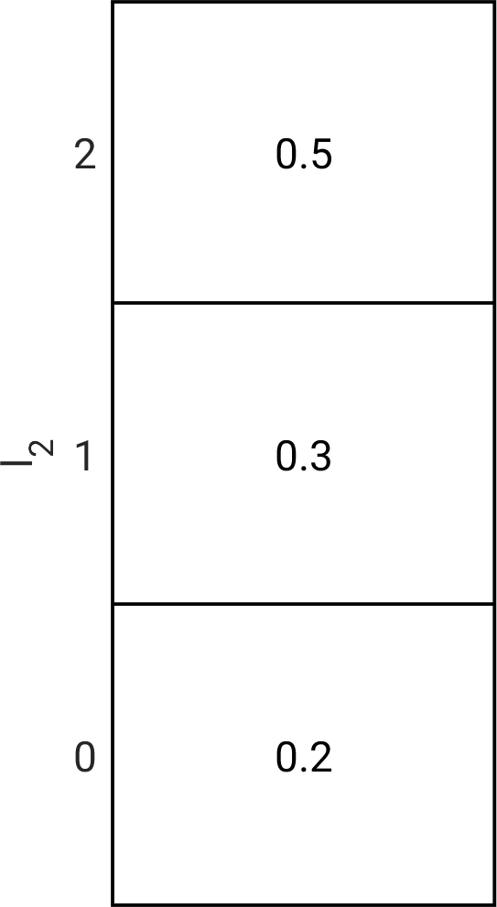
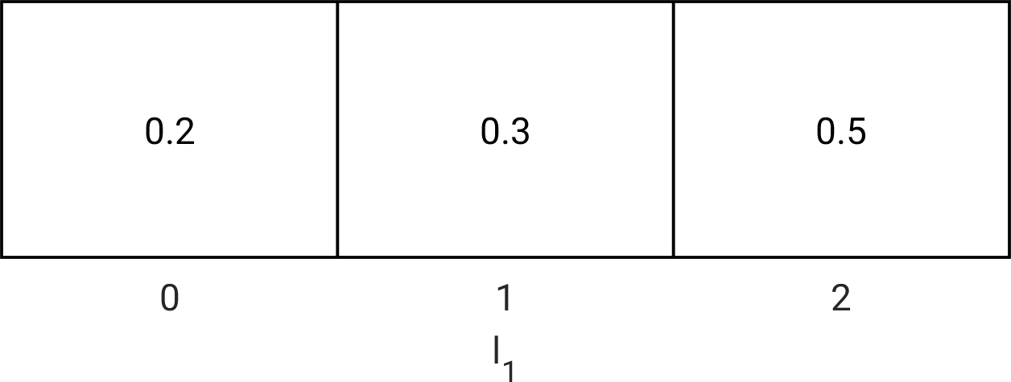
Toy example
voxels
classes
=
.

Slide 18





Gaussian mixture model
“labeling model”
“imaging model”
Label image
MRI image
  Drawn the intensity in each voxel with label from a Gaussian distribution with mean and variance

Slide 19

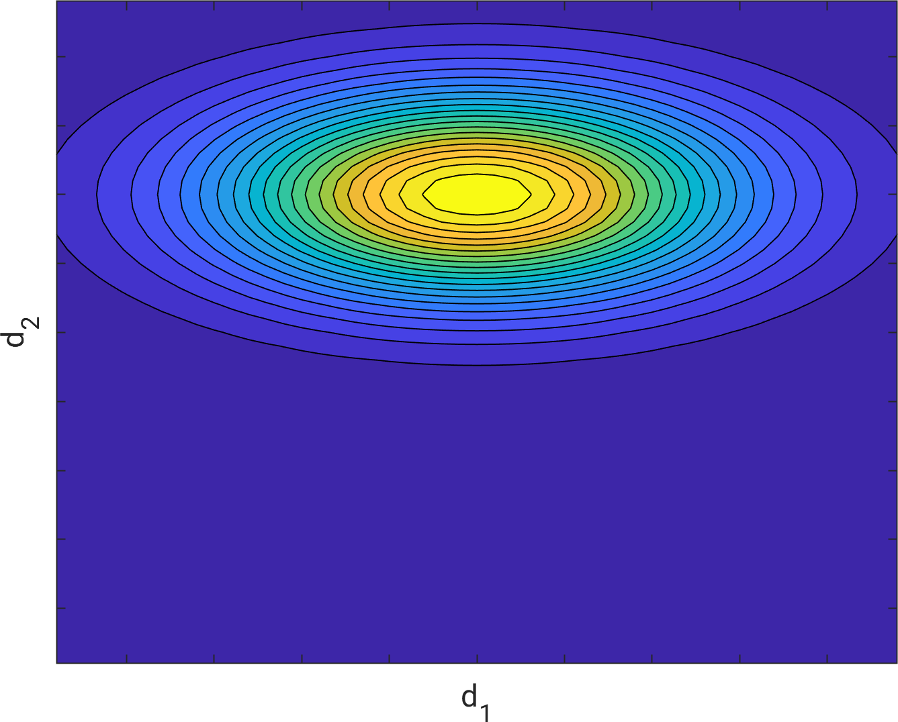
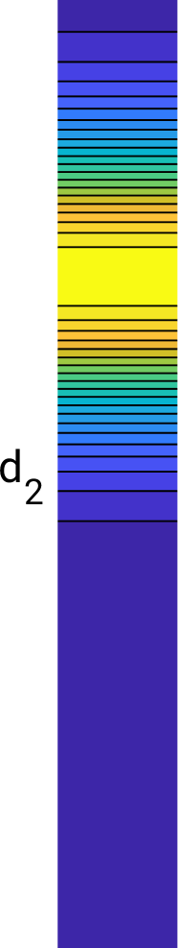
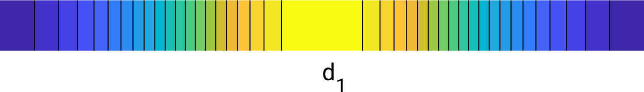
Toy example
voxels
classes
=
.

Slide 20
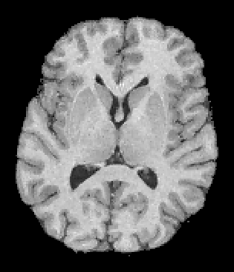
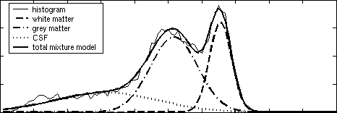

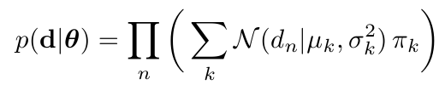
Gaussian mixture model
labels

Slide 21
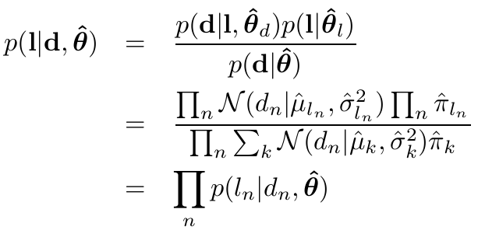
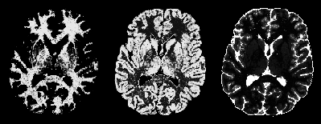
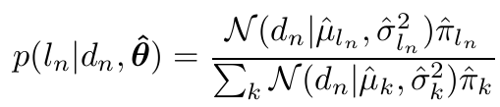
Posterior probability distribution

Slide 22

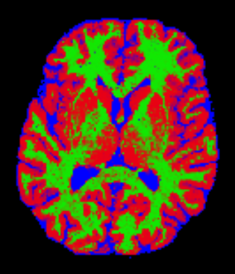
Maximum a posteriori segmentation
white matter
CSF
gray matter

Slide 23
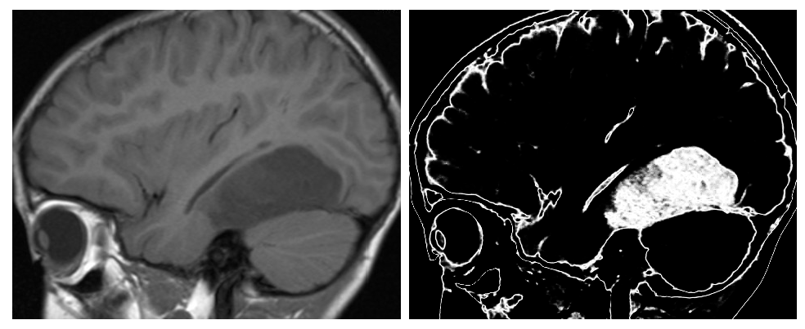
Problem solved?
Two-component Gaussian mixture model:
tumor vs. “other”
MR scan
Posterior probability for tumor

Slide 24
Gaussian mixture model
“labeling model”
“imaging model”
Label image
MRI image

Slide 25
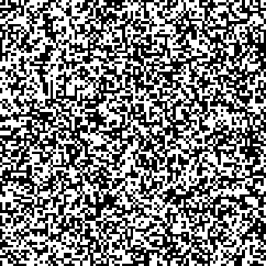
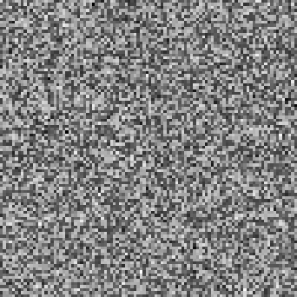
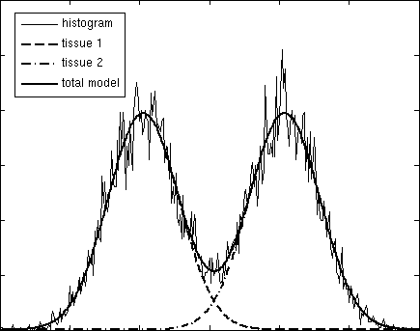
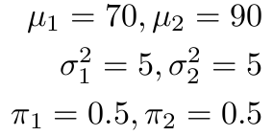
Gaussian mixture model
“labeling model”
“imaging model”
Label image
MRI image

Slide 26
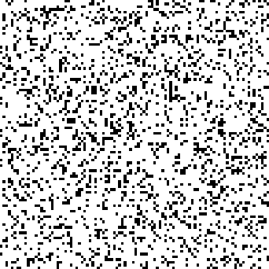
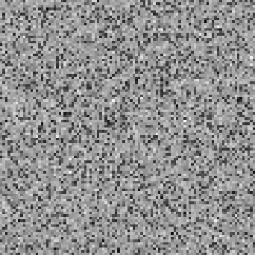
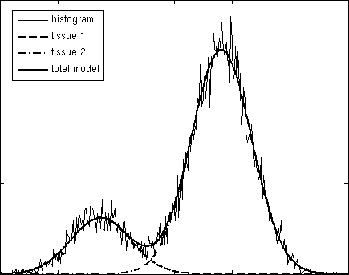
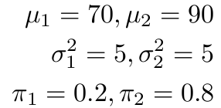
Gaussian mixture model
“labeling model”
“imaging model”
Label image
MRI image

Slide 27
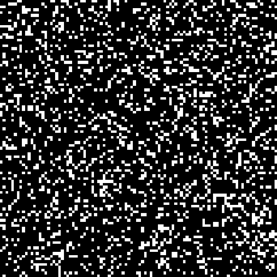
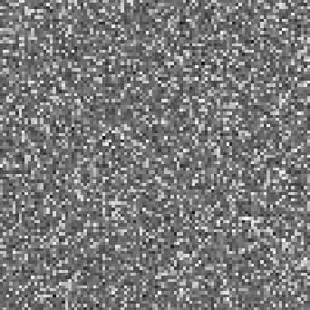
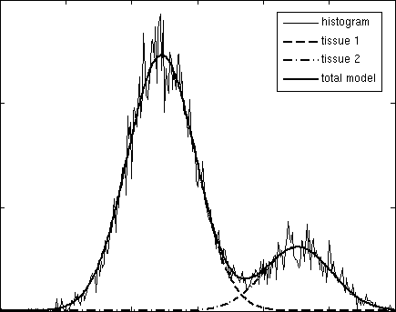
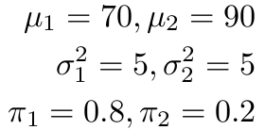
Gaussian mixture model
“labeling model”
“imaging model”
Label image
MRI image

Slide 28

Markov random field model
“labeling model”
“imaging model”
Label image
MRI image

Slide 29



Markov random field model
  Prior that prefers voxels with the same label to be spatially clustered
  is a normalizing constant

Slide 30
Markov random field model
  Prior that prefers voxels with the same label to be spatially clustered
sum over all neighboring voxels
  is a normalizing constant

Slide 31
Markov random field model
  Prior that prefers voxels with the same label to be spatially clustered
zero if labels are the same,
one otherwise
  is a normalizing constant

Slide 32
Markov random field model
  Prior that prefers voxels with the same label to be spatially clustered
Parameter controling
strength of penalization
  is a normalizing constant

Slide 33
Markov random field model
  Prior that prefers voxels with the same label to be spatially clustered
  is a normalizing constant
Not needed in practice

Slide 34



Markov random field model
  Slightly more general:
  are the model parameters
  Reduces to Gaussian mixture model prior
  for !

Slide 35




Toy example
voxels
classes

Slide 36
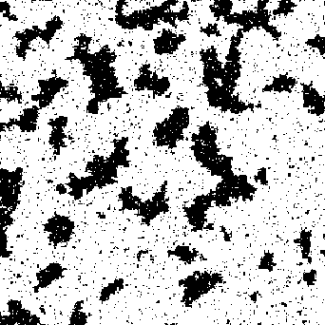
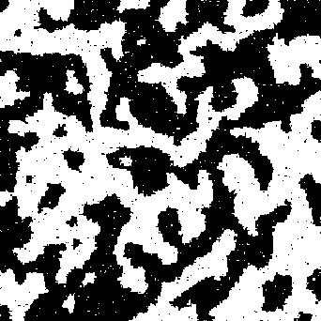
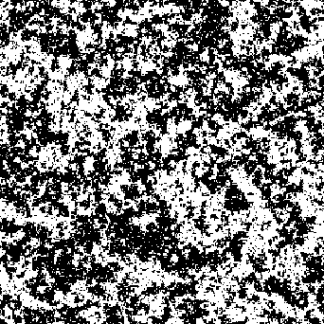
Samples
  Different values for model parameters

Slide 37
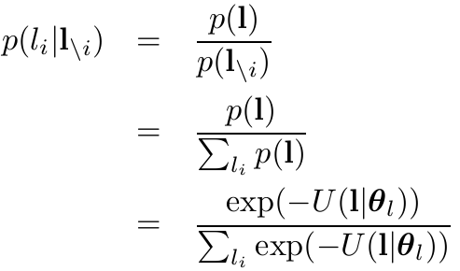
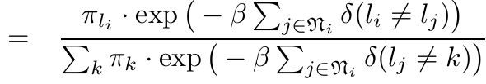
Why exactly this model?
  Long-range statistical dependencies between voxels
  Local computations (efficient!):

Slide 38
Why exactly this model?
  Long-range statistical dependencies between voxels
  Local computations (efficient!):
All labels
except the one
of voxel i

Slide 39
Why exactly this model?
  Long-range statistical dependencies between voxels
  Local computations (efficient!):
neighbors
of voxel i

Slide 40


Mean field approximation
  In the Gaussian mixture model, the posterior was of the form
  With the Markov random field model, the posterior no longer “factorizes” that way
  For a 2-label model in a standard 256x256x128 MR scan, there are over 10¹⁰⁰⁰⁰⁰⁰ unique label images with each its own posterior probability!
  Solution: approximate

Slide 41



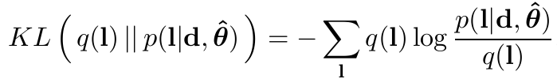
Mean field approximation
  Approximate with something of the form
  Find the voxel-wise distributions that minimize the
  difference between and
  Quantify the difference between the two distributions using the “Kullback-Leibler divergence”

Slide 42



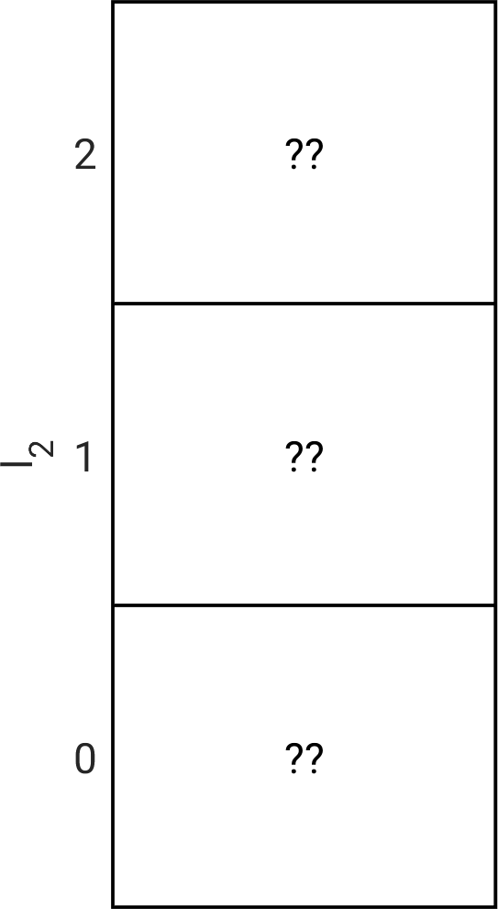
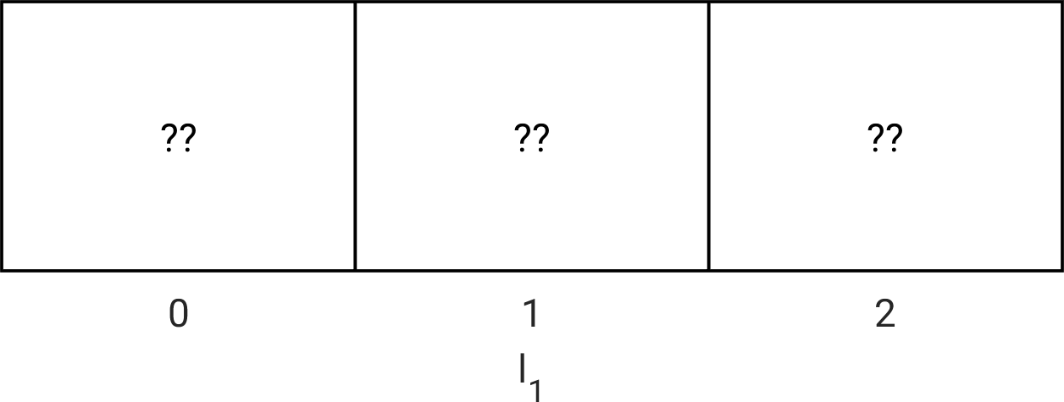

Toy example
voxels
classes
.

Slide 43

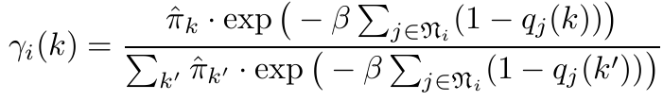
Mean field approximation
  Solution for one voxel :
  where

Slide 44
Mean field approximation
  Solution for one voxel :
  where
Influenced by the result
in neighboring voxels:
spatial context!!!!

Slide 45
Mean field approximation
  Solution for one voxel :
  where
Influenced by the result
in neighboring voxels:
spatial context!!!!
  Need to iterate across all voxels

Slide 46
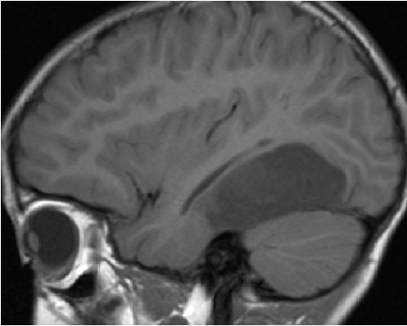
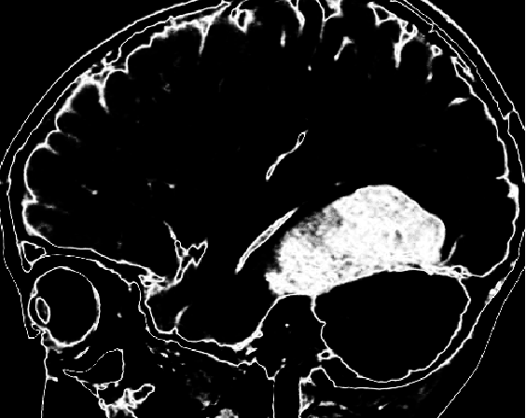


Example
Two-component Gaussian mixture model:
tumor vs. “other”
MR scan
for tumor class

Slide 47


Example
Two-component Gaussian mixture model:
tumor vs. “other”
MR scan
for tumor class

Slide 48


Example
Two-component Gaussian mixture model:
tumor vs. “other”
MR scan
for tumor class

