Slide 1
Landmark-based
Registration
Medical Image Analysis
Koen Van Leemput
Fall 2023

Slide 2
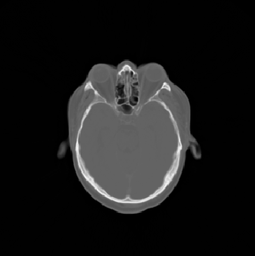
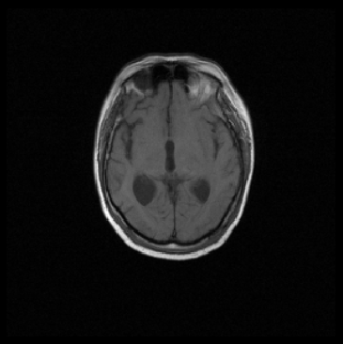
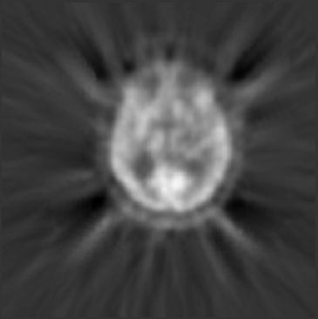
Image registration
Combine information contained in different scans
Images need to be spatially aligned!
?
?

Slide 3
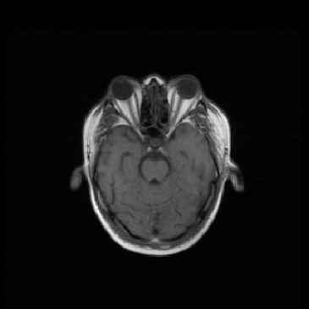
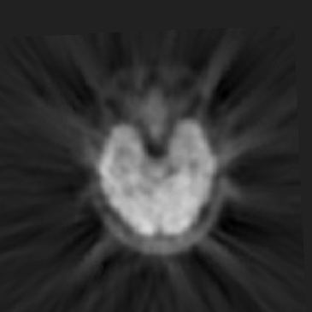
Image registration
Combine information contained in different scans
Images need to be spatially aligned!
!
!

Slide 4

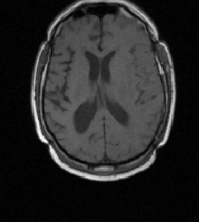
Example: PET/MR
Before registration...

Slide 5
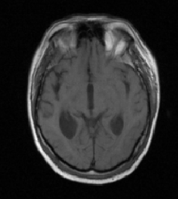
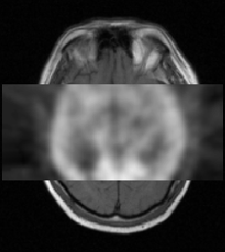
Example: PET/MR
… after registration

Slide 6
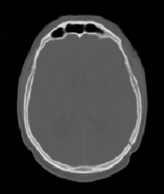
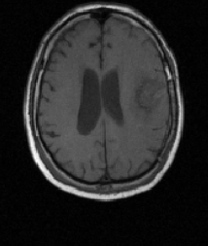
Example: CT/MR
Before registration…

Slide 7
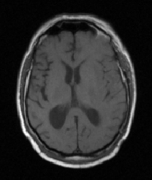
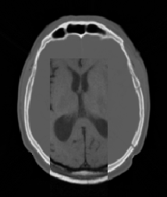
Example: CT/MR
… after registration

Slide 8
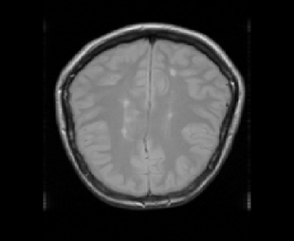
Example: longitudinal scans
Patient with multiple sclerosis (MS)
two months ago

Slide 9
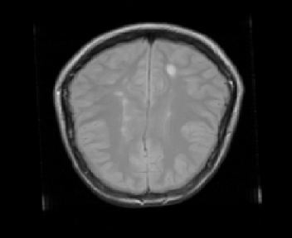
Example: longitudinal scans
Patient with multiple sclerosis (MS)
today

Slide 10
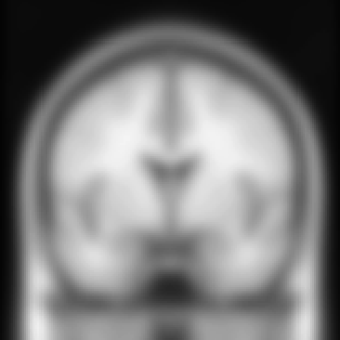
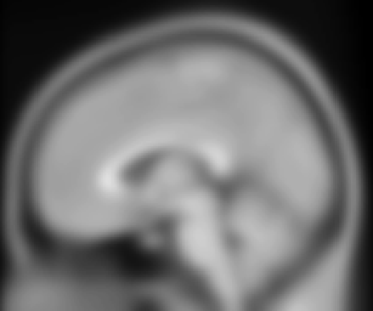
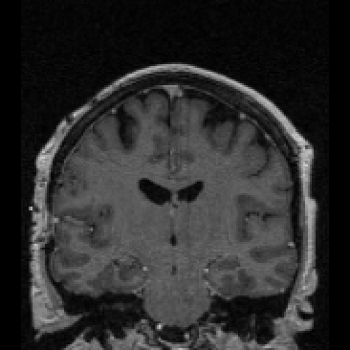
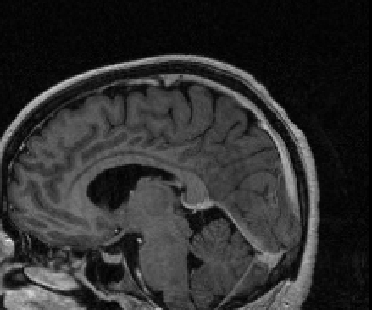
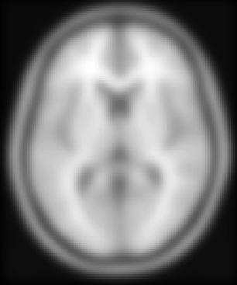
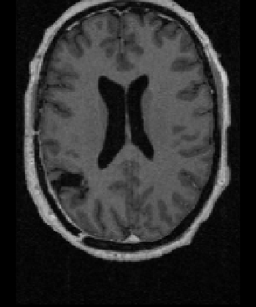
Example: population studies
average of 152 individuals
International Consortium for Brain Mapping

Slide 11
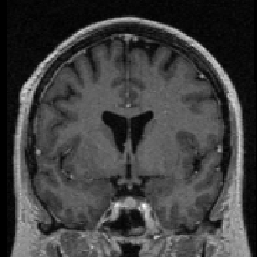
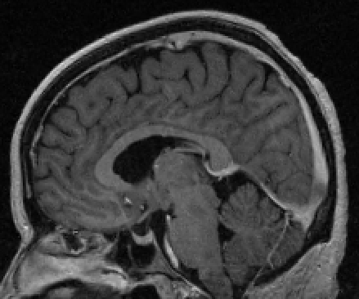
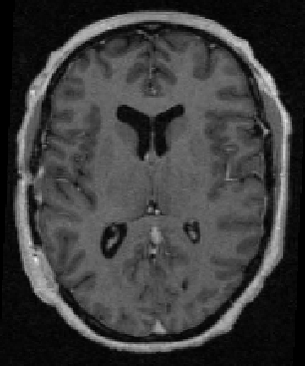
Example: population studies
average of 152 individuals
International Consortium for Brain Mapping

Slide 12
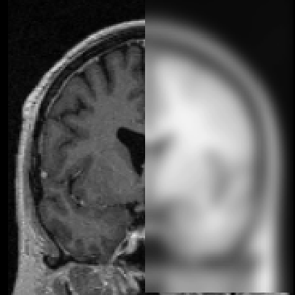
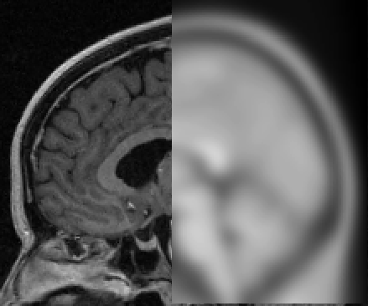
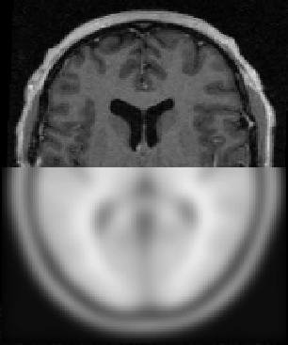
Example: population studies
average of 152 individuals
International Consortium for Brain Mapping

Slide 13


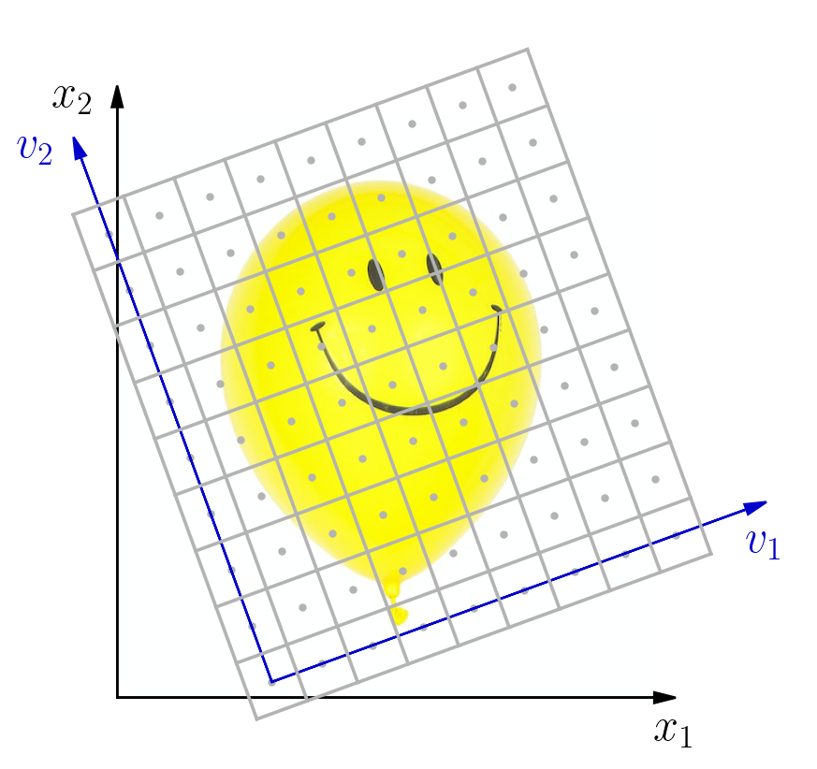
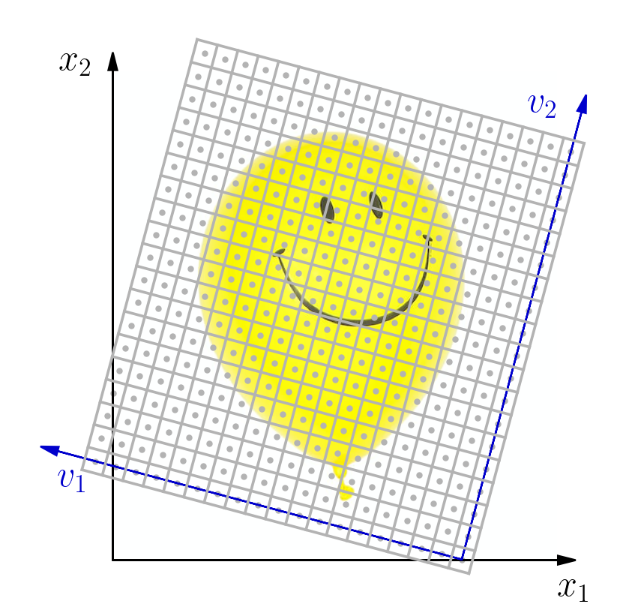
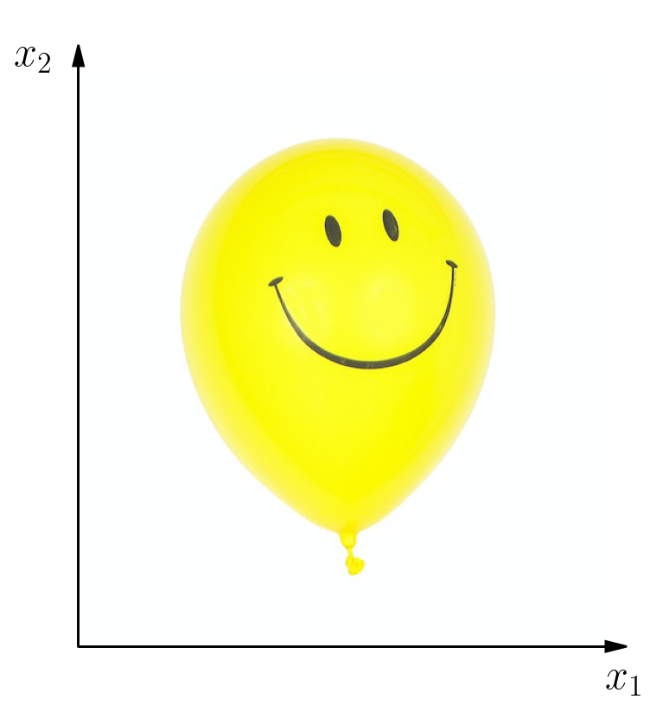

Coordinate systems
For each image, there are two coordinate systems:
Voxel coordinates (integer indices)
World coordinates (in mm)
Conversion:

Slide 14
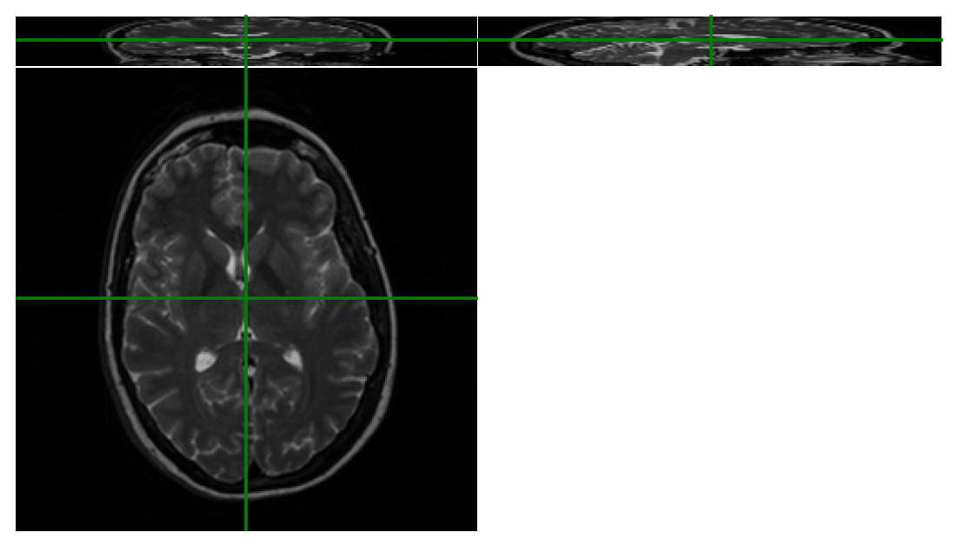
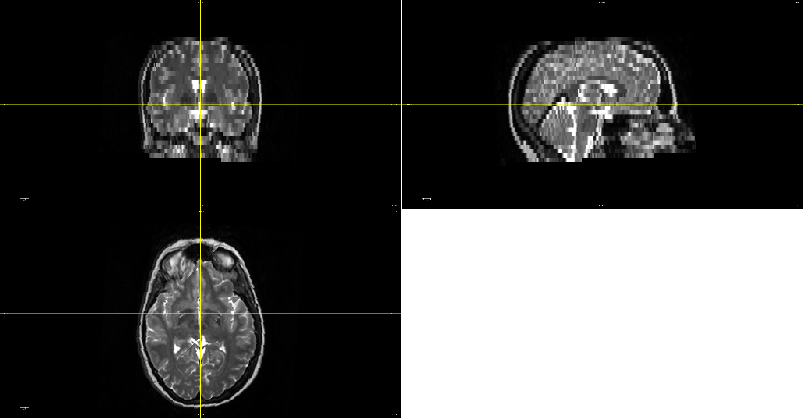


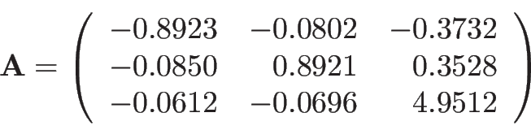
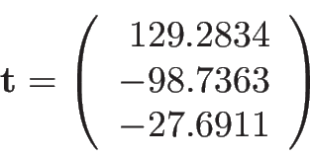
Coordinate systems
voxel indices
world positions
Conversion:

Slide 15

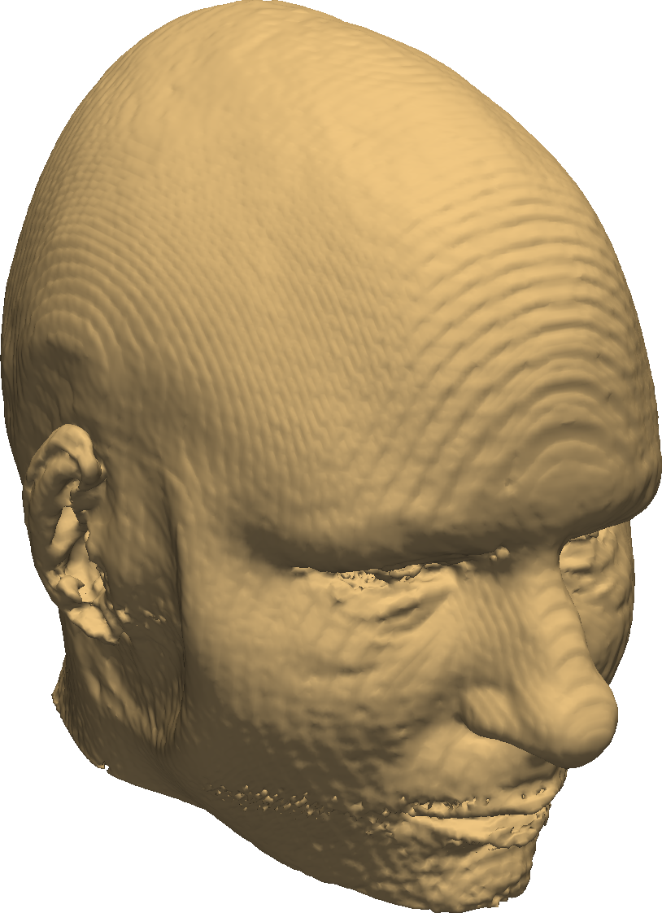
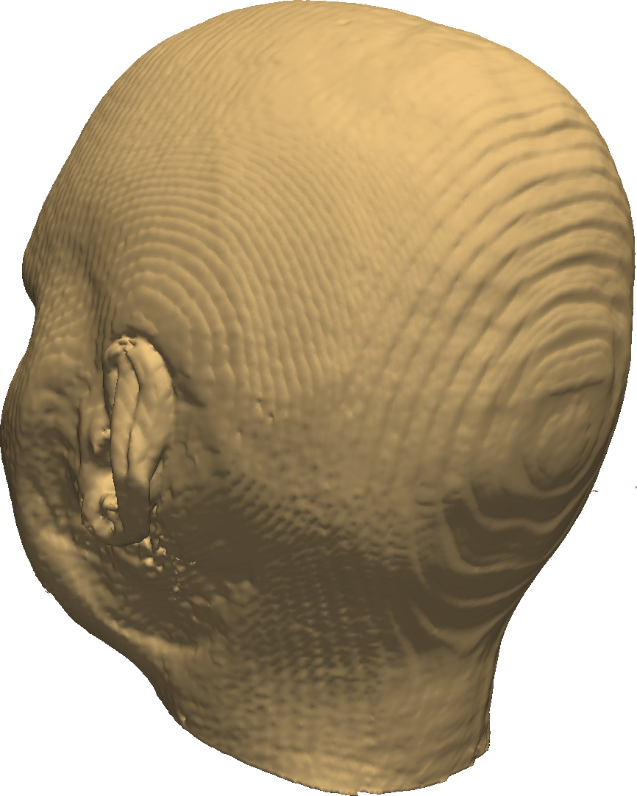


World coordinates = convention
Important to know which convention is used!
Right – Anterior – Superior (RAS)
Left – Posterior – Superior (LPS)

Slide 16
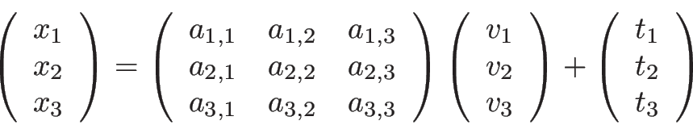
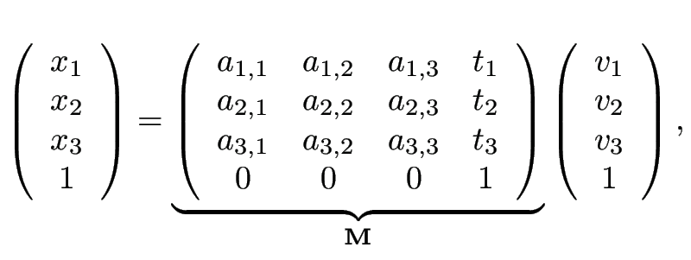
Homogeneous coordinates
Vectors are augmented with a 1 at the end
Idea: Rewrite , i.e,
as:
Benefit: map voxel indices using only matrix multiplications

Slide 17
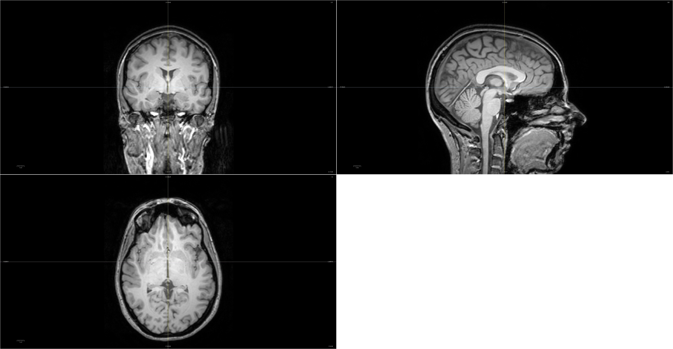


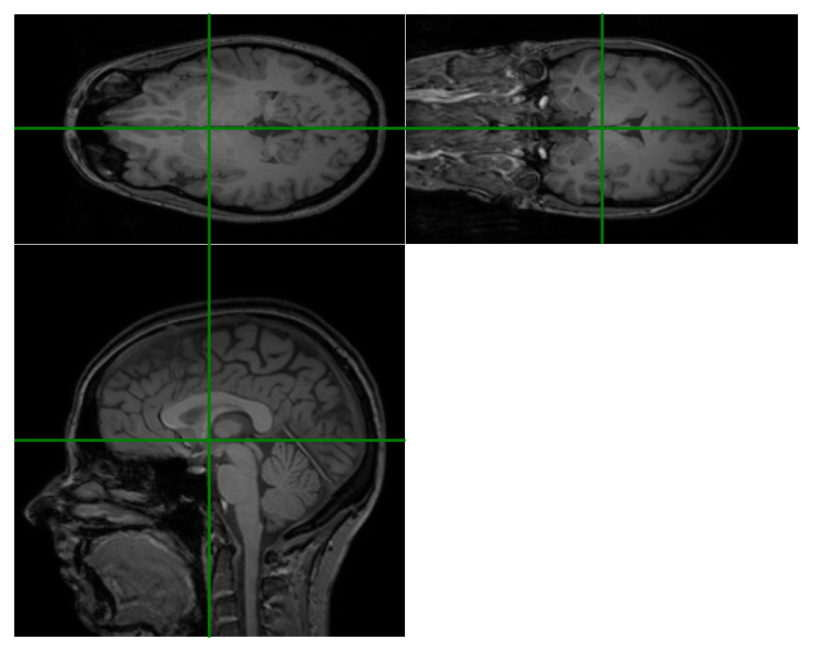


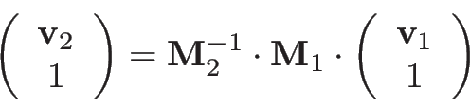
world positions
voxel indices
voxel indices

Slide 18
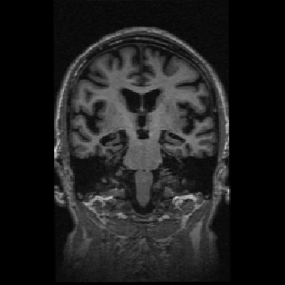
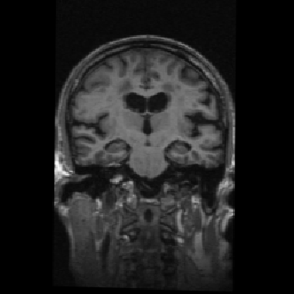


Spatial transformations
“fixed” image
“moving” image

Slide 19
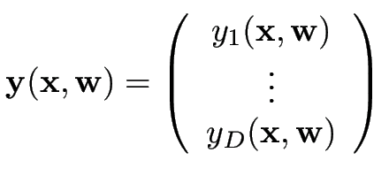
Spatial transformations
“fixed” image
“moving” image

Slide 20




Spatial transformations
“fixed” image
“moving” image
controls how points in the fixed image
move along the -th direction in the moving image
as the parameters are varied

Slide 21
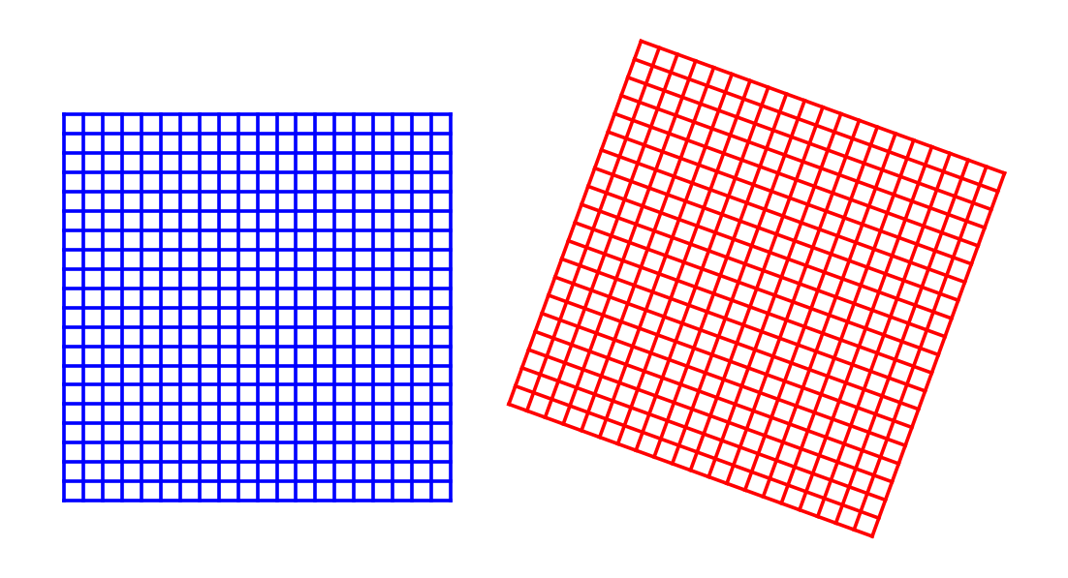
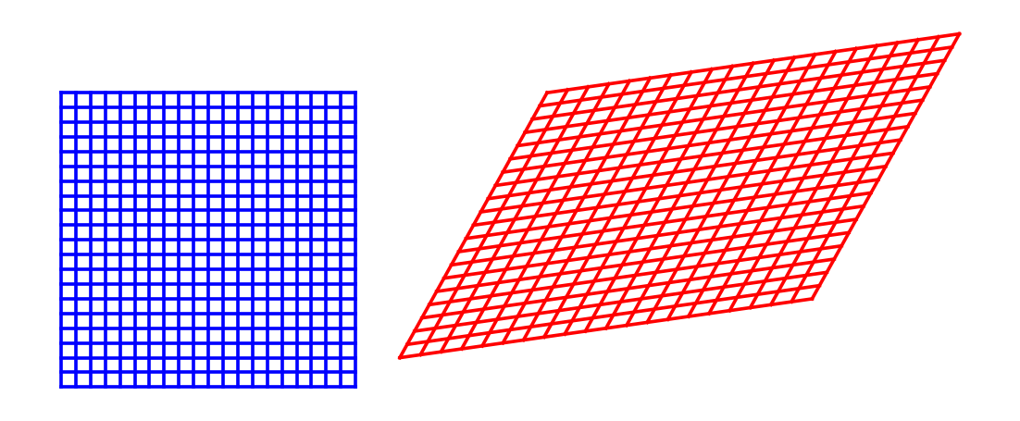
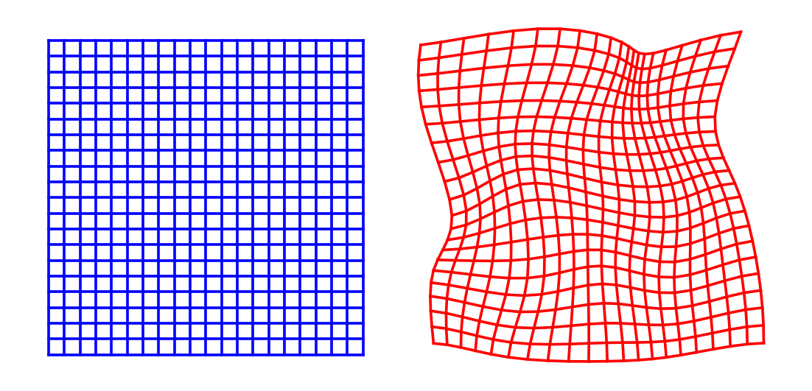
Spatial transformations
rigid
affine
nonlinear

Slide 22
Spatial transformations
rigid
Examples of usage?
affine
nonlinear

Slide 23

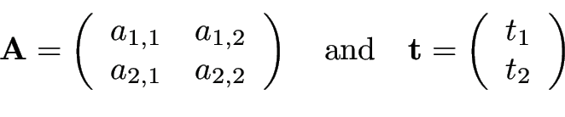
Affine transformation

Slide 24



Affine transformation
controls how points in the fixed image
move along the -th direction in the moving image
as the parameters are varied

Slide 25
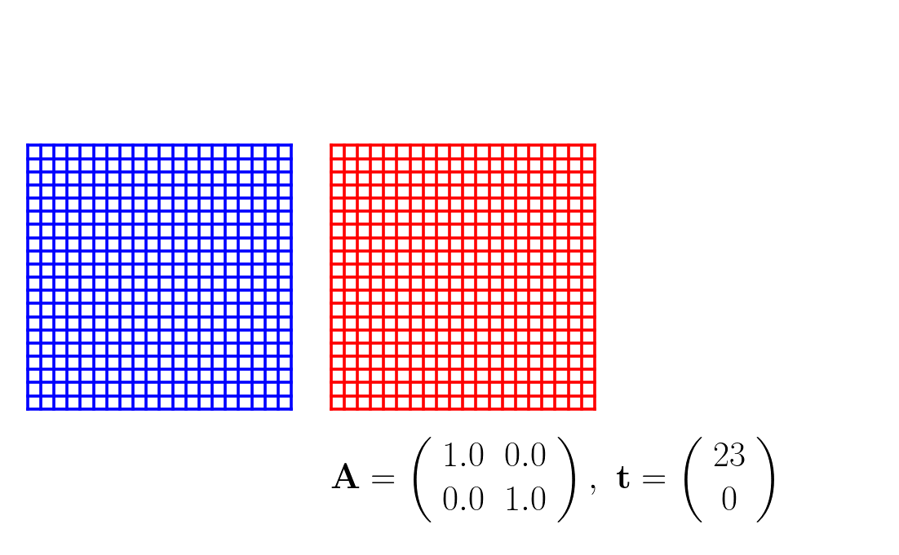
Affine transformation

Slide 26
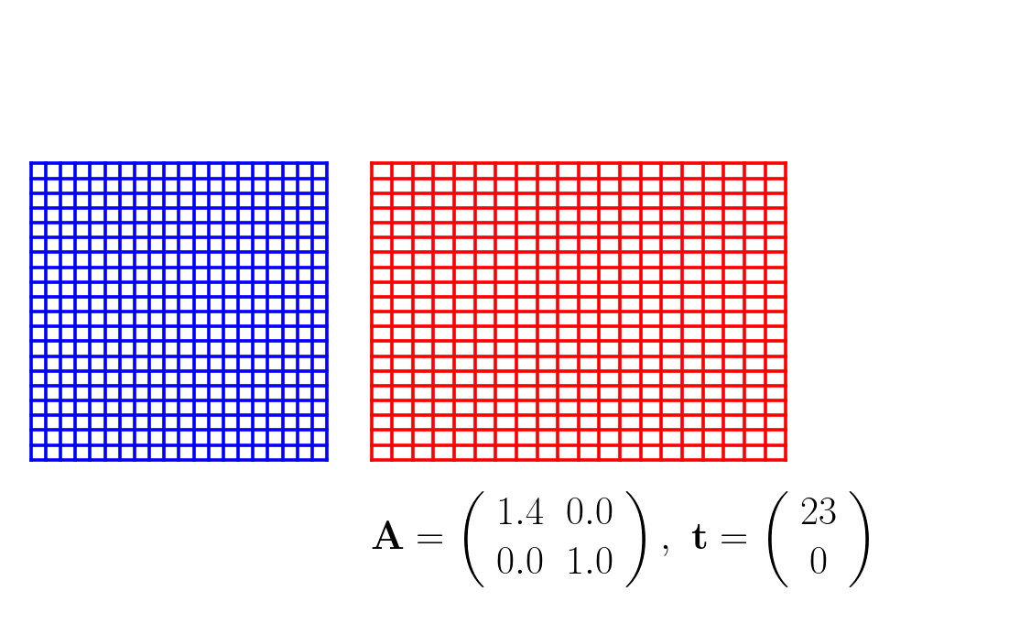
Affine transformation

Slide 27
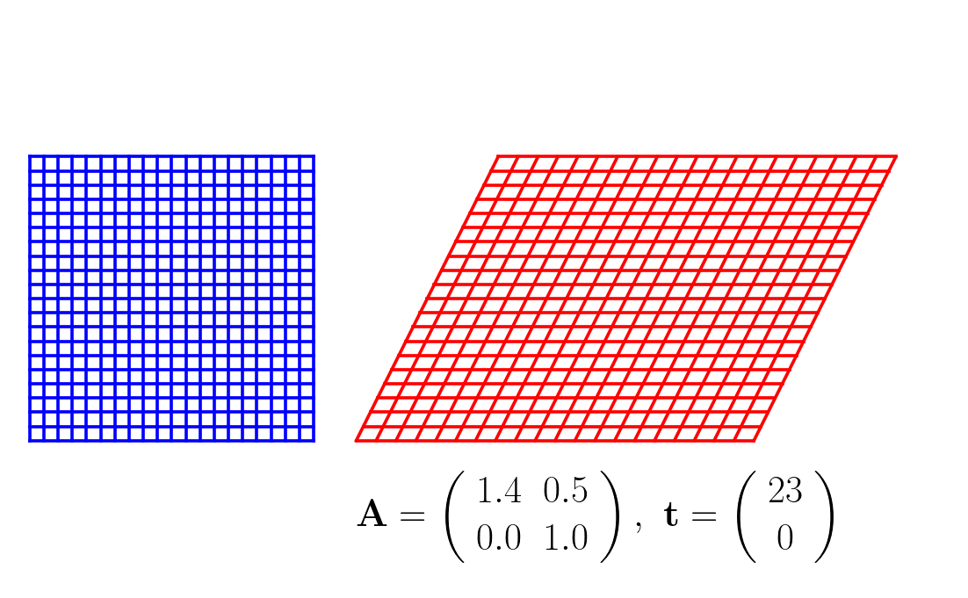
Affine transformation

Slide 28

Affine transformation

Slide 29

Affine transformation

Slide 30



Rigid transformation
and

Slide 31



Rigid transformation
Task: why do
and impose a rotation?

Slide 32



Rigid transformation
Task: why do
and impose a rotation?

Slide 33
Rigid transformation
Task: why do
and impose a rotation?
?

Slide 34

Rigid transformation
Task: why do
and impose a rotation?
?

Slide 35






Landmark-based registration
Manually annotate corresponding points in two images:
Register the images by minimizing the distance between matching point pairs:
fixed image
moving image

Slide 36




Landmark-based registration
Applied to affine registration:
Task 1: if , what is ?
Hint: remember that
Task 2: in the general case, what are and ?

Slide 37

Landmark-based registration
Applied to affine registration:
Task 1: if , what is ?
Hint: remember that
Task 2: in the general case, what are and ?

Slide 38
Landmark-based registration
Applied to affine registration:
Task 1: if , what is ?
Hint: remember that
Task 2: in the general case, what are and ?

Slide 39

Landmark-based registration
Applied to affine registration:
Task 1: if , what is ?
Hint: remember that
Task 2: in the general case, what are and ?

Slide 40


Landmark-based registration
Applied to affine registration:
Task 1: if , what is ?
Hint: remember that
Task 2: in the general case, what are and ?
where

Slide 41

Landmark-based registration
fixed image
moving image
fixed + moving
Before registration

Slide 42


Landmark-based registration
fixed image
moving image
fixed + moving
After registration

Slide 43











Landmark-based registration
Applied to rigid registration:
Constraints and make the math much more complicated!
Solution:
where
and
with
and
(“flip” a column of if )

