Slide 1
DAVIS Workshops
Prepared with data as of March 20, 2019

Slide 2
DAVIS workshops
Goal: increase working efficiency with understanding of research and data better practices
Workshops focus on a mix of concepts and tools
Are the workshops effective in improving research skills of the OU community?
42 completed responses for 7 topics

Slide 3
Post-workshop self-assessment of skill
Success in expanding research efficiency for majority of learners
Some learners may need additional assistance or workshops

Slide 4
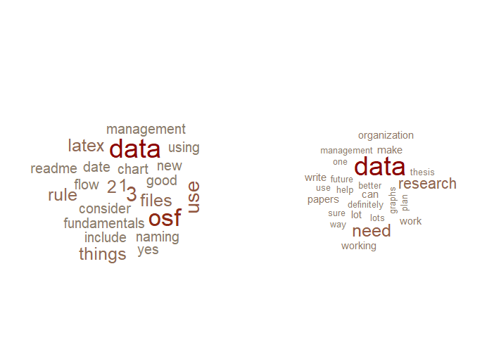
Learning outcome comments
Did you learn something new?
Yes, and it was…
Do you anticipate that this new knowledge
can be applied to your research?
Yes, because…
Notes:
Everyone answered yes or did not answer (there were not any “no” answers to these questions). We appear to be hitting our target of helping people with data-related skills.

Slide 5
Workshop marketing
Notes:
Emails are effective, flyers less so.
Caveats: Pre-registered doesn’t mean they attended; this is from registration. Walk-ins are from attendees only.

Slide 6
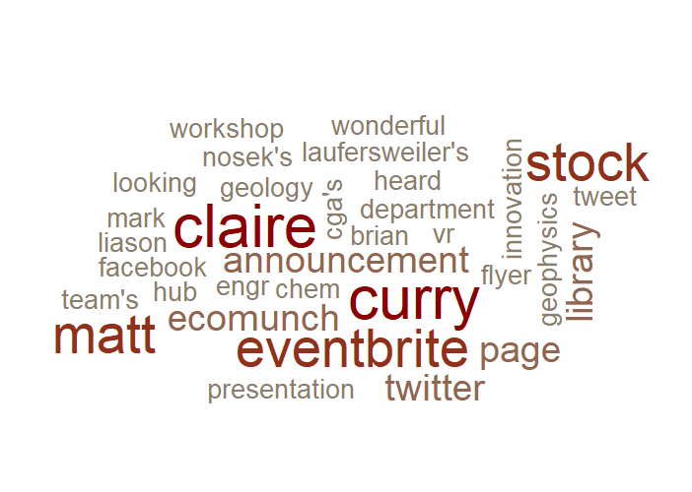
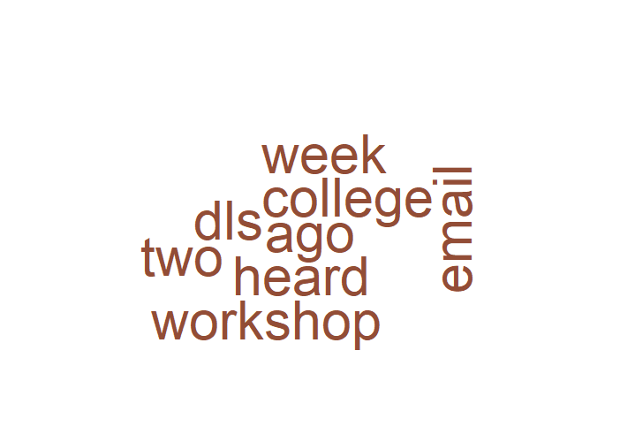
Workshop marketing: other sources
58 pre-registrations
14 walk-in learners
Notes:
These word clouds show all responses with stop words removed.
Liaisons and social media appear important for pre-registrations, and potentially libraries emails and/or word of mouth for walk-ins.

