Slide 1
These workshops are effective
Success in expanding research efficiency for majority of learners
Some learners may need additional assistance or workshops
Notes:
N = 61 completed responses from Feb. – May 2019 for 7+ topics

Slide 2
Workshop comments
“I like how each workshop is focused and specific”
“Keep these intensive workshops coming!”
“This will help me tremendously”
“It will really help to give me options”
Notes:
We appear to be hitting our target of helping people with data-related skills.

Slide 3
How did they find us?
Notes:
Emails are effective, flyers less so.
Caveats: Pre-registered doesn’t mean they attended; this is from registration. Walk-ins are from attendees only.

Slide 4
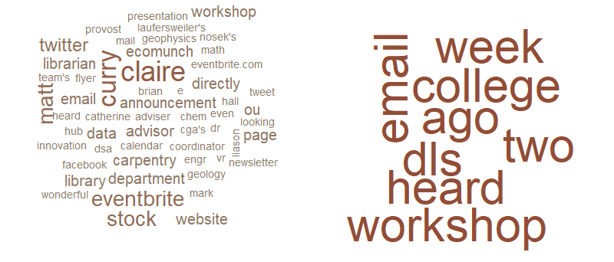
What was “other”?
Pre-registered (n = 138)
Walk-ins (n = 19)
Notes:
138 registrations, 19 These word clouds show all responses with stop words removed.
Liaisons and social media appear important for pre-registrations, and potentially libraries emails and/or word of mouth for walk-ins.

Slide 5
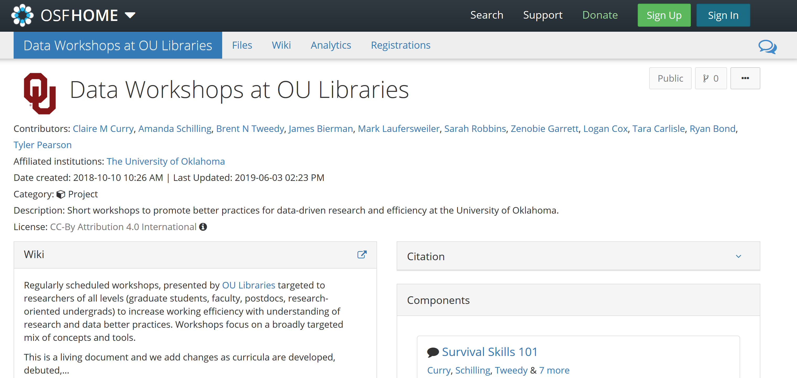
Sharing our materials CC-BY
Notes:
University of Kansas has contacted us for LaTeX guided course

Slide 6
Our next steps
Developing new materials each year
How to choose a visualization tool
Repetitive tasks in R
Intermediate bash scripting
Visualizations in Excel
OSF for teaching
Presentations 101
Recruiting outside partners
Continuing to disseminate materials

Slide 7
Take-home lessons
Researchers need this help – based on our experience and from comments at Carpentries workshops
Feedback shows activities effective
Emails and word of mouth for marketing
Curriculum available at https://osf.io/ymzu8 - fork or contribute

Slide 8
Thank you for your attention!
Amanda Schilling
amanda.schilling@ou.edu
Brent Tweedy
brent.tweedy@ou.edu
Claire Curry
cmcurry@ou.edu

