Slide 1
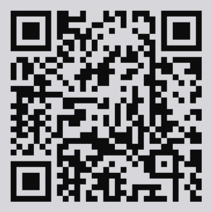
Please take 3 min to help us improve
Survey link: https://ou.libwizard.com/f/datasurvey
or use QR code
Workshop topic: Repetitive Tasks in R
Workshop date: May 16, 2023
Notes:
For those who didn’t bring a device, offer to email them via EventBrite

