Slide 1

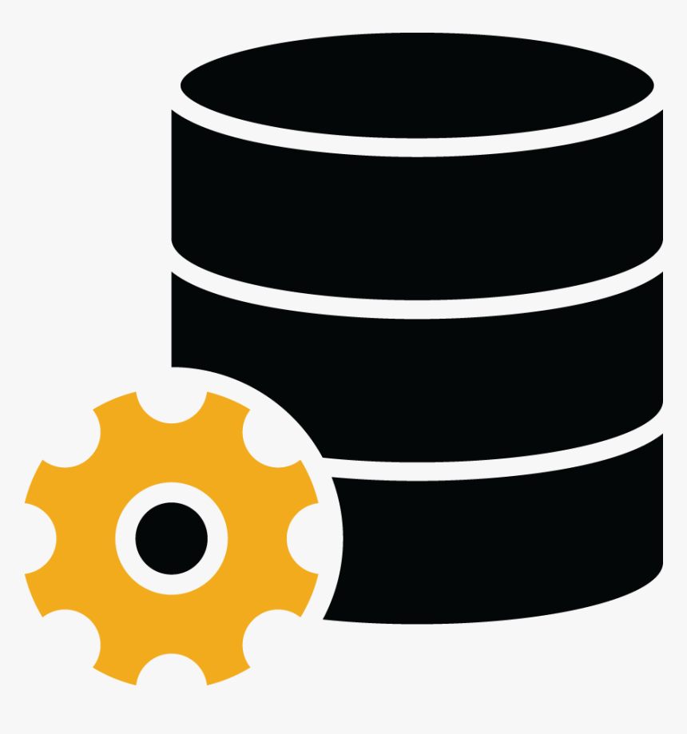

Relational
Database
Presentation of
RDBMS
Management system

Slide 2
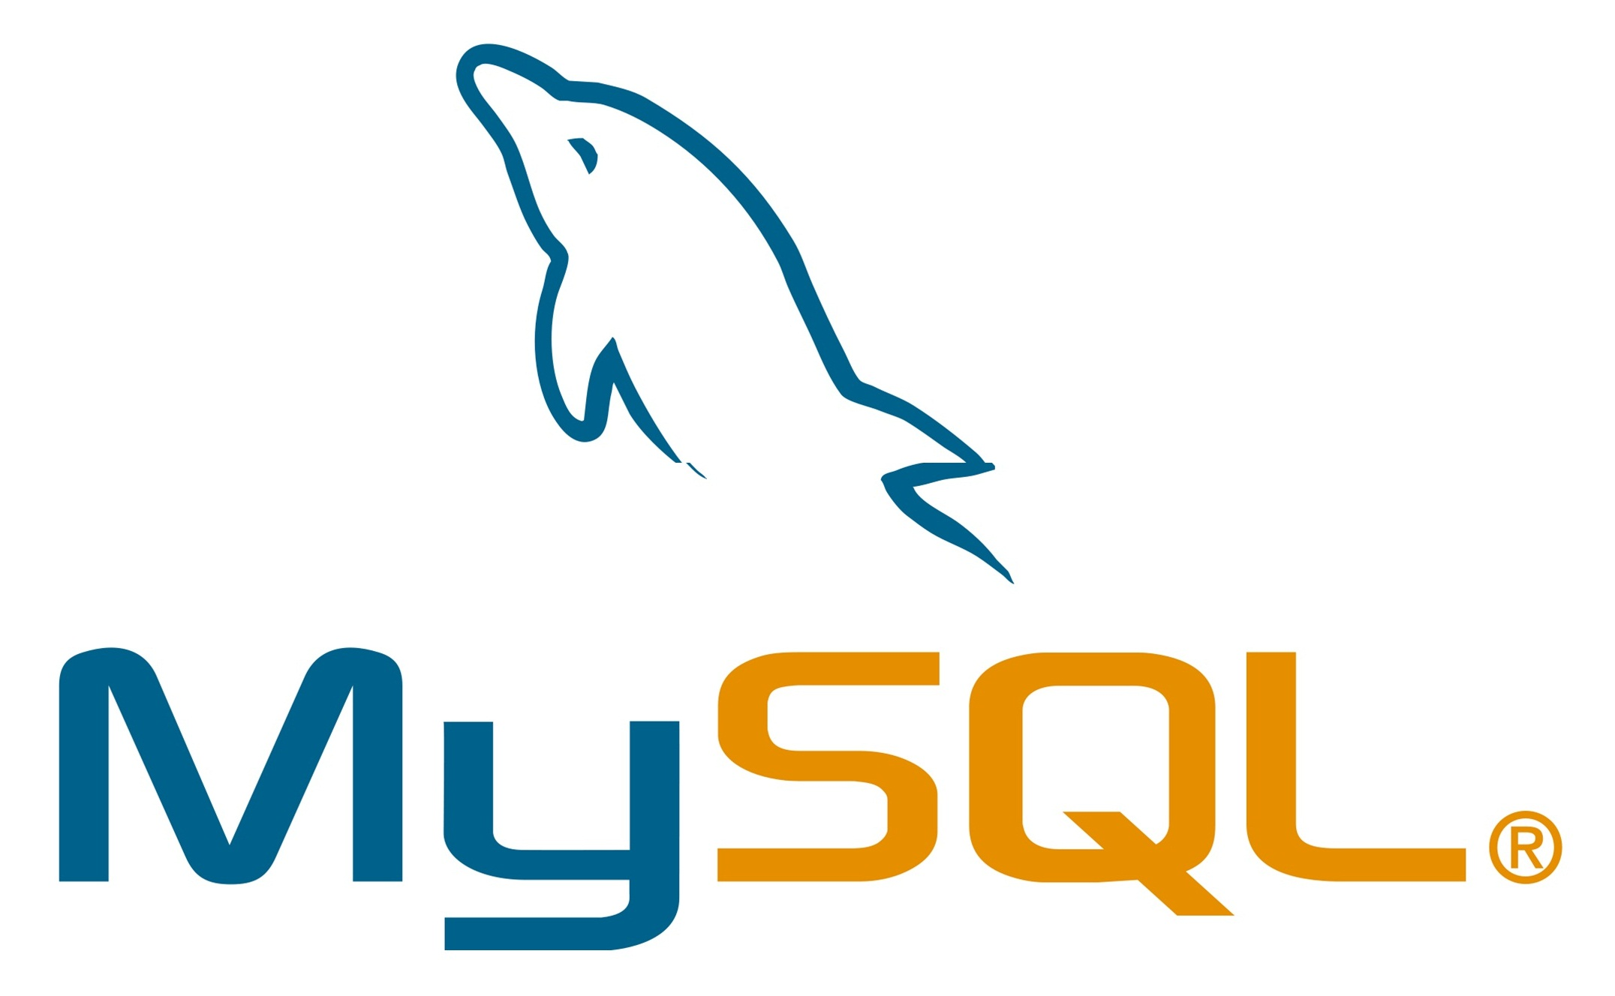
MySQL
is an Oracle-backed open source relational database management system (RDBMS) based on Structured Query Language (SQL)
widely compatible
You can do whatever you want, go a impress your audience MySQL was designed to be extensively compatible with other technologies and architectures an amazing presentation.
MySQL databases are relational
contain records in multiple, separate, and highly codified tables, as opposed to a single all-encompassing repository
is an open-source
Any individual or enterprise may freely use, modify, publish, and expand on Oracle’s open-source MySQL code base
is easy to use
Though MySQL’s relational nature and the ensuing rigid storage structures might seem restrictive, the tabular paradigm is perhaps the most intuitive, and ultimately allows for greater usability

Slide 3

PostgreSQL
It is a powerful, open source object-relational database system that uses and extends the SQL language combined with many features that safely store and scale the most complicated data workloads
Data Types
Data Integrity
Primitives, Structured, Customizations
Unique,
Primary key,
Exclusion Constraints
Concurrency, Performance
Security
Robust access-control system
Column and row-level security
Multi-factor authentication with certificates and an additional method
Indexing,
Table partitioning,
Just-in-time (JIT) compilation of expressions

Slide 4
SQL Server
It is a database server by Microsoft that implements the Structured Query Language (SQL)
High Performance
High Security
Scalability and Flexibility
Robust Transactional Support
It is very easy to provide permissions on tables, procedures, and views hence SQL give security to your data
SQL provide high performance programming capability for highly transactional, heavy workload and high usage database system
High Availability
it is easy to create an application extension for procedural programming and various other functions which is additional features thus converting SQL into a powerful tool
With SQL programming can handle large records and manage numerous transactions
SQL provide Scalability and Flexibility. It is very easy to create new tables and previously created or not used tables can be dropped or deleted in a database

Slide 5
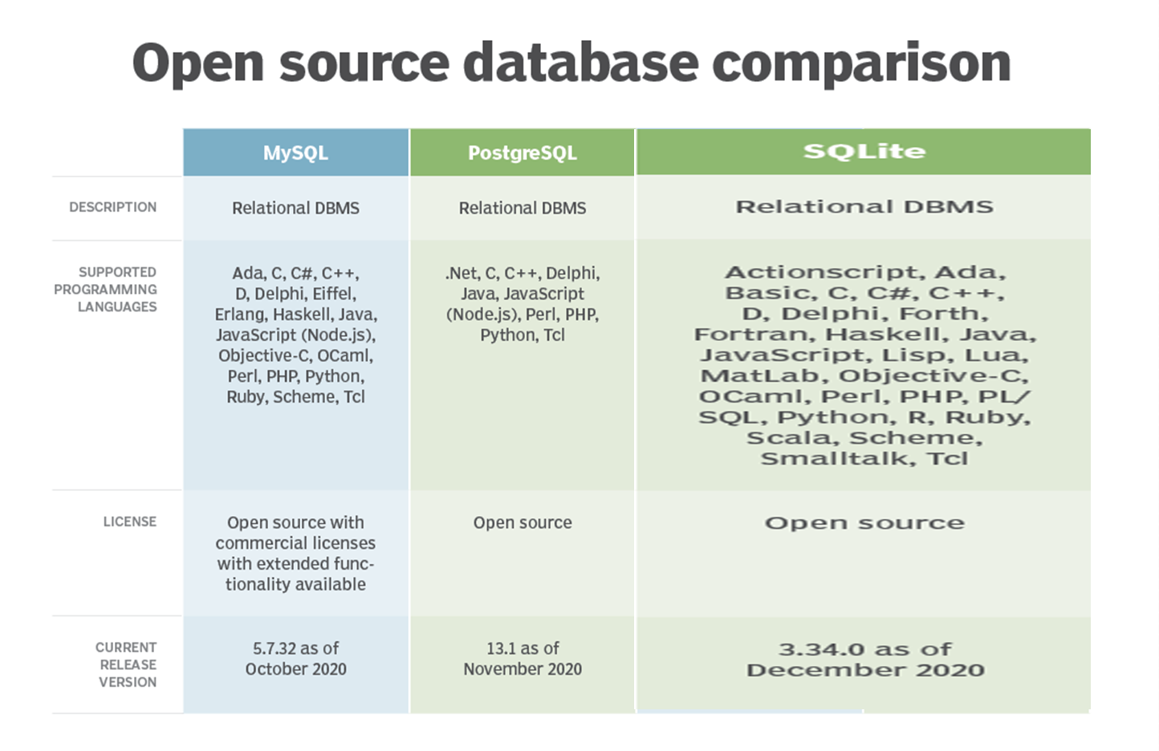
Database Comparison

Slide 6
THANKS for your attention

