Slide 1
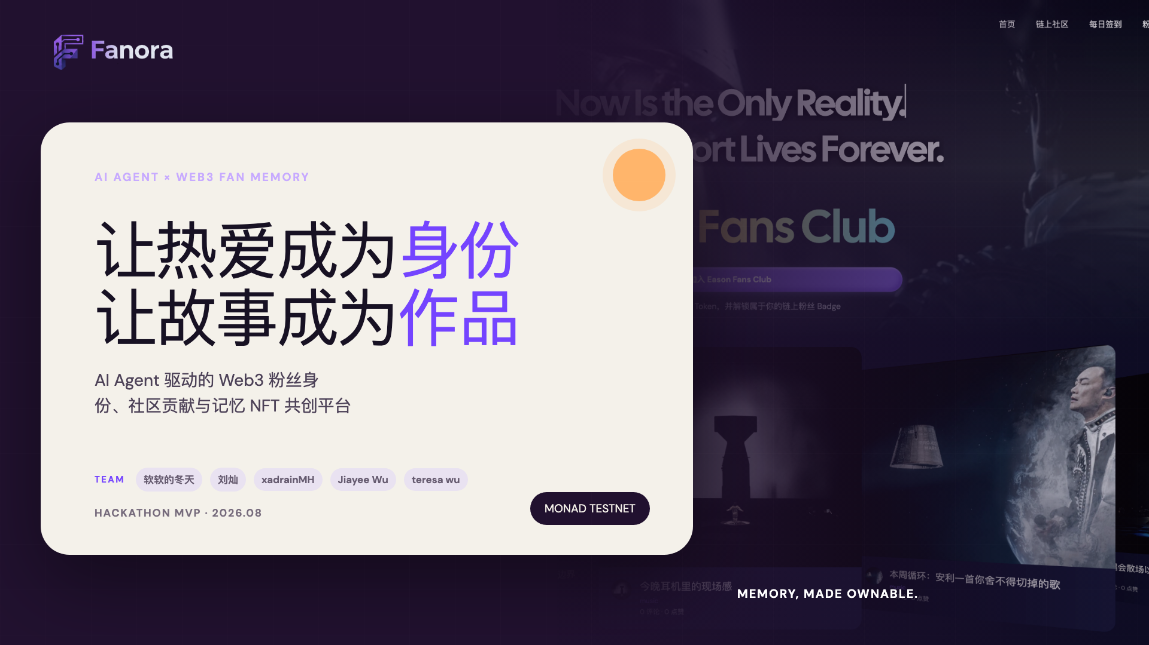
Notes:
[Sources]
- User-provided outline: docs/ppt/Fanora_展示文稿题纲.md
- Product UI and brand assets: local Fanora repository
[/Sources]

Slide 2
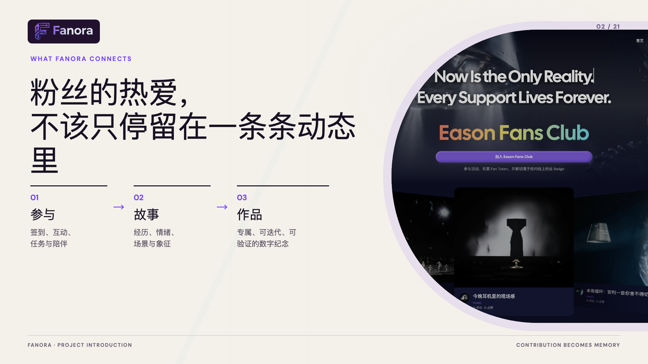
Notes:
[Sources]
- User-provided outline: docs/ppt/Fanora_展示文稿题纲.md
- Product UI and brand assets: local Fanora repository
[/Sources]

Slide 3

Notes:
[Sources]
- User-provided outline: docs/ppt/Fanora_展示文稿题纲.md
- Product UI and brand assets: local Fanora repository
[/Sources]

Slide 4
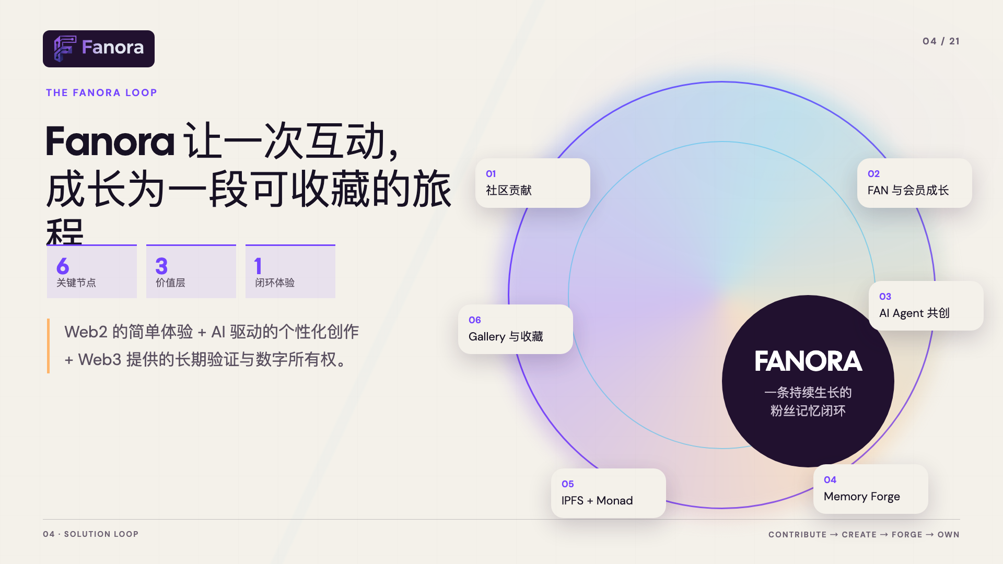
Notes:
[Sources]
- User-provided outline: docs/ppt/Fanora_展示文稿题纲.md
- Product UI and brand assets: local Fanora repository
[/Sources]

Slide 5

Notes:
[Sources]
- User-provided outline: docs/ppt/Fanora_展示文稿题纲.md
- Product UI and brand assets: local Fanora repository
[/Sources]

Slide 6
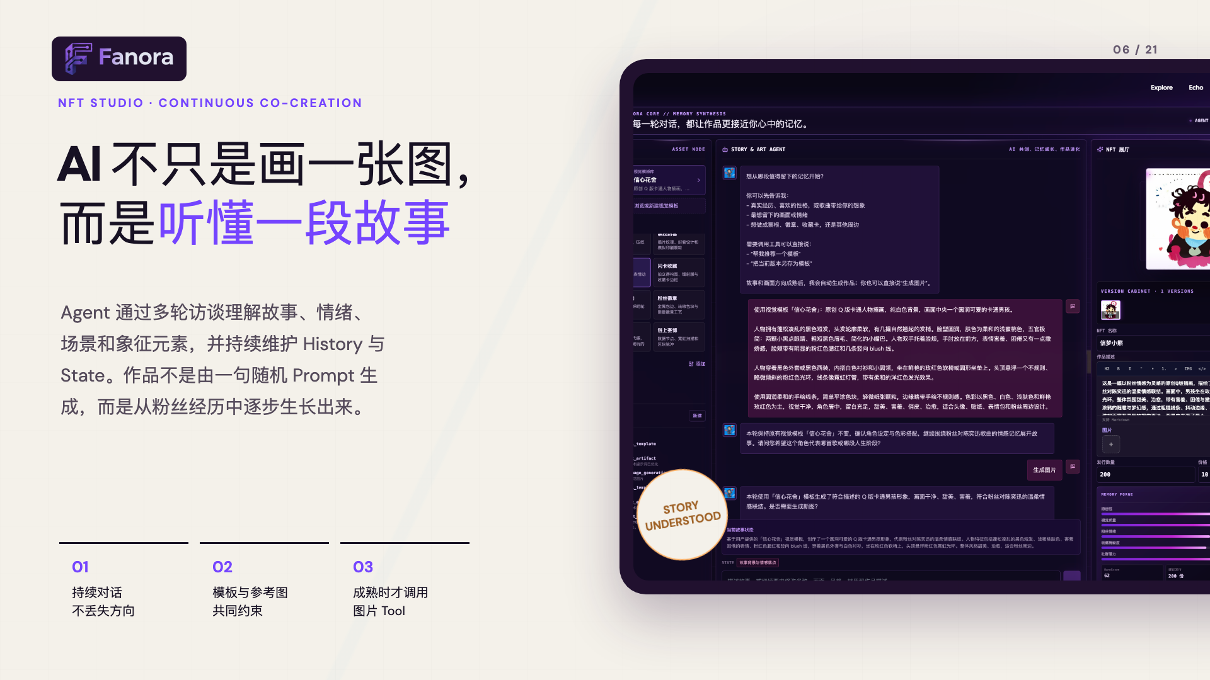
Notes:
[Sources]
- User-provided outline: docs/ppt/Fanora_展示文稿题纲.md
- Product UI and brand assets: local Fanora repository
[/Sources]

Slide 7
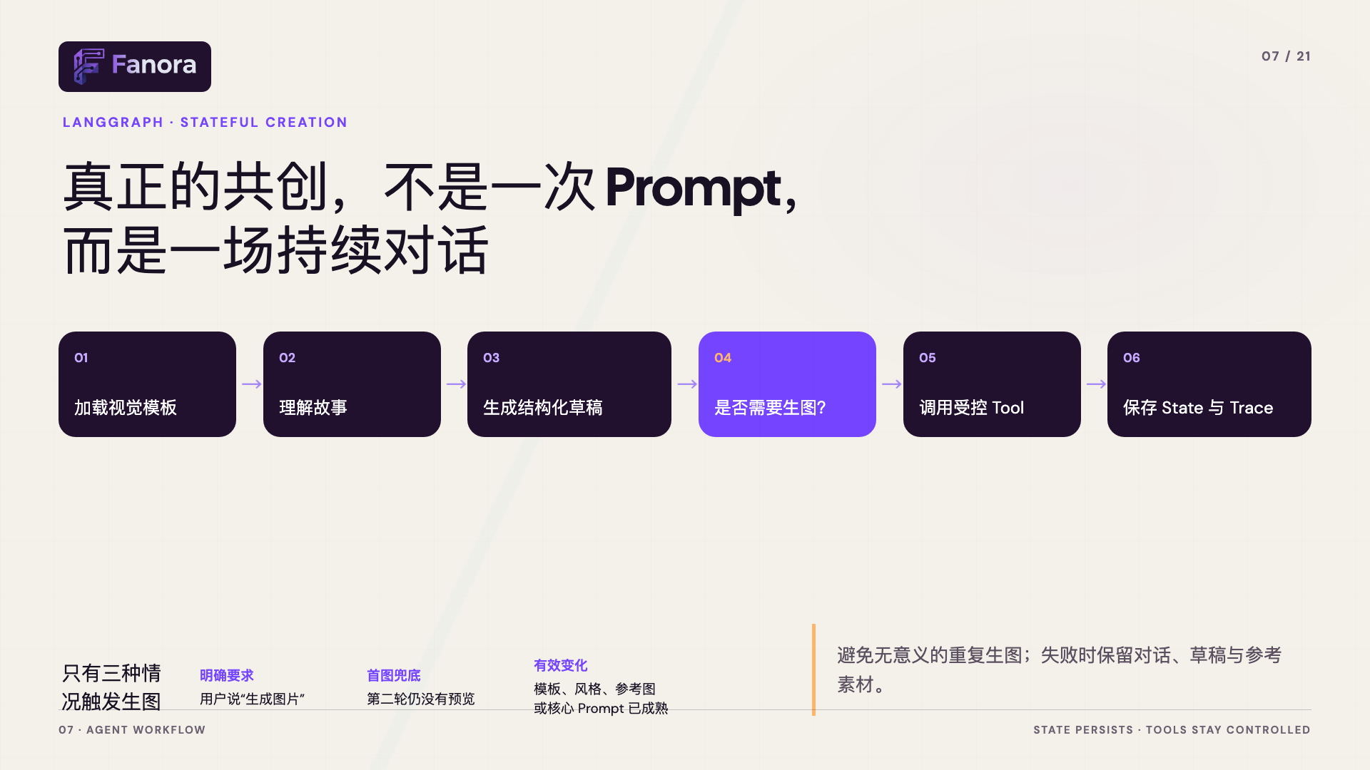
Notes:
[Sources]
- User-provided outline: docs/ppt/Fanora_展示文稿题纲.md
- Product UI and brand assets: local Fanora repository
[/Sources]

Slide 8
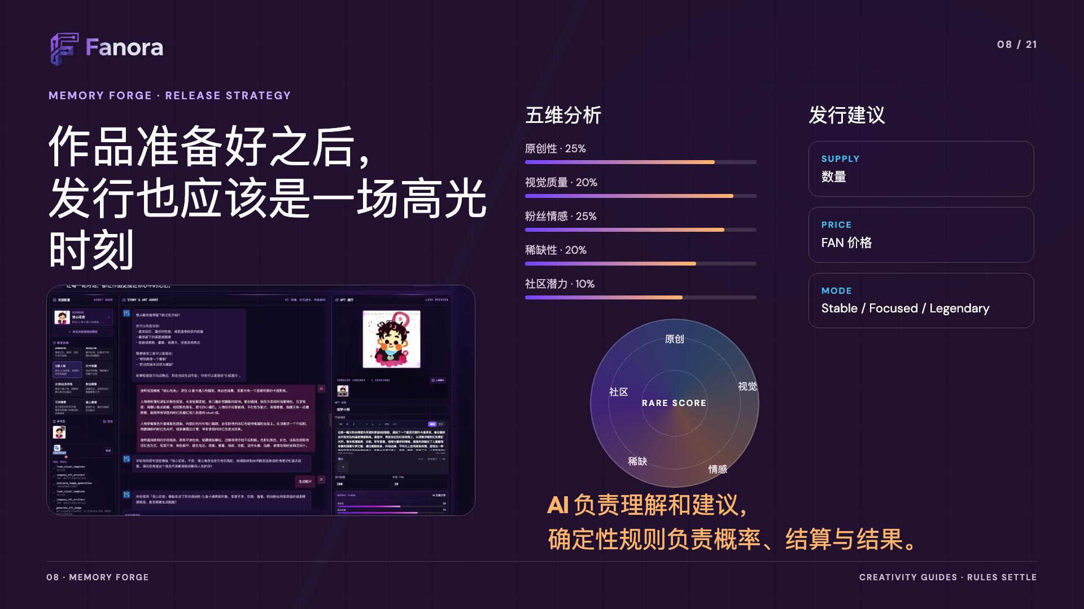
Notes:
[Sources]
- User-provided outline: docs/ppt/Fanora_展示文稿题纲.md
- Product UI and brand assets: local Fanora repository
[/Sources]

Slide 9
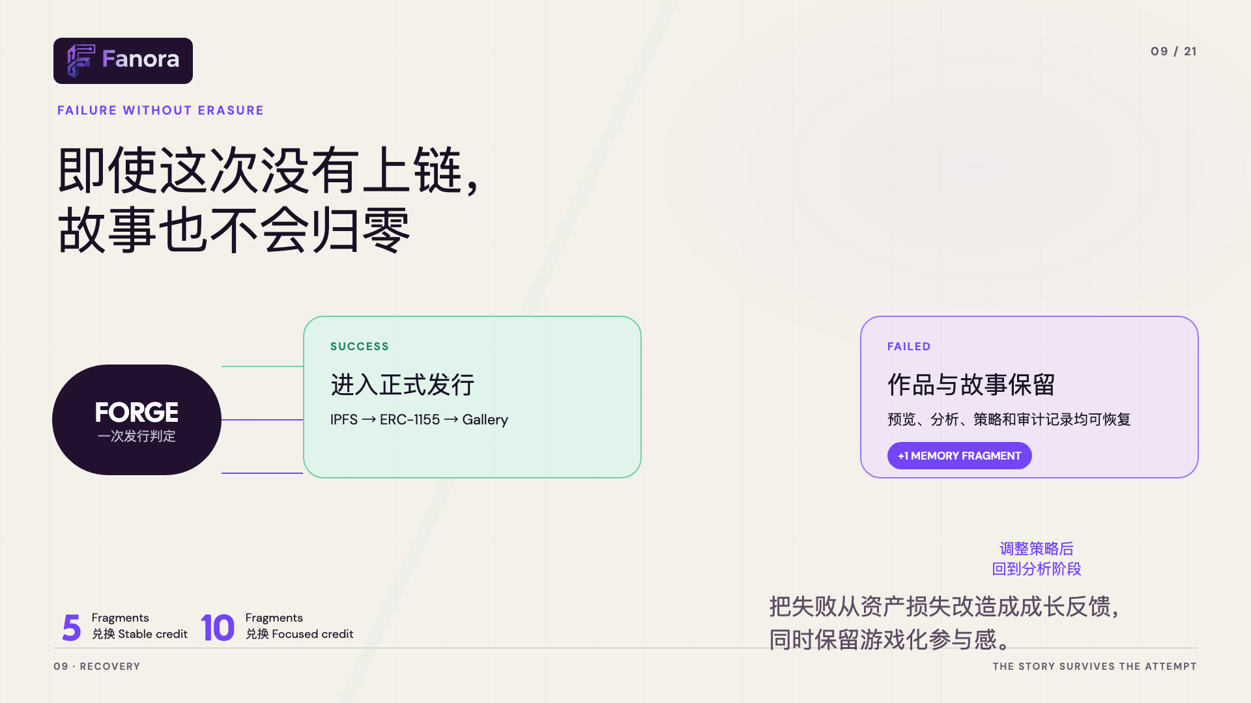
Notes:
[Sources]
- User-provided outline: docs/ppt/Fanora_展示文稿题纲.md
- Product UI and brand assets: local Fanora repository
[/Sources]

Slide 10
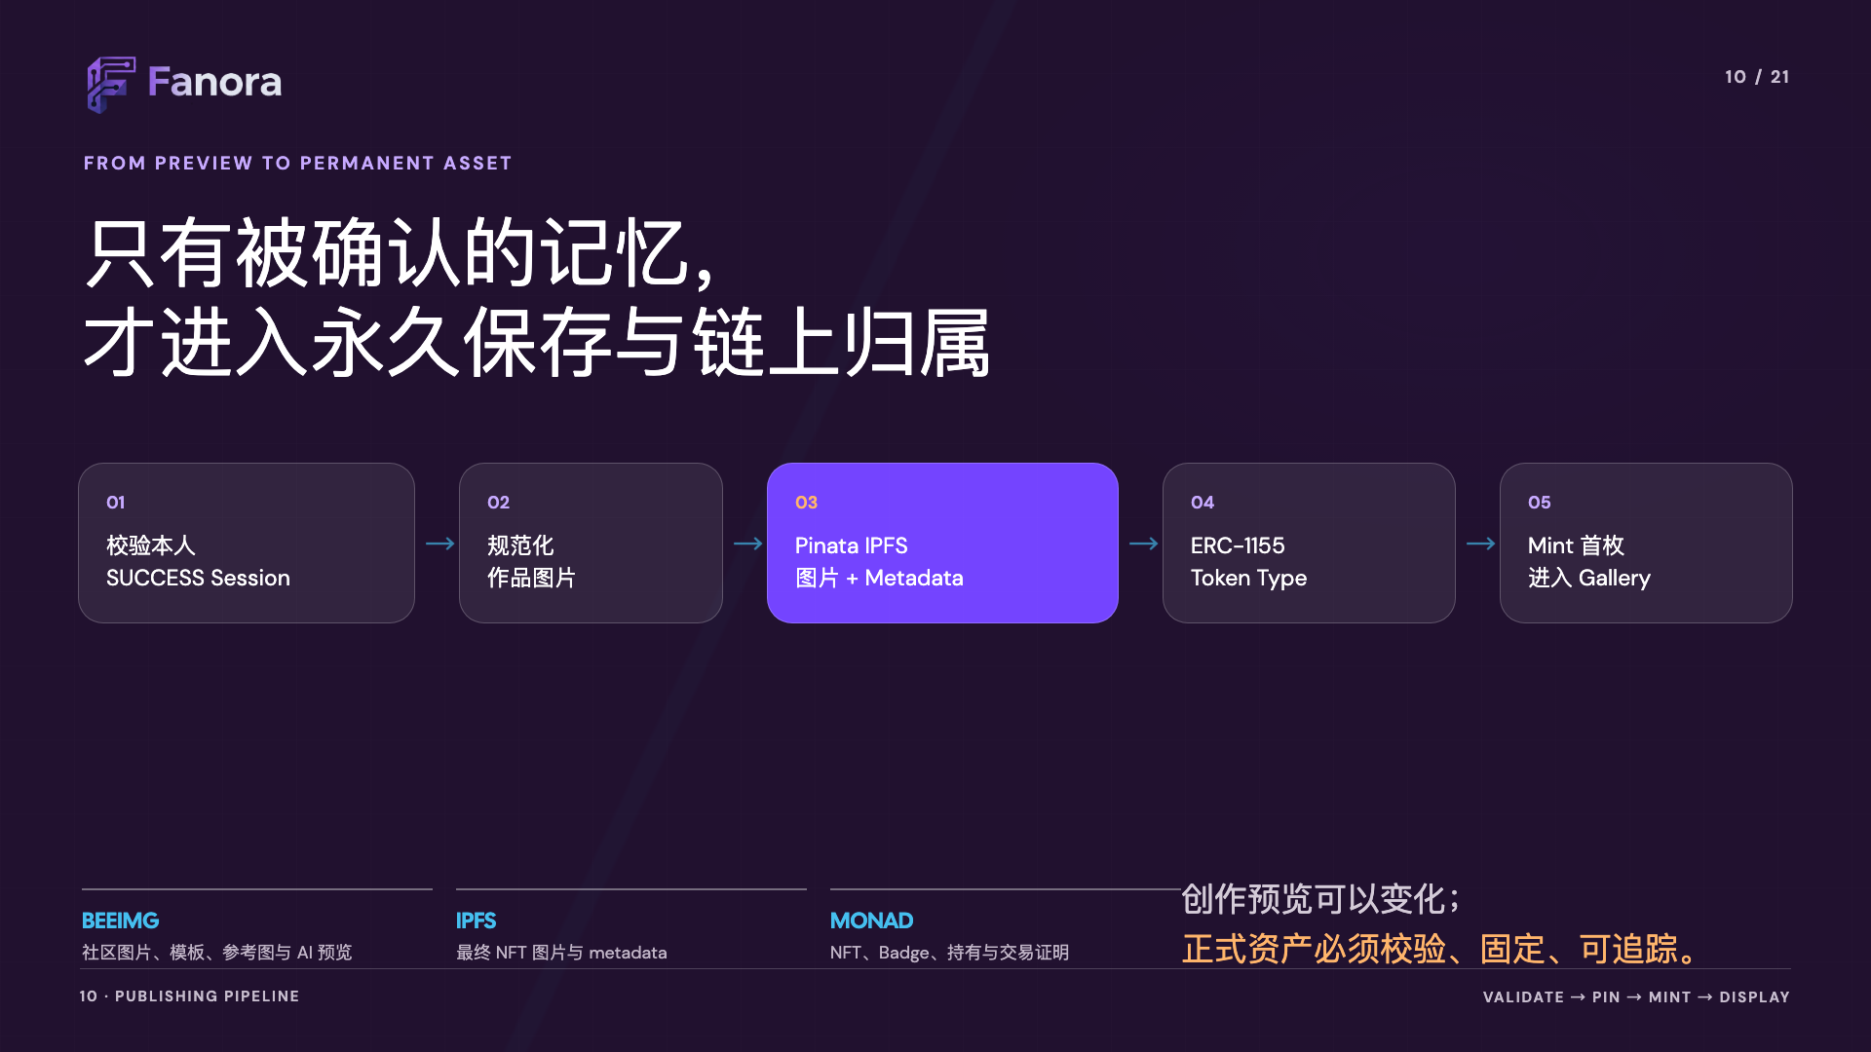
Notes:
[Sources]
- User-provided outline: docs/ppt/Fanora_展示文稿题纲.md
- Product UI and brand assets: local Fanora repository
[/Sources]

Slide 11
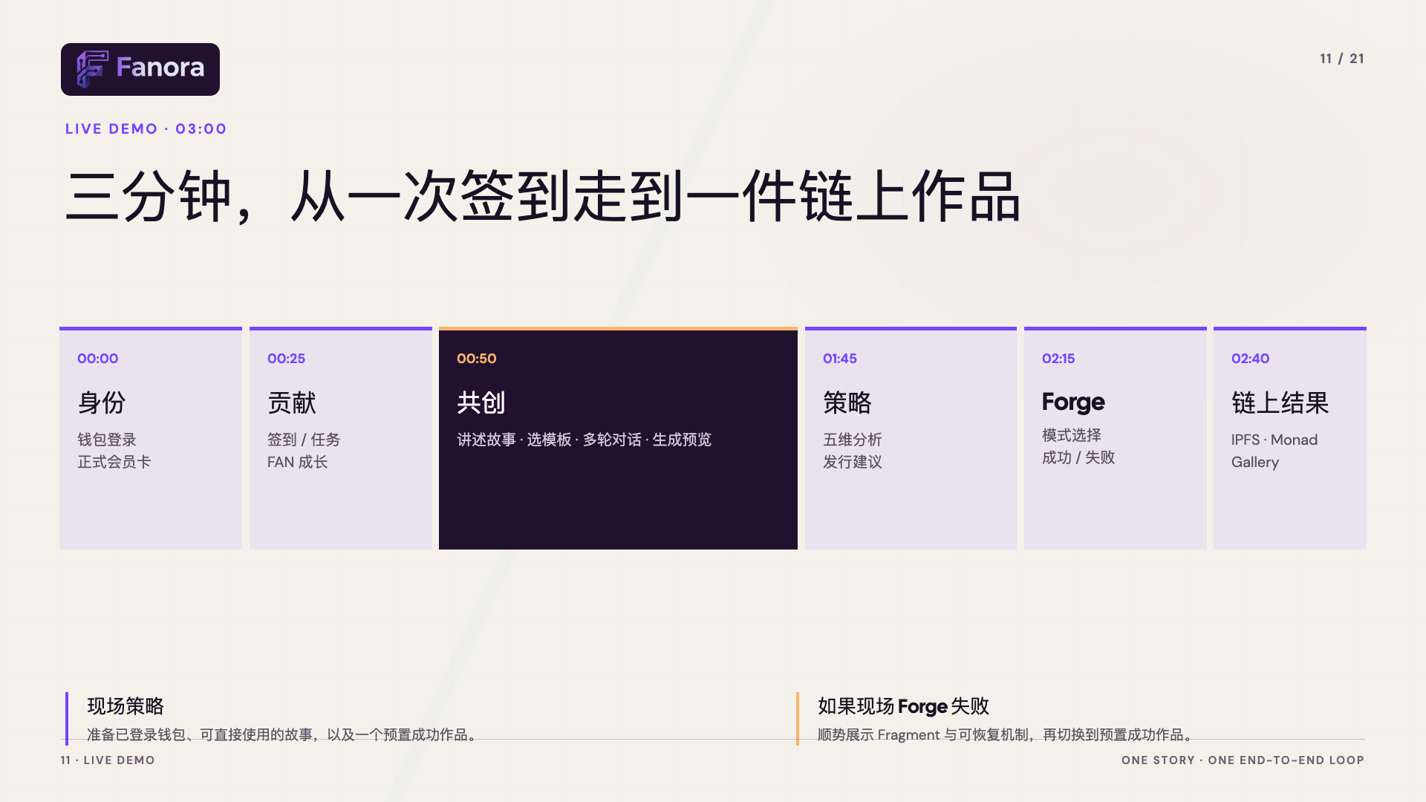
Notes:
[Sources]
- User-provided outline: docs/ppt/Fanora_展示文稿题纲.md
- Product UI and brand assets: local Fanora repository
[/Sources]

Slide 12

Notes:
[Sources]
- User-provided outline: docs/ppt/Fanora_展示文稿题纲.md
- Product UI and brand assets: local Fanora repository
[/Sources]

Slide 13
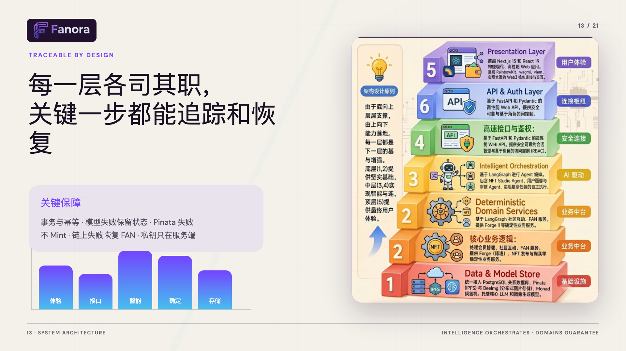
Notes:
[Sources]
- User-provided outline: docs/ppt/Fanora_展示文稿题纲.md
- Product UI and brand assets: local Fanora repository
[/Sources]

Slide 14
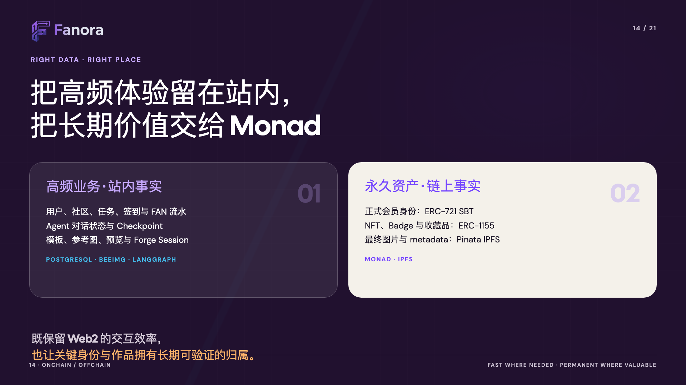
Notes:
[Sources]
- User-provided outline: docs/ppt/Fanora_展示文稿题纲.md
- Product UI and brand assets: local Fanora repository
[/Sources]

Slide 15
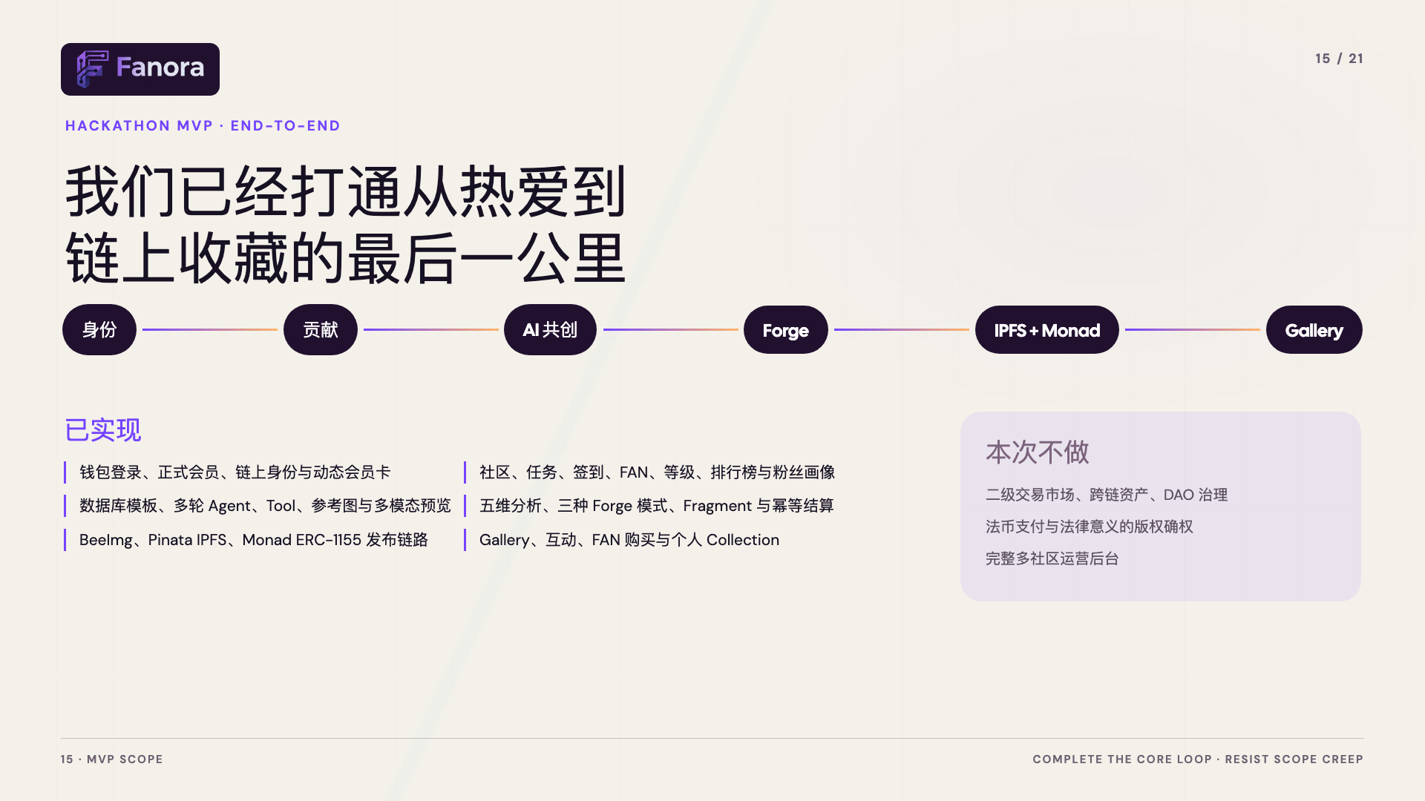
Notes:
[Sources]
- User-provided outline: docs/ppt/Fanora_展示文稿题纲.md
- Product UI and brand assets: local Fanora repository
[/Sources]

Slide 16

Notes:
[Sources]
- User-provided outline: docs/ppt/Fanora_展示文稿题纲.md
- Product UI and brand assets: local Fanora repository
[/Sources]

Slide 17
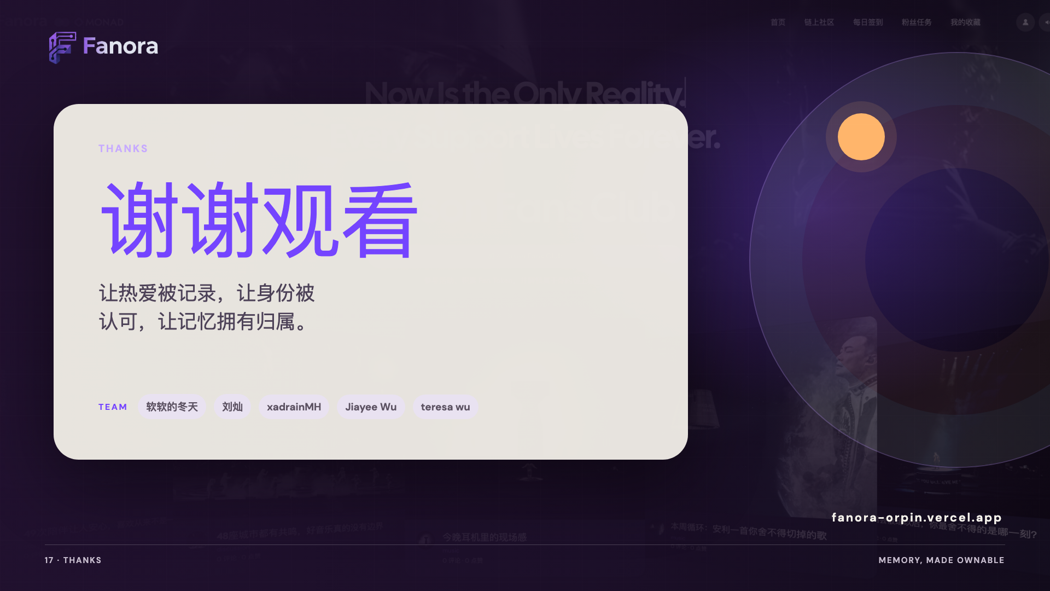
Notes:
[Sources]
- User-provided outline: docs/ppt/Fanora_展示文稿题纲.md
- Product UI and brand assets: local Fanora repository
[/Sources]

Slide 18
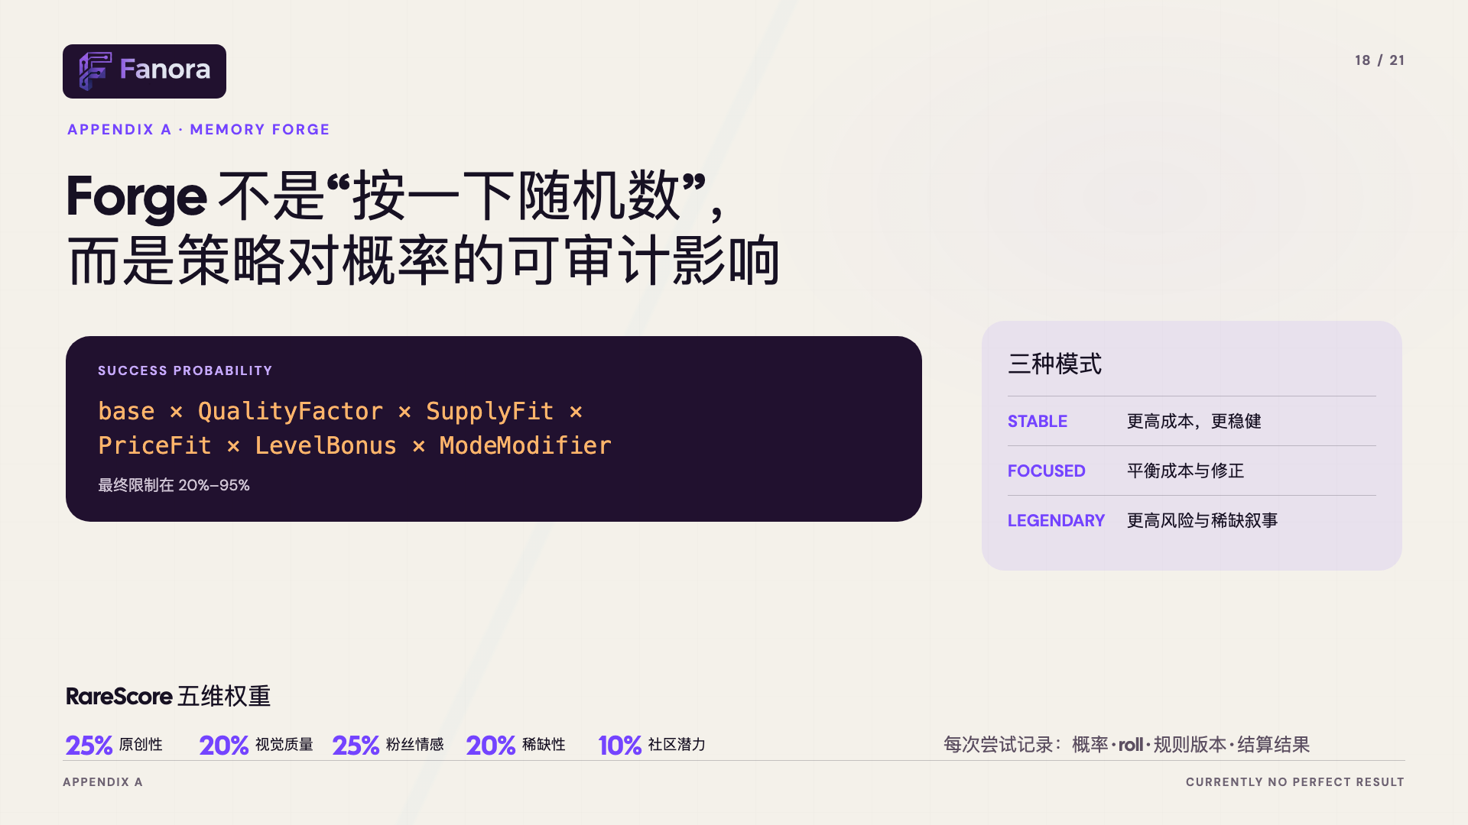
Notes:
[Sources]
- User-provided outline: docs/ppt/Fanora_展示文稿题纲.md
- Product UI and brand assets: local Fanora repository
[/Sources]

Slide 19
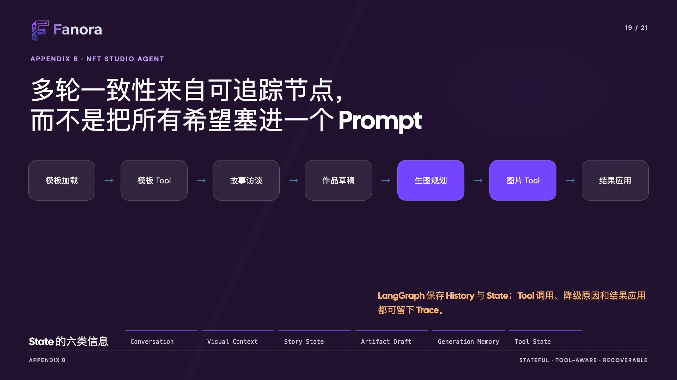
Notes:
[Sources]
- User-provided outline: docs/ppt/Fanora_展示文稿题纲.md
- Product UI and brand assets: local Fanora repository
- Monad network reference: https://docs.monad.xyz/developer-essentials/network-information
[/Sources]

Slide 20
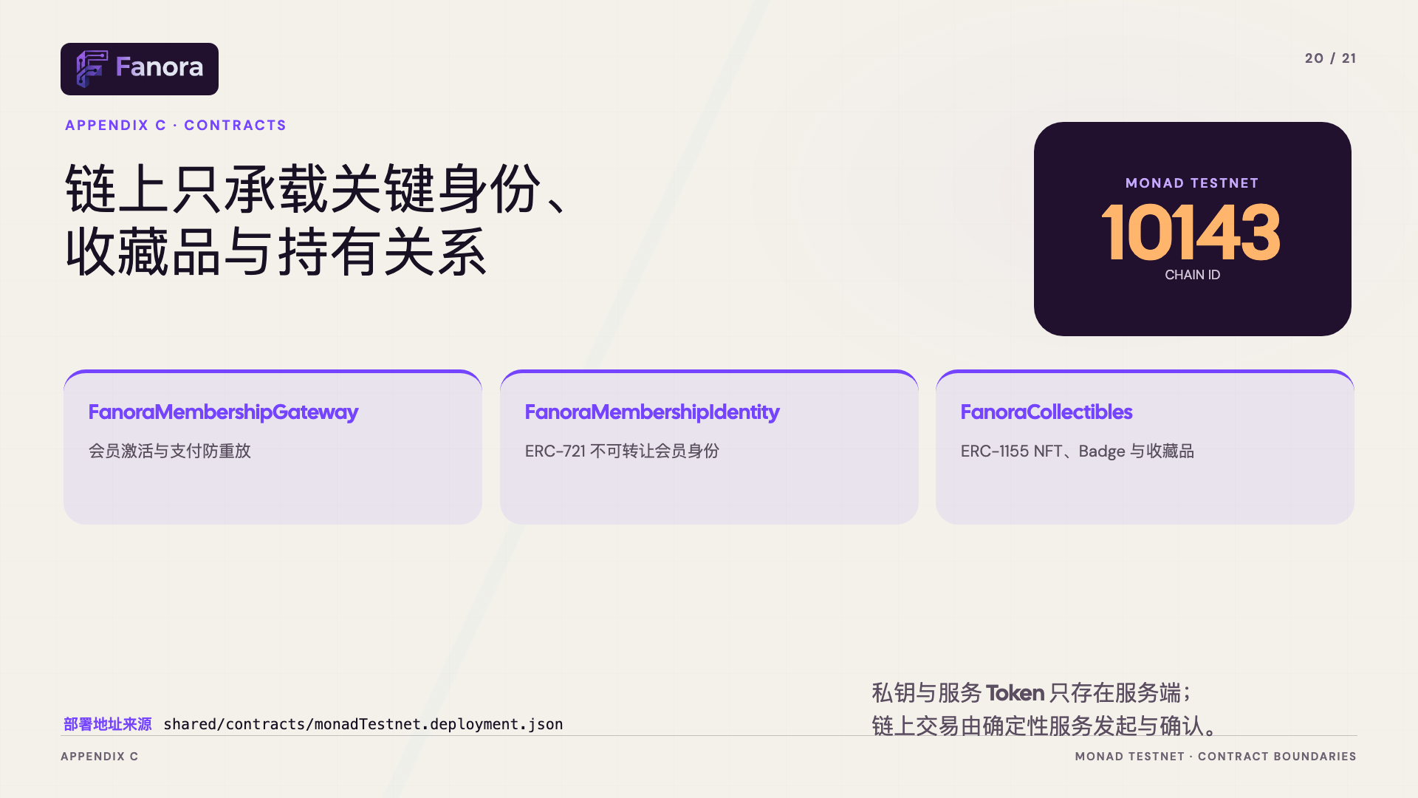
Notes:
[Sources]
- User-provided outline: docs/ppt/Fanora_展示文稿题纲.md
- Product UI and brand assets: local Fanora repository
[/Sources]

Slide 21
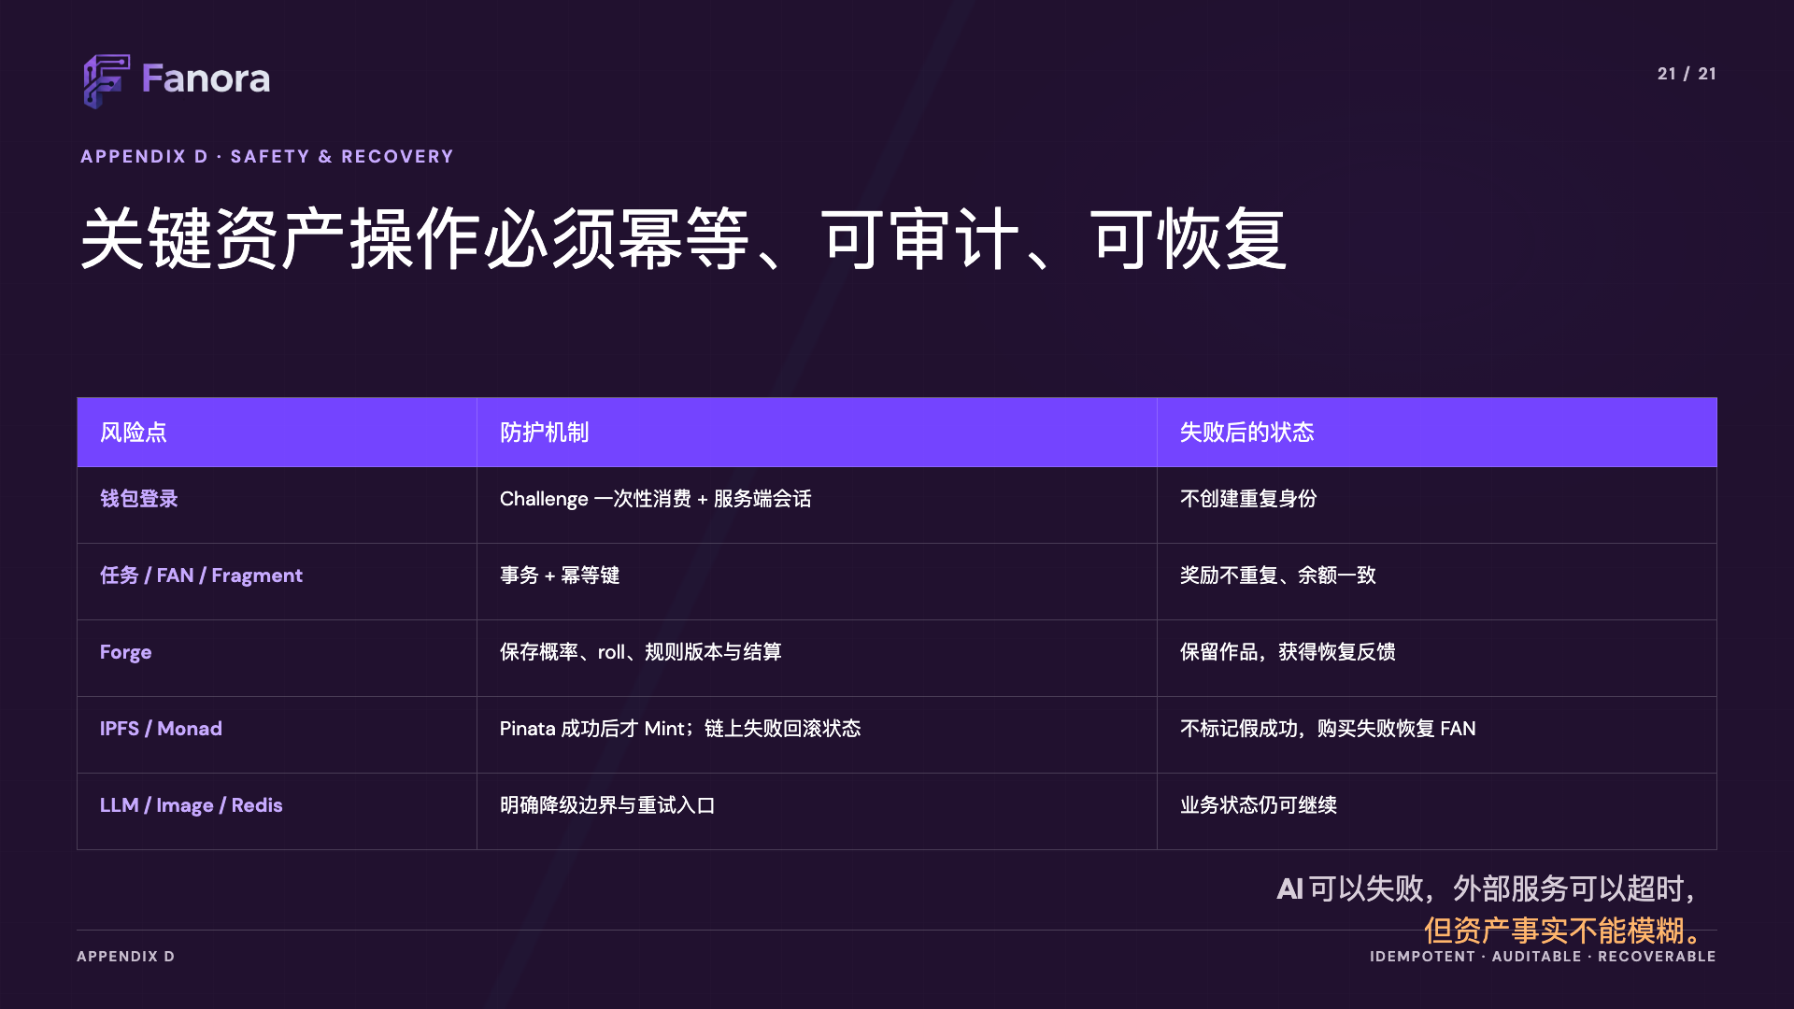
Notes:
[Sources]
- User-provided outline: docs/ppt/Fanora_展示文稿题纲.md
- Product UI and brand assets: local Fanora repository
[/Sources]

