Slide 1
1MAC Talks:
From data analysis to Big data
Data Analyst Track ;)
By: OUMOUSS EL MEHDI
Data scientist

Slide 2
The goals behind this presentation
Share (knowledge & experience)
Guide (future studies / career, Where to start from ?)

Slide 3
1MAC Program
SQL (Relational DBs):
Basics (select from where)
Joins (join)
Aggregates (group by)
Subqueries and temporary tables
data cleaning
Descriptive Statistic:
mean, median
quartiles
data distributions

Slide 4

Use Case : Big Distribution Company
Let’s suppose you are a data analyst at a big distribution company (ex: Walmart),
and you boss asked you to report to him the total sales of a certain product for the current month and the one before, world wild !
Issues:
Access
data heterogeneity (dbs with different schemas)
data transfer
US
FR
...
UAE

Slide 5
Data Warehouse (DW)
US
UAE
A data warehouse (DW) is a database use to collect / store a collection of corporate information and data coming from different operational systems (data bases) and external data sources.
Goal :
A data warehouse is designed to support business decisions
How:
Allowing data consolidation, analysis and reporting at different aggregate levels.
Users
CRM
CRM
ETL
Data Warehouse
ERP
ERP
ETL
OLAP Analysis
Data Mining
Reporting
Ext. Rsc
Ext. Rsc
ETL
Data is populated into the DW through the processes of extraction, transformation and loading (ETL)
Notes:
https://www.techopedia.com/definition/1184/data-warehouse-dw

Slide 6
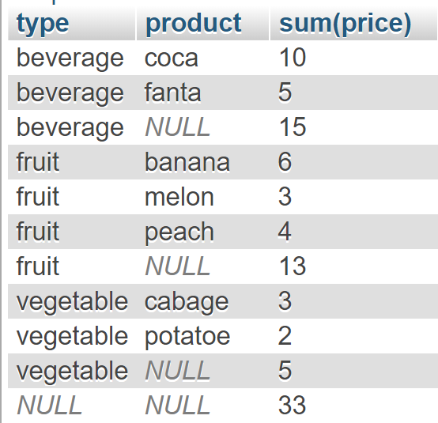
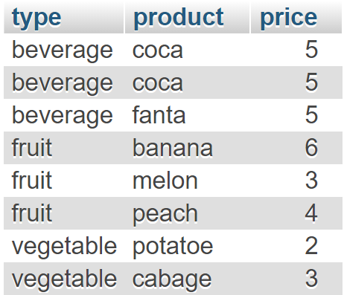
OLAP Queries (Example)
SQL 99
SELECT type, product, SUM(price)
FROM orders, order_details
GROUP BY ROLLUP (type, product)

Slide 7
Many other clauses
Aggregation commands:
Cube
Rollup
Grouping_sets
Window Partitioning (OVER):
Ranking functions: Rank, Dense_rank
Reporting functions: Lag, Lead, first_value
Plus many other functions ...

Slide 8
Big Data & NoSQL

Slide 9
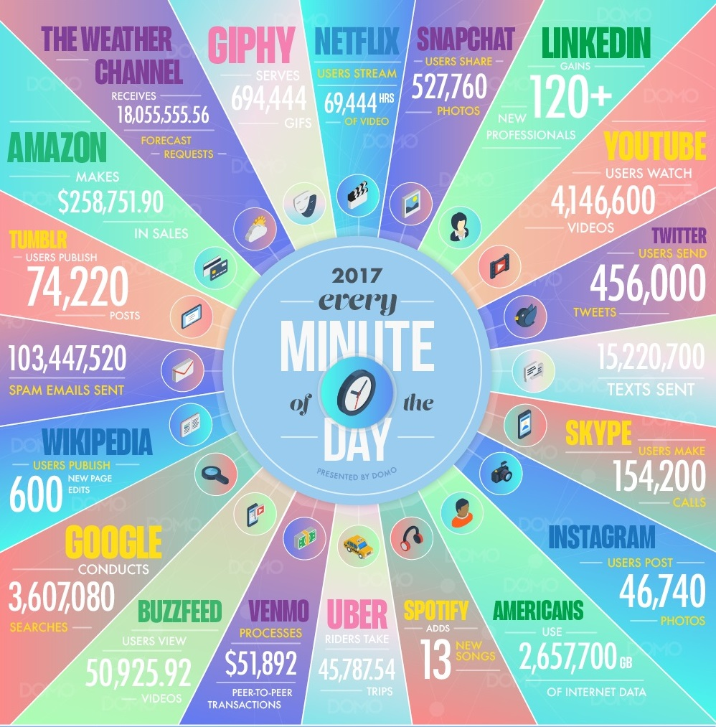
How much data we generate every minute?
Notes:
More data was created in the last two years than the previous 5,000 years of humanity

Slide 10
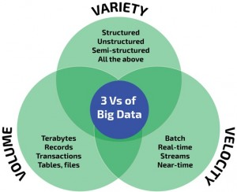
Big Data V’s
This data has several characteristics :
Volume : we are talking already talking about terabytes (1000 GB) < petabytes (1000 TB)
Variety : of sources (transactions, etc) as well as formats (video, audio, text, etc)
Velocity : data comes in different speeds (Batch, Streaming)
Notes:
With inception of this concept we found many emerging technologies which either facilitate the storage or processing of these data in a distributed fashion. Apache Hadoop being one of those early technologies/framework which started handling these data with it’s sub-projects like HDFS, MapReduce, Hive, Pig, HBase etc

Slide 11
Big Data Challenges
All these features makes it very challenging to deal with data using traditional data management tools.
It is to answer these different problems that the Big data era was born
In short, big data is a solution to handle storage and processing of large amount of data in a distributed way !
As a result, the emergence of different technologies !
Storage
Processing

Slide 12
Storage solutions
No SQL
Not Only SQL

Slide 13
RDBMS vs noSQL
Relational Data bases
(Structured/Tabular Data)
noSQL DBs
(Un/Semi-Structured data)
VS

Slide 14
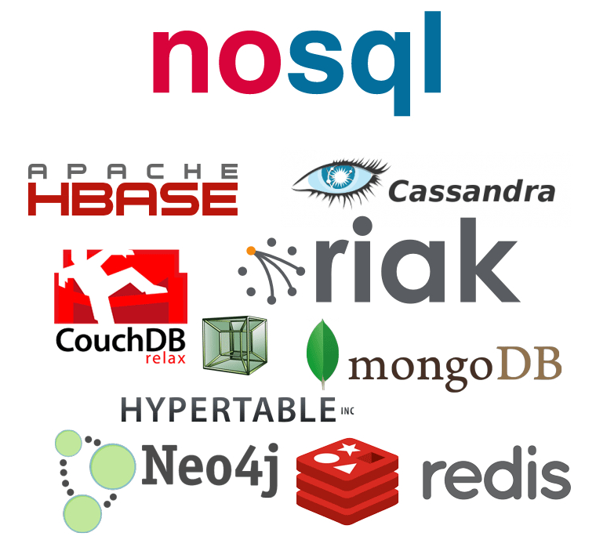
NoSQL (Not Only SQL)
Key-value stores:
Example: Redis
Wide-column stores
store data together as columns instead of rows and are optimized for queries over large datasets.
Example : Cassandra
Document databases
pair each key with a complex data structure known as a document.
Example : MongoDB
Graph databases
Stores data as graphs (networks)
Example : Neo4J
Notes:
https://www.mongodb.com/scale/types-of-nosql-databases
Thanks to their flexibility, these non-relational databases enable the management of large volumes of heterogeneous data on a set of distributed storage servers, with a very high scalability.

Slide 15
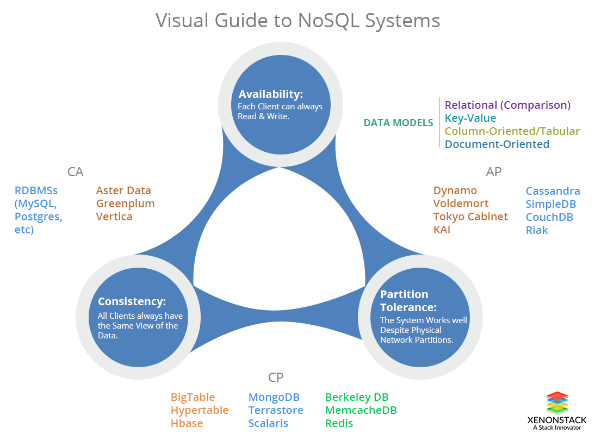
CAP Theorem
It is impossible for a distributed data store to simultaneously provide more than two out of the following three guarantees
Consistency: Every read receives the most recent write or an error
Availability: Every request receives a (non-error) response – without guarantee that it contains the most recent write
Partition tolerance: The system continues to operate despite an arbitrary number of messages being dropped (or delayed) by the network between nodes
[Wikipedia - CAP Theorem]

Slide 16
Processing solutions

Slide 17
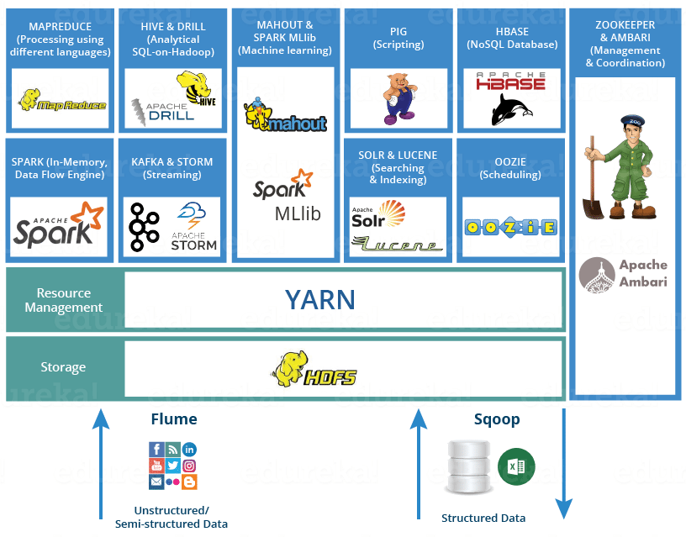
Hadoop Ecosystem
Data Bases
Data Warehouse
Data Lakes
The three principal Hadoop distribution :
Cloudera
HortonWorks
MapR.

Slide 18
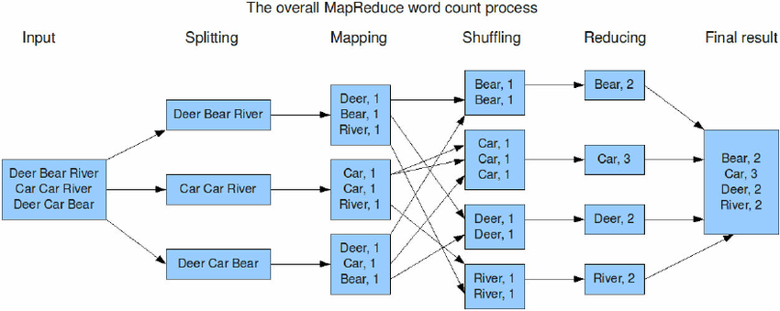
(Hadoop) Map Reduce
Notes:
https://www.researchgate.net/figure/Word-count-program-flow-executed-with-MapReduce-5_fig6_270448794

Slide 19

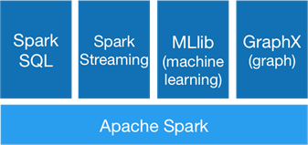
Spark
Apache Spark™ is a unified analytics engine for large-scale data processing.
https://spark.apache.org/
Hadoop map reduce vs spark ?
RDD / Dataframe / Datasets
Partitions
Databricks:
https://community.cloud.databricks.com/login.html

Slide 20
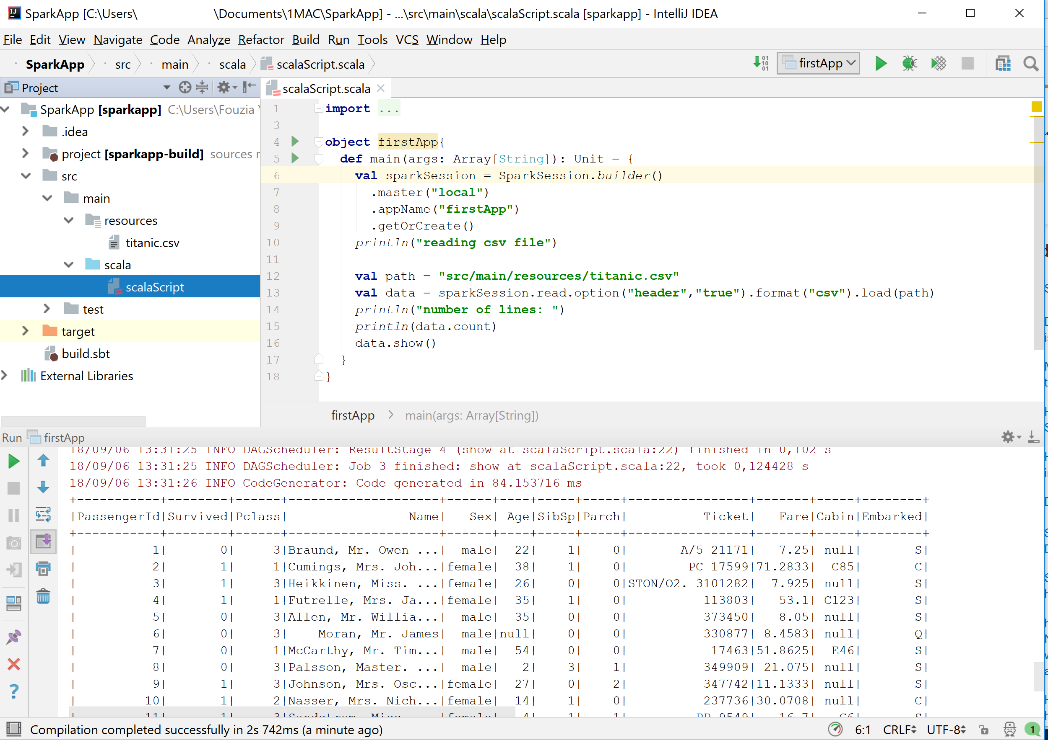
Demo (Apache Spark)
IntelliJ Idea
Scala sbt
Spark 2.11

Slide 21
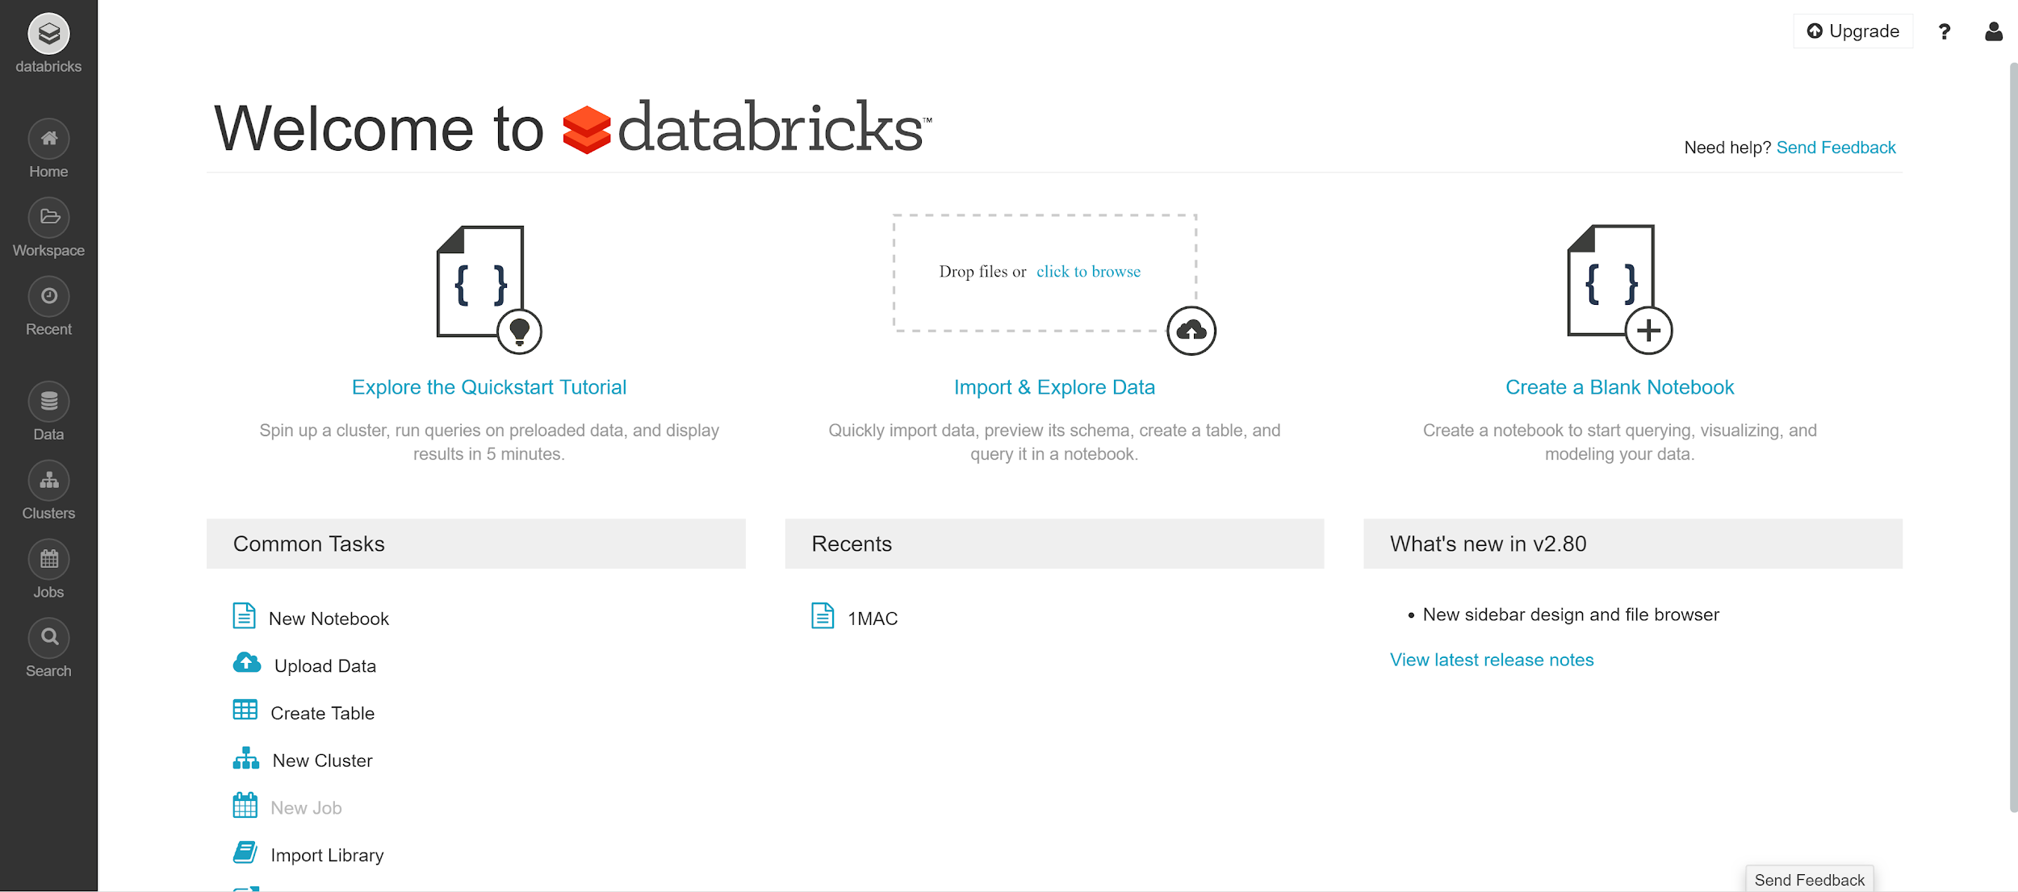
Demo (Another one !)

Slide 22
The Cloud

Slide 23


The Cloud
The cloud is simply renting servers (computational power) from providers.
Concepts:
IaaS : Infrastructure as a Service
PaaS : Platform as a Service
SaaS : Software as a Service
https://cloud.google.com/free/docs/map-aws-google-cloud-platform

Slide 24
IoT : Internet of Things

Slide 25
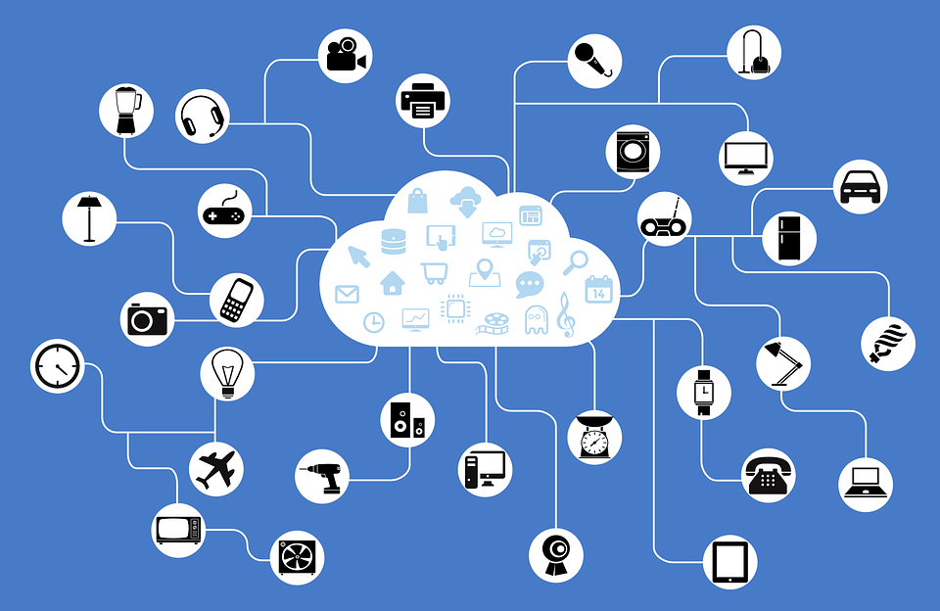
IoT
Internet of thing can be described as the extension of internet to the different objects of the physical world.
=> connected objects (watches, cars, electrical appliances, etc)
capable of connecting and exchanging information with other objects
Notes:
Example: smart houses > adjust temperature
luminosity of the house adjust depending on the light outside the home

Slide 26

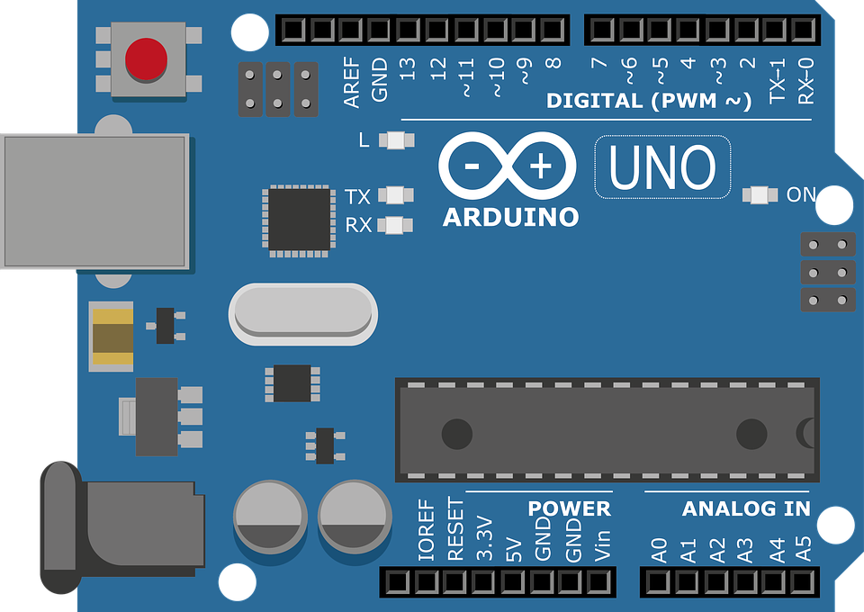
Starting with IoT
ArduIno
Raspberry Pi

Slide 27
Interesting links

Slide 28
Interesting links:
Stack overflow (ask questions to the community)
Hacker rank / Leetcode (improve your programming skills)
Twitter / Linkedin (follow pioneers in your field of interest)

Slide 29
Thank you for you attention :D

