Slide 1
Here comes another tangent.
for ijava in `find . -name '*-i.java'`
do
if ! grep -q abstract $ijava; then
if ! grep -q toString $ijava; then
echo \ "Add a toString method to $ijava."
fi
fi
done
Add a toString method to ./SeqExp-i.java.
Add a toString method to ./EnvSource/Val-i.java.
Add a toString method to ./LetrecExp-i.java.
Add a toString method to ./Program-i.java.
Add a toString method to ./LetrecDecls-i.java.
Add a toString method to ./LetDecls-i.java.
Add a toString method to ./LetExp-i.java.
Learn scripting! Very handy.

Slide 2
F. Recursion & Global Variables
Spring 2021
This … is
V5

Slide 3
Let’s Do Recursion Right!
The letrec will be
a distinct version of the let expression
that puts the current bindings of variables into an environment
that procs defined in that expression can actually use.
--> let fact = proc(n) if n then *(n,.fact(sub1(n))) else 1 in .fact(5)
java.lang.RuntimeException: no binding for fact
--> letrec fact = proc(n) if n then *(n,.fact(sub1(n))) else 1 in .fact(5)
120

Slide 4
The Procedure
Unlike let, create an empty environment before processing the declarations.
As before, create an empty list of Bindings.
As before, process each declaration, adding the Binding made to the list.
Difference: the ProcVal’s environment is set to the new, empty one!
Note that when a ProcExp is evaluated, it is not applied. This means the body is not evaluated, so “unknown” variables in the body are not an issue.
Unlike let, replace the environment’s empty Bindings with the just-created list of Bindings.
New functionality for EnvNode

Slide 5
Diagrammatically...
letrec
let
fact = proc(n) if n then *(n,.fact(sub1(n))) else 1 in .fact(5)
gets
created
earlier
new
env
outer
env
env
still gets
created
late
Using let:
Using letrec:
fact
the ProcVal
n
if n then *(n,.fact(sub1(n))) else 1

Slide 6
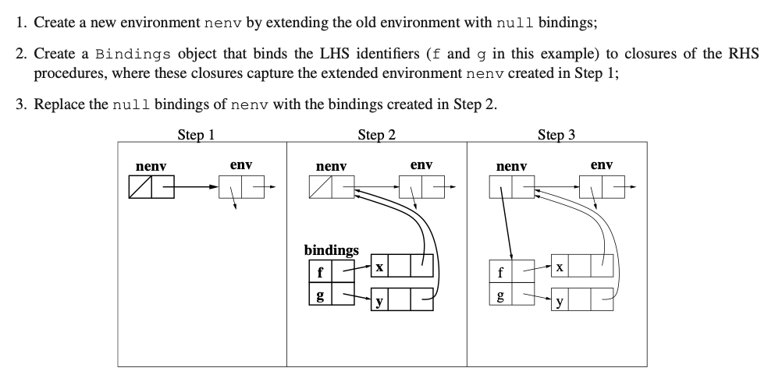
Another Perspectove from Fossum's Notes (3.88)

Slide 7
All Functions in the Group Can See Each Other!
letrec
even? = proc(x) if zero?(x) then 1 else .odd?(sub1(x))
odd? = proc(x) if zero?(x) then 0 else .even?(sub1(x))
in
.even?(11)
0

Slide 8
"Global" Variable Definition
A paradigm shift
This … is
V6

Slide 9

So far… <program> ::= <exp>
Each of our programs has been a single expression.
Those programs may have other expressions nested inside them.
They may even define temporary variables.
But once the expression is executed, everything is lost.
To do more, we must expand our semantics.
Executing a line of code may not always just be for evaluating an expression to get a result.
Sometimes it is to establish bindings that are remembered in the future.
We need… variables that stay.

Slide 10
Redefining the Top of the Grammar
<program>:Define ::= DEFINE <VAR> ASSIGN <exp>
<program>:Eval ::= <exp>
Semantically, these definitions will survive for the entire time we execute rep.
$ rep
--> define a = 20
20
--> /( a, 10 )
2

Slide 11
The toString Method for Eval
<program>:Eval ::= <exp>
It’s what used to be in Program.
But now Program is abstract.
public String toString() {
return exp.eval( initEnv ).toString();
}
X
no bindings yet
Program
%%%
//// **** Note that this class is abstract. ****
public static Env initEnv = Env.ENV_NULL.extendEnv(
new Bindings( new LinkedList<>() )
);
%%%

Slide 12
The toString Method for Define
<program>:Define ::= DEFINE <VAR> ASSIGN <exp>
public String toString() {
Val val = exp.eval( Program.initEnv );
Program.initEnv.addFirst(
new Binding( var.str, val )
);
return var.str + " set to " + val;
}
new method

Slide 13
The New Env (EnvNode) Method addFirst
/**
* Add a new binding to the front of this
* environment's existing ones.
*/
public void addFirst( Binding newBinding ) {
this.bindings.addFirst( newBinding );
}

Slide 14
The New Bindings Method addFirst
/**
* Add a newBinding object to
* List of Bindings.
*/
public void addFirst( Binding b ) {
bindingList.add( 0, b );
}

Slide 15
Another Example
$ rep
--> define z = 5
z set to 5
--> define double = proc(x) *(x,2)
double set to CLOSURE<λ(x) { return *(x,2) },env not shown>
--> .double(z)
10

Slide 16
Storing Definitions in Files
defs.v6
define fact = proc(n) if n then *(n,.fact(sub1(n))) else 1
define hundred = 100
define even? = proc(x) if zero?(x) then 1 else .odd?(sub1(x))
define odd? = proc(x) if zero?(x) then 0 else .even?(sub1(x))
define venti = 20
define z = 5
define double = proc(x) *(x,2)

Slide 17
Samples of Execution
$ rep defs.v6
fact set to CLOSURE<λ(n) { return n ? *(n,CALL [fact](sub1(n))) : 1 },..
hundred set to 100
even? set to CLOSURE<λ(x) { return sub1(x) ? 1 : CALL [odd?](sub1(x)) },.
odd? set to CLOSURE<λ(x) { return sub1(x) ? 0 : CALL [even?](sub1(x)) },..
venti set to 20
z set to 5
double set to CLOSURE<λ(x) { return *(x,2) },..
--> .even?(z)
0
--> .even?(.double(z))
1
--> .fact(5)
120
--> .fact(18)
-898433024
--> .fact(16)
2004189184

Slide 18
Thought Exercise
Is it now possible to redefine a variable?
Come up with an answer, and give a reason.
Hand them in!

