Slide 1
Programming Language Concepts
with Jim Heliotis

Slide 2
Homework 2 is Out
Due Tuesday 8 September
Review early to make sure your questions get answered.
Lingering questions on Homework #1?

Slide 3
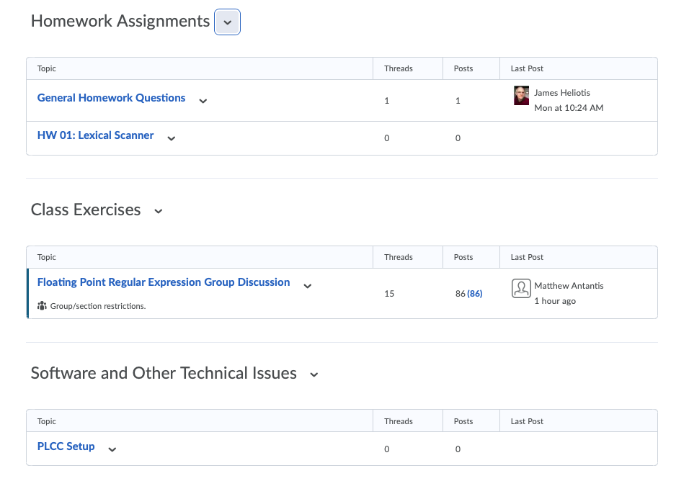
Let's talk "Discussions"

Slide 4
Beginners’ PLCC
Getting started using the tool
Spring 2020

Slide 5
PLCC File Syntax
plcc.py (plcc and plccmk) is used to create language processors.
It reads a file containing a specification of
The tokens of your language
The grammar of your language
Additional support code (Java) to help process the resulting abstract syntax tree
By default the plcc expects the specification file to be named grammar.
Our files will have distinct names and will end in ".plcc".

Slide 6
PLCC Use Quick Start
$ plcc lang_spec.plcc
# Runs plcc.py, which
# reads your file, named on the command line;
# generates Java class files based on your file;
# adds some standard PLCC library classes (Std directory).
$ cd Java
$ javac *.java
# Scan class only runs the lexical scanner.
# Parser class runs all code generated by plcc.
# Rep class repeatedly prompts you for new "programs".
Now for some useful extras…

Slide 7
PLCC Use Quick Start 2
$ plccmk lang_spec.plcc
# Runs plcc.py, which
# reads your file, named on the command line;
# generates Java class files based on your file;
# adds some standard PLCC library classes (Std directory);
# compiles the code it put in the Java directory
# scan script only runs the lexical scanner.
# parse script runs all code generated by plcc.
# rep script repeatedly prompts you for new "programs".
# rep-t script runs rep but also traces execution.
Now for some useful extras…

Slide 8
Format of Grammar File (.plcc)
token definitions, using regular expressions (Java syntax)
%
grammar definition (to be explained later)
%
Java code for semantic behavior
can be included from other files (I like using the suffix –i.java)
Comment lines start with "#".

Slide 9
Learning By Example: 1_nos+ids.plcc
token NUM '\d+'
token ID '[A-Za-z]\w*'
%
%
This recognizes decimal integers and identifiers … sort of.

Slide 10
Learning By Example: 2_nos+ids+nl.plcc
token NEWLINE '\n'
token NUMBER '\d+'
token IDENT '[A-Za-z]\w*'
% %
…better

Slide 11
Learning By Example: 3_nos+ids.plcc
# Recognize number literals and identifiers as tokens.
# Skip over whitespace
skip WHITESPACE '\s+'
token NUMBER '\d+'
token IDENT '[A-Za-z]\w*'
% %
…OK this can work.

Slide 12
A Tease for What's Ahead
Let's look at the TEST_PLCC example
Used to verify a successful installation of PLCC

Slide 13
Classic BNF Grammar
Bachus – Naur Form
Variable ::= TERM TERM TERM …
Where TERM can be a token type or another Variable.
Example 1: Binary Operations
Term ::= LITERAL
Term ::= IDENTIFIER
Expression ::= Term
Expression ::= Expression OPERATOR Expression # What's wrong with this?
Example 2: Function Calls
Call ::= Expression LPAREN Args RPAREN
Args ::=
Args ::= Expression COMMA Args # What's wrong with this?
Notes:
Problem 1: ambiguity
Problem 2: comma after last argument
Suggestion: show resulting ASTs

Slide 14

Example: LISP Lists
The LISP family of languages is based largely on linked lists.
The most basic data structure is a cons cell.
( A . B )
( A . ( B . ( C . nil ) ) )
The above is atypical. Lists are usually expressed as
( A B C )
(As an expression, "(A B C)" is interpreted as "A(B,C)" in a more common language, but that is not important right now.)

Slide 15
Grammar Example: a list of numbers
Examples: () ; (2) ; (15 8 345 0)
S ::= l M r
M ::= ''
M ::= n M
Where
l = '(' ; r = ')'
n = '[0-9]+'
Alternative form #1
S ::= l M r
M ::= '' | n M
Alternative form #2
S ::= l n* r
(ignoring issues of white space separation)

Slide 16
What Are Our PLCC Tokens?
token LPAREN '('
token RPAREN ')'
token NUMBER '\d+'
Add white space.
skip WHITESPACE '\s+'

Slide 17
Why does this not work?
skip WHITESPACE '\s+'
token LPAREN '\('
token RPAREN '\)'
token NUMBERS '(\d+\s*)*'
Notes:
Each number should be a separate token.

Slide 18
PLCC Section 2: the Context-Free Grammar (2nd section of grammar file)

Slide 19
Stepping Back: The Big Picture
1/3
BNF Grammar Rules
OP ::= '+' | '-'
COLON ::= ':'
Foo ::= . . .
Bar ::= Foo OP Foo COLON Bar
The first two lines represent Token class instances.
The last two lines become user-defined classes. constructor?:
Bar( Foo foo, Token op, Foo foo, Token colon, Bar bar )
These would be defined as tokens in PLCC.
I don't care about the colon.
oops!

Slide 20
Stepping Back: The Big Picture
2/3
PLCC syntax
token OP '[+\-]'
token COLON ':'
%
<foo> ::= . . .
<bar> ::= <foo>prim <OP> <foo>sec COLON <bar>
Resulting constructor:
Bar( Foo prim, Token op, Foo sec, Bar bar )

Slide 21
Stepping Back: The Big Picture
3/3
If you need to save some piece of information for semantic analysis, wrap that thing's grammar name in angle brackets!
Smaller but important rules for sections 1 & 2
Token names are all upper-case.
Grammar rule names start with lower case. (except for rule choice names, TBD)
They turn into classes with the first letter capitalized.
<classHeader> ::= CLASS <ID> LBRACE <classBody> RBRACE
In the above rule, the IDentifier token is kept as a ClassHeader constructor parameter, but the other tokens are not.

Slide 22
More Formally
Terminal
An identifier defined in the token section (section 1)
possibly surrounded by "<…>"
Non-terminal, right-hand side
<id>
<id>alt – required if <id> appears multiple times on right-hand side
Non-terminal, left hand side
<id> as above, or
<id>:sub_id for multiple choices of rules for <id>

Slide 23
PLCC CFG, continued: Syntax
id string begins with lower case in the grammar but its class's name begins with upper case.
lhs ::= term*
lhs:
<id>
<id>:sub_id
term:
<id>
<id>id2
token
<token>
<token>id2
The syntax of each rule
Left-hand side can be
a class name, which is defined by this rule
a class and a subclass name, the latter of which is defined by this rule
Each term in the sequence on the right side can be
a class name whose identifier has the name = id
a class name with an identifier name for the instance
a token name, which is not saved
a token name, which is saved as an instance of Token
a token name, which is saved as an instance of Token but in another variable
If a token is saved without an id2, its variable's name is all lower case.

Slide 24
Number List, PLCC Style (1 23 456 )
skip WHITESPACE '\s+'
NUMBER '\d+'
LPAREN '\('
RPAREN '\)'
%
<numSeq> ::= LPAREN <numbers> RPAREN
<numbers>:NonEmptyNumbers ::= <NUMBER> <numbers>
<numbers>:EmptyNumbers ::=
%
numlistv1.plcc

Slide 25
Java Class Correspondence
<numSeq> ::= LPAREN <numbers> RPAREN
<numbers>:NonEmptyNumbers ::= <NUMBER> <numbers>
<numbers>:EmptyNumbers ::=

Slide 26
The result of parsing
( 1 2 3 )

Slide 27
Renaming (not needed here)
<numSeq> ::= LPAREN <numbers>all RPAREN
<numbers>:NonEmptyNumbers ::= <NUMBER>item <numbers>rest
<numbers>:EmptyNumbers ::=

Slide 28
Using Repetition (and Java Lists)
<numSeq> ::= LPAREN <nums> RPAREN
<nums> **= <NUM>

Slide 29
What happens when you "run" the compiler?
$ /bin/rm -r Java
$ plccmk numlistv2.plcc
: (Some info prints here.)
$ parse
( 1 2 3)
NumSeq@24d46ca6
$ rep
--> ( 1 2 3 )
NumSeq@372f7a8d
--> ()
NumSeq@2f92e0f4
--> (456)
NumSeq@28a418fc
--> ^D
<numSeq> ::= LPAREN <nums> RPAREN
<nums> **= <NUM>

Slide 30
PLCC Section 3: Defining Semantic Actions
<numSeq> ::= LPAREN <nums> RPAREN
<nums> **= <NUM>
%
NumSeq
%%%
public String toString() {
String ret = "( ";
for (Token tok: nums.numList)
ret += tok + " ";
return ret + ")";
}
%%%
I will now add features to class NumSeq
Here is a new method.

Slide 31
$ plccmk numlistv3.plcc
Nonterminals (* indicates start symbol):
*<numSeq>
<nums>
Abstract classes:
Java source files created:
NumSeq.java
Nums.java
$ parse
(1 2 3)
( 1 2 3 )
$ rep
--> (1 2 3)
( 1 2 3 )
--> (23 59 )
( 23 59 )
--> (8)
( 8 )
--> ()
( )
--> ^D

Slide 32
Files to Review
numlistv1.plcc – recursive grammar
numlistv2.plcc – iterative grammar
numlistv3.plcc – iterative grammar with redisplay semantics
numlistv4.plcc – as in v3 but with more info about tokens shown
numlistv5.plcc – ¡new feature! – iteration with separators
numlistv6.plcc – recursive grammar with min-finding semantics

Slide 33
Now You Know Everything about Using PLCC
(except for some "cool" stuff you can do in the Java section)

Slide 34
Exercise
Given that
the tokens {LPAREN,RPAREN,LBRACE,RBRACE,WHILE,SEMI} and
the grammar variables {<expr>,<stmt>}
are already defined,
Write grammar rules for the classic C/Java while statement.
while ( EXPR ) {
STMT ;
while ( EXPR ) { STMT ; STMT ; STMT ; }
STMT ;
STMT ;
}
<prog> ::= <stmt>
<stmt>:Default ::= <STMT> SEMI
<stmt>:While ::= WHILE LPAREN <expr> RPAREN LBRACE <stmts> RBRACE
<stmts>:None ::=
<stmts>:More ::= <stmt> <stmts>
<expr> ::= <EXPR>
while(EXPR){STMT;}

Slide 35
Exercise
Given that
the tokens {LPAREN,RPAREN,IF,ELSE,SEMI} and
the grammar variables {<expr>,<stmt>}
are already defined,
Write grammar rules for the classic C/Java if statement.
<stmt>:ifStmt ::= IF LPAREN <expr> RPAREN <stmt> <elsePart>
<elsePart>:RealElse ::= ELSE <stmt>
<elsePart>:NoElse ::=
Ambiguous—
Doesn’t work!!

