Slide 1
F. Recursion & Global Variables
Fall 2020

Slide 2
Let’s Do Recursion Right!
The letrec will be
a distinct version of the let expression
that puts the current bindings of variables into an environment
that procs defined in that expression can actually use.
--> let fact = proc(n) if n then *(n,.fact(sub1(n))) else 1 in .fact(5)
java.lang.RuntimeException: no binding for fact
--> letrec fact = proc(n) if n then *(n,.fact(sub1(n))) else 1 in .fact(5)
120

Slide 3
The Procedure
Unlike let, create an empty environment before processing the declarations.
As before, create an empty list of Bindings.
As before, process each declaration, adding the Binding made to the list.
Difference: the ProcVal’s environment is set to the new, empty one!
Note that when a ProcExp is evaluated, it is not applied. This means the body is not evaluated, so “unknown” variables in the body are not an issue.
Unlike let, replace the environment’s empty Bindings with the just-created list of Bindings.

Slide 4
Diagrammatically...
letrec
let
fact = proc(n) if n then *(n,.fact(sub1(n))) else 1 in .fact(5)
new
env
outer
env
env
Using let:
Using letrec:
fact
the ProcVal
n
if n then *(n,.fact(sub1(n))) else 1

Slide 5
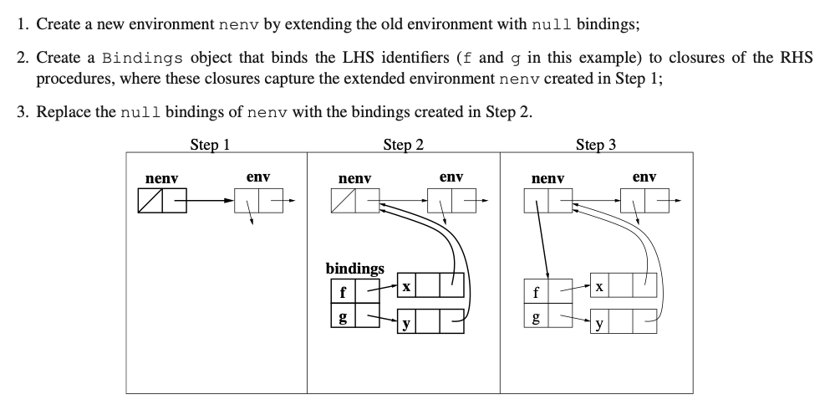
Another Perspectove from Fossum's Notes (3.88)

Slide 6
All Functions in the Group Can See Each Other!
letrec
even? = proc(x) if zero?(x) then 1 else .odd?(sub1(x))
odd? = proc(x) if zero?(x) then 0 else .even?(sub1(x))
in
.even?(11)
0

Slide 7
"Global" Variable Definition
A paradigm shift

Slide 8

So far… <program> ::= <exp>
Each of our programs has been a single expression.
Those programs may have other expressions nested inside them.
They may even define temporary variables.
But once the expression is executed, everything is lost.
To do more, we must expand our semantics.
Executing a line of code may not always just be for evaluating an expression to get a result.
Sometimes it is to establish bindings that are remembered in the future.
We need… variables that stay.

Slide 9
Redefining the Top of the Grammar
<program>:Define ::= DEFINE <VAR> ASSIGN <exp>
<program>:Eval ::= <exp>
Semantically, these definitions will survive for the entire time we execute rep.
$ rep
--> define a = 20
20
--> /( a, 10 )
2

Slide 10
The toString Method for Eval
<program>:Eval ::= <exp>
public String toString() {
return exp.eval( initEnv ).toString();
}
X
i | 1
v | 5
x | 10
l | 50
c | 100
d | 500
m | 1000
It’s what used to be in Program.
But now Program is abstract.

Slide 11
The toString Method for Define
<program>:Define ::= DEFINE <VAR> ASSIGN <exp>
public String toString() {
Val val = exp.eval( Program.initEnv );
Program.initEnv.addFirst(
new Binding( var.str, val )
);
return var.str + " set to " + val;
}
new method

Slide 12
The New Env (EnvNode) Method addFirst
/**
* Add a new binding to the front of this
* environment's existing ones.
*/
public void addFirst( Binding newBinding ) {
this.bindings.addFirst( newBinding );
}

Slide 13
The New Bindings Method addFirst
/**
* Add a newBinding object to
* List of Bindings.
*/
public void addFirst( Binding b ) {
bindingList.add( 0, b );
}

Slide 14
Another Example
$ rep
--> define z = 5
z set to 5
--> define double = proc(x) *(x,2)
double set to CLOSURE<λ(x) { return *(x,2) },env not shown>
--> .double(z)
10

Slide 15
Storing Definitions in Files
defs.v6
define fact = proc(n) if n then *(n,.fact(sub1(n))) else 1
define hundred = 100
define even? = proc(x) if zero?(x) then 1 else .odd?(sub1(x))
define odd? = proc(x) if zero?(x) then 0 else .even?(sub1(x))
define venti = 20
define z = 5
define double = proc(x) *(x,2)

Slide 16
Samples of Execution
$ rep defs.v6
fact set to CLOSURE<λ(n) { return n ? *(n,CALL [fact](sub1(n))) : 1 },..
hundred set to 100
even? set to CLOSURE<λ(x) { return sub1(x) ? 1 : CALL [odd?](sub1(x)) },.
odd? set to CLOSURE<λ(x) { return sub1(x) ? 0 : CALL [even?](sub1(x)) },..
venti set to 20
z set to 5
double set to CLOSURE<λ(x) { return *(x,2) },..
--> .even?(z)
0
--> .even?(.double(z))
1
--> .fact(5)
120
--> .fact(18)
-898433024
--> .fact(16)
2004189184

Slide 17
Thought Exercise
Is it now possible to redefine a variable?
Come up with an answer, and give a reason.
Hand them in!

Slide 18
Tally
Yes: IIIII IIIII IIIII |  | No: IIIII
?? |  | addFirst means the old value is seen
old value becomes inaccessible |  | it won't replace the old binding; it will add one.
it should work; seems natural |  | because the old value will always be used
it will overwrite the previous binding.

Slide 19
Tally
yes votes:IIIII III |  | no votes:II
new val in front of bindings (old still there) | but not for old procs? | binding is not initially set up anyway, so can't change
It creates a new env. |  | a NEW binding is made; the old one is still there.
(no reason given) ("because we said so"?)
why not?

