Slide 1
AMAZON ✕ SIMPLON MAGHREB
Amazon Sales Performance
Analysis & Customer Insights
A Jupyter Notebook analysis pipeline, from raw data to a Power BI dashboard.
1
Load
2
Explore
3
Clean & Test
4
Model
5
Visualize
100K
$91.8M
43K
5 yrs
Orders Analyzed
Total Revenue
Unique Customers
2020 – 2024 Data

Slide 2









TECH STACK
Tools & Technologies
Python
Pandas
NumPy
Core language for the analysis pipeline
Data loading, cleaning & transformation
Numerical operations on arrays
Matplotlib
Seaborn
SciPy
Exploratory charts & distributions
Statistical data visualization
T-test, Chi² and correlation testing
Kagglehub
Jupyter
Power BI
Dataset sourcing (Kaggle API)
Interactive notebook environment
Interactive dashboard & reporting
3

Slide 3






METHODOLOGY
Project Roadmap
1
Organisation & Piloting
Project management tool, tasks, milestones and deliverables planning.
2
Business Framing
Business context analysis, problem reformulation, objectives & 5+ actionable KPIs.
3
Data Sourcing
Selection of 2+ complementary data sources, quality checks and documentation.
4
Exploratory Analysis (EDA)
Descriptive statistics, distributions, anomaly detection, first insights.
5
Cleaning & Modeling
Handling missing values & duplicates, normalization, star-schema data model.
6
Statistical Testing
T-test, Chi², correlation — hypothesis validation & business interpretation.
7
Dashboard & Visualization
Summary + detail pages, interactive filters, clear navigation, decision-oriented views.
2

Slide 4

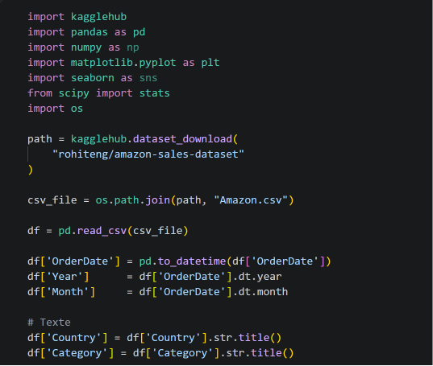


1
Loading & Preparing the Data
test.ipynb — pandas + kagglehub
Download via kagglehub
Pulled the “Amazon Sales Dataset” (rohiteng) straight into the notebook — no manual file handling.
import kagglehub, pandas as pd, os
path = kagglehub.dataset_download(
Parse dates
"rohiteng/amazon-sales-dataset")
Converted OrderDate to datetime and derived Year / Month columns for time-based analysis.
csv_file = os.path.join(path, "Amazon.csv")
df = pd.read_csv(csv_file)
Normalize text
df['OrderDate'] = pd.to_datetime(df['OrderDate'])
Standardized Country and Category text casing with .str.title() for consistent grouping.
df['Year'] = df['OrderDate'].dt.year
df['Month'] = df['OrderDate'].dt.month
df['Country'] = df['Country'].str.title()
22 columns · 100,000 rows
df['Category'] = df['Category'].str.title()
Orders, customers, products, payments and geography, ready for exploration.
2

Slide 5
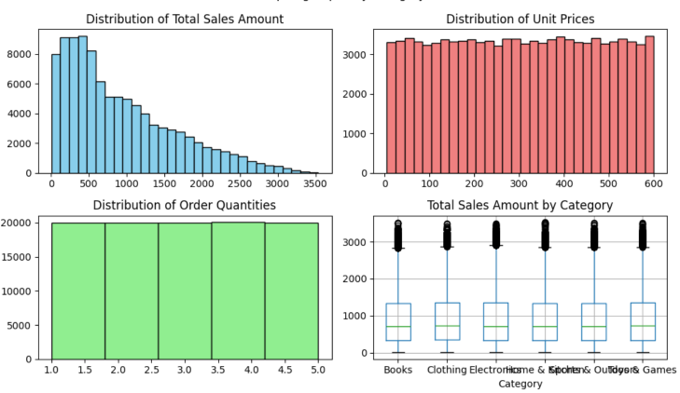
2
Descriptive Statistics & Data Quality
df.describe() + distribution & outlier checks
1. Distribution of Total Sales Amount
Most orders have a low to medium total amount, while only a few orders have very high values. This indicates a right-skewed distribution.
2. Distribution of Unit Prices
Unit prices are evenly distributed across the dataset, showing that products are available in different price ranges.
3. Distribution of Order Quantities
Order quantities are evenly distributed between 1 and 5 items, indicating that customers purchase different quantities with no dominant value.
4. Total Sales Amount by Category
All categories have a similar distribution of sales amounts. Several outliers are present, indicating that a few orders have exceptionally high sales values.
3

Slide 6
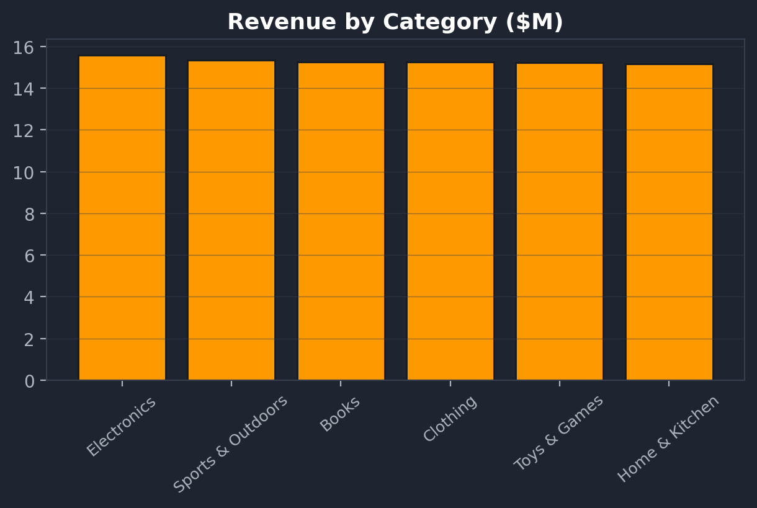
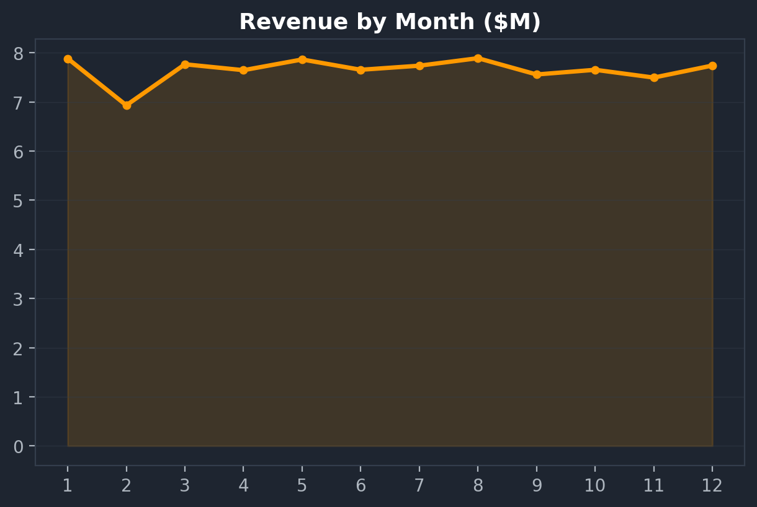
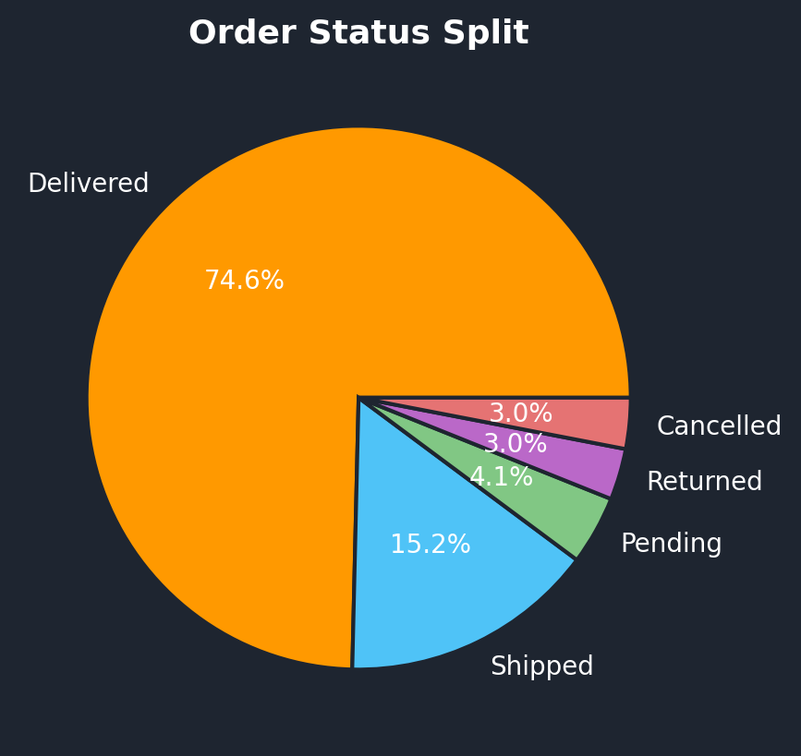
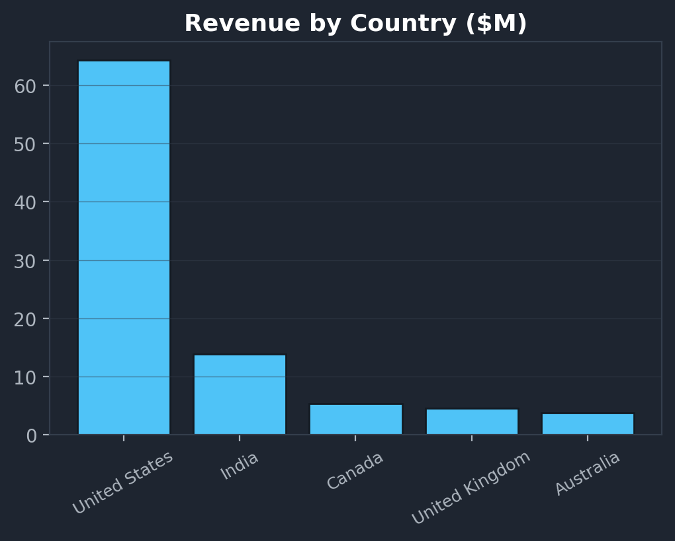
3
Exploratory Visuals & First Insights
Revenue patterns across category, time, status and geography
Electronics leads revenue; categories perform comparably overall.
Sales stay stable year-round — peak in August, dip in February.
About 75% of orders are Delivered; cancellations/returns are minor.
United States drives the most revenue, followed by India.
4

Slide 7
4
Cleaning & Statistical Testing
drop duplicates / nulls, then SciPy hypothesis tests
0
0
100,000
22
Missing values
Duplicate rows
Rows after cleaning
Final columns
T-Test
Chi-Square
Pearson r
Does order value differ between Delivered vs. Cancelled orders?
Does payment method affect order status?
Is discount correlated with total order amount?
p = 0.058
p = 0.777
r = -0.108
Not significant
Not significant
Significant (p < 0.001)
Order amount does not influence delivery outcome.
Payment method has no measurable relationship with order status.
Higher discounts are weakly associated with lower order totals.
5

Slide 8
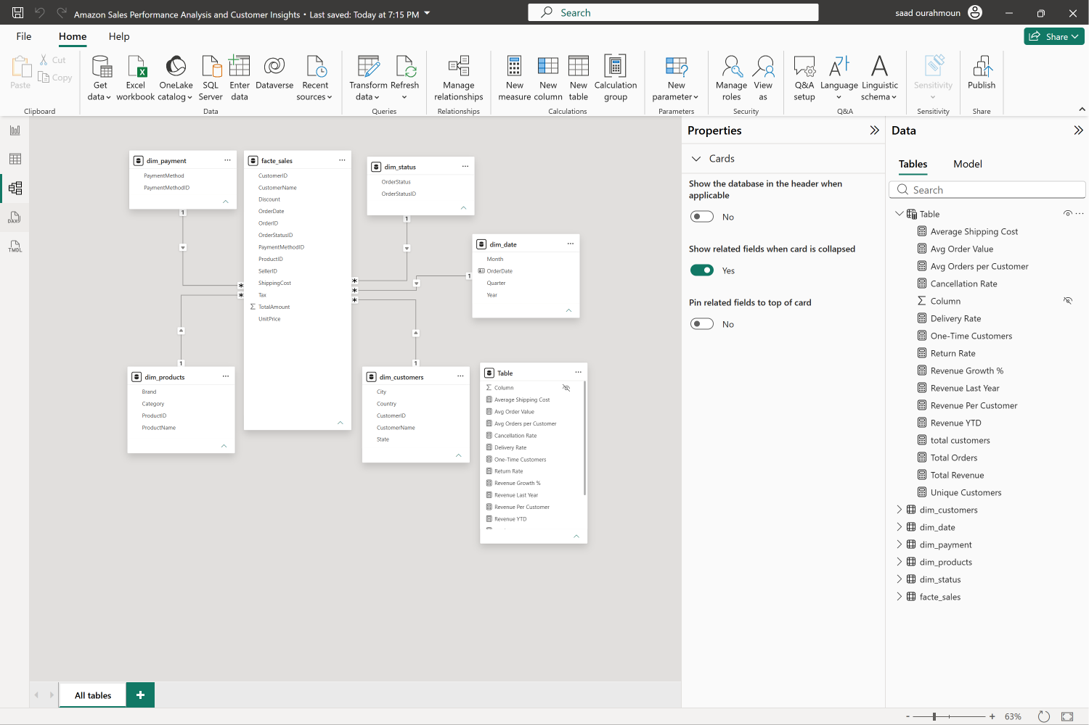
5
Data Modeling in Power BI
Star schema built with Power Query & DAX measures
One fact, five dimensions
facte_sales
Order line grain: quantity, discount, tax, shipping, total amount
dim_customers
Customer name, city, state, country
dim_products
Product, category, brand
dim_date
Order date, month, quarter, year
dim_payment / dim_status
Payment method & order status lookups
20+ DAX measures
Total Revenue, Avg Order Value, Revenue Growth %, Return Rate, Cancellation Rate, Revenue Per Customer, and more.
6

Slide 9
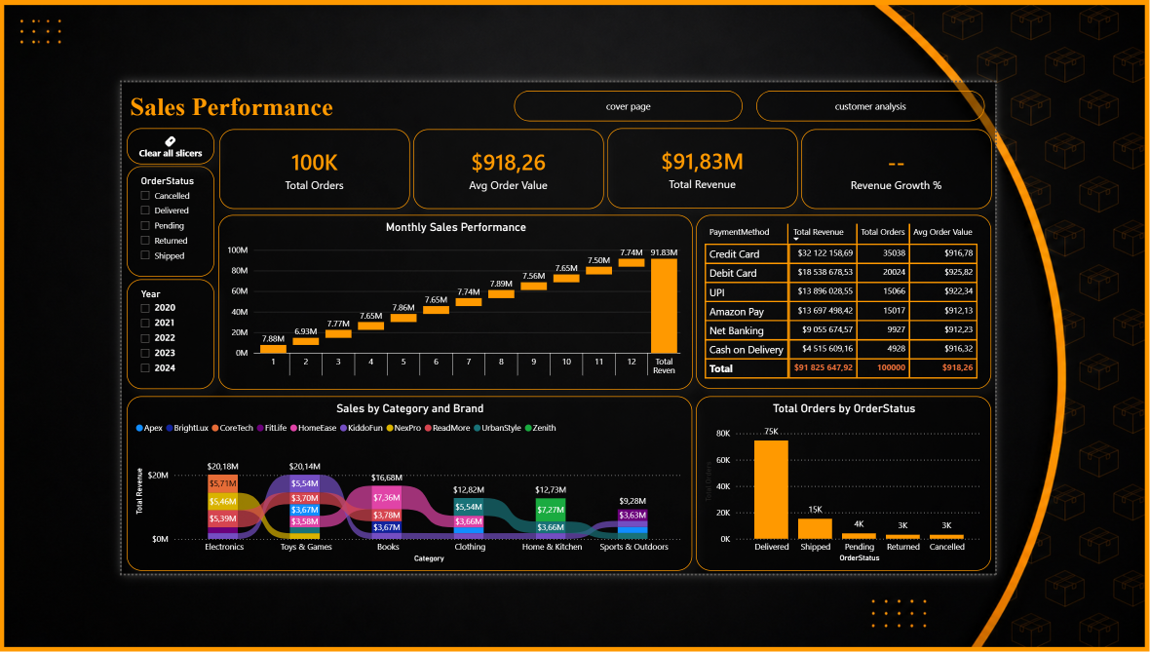
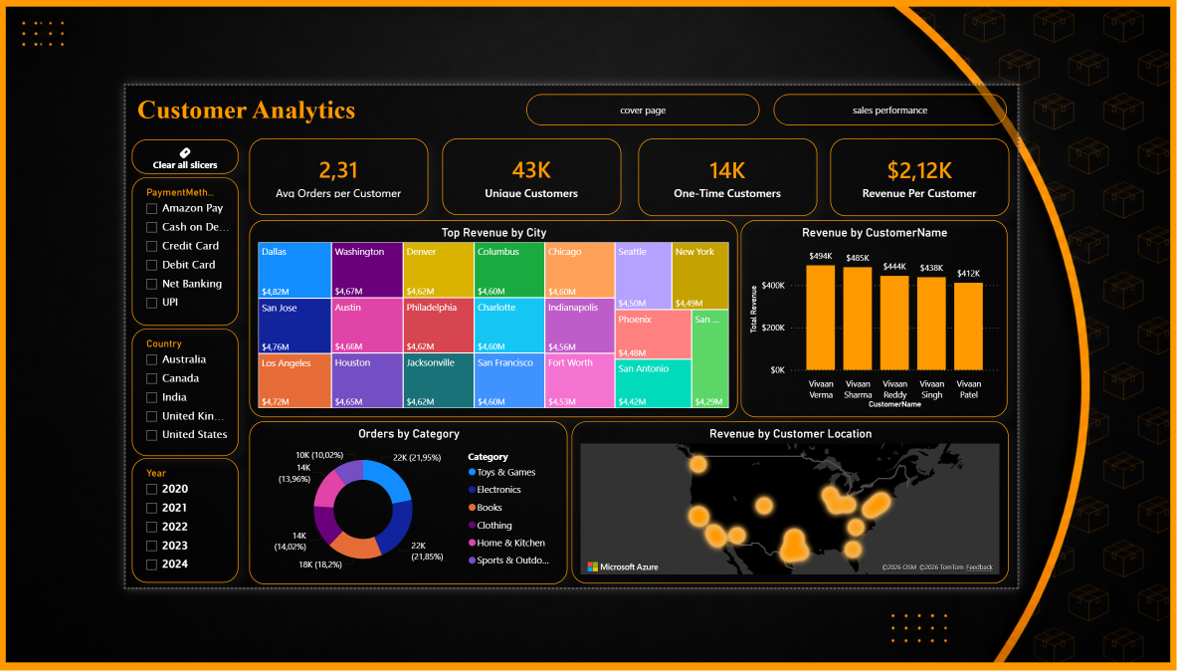
6
Interactive Power BI Dashboard
Two connected report pages for sales & customer analysis
Sales Performance
Customer Analytics
Monthly trend, revenue by payment method, category & brand breakdown, order status.
Revenue by city & customer, order share by category, geographic revenue heatmap.
7

