Slide 1

找Deal-3期-2组 WK1 HW

Slide 2

在广袤的中西部， 总有许多的机会在等着我们。
我组成员分布在OH，TX， MO，GA，IL，AL等多地且有自己的追求。所以我们选择以strategy分为以下两类各自提交作业：
Buy & Hold
Flip

Slide 3
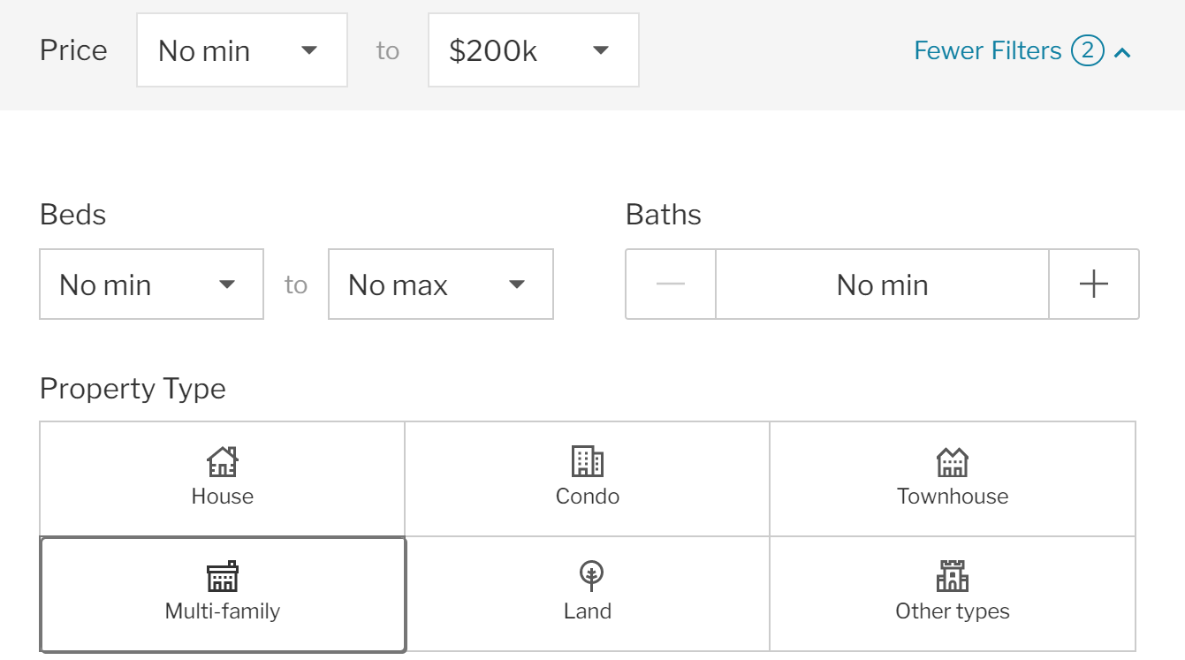
Buy & Hold #1 – 乔依
Location:
Cities near Dayton, OH (Kettering, Riversides, Fairborn, Huber Hts)
Criteria: Multi-family, 2+ units
Reasons:
1) High quality tents source:
There are air force base (30K hiring), university of Dayton (party school) and several companies including healthcare institutes. Amazon seems is creating a logistic center there.
2) Unit rental price – 850+ (2BR1BA); 450+ (1BR1BA).
3) To achieve 1%+ rule, the purchase price should not be higher than 200K.
4) Left side is the basic analysis for a two unit multi-families.
其实Dayton附近比较好的city也有flip或者BRRR的潜质。
很多潜在租户/买家是年轻的couple, 经济实力有限。这对于作为新手的我们是一个好消息。
可以从小房子的改造开始， 提供给租户/买家更现代的环境来创造更好的现金流。 再过渡到，增
加房子的功能和观感已取得更丰厚的回报率。

Slide 4
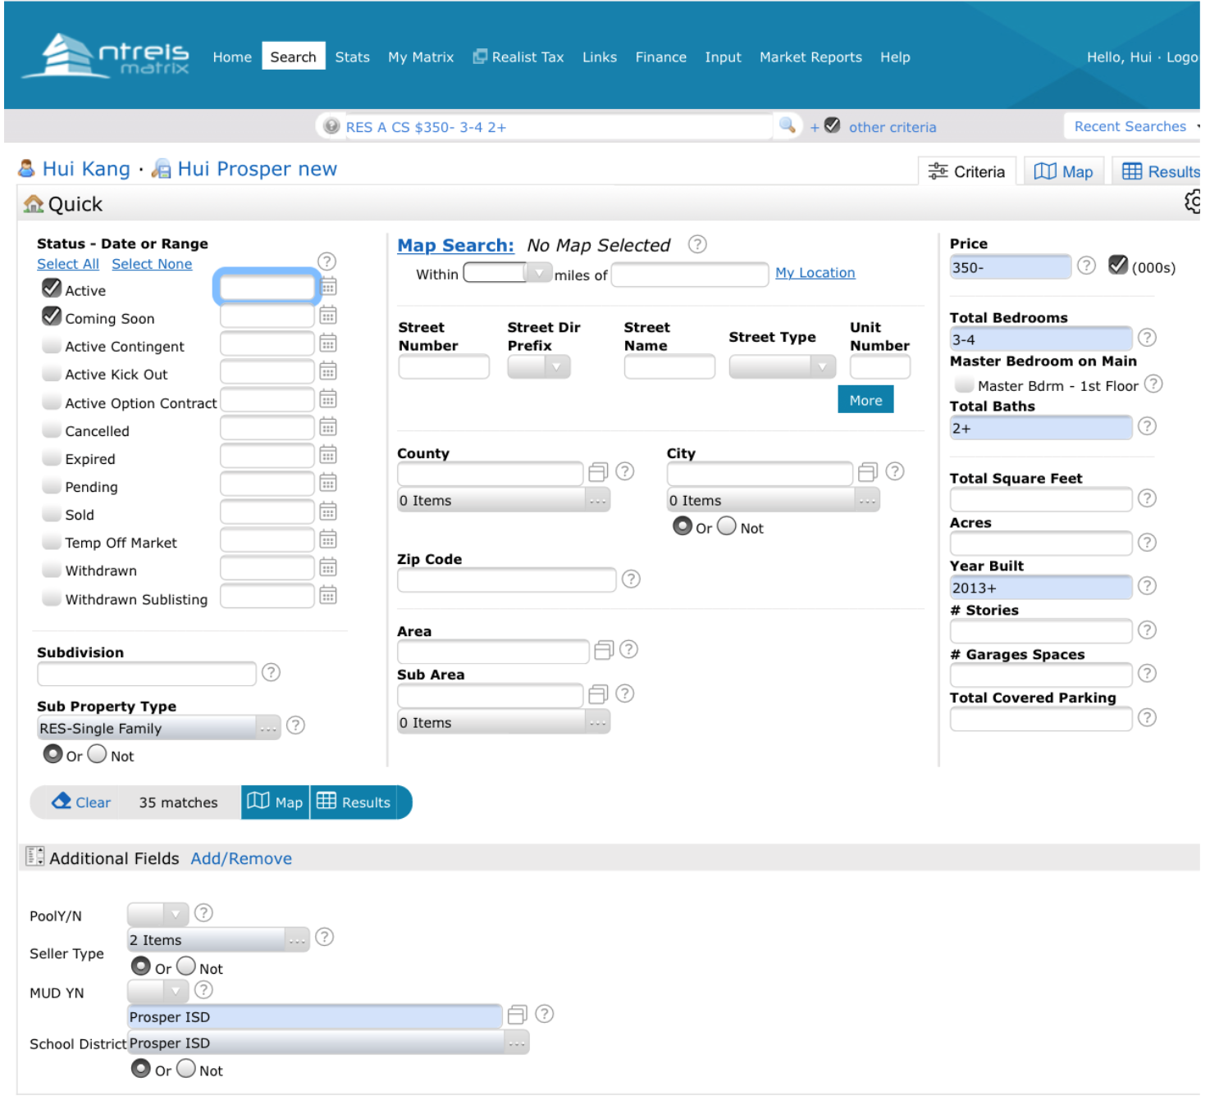
Buy & Hold #2 – Hui Kang
Location: Celina, TX (nearDallas)
Criteria:
< 350K, 3-4BR, 2+BA, Newer than 2013, Prosper ISD
Reason:
next to booming city with more reasonable price
Part of the city zone to prestigious school district (Prosper ISD)
Relatively rent/price ratio

Slide 5
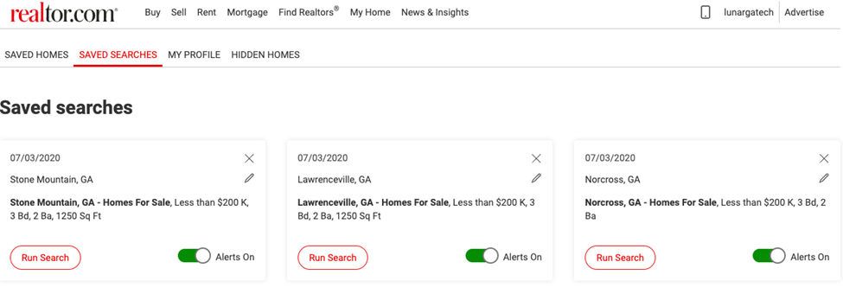
Buy & Hold #3 – Lily
Location: multiple cities in GA (Lawrenceville, Norcross, Stone Mountain)
Criteria:
3+ BR, 2BA, >1250sft
Reason：
虽然租售比不高， 但是胜在租客客流稳定（以蓝领居多），租金价位合适，交通方便，空房率较低，能够保障正现金流。

Slide 6
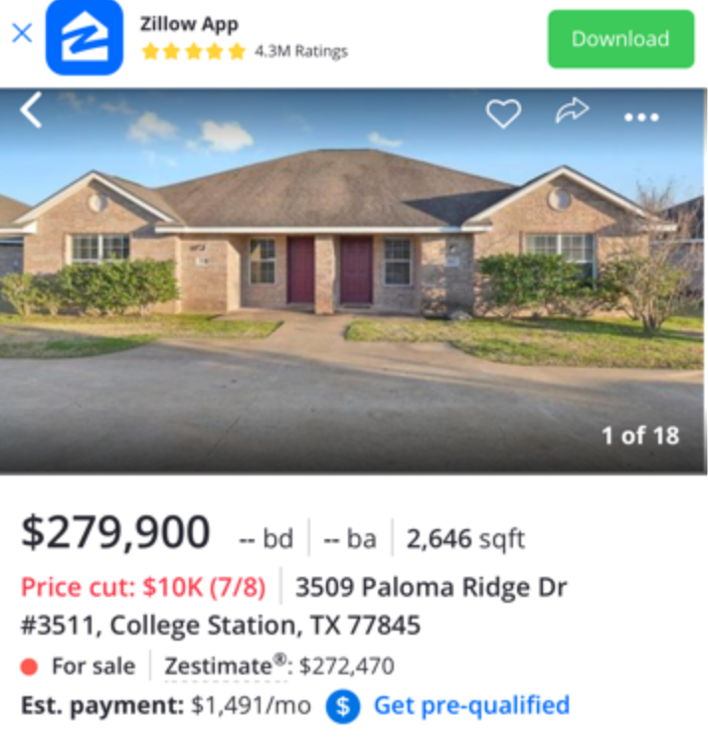
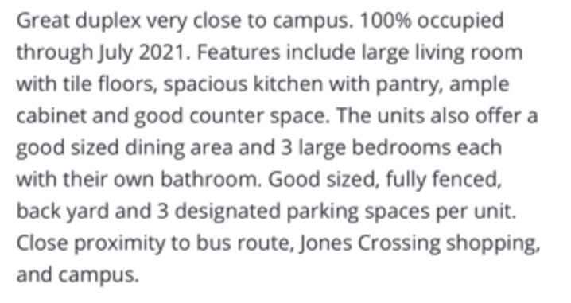
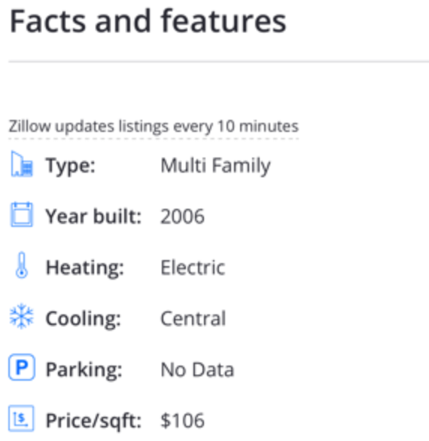
Buy & Hold #4 – Bo Xuan
Location: College Station, TX
Criteria:
Duplex (relatively newer) with current rent ranging from 2K to 2.5K
Reason：
1) College Station is where Texas A&T is located so students rental can be the niche.
2) With a newer house, the maintenance cost is lower and the quality of tenants could be higher.

Slide 7
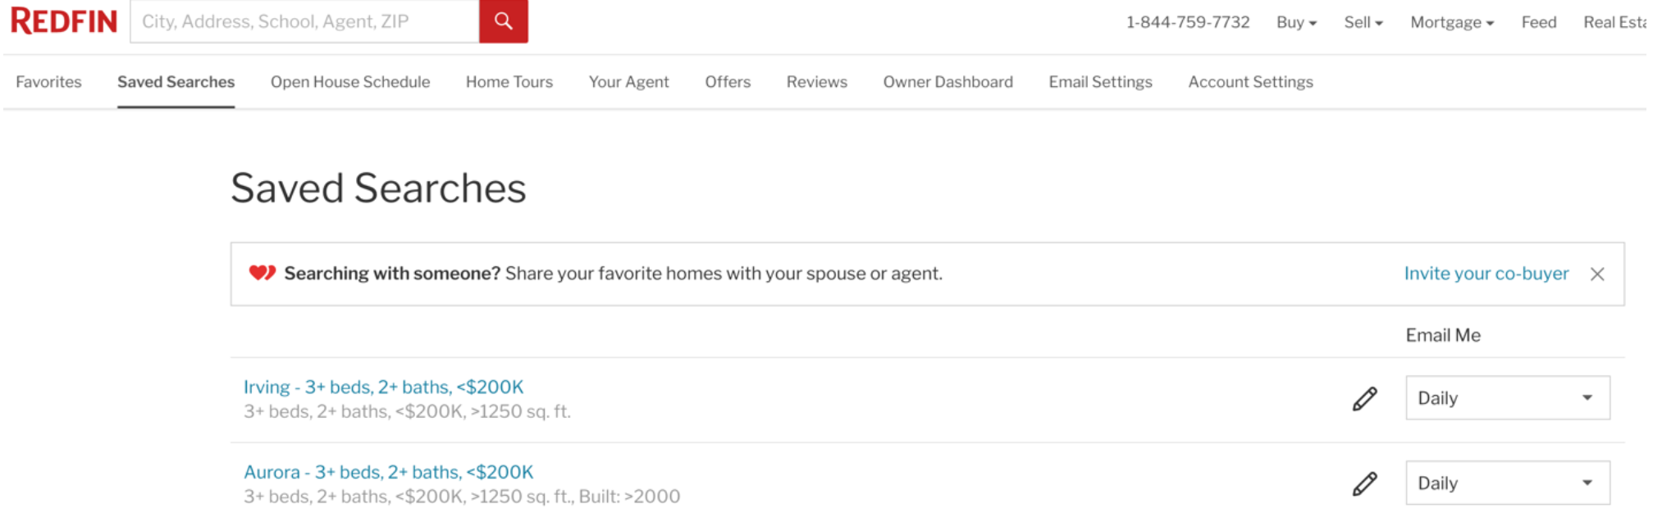
Flip #1 – Victor
Location: Various
Criteria:
Irving (near Dallas)
3+BR, 2+BA, >1250sqft, price<200K
Aurora (near Chicago)
3+BR, 2+BA, >1250sqft, price<200K, <20yr old, w/ basement & garage

