Slide 1


2020-Y1-Team03 第三组
第二讲课后作业
远程投资地区投研报告

Slide 2
作业要求
设立自己的投资目标
选定几个小的区域比如zipcode
选定价位，房龄，房屋大小
具体数据和选择的理由
小组分工设置
内容A. 设立自己的投资目标，具体体数据和（或）选择的理由
内容B. 选定每个城市选择1个zipcode，具体体数据和（或）选择的理由
内容C. 选定价位，房龄，房屋大小，具体体数据和（或）选择的理由

Slide 3

Project 1： NC Research Triangle: Raleigh vs. Durham
Project Coordinator: Tony-NY （负责汇总与整理）
完成Raleigh, Durham 两个城市的比较表格（Pro & Con)
内容A。分析员：Tony-NY， 等
内容B。分析员：五月天-FL，等
内容C。分析员：Angela，等

Slide 4
Project 1： NC Research Triangle - Raleigh
A. 投资目标
一年内，房价低于30万，租客好管理，房屋维护简单，房价稳定，租金洼地的地区。
近期由于疫情引起的forberance and ban on eviction，计划给市场半年到一年时间稳定下来再做实际投资
关注年轻且房价在过去几年内稳步攀升的地区
现金流就是生命线，必须是正现金流，在这基础上寻找升值潜力大的城市

Slide 5
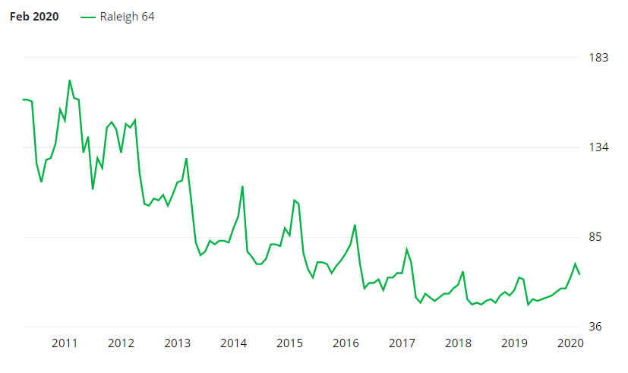
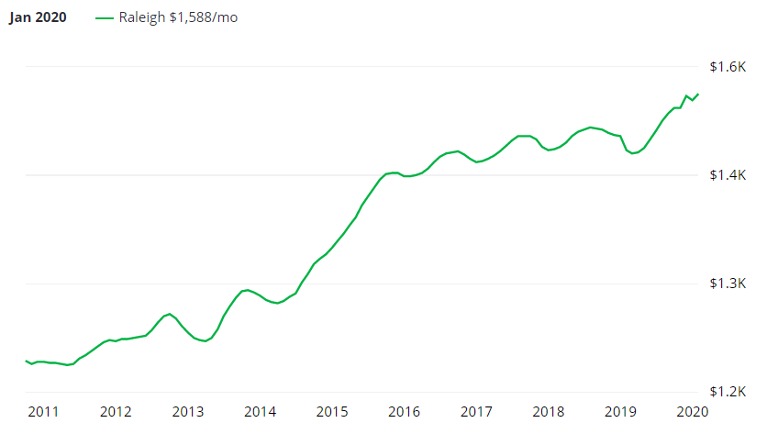
Project 1： NC Research Triangle - Raleigh
Days on market一直在下降，但是目前有回升势态
Rent也一直在增高，但是离1%法则距离较远，已经不再是主打现金流的市场

Slide 6
Raleigh (After comparing 21 zip codes, find best two zip codes: 27603 vs 27616)
Zip Code | 27603 | 27616
land area (sq mile) | 51.6 | 22.2
Population (2000) | 31,527 | 21,974
Population (2010) | 47,033 | 42,294
Population (2016) | 51,860 | 51,114
Population (2017) | 54,481 ( 5.1%) | 53,452 ( 4.6%)
Population density (/SQM) (2016/2019) | 1,005/1,056 | 2,300/2,406
Cost of living (Mar. 2016/Mar. 2019) | 95.1/94.6 | 94.6/93.9
Median resident age (2017) | 32.5 | 33.3
Real estate property taxes (2016) | $1,519 (0.7%) | $1,770 (0.9%)
Real estate property taxes (2017) | $1,557 (0.7%) | $1,848 (0.9%)
Estimate Median household/condo value (2016) | $210,106 | $194,567
Estimate Median household/condo value (2017) | $218,274 ( 3.9%) | $201,744 ( 3.7%)

Slide 7
Raleigh ( Zip code 27603 vs 27616 continued)
Zip Code | 27603 | 27616
Total housing units | 12,336 | 11,526
Estimate Median household income (2016) | $59,640 | $64,549
Estimate Median household income (2017) | $63,760 ( 6.9%) | $67,201 ( 4.1%)
Renter % (2017) | 38.0 | 38.0
Median gross rent (2016) | $985 | $1,006
Median gross rent (2017) | $1,024 ( 4.0%) | $1,028 ( 2.2%)
Median price asked for vacant for-sale houses and condos (2016) | $192,855 | $251,272
Median price asked for vacant for-sale houses and condos (2017) | $204,915 ( 6.3%) | $222,609 ( 11.4%)
Unemployment % (2016) | 4.6 | 6.6
Demographic (W/H/B/A) % | 96.5/19.9/26.7/2.9 | 71.2/31.2/74.1/10.2
Education (>= High school/ >= College) ( >25 yr %) | 89.6/39.3 | 88.6/40.9

Slide 8
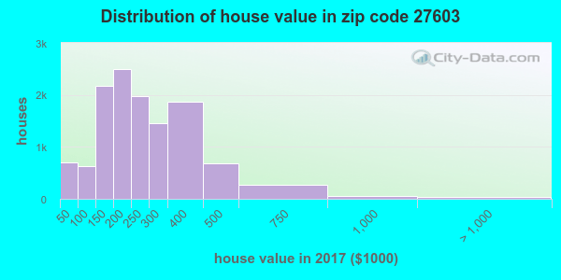
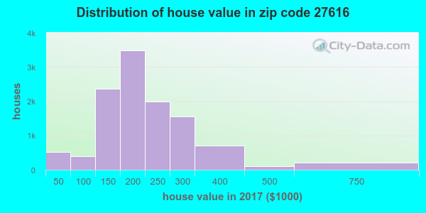
Comparison Result
In conclusion, zip 27603 verses 27616 has a larger land area with a little larger population. It has a bigger chance for physical potential growth. With historical data, it is easy to tell 27603 has bigger yearly population growth rate with decent, less than US average Cost of living. It is a relatively young population condensed area with only 32.5 years as median resident age in 2017. However, the unemployment rate is 4.6% which is still good in 2016. The property tax rate in 27603 is only 0.7% which is way lower than US average. The yearly median household/condo value increase is decent at 3.9% from 2016 to 2017 which is above US inflation rate. The yearly Median gross rent increase is parallel to the rate of the median house value increase at 4.0% from 2016 to 2017. The median price asked for vacant for-sale houses/condos increased at 6.3% from 2016 to 2017. And the median household/condo in 2017 is $218,274 which is still within our comfort purchasing zone which is below $300,00. From above charts, we can easily tell that more than 6,000 houses are within our target price range of $150,000 ~ $300,000. And obviously the median price asked for vacant for-sale houses and condos in zip code 27616 is dropping by 11.4% from 2016 to 2017 which indicate it is a comparatively more volatile market. And also the median household income in zip 27603 is increased by 6.9% from 2016 to 2017 which indicates there is more growth momentum in this area. Both zip codes have the same renter percent of 38% which meet our investment goal. Obviously from the demographic data, zip 27603 has a smaller black community. And the education level of population in both zip codes are comparable and decent. In all, based on our detail data analysis that zip 27603 is the best target area in Raleigh to achieve our investment goal.

Slide 9
Durham (27713)
Zip Code | 27713
land area (sq mile) | 32.6
Population (2000) | 30,903
Population (2010) | 46,660
Population (2016)
Population (2017) | 53,485 ( 15% vs. 2010, 73% vs. 2000)
Population density (/SQMile) (2017) | 1,642
Cost of living (2016) | 93.4
Median resident age (2017) | 34.9
Real estate property taxes (2016) | 1.2%
Estimate Median household/condo value (2017) | $249,087

Slide 10
Durham (27713) continued
Zip Code | 27713
Total housing units | 12,470
Estimate Median household income (2017) | $77,244
Renter % (2017) | 45%
Median gross rent (2017) | $1,058
Median price asked for vacant for-sale houses and condos (2017) | $162,567
Unemployment % (2016) | 3.2
Demographic (W/H/B/A) % | 68.7/12.6/54.1/11.2

Slide 11
Raleigh 27603 vs Durham 27713
Zip Code | 27603 | 27713
land area (sq mile) | 51.6 | 32.6
Population (2017) | 54,481(16% vs. 2010, 73% vs. 2000) | 53,485 (15% vs. 2010, 73% vs. 2000)
Population density (/SQM) | 1,056 | 1,642
Cost of living (Mar. 2016/Mar. 2019) | 95.1/94.6 | 93.4
Median resident age (2017) | 32.5 | 34.9
Real estate property taxes (2016) | 0.7% | 1.2%
Estimate Median household/condo value (2017) | $218,274 | $249,087
Renter % (2017) | 38% | 45%
Total housing units | 12,336 | 12,470
Estimate Median household income | $63,760 | $77,244
Median gross rent (2017) | $1,024 | $1,058
Demographic (W/H/B/A) % | 96.5/19.9/26.7/2.9 | 68.7/12.6/54.1/11.2

Slide 12
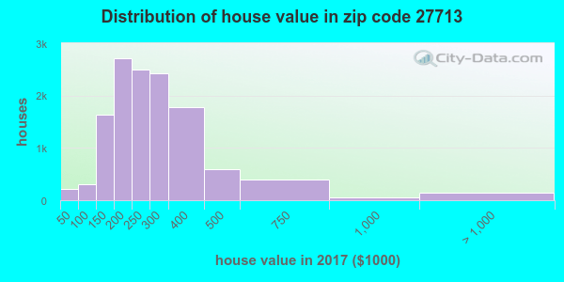
Raleigh 27603 vs Durham 27713
Both areas are quite similar in terms of population, median age, median gross rent, cost of living etc.
27603 has lower population density, lower property tax, and lower median house price
27713 has higher renter percentage, and higher median household income
In general, both areas have similar value proposition for residential property investment. However, the house price in 27713 has gone up a lot, and we think 27603 will follow similar pathway and offer more room in growth
In conclusion, our target investment areas will place 27603 before 27713

Slide 13
Project 2：Atlanta,GA:
Cartersville vs. Lawrenceville
Project Coordinator: Dewayne-MS （负责汇总与整理）
完成Cartersville,Lawrenceville两个城市的比较表格（Pro & Con)
内容A。分析员：Mona， Dewayne-MS，等
内容B。分析员：Xiao Yun，等
内容C。分析员：红-IN，等

Slide 14
选择大区的主要理由
The State | Next 20 Years, Young, Projected Median Age
The State | Next 20 Years, From 9th to 5th Large State
The State | Republic
Atlanta | Primary Transportation Hub of Southeast
Atlanta | 13th Best Places for Business and Careers in 2019
Atlanta | Contains Several Would Headquarters
Target Area | In the North, Best Living sub-cites near Atlanta

Slide 15
Cartersville vs. Lawrenceville 城市比较
Items | Cartersville | Pro | Lawrenceville | Resources
2020 Population | 22,151 | → | 30,249 | worldpopulationreview.com
Population Prediction (next 40 years) | 0-50% | → | 100%+ | Proximityone,com
Crime Rate | Above average | → | Average | Nighborhoodscout.com
Building Permit (MFB) From 2012 | Started last 3 year | → | 35.1%+ | socds.huduser.gov
Average Weekly wages | $850, < US | → | $1000+, ≈US | bls.gov/data/
Rent /house Value Ratio (Past 6 Years) | 0.48% | → | 0.60-0.90% | Zillow (US:0.81%)
Population Change (Last 10 years) | 12.1%+ | ← | 10.7%+ | worldpopulationreview.com
White/Black Population Ratio | 59.70%/22.40% | ← | 25.70%/33.70% | CityData.com
Building Permit (SFH) From 2012 | 28.45%+ | ← | 3.09%+ | socds.huduser.gov
Median RE Property Tax | $1,140 ( 0.81%) | ← | $2,258 (1.22%) | smartasset.com
Median House Value | $140,500 | ← | $185,200 | smartasset.com
County Population Density | 229/Sq Mile | NA | 2127/Sq Mile | CityData.com

Slide 16
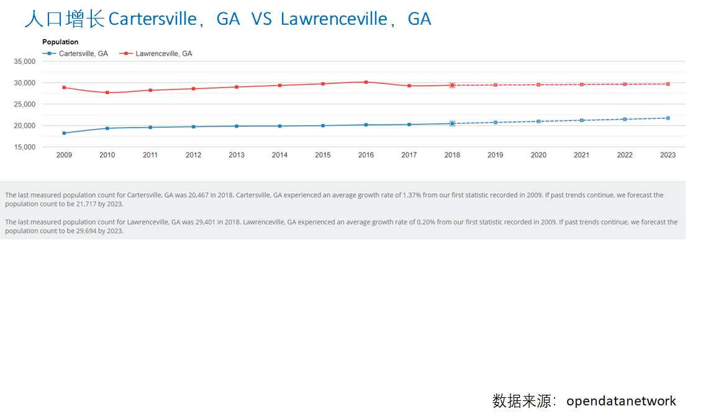
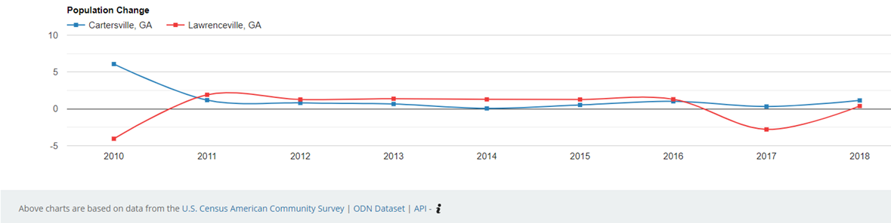

Slide 17
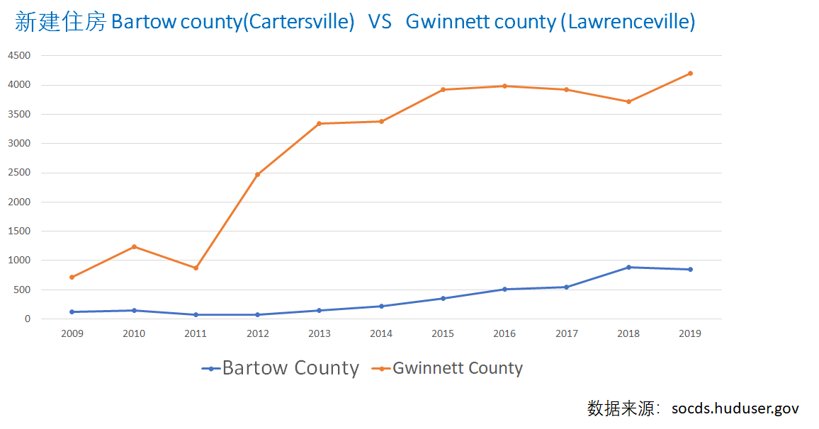

Slide 18
个人投资目标
本金：5-40万美金 ，用于购置0 – 25 - 200万房产
贷款额度：当地小银行以LLC 名义贷款70-80%+Rehab Fund。
投资前准备：需要3到6个月
收集数据。历史数据、当前数据、预测数据。得到综合投资预测与风险评估报告。
市场评估与投资理财咨询。CFP/投资策划。投资房产与投资金融产品相结合。
和专业人士打交道。Search and Research，建立广义投资团队。
购房策略：纪律投资=财富积累。中程、规模投资。
大区（红州）-> 城市 -> Zip Code。中等(及偏下)收入群体，适当考虑学生与流动人口。
优先顺序与决策。小型多单元、 多单元、SFH。进入时机、决策效率。
流程。Realtors (10->3) – Lenders(5->2) – Offer – PM/Contractors(5->2) - Closing
团队建立与运作：管理团队、市场团队。不是老师、学生，是决策人、伙伴。
投资获利预期：稳定中速增长、退出容易。
低风险比高汇报重要。购房 = 购风险。6层保险。
有增值潜力。房价升值套利退出。租售比：0.8-1.0% -- > 1.0-1.2%(三年内达到)
租金洼地。短期内有正现金流或接近0现金流，租金增长超过inflation。

Slide 19
Cartersville 30101 vs Lawrenceville 30043
ZIP CODE | 30043 | 30101
人口 | 89,889, 高中或以上:90.7％ | 59,189，高中或以上:94.4％
人口密度 | 每平方英里 2764 人 | 每平方英里 1,467 人
2019年生活指数 | 96.2 | 96.1
房产税 | 0.012 | 0.009
种族 | 65.2％白色，24.7％黑色，14.8％亚州 | 101.6%白色，20.2％黑色，3.76％亚州
房价 | $207,367 | $237,71
犯罪率 | 低于州平均 | 低
年龄 | 36.6岁 | 38岁
收入 | $76,114 | $87,423
购物中心 | 5个 | 2个
学校 | 初中9，高中7，小学8 | 初中8，高中6，小学8

Slide 20
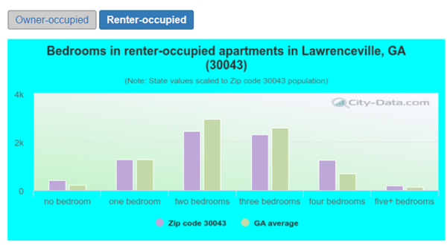
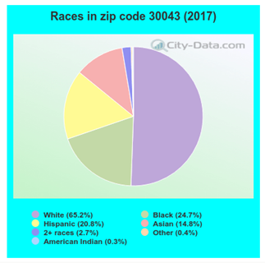
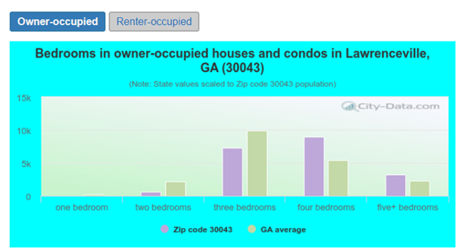

Slide 21
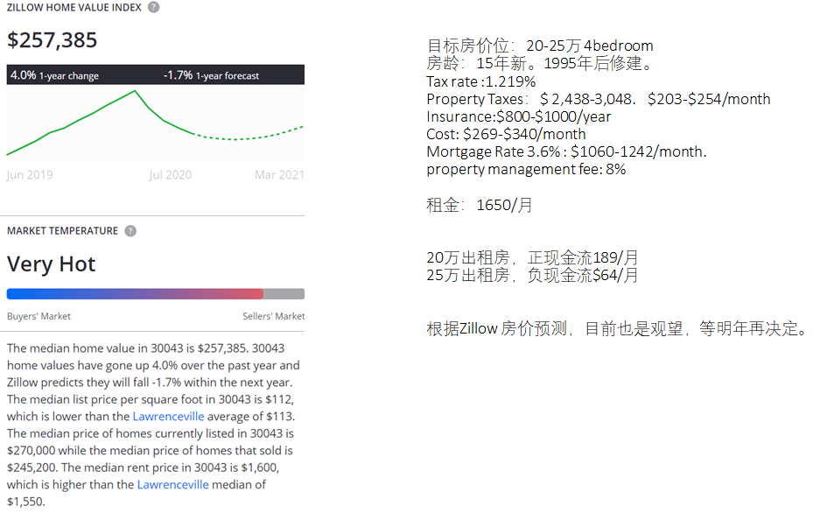

Slide 22
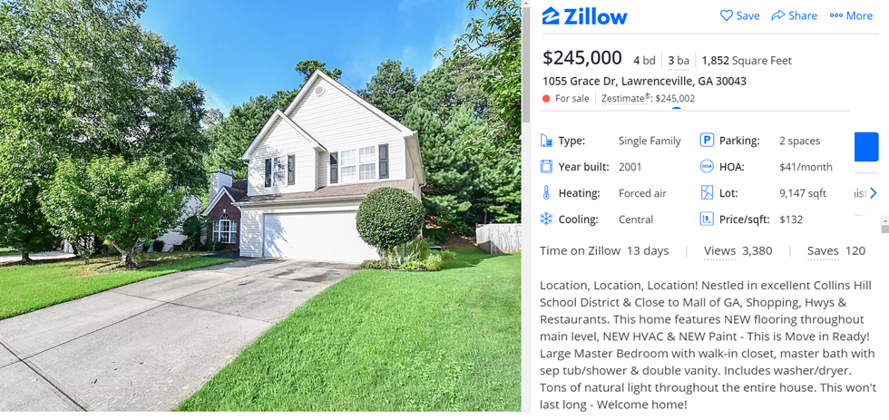
选择的房屋：

Slide 23
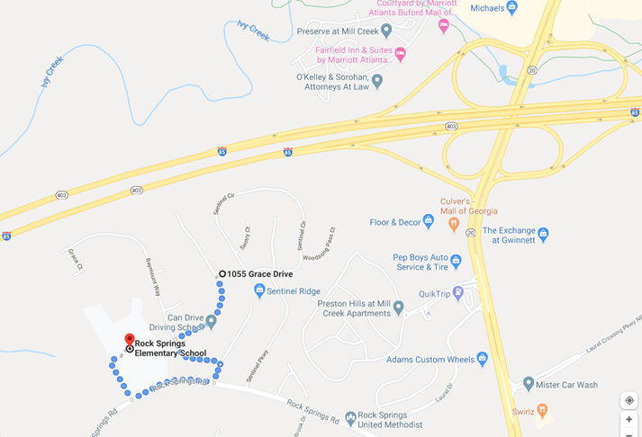
理由：交通便利，高速旁，Mall附近。走路13分钟到小学。

Slide 24
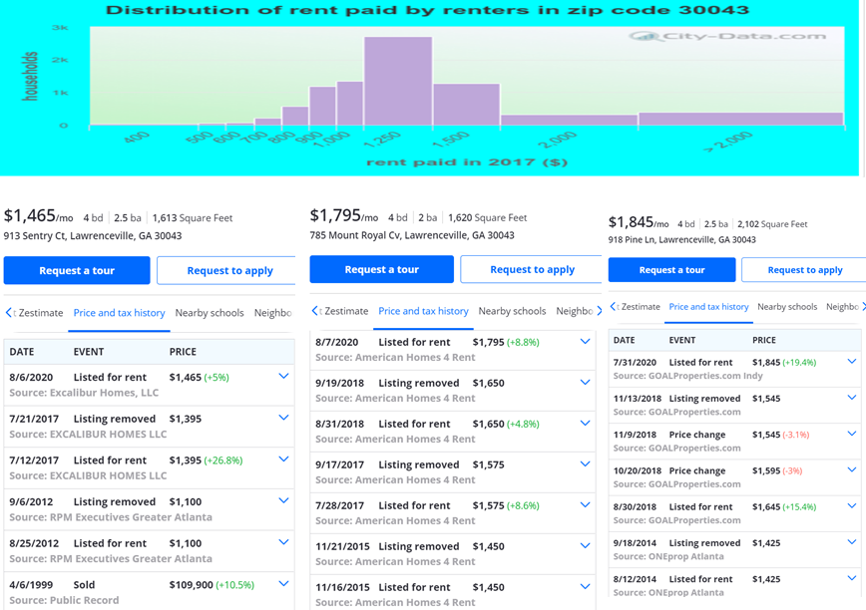
租金定价及参考：1650/月

