Slide 1
Maryland Chapter 7 bankruptcy information
In a Chapter 7 bankruptcy you wipe out your debts and get a “Fresh Start”. Chapter 7 bankruptcy is a liquidation where the trustee collects all of your assets and sells any assets which are not exempt. (see Maryland Exemptions) The trustee sells the assets and pays you, the debtor, any amount exempted. The net proceeds of the liquidation are then distributed to your creditors with a commission taken by the trustee overseeing the distribution.
Certain debts cannot be discharged in a Chapter 7 bankruptcy, such as alimony, child support, fraudulent debts, certain taxes, student loans, and certain items charged. (see Maryland Non-Dischargeable Debts) In most Chapter 7 cases, the debtor has large credit card debt and other unsecured bills and very few assets. In the vast majority of cases a Chapter 7 bankruptcy is able to completely eliminate all of these debts.
You may keep certain secured debts such as your car or your furniture or house by reaffirming those debts. To do so, you must sign a voluntary “Reaffirmation Agreement”. If you decide that you want to keep your house or your car or your furniture, and you reaffirm the debt, you cannot bankrupt (or wipe-out) that debt again for eight years. You will still owe that debt and you must continue to pay it just as you were obligated to continue to pay it before you filed bankruptcy. In order to reaffirm the debt, you must also bring it current. In other words, if you are three or four months behind, then you must pay the back payments which are due in order to reaffirm it. You can selectively reaffirm your debts – you can state that you wish to keep the house and the furniture, but that you want the car and the jewelry to go back to the respective Creditors.
Reaffirmation agreements can be set aside during the earlier of 60 days after the agreement is filed with the Court, or upon the Court’s issuance of an Order of Discharge.
http://www.marylandbankruptcy.com/chapter7.html

Slide 2
Maryland Chapter 13 Bankruptcy Information
Under a chapter 13 bankruptcy, a debtor proposes a 3-5 year repayment plan to the creditors offering to pay off all or part of the debts from the debtor’s future income. You can use Chapter 13 to prevent a house foreclosure; make up missed car or mortgage payments; pay back taxes; stop interest from accruing on your tax debt (local, Maryland state, or federal); keep valuable non-exempt property (see Maryland exemptions); and more. If you can stick to the terms of your repayment agreement, all your remaining dischargeable debt will be released at the end of the plan (typically three to five years). The amount to be repaid is determined by several factors including the debtor’s disposable income as is usually determined as part of the Maryland Means Test. In addition, the total amount paid to creditors under the Chapter 13 plan must also be at least as much as creditors would have received if the debtor filed a Chapter 7 bankruptcy. To file Chapter 13 bankruptcy you must have a “regular source of income” and have some disposable income to apply towards your Chapter 13 payment plan.
Chapter 13 bankruptcy is generally used by debtors who want to keep secured assets, such as a home or car, when they have more equity in the secured assets than they can protect with their Maryland bankruptcy exemptions. Chapter 13 bankruptcy is a reorganization whereas Chapter 7 bankruptcy is a liquidation.
A chapter 13 bankruptcy allows them to make up their overdue payments over time and to reinstate the original agreement. Where a debtor has valuable nonexempt property and wants to keep it, a chapter 13 may be a better option. However, for the vast majority of individuals who simply want to eliminate their heavy debt burden without paying any of it back, Chapter 7 provides the most attractive choice.
http://www.marylandbankruptcy.com/chapter13.html

Slide 3
New York Chapter 13 Bankruptcy Information
Under a chapter 13 bankruptcy, a debtor proposes a 3-5 year repayment plan to the creditors offering to pay off all or part of the debts from the debtor’s future income. You can use Chapter 13 to prevent a house foreclosure; make up missed car or mortgage payments; pay back taxes; stop interest from accruing on your tax debt (local, New York state, or federal); keep valuable non-exempt property (see New York exemptions); and more. If you can stick to the terms of your repayment agreement, all your remaining dischargeable debt will be released at the end of the plan (typically three to five years). The amount to be repaid is determined by several factors including the debtor’s disposable income as is usually determined as part of the New York Means Test. In addition, the total amount paid to creditors under the Chapter 13 plan must also be at least as much as creditors would have received if the debtor filed a Chapter 7 bankruptcy. To file Chapter 13 bankruptcy you must have a “regular source of income” and have some disposable income to apply towards your Chapter 13 payment plan.
Chapter 13 bankruptcy is generally used by debtors who want to keep secured assets, such as a home or car, when they have more equity in the secured assets than they can protect with their New York bankruptcy exemptions. Chapter 13 bankruptcy is a reorganization whereas Chapter 7 bankruptcy is a liquidation.
A chapter 13 bankruptcy allows them to make up their overdue payments over time and to reinstate the original agreement. Where a debtor has valuable nonexempt property and wants to keep it, a chapter 13 may be a better option. However, for the vast majority of individuals who simply want to eliminate their heavy debt burden without paying any of it back, Chapter 7 provides the most attractive choice
http://www.newyorkbankruptcylaw.com/chapter12.html

Slide 4
New York Chapter 7 bankruptcy information
In a Chapter 7 bankruptcy you wipe out your debts and get a “Fresh Start”. Chapter 7 bankruptcy is a liquidation where the trustee collects all of your assets and sells any assets which are not exempt. (see New York Exemptions) The trustee sells the assets and pays you, the debtor, any amount exempted. The net proceeds of the liquidation are then distributed to your creditors with a commission taken by the trustee overseeing the distribution.
Certain debts cannot be discharged in a Chapter 7 bankruptcy, such as alimony, child support, fraudulent debts, certain taxes, student loans, and certain items charged. (see New York Non-Dischargeable Debts) In most Chapter 7 cases, the debtor has large credit card debt and other unsecured bills and very few assets. In the vast majority of cases a Chapter 7 bankruptcy is able to completely eliminate all of these debts.
You may keep certain secured debts such as your car or your furniture or house by reaffirming those debts. To do so, you must sign a voluntary “Reaffirmation Agreement”. If you decide that you want to keep your house or your car or your furniture, and you reaffirm the debt, you cannot bankrupt (or wipe-out) that debt again for eight years. You will still owe that debt and you must continue to pay it just as you were obligated to continue to pay it before you filed bankruptcy. In order to reaffirm the debt, you must also bring it current. In other words, if you are three or four months behind, then you must pay the back payments which are due in order to reaffirm it. You can selectively reaffirm your debts – you can state that you wish to keep the house and the furniture, but that you want the car and the jewelry to go back to the respective Creditors.
Reaffirmation agreements can be set aside during the earlier of 60 days after the agreement is filed with the Court, or upon the Court’s issuance of an Order of Discharge.
http://www.newyorkbankruptcylaw.com/chapter7.html

Slide 5
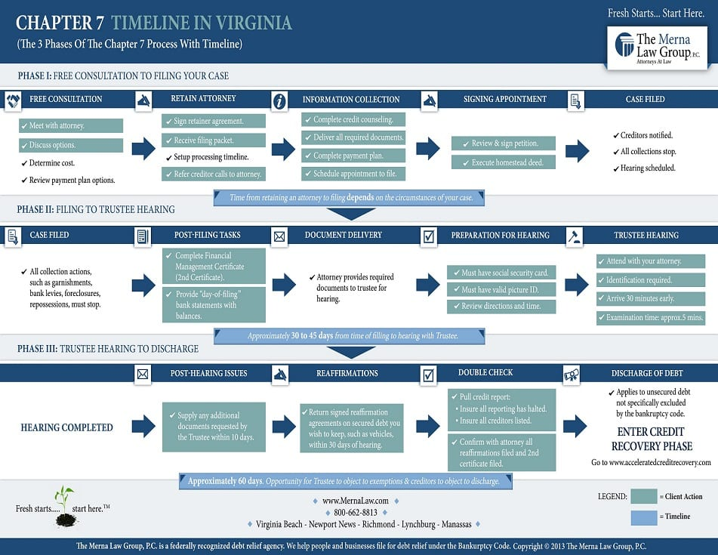

Slide 6
