Slide 1



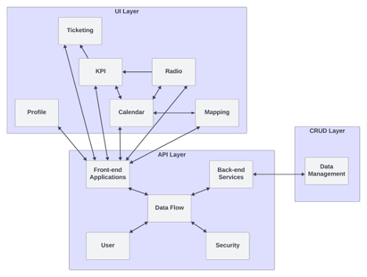
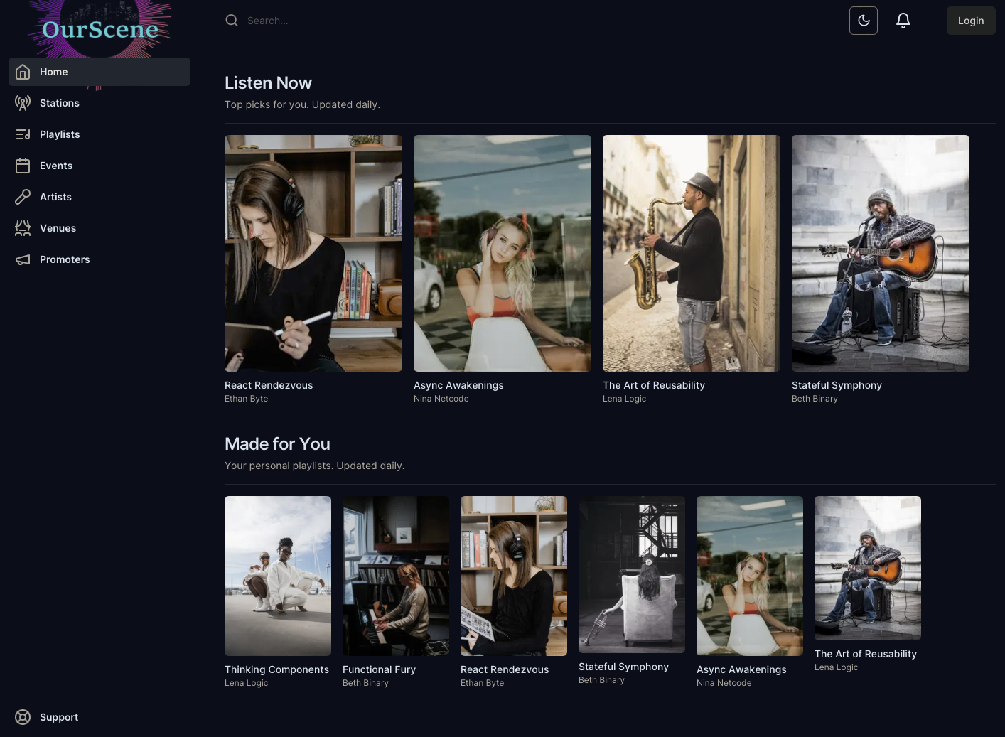
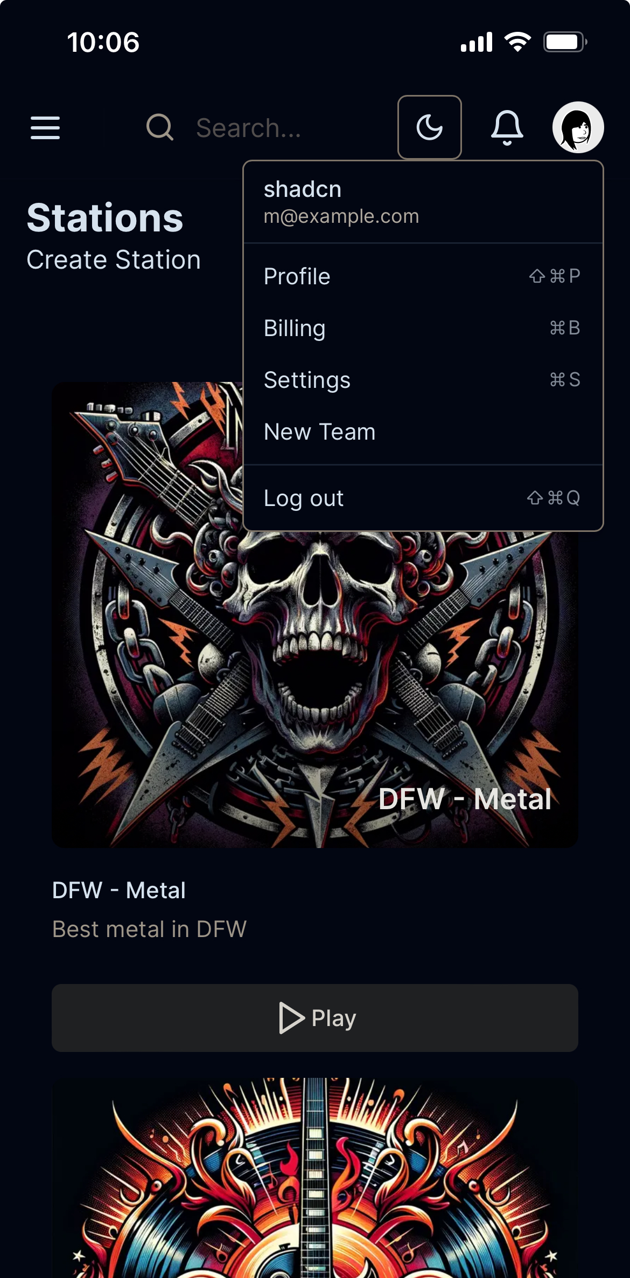
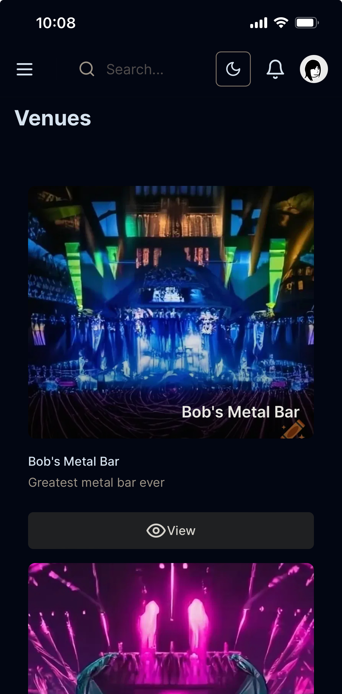
OurScene
QR Code To Website or Paper Goes Here
Senior Design
Harrison Cawood, Bryan Cox, Shawn Hyder, Vincent Nguyen, Daniel Palma, Sanny Tesfay
Background
Architectural Design
The local music scene faces a major problem, there is a glaring absence of a digital interface to bridge its various players and components. With numerous challenges flooding the current landscape: local bands struggle with visibility and engagement of their already built audiences as well as finding new fans, while venues and promoters alike find it a strain to discern the potential draw of bands . As a result, fans of music often miss out on shows they may otherwise have attended and enjoyed.
“OurScene” is a comprehensive app solution. Having collaborated closely with promoters, bands, venues and made by fans of music the app will offer bands direct engagement with their audience as well as allows for discoverability with tailored playlists and a continuous radio stations playing their top tracks. Fans of local music will benefit from the interactive map display of local shows, if bands featured in these shows are registered with “OurScene”, users can access a playlist tailored for the event, enhancing their pre-show experience. While promoters and venues will be able to more easily discern talent to be booked for their events
The architecture for OurScene consists of three main layers: The UI, API, and CRUD. The user interface layer handles all processes of a user in regards to their personal page and activities done within the site. The API Layer is connected by one-to-many through the front end services process, allowing all user interaction to flow through the APIs for handling. All processes in the API layer are managed through the data flow to ease data overhead. The final layer is the CRUD layer (Create, Read, Update, Delete), which handles all database management through a one-to-one relationship with the back end services. All queries are handled by this layer and filtered throughout the previous two layers until it reaches its necessary location.
Implementation Details
Stack
Client / Server
Tailwind CSS
Tailwind UI
shadcn/ui
Zod
Lucide Icons
Backend
AWS Amplify
Amazon Cognito
AWS AppSync
Amazon Dynamo DB
Amazon S3
Key Requirements
Login/Account Creation: OurScene users will need to be able to create and log into accounts with unique identifiers that give access to areas of the application based on their identifier.
Security: To protect user data and to make future parts of the application possible, security is of the utmost importance for the initial release of OurScene.
Dashboard: Dashboard with summary of events and posts users are participating in or put out for their followers/scene
Events/Calendar: Events and calendar integration for integration with users' devices
Unique Account Features: Based on the users account type they will need to be able to access different versions of key features such as Artist vs. Venue events. This is to prevent multiple account creation and will need to be presented in a clean way.
Messaging: Basic communication between users is essential for the growth of any scene.
Desktop homepage
Mobile stations with user menu
Mobile venue
Conclusions and Future Work
References
Conclusions: OurScene offers a space for all artists, venues, and fans to grow their local scene. By combining the essential elements of music management, all users can efficiently manage and participate in their scene all in one app. Fostering an environment for creatives to thrive.
Future Work: Should development continue, features necessary for participating in your scene, i.e. ticketing, will be the next feature to be completed with basic analytics to follow.
April 2024

