Slide 1
union
different types “timesharing” a memory location.
union
  Share Memory
  union FIGURE
{
……...
};
  enum FIGURE_TYPE {LINE, RECTANGLE, ELLIPSE};
  struct Line struct Rectangle
  { FIGURE_TYPE t ; { FIGURE_TYPE t;
  int x1, y1, x2, y2; int lef, top, rig, bot;
  }; }；
  struct Ellipse
  { FIGURE_TYPE t;
  int x, y, r;
  }；
  union FIGURE
{ FIGURE_TYPE t;
Line line;
Rectangle rect;
Ellipse ellipse;
};
union B
{
char b; // 1
int a; //4
short c; //2
};
cout << sizeof(B);
union Matrix
{
struct
{ double _a11, _a12, _a13;
double _a21, _a22, _a23;
double _a31, _a32, _a33;
};
};
double _element[3][3];
Sample ： Matrix

Slide 2
“In C++, a user-defined type is intended to be a first-class citizen;
it should be supported as well as and as efficiently as a built-in type,
and it should be usable in the same ways.”
Variant
Q1：类型不安全
Q2：无法知道当前存储的类型
non-trivial
Q3：类型局限性
struct Variant {
public:
Variant() : m_index(-1) {}
private:
int m_index;
};
//
RTTI（ Run-Time Type Information）
std::bad_any_cast
std::any a;
a = 66;
std::cout << std::any_cast<std::string>(a) ;
union variant_t
{
int i;
double d;
char c;
};
int main(){
variant_t v;
v.i = 66;
std::cout << v.d << std::endl;
}
class Circle : public Shape { /*...*/ };
class Rectangle : public Shape { /*...*/ };
X
Variant v;
Shape* shape = new Rectangle;
heap
virtual func
Q4：any是运行时检查 too late
UB
Q5：继承和多态的局限性

Slide 3
#include <variant>
Variant
std::variant<int, double, std::string> v;
v = 42;
v = 3.14;
v = "hello";
try {
std::cout << std::get<std::string>(v) << std::endl;
} catch (const std::bad_variant_access& e) {
std::cout << "Wrong type access: " << e.what() << std::endl;
}
X
compile
std::cout << std::get<float>(v) << std::endl;
X
runtime
std::cout << std::get<int>(v) << std::endl;
Method1:
std::cout << "Current index: " << v.index() << std::endl;
避免exception
Method2:
if (std::holds_alternative<int>(v))
std::cout << "Holds an int: " << std::get<int>(v) << std::endl;
else if (std::holds_alternative<double>(v))
std::cout << "Holds a double" << std::endl;

Slide 4
Case Study
场景
  开发者正在维护一个矢量图形库（Graphics Library），其中包含稳定的基础图形类（如 Circle, Rectangle）。这些类目前主要负责几何计算（如 area()）
新增需求
  现在的业务方提出新要求：需要将画布上的所有图形导出为 XML 格式，以便保存或传输
设计挑战与约束
  单一职责原则 (SRP)：Shape 类应该只关注几何属性（半径、长宽），不应该包含复杂的 IO 或格式化逻辑（如 XML 生成代码）。
  开闭原则 (OCP)：我们预见到未来还会有导出 JSON、PDF 或进行压缩的需求，我们不希望每次增加新操作都去修改稳定的 Shape 基类

Slide 5
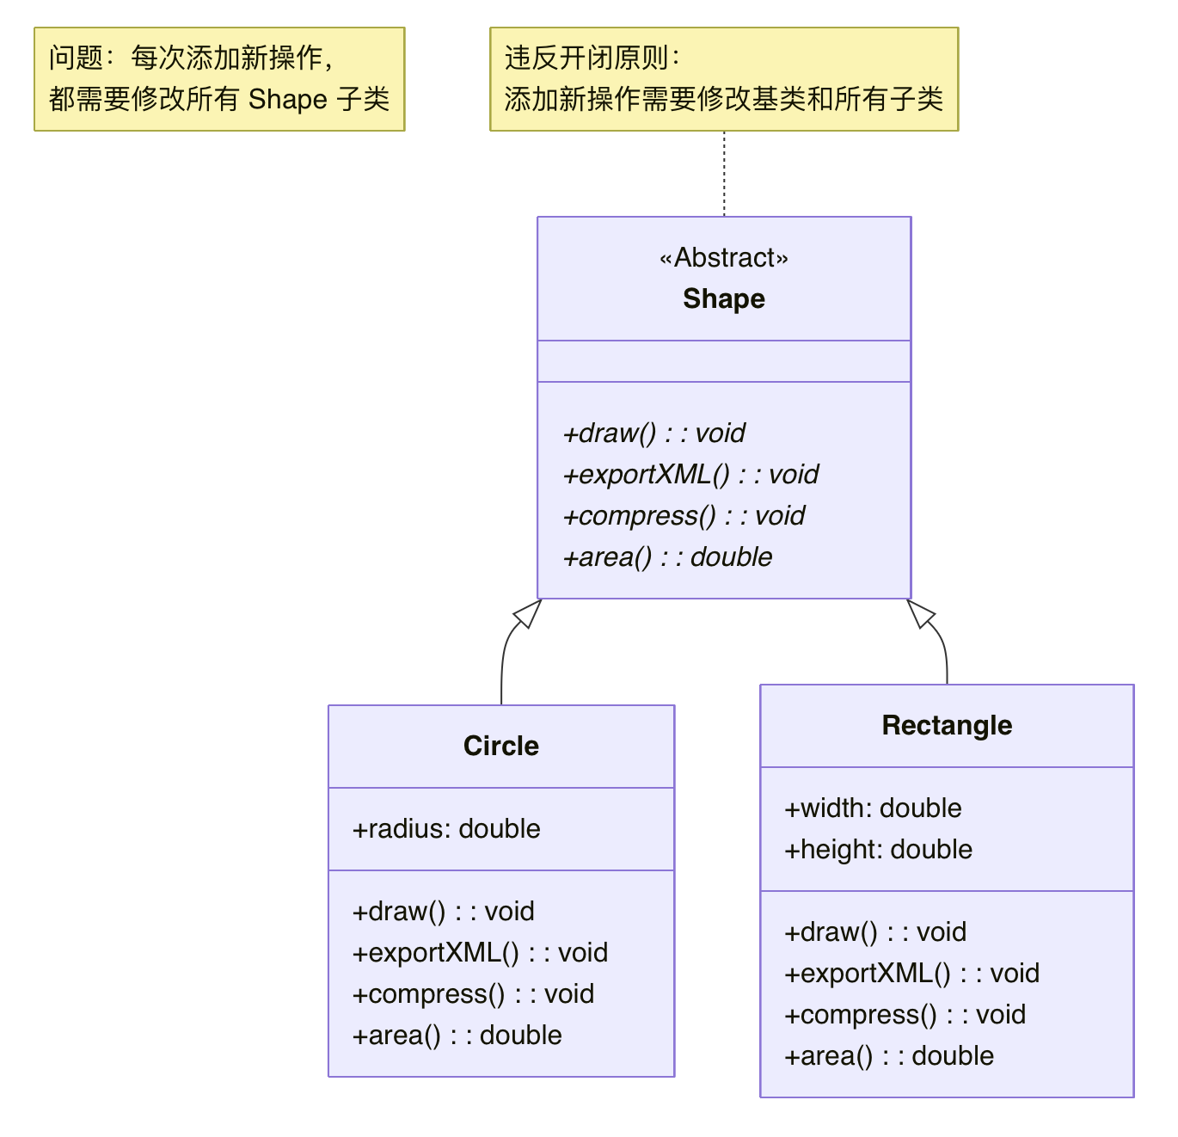
传统的实现
  每个操作都作为虚函数直接添加到 Shape 类中
virtual void exportXML() = 0;
virtual void compress() = 0;
// 新需求：需要修改基类
void exportXML() override {
std::cout << "Exporting XML\n";
}// 必须实现
voidcompress() override {
std::cout << "Compressing Circle\n";
}// 必须实现

Slide 6
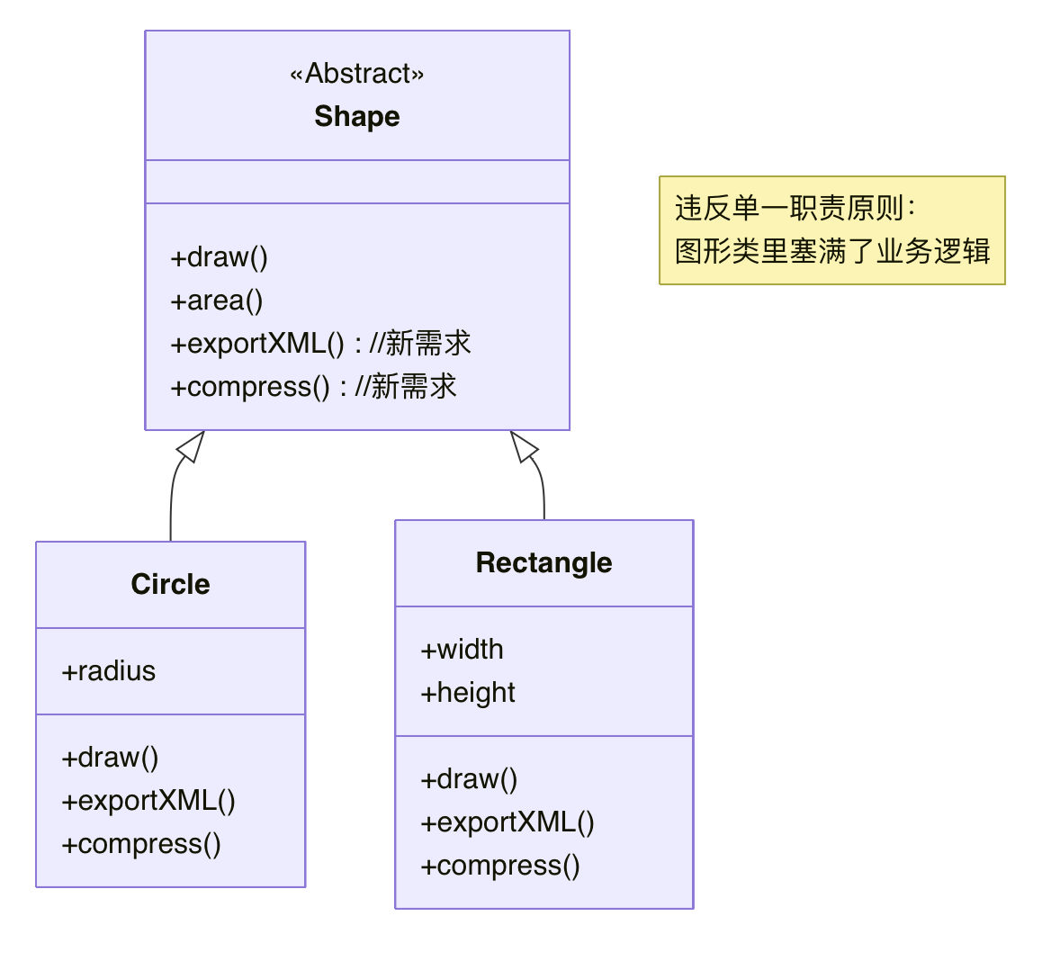
引入Visitor模式
Design Pattern
"Design Patterns: Elements of Reusable Object-Oriented Software“
Erich Gamma, Richard Helm, Ralph Johnson, John Vlissides
随着功能增加，类也随之变得臃肿
  每次加功能，都需要修改 Shape、Circle、Rectangle 三个文件，重新编译整个项目！

Slide 7
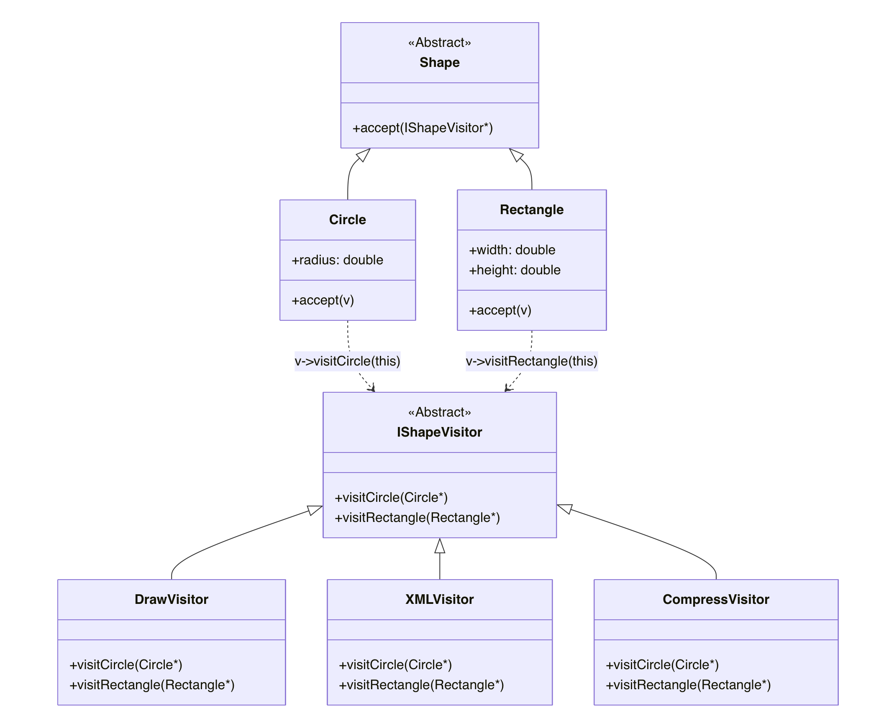
使用 Visitor 模式
优势：添加新操作只需添加新的 Visitor 类，
无需修改 Shape 类
符合开闭原则：
Shape 类结构稳定，
新操作通过 Visitor 扩展
Double Dispatch

Slide 8
代码实现
使用方式
int main() {
std::vector<Shape *> shapes = {
new Circle{5.0},
new Rectangle{10, 20}
};
XMLVisitor xmlExporter;
for (auto s : shapes) {
  s->accept(&xmlExporter); // 通过 Visitor 执行操作
}
...
return 0;
}

Slide 9
代码实现
Shape具体实现与Visitor具体实现
class Circle : public Shape { // Circle 实现
public:
  double radius;
  void accept(IShapeVisitor*v) override {
    v->visitCircle(this); // 双重分发
  }
  double area() override {...}
  };
将this传给visitor
class XMLVisitor : publicIShapeVisitor { // XML 导出 Visitor实现
public:
  void visitCircle(Circle *c) override {
  std::cout << "Exporting Circle (r=" << c->radius << ") to XML\n";
}
  void visitRectangle(Rectangle *r) override {...}
};

Slide 10
代码实现
Visitor 接口与Shape 基类
// 前置声明
class Circle;
class Rectangle;
class IShapeVisitor { // Visitor 接口
public:
virtual ~IShapeVisitor() = default;
virtual void visitCircle(Circle *c) = 0;
virtual void visitRectangle(Rectangle *r) = 0;
};
由于循环依赖，这里需要前置声明
对于所有的具体类，都实现visit方法
class Shape { // Shape 基类（只负责结构，不负责操作）
public:
virtual ~Shape() = default;
virtual void accept(IShapeVisitor *v) = 0;
virtual double area() = 0;
};

Slide 11
Visitor 模式
访问者模式 (Visitor Pattern) 是一种行为型设计模式，它允许你在不改变对象结构的前提下，定义作用于这些对象的新操作
  核心思想：
    将数据结构与数据操作分离
    通过"双重分发" (Double Dispatch) 机制实现多态
    遵循"开闭原则"：对扩展开放，对修改关闭
  双重分发：
    单分发（普通多态）：
    双重分发（Visitor 模式）：
Shape * s = new Circle();
s->draw(); // 只根据 s 的类型决定调用哪个 draw
Shape * s = new Circle();
Visitor * v = new DrawVisitor();
s->accept(v); // 第一次分发：根据 s 的类型
// 第二次分发：根据 v 的类型

Slide 12
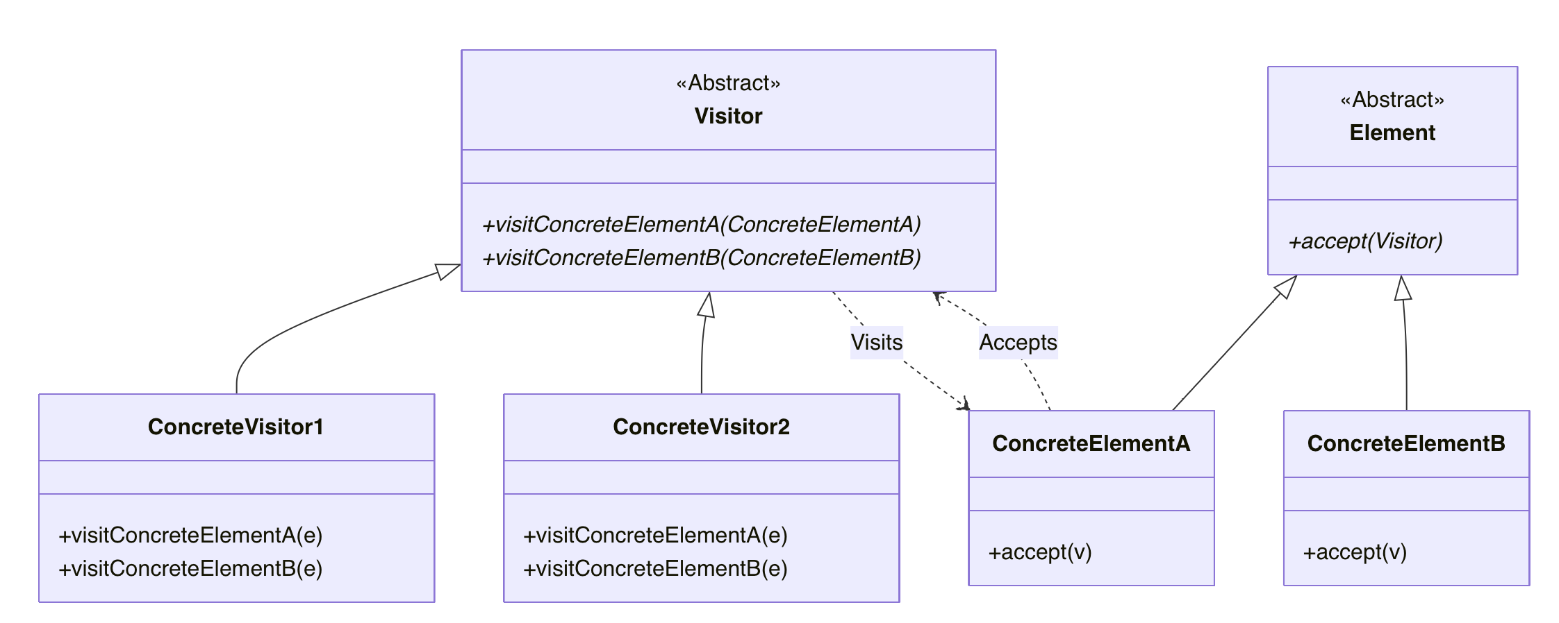
Visitor模式的标准结构
概念层类图
Visitor 需要知道每个具体Element的信息来创建visit函数
Element 需要知道Visitor来调用visit函数，将自己传给Visitor
Circular Dependency

Slide 13
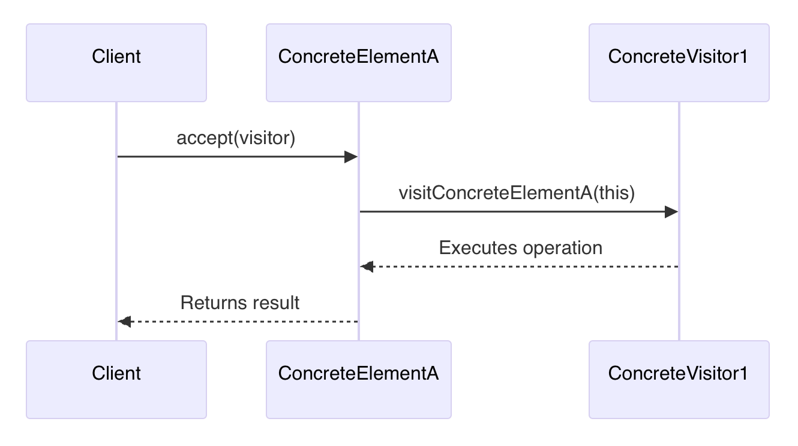
Double Dispatch 流程
第一次分发： Element 调用 accept(Visitor)
第二次分发：Visitor 调用 visit(ConcreteElement)

Slide 14
Visitor Pattern
对比项 | 传统虚函数方式 | Visitor 模式
添加新操作 | 需修改基类和所有子类 | 只需添加新的 Visitor 类
添加新类型 | 只需添加新子类 | 需修改所有 Visitor 类
代码耦合 | 操作与结构耦合 | 操作与结构解耦
编译影响 | 修改基类影响大 | 新操作不影响现有代码
适用场景 | 操作类型稳定 | 操作类型频繁变化
❌ 破坏封装：要求元素公开内部状态
❌ 增加新元素类困难
❌ 对象结构变化会影响所有访问者

Slide 15
std::variant
类型安全的联合体 std::variant
  借助std::variant，可以灵活组合不同的类
优势
  不需要基类 Shape
  不需要虚函数
  类型安全（编译期检查）
using Shape = std::variant<Circle, Rectangle>;

Slide 16
访问方式——std::visit
核心功能
  std::visit是C++ 标准库提供的函数模板，用于将一个访问器（Visitor）应用到 std::variant 内部存储的具体数据上。
工作原理
  自动识别：检查 variant 当前存的是哪个类型。
  自动匹配：去 Visitor 里找对应的重载函数如：operator() (Circle) 或 operator() (Rectangle)。
  编译期安全：如果少写了某种类型的处理逻辑，编译器会直接报错。

Slide 17
代码实现
核心调用
int main() {
std::vector<Shape> shapes = {
Circle{5.0},
Rectangle{10, 20}
};
// 使用 std::visit
DrawVisitor draw;
XMLVisitor xml;
for (constauto& s : shapes) {
  std::visit(draw, s);
  std::visit(xml, s);
}
return 0;
}

Slide 18
代码实现
定义数据
定义访问者 (Visitor)
// 纯数据类 (无需继承，无需 accept)
struct Circle { double radius; };
struct Rectangle { double w, h; };
// 定义类型集合
using Shape = std::variant<Circle, Rectangle>;
// 定义访问者 (使用 struct 重载 () 操作符)
struct DrawVisitor {
void operator()(const Circle &c) {
std::cout << "Drawing Circle r=" << c.radius << "\n"; }
void operator()(const Rectangle&r) { ... }
};

Slide 19

using MyVariant = std::variant<int, double, std::string>;
int main() {
MyVariant v1 = 42;
MyVariant v2 = 3.14;
MyVariant v3 = "hello";
return 0;
}
std::visit
std::visit(Visitor visitor, Variant v);
Visitor visitor;
std::visit(visitor, v1);
std::visit(visitor, v2);
std::visit(visitor, v3);
Visitor： 函数、Lambda 、重载了 operator() 的类
void handleVariant(const MyVariant& v) {
std::visit([](const auto& arg) {
using T = std::decay_t<decltype(arg)>;
if constexpr (std::is_same_v<T, int>) {
std::cout << "Got an int: " << arg << '\n';
} else if constexpr (std::is_same_v<T, double>) {
std::cout << "Got a double: " << arg << '\n';
} else if constexpr (std::is_same_v<T, std::string>) {
std::cout << "Got a string: " << arg << '\n';
}
}, v);
}
//visitor->visit(this);
handleVariant(v1);
handleVariant(v2);
handleVariant(v3);
struct Visitor {
void operator()(int i) const {
std::cout << "Got int: " << i << std::endl;
}
void operator()(double d) const {
std::cout << "Got double: " << d << std::endl;
}
void operator()(const std::string& s) const {
std::cout << "Got string: " << s << std::endl;
}
};

Slide 20
any
Python
a = 1
a += 1
print(a)
a = 1.5
print(a)
a = "hello"
print(a)
any a;
a = any_cast<int>(a) + 1;
cout << any_cast<int>(a) << endl;
a = 1.5;
cout << any_cast<double>(a) << endl;
a = string("hello");
cout << any_cast<string>(a) << endl;

Slide 21
std::any cont’
C++17
  类型安全（type-safe）
    可以安全封装任意类型的单个值
    通过 std::any_cast 进行类型安全的取值
  运行时多态
    值的类型在运行时确定，而不是编译期固定
  语义与限制
    支持空值状态（默认构造时为空）
    值必须可拷贝构造
    支持拷贝、移动拷贝、移动赋值

Slide 22
C++ vs. Python
obj = 1
print(obj)
obj = 3.14
print(obj)
obj = "hello"
print(obj)
int main(){
any obj;
obj = 1;
print_any(obj);
obj = 3.14;
print_any(obj);
obj = string("hello");
print_any(obj);
}
1
3.14
hello
1
3.14
hello
void print_any (const any &a){
if (a.type() == typeid(int)) {
std::cout <<std::any_cast<int>(a) <<std::endl;
} elseif (a.type() == typeid(double)) {
std::cout <<std::any_cast<double>(a) <<std::endl;
} elseif (a.type() == typeid(std::string)) {
std::cout <<std::any_cast<std::string>(a) <<std::endl;
} else {
std::cout<<“Unkonw"<<std::endl;
}}
const type_info& t = a.type();

Slide 23
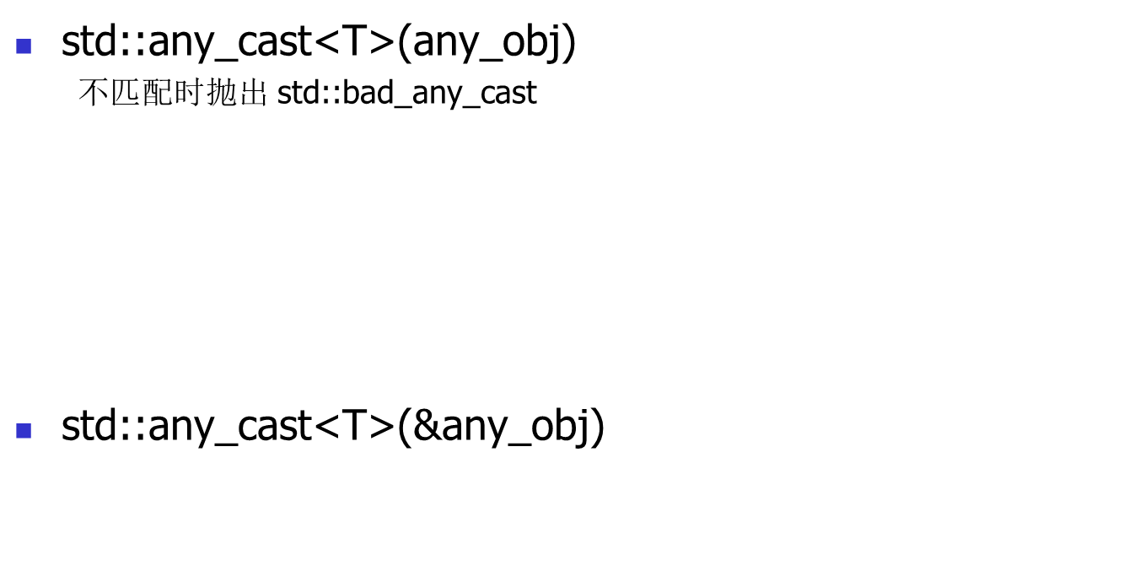
any_cast
type_safe
Throw bad_any_cast() exception
any obj = 42;
try{
doubled = any_cast<int>(obj);
cout<<“succeed: "<<d<<"\n";
} catch (const bad_any_cast& e) {
cout<<“type error: "<<e.what() <<endl;
}
any obj = 42;
try{
doubled = any_cast<double>(obj);
cout<<" succeed: "<<d<<"\n";
} catch (const bad_any_cast& e) {
cout<<" type error: "<<e.what() <<endl;
}
succeed: 42
type error: bad any cast
any obj = 42;
auto p = std::any_cast<int>(&obj);
if (p != nullptr) {
std::cout<<“succeed: "<< *p<<"\n";
} else {
std::cout<<“type error\n"; }
当使用取指针的方式调用any_cast时，如果类型不匹配，并不会抛出异常，而是返回 nullptr

Slide 24
reset & has_value
空值与重置
  默认构造为空值
  has_value() 判断是否有值
  reset() 清空内容
any obj4;
cout<<“obj type: "<<obj4.type().name() <<endl;
  cout<<“has value: "<<obj4.has_value() <<endl;
void
obj type : v
has value : 0
obj4=42;
cout<<" obj type : "<<obj4.type().name() <<endl;
cout<<" has value : "<<obj4.has_value() <<endl;
obj type : i
has value : 1
obj4.reset();
cout<<" obj type : "<<obj4.type().name() <<endl;
cout<<" has value : "<<obj4.has_value() <<endl;
obj type : v
has value : 0

Slide 25
Struct & implementation
T类型存入时，对应类型的函数地址被存到 Handler 中
enum class _Action
{ _Destroy, _Copy, _Move, _Get, _TypeInfo };
Handler 为空表示当前没有存储值
管理函数指针
负责Copy、Destroy、Get type_info 等操作
Handler _HandleFuncPtr =
void* (*) (Args...);
any obj=7;
32 bytes
ac a5 6d 00 01 00 00 00 07 00 00 00 00 00 00 00
00 00 00 00 00 00 00 00 00 00 00 00 00 00 00 00
Storage union{
void* ptr;
__any_imp::_Buffer __buf;
}
64位系统
Little-Endian
内部缓冲区
3 个字长，用于SOO (小对象优化)
存储对象或指向堆内存的指针
存对象或指针

Slide 26
any Struct cont’
obj=7.5;
cout<<“obj addr: "<< &obj<<endl;
cout<<“data addr: "<<std::any_cast<double>(&obj)
<<" value: "<<std::any_cast<double>(obj) <<endl;
print_any_bytes(obj);
any obj;
memset(&obj,0,sizeof(obj));
obj=7;
int* p = std::any_cast<int>(&obj);
cout<<“obj addr: "<< &obj<<endl;
cout<<“data addr: "<<p<<" value: "<< *p<<endl;
print_any_bytes(obj);
obj adr: 0x16faf2490
data addr: 0x16faf2498 value: 7.5
std::any size = 32 bytes
30 f6 30 00 01 00 00 00 00 00 00 00 00 00 1e 40
00 00 00 00 00 00 00 00 00 00 00 00 00 00 00 00
obj addr: 0x16faf2490
data addr: 0x16faf2498 value: 7
std::any size = 32 bytes
ac e5 30 00 01 00 00 00 07 00 00 00 00 00 00 00
00 00 00 00 00 00 00 00 00 00 00 00 00 00 00 00
Data Addr = Obj Addr + 8
obj=string("0000000000000000000000");
44 ec 30 00 01 00 00 00 30 30 30 30 30 30 30 30
30 30 30 30 30 30 30 30 30 30 30 30 30 30 00 16

Slide 27
any Struct cont’
struct large {
int a[10]={1,2,3,4,5,6,7,8,9,10};
};
obj=large{};
Data Size 超出缓冲区
struct large*s = std::any_cast<large>(&obj);
cout<<“obj addr: "<< &obj<<endl;
cout<<“data addr: "<< s <<endl;
cout<<"s.a[9] value: "<< s->a[9] << endl;
print_any_bytes(obj);
obj addr: 0x16faf2490
data addr: 0x12bf04120
s.a[9] value: 10
std::any size = 32 bytes
18 fd 30 00 01 00 00 00 20 41 f0 2b 01 00 00 00
00 00 00 00 00 00 00 00 00 00 00 00 00 00 00 00

Slide 28
Any Struct cont’
Same Addr
std::any
值: 7
e4 28 73 04 01 00 00 00 07 00 00 00 00 00 00 00
00 00 00 00 00 00 00 00 00 00 00 00 00 00 00 00
值: 7.5
68 39 73 04 01 00 00 00 00 00 00 00 00 00 1e 40
00 00 00 00 00 00 00 00 00 00 00 00 00 00 00 00
值: 64
e4 28 73 04 01 00 00 00 40 00 00 00 00 00 1e 40
00 00 00 00 00 00 00 00 00 00 00 00 00 00 00 00
obj=7;
_HandleFuncPtr __h_ :
0x00000001047328e4
obj=7.5;
_Storage __s_:
00000007
obj=64;

Slide 29
any Handler
enum class _Action { _Destroy, _Copy, _Move, _Get, _TypeInfo };
using _HandleFuncPtr =
void* (*)(_Action, const any*, any*, const std::type_info*, const void*);
switch (__act) {
case _Action::_Destroy:
__destroy(const_cast<any&>(*__this));
return nullptr;
case _Action::_Copy:
__copy(*__this, *__other);
return nullptr;
case _Action::_Move:
__move(const_cast<any&>(*__this), *__other);
return nullptr;
case _Action::_Get:
return __get(const_cast<any&>(*__this), __info, __fallback_info);
case _Action::_TypeInfo:
return __type_info();
}

Slide 30
any Handler samples
_Action::_TypeInfo
_Action::_Copy
void* raw = handler(_Action::_TypeInfo, nullptr,
nullptr, nullptr, nullptr);
std::type_info* ti = reinterpret_cast<std::type_info*>(raw);
cout<<"type_info name: "<<ti->name() <<endl;
any obj;
memset(&obj,0,sizeof(obj));
obj = 7;
int* p = std::any_cast<int>(&obj);
type_info name: i
auto handler = *(reinterpret_cast<_HandleFuncPtr*>(&obj));
any objcpy;
memset(&objcpy,0,sizeof(objcpy));
handler(_Action::_Copy, &obj, &objcpy, nullptr, nullptr);
&obj
0x16b7ba480
P 0x16b7ba488
obj
5c 69 64 04 01 00 00 00 07 00 00 00 00 00 00 00
00 00 00 00 00 00 00 00 00 00 00 00 00 00 00 00
objcpy
5c 69 64 04 01 00 00 00 07 00 00 00 00 00 00 00
00 00 00 00 00 00 00 00 00 00 00 00 00 00 00 00

Slide 31
variant cont’
sizeof(string)
unsigned int
(align = 8 )
variant size: union size + index
std::variant<int,double,string> obj;
memset(&obj,0,sizeof(obj));
obj=7;
cout<<"index : "<<obj.index() <<endl;
cout<<“value : "<<std::get<int>(obj) <<endl;
print_variant_bytes(&obj);
obj=7.5;
cout<<" index : "<<obj.index() <<endl;
cout<<" value : "<<std::get<double>(obj) <<endl;
print_variant_bytes(&obj);
obj=std::string("0000000000000000000000");
cout<<" index : "<<obj.index() <<endl;
cout<<" value : "<<std::get<string>(obj) <<endl;
print_variant_bytes(&obj);
index
index : 0
value : 7
variant size = 32 bytes
07 00 00 00 00 00 00 00 00 00 00 00 00 00 00 00
00 00 00 00 00 00 00 00 00 00 00 00 00 00 00 00
index : 1
value : 7.5
variant size = 32 bytes
00 00 00 00 00 00 1e 40 00 00 00 00 00 00 00 00
00 00 00 00 00 00 00 00 01 00 00 00 00 00 00 00
index : 2
value : 0000000000000000000000
variant size = 32 bytes
30 30 30 30 30 30 30 30 30 30 30 30 30 30 30 30
30 30 30 30 30 30 00 16 02 00 00 00 00 00 00 00
alignment

Slide 32
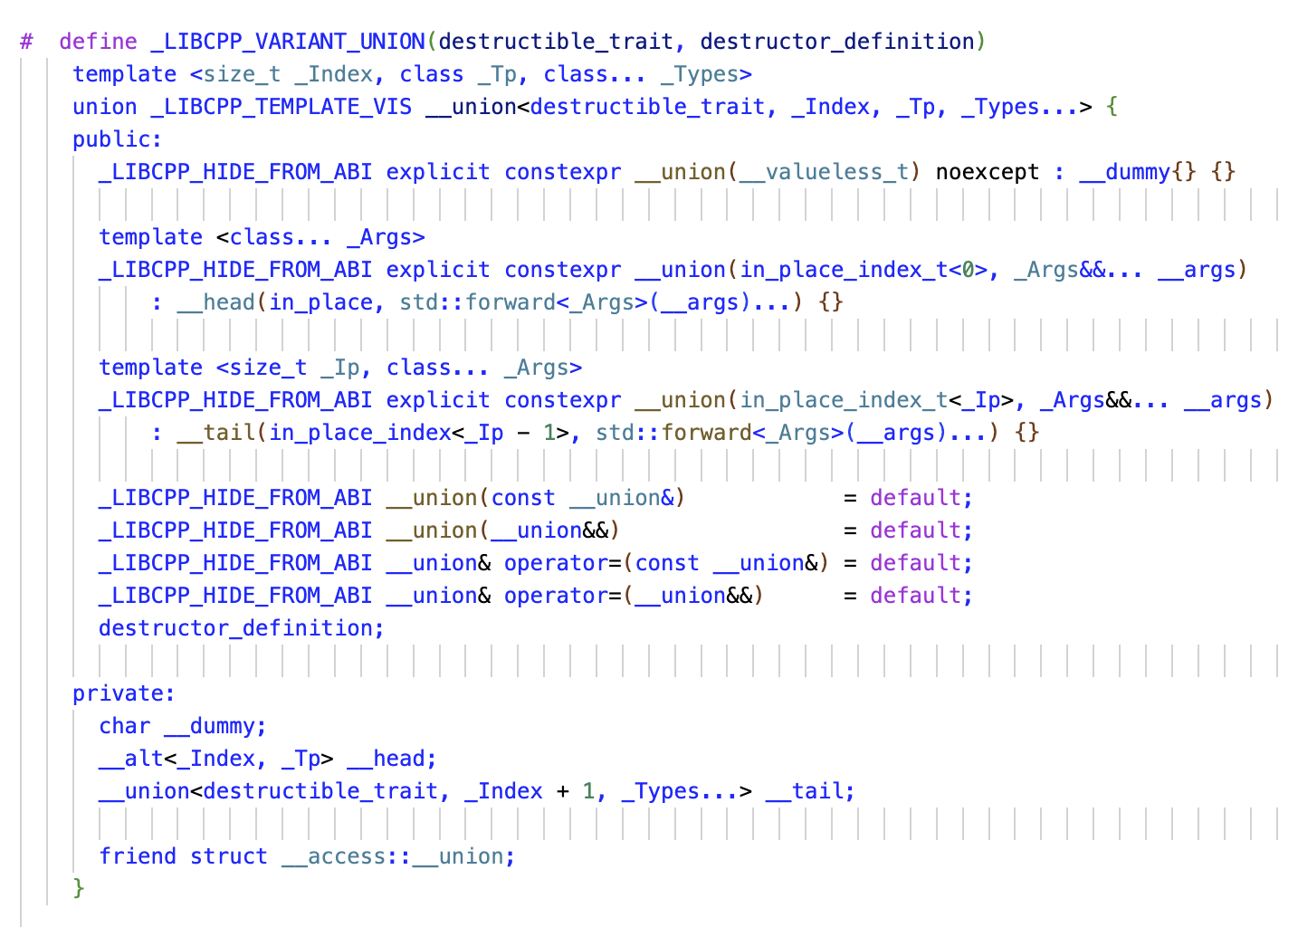
variant<int, double, string>
__union data
variant<int, double, string>
union {
  char __dummy;
__alt<0, int> __head;
union {
  char __dummy;
__alt<1, double> __head;
  union {
  char __dummy;
__alt<2, string> __head;
    union {
      char __dummy;
        }
} ;
} ;
}

Slide 33
any vs. variant
Type
  std::any
    编译期未确定，运行时检查
  std::variant
    编译期确定、检查
    运行时仅检查当前存放数据的激活索引是否匹配
Visit
  std::any
    需通过 any_cast，即调用handler，并通过 typeid 检查确认类型是否匹配
    含一次函数调用开销和类型比较开销
  std::variant
    std::get<T>(v) 或 std::get<I>(v)
    类型 T /索引 I 在编译期已知，内部直接转换为索引访问（调用 __get_alt<I>(...)，直接返回存储对象的引用）

Slide 34
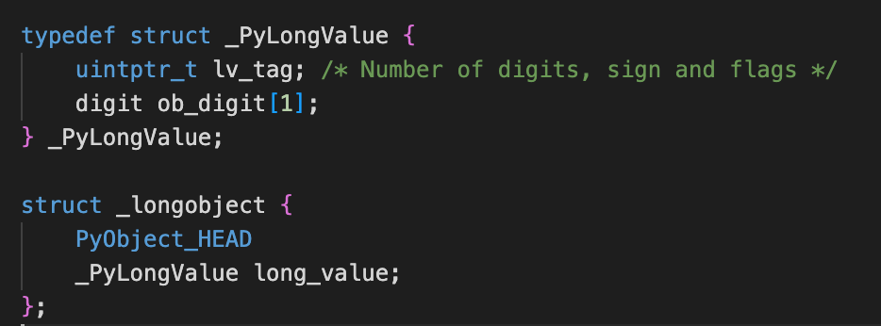
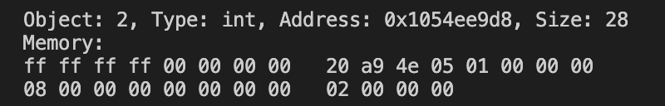
Python LongType
Py_size_t ob_refcnt
PyTypeObject* ob_type
unsigned long ob_size
ob_digit[0]
.
.
.
ob_digit[n]

Slide 35
struct A {
char c;
short s;
int i;
float f;
};
A a = { ‘a’, 3 , 259, 7.25};
showBytes(&a, sizeof(A));
struct
alignment
Padding
12
00000070A33BEB78 : 01100001 11001100 00000011 00000000
00000070A33BEB7C : 00000011 00000001 00000000 00000000
00000070A33BEB80 : 00000000 00000000 11101000 01000000
struct B {
char c;
int i;
short s;
float f;
};
B b = { 'a’, 259, 3, 7.25 };
showBytes(&b, sizeof(B));
Little Endian
16
00000070A33BEBA8 : 01100001 11001100 11001100 11001100
00000070A33BEBAC : 00000011 00000001 00000000 00000000
00000070A33BEBB0 : 00000011 00000000 11001100 11001100
00000070A33BEBB4 : 00000000 00000000 11101000 01000000

Slide 36
Multi output arguments
tuple
M1：
void foo(int& i, float& f)
{ i = 1;
f = 3.0f;
return;
}
M3:
tuple<int, float> foo()
{ return { 1, 3.0f };
}
{ int i; float f;
foo(i, f);
cout << i << f; }
{auto r = foo();
cout << get<0>(r) << " "
<< get<1>(r); }
M2:
struct Rtn{
int i;
float f;
};
Rtn foo()
{ return { 1, 3.0f };
}
{ auto r = foo();
std::tie(i, f) = r;
cout << i<< f ; }
{ auto r = foo();
cout << r.i << r.f; }

Slide 37
std::optional<int> opt;
try {
int id = opt.value();
} catch (const std::bad_optional_access& e) {
cout << “” ;}
}
#include <optional>
return invaild value
optional C++17
opt..has_value()
int findUserID(const std::string& username) {
// ...
if (用户存在) {
return corresponding_id;
} else {
return -1; // 用 -1 表示“未找到”
}
}
int id = opt.value_or(-1);
std::cout << "ID is: " << id << std::endl;
X Magic Num
int* findUserID(const std::string& username) {
// ...
if (用户存在) {
return new int(corresponding_id);
} else {
return nullptr; // 用空指针表示“未找到”
}
}
X Memory Leak Risk
bool findUserID(const std::string& username, int& outID) {
// ...
if (用户存在) {
outID = corresponding_id;
return true;
} else {
return false;
}
}
#include <optional>
std::optional<int> findUserID(const std::string& username) {
// ...
if (用户存在) {
return corresponding_id; // 返回一个包含值的 optional
} else {
return std::nullopt; // 或者 return {}; 返回一个空的 optional
}
}
X addiotnal parameter

Slide 38
Generic & Functional Programming
Tuple C++11
打包数据
返回多个值
接收并解包
忽略部分返回值
构成复杂元素
Set
Fixed size
Heterogeneous
Create
std::tuple<int, std::string, double> getInfo(int id) {
… return std::make_tuple(1, "Alice", 92.5);
…. return std::tuple<int, std::string, double>(2, "Bob", 88.0);
… return {1, "Alice", 92.5};}
std::tuple<int, std::string, double> student = getInfo(0);
C++17
CTAD
Visit
std::cout << "ID: " << std::get<0>(student);
std::cout << “Score: “ << std::get<double>(student) ;
C++14
std::tie(Id, Name, Score) = getInfo(0);
std::tie(std::ignore, Name, std::ignore) = getInfo(0);
解包
auto [id, name, score] = getInfo(0);
const auto& [refId, refName, refScore] = getInfo(0);
C++17
Structured Binding

Slide 39
malloc
High
+----------------------+
| Kernel Space |
+----------------------+
| Stack |
| ↓ |
+----------------------+
| ... | mmap
| ↑ |
+----------------------+
| Heap | brk
+----------------------+
| BSS Segment |
+----------------------+
| Data Segment | Initialized
+----------------------+
| Text Segment |
+----------------------+
Low
减少系统调用
原则
快速匹配
减少锁竞争
size
tag
p_avail
/////
…
….
System Calls
brk
mmap/munmap
head
ptr
#include <sys/mman.h>
Different Strategy
dlmalloc (Doug Lea's Malloc)
jemalloc (Jason Evans' Malloc)
ptmalloc (Per-Thread Malloc)
tcmalloc (Thread-Caching Malloc)
Fastbin
Smallbin
Largebin
Unsortedbin
bin 回收管理
Arenas
Memory Modal
多线程和内存并发访问的语义被正式纳入语言标准
实现高效的无锁数据结构和算法
进化为支持现代、高效、可移植并发编程的语言

Slide 40
谁申请，谁释放
利用栈展开
异常安全
零开销抽象
RAII
Resource Acquisition Is Initialization
void old_use(Args a) {
auto q = new Blob(a);
// ...
// ...
delete q; // 容易忘
}
void newer_use(Args a) {
auto p = int_ptr(new Blob(a));
// ...
if (foo) throw Bad(); // 不会泄漏
if (bar) return; // 不会泄漏
// ...
}
if (foo) throw Bad(); // 会泄漏
if (bar) return; // 会泄漏
class int_ptr
{ public:
int_ptr(int *p=0):ptr(p) {}
~int_ptr() { delete ptr; }
private:
int* ptr;
};
Q1
int* operator->() const { return ptr;}
int& operator *() const { return *ptr; }
Memory Leak
在构造函数中获取资源
在析构函数中释放资源
利用 C++ 对象生命周期自动管理资源

Slide 41
std::unique_ptr<int> p1{new int(20)};
unique_ptr<int> p2 = p1; // compile error
X
auto_ptr<int> p1(new int(10)); // p1 拥有 int 10
auto_ptr<int> p2 = p1; // 所有权从 p1 转移到 p2
cout << *p2 << endl; // 输出 10
cout << *p1 << endl; // ????
std::unique_ptr<int> p2 = std::move(p1);
X
std::cout << *p1 << std::endl; // ????
X
反直觉的拷贝语义
不适合 STL 容器
不支持数组
template<typename T>
class auto_ptr {
private:
T* ptr;
public:
explicit auto_ptr(T* p = nullptr) : ptr(p) {}
~auto_ptr() { delete ptr; }
T& operator*() const { return *ptr; }
T* operator->() const { return ptr; }
auto_ptr(auto_ptr& other) : ptr(other.release()) {}
auto_ptr& operator=(auto_ptr& other) {
if (this != &other) {
delete ptr;
ptr = other.release();
}
return *this;
}
T* release() {
T* old_ptr = ptr;
ptr = nullptr;
return old_ptr;
}
};
auto_ptr
11
unique_ptr
98
Deep Copy is denied
unique_ptr(const unique_ptr&) = delete;
unique_ptr& operator=(const unique_ptr&) = delete;
X
unique_ptr(unique_ptr&& other) noexcept : ptr(other.release()) {}
unique_ptr& operator=(unique_ptr&& other) noexcept {
if (this != &other) {
reset(other.release());
}
return *this;
}

Slide 42
Communication
Shared Resource
shared_ptr
std::shared_ptr<int> p1{new int(10)};
std::cout << "*P1: " << *p1 << std::endl;
std::shared_ptr<int> p2 = p1;
std::cout << "*P2: " << *p2 << std::endl;
*p2 = 20;
std::shared_ptr<int> p3 = p2;
*p3 = 30;
std::cout << "P1 count :" << p1.use_count()<< std::endl;
use_count
std::cout << "P1 count :" << p1.use_count()<< std::endl;
std::cout << "P3 count :" << p3.use_count()<< std::endl;
std::cout << "P1 count : " << p1.use_count() << std::endl;
Q2
Idle Pointer

Slide 43
int main() {
Cache cache;
Key key1 = "key1";
Key key2 = "key2";
cache.addResource(key1, std::make_shared<Resource>());
cache.addResource(key2, std::make_shared<Resource>());
std::shared_ptr<Resource> r1 = cache.getResource(key1);
r1->doSomething();
std::shared_ptr<Resource> r2 = cache.getResource(key2);
r2->doSomething();
return 0;
}
Resource Cache
using Key = std::string;
class Resource {
public:
Resource() { std::cout << "Resource acquired\n"; }
~Resource() { std::cout << "Resource destroyed\n"; }
void doSomething() { std::cout << "Doing something with Resource\n"; }
};
DB Connection
Thread
Socket
Device Handler
class Cache {
std::unordered_map<Key, std::shared_ptr<Resource>> m_cache;
public:
Cache() { std::cout << "Cache created\n"; }
void clear() { m_cache.clear(); }
~Cache() { clear(); std::cout << "Cache destroyed\n"; }
void addResource(Key key, std::shared_ptr<Resource> resource) {
m_cache[key] = resource; }
std::shared_ptr<Resource> getResource(Key key) {
// ... Serach / create resource
return m_cache[key]; // 调用者共享所有权
}
Cache(const Cache&) = delete;
Cache& operator=(const Cache&) = delete;
Cache(Cache&&) = delete;
Cache& operator=(Cache&&) = delete;
};
Observer Pattern
weak_ptr
Document/View

Slide 44
struct Node_old{
std::string name;
Node_old *next;
Node_old *prev;
};
struct Node {
std::string name;
std::shared_ptr<Node> next;
std::shared_ptr<Node> prev;
Node(const std::string& n) : name(n) {}
~Node() {}
};
Doubly Linked List
？
std::weak_ptr<Node> prev;
void release() {
Node_old *current = head;
while (current != nullptr) {
Node_old *next = current->next;
std::cout << current->name << " destroyed " << std::endl;
delete current;
current = next;
}
}
Node_old *head;
void enqueue_old(std::string name) {
auto node = new Node_old();
node->name = name;
node->next = nullptr;
node->prev = nullptr;
if (head == nullptr) {
head = node;
} else {
Node_old *current = head;
while (current->next != nullptr) {
current = current->next;
}
current->next = node;
node->prev = current;
}
}
void enqueue(std::string name) {
auto node = std::make_shared<Node>(name);
if (head1 == nullptr) {
head1 = node;
} else {
auto current = head1;
while (current->next != nullptr)
{
current = current->next;
}
current->next = node;
node->prev = current;
}
}
void display() {
auto curr = head1;
while (curr != nullptr) {
std::cout << current->name
<< ": curr count = " << curr.use_count()
<< ", next count = " << (curr >next ? curr >next.use_count() : 0)
<< ", prev count = " << curr >prev.use_count()
<< std::endl;
curr = curr >next;
}
}
void dispay_old() {
Node_old *current = head;
while (current != nullptr) {
std::cout << current->name << " " << std::endl;
current = current->next;
}
}
void sample_old() {
enqueue_old("node1");
enqueue_old("node2");
enqueue_old("node3");
enqueue_old("node4");
dispay_old();
release();
}
void Sample() {
enqueue("node1");
enqueue("node2");
enqueue("node3");
enqueue("node4");
display();
}
Node_old *head;
std::shared_ptr<Node> head1 = nullptr;

Slide 45
class Teacher {
public:
Teacher(const std::string& name) : name_(name) {}
~Teacher() {std::cout << name_ << " gone" << std::endl; }
void addStudent(std::shared_ptr<Student> student) {
student_.push_back(student);
}
void teach(const std::string& lesson) {
std::cout << name_ << " is giving: " << lesson << std::endl;
for (auto& student : student_) {
student->listen(lesson);
}
}
private:
std::string name_;
std::vector<std::shared_ptr<Student>> student_;
};
Observer
void askQuestion() {
auto teacher = teacher_.lock();
if (teacher) {
std::cout << name_ << " is asking..." << std::endl;
} else {
std::cout << "Teacher is gone!" << std::endl;
}
}
class Student {
public:
Student(const std::string& name) : name_(name) {}
~Student() { std::cout << name_ << " gone" << std::endl; }
void listen(const std::string& lesson) {
std::cout << name_ << " listening: " << lesson << std::endl;
}
void rememberTeacher(std::shared_ptr<Teacher> teacher) {
teacher_ = teacher;
private:
std::string name_;
std::weak_ptr<Teacher> teacher_;
};
void demonstrate() {
auto teacher = std::make_shared<Teacher>("Mr. Wang");
auto student1 = std::make_shared<Student>("Student1");
auto student2 = std::make_shared<Student>("Student2");
teacher->addStudent(student1);
teacher->addStudent(student2);
student1->rememberTeacher(teacher);
student2->rememberTeacher(teacher);
teacher->teach("Programming");
}
student1->askQuestion();
teacher.reset();
student2->askQuestion();
Mr. Wang is giving: Programming
Student1 listening: Programming
Student2 listening: Programming
Teacher: 1, stdent1: 2, stdent2: 2, stdent3: 2

Slide 46
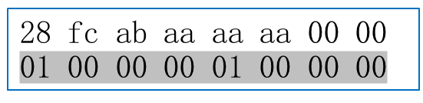
template<typename T>
class unique_ptr {
T* ptr;
};
// unique_ptr<T[]>
template<typename T>
class unique_ptr<T[]> {
T* ptr;
};
naked pointer
Implementation unique_ptr
shared_ptr
weak_ptr
get()
use_count()
Data Addr
Ctrl Addr
FF 00 00 00 FF 00 00 00
weakcount
sp1
？
vtable
sp2
02
02
02
03
auto sp1 = make_shared<MyObject>(0xFF);
wp
auto sp2 = sp1;
weak_ptr<MyObject> wp = sp1;
auto sp_locked = wp.lock();
sp_locked.reset();

