Slide 1
Functional Programming
Imperative Programming
“How”
通过一系列语句改变程序状态
Functional Programming
“What”
将计算视为数学函数的求值，避免状态和可变数据
Pure Function
相同的输入总是产生相同的输出
没有可观察的副作用

Slide 2
Q2、Write a function to check if a string is the prefix of another
Scheme
(define (is-prefix prefix str)
(cond
((null? prefix) #t)
((null? str) #f)
((char=? (car prefix) (car str))
(is-prefix (cdr prefix) (cdr str)))
(else #f)))
std::string_view
C++
bool is_prefix(std::string prefix, std::string str) {
return prefix.empty() ? true :
str.empty() ? false :
prefix[0] == str[0] ? is_prefix(prefix.substr(1), str.substr(1)) :
false;
}

Slide 3
Q1、Given a two lists of sorted numbers, produce a sorted list of all the numbers
merge :: Ord a => [a] -> [a] -> [a]
merge xs [] = xs
merge [] ys = ys
merge (x:xs) (y:ys)
| x <= y = x : merge xs (y:ys)
| otherwise = y : merge (x:xs) ys
Haskell
std::vector<int> mergeSorted(std::vector<int> list1, std::vector<int> list2) {
if (list1.empty()) return list2;
if (list2.empty()) return list1;
if (list1.front() <= list2.front()) {
return rest;
} else {
return rest;
}
}
FP style pattern matching
int head = list1.front();
list1.erase(list1.begin());
std::vector<int> rest = mergeSorted(std::move(list1), std::move(list2));
rest.insert(rest.begin(), head);
C++
26?
int head = list2.front();
list2.erase(list2.begin());
std::vector<int> rest = mergeSorted(std::move(list1), std::move(list2));
rest.insert(rest.begin(), head);

Slide 4
Q3、Count Capital Letters in a list of string
Scheme
(define (count-uppercase str-list)
(define (uppercase? char)
(and (char>=? char #\A) (char<=? char #\Z)))
(define (count-in-string str)
(apply +
(map (lambda (c) (if (uppercase? c) 1 0))
(string->list str))))
(apply + (map count-in-string str-list)))
The Big Three
filter
Filter
Map
Reduce
(filter even? '(1 2 3 4 5)) ;; => (2 4)
(filter (lambda (x) (> x 2)) '(1 2 3 4)) ;; => (3 4)
transform
map (+1) [1,2,3] -- [2,3,4]
accumulate
(reduce + 0 '(1 2 3 4)) ;; (+ (+ (+ (+ 0 1) 2) 3) 4)
(apply + '(1 2 3 4)) ;; (+ 1 2 3 4)

Slide 5
filter
std::vector<int> src= {1, 2, 3, 4, 5, 6, 7, 8, 9, 10};
std::vector<int> target;
bool isEven(int n) { return n % 2 == 0; }
target.begin()
std::copy_if(src.begin(), src.end(),
std::back_inserter(target),
isEven);
std::vector<int> target(src.size());
2，4，6，8，10
std::list<int> target;
std::front_inserter(target);
[](int n) { return n % 2 == 0; });
std::set<int> target;
std::inserter(target, target.begin()),
auto new_end = std::remove_if(src.begin(), src.end(),
isEven);
src.erase(new_end, src.end());
//
1，3，5，7，9
1，3，5，7，9，6，7，8，9，10
auto target = src | std::views::filter(isEven)；
src | std::views::filter([](int n) { return n % 2== 0; })

Slide 6
transform
编译器优化
std::vector<int> numbers = {1, 2, 3, 4, 5};
auto squares = numbers | std::views::transform([](int n) {
return n * n;});
auto strings = numbers | std::views::transform([](int n) {
return "Value: " + std::to_string(n); });
std::vector<std::string> words = {"hello", "world", "cpp", "ranges"};
auto upper_words = words | std::views::transform([](const std::string& s) {
std::string result = s;
for (char& c : result) { c = std::toupper(c); }
return result; });
计算
类型转换
字符串处理

Slide 7
无限序列
auto fibonacci = std::views::iota(0) | std::views::transform([](int n)
{ auto fib = [](auto&& self, int n) -> long long {
if (n <= 1) return n;
return self(self, n - 1) + self(self, n - 2);
};
return fib(fib, n);
});
transform Lazy Evaluation
#include <ranges>
auto fibonacci = std::views::iota(0) | std::views::transform([](int n) {
if (n <= 1) return static_cast<long long>(n);
long long a = 0, b = 1;
for (int i = 2; i <= n; ++i) {
long long next = a + b;
a = b;
b = next;
}
return b;
});
int expensive_operation(int n) {
std::cout << "computing: " << n << std::endl;
return n*n;
}
computing: 1
result: 1
computing: 2
result: 4
computing: 3
result: 9
std::vector<int> numbers = {1, 2, 3};
std::vector<int> instant;
auto lazy_view = numbers | std::views::transform(expensive_operation);
for (int n : lazy_view) {
std::cout << "result: " << n << std::endl;
}
| std::views::take(2);
| std::views::drop(2);
| std::views::reverse;
std::transform(numbers.begin(), numbers.end(),
std::back_inserter(instant),
expensive_operation);
for (int n : instant) {
std::cout << "rerult: " << n << std::endl;
}
computing: 1
computing: 2
computing: 3
rerult: 1
rerult: 4
rerult: 9

Slide 8
template< class InputIt, class T, class BinaryOperation >
T accumulate( InputIt first, InputIt last, T init,
BinaryOperation op );
first, last：范围 [first, last)。
init：初始值，同时决定了计算结果的类型
op：双目，默认是 +
accumulate
std::vector<int> nums = {1, 2, 3, 4, 5};
auto sum = std::accumulate(nums.begin(), nums.end(), 0);
std::vector<std::string> words = {"Hello", " ", "World", "!"};
std::string sentence = std::accumulate(words.begin(), words.end(), std::string(""));
std::vector<double> nums = {1.0, 2.0, 3.0, 4.0};
auto product = std::accumulate(nums.begin(), nums.end(), 1.0,
[](double a, double b) { return a * b; });
((((1.0 * 1.0) * 2.0) * 3.0) * 4.0)
std::vector<std::vector<int>> vecOfVecs = {{1, 2}, {3, 4, 5}, {6}};
std::vector<int> flattened = std::accumulate(vecOfVecs.begin(), vecOfVecs.end(),
std::vector<int>{},
[](std::vector<int> a, const std::vector<int>& b) {
a.insert(a.end(), b.begin(), b.end());
return a;});
std::vector<int> nums = {3, 1, 4, 1, 5, 9, 2, 6};
auto max_value = std::accumulate(std::next(nums.begin()), nums.end(),
nums.front(),
[](int current_max, int value) {
return std::max(current_max, value);
});

Slide 9
Q3、Count Capital Letters in a list of string
(define (count-uppercase str-list)
(define (uppercase? char)
(and (char>=? char #\A) (char<=? char #\Z)))
(define (count-in-string str)
(apply +
(map (lambda (c) (if (uppercase? c) 1 0))
(string->list str))))
(apply + (map count-in-string str-list)))
int count_uppercase(const std::vector<std::string>& str_list) {
auto uppercase = [](char c) { return std::isupper(c); };
auto count_in_string = [&](std::string str) {
return std::accumulate(str.begin(), str.end(), 0,
[&](int count, char c) {
return count + (uppercase(c) ? 1 : 0);
});};
return std::accumulate(str_list.begin(), str_list.end(), 0,
[&](int total, const std::string& str) {
return total + count_in_string(str);
});
}
size_t count_uppercase(const std::vector<std::string>& strings) {
auto capitalCounts = strings | std::views::transform([](const std::string& str) {
return std::ranges::count_if(str,
[](char c) { return std::isupper(c); });
});
return std::accumulate(capitalCounts.begin(), capitalCounts.end(), 0);
}
ranges

Slide 10
Excellent students:
Major 1 (2 person):
Zhang - grade: 4.5
Wang - grade: 4
Average: 4.25
Major 2 (2 person):
Li - grade: 4.95
Chen - grade: 4.6
Average: 4.775
Major 3 (2 person):
Qian - grade: 4.8
Zhou - grade: 4.5
Average: 4.65
struct Student {
std::string name;
double grade;
int major;
};
std::vector<Student> se22 = {
{"Zhang", 4.5, 1},
{"Wang", 4.0, 1},
{"Li", 4.95, 2},
{"Chen", 4.6, 2},
{"Sun", 3.8, 1},
{"Qian", 4.8, 3},
{"Zhao", 2.8, 3},
{"Zhou", 4.5, 3},
};
Q4、Sample
pair/tuple
auto processStudents(const std::vector<Student>& students) {
auto select= students
| std::views::filter([](const Student& p) { return p.grade >= 4.0; })
| std::views::transform([](const Student& s) {
return std::make_pair(s.major, s);
});
return std::accumulate(
select.begin(), select.end(),
std::map<int, std::vector<Student>>{},
[](auto acc, const auto& pair) {
auto& [major, student] = pair;
acc[major].push_back(student);
return acc;
}
);
}
int main() {
std::vector<Student> se22 = { …….. }
auto grouped = processStudents(se22);
std::cout << "Excellent students:" << std::endl;
for (const auto& [major, students] : grouped) {
std::cout << "Major " << major << " (" << students.size()
<< " person):" << std::endl;
for (const auto& s : students) {
std::cout << " " << s.name << " - grade: "
<< s.grade << std::endl;
}
double avg = std::accumulate(
students.begin(), students.end(), 0.0,
[](double sum, const Student& s) { return sum + s.grade; }
) / students.size();
std::cout << " Average: " << avg_grade << std::endl;
}
return 0;
}
| std::views::filter([](const auto& pair)
{ return pair.first >= 2; })；

Slide 11
Lamda Expression
[capture list] (parameter list) specifiers exception -> type { function body }
capture list：用于指定Lambda表达式内部如何访问其外部作用域中的变量。
捕获方式有值(=)捕获、引用(&)捕获和混合捕获。
parameter list: 定义Lambda表达式的参数，可以省略。
specifiers：用于指定Lambda表达式的属性，如mutable。
exception specifier：用于指定Lambda表达式是否抛出异常，如noexcept。
function body：Lambda表达式的主体部分，包含具体的执行代码。
class ExpensiveCalculation {
private:
double input;
mutable bool cacheValid;
mutable double cachedResult;
public:
ExpensiveCalculation(double val) : input(val),
cacheValid(false), cachedResult(0) {}
double getResult() const {
if (!cacheValid) { computeResult();
}
return cachedResult; }
void setInput(double val) {
input = val; cacheValid = false; }
};
void computeResult() const {
// "very expansive computing..."
cachedResult = std::sin(input) *
std::cos(input) * std::log(input + 1.0);
cacheValid = true;
}
void demoCache() {
const ExpensiveCalculation con_value(5.0);
ExpensiveCalculation calc(5.0);
std::cout << calc.getResult() << std::endl; // computing
std::cout << calc.getResult() << std::endl; // using buffer
calc.setInput(10.0);
std::cout << calc.getResult() << std::endl; // recomputing
}

Slide 12
Lambda Calculus
x Variable
λx.M Abstraction
M N Application
Currying
Currying是将接受多个参数的函数转换为一系列接受单一参数的函数的过程
Currying
λx.(λy.(x + y))
λ(x, y).(x + y)
λx.λy.(x + y)
λ(x₁, x₂, ..., xₙ).M
λx₁.λx₂. ... .λxₙ.M
int add(int x,int y, int z){ return x+y+z;}
auto add = [](int x)
{ return [x](int y){
return [x, y](int z){
return x + y + z;
};
};
};
cout << add(1)(2)(3) << endl;
auto add1 = add(1);
auto add2 = add1(2);
cout << add2(3) << endl;

Slide 13
function本质上是类模板
#include<functional>
#include<iostream>
#include<map>
using namespace std;
int add(int a, int b){
return a + b;
}
struct ADD
{ int operator()(int a, int b){
return a + b;
}
};
int main()
{
map<string, function<int(int, int)>> opmap =
{ {"fun_pointer", add},
{"operator()", ADD()},
{"lambda", [](int a, int b)->int {return a + b; }}
};
cout << opmap["fun_pointer"](1, 2) << endl;
cout << opmap["operator()"](3, 4) << endl;
cout << opmap["lambda"](5, 6) << endl;
return 0;
}
auto newCallable = bind(callable, arg_list);
int Add3(int a,int b, int c)
{
cout << a << " " << b << " " << c << endl;
return a + b – c;
}
auto NewAdd = bind(Add3, placeholders::_1, 0, placeholders::_2);
auto NewAdd = bind(Add3, placeholders::_2, 0, placeholders::_1);
,
{"bind",NewAdd}
cout << opmap["bind"](7, 8) << endl;

Slide 14
virtual std::unique_ptr<CallableBase> clone() const = 0;
Function(const Function& other)
Function(Function&& other)
Function& operator=(const Function& other)
Function& operator=(Function&& other)
#include <iostream>
#include <functional>
#include <memory>
std::function
template<typename R, typename... Args>
class Function<R(Args...)> {
struct CallableBase {
virtual ~CallableBase() = default;
virtual R call(Args... args) = 0;
};
template<typename F>
struct CallableImpl : CallableBase {
F f;
CallableImpl(F func) : f(std::move(func)) {}
R call(Args... args) override { return f(args...); }
};
std::unique_ptr<CallableBase> ptr;
public:
Function() = default;
template<typename F>
Function(F f) : ptr(std::make_unique<CallableImpl<F>>(std::move(f))) {}
R operator()(Args... args) const {
return ptr->call(std::forward<Args>(args)...);
}
};
int main(){
Function<int(int, int)> func;
func = [](int a, int b) { return a + b; };
func = std::plus<int>();
int (*add)(int, int) = [](int a, int b) { return a + b; };
func = add;
}
Type-erasure
Bridge pattern

Slide 15
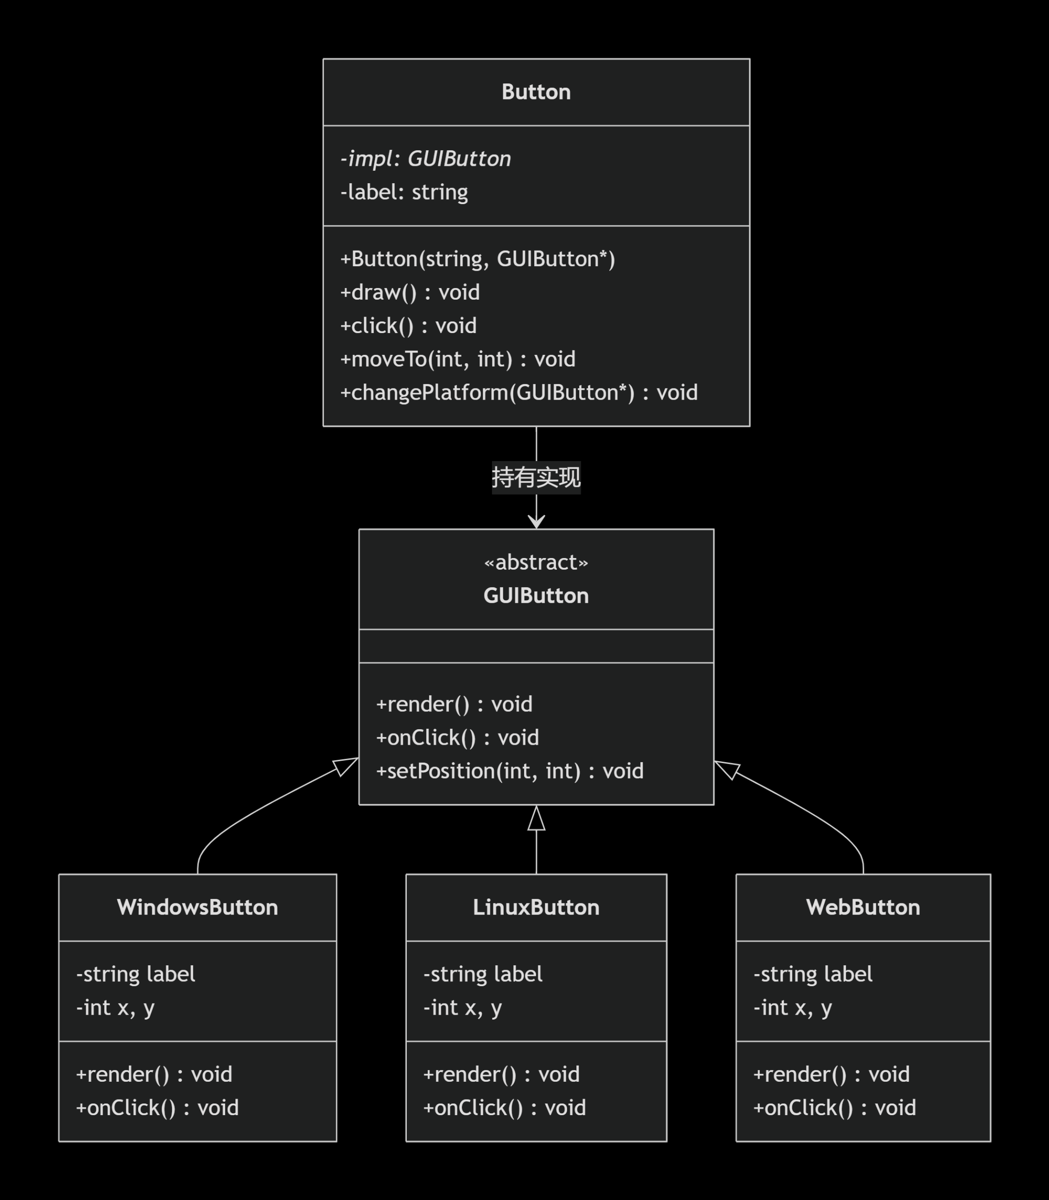
bridge pattern
class GUIButton {
public:
virtual ~GUIButton() = default;
virtual void render(std::string& label, int x, int y) = 0;
virtual void onClick() = 0;
virtual void setPosition(int x, int y) = 0;
virtual std::string getPlatform() const = 0;
};
class WindowsButton : public GUIButton { .... }
class LinuxButton : public GUIButton { .... }
class WebButton : public GUIButton { .... }
class Button {
private:
GUIButton* impl_;
std::string label_;
int x_, y_;
public:
Button(const std::string& label,
GUIButton* impl, int x = 0, int y = 0)
: impl_(impl), label_(label), x_(x), y_(y) { }
void draw() {
std::cout << label_ ;
std::cout << impl_->getPlatform();
impl_->render(label_, x_, y_);
}
void changePlatform(GUIButton* newImpl) {
std::cout << “switch: " << impl_->getPlatform()
<< " → " << newImpl->getPlatform() ;
delete impl_;
impl_ = newImpl;
draw();
}

Slide 16
1979 C with Classes
First non-research user
Language: classes, constructors/destructors, public/private,
simple inheritance, function argument type checking
Library: tasks (coroutines and simulation support)
vector parameterized with macros
1985 TC++PL1
First commercial release
Language: virtual functions, operator overloading, references, const
Library: complex arithmetic, stream I/O
FUTURE
Improved Unicode support
Support for simple graphics and simple user interaction
Support for new kinds of hardware
Exploration of improved styles and implementations of error-handling
Pursue the goal of a completely resource-safe and type-safe C++
Support a wide variety of hardware well
Maintain C++‘s record of stability (compatibility)
1989-91 TC++PL2
ANSI and ISO
Language: abstract classes, multiple inheritance, exceptions, templates
Library: iostreams (but no tasks)
1998 TC++PL3
C++98 the first ISO C++ standard
Language: namespaces, named casts(static_cast、reinterpret_cast、const_cast), dynamic_cast, RTTI
Library: the STL (containers and algorithms), string, bitset
2011 TC++PL4
Language: memory model, auto, for, constexpr, lambdas, user-defined literals, nullptr, move constructor
Library: threads and locks, future, unique_ptr, shared_ptr, array,
time and clocks, random numbers, unordered containers (hash tables), ...
2014 C++14
2017 C++17
Language: generic lambdas, digit separators,
local variables in constexpr func, ...
Library: user-defined literals, ...
Language: structured bindings, variable templates,
template argument deduction from constructors, ...
Library: file system, scoped_lock, shared_mutex (reader-writer locks)
any, variant, optional, string_view, parallel algorithms, ...
2020 C++20
2023
Language: Static reflection facilities
FP style pattern matching
Contracts
Library：coroutines
A modular standard library
executors
Networking
Language: concepts, modules, coroutines, three-way comparisons,
improved support for compile-time computation, ...
Library: concepts, ranges, dates and time zones, span,
formats, improved concurrency and parallelism support, ...

