Slide 1

Application Development with C++ (ELEC362)
Lecture 1: Introduction
mihasan@liverpool.ac.uk

Slide 2
This lecture
What is covered in this lecture?
1. Introduction to the module. 2. Overview of C++.
Why is it covered?
1. To explain the module’s structure and assessment.
2. To appreciate the advantages of C++ .

Slide 3
The learning outcomes
This module will teach you:
1. How to use C++ to implement console-based software.
2. How to use C++ to implement Graphic User Interface (GUI)-based software.
3. How to effectively use online documentations and resources for self-learning in programming context.
Note: This module is NOT a computer science degree in a single module!

Slide 4
Basic information
Pre-request modules:
ELEC129
Or ELEC102 (XJTLU students)
Or COMP122 (Comp Sci & EE students)
Background knowledge : algorithms, basic programming experience, and basic maths.
Statistics from last year: Average mark (61%) Failure rate (6.6%) Top mark (84).

Slide 5
Workload and assessment
The module is 15 credits module (corresponding to 150 hours of study) distributed as:
Lectures ( 18 hours) Lab sessions (36 hours) Project and assignment ( 55 hours total) Self-study ( 39 hours)
Mark distribution:
Assessment | Weight (%) | Assessment aspect | Deadline
Assignment | 30 | Console-based software | Week 6
Project | 70 | GUI-based software Independent learning | Week 13

Slide 6
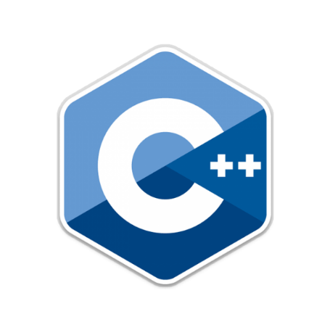

Topics covered
Data Structure
Libraries
GUI Development
Libraries
Games
Engines
Libraries
Scientific
Computing
Libraries
Lectures 10-18
Libraries
Classes
Lectures 6-9
Functions
Lecture 5
Control structures
Lecture 4
Variables
Lecture 3

Slide 7
Resources
Books: Professional C++ , Marc Gregoire (2018).
C++ GUI Programming with Qt, J Blanchette & M Summerfield (2008).
Online documentation: C++ : http://www.cplusplus.com/reference/
Qt : https://doc.qt.io/
Educational websites: https://www.geeksforgeeks.org/c-plus-plus/
https://www.tutorialspoint.com/cplusplus/
Online developers community: https://stackoverflow.com/
https://forum.qt.io/

Slide 8
C++ Overview
C++ is a general purpose programming language, appeared in 1983.
Since its creation, many standard editions of C++ where released including C++ 98, C++ 11, C++ 14, and C++ 17.
In its early times there were many other programming languages:
The Object Oriented Programming (OOP) paradigm enabled C++ to be customisable for any field.
Language | Primary use
COBOL | Business theme
Fortran | Scientific computing
Pascal | Data structures

Slide 9







C++ Overview
As a result, C++ became widely used on all levels of software including:
Operating systems
Applications
Firmware

Slide 10
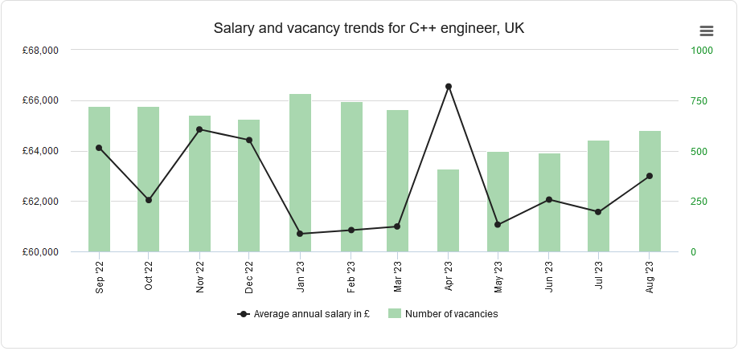
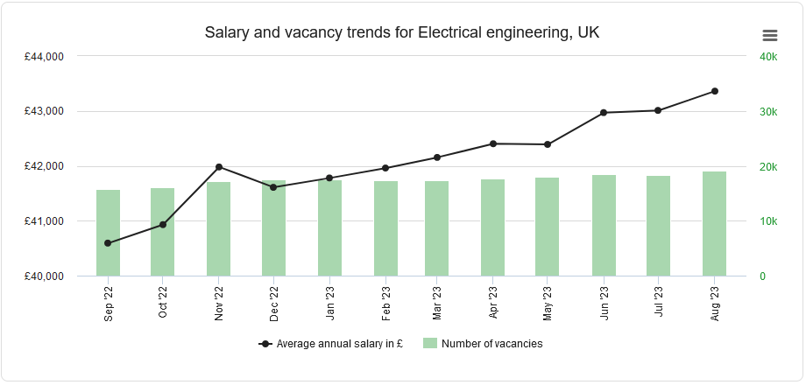
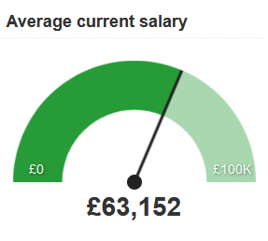
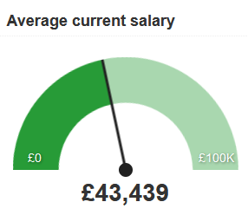
C++ Overview
Despite it being old, C++ is still a valuable skill to have:
https://www.adzuna.co.uk/jobs/salaries/c++-engineer
https://www.adzuna.co.uk/jobs/salaries/electrical-engineering

Slide 11
High level programming languages
Based on the level of programming languages, they are split into two categories:
1. High level languages: programming languages that use human readable syntax. Examples include: C++, MATLAB, Python.
2. Low level languages: programming languages that use machine readable syntax.
Examples include: Assembly language.
The computer only understands Low level languages.
We need a “translator” software to translate high level to low level languages.

Slide 12
High level programming languages
Programming languages
The “translator” can be either a compiler or an interpreter, thus leading to compiled languages and interpreted languages.
Low-level languages
High-level languages
Compiler
Compiled languages
Interpreted languages
Interpreter

Slide 13

Compiled vs Interpreted languages
Compiled languages:
QUESTION: Based on this explanation, are there any clear advantages of either languages?
Interpreted languages:
Source
code
Binary executable
Binary interpretation
Source
code
Interpreter
Line 1
Line 2
Line 3
…….
010110
101010
111011
010010
010110
Line 1
Line 2
Line 3
…….
Compiler

Slide 14
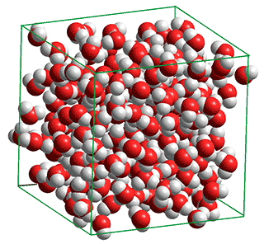
Compiled vs Interpreted languages
Example of compiled languages are C++ and Fortran. While examples of interpreted languages are MATLAB and Python.
QUESTION: Is it all bad for interpreted languages?
Simulation steps | Time (Fortran) | Time (MATLAB)
7000 | 15 sec | 4439 sec
25000 | 38 sec | 13 hours
105000 | 138 sec | ???
http://utkstair.org/clausius/docs/che548/pdf/md_sim.pdf

Slide 15
The compilation process
The code written by the software developer is knowns as the source code.
Source code: The version of software as it is originally written by a human in plain text.
Header file: A file containing parts of code to be shared among multiple source files.
Executable file: A file that runs the programme when it is opened.
The end user only deals with the executable file.

Slide 16

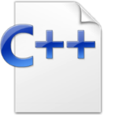


The compilation process
Pre-processor
Compiler
Object file 1 (.obj)
Source code 1 (.cpp)
Linker
Header file 1 (.h)
Executable file (.exe)
Pre-processor
Compiler
Source code 2 (.cpp)
Object file 2 (.obj)
Example of Compiler | Platform | Reference
MSVC | Windows | link
MinGW | Windows | link
g++ | Linux | link

Slide 17



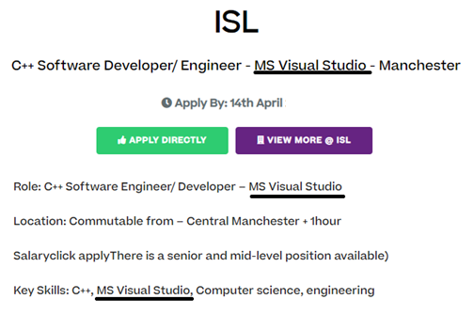
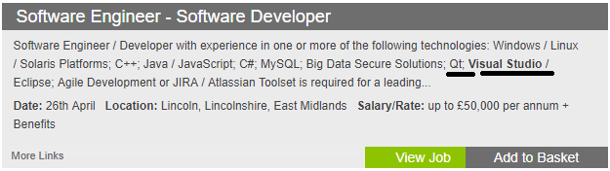
Integrated Development Environments (IDE)
Code development is done using software known as IDE.
For this module we will use Visual Studio (community version):
https://visualstudio.microsoft.com/downloads/
Visual studio is standardly used in the job market.
Knowing it will boost your CV!!

Slide 18
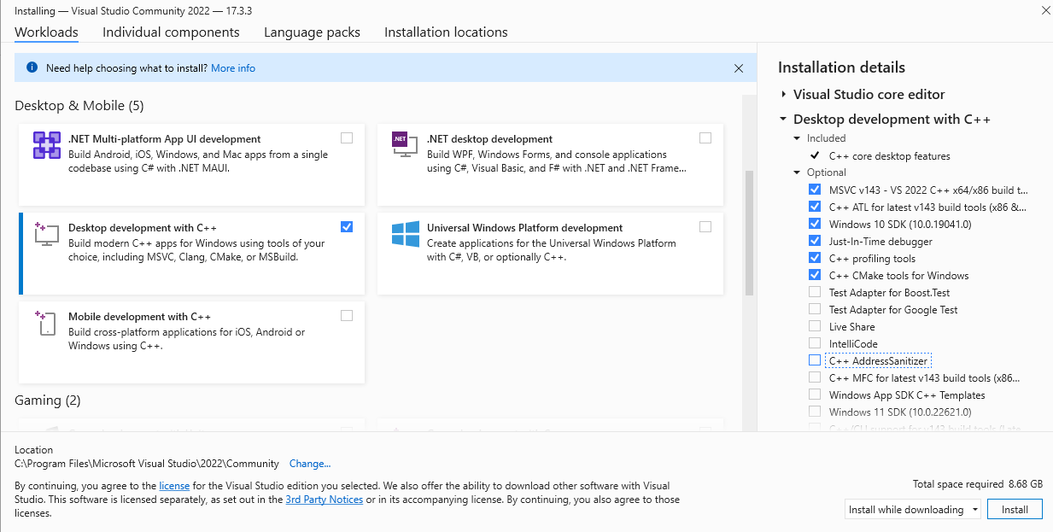
Installing Visual Studio
Download Visual Studio from https://visualstudio.microsoft.com/downloads/
Download the community version, choose the follow option:
Login within 30 days (only on your PC or laptop, not on Uni’s computers).
MAC users can choose any IDE (XCode is a popular choice)
This option

Slide 19
Basic rules of a C++ code
Go to L1D1.cpp
Every programme consists of a set of statements.
Every line has to end with a semicolon;
The code consists of one or more blocks (a block starts with { and ends with }).
Every programme must have one and only one main block/function.
For comments, // is used to make a line of comment, while /* and */ are used to mark the beginning and the end of a block of comments.

Slide 20
Commenting codes
Comments are explanatory statements written by the developer in the code to make it more readable by other developers.
Comments are very important particularly in projects with multiple developers.
Summary for good practice of coding can be found here.
Practical notes:
Follow the comment convention when working on a project with multiple developers.
Convention for this module: state the functionality of every code block in a comment, in addition to commenting any statement with a new function.

Slide 21
Summary
An overview of C++
Difference between complied and interpreted languages.
The role of compliers and how executable files are created.
Introduction to Visual Studio.
Basic rules of C++ coding.

