Slide 1

Application Development with C++ (ELEC362)
Lecture 11: More on Standard Template Library (STL)
mihasan@liverpool.ac.uk

Slide 2
Previous lecture
The Standard Template Library (STL) was introduced and its components were discussed.
Different types of containers were discussed.
Vectors, deques, and lists were discussed.
Maps were discussed.

Slide 3
This lecture
What is covered in this lecture?
Iterators and algorithms in the Standard Template Library (STL)
Why is it covered?
Combining Iterators and algorithms with containers realises the full potential of STL
How are topics covered in this lecture:
7 source codes and discussion questions.

Slide 4
Iterators
Iterators are objects used to access elements of containers.
Can be included in any code using #include <iterator>
Reference: http://www.cplusplus.com/reference/iterator/
There are 5 categories of iterators with different capabilities:
Input: read element multiple times but can’t write.
Output: only write an element and can do it once.
Forward: read and write elements while moving toward the last element.
Bidirectional: read and write elements while moving toward the last or the first element.
Random access: read and write elements anywhere in the container.
Forward
Bidirectional
Obj
Obj
Obj
Obj
Obj
Random access

Slide 5
Iterators
If we have an iterator i and a variable x then:
The keyword “auto” can most of the time identify the right type of iterator.
QUESTION: Why not use pointers instead of iterators?
Go to L11D1.cpp
 | Output | Input | Forward | Bidirectional | Random
Read |  | x = *i | x = *i | x = *i | x = *i
Write | *i = x |  | *i = x | *i = x | *i = x
Move | ++ | ++ | ++ | ++, -- | ++, --, +, - ,-=, +=
Compare |  | == , != | == , != | == , != | == , !=, <, >, <=, >=

Slide 6
Vector iterators
Vector iterators are iterator-specific to vector-type containers.
The datatype of vector-specific iterator is “vector<template>::iterator”
Iterators “begin” and “end” give access to first and one past last element.
Iterator “begin + n” points to the n^{th} element.
Go to L11D2.cpp
rbegin(v)
rend(v)
vector v
Obj
Obj
Obj
Obj
Obj
Obj
begin(v)
begin(v)+2
end(v)

Slide 7
Stream iterators
Stream iterators are stand-alone iterators which iterate on input/output streams.
Header: #include <iterator>
Ref: http://www.cplusplus.com/reference/iterator/istream_iterator/
Ref: http://www.cplusplus.com/reference/iterator/ostream_iterator/
They behave similar to input iterators and output iterators.
For input stream (using cin), the stream iterator is istream_iterator. For output streams (using cout), the stream operator is ostream_iterator.
Go to L11D3.cpp

Slide 8
Insert iterators
Insert iterators are stand-alone iterators that can be used to break insertion/deletion rules for certain containers (including vector, deque, and list).
Header: #include <iterator>
They are used to specify a location in the container to insert a new element.
There are three types of insert iterators:
QUESTION: What is the point of having insertion rules for containers then?
Iterator | Vector-equivalent function
back_insert_iterator <container <T>> | push_back()
front_insert_iterator <container <T>> | push_front()
insert_iterator <container <T>> | insert()

Slide 9
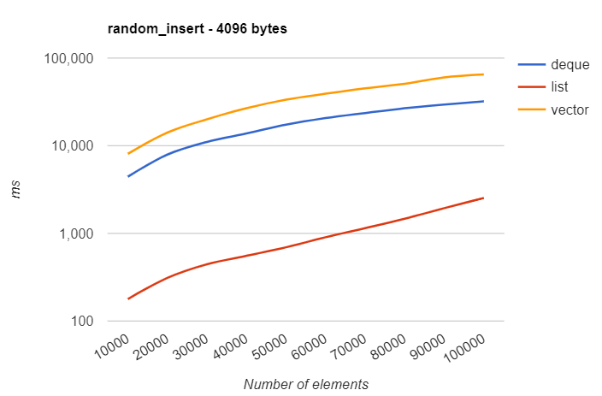
Insertion benchmark
Go to L11D4.cpp
https://baptiste-wicht.com/posts/2012/12/cpp-benchmark-vector-list-deque.html#
Practical note:
Use the most suitable container for the purpose of your code

Slide 10
Iterator invalidation
For some containers, when an element is added/removed the iterators are invalidated (they no longer point to the container).
The rules of this happening vary from one container to another.
Go to L11D5.cpp
To mitigate for this happening, it is better to use index iteration or use the keyword const when handling containers with iterators.
Practical note:
Use const in a function when the container does need changing.

Slide 11
Smart pointers
Smart pointers are stand-alone iterators that behave like a pointer but is optimised for dynamic memory allocation.
Can be included in any code using #include <memory>
Reference: http://www.cplusplus.com/reference/memory/
Most of smart pointers were introduced in C++11.
A noticeable feature when using smart pointers is that “delete” is no longer required.

Slide 12
Smart pointers types
unique_ptr : A smart pointer that contains the only copy of the address of a given location in memory, such that the address (i.e. the ownership) can be moved to another pointer without copying.
shared_ptr : A smart pointer similar to raw pointers, except that it counts the number of pointers holding the same address.
weak_ptr : A special case of shared_ptr where it has the same address of that of shared_ptr without being included in reference counting.
Go to L11D6.cpp
Practical note: User smart pointers mainly when ownership matters.

Slide 13
Algorithms
Algorithms are function templates that act on containers and provide means for various operations for the contents of the containers.
Can be included in any code using #include <algorithm>
Reference: http://www.cplusplus.com/reference/algorithm/
Examples of these algorithms include sorting, searching, finding minimum/maximum, etc.

Slide 14
Functors
Functors are classes where the objects behave as functions.
They are used to customise algorithms’ functionality.
They are used in many occasions in STL library.
Can be included in any code using #include <functional>
The basic idea behind functor is to overload the call operator, such that:
Reference: http://www.cplusplus.com/reference/functional/
Go to L11D7.cpp
MyFunctor (1)
MyFunctor.operator() (1)

Slide 15
Summary
Iterators were introduced and the different types of iterators were discussed.
Stream iterators and insert operators were discussed.
Smart pointers were discussed.
Algorithms and Functors were defined and discussed.

