Slide 1

Application Development with C++ (ELEC362)
Lecture 14: Building the first application
mihasan@liverpool.ac.uk

Slide 2
Previous lecture
Justification for learning Qt was given.
Basic structure of Qt was explained.
An introduction to Qt Creator was given.
Deploying an application using Qt was explained.

Slide 3
This lecture
What is covered in this lecture?
1. Introduction to the concept of applications building using Qt.
2. Introduction of some of frequently used classes (application frames and texts).
Why it is covered?
To understand an application can be built from the classes in Qt.
How are topics covered in this lecture:
Building a sample application.

Slide 4
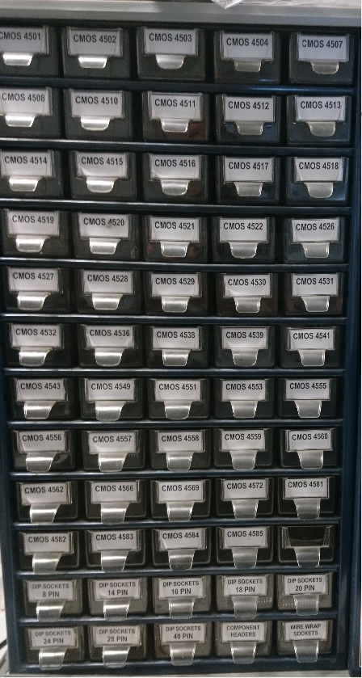
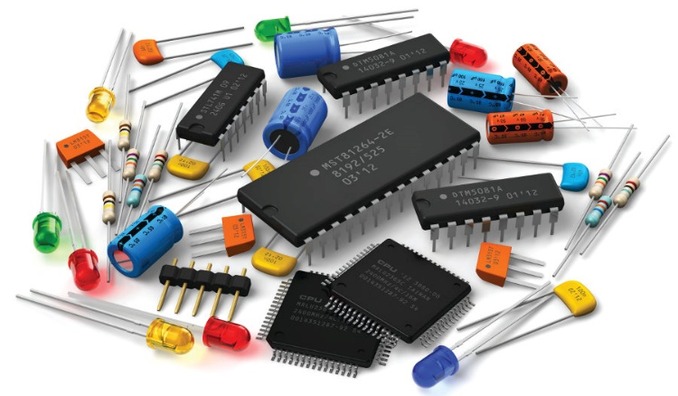
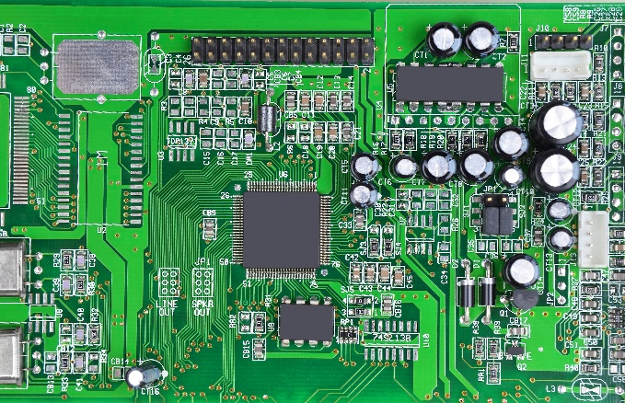
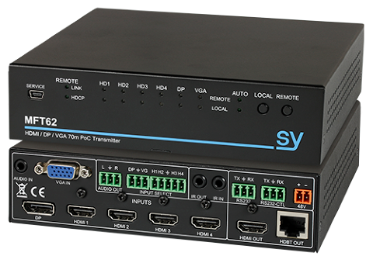
The concept
The main question is: how can an application be built from a library of classes?
Analogous question: how can an electronic device be built from a storage cabinet of electronic components?
Components / objects
Terminals / member functions & data
Circuits / applications
Devices / GUIs
Cabinet / library
Drawer / class

Slide 5
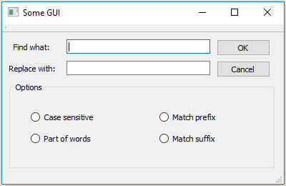
Widgets
When using Qt, every visual item in any window is a “widget” (stands for window gadget).
Every widget is an object of a class but the opposite is not true!
QLineEdit
QDialog
QLabel
QBushButton
QRadioButton
QGroupBox
QRadioButton

Slide 6
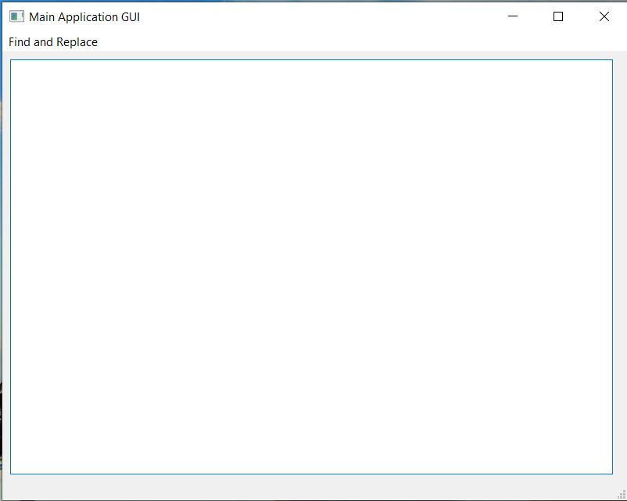
Parent and Child Widgets
In a complex application where there are multiple widgets and multiple windows, the widgets can be parent and/or child widgets.
Parent-Child widgets is
not inheritance.
When a parent widget is closed,
all its children are automatically
closed or deleted.
Parent
Parent
Child
Child
Parent
Child

Slide 7
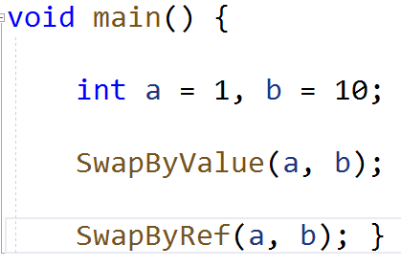
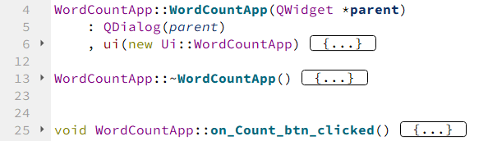
Core difference between CLI and GUI apps
The main difference between standard C++ and Qt is how the code is executed:
The parent widget of the application can be one of three classes only:
QWidget, QDialog, or QMainWindow
Do this when the app starts
Do this
Do this when the app closes
Then this
Then this
Do this when the user clicks on button

Slide 8
QWidget Class
This class is the base class for all user interface classes.
Reference: https://doc.qt.io/qt-6/qwidget.html
Its member data / functions control the following:
Setting the outline of the widget (its shape, design, colours, size policy, etc..)
Settings for mouse tracking, tool tips, curser type, etc..
When used as a parent widget, it generate an empty user interface.

Slide 9
QMainWindow Class
This class provides a framework for applications where the user interacts with one weidget most of the time (called the central widget).
Reference: https://doc.qt.io/qt-6/qmainwindow.html
Its member data / functions control the following:
Docking options for child widgets
Options for menus and toolbars.
When used as a parent widget, it creates a widget with menu bar and status bar templates (suitable for apps with menus and toolbars).

Slide 10
QDialog Class
This class is used to create windows for breif interaction with user. It is suitable for applications where the user interacts with most widgets equally.
Reference: https://doc.qt.io/qt-6/qdialog.html
Its member data / functions control the following:
Modality of the window (whether the window freezes the app until closed or not).
It can provide a return value when the window is closed.
When used as a parent widget, it generate an empty user interface. It is suitable for apps where there are buttons and many input/output widgets

Slide 11
A sample application: Word counter
The task: Design and implement a Qt based GUI application that counts the occurrence of a given word in a typed paragraph. The user will provide both the paragraph and the word to be counted.
Step 1: Requirement analysis: the application must be able to:
Allow the user to input a paragraph or text to be scanned for the counted word (input).
Allow the user to specify the word to be counted (input).
Allows the user to trigger the counter (user action).
Display to the user the count number (output).

Slide 12
A sample application: Word counter
Step 2: Following the incremental model:
Step 3: Create
the app!!
(demonstration).
Count word input
Requirements
widget
choice
Grant access to the word from the code
Does it work?
Paragraph input and word counting
widget
choice
Grant access to the paragraph from the code + word counting
Does it work?
Does it count correctly?
Count word output
widget
choice
Pass count number to the output widget
Does it work?
Practical note: Write a comment in every block to state when it is called

Slide 13
Guess the function trick!!
Every class has 10s of functions, how can we know what function we need easily?
When looking for a function in the documentation, ask three quesitions:
What is the expected return datatype? (important when getting data from object)
What does the function do (in simple words)?
What are the datatypes of its input parameters? (important when giving data to object)
Think of multiple answers per question, most of the time you can guess the function from one answer only!
Answer1
Answer2 (Answer 3)

Slide 14


Guess the function trick!!
Few notes to improve your guess:
A return type void is the most probable when the function returns nothing, or the function is used to modify something.
Example:
A function has no paramters is the most probable if it returns a propertie of the object. Or if the function means only one thing.
Example:

Slide 15
Connecting objects in the application
Every window in the application is defined by a pointer, for the parent window the pointer has the name ui
Every widget we add in Qt Designer is also defined by a pointer, which has a name shown to the right of the screen (example: lineEdit is a pointer to QLineEdit)
The objects in the code can interact through variables we define in the header file, such variables are used to read the data from a widget, process it, and output it to another widget, example:
text()
insert()
p_word
lineEdit_input
lineEdit_output

Slide 16
QDebug Class
This class is used whenever the developer needs to write out debugging or tracing information to a device, file, string or console.
Reference: https://doc.qt.io/qt-6/qdebug.html
Its most wide use is as follows (assuming x is a variable in the code):
This class mimics cout and cin, which are used primarily for debugging when developing a GUI.
qDebug() << “The value of x: “<<x;

Slide 17
Word counter – Further improvements
Verfication on the application level is done, what about validation?
- Try counting how many “h“ in “Hello, How are you?“
Try counting how many “Hello”, then how many “are” in the same sentence.
Try to move the edge of the application.
Validation requires a lot of further work! That is why software testing is a job on its own!

Slide 18
Summary
The concept of developing a GUI application from classes in a library is discussed.
The concept of widgets, parent and child relation were introduced.
The first application has been built.
The object-object connection and the user interface-object connections were discussed.
Classes introduced: QWidget, QDialog, QMainWindow, QDebug, QLineEdit, QBushButton, QPlainTextEdit, QString

