Slide 1

Application Development with C++ (ELEC362)
Lecture 15: Qt Designer
mihasan@liverpool.ac.uk

Slide 2
Previous lecture
The concept of developing a GUI application from classes in a library is discussed.
The concept of widgets, parent and child relation were introduced.
The first application has been built.
The object-object connection and the user interface-object connections were discussed.
Classes introduced: QWidget, QDialog, QMainWindow, QDebug, QLineEdit, QBushButton, QPlainTextEdit, QString

Slide 3
This lecture
What is covered in this lecture?
1. Using Qt designer to improve the application’s user interface and behaviour.
2. Signal-Slot mechanism
Why it is covered?
1. An application with a very good user interface have much higher chances of commercial success.
2. The signal-slot mechanism is very efficient method for object-object communications.
How are topics covered in this lecture: Live demonstration

Slide 4
Qt Designer formatting features
In addition to its use as a source for widgets in a UI, Qt Designer can also be used for:
Controlling the layout of the application (how it looks on different screens and at different sizes).
Controlling the stylesheet of the widgets (their colour, appearance, style, etc..).
Quick implementation of the signal-slot mechanism.
Adding external resources to the project.
Reference: https://doc.qt.io/qt-6/qtdesigner-manual.html

Slide 5
Classes interacting with Qt Designer
Qt Designer walkthrough (demonstration).
By setting options through Qt Designer, we are implicitly manipulating many classes related to the look and the style of the application, including:
Fortunately, Qt Designer sets all the options for these classes automatically!
Anything done in Qt Designer is transformed into a code that is hidden from the developer.
Class | What it does
QLayout | Controls the arrangement of the child widgets in the parent widget and how they change when size/window change.
QStyle | Controls the appearance of individual widgets.

Slide 6


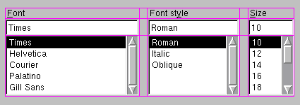
QLayout Class
This class is responsible for managing how the shape of the widgets change when the window is resized, or is drawn on a different size screen.
The class QLayout is not used on its own, instead its subclasses are used:
QHBoxLayout : is used to construct horizontal box of widgets.
QVBoxLayout : is used to construct vertical box of widgets.
QGridLayout : divides the parent widget into rows and columns, and puts each widget it manages into the correct cell.
Practical note: Make sure the layout is sit for any window in your application

Slide 7
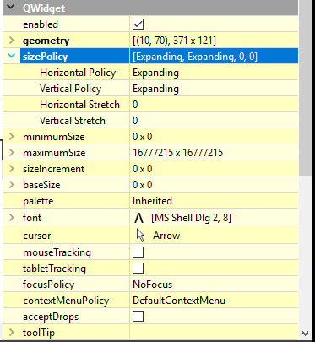
Controlling the appearance of widgets
The layout distributes the space on the parent widget among child widgets based on their size policies.
The size policy of a widget can be changed from
this menu (bottom right of the screen).
Every widget has a “sizeHint()” property, which holds
the ideal size of the widget.
Reference: https://doc.qt.io/qt-6/qsizepolicy.html
Adding simple help messages is possible through the properties of QWidget.
Practical note: Add some quick help messages to improve user experience

Slide 8
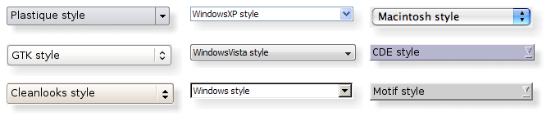
QStyle Class
Qt Designer automatically chooses the Style of the application to make it look native to the platform it is operating on.
Another example: https://doc.qt.io/qt-6.4/gallery.html
How to change the style is here: https://doc.qt.io/qt-6/style-reference.html
Practical note:
A good application must be consistent with its native style

Slide 9
Style sheet of a widget
Style sheets are appearance properties that each widget has. Changing the style sheet allows the developer to control the look of a widget.
Every widget has a list of properties that can be customised, in addition to the allowed values can be found here: https://doc.qt.io/qt-6/stylesheet-reference.html#
To get you started quickly, here is a list of examples by widget: https://doc.qt.io/qt-6/stylesheet-examples.html

Slide 10
Adding resource files to an application
What if you want more customisation options than Qt can offer?
A resource file is data file that can be integrated into the executable file of the application and is accessible during runtime.
Resources files can be pictures, colours, fonts, etc. Which can be imported into a Qt application to customise it.
Practical note:
Make sure you use transparent pictures/icons as resources. If available use vector graphics (extension of .svg or .eps).
A good source of free icons is the noun project.

Slide 11

Signal - Slot mechanism
Qt executes parts of the code based on user’s actions
Signals and Slots are functions, the only difference between them is when they are executed.
Signals (action)
Slots (reaction)
User actions/events (Lecture 16)
WordCountApp::on_Count_btn_clicked()
Functions reporting a change in status
QlcdNumber::display(int value)
ValueChanged (int NewValue);

Slide 12
Signal - Slot mechanism
A Signal is a function which is emits/ transmits its output to all Slots of objects it is connected to automatically.
A Slot is a function that takes the emitted signal as an input and is automatically executed when the signal is received.
This allows for instantaneous update of functions, in contrast to the use of local variables.
The developer can defined their own signals and slots as well:
// Somewhere in a header file:
public slots: // Can be public, private, or protected
//normal function prototype
signals: // has no access specifier
//normal function prototype

Slide 13
Signal - Slot mechanism
Using local variables:
Using signal-slot mechanism:
Fun1()
Fun2()
local_variable
Input_obj
Output_obj
Not necessarily at the same time
Fun1()
Fun2()
Input_obj
Output_obj
Information is sent instantly

Slide 14
Signal - Slot connection
The signals and slots of an object are separated from other functions in the documentation, example: https://doc.qt.io/qt-6/qabstractbutton.html
To connect signals and slots from Qt Designer, press on this icon on the top left
Connecting a single to slot can be done in the code as well:
Further reading: https://doc.qt.io/qt-6/signalsandslots.html
A simple dial reader (demonstration).
connect(sender_obj,SIGNAL(signal_fun()),receiver_obj,SLOT(slot_fun()))
Pointer to receiver object
Pointer to sender object
Must have similar argument type

Slide 15
Summary
In this lecture, further uses of Qt Designer were discussed.
Formatting the lay out of the application and controlling its sizing were discussed.
Controlling the style of a Widget was discussed.
Adding resource files to an application was explained.
The Signal-Slot mechanism was discussed and it was contrasted with connecting objects using variables.
Classes introduced: QLayout, QStyle, QHBoxLayout, QVBoxLayout, QGridLayout, QDial, QLCDNumber

