Slide 1

Application Development with C++ (ELEC362)
Lecture 16: Event handling, QActions and context menus
mihasan@liverpool.ac.uk

Slide 2
Previous lecture
Further uses of Qt Designer were discussed.
Formatting the lay out of the application and controlling its sizing were discussed.
Controlling the style of a Widget was discussed.
Adding resource files to an application was explained.
The Signal-Slot mechanism was discussed and it was contrasted with connecting objects using variables.
Classes introduced: QLayout, QStyle, QHBoxLayout, QVBoxLayout, QGridLayout

Slide 3
This lecture
What is covered in this lecture?
1. Event handling in Qt. 2. Introducing multiple ways to achieve a task in an application.
Why it is covered?
1. Even handling extends the capability of the app beyond what pre-defined widgets can do.
2. Having multiple ways to achieve a task in an application makes applications user friendly.
How are topics covered in this lecture: Live demonstration

Slide 4
What is an Event?
In simple terms, an event is a user action through an input device.
In more advanced terms, an event is a change in the state of an object.
In Qt, there is a class for all types of events, all of which are subclasses from QEvent.
Unlike other classes, objects of event-based classes are constructed by the physical action of the user. Example: https://doc.qt.io/qt-6/qmouseevent.html
Enumerators and flags are heavily used in event classes: https://doc.qt.io/qt-6/qt.html
Event classes | What it describes
QKeyEvent | A key input from the keyboard by the user
QMouseEvent | A mouse click by the user
QTouchEvent | A touch on a smartphone’s screen or a tablet

Slide 5
What is an Event handler?
An event handler is a function that is executed when a particular event occurs.
Event handlers are typically member functions of the widgets receiving the event.
The class QWidget, being the parent of all UI classes has a lot of virtual event handlers (https://doc.qt.io/qt-6/qwidget.html#protected-functions).
Most of event handlers have the word “event” in their name.
The input parameter of an event handler is an object of a class event.
Example:
Mouse event object accessed by pointer
// In a cpp file:
MyWidget::mousePressEvent(QMouseEvent *event){};
Event handler for QWidget class

Slide 6
A sample application: Mouse locator
The task: Design and implement a Qt based GUI application that displays the coordinates at which the mouse is clicked in an empty rectangle.
Applying the incremental model is an exercise for you!!
To implement a virtual function in a class, it must be defined in the header file with a name that is identical to the documentation.
Don’t forget to add the header file of the class if it is not already defined in Qt Designer.
Build the application (demonstration).

Slide 7

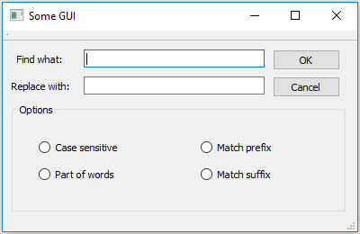
QMouseEvent Class
This class describes a mouse-clicking event by the user.
Reference:
https://doc.qt.io/qt-6/qmouseevent.html
The event records which button was clicked and where (in local coordinates and in global coordinates).
(0,0)
global
x
(0,0)
local
y

Slide 8
Completion list in Qt creator
When coding in Qt creator, one can get a completion list showing suggestions of what you type. It helps writing faster and reducing compiling mistakes.
It can be shown by pressing
See the list of displayed symbols here: https://doc.qt.io/qtcreator/creator-completing-code.html
For a list of keyboard shortcuts:
https://doc.qt.io/qtcreator/creator-keyboard-shortcuts.html
Ctrl
+
Spacebar

Slide 9

Actions
Instead of having an individual event handler for every user action. We can define objects that allow for multiple user events to have a single event handler.
QUESTION: How many ways can one save a document in MS Word?
Three levels of responses from the app:
Signals
Slots
Actions
Events
Event handlers
Non-user signals: timeout()
Other slots: triggered()

Slide 10
QAction Class
This class defines a command that can be invoked by multiple widgets/user actions.
Reference: https://doc.qt.io/qt-6/qaction.html
Just like other classes in Qt, every QAction property has a setter and getter function.
Every object of the class QAction can have an icon attached to it ( using resource files).
The functionality of the Action can be implemented by implementing the function triggered(). Such that whenever the action is called, this function is executed.
Objects of the class QAction are automatically created by Qt Designer when the chosen class of the application is QMainWindow.

Slide 11
A sample application: Text formatting app
The task: Design and implement a Qt based GUI application that allows the user to type paragraphs, change their font size and colour in the application. The app should have at least 3 different methods to change of the colour and the size of the text.
Applying the incremental model is an exercise for you!!
We choose QTextEdit object over QPlainTextEdit because it allows formatting.
Build the application (demonstration).

Slide 12
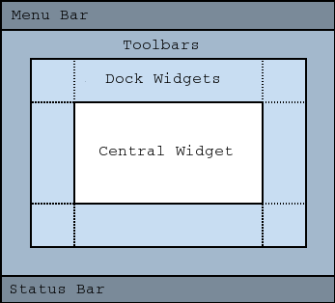
QMainWindow revisited
Any window based on QMainWindow class has a default layout, which can be activated from the constructor.
Practical note:
When developing an application that relies on menus and toolboxes, use QMainWindow as the base class for the application.

Slide 13
QMenu Class
This class constructs menus in the application.
Reference: https://doc.qt.io/qt-6/qmenu.html
The menus can belong to a menu bar, or they can be context menus (right-click menus).
Menus can be nested (parent menu opens child menus)
Qt Designer creates menus very easily when using QMainWindow, for every item in the menu, an action (object of QAction) is generated automatically.
In Qt, menus do nothing on their own, they merely link the user to an action.

Slide 14
QContextMenuEvent Class
This class constructs context menus (right-click menu).
Reference: https://doc.qt.io/qt-6/qcontextmenuevent.html
This class is a special case from QMouseEvent optimised for creating context menus.
It is a virtual event handler for all classes derived from QWidget.
The context menu must be constructed by code (not doable from Qt Designer).
To create the menu, we need to create a function to construct the menu, and call it in the constructor.
Practical note: For good code organisation create functions to construct menus and call them in the constructor

Slide 15
Create a child window
Up to this point we only developed one-window applications.
To create a child window, a class has to be defined representing the child window. The child window is displayed when an object of the class is constructed.
Most of the time, the child window has to be of the QDialog type.
To pass data from the QDialog object, the function exec()has to be used.
Pass the data from the local variables in the child window to the local variables in the parent window.

Slide 16
Summary
In this lecture, the concept of events and event handling was discussed.
The coordinates systems in Qt were discussed.
The concept of actions has been discussed.
Constructing menus in menu bars, toolbars and context menus was shown
Creating a child window in an application was shown.
Classes introduced: QEvent, QKeyEvent, QMouseEvent, QTouchEvent, QAction, QMenu, QContextMenuEvent, QTextEdit

