Slide 1

Application Development with C++ (ELEC362)
Lecture 17: Drawings in Qt Applications
mihasan@liverpool.ac.uk

Slide 2
Previous lecture
In the previous lecture, the concept of events and event handling was discussed.
The coordinates systems in Qt were discussed.
The concept of actions has been discussed.
Constructing menus in menu bars, toolbars and context menus was shown
Creating a child window in an application was shown.
Classes introduced: QEvent, QKeyEvent, QMouseEvent, QTouchEvent, QAction, QMenu, QContextMenuEvent, QTextEdit

Slide 3
This lecture
What is covered in this lecture?
Classes related to drawings, paintings, and image handling
Why is it covered?
Almost every application in existence has one aspect related to paints/drawings
How are topics covered in this lecture: Live demonstration

Slide 4

QPainter Class
This class is responsible for low-level drawings ranging from simple lines to complex polygons and images.
Reference: https://doc.qt.io/qt-6/qpainter.html
Objects of this class can operate on any object of a class
inheriting QPaintDevice (such as QWidget).
A QPainter object can operate on a widget by implementing
the virtual function paintEven(QPaintEvent *event).
A QPainter object initiates the drawing process, it can
draw independently, or using other objects.
QPainter obj
QPaintDevice obj

Slide 5
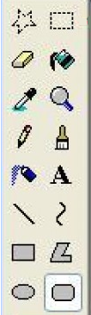
Classes that work with QPainter
This is a brief list of selected classes used for painting with QPainter objects:
A simple way to think of it is to imagine taking the widget to MS Painter to paint on it and return it back to Qt.
Class | What it does
QPen | Defines a “pen” to draw shapes (its style, width, and colour).
QBrush | Defines the colour and the fill pattern of closed shapes.
QRectF | Defines a rectangle (F stands for Float).
QPolygon | Defines polygons by having a set of points.
QPointF | Defines a point (F stands for Float).
QImage | Defines an image imported to the project.

Slide 6
Painting events
The function paintEvent()is implicitly called in the constructor.
To change a painting during the operation of the application, the function repaint()or update()should be called. Both functions belong to the widget where the paint change should occur.
The function repaint()redraws the widget immediately, but can cause flickering for widgets with heavy paints. The function update()redraws the widget in the next event loop iteration, thus it minimises the flicker.
Example of flickering: https://www.youtube.com/watch?v=CxLvnNrutG4. It can be resolved by a technique known as double-buffering, which is implemented by default in Qt.

Slide 7
A sample application: Mouse tracker
The task: Modify the Mouse tracker application such that the type of the click (left, right, or middle) is indicated by a changing colour of a rectangle in the application window.
Build the application (demonstration).
Practical note:
Remember to include the header of every class that was not defined in Qt designer.
Only use Qpainter for non functional drawings (i.e controlling the look of the widget)

Slide 8
The graphics view framework
For large drawings, dealing with every line, shape, or colour becomes a burden.
A high-level alternative is the Graphics View Framework.
Reference: https://doc.qt.io/qt-6/graphicsview.html
It is far more efficient to deal with drawings as composition of objects rather than a composition of lines and colours.
The graphics view framework is a special case of the model-view programming in Qt.
Reference: https://doc.qt.io/qt-6/model-view-programming.html

Slide 9
The graphics view framework
The graphics view framework consists primarily of three classes:
QGraphicsScene: The area of the drawing.
QGraphicsView: The window showing the visible part of the drawing.
QGraphicsItem: The building blocks of the drawing.
QGraphicsItem obj
QGraphicsScene obj

Slide 10
QGraphicsScene Class
This class provides surface to draw large 2D graphic items, all of which are QGraphicsItem objects.
Reference: https://doc.qt.io/qt-6/qgraphicsscene.html
An object of this class can be thought of as a hidden drawing, it needs a QGraphicsView object to be seen.
It can efficiently manage millions of items, providing functionalities such as zooming, locating and tracking of items with simple lines of code.

Slide 11
QGraphicsView Class
This class provides a widget to visualise the content of a QGraphicsScene object.
Reference: https://doc.qt.io/qt-6/qgraphicsview.html
An object of this class can be added to the UI from Qt Designer.
An object of this class can be used to visualise a whole scene or parts of it.
It provides scroll bars, in addition to pan functionality to the scene it is visualising with minimal coding.

Slide 12
QGraphicsItem Class
An abstract class that is the base class for all items in any QGraphicsScene object.
Reference: https://doc.qt.io/qt-6/qgraphicsitem.html
In addition to a large number of predefined items, such as rectangles, polygons, pixelmaps and paths, it allows the developers to define their custom items.
It has lots of virtual event handlers, allowing the addition of complex functionality to the drawing, including item-item interaction.
Every object of this class has a bounding rectangle
w
(x,y)
h
With respect to scene

Slide 13
Coordinates transformation
In the Graphics View Framework, every element has its own coordinates!
QGraphicsView obj
x
(0,0)
The view has the coordinates of the widget.
Items are placed using the scene's coordinates.
Mapping is done using mapFromScene(), mapToScene(), and mapFromItem()
QGraphicsScene obj
x
(0,0)
(3,1)
QGraphicsItem obj
(1,2)
(0,0)
(0,0)
x
y
y
x
y
y

Slide 14
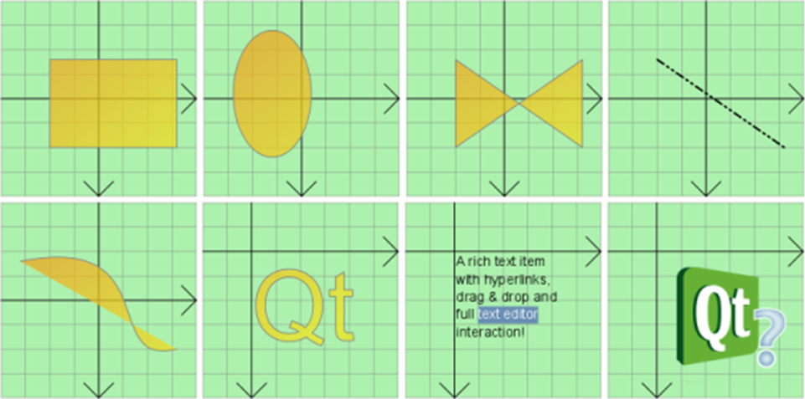
Derived classes from QGraphicsItem
Rect
Ellipse
Polygon
Line
The name of any of these classes is:
QGraphics”word”Item where “word” is one of these indicated to the left.
You can define your own custom items.
Path
SimpleText
Text
Pixmap

Slide 15
A sample application: Orbit animation
The task: Design and implement a Qt-based GUI application that animates the motion of the earth around the sun.
Build the application (demonstration).
Practical note:
Remember to set the scene in the constructor when working with graphics view framework.
Because the scene object and the view object are highly dynamic, verify that they interact as intended while developing the code.
When you need to scale, rotate or shear items, draw a small circle centered at the origin of the scene to keep track of your work.

Slide 16
QTimer Class
This class provides time synchronised signals in single shot mode and in repetitive mode.
Reference: https://doc.qt.io/qt-6/qtimer.html
The signal emitted from an object of this class is called timeout().
Combining a Timer object with paint/graphics is the basis for simple animations.
They are best implemented using the signal-slot mechanism.
timeout()
timeout()
time (ms)
t = 0
start(50)
50
100

Slide 17
QTransform Class
This class controls the translation, rotation, scaling, and shearing of coordinate system .
Reference: https://doc.qt.io/qt-6/qtransform.html
Typically used when dealing with graphics, as well as simple drawings using QPainter.
It works by multiplying the coordinates of every point in the coordinate by a matrix to obtain the new coordinates. The matrix can be automatically generated or specified by the developer.
The origin point in any transform is the origin of the view. Unless the function translate()is called, which moves the origin point of the transform.

Slide 18
Graphics View Framework vs QPainter
A comparison between the two approaches:
QUESTION: When is it better to use one of the two approaches over the other?
Aspect | QPainter | Graphics View Framework
Simplified concept | Similar to changing canvases when a modification is required | Similar to changing “stickers” on a single canvas.
Interaction with user | Not possible as the drawing is static | Ideal for interaction as every element is an object
Ease of coding | Relatively easy | Requires invoking QTransform when the objects change shape/position

Slide 19
Summary
In this lecture, different drawing/graphics approaches in Qt were discussed.
Painting on widgets was discussed.
Handling graphics using the Graphics View Framework was discussed.
Classes introduced: QPainter, QPen, QBrush, QRectF, QTimer, QGraphicsView, QGraphicsScene, QGraphicsItem, QTransform

