Slide 1

Application Development with C++ (ELEC362)
Lecture 5: Memory management
mihasan@liverpool.ac.uk

Slide 2
Previous lecture
Cases where the code may not run sequentially were discussed
If-else and switch-case structures were discussed under selection structures.
For loop, While and Do-while loops were discussed under repetition structures.
The concept of event loops was discussed.
The definition of functions and how they work was discussed.
Error handling was discussed.

Slide 3
This lecture
What is covered in this lecture?
1. Pointers. 2. Memory managment
Why is it covered?
1. Pointers are vital for efficient memory management of any programme.
2. Memory management is the ultimate point of having pointers.
How are topics covered in this lecture:
2 source codes

Slide 4
Pointers definition
Pointers are variables that store the memory address of a variable of the same type , or memory location.
Syntax:
Google style code requires the dereferencing operator “*” to be attached to either the data type or the variable’s name.
Memory
int Number = 10;
0x0001496
Number
10
0x0001500
0x0001504
DataType *pVariableName;
DataType* pVariableName;
4 -bytes
Memory
pVariableName
0x0001544
0x0001600

Slide 5
Pointers naming and initialisation
It is recommended to start the name of a pointer by “p”.
To initialise a pointer, the referencing operator “&” should be used.
Examples:
The datatype of the pointer must match the datatype of the variable it is pointing to.
int Number{99};
int *pNumber;//Declare pointer
pNumber = &Number;//Initialise it
int Number{99};
//Declaration & initialization
int *pNumber{&Number};

Slide 6
Referencing and Dereferencing operators
The two operators to handle pointer are the reference operator “&” and the dereferencing operator “*”, what they do depends on where they appear.
Context | dereferencing operator “*” | reference operator “&”
In a declaration | int *pNumber; Means the variable pNumber must hold a memory address | int &rNumber=x; Means the variable rNumber is another name of the variable x
Elsewhere | cout << *pNumber; Means read the value stored in the memory address held in pNumber. | pNumber=&x; Means read the memory address where the variable x is stored in the memory.
int Number=99;
int rNumber=Number;
Memory
int Number=99;
int &rNumber=Number;
Number
99
0x0001496
rNumber
99
0x0001500

Slide 7
Referencing and Dereferencing operators
Example:
QUESTION: Is it better to use pointers or references?
int Number = 40;
int *pNumber = &Number; // Say its 0x0064fd
int &rNumber = Number; // “Alias” variable
std::cout << Number << endl;
std::cout << &Number << endl;
std::cout << rNumber << endl;
std::cout << pNumber << endl;
std::cout << *pNumber << endl;
Memory
Number
40
0x0064fd
&Number

Slide 8
Pointers and arrays
The name of any array in C++ is a memory address, which can be used to initialize a pointer to access and manipulate the elements of the array.
Example:
data
int Data[4]{1,2,3,4};
int *pData{nullptr}; // Points nowhere
pData = Data; // Equivalent to pData=&Data[0];
std::cout<<*(pData+2)<<endl;
std::cout<<Data<<endl;
1
0x0001496
2
0x0001500
3
0x0001504
4
0x0001508
Practical note:
Make sure your code does not access memory locations beyond the array’s end.
After a pointer is not needed, reinitialise it to nullptr

Slide 9
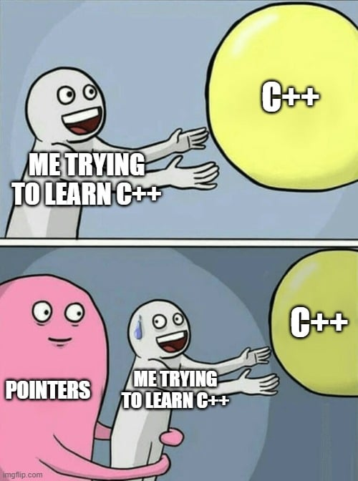
Why are pointers a thing?
Pointers are the key to memory management of a code.
Mostly this is done by two strategies enabled by pointers:
Dynamic memory allocations: Leaving it to the user to
decide how much memory is needed and for how long.
Avoiding copying in memory: using pointer to pass data to functions prevent replication.
From Lecture 10 onwards, things will be simpler!!

Slide 10
Dynamic memory allocation
Programs use static memory (the stack) and dynamic memory (the heap).
Pointers are the only way the programme can have access to dynamic memory.
Pointers can access dynamic memory through new keyword (for allocation) and delete (for freeing memory). new and delete ( delete [] for arrays) must operate on the same memory location.
Go to L5D1.cpp
Aspect | Static memory | Dynamic memory
Allocation | Allocation is done at compile-time only | Allocation can be done at compile time or run-time
Lifetime | As long as the programme is running | Can be controlled
Size | Fixed | Variable
Practical note: Maximise the use of dynamic memory in your code.

Slide 11
Dynamic memory allocation algorithm
This is how code L5D1 works:
User input: 5
pdynArray
φ
pdynArray
pdynArray
5
ptempArray
φ
ptempArray
ptempArray
5
pdynArray
5
ptempArray
pdynArray
φ
ptempArray
5
pdynArray
5
pdynArray
ptempArray
φ
ptempArray
5

Slide 12
Passing data to functions using pointers
In Lecture 4, we discussed simple functions of the type:
The main limitation of simple functions is that they can only return one variable.
The use of pointers and references allow us to do this instead:
Go to L5D2.cpp
return_type FunctionName(datatype arg1, datatype arg2){return output; }
void FunctionName(datatype& arg1, datatype& arg2, datatype& arg3,..){}
These can be input and output at the same time!!!

Slide 13

Arguments passing in functions
This is how code L5D2 works:
Memory
a
1
0x0001496
b
10
0x0001500
void SwapByRef(int& x,int& y);
void SwapByValue(int x,int y);
x
1
0x0001596
y
10
0x0001600
Practical note: Pass variables by reference or pointers whenever possible.

Slide 14
Professionally written functions
A lot of libraries written by C++ community use the memory managed style of functions:
GSL Library, SUNDAILS library, even functions in C++ header files.
Sometimes the return of a function is used as an error indicator.
To tell the other developers that one of the parameters is an input only, const is used.
int gsl_matrix_fwrite(FILE *stream, const gsl_matrix *m)
Return a number to say how it went, (0 for success)
Function to write a GSL matrix to a file
File to be written to
Matrix to be written in the file

Slide 15
Function overloading
Function overloading is defining multiple functions with the same name but different parameters. The compiler can decide which one to call based on the parameters passed at calling.
Example:
// Two integer version
int Max(int x,int y); {return (x > y ? x : y);}
// Three integer version
int Max(int x,int y,int z); {int m = (x > y ? x : y);
return (z > m ? z : m);}
//Two double version
double Max(double x,double y); {return (x > y ? x : y);}
void main () { int c = 2, d = 4;
double g = 2.3 , h = 5.2;
Max(g,h);
Max (c,d);
}

Slide 16
Function templates
Function templates are efficient way to generate overloaded functions for different data types.
The idea is to pass the data type as it is a parameter to the function.
template <typename T> // T is the arbitrary datatype
T Max(T x,T y){return (x > y ? x : y);}
void main () { int c = 2, d = 4;
double g = 2.3 , h = 5.2;
char j=‘y’, k=‘w’;
Max<double>(g,h); // T is double
Max<int>(c,d); // T is integer
Max<char>(j,k); // T is character
}

Slide 17
Summary
The definition of pointers, their use and their advantages were discussed.
Differences between two types of memory were discussed.
Memory efficient functions were discussed.
Functions overloading and templates were discussed .

