Slide 1

Application Development with C++ (ELEC362)
Lecture 6: Classes & Object-Oriented Programming
mihasan@liverpool.ac.uk

Slide 2
Previous lecture
The definition of pointers, their use and their advantages were discussed.
Differences between two types of memory were discussed.
Memory efficient functions were discussed.
Functions overloading and templates were discussed .

Slide 3
This lecture
What is covered in this lecture?
1. Object Oriented Programming (OOP). 2. Introduction to classes.
Why is it covered?
1. Classes are the building block of any software.
2. OOP is the standard paradigm in software development.
How are topics covered in this lecture:
2 source codes and a practical example.

Slide 4
Side story
Side story: Integrated Circuits (IC) in Electronics

Slide 5
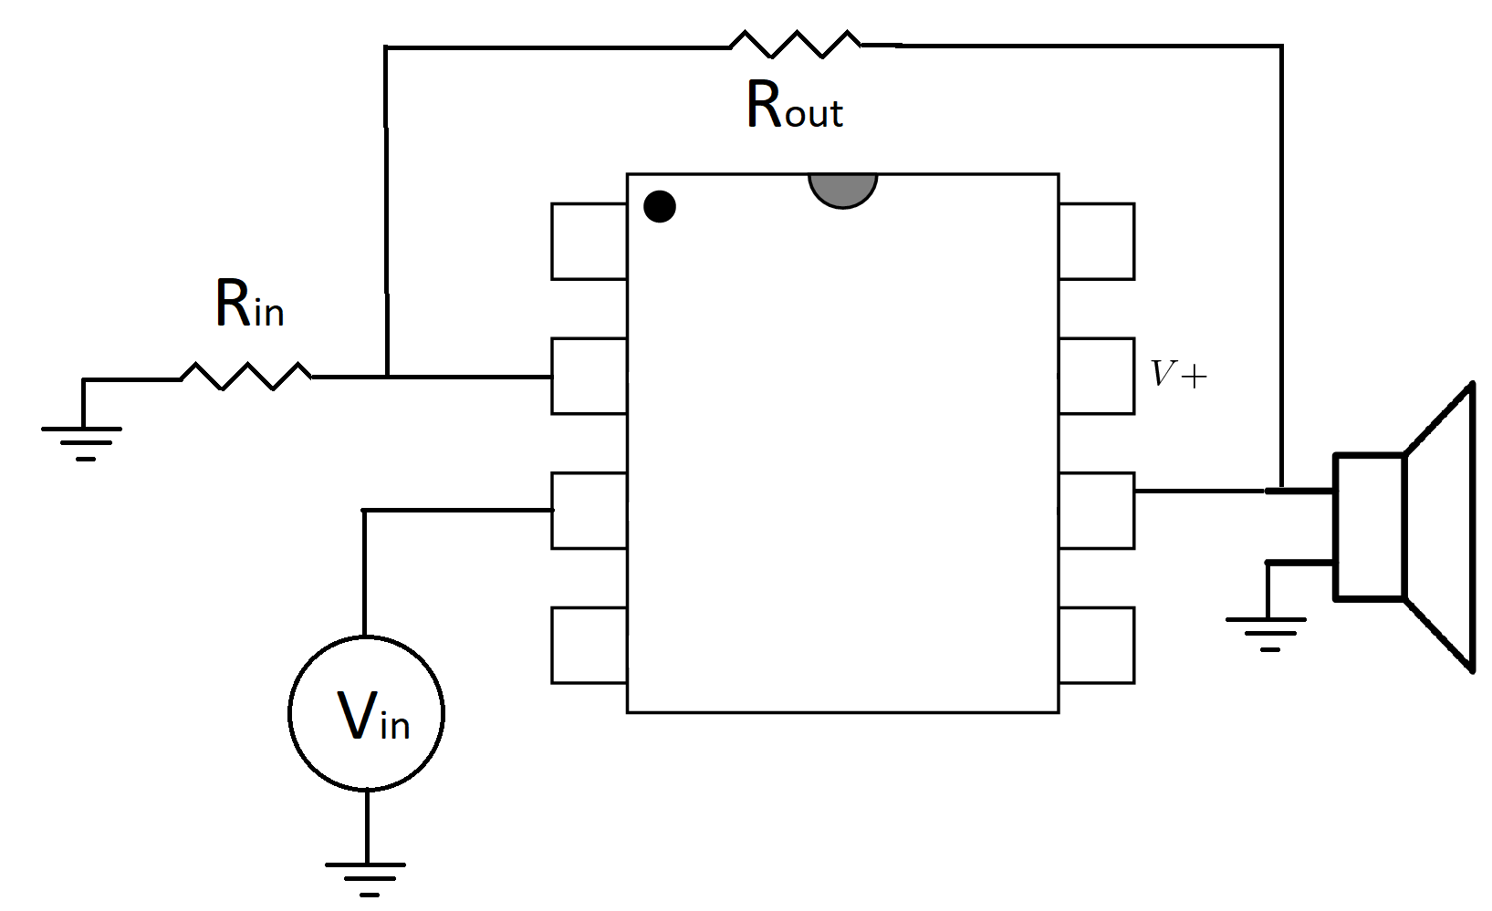
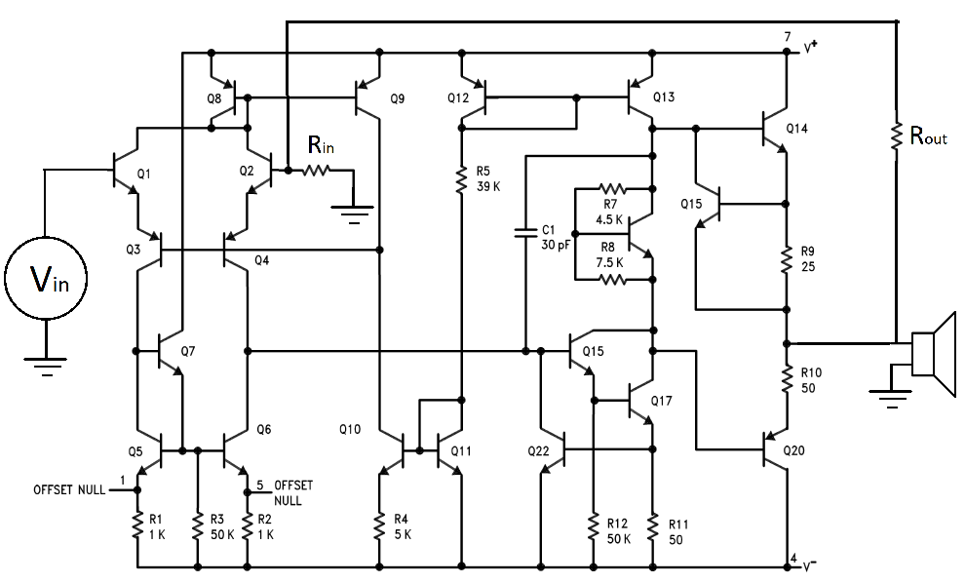
ICs versus basic components
If you are asked to build an amplifier circuit, which one will you build?
Do you prefer using Arduino/Raspberry Pi or basic components in your FYP?

Slide 6
ICs versus basic components
The vast majority of electronics engineers prefer using ICs for many reasons including:
It is easier: Fewer design decisions to make.
It saves a lot of time: No need to repeat what others have built.
It gives a consistent performance: Same performance for same IC.
It is cheaper: Saving production costs and time.
Since their invention in 1958, ICs revolutionized technology, leading its inventor to win a Nobel Prize in Physics in 2000 (https://www.nobelprize.org/prizes/physics/2000/summary/)

Slide 7
Side story
End of the side story

Slide 8

Object Oriented Programming
Some computer scientists in the 60s were like:
Object Oriented Programming (OOP)
revolutionised software just like ICs
revolutionised all electronics.
The core idea is: Instead of building codes
using basic variables, they are built using
higher-level variables known as “objects”.

Slide 9
Object Oriented Programming
A conceptual comparison between ICs and OOP:
Aspect | Modern Electronics | Modern software
Building block | Integrated circuits | Objects
What is the building block made from | Made from basic components such as resistors, transistors, capacitors, etc. | Made from basic variables datatypes and control structures such as double, integer, bool, and for loops
Requirements for using building block | Having the datasheet | Having the documentation

Slide 10

Object Oriented Programming
Object Oriented Programming (OOP) is a programming paradigm where the programming problem is defined as a collection of interacting objects describing real-world entities.
Abstract concept of the object in software such as MultiSim:
Resistor
Entity (object)
value
Max_power
Attributes (properties)
VI_char()
Methods (functionalities)

Slide 11

Object Oriented Programming
Another example:
Object | Properties | functionality
Mario | Number of lives, collected coins | Fire bullets, flying, sliding
Turtle | Points gained when beat | Range of motion, range of fly
Level | Time, terrane, map | ??
Mystery box | Design, points hidden | Fire flower release, Mushroom motion

Slide 12
Object Oriented Software Design
When designing a software based on OOP, the following steps has to be followed:
1. Given the specification, Identify different entities of the software.
2. Define the relationship between these entities.
3. Define the attributes of these entities.
4. Defined methods/functions of these entities.

Slide 13
Object Oriented concepts
There are 4 major concepts in OOP:
Encapsulation: binding together the data and the functions that manipulate them.
Abstraction: displaying only essential information on data and hiding the details of implementation.
Object Oriented Programming
Polymorphism: Lecture 8
Inheritance: Lecture 9

Slide 14
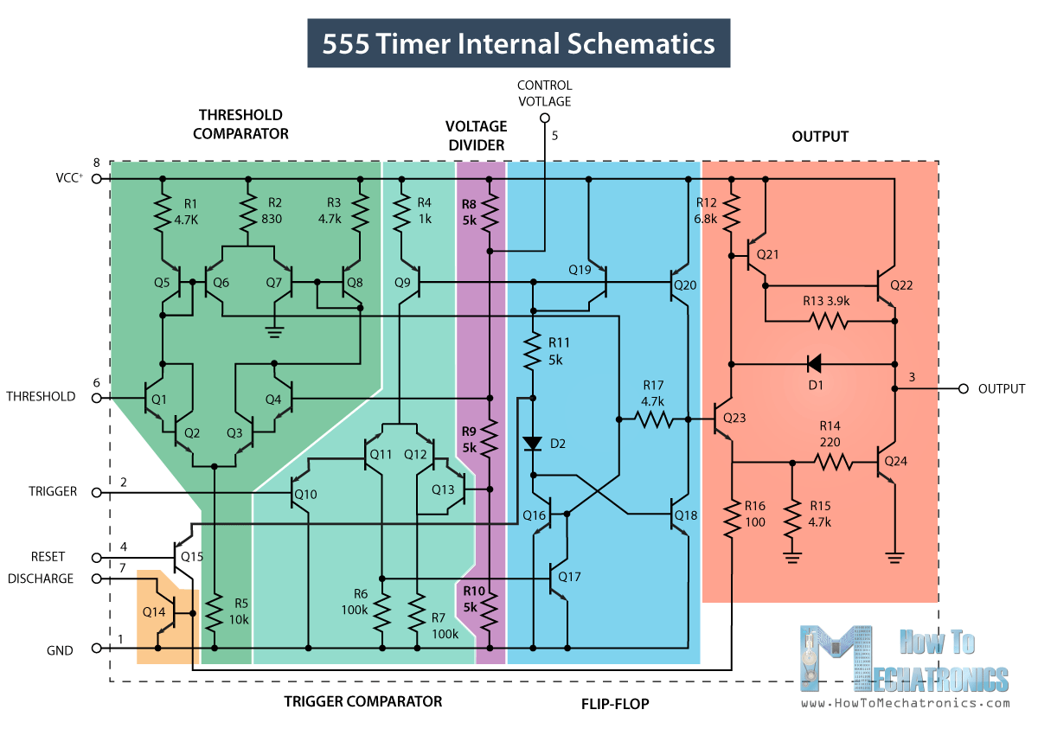
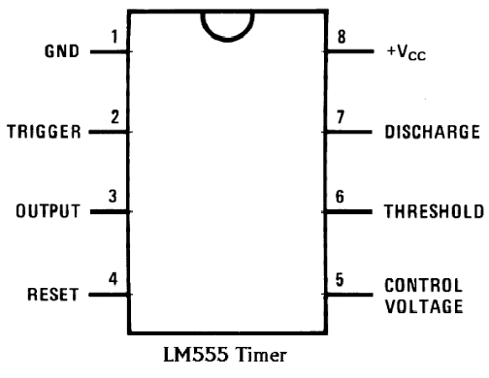
Encapsulation and Abstraction
Encapsulation means hiding the details of the implementation inside the object.
Abstraction is the concept of dealing with the object as a “black box”.
Abstraction is a result of Encapsulation.
A higher level of encapsulation leads
to better abstraction, which leads to more efficient code development / user friendly software.
Practical example: MOOSE vs DEAL II

Slide 15
Classes
A class is a user defined data type, which holds its own data members and member functions, which can be accessed and used by creating an instance of that class.
Code implementation of an example object in MultiSim:
An instant of a particular class is called an Object.
Resistor
Class
value
Max_power
Member data
VI_char()
Member functions

Slide 16
Classes
Syntax:
Google style for naming classes is similar to that of functions.
Go to L6D1.cpp
class ClassName {
public:
//member data and functions
private:
//member data and functions
protected:
//member data and functions
} ;
Access specifier

Slide 17
Making classes truly custom-made datatypes
In Lecture 1, we said OOP can make C++ customisable for any purpose, essentially defining “new” datatypes:
Basic datatypes
Custom-made datatypes (classes)
Declaration and Initialisation
(Lecture 3)
Declaration and Initialisation
(Lecture 7)
Operators
(Lecture 3)
Operators
(Lecture 8)
Relating to other datatypes- casting
(Lecture 3)
Relating to other datatypes- casting
(Lecture 9)

Slide 18
Access specifiers
The class must be defined before it is used in the main function:
Access specifiers control access to class members from outside the class.
1. public: allows access from outside the class.
2. private: gives access only within the class.
3. protected: gives access within the class and to derived classes (Lecture 9).
class MyClass{
//Class definition here;
}
int main () {
//Statements;
}

Slide 19
Class vs Object revisited
The class is a user-defined datatype, whereas the object is an entity (or a variable) of that datatype.
Class
Object
class Triangle {
private:
double a,b,c,s; // member data
public:
// Methods or member functions
void SetSides(double x,double y, double z){};
double CalcPerimeter(){};
double CalcArea(){};
};
Triangle t;
double x = 1, y = 2, z = 3;
t.SetSides(x,y,z);
This is how to call a member function to operate on an object

Slide 20
Structure
Structures are the historic origin of classes.
Syntax:
The major difference between a class and a structure is that all member data/functions in a class are private by default, while in a structure they are public.
Go to L6D2.cpp
struct MyStruct {
// member data
// Methods or member functions
};
Practical note: Use structures only for data saving.

Slide 21
Summary
The definition of Object Oriented Programming and its 4 major components were discussed.
Defining classes and objects in a code were discussed.
The role of access specifiers was discussed.
Structures were discussed and compared to classes.

