Slide 1
Bayesian statistics 2/4 Core concepts & parameter estimation
Oussama Abdoun (MEng, PhD) – oussama.abdoun@pm.me
Bayesian Statistics – CRNL – dec 2024

Slide 2
On the menu
Part 1
Bayes law
Parameter estimation
Credible intervals
Frequentist vs. Bayesian statistics
Part 2
Prior specification
Numerical resolution (MCMC)
Statistical testing
Bayesian Factor
Application to simple models: correlation, two-sample tests
Associated code at: gitlab.com/ousabd/statscourse2023/-/tree/master/ 2.03-2.04_bayesian-statistics

Slide 3
Recap of frequentist statistics
In frequentist statistics, parameter estimation relies on maximizing data likelihood
In frequentist statistics, the interpretation of CIs and p-values is convoluted and counter-intuitive:
they do not state anything about population parameters/hypotheses
CIs can only be interpreted in relation to a series of replications (e.g. meta-analysis)
p-values are not absolute measures of evidence
The modern NHST is fundamentally broken:
it combines, in an inconsistent way, two distinct procedures (Fisher's and the Neyman-Pearson) that had fundamentally different goals and only superficial resemblance
for example, it is used to decide between two hypotheses but it specifies only one
the publication system (favoring p < .05) perpetuates these inconsistencies and creates downstream issues
Bayesian statistics provides inference (CIs and hypothesis testing) with intuitive and straightforward interpretation

Slide 4

Medical test example
A 44-year old woman got a positive test from a mammogram.
How worried should she be about having a breast cancer?
Frequentist-like approach: H₀ = no cancer. According to the medical literature, the probability of getting a false positive test (= observing the data assuming H₀) is .10
→ p > .05 therefore we can not reject the null hypothesis
Ok, so what??

Slide 5
Classification errors & prevalence
= positive test
affected
not affected
true positives
false positives
false negatives
true negatives

Slide 6
Classification errors & prevalence
= positive test
affected
not affected
true positives
false positives
false negatives
true negatives

Slide 7
Classification errors & prevalence
50% prevalence
12% prevalence
= positive test
= positive test
affected
not affected
true positives
false positives
false negatives
true negatives

Slide 8
Classification errors & prevalence
50% prevalence
12% prevalence
= positive test
= positive test
affected
not affected
true positives
false positives
false negatives
true negatives

Slide 9
Medical test example
A 44-year old woman got a positive test from a mammogram.
How worried should she be about having a breast cancer?
Bayesian approach. Using Bayes’ equation, we can write down and calculate the probability of having a cancer given the positive test:
$$p\left(C | PT\right)=\frac{p\left(PT | C\right).p(C)}{p(PT)}$$
According to the American Cancer Society, the false negative rate $$p\left(NT | C\right)$$ is 12.5%, therefore the true positive rate $$p\left(PT | C\right)$$ is 87.5%. In addition, the prevalence of breast cancer in women aged between 40 and 50 is about 1% = $$p(C)$$. Therefore:
$$p\left(C | PT\right)=\frac{.875×.01}{.1075}\sim .081=8,1\%$$
$$p\left(PT\right)=p\left(PT | C\right).p\left(C\right)+p\left(PT | \overline{C}\right).p\left(\overline{C}\right)$$
= $$.875$$ $$×.01+.1×.99=.1078$$
(compare to the probability prior to observing the test result: 1%)

Slide 10
What we “discovered”
Making a statement about a hypothesis (given the data) requires information on the probability of the hypothesis prior to seeing the data

Slide 11
Modern statisticians have developed extensive mathematical techniques, but for the most part have rejected the notion of the probability of a hypothesis, and thereby deprived themselves of any way of saying precisely what they mean when they decide between hypotheses.
Harold Jeffreys Theory of probability (1961)

Slide 12
1.
Elements of probability theory

Slide 13

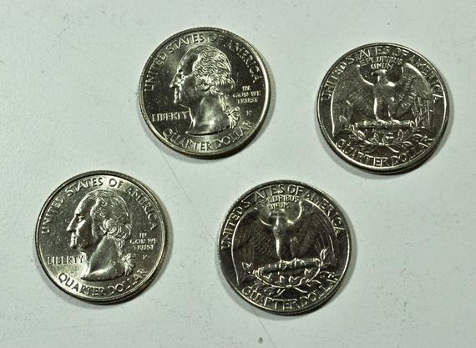
Basic concepts
Tossing a coin is a process that results in a random outcome. Let $$X$$ denote the outcome. $$X$$ is a random variable.
$$X$$ can take one of two values: heads or tails, each with a probability 0.5:
$$\operatorname{Pr}\left(X=heads\right)=0.5$$ $$and Pr\left(X=tails\right)=0.5$$
Every time the coin is tossed, we obtain a realization of $$X$$: $$x_{1},{ x}_{2}, x_{3}$$, etc.
We expect about 50% of the realizations to be heads, and 50% to be tails.
If we assign the value 1 to heads and 0 to tails, then the expected value of $$X$$ is 0.5:
$$E\left(X\right)=\operatorname{Pr}\left(X=1\right)×1+\operatorname{Pr}\left(X=0\right)×0=0.5$$

Slide 14
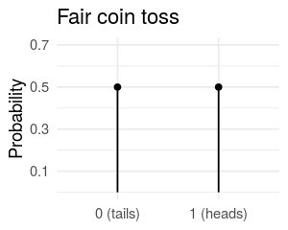
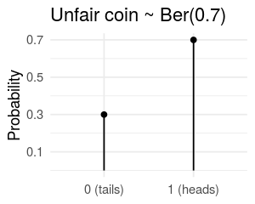
Basic concepts
The probability distribution is the function that gives the probabilities of occurrence for different possible outcomes of a random process.
The set of values that $$X$$ can take is the support. Here, it is discrete.
The probability distribution is uniform: the two possible outcomes, heads and tails, are equally likely.
Suppose the coin is unfair: it yields heads with probability $$p (p≠0.5)$$.
The probability distribution of $$X$$ is still discrete, but not uniform anymore. $$X$$ is said to follow the Bernouilli distribution with parameter $$p$$:
$$X \sim Ber(p)$$
Notes:
When the probability distribution has a discrete support, it is called a probability mass function (pmf). Its sum is 1.
When the probability distribution has a continuous support, it is called a probability mass function (pdf). Its integral is 1.

Slide 15

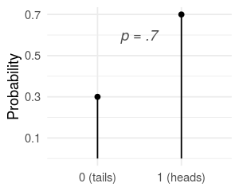
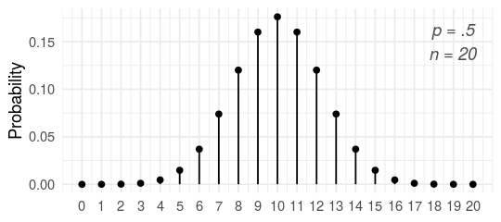
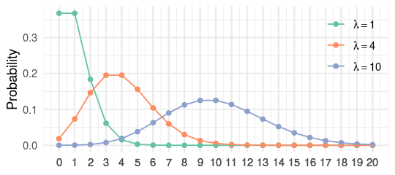
Common discrete probability distributions
Bernouilli
Binomial
Poisson
$$Ber(p)$$
$$B(n,p)$$
$$Pois(λ)$$
Binary outcome (no / yes, 0 / 1, fail / success, etc.) with $$p$$ = probability of “success”
Number of successes in a sequence of $$n$$ trials of a Bernouilli process of parameter $$p$$
Number of events occurring in a fixed interval of time (or space), with events occurring randomly with a constant mean rate of $$λ$$
Toin coss
Outcome of a medical treatment (cured / not cured)
Number of successful treatments in a group of patients
number of spontaneous spikes in 1s bins
number of DNA mutations per million year
Notes:
Discrete probability distributions are for processes that are essentially discrete (Bernouilli), or for outcomes that result from counting (Binomial, Poisson)

Slide 16
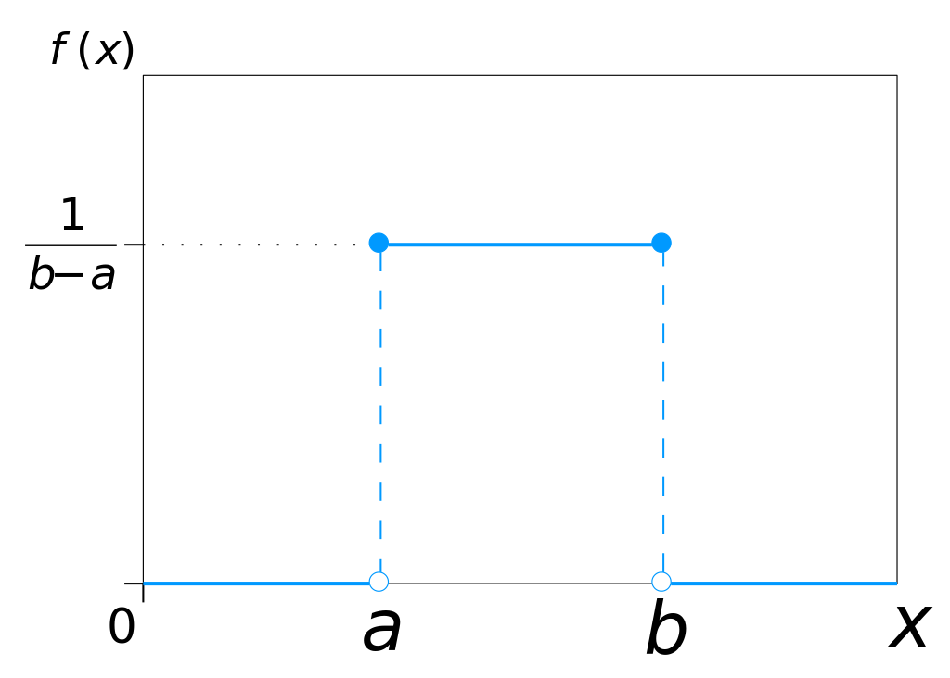
Continuous distribution
Continuous distributions are distributions whose support is infinite.
For example, the uniform distribution between 0 and 1, denoted $$U(0,1)$$ can take any real value comprised between 0 and 1 with equal probability.
The interpretation of the values of a probability density function (continuous distributions) is slightly different from the values of a probability mass function (discrete distributions): relative vs. absolute likelihood.

Slide 17
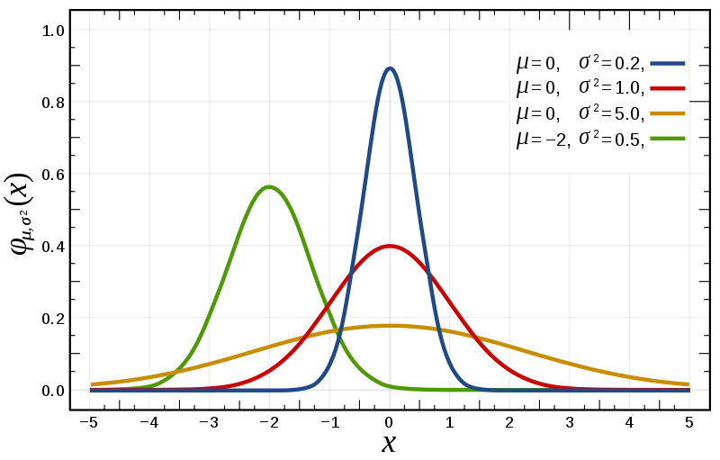
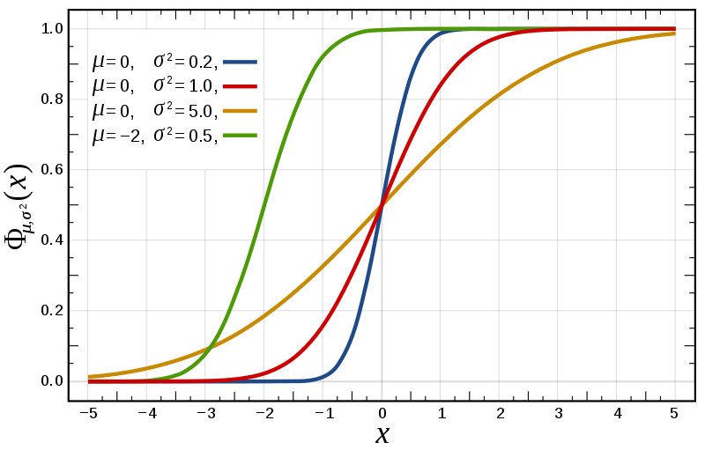
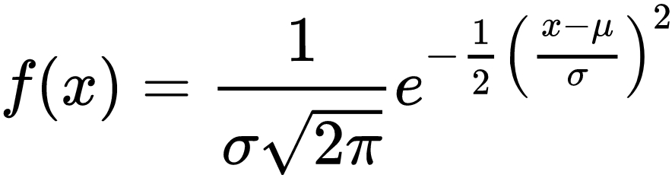
The normal distribution
$$𝒩(μ,σ^{2})$$
Probability density function
Red curve = standard normal distribution = $$Z$$
Cumulative density function

Slide 18
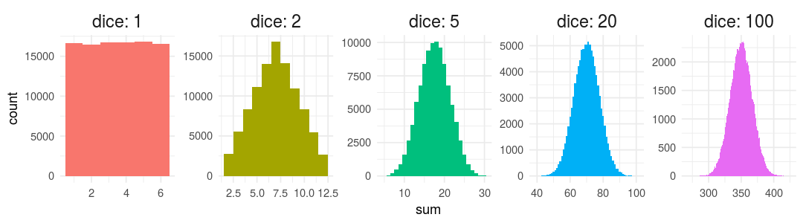
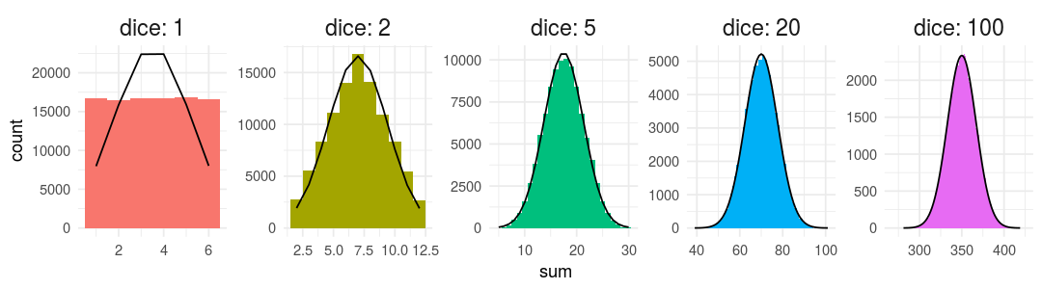
Why is the normal distribution so common?
Let’s roll many dice. Dice rolls follow a discrete, uniform distribution.
Question: What is the distribution of the sum?
Result: The distribution of the sum of uniformly distributed variables looks more and more gaussian when we increase the number of variables!

Slide 19
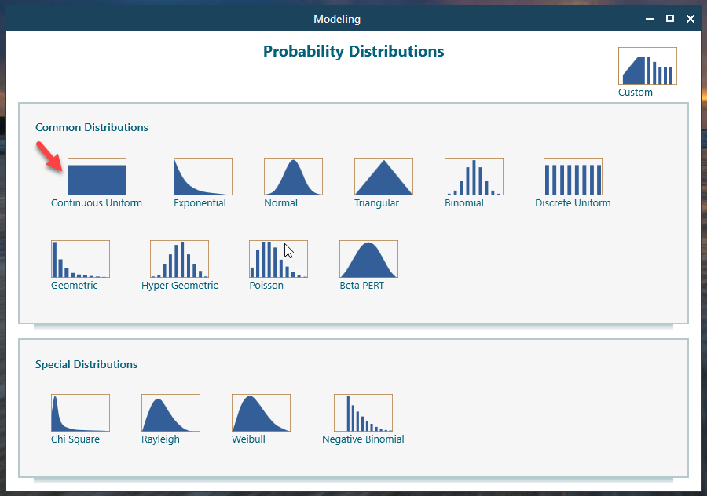
Why is the normal distribution so widespread?
Because of the central limit theorem: the sum of independent random variables tends toward a normal distribution, even if the original variables themselves are not normally distributed.
Resulting property: normal distribution
The properties of most objects, including living beings (size, weight, composition, etc.) result from the superimposed action of many sub-processes.
Whatever distributions underlie these processes, the macroscopic result will likely follow a normal distribution thanks to the central limit theorem.
+
Sub-processes / factors with various distributions

Slide 20
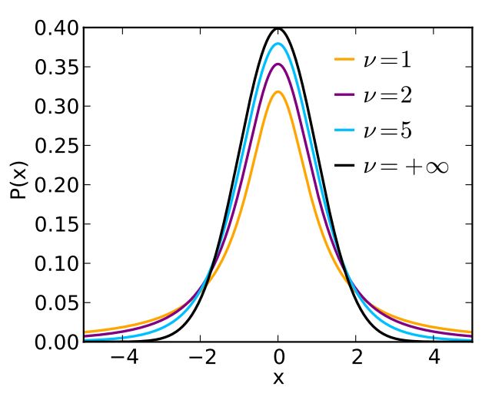
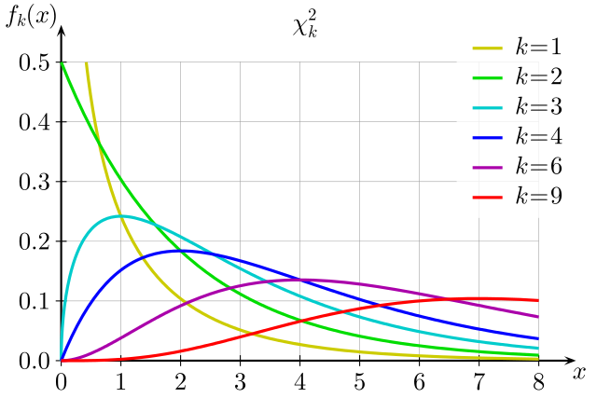
Continuous probability distributions derived from the normal distribution
Student’s t
Chi square
Difference between the sample mean and the population mean, divided by the sample standard deviation. $$ν=$$ degrees of freedom (dof)
Sum of the squares of $$k$$ independent, standard normal random variables.
Both are extremely useful for hypothesis testing and confidence intervals

Slide 21
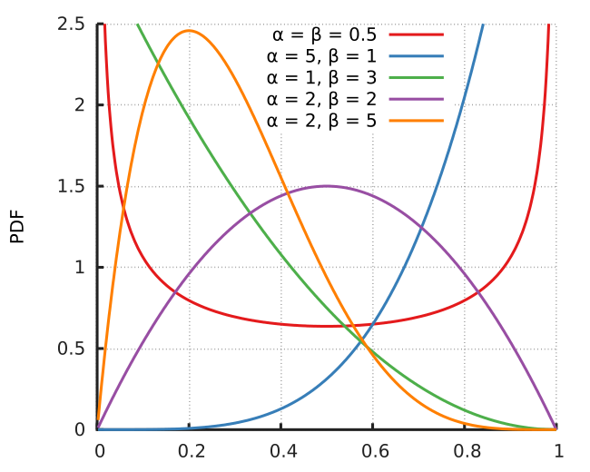
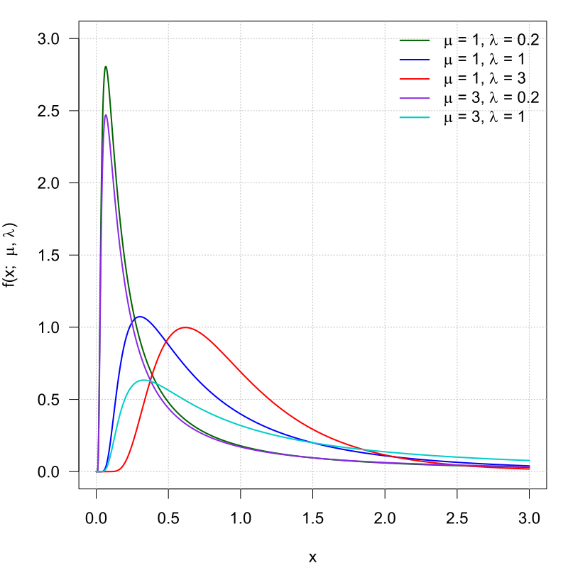
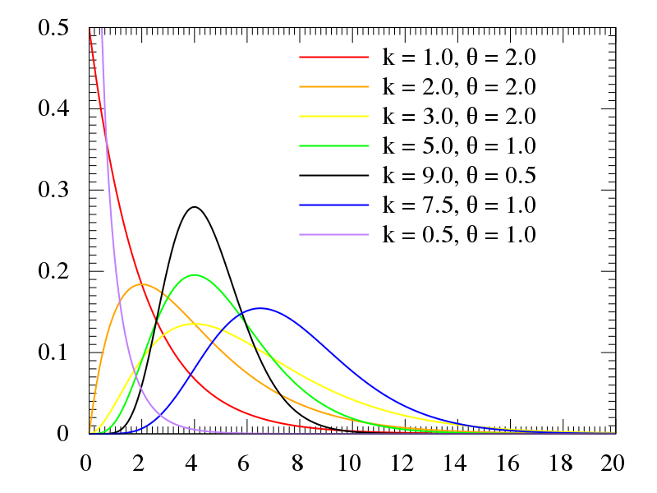
Other continuous probability distributions
Beta
Inverse Gaussian
Gamma
For variables constrained between 0 and 1, such as proportions and frequencies.
The time for a positive drift, random process to reach a certain level, as in drift diffusion models. Good for RTs.
Time for $$k$$ events to occur in a random Poisson process of rate $$1/θ$$

Slide 22
Bayes’ theorem: derivation
conditional probability of A given B $$p\left(A|B\right)$$
joint probability $$p\left(A,B\right)$$
marginal probability of A $$p\left(A\right)$$ and B $$p\left(B\right)$$
Interactive visualization

Slide 23
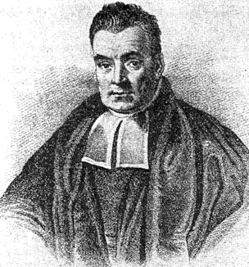
Bayes’ theorem: derivation
The conditional probability of A given B $$p\left(A|B\right)$$ is the joint probability $$p\left(A,B\right)$$ divided by the marginal probability of B $$p\left(B\right)$$
Symmetrically:
1
$$p\left(A|B\right)=p\left(A,B\right)/p\left(B\right)$$
2
$$p\left(B|A\right)=p\left(B,A\right)/p\left(A\right)$$
visualize on setosa.io/conditional/
Combining and we obtain Bayes’ law/equation/theorem:
1
2
$$p\left(B|A\right)=\frac{p\left(A | B\right).p(B) }{p(A)}$$
Reverend Thomas Bayes
1702-1761

Slide 24
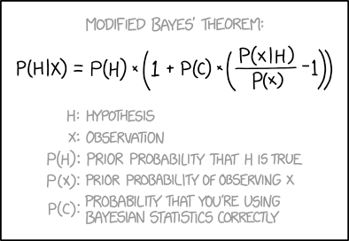
2.
Bayesian statistics: estimation
“Don’t forget to add another term for “probability that the Modified Bayes’ Theorem is correct”.”
xkcd.com/2059

Slide 25
Bayesian inference
Bayesian inference is the application of the Bayes’ equation to the estimation of the parameters of a statistical model.
$$p\left(B|A\right)=\frac{p\left(A | B\right).p(B) }{p(A)}$$
(conditional) likelihood
posterior
$$p\left(θ|y\right)=\frac{p\left(y | θ\right).p(θ) }{p(y)}$$
prior
marginal likelihood
where $$θ$$ denotes the model parameter(s) and $$y$$ the observed data.

Slide 26
Bayesian inference: interpretations
The Bayes equation…
…integrates prior knowledge with new information to yield the best possible expectation
…offers the best compromise between subjective beliefs and observed data
…updates prior belief with new evidence
$$p\left(θ|y\right)=\frac{p\left(y | θ\right).p(θ) }{p(y)}$$

Slide 27
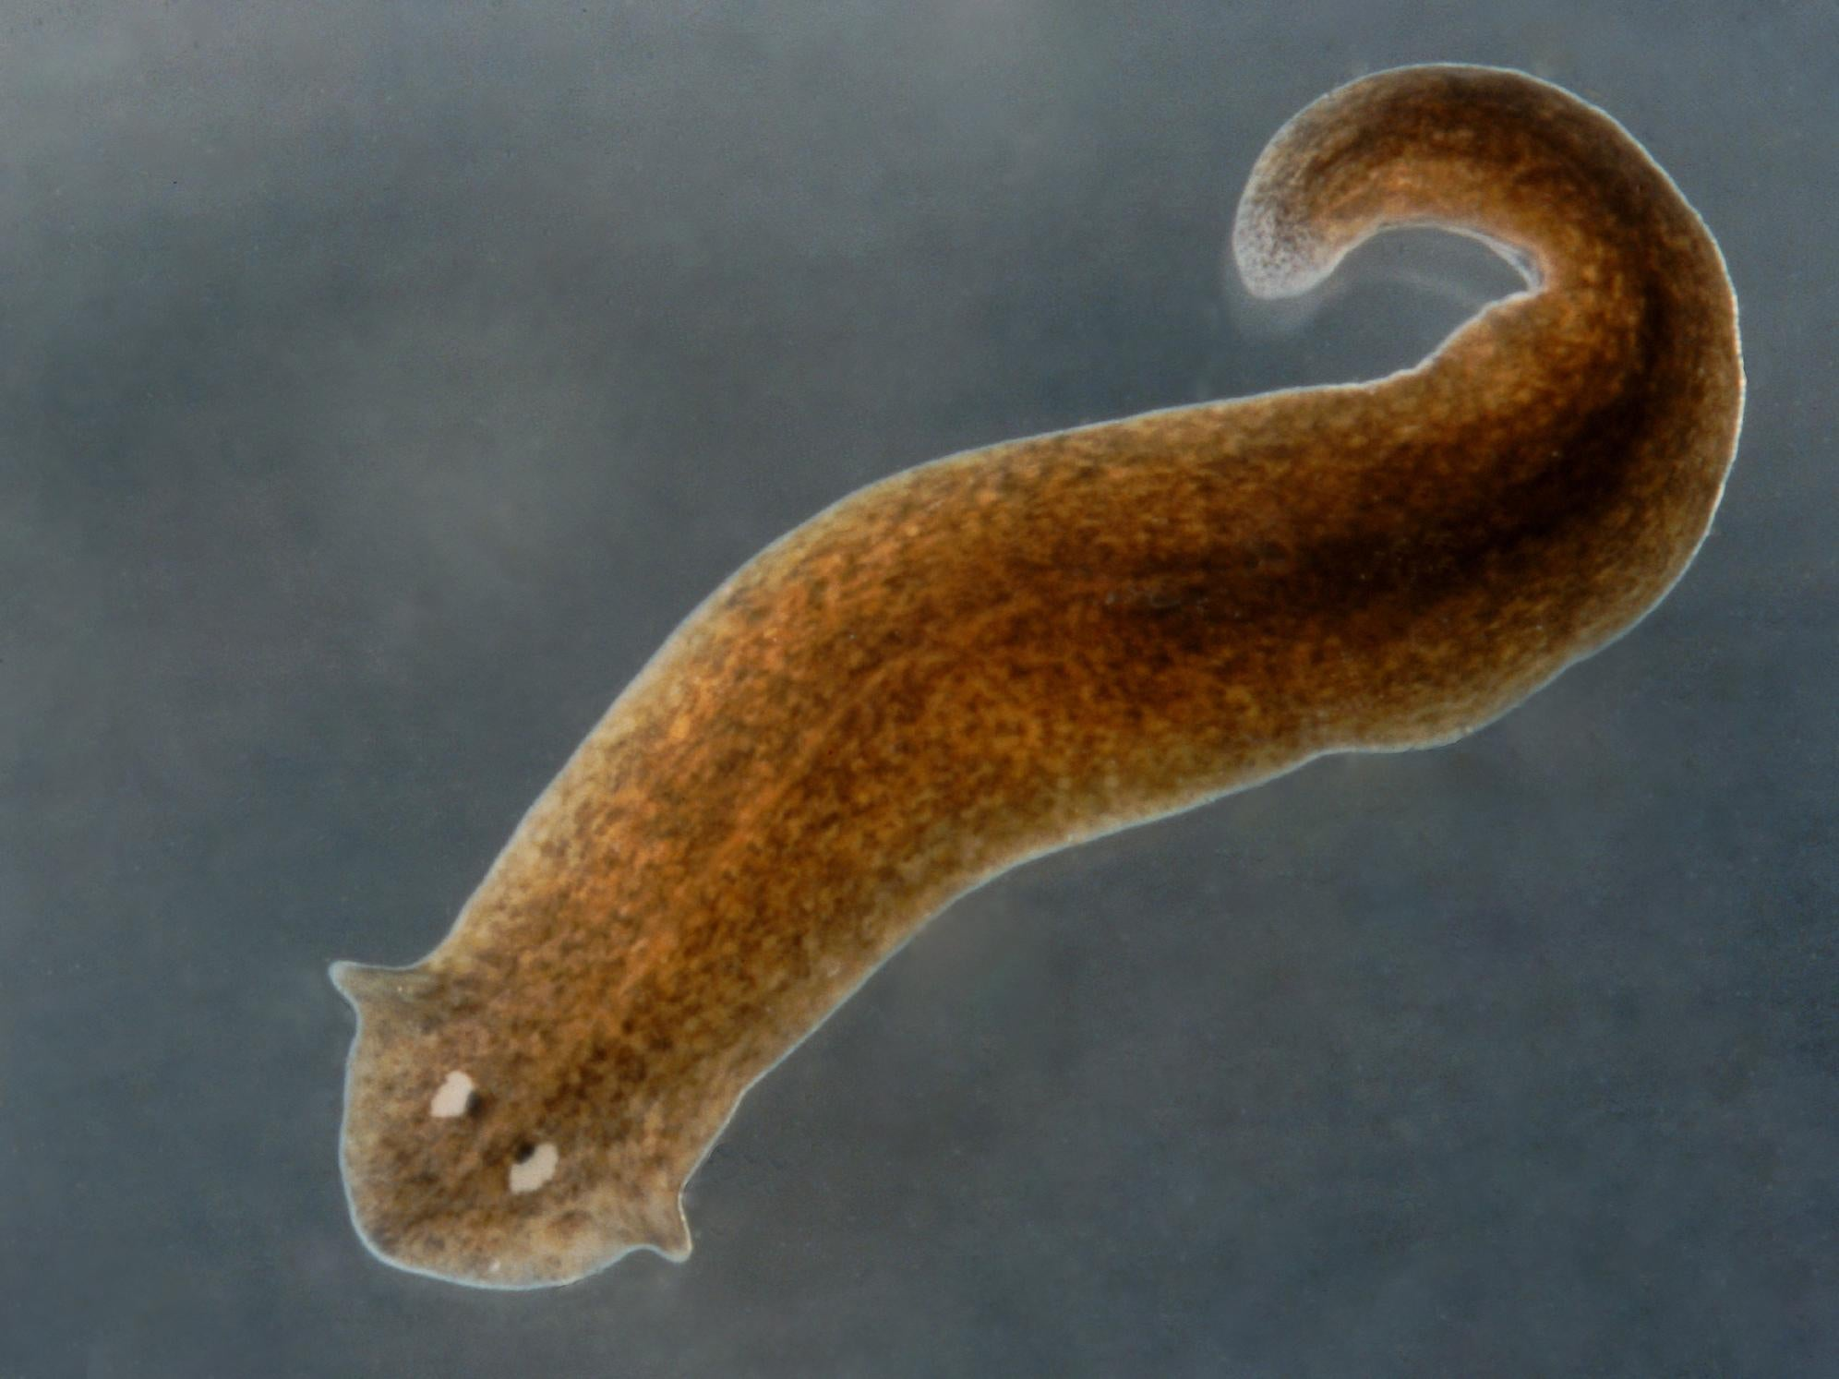
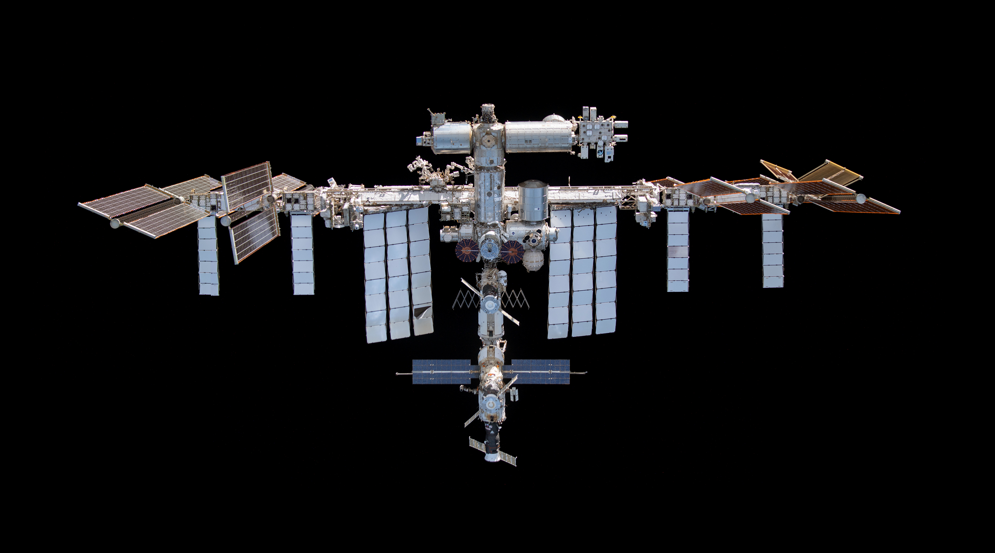
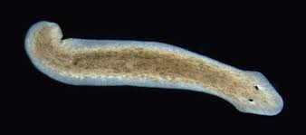
Application : the space planarians
$$X_{1}$$
$$X_{D} ?$$

Slide 28
What we “discovered”
Making a statement about a hypothesis (given the data) requires information on the probability of the hypothesis prior to seeing the data
Both the prior and the data “pull” the posterior toward their means, proportional to their precision
The precision of the posterior is always higher than both the precision of the prior and the precision of the likelihood ⇒ it measures the amount of combined information

Slide 29


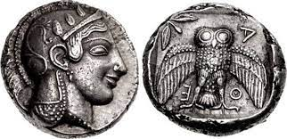
Application : the coin example
Scenario A
Standard modern coin
Scenario B
Ancient, irregular coin
Scenario C
Magic show coin

Slide 30
The coin example: the likelihood
$$p\left(q|k\right)=\frac{p\left(k | q\right).p(q) }{p(k)}$$
Let’s apply the Bayesian equation for model parameters…
$$p\left(θ|y\right)=\frac{p\left(y | θ\right).p(θ) }{p(y)}$$
…to the specific situation of assessing whether a coin is fair:
$$p\left(q|k\right)=\frac{p\left(k | q\right).p(q) }{p(k)}$$
We model the number of heads coming out of $$n$$ coin tosses as a random variable $$X$$ that follows a binomial distribution. Therefore $$q$$ denotes the parameter of the binomial distribution (the probability of the coin to land on heads) and $$k$$ the number of heads out of $$n$$ coin tosses.
$$X \sim B\left(n,q\right)$$
$$⇒p\left(X=k | q,n\right)=f\left(q\right)=\frac{n!}{k!\left(n−k\right)!}q^{k}{(1−q)}^{n−k}$$
probability mass function of a binomial distribution

Slide 31
The coin example: the prior
$$p\left(q|k\right)=\frac{p\left(k | q\right).p(q) }{p(k)}$$
The model parameter $$q$$ is unknown. In the Bayesian paradigm, it is also modeled as a random variable. $$q$$ is a continuous quantity between 0 and 1. The Beta distribution is well suited to model this kind of variable:
$$q \sim Beta$$
$$⇒p(q)=\frac{q^{α−1}{(1−q)}^{β−1} }{B(α,β)}$$
where $$B$$is the Beta function. $$α$$ and $$β$$ are parameters of the prior Beta distribution, and are called hyperparameters to avoid the confusion with parameters of the sampling model.
probability density functions of various Beta distributions

Slide 32
The coin example: the posterior
$$p\left(q|k\right)=\frac{p\left(k | q\right).p(q) }{p(k)}$$
$$p\left(k\right)=\int_{0}^{1}{p\left(k | q\right)p\left(q\right)dq}=constant$$
The denominator $$p(k)$$ can be calculated using marginalization:
Combining everything, and after some (omitted) maths, we finally obtain a mathematical expression for the posterior distribution:
$$p\left(q=x|k,n\right)=\frac{x^{α−1+k}{(1−x)}^{β−1+n−k} }{B(α+k,β+n−k)}$$
Which is the equation of a Beta distribution too, just like the prior!
$$q|k,n \sim Beta\left(α+k, β+n−k\right)$$

Slide 33
What we “discovered”
Making a statement about a hypothesis (given the data) requires information on the probability of the hypothesis prior to seeing the data
Both the prior and the data “pull” the posterior toward their means, proportional to their precision
The precision of the posterior is always higher than both the precision of the prior and the precision of the likelihood ⇒ it measures the amount of combined information
Well-chosen distributions make the calculation of the posterior easy Given a model of how the data is generated (the likelihood function), a conjugate distribution can be chosen for the prior, so that the posterior will have the same distribution as the prior (see other examples on Wikipedia) ⇒ otherwise, numerical simulations (see parts 3 and 4 of this course)

Slide 34
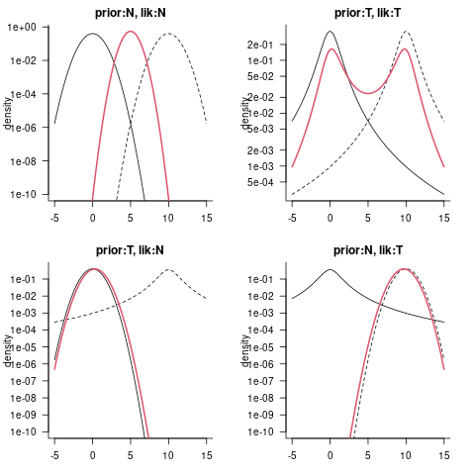
Surprising combinations of prior & likelihood
When one distribution is more heavy-tailed than the other (e.g. a t-distribution and a Gaussian), the heavy-tailed one “gives way” to the other in the posterior.
But when both are heavy-tailed and far apart, a strange posterior can arise!

Slide 35
The central role of the posterior distribution
In Bayesian statistics, all results are derived from the posterior distribution
posterior distribution
point estimates
mean, median,
mode/MAP
credible intervals
HDI, ETI
hypothesis testing
Bayes factor
prediction
posterior predictive distribution

Slide 36
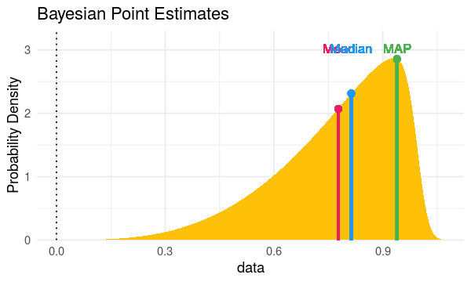
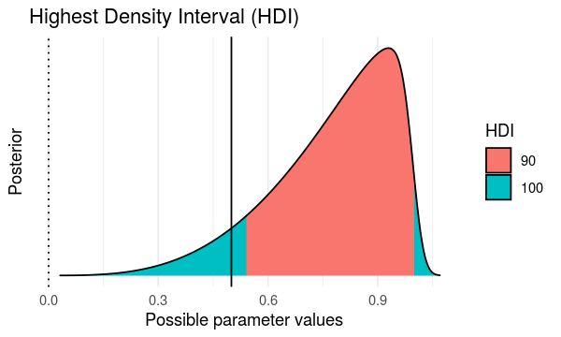
Point and interval estimates
bayestestR package in the easystats ecosystem
easystats.github.io/bayestestR/
point estimates
mean, median,
mode/MAP
credible intervals
HDI, (ETI)
point_estimate()
hdi()

Slide 37
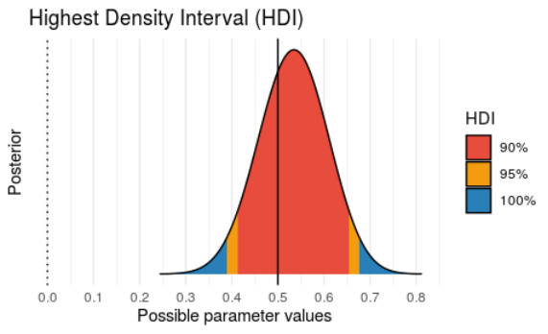
Credible interval: 95% or 90%?
Compared to the 95%, the 90% credible interval is…
+ more stable to numerical errors
– less conservative
➙ Use 95% if there are more than 10.000 samples of the posterior distribution
In bayestestR, the default is 89% (!) to highlight the arbitrariness of the confidence level.

Slide 38
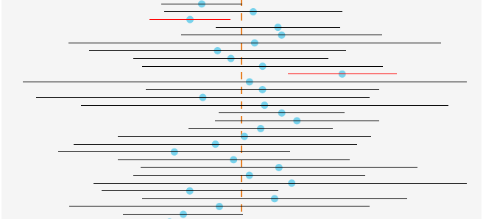
Frequentist vs. Bayesian statistics
Definition of probability
View on model parameters
Method of estimation
Uncertainty interval
Frequentist
Long-run frequency of events
True value: unknown Estimate: fixed
From the data only
“Confidence interval”
Confidence level is a property of the procedure, not of the interval
Bayesian
Degree of belief / certainty
True value: unknown Estimate: probabilistic
From the posterior (data + prior)
“Credibility intervals”
Confidence level is a statement about the uncertainty around the estimate

Slide 39
3.
Prior specification

Slide 40
Choosing the prior
“I know nothing of the modeled phenomena and I want the prior to express that high uncertainty.”
“There are physical constraints that dictate what values are unlikely.”
“I have expert judgment based on experience, existing literature and technical considerations.”
diffuse priors
weakly informative priors
informative priors

Slide 41
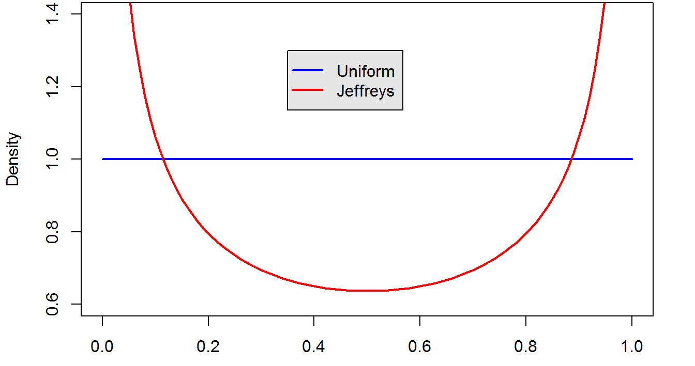
Diffuse priors
Flat/uniform prior
Assign equal probability to all parameter values.
$$Beta\left(1,1\right)$$
Frequentist estimate: $${\hat{p}}_{MLE}=\frac{k}{n}$$
$$p$$
Bayesian estimate: $${\hat{p}}_{MAP}=\frac{α_{posterior}−1}{α_{posterior}+β_{posterior}−2}=\frac{α_{prior}+k−1}{α_{prior}+k+β_{prior}+n−k−2}$$
$${{\hat{p}}_{MLE}=\hat{p}}_{MAP} \overset{⇔}{ } { α}_{prior}=β_{prior}=1$$
Under uniform prior, the posterior MAP coincides with the frequentist MLE!

Slide 42
Diffuse priors
Example for a Bernoulli model
Jeffreys prior
= a prior that is invariant to reparametrizations of the sampling model
Standard parametrization
$$q$$
Odds parametrization
$$ψ=f\left(q\right)=\frac{q}{1−q}$$
$$f$$
Jeffreys prior
for $$q$$
Jeffreys prior
for $$ψ$$
$$f$$
Reference prior
= the prior that maximizes the contribution of the data relatively to the prior.
In univariate settings, the Jeffreys prior is the reference prior !
$$Beta\left(1,1\right)$$
$$Beta\left(0.5,0.5\right)$$
$$p$$

Slide 43
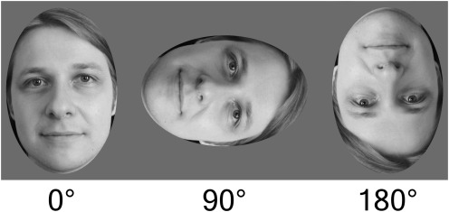
Informative / reasonable priors
Imagine you want to test the theory that some symptoms of schizophrenia arise from the disruption of low-level perceptual mechanisms. You design a visual discrimination task and model the difference in response time between patients and a control group.
What prior for the population difference in RT?
upright vs. upside-down

Slide 44
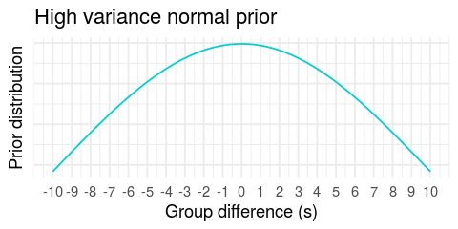
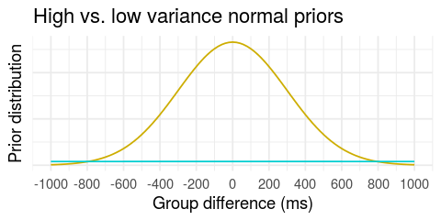
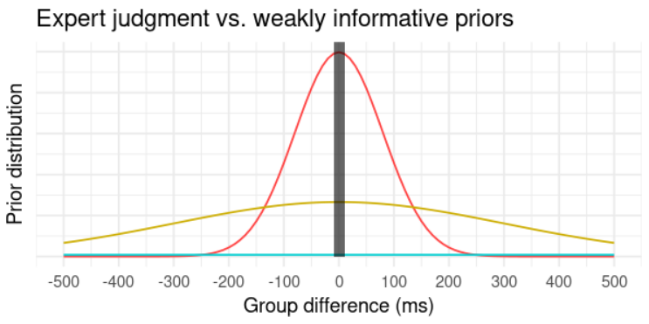
Informative / reasonable priors
Imagine you want to test the theory that some symptoms of schizophrenia arise from the disruption of low-level perceptual mechanisms. You design a visual discrimination task and model the difference in response time between patients and a control group.
physical / logical constrains
domain knowledge
literature
past data
weakly informative
highly informative

Slide 45
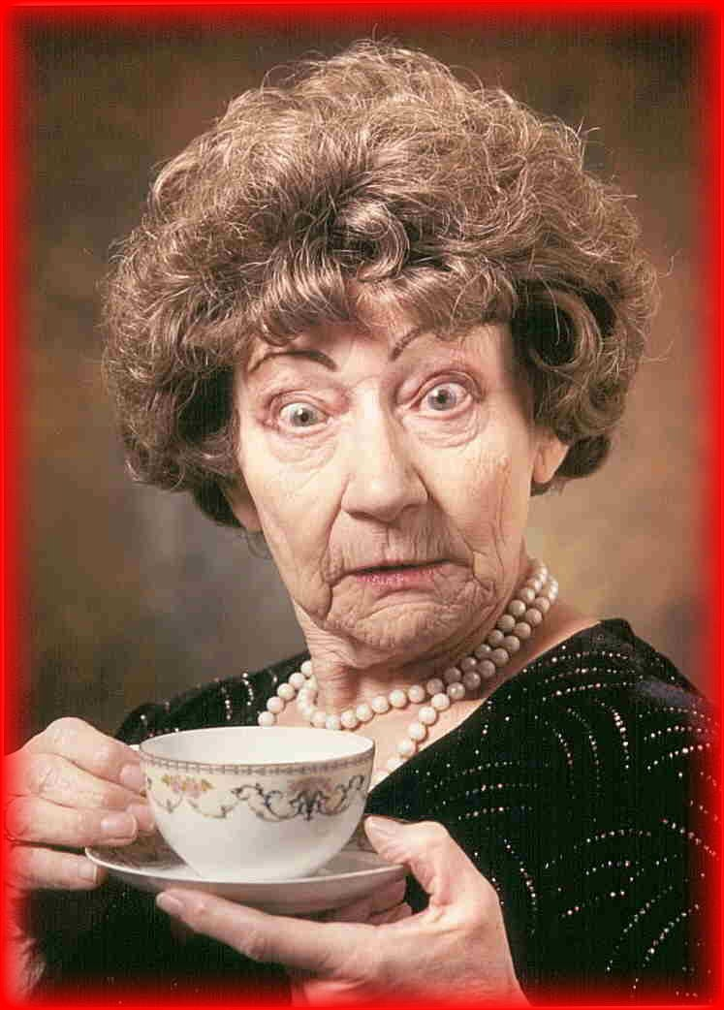
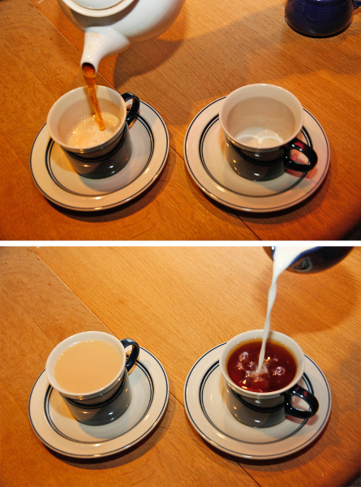
Prior as a bet
I can taste which of milk or tea has been poured first!I
I can tell which of milk or tea is poured first in another room!
or
Right 9 times out of 10 !
Right 9 times out of 10 !
Exceptional palate?
Would you use the same standard of evidence?
Extra-sensory perception?
Bayesian statistics offer a formal treatment of context and expectations

Slide 46
Prior as a bet
What is the effect of drinking coffee after dinner compared to no coffee on the time to fall asleep?
treatment / condition
dependent variable
The Sheffield Elicitation Framework
elicit() in SHELF

Slide 47
Prior elicitation
physical / logical constraints
literature
What is the minimum possible value? The maximum?
Posterior distribution from a Bayesian random effect meta-analysis
Or (more simply)
the distribution of effect sizes in a meta-analytic study, or informal review
domain knowledge
What is the median value? The quartile values?
past data
elicit() in SHELF
Posterior distribution from a previous study

Slide 48
On Bayesian « subjectivity »
The Bayesian framework requires the setting of a prior belief, which some people object to due to its subjective nature.
But what is subjectivity? Definitions from the Oxford Dictionary:
1. “the quality of being based on or influenced by personal feelings, tastes, or opinions.”
2. “the quality of existing in someone's mind rather than the external world.”
Scientific practice is full of decisions and judgments that are constantly justified, analyzed and debated between scientists:
selection of scientific questions worthy of being investigated
design of experiments, including the calculation of statistical power
choice of dependent variables, preprocessing steps, statistical models, etc.

Slide 49
There is no loss in dispensing with the illusion of objectivity in hypothesis testing. Researchers are acclimated to elements of social negotiation and subjectivity in scientific endeavors. Negotiating the appropriateness of various alternatives is no more troubling than of other elements, including design, operationalization, and interpretation. (...) We have the communal infrastructure to evaluate and critique the specification of alternatives. This (...) is vastly preferable to the current practice, in which significance tests are mistakenly regarded as objective. Even though inference is subjective, we can agree on the boundaries of reasonable alternatives.
Rouder et al. (2009)

