Slide 1
Bayesian statistics 3/4 Hypothesis testing
Oussama Abdoun (MEng, PhD) – oussama.abdoun@pm.me
Bayesian Statistics – CRNL – dec 2024

Slide 2
1.
Posterior-based hypothesis testing

Slide 3
The central role of the posterior distribution
In Bayesian statistics, all results are derived from the posterior distribution
posterior distribution
point estimates
mean, median,
mode/MAP
credible intervals
HDI, ETI
hypothesis testing
Bayes factor
prediction
posterior predictive distribution

Slide 4
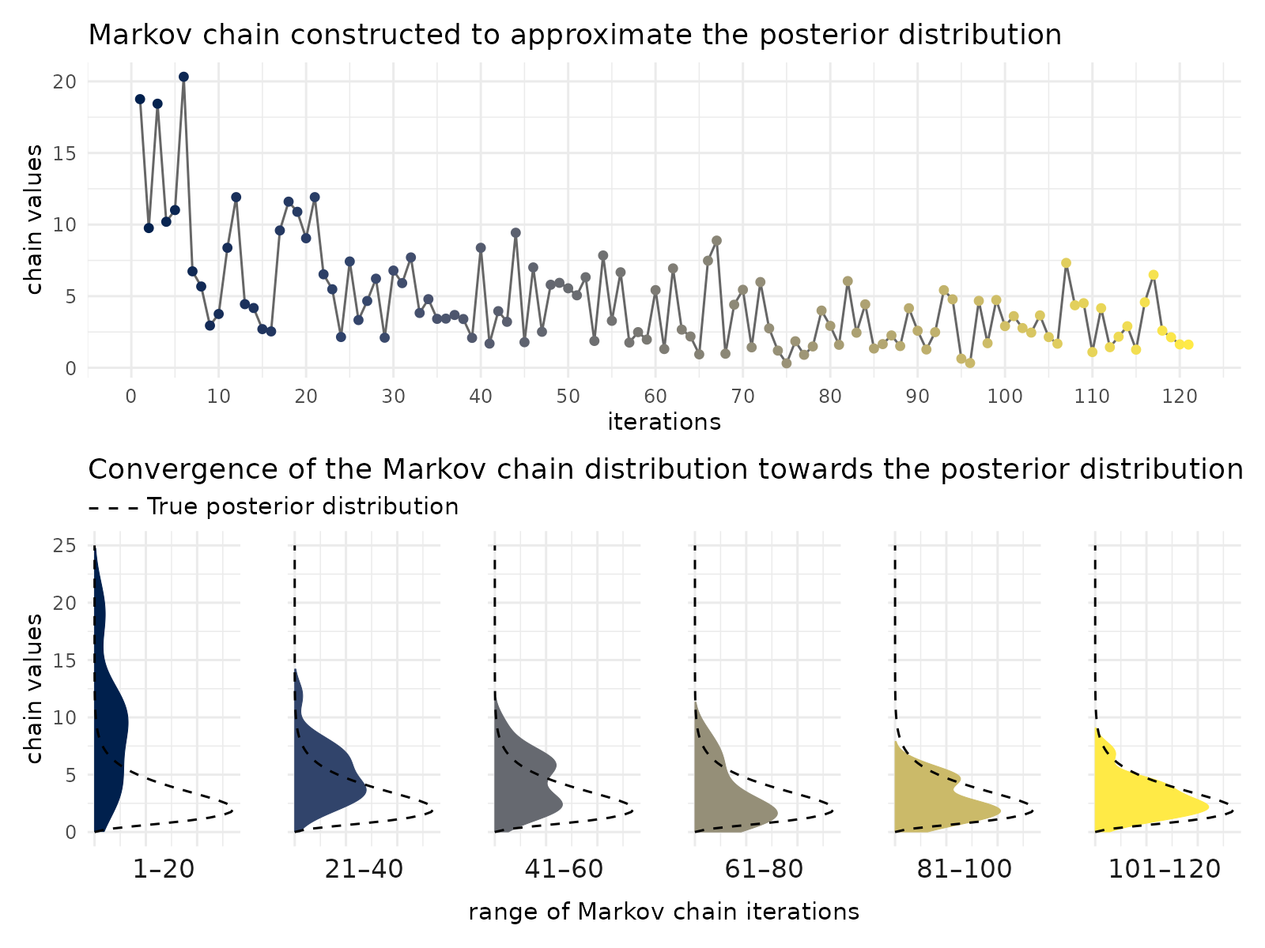
Numerical simulation of the posterior: MCMC
When prior distributions are not conjugate distributions of the likelihood, we don’t have an explicit expression of the posterior distribution anymore and we need to calculate it numerically. We use Markov chain Monte Carlo (MCMC) techniques, a family of algorithms sharing the same basic procedure:
1. A Markov chain (= random process where each sample depends probabilistically on the previous one) is created such that it, in the long run, its distribution converges towards the true posterior distribution.
2. A large number of samples (several to tens of thousands) are generated iteratively from the Markov chain.
3. Initial samples (typically 1000) are considered as not converged yet and rejected (“warm up” phase); the rest of the samples is used as an approximation of the posterior distribution.

Slide 5
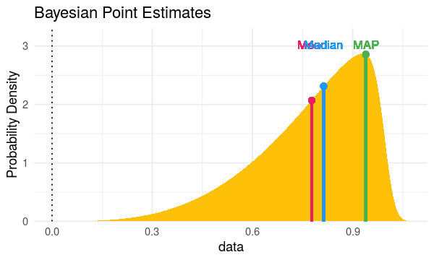
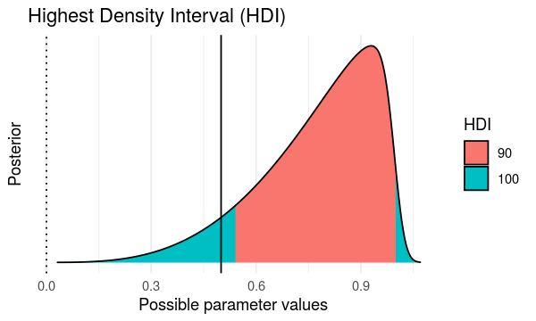

Point and interval estimates
bayestestR package in the easystats ecosystem
easystats.github.io/bayestestR/
point estimates
mean, median,
mode/MAP
credible intervals
HDI, (ETI)
point_estimate()
hdi()

Slide 6
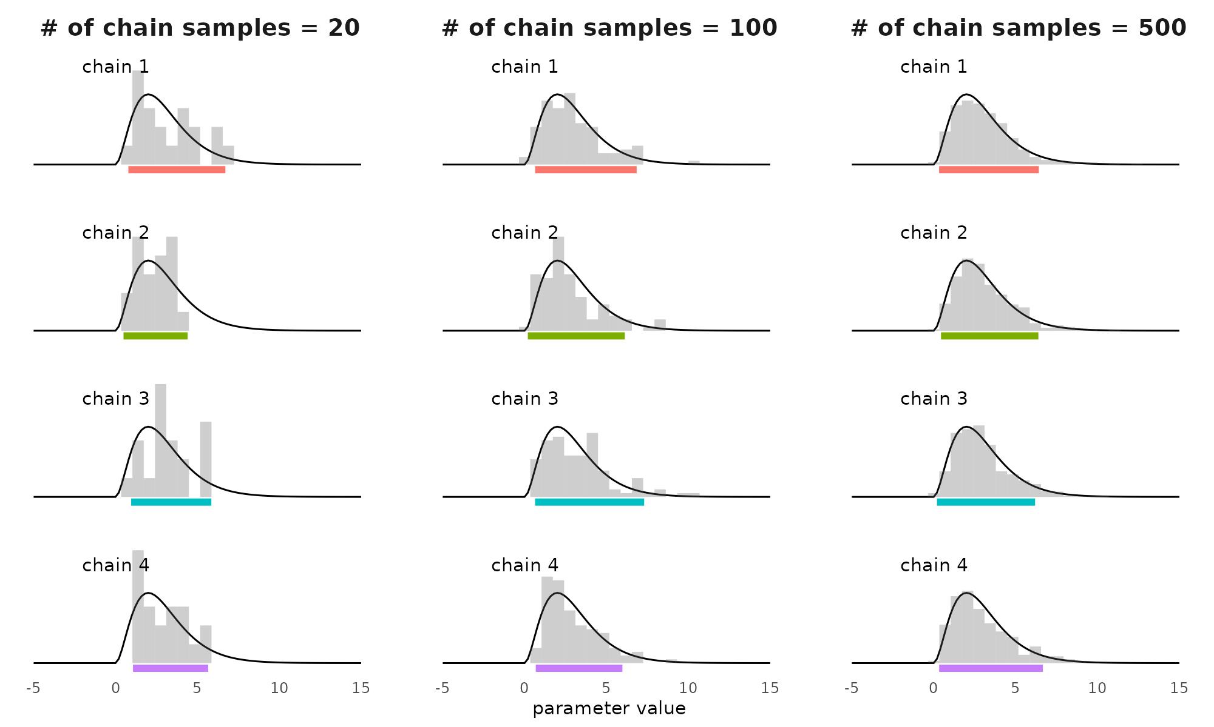
Credible intervals & numerical simulations
The more samples in the posterior distribution, the more stable the credible interval

Slide 7
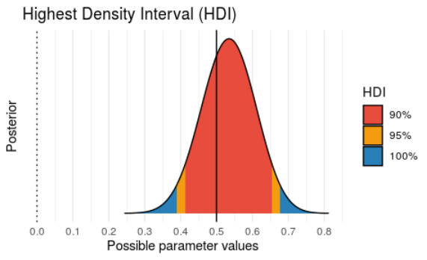
Credible interval: 95% or 90%?
Compared to the 95%, the 90% credible interval is…
+ more stable to numerical errors
– less conservative
➙ Use 95% if there are more than 10.000 samples of the posterior distribution
In bayestestR, the default is 89% (!) to highlight the arbitrariness of the confidence level.

Slide 8
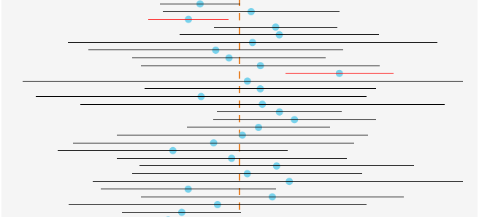
Frequentist vs. Bayesian statistics
Definition of probability
View on model parameters
Method of estimation
Uncertainty interval
Frequentist
Long-run frequency of events
True value: unknown Estimate: fixed
From the data only
“Confidence intervals”
Confidence level (e.g. 95%) is a property of the procedure, not of the interval
Bayesian
Degree of belief / certainty
True value: unknown Estimate: probabilistic
From the posterior (data + prior)
“Credibility intervals”
Confidence level (e.g. 95%) is a measure of the uncertainty around the estimate

Slide 9
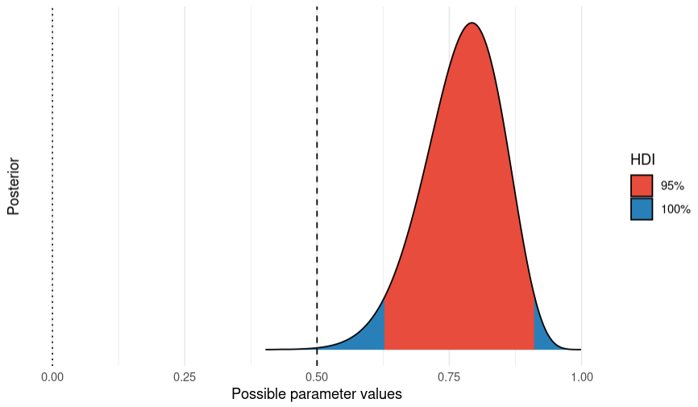
Can we test a hypothesis on a parameter from its posterior distribution?

Slide 10
Hypothesis testing based on the posterior Exact/point/precise hypothesis
The credible interval defines a whole range of exact hypotheses that can be rejected with high confidence.
$$p\left(θ_{low}≤θ≤θ_{high}\right)=.95$$
$$⇔p\left(θ{∉[θ_{low}, θ}_{high}]\right)=.05$$
$$⟹p\left(θ=θ_{0}\right)<.05$$
Note: this is very different from the frequentist p-value which is $$p\left(==y_{obs} | θ=θ_{0}\right)$$
However, it does not allow to accept an exact hypothesis, only to reject it (at best).

Slide 11
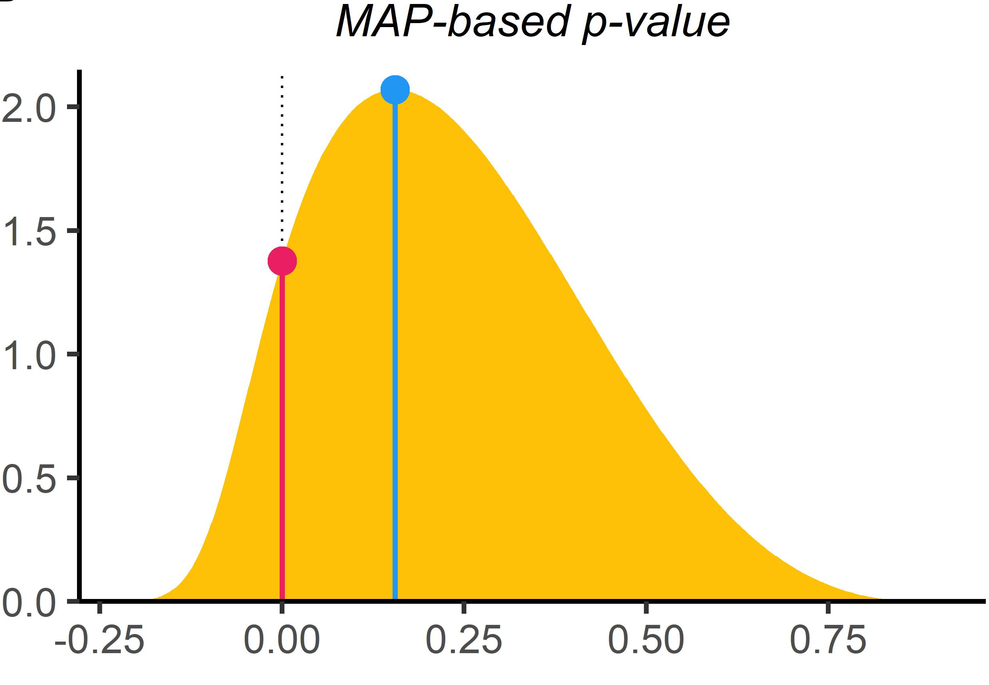
Hypothesis testing based on the posterior Exact/point/precise hypothesis
For a continuous parameter, the absolute probability of an exact hypothesis, $$p(H_{0}:θ=θ_{0})$$ is meaningless. That’s why probability values are called densities.
But we could compare the probability of the null hypothesis with the probability of the most likely value (the MAP): $$p\left(θ=θ_{0}\right)/p\left(θ=θ_{MAP}\right)$$
Limitations:
ignores most of the information contained in the posterior distribution
can not provide evidence for the null: at best, $$θ_{0}$$ is the MAP and p = 1
posterior distribution
Strengths:
no need for hypothesis-specific priors (unlike BF)
no Jeffreys-Lindley-Bartlett paradox (unlike BF)
p_pointnull() in bayestestR
Mills, J. A. (2007). Objective Bayesian Precise Hypothesis Testing.

Slide 12
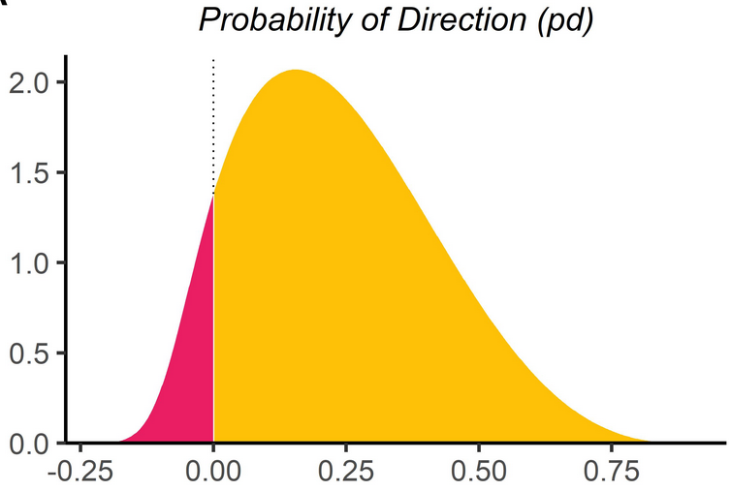
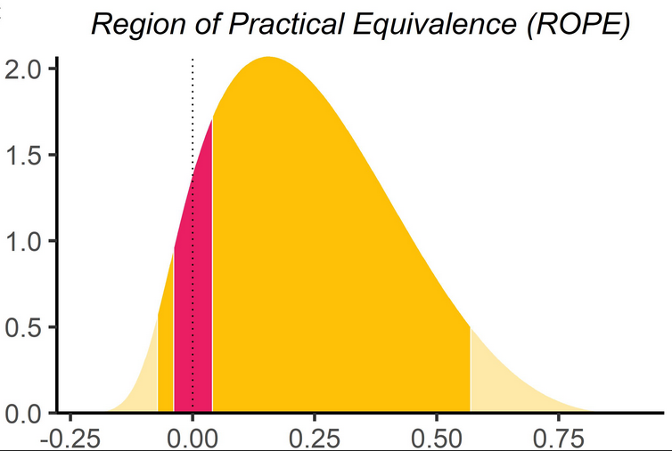
Hypothesis testing based on the posterior Range hypothesis
Arguments against point hypotheses
the null hypothesis can always be rejected: trivial deviations due to measurement bias, sampling error and other uncontrolled factors will come out as statistically significant given sufficiently large sample sizes (Meehl 1978, Cohen 1994)
rejecting the exact null hyothesis (the frequentist NHST approach) is a weak form of theory testing
theories rarely make exact hypotheses (except when they specify a complete and detailed mechanism, e.g. physical equation).
Alternative: use a range hypothesis as a more powerful statement. Two possibilities:
test a direction hypothesis
test a null range, also called the region of practical equivalence (ROPE), that encodes negligible effects
Range hypotheses can be rejected, accepted or neither (no conclusion).
p_direction() in bayestestR
p_rope() in bayestestR

Slide 13
2.
Bayes Factors

Slide 14
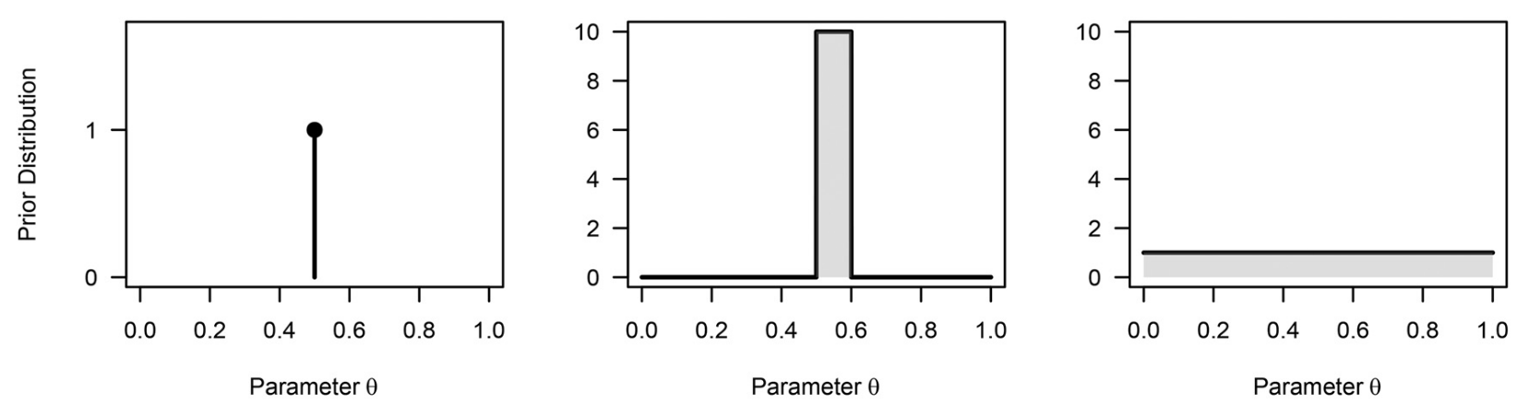
Hypotheses as generative models
Different hypotheses can be encoded as distinct models making speciﬁc predictions for the data. Here, a model = statistical model + prior distribution for the parameters $$θ$$. Examples for a binary outcome experiment (coin toss, medical treatment, test accuracy, etc.):
A null hypothesis
An "agnostic" hypothesis
An opiniated hypothesis
$$p\left(θ | M_{0}\right)$$
$$p\left(θ | M_{1}\right)$$
$$p\left(θ | M_{2}\right)$$

Slide 15
Bayes Factor As a (marginal) likelihood ratio
Testing the likelihood of isolated hypotheses is of little interest. We are usually interested in how competing hypotheses are differentially supported by data.
Definition: the Bayes Factor is the ratio of the likelihoods of two statistical models, integrated over the prior probabilities of their parameters (“marginal likelihood”):
$${BF}_{ij}=\frac{p\left(y | M_{i}\right) }{p\left(y | M_{j}\right)}=$$
Interpretation: “Model $$M_{i}$$ predicts the data $${BF}_{ij}$$ times better than $$M_{j}$$”
If $$M_{0}$$ is a null hypothesis, then:
Compare with the likelihood ratio test:
$${BF}_{i0}=\frac{p\left(y | M_{i}\right) }{p\left(y | M_{0}\right)}=\frac{\int{p\left(y | θ_{i}\right)p(θ_{i})dθ_{i}} }{p\left(y | θ_{0}\right)}$$
$$LR=\frac{p\left(y | θ_{MLE}\right) }{p\left(y | θ_{0}\right)}$$

Slide 16
Bayes Factor As relative belief updating
Thus, the Bayes factor is...
— ...a continuous measure of evidence
— ...a predictive updating factor
— ...independent of models’ prior probability
— ...equal to the posterior model odds if models are equally probable a priori
Applying the Bayes theorem:
$${BF}_{10}=\frac{p\left(y | M_{1}\right) }{p\left(y | M_{0}\right)}=\frac{\frac{p\left(M_{1} | y\right) }{p(M_{1})}}{\frac{p\left(M_{0} | y\right) }{p(M_{0})}}$$
= belief updating of model $$M_{1}$$
= belief updating of model $$M_{0}$$
Which we can rewrite :
$$\frac{p\left(M_{1} | y\right)}{p\left(M_{0} | y\right)} ={ BF}_{10} × \frac{p(M_{1})}{p(M_{0})}$$
Initially, I believed $$M_{1}$$ was times more likely than $$M_{0}$$.
After seeing the new data, which is times better predicted by $$M_{1}$$ than $$M_{0}$$, I now believe $$M_{1}$$ is times more likely than $$M_{0}$$. Therefore, my prior belief ratio has changed by a factor
posterior model odds
likelihood ratio
prior model odds

Slide 17
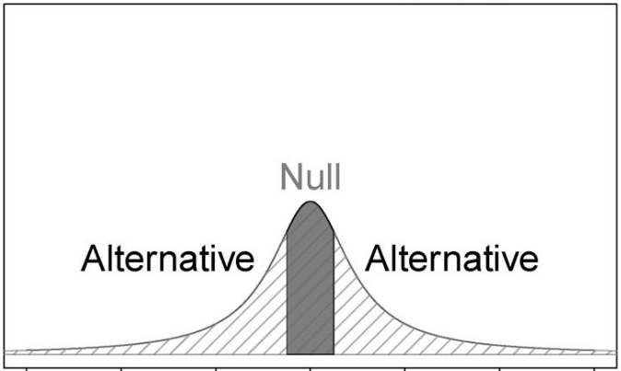
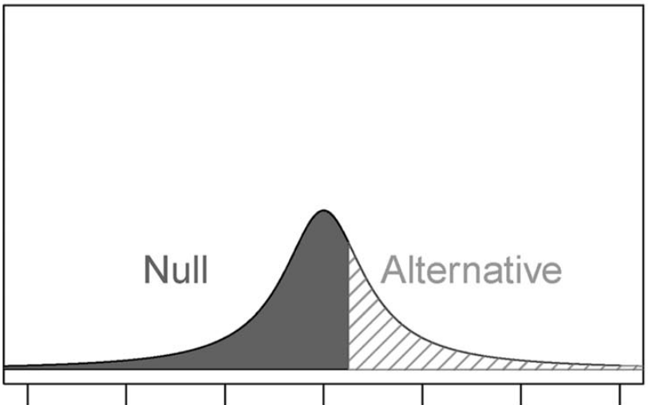
Bayes Factor for range hypotheses
The calculation of the BF is straightforward when the competing models are non-overlapping, complementary intervals from the same distribution
“two-sided”
“one-sided”

Slide 18
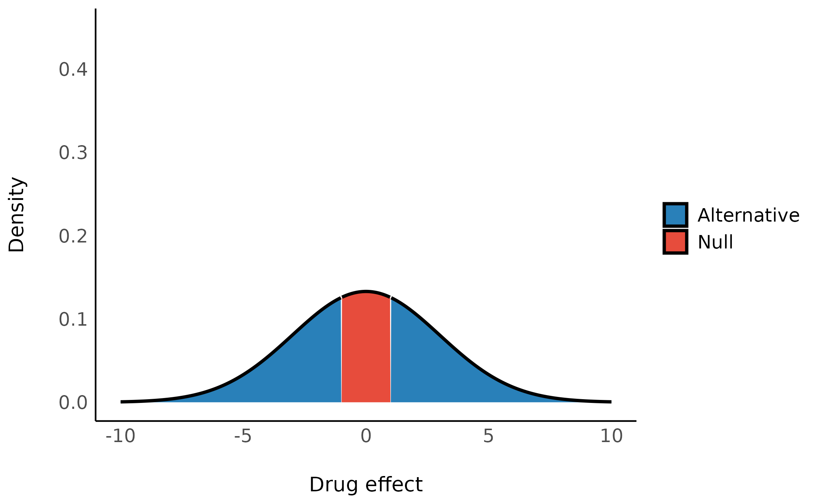
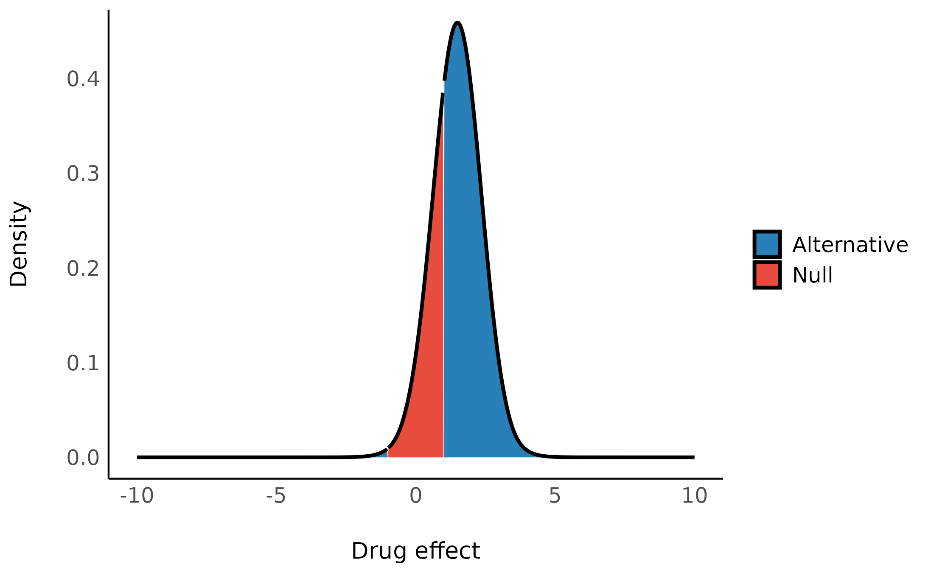
Bayes Factor for range hypotheses
prior distribution
posterior distribution
Bayes Factor
$${BF}_{10}={\frac{p\left(M_{1} | y\right) }{p(M_{1})}}/{\frac{p\left(M_{0} | y\right) }{p(M_{0})}}$$
$$+$$
$$+$$

Slide 19
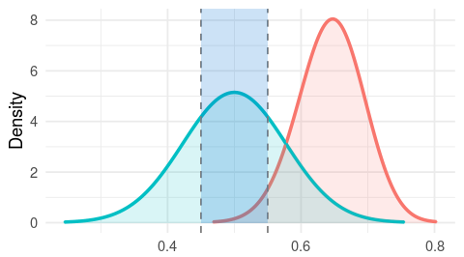
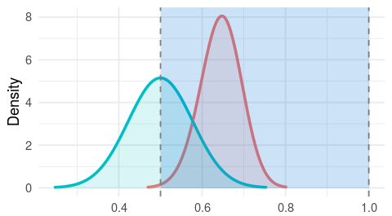
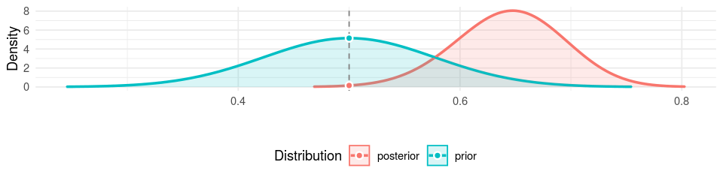
Bayes Factor for range hypotheses
Region of practical equivalence (ROPE)
Probability of direction
bf_params() in bayestestR

Slide 20
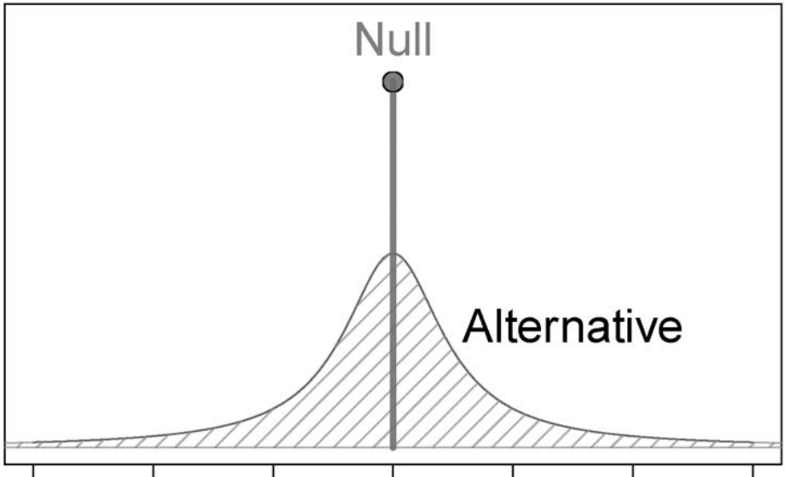
Bayes Factor for exact hypotheses Savage-Dickey density ratio
Let $$H_{0}$$ be an exact null hypothesis ($$H_{0}: θ=θ_{0}$$) and $$H_{1}$$ the complementary hypothesis ($$H_{1}: θ≠θ_{0}$$). Then:
$${BF}_{01}=\frac{p(θ=θ_{0}|y)}{p(θ=θ_{0})}$$
This special case of the Bayes Factor is called the Savage-Dickey density ratio.
bf_params() in bayestestR

Slide 21
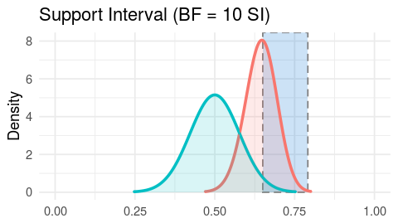
Bayes Factor for exact hypotheses Support interval
Which values of the parameter are best supported by data?
Support interval = all values for which the Savage-Dickey density ratio is above a certain threshold (here, 10).
si() in bayestestR

Slide 22

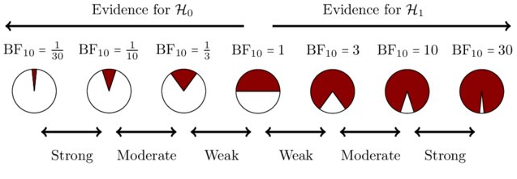
Bayes Factor Measure of evidence
Conventional interpretation of Bayes factor values (Kass & Raftery 1995)
$$BF$$ | $$\log_{10}BF$$ | Strength of evidence
1 to 3 | 0 to 1/2 | Barely worth mentioning
3 to 10 | 1/2 to 1 | Substantial
10 to 100 | 1 to 2 | Strong
> 100 | > 2 | Decisive
Don’t replace the p-value dichotomous ritual by a BF multichotomous ritual!!

Slide 23
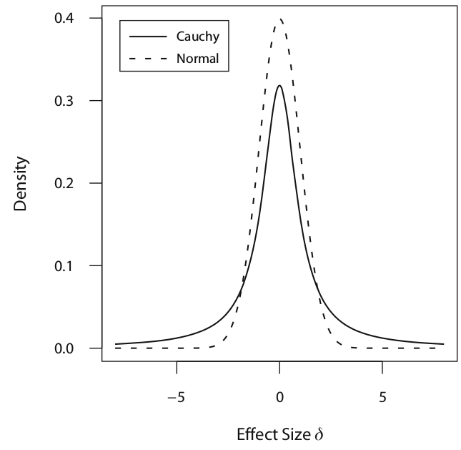
Bayes Factor Application to the two-sample location test
Approach implemented in BayesFactor and JASP:
— parametrize the model in terms of the standardized effect size (~ Cohen’s d): $$δ=μ/σ$$
— prior = Cauchy distribution with scale r (~ variance) ⇒ fatter tails than the normal distribution
ttestBF() in the BayesFactor package
Rouder, Speckman, Sun, Morey & Iverson (2009). Bayesian t tests for accepting and rejecting the null hypothesis. Psychonomic Bulletin & Review doi.org/10.3758/PBR.16.2.225

Slide 24
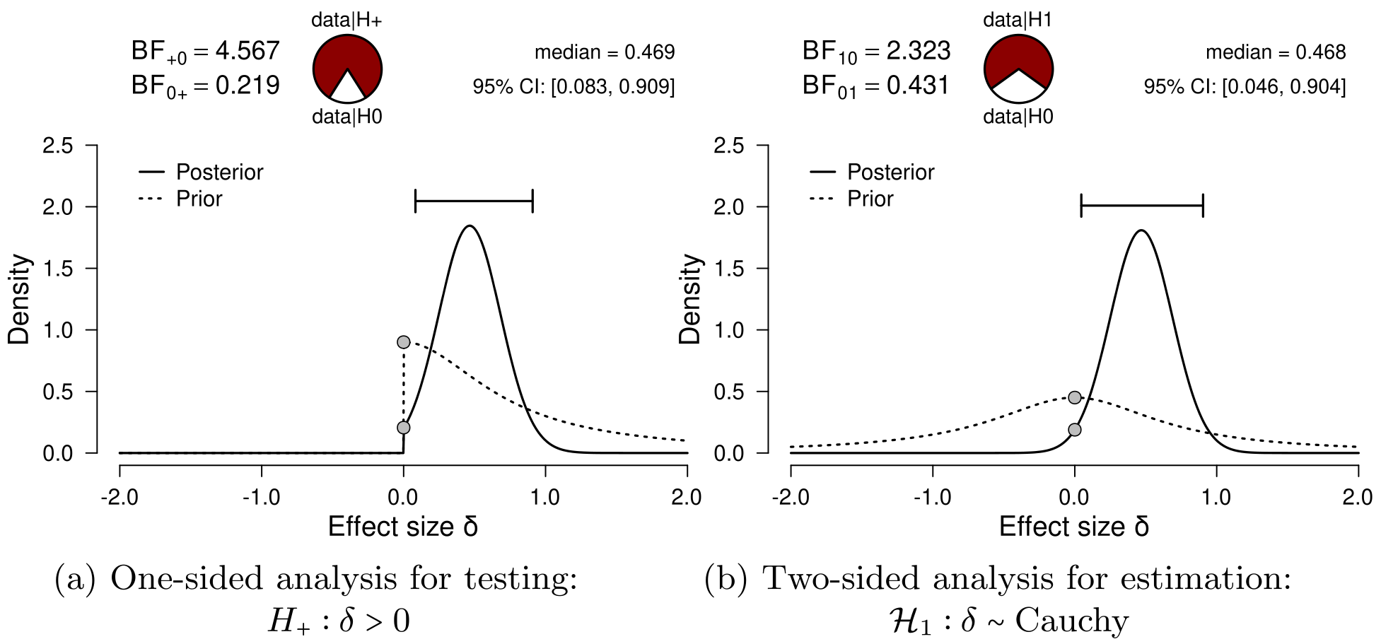
Bayes Factor Application to the two-sample location test

Slide 25
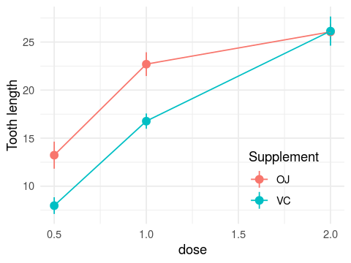


Bayes Factor Application to the ANOVA
Guinea pigs are assigned to one of two treatments (vitamin C or orange juice) in one of three doses. The effect on tooth growth is measured.
or

Slide 26
Bayes Factor Application to the ANOVA
New challenges:
— multiple variables ⇒ multiple parameters
— a single variable (here, dose) can be encoded with 2 parameters
Solution implemented in BayesFactor and JASP
= comparison between nested models e.g. with ($$M_{2}$$) and without ($$M_{1}$$) the interaction
$${BF}_{21}=\frac{p\left(y | M_{2}\right) }{p\left(y | M_{1}\right)}$$
$$BF$$ apply not only to models with different priors, but also to models with different structures!

Slide 27
Bayes Factor Comparing multiple models
Transitivity
Imagine we have k models to compare: $$M_{1}$$, $$M_{2}$$, ..., $$M_{k}$$
To compare them, we don’t need to calculate all pairwise $$BF$$. Thanks to the transitivity of Bayes Factors, we only need $$BF$$,transitivity
$${BF}_{32}=\frac{p\left(M_{3} | y\right)}{p\left(M_{2} | y\right)}=\frac{p\left(M_{3} | y\right)}{p\left(M_{1} | y\right)} × \frac{p\left(M_{1} | y\right)}{p\left(M_{2} | y\right)}=\frac{{BF}_{31}}{{BF}_{21}}$$
Posterior model probability
Using the definition of Bayes factors and the Bayes law, we can show that:
$$p\left(M_{i} | y\right)=\frac{{BF}_{i1}.p(M_{i})}{\sum_{j=0}^{k}{{BF}_{j1}×p(M_{j})}}$$
which can be simplified, when the prior distribution is uniform over the model space:
$$p\left(M_{i} | y\right)=\frac{{BF}_{i1}}{\sum_{j=0}^{k}{{BF}_{j1}}}$$

Slide 28
Bayes Factor Application to multiple regression
Suppose we study a phenomenon for which we have several candidate predictors. For example, the concentration of a pollutant in the air might depend on temperature, humidity and/or wind:
conc ~ temp, humid, wind
Instead, we can try all possible models, with any combination of the 3 predictors. Each can be included or not, so there are $$2^{3}=8$$ possible models:
null |  | 1 predictor |  | 2 predictors |  | 3 predictors
~ 1 | $$M_{0}$$ | ~ temp | $$M_{1}$$ | ~ temp, humid | $$M_{4}$$ | ~ temp, humid, wind | $$M_{7}$$
 |  | ~ humid | $$M_{2}$$ | ~ temp, wind | $$M_{5}$$
 |  | ~ wind | $$M_{3}$$ | ~ humid, wind | $$M_{6}$$
see also JASP blog post

Slide 29
Bayesian Model Averaging (BMA) Application to multiple regression
Now we can calculate the posterior probability of including temp as a predictor by summing up the posterior probabilities of the models where it shows up:
$$p({incl}_{temp}|y)= p(M_{1}|y)+p(M_{4}|y)+p(M_{5}|y)+p(M_{7}|y)$$
We can run a similar calculation for the prior probability of including temp as a predictor and derive a Bayes factor of inclusion: $${BF}_{incl}={p({incl}_{temp}|y) }/{ p({incl}_{temp})}$$
The estimation of the effect of a specific predictor (e.g. temperature temp) depends on the model considered. Instead of relying on a single model, we average on all models that include temp as a predictor, weighted by their respective posterior model probabilities to obtain a weighted posterior distribution of the regression coefficient for temp.
null |  | 1 predictor |  | 2 predictors |  | 3 predictors
~ 1 | $$M_{0}$$ | ~ temp | $$M_{1}$$ | ~ temp, humid | $$M_{4}$$ | ~ temp, humid, wind | $$M_{7}$$
 |  | ~ humid | $$M_{2}$$ | ~ temp, wind | $$M_{5}$$
 |  | ~ wind | $$M_{3}$$ | ~ humid, wind | $$M_{6}$$
$$p(β_{temp}|y)=p(β_{temp} { M}_{1}) × p(M_{1}|y)+$$ $$...+$$
$$p(β_{temp}|y,M_{7}) × p(M_{7}|y)$$

Slide 30
The many ways of Bayesian hypothesis testing
Frequentist NHST
Bayesian
Point (exact) hypothesis
Range hypotheses
Generative models
Hypothesis
Null
Method
Likelihood
Parameter estimation
Belief updating
Evidence
p-value
only against H₀
Posterior distribution
exact H₀: only against H₀
range H₀: against or in favor of H₀
Bayes Factor
against or in favor of H₀ (or model)

Slide 31
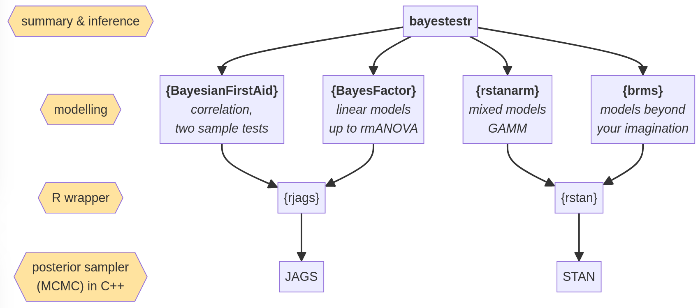
Software & package ecosystem

Slide 32
Frequentist vs. Bayesian statistics
Definition of probability
View on model parameters
Point estimates
Interval estimates
Hypothesis testing
Limitations
Frequentist
Long-run frequency of events
Fixed
Derived from the sample
Confidence interval ; confidence level is a property of the procedure, not of the intervals themselves
Point hypotheses only
Can only reject a hypothesis
Interpretability Usefulness
Bayesian
Degree of belief / certainty
Probabilistic
Derived from the posterior distribution
Credibility intervals ; confidence level is a statement about the uncertainty of the model parameters
Point and range hypotheses
Can select the best one among multiple
Time consuming (prior + computation) Lack of standards, rapid evolution

