Slide 1
Bayesian statistics 4/4 Performance, model evaluation, reporting
Oussama Abdoun (MEng, PhD) – oussama.abdoun@pm.me
Bayesian Statistics – CRNL – dec 2024

Slide 2
9 pragmatics reason to go bayesian
Parameter estimation
1. To obtain a measure of uncertainty that can be interpreted intuitively
2. To improve precision & decrease variance (for small samples in particular)
Hypothesis testing
3. To test hypotheses of interest formally
4. To obtain a quantitative measure of evidence (BF) 5. To obtain evidence in favor of the null
6. To eliminate the multiple comparison problem
Beneficial “side effects”
7. Thinking deeply about statistical models 8. Learning and reasoning about effect sizes
9. Having an opportunity to read the literature!

Slide 3
1.
Performance of bayesian inference

Slide 4

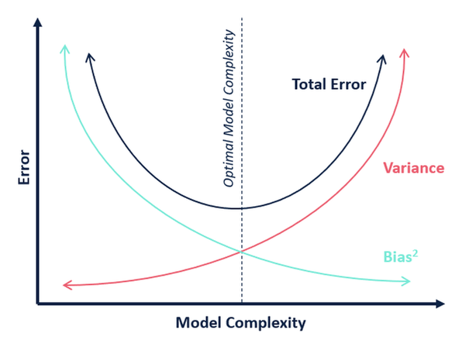
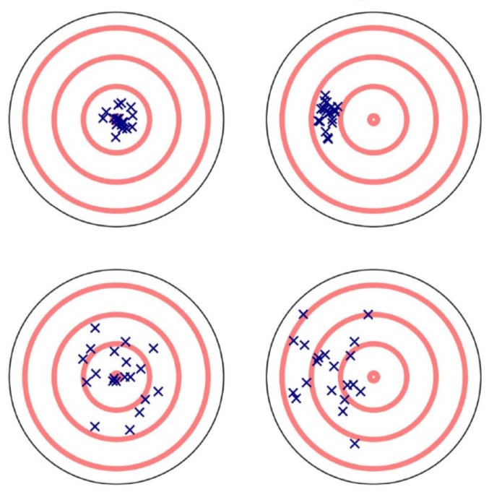
Bias-variance tradeoff
Bias = systematic error due to inadequate model (underfitting)
Variance = sensitivity to small fluctuations in the data (overfitting)
→ variability of parameter estimates across replications
Low bias
High bias
Low variance
High variance
Target center = true value
Crosses = model predictions

Slide 5
Bayes Factor As an Occam’s razor
$${BF}_{21}=\frac{p\left(y | M_{2}\right) }{p\left(y | M_{1}\right)}=\frac{\int{p\left(y | θ_{2}\right)p(θ_{2})dθ_{2}} }{\int{p\left(y | θ_{1}\right)}p(θ_{1})dθ_{1}}$$
Model complexity is automatically penalized by the Bayes Factor:
— the more parameters, the more the prior is spread out over “irrelevant” regions, the more “diluted” the predictive power of the model
— diffuse priors follow the same logic

Slide 6
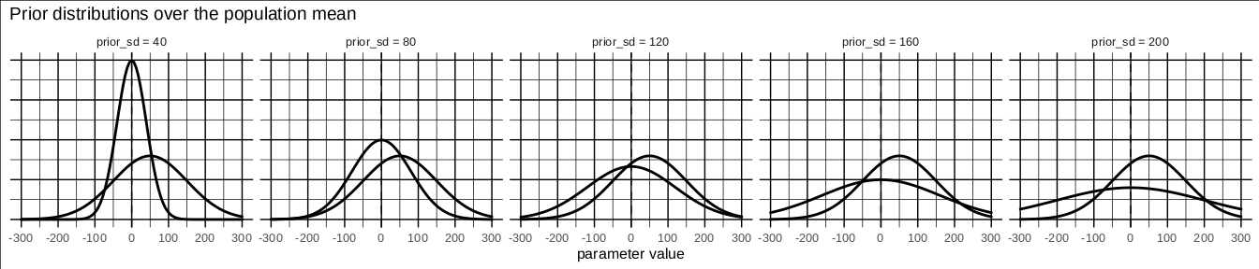
Bayesian vs. Frequentist A simulation study
Let’s model a population with true mean = 50 and std = 100 (for example, the difference in reaction times between 2 groups or conditions). The values correspond to a Cohen’s d of 0.5.
We will compare frequentist and bayesian results systematically, for a range of prior variance and sample sizes. For each combination of simulation parameters, we generate 1000 samples.

Slide 7
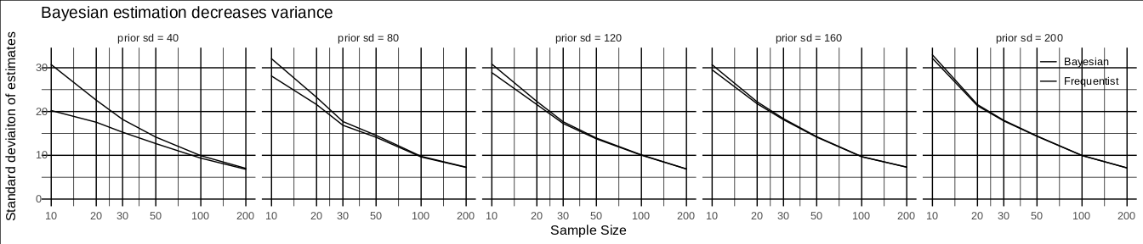
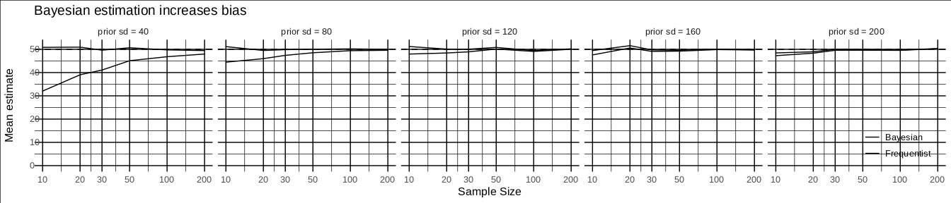
Bayesian vs. Frequentist Bias & variance

Slide 8
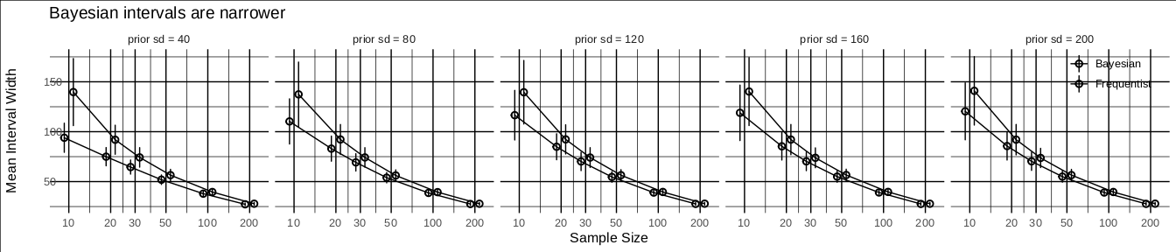
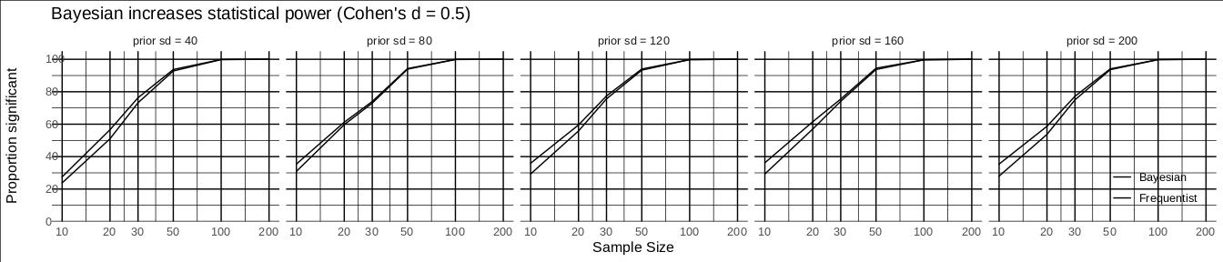
Bayesian vs. Frequentist Improved precision

Slide 9
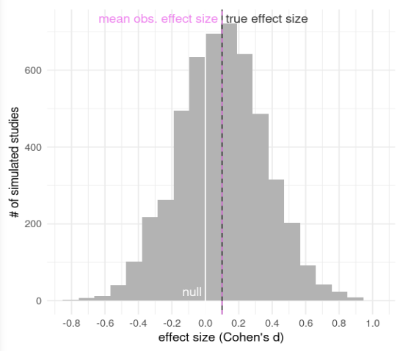
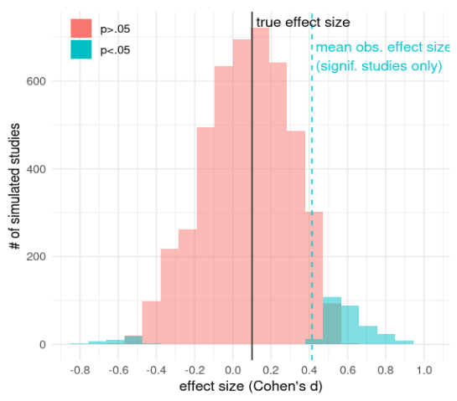
Type M and type S errors
Despite low power, replications will converge towards the true effect size...
M error
S errors
...unless non-significant findings are ignored and only significant ones are considered !

Slide 10
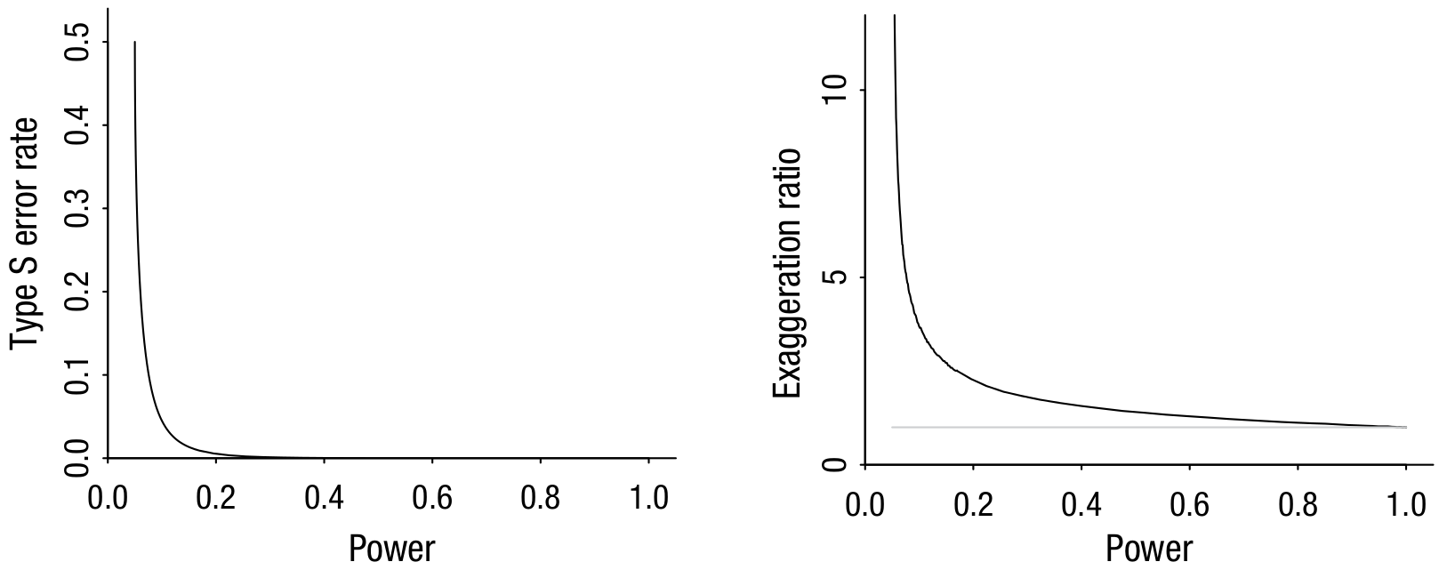
Type M and type S errors
The previous analysis can be extended to a range of true statistical powers :
These figures assume that only significant results enter meta-analyses, which implies extreme selective reporting (aka publication bias). Comparative analysis of registered and unregistered reports suggest that positive findings are 20x more likely to be published than null ones.
Gelman & Carlin (2014). Beyond Power Calculations: Assessing Type S (Sign) and Type M (Magnitude) Errors [link]

Slide 11
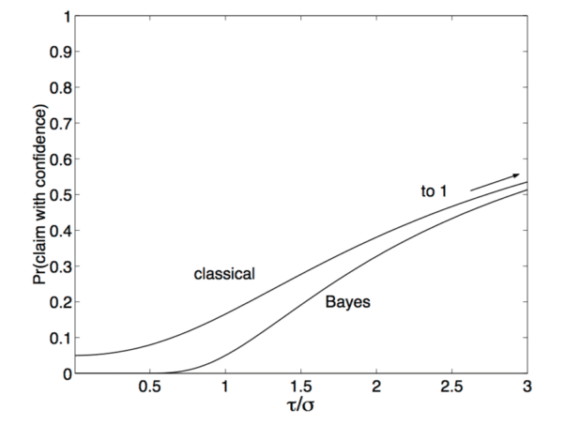
Bayesian vs. Frequentist The multiple comparison problem
If the prior distribution matches the true distribution of effect sizes:
— no type M error
— type S error always < 2.5%
— no need of a correction for multiple comparison
If the prior variance overestimates* the true variance of effect sizes, we start loosing the beneficial effects of the Bayesian inference.
If the prior variance underestimates* the true variance of effect sizes, we start loosing statistical power with Bayesian inference.
small effects and/or sample size
large effects and/or sample size
*by a factor 3 or more to have visible effects
Gelman (2016). Bayesian inference completely solves the multiple comparisons problem [link]

Slide 12
Bayesian vs. Frequentist Sequential hypothesis testing / optional stopping
The standard procedure in the frequentist paradigm:
— postulate an effect size d
— calculate sample size needed to reject H₀ under such an effect (N)
— collect data... and pray
But we could obtain p < .05 with less data, especially if true effect size > d
Unfortunately, we can’t run the stats after each new data point and stop when p < .05 ⇒ substantial increase of the risk of false positives!
What about Bayesian inference?
We can legitimately run the analysis after each data point and stop collecting data when...
— a certain BF-threshold has been reached (e.g. BF₁₀ or BF₀₁ = 10, or 30): Schönbrodt et al. 2015 [link]
— a certain precision of the posterio distribution has been reached: Kruschke 2013 [link to blog post]
Rouder (2014). Optional stopping: No problem for Bayesians [link]

Slide 13
What about significance hacking?
Questionable research practices that increase the risk of type I error include any change in the analysis pipeline performed after looking at the results:
— data sifting: excluding participants, data points, conditions...
— model tweaking: adding or removing interactions, predictors, moderators...
— selective reporting of a subset of dependent variables, experimental factors...
In frequentist statistics, they are incentivized by the dichotomous rule of “p < .05”
In bayesian statistics, treating BF and other measures as continuous measures of evidence (as it should) deflates the (conscious or unconscious) urge for significance hacking. You can further protect yourself with the usual measures:
— think of all the details of your analyses ahead of time (preregistration)
— validate your model before doing hypothesis testing
— report everything you did/tried

Slide 14
2.
Model checking & diagnosis

Slide 15
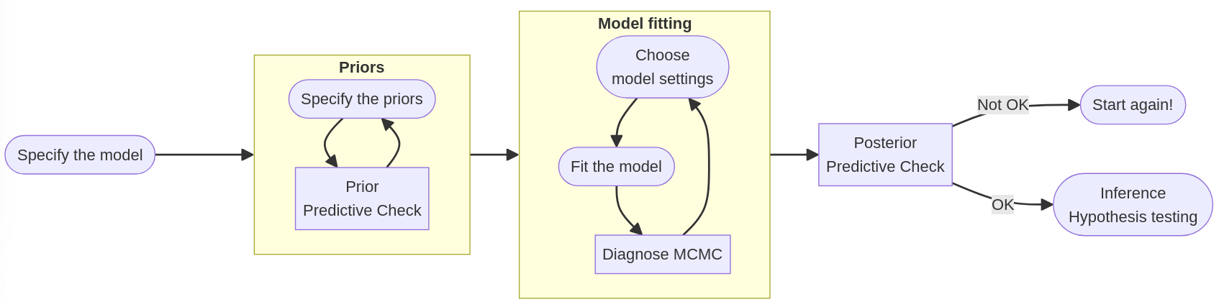
Workflow of bayesian modeling
See Schad, Betancourt & Vasishth (2021) for a more sophisticated workflow [link]

Slide 16

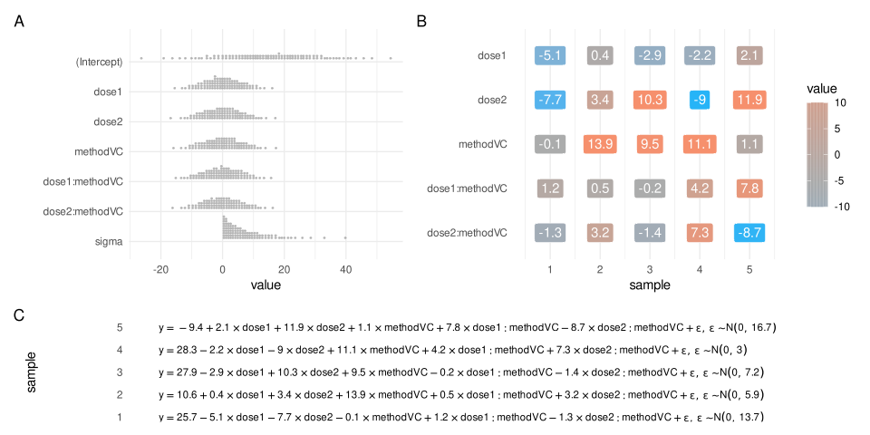
Prior predictive checks
Spe Specify prior distributions for each parameter of the model
A
B
(B) Randomly draw a set of parameters from the priors
(C) Plug the values into the model to generate a synthetic dataset
C
Repeat (B) and (C) many times (a few tens or hundreds).
Adjust priors if needed and restart from (A).

Slide 17
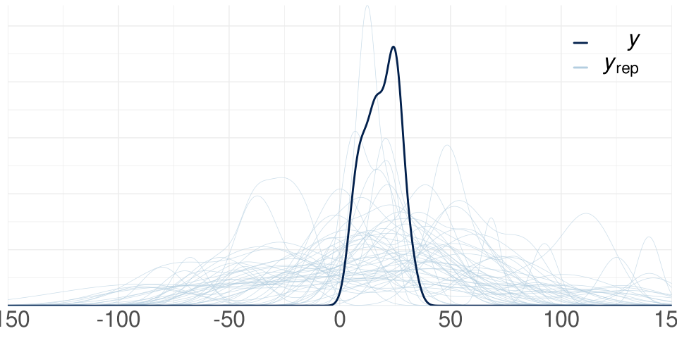
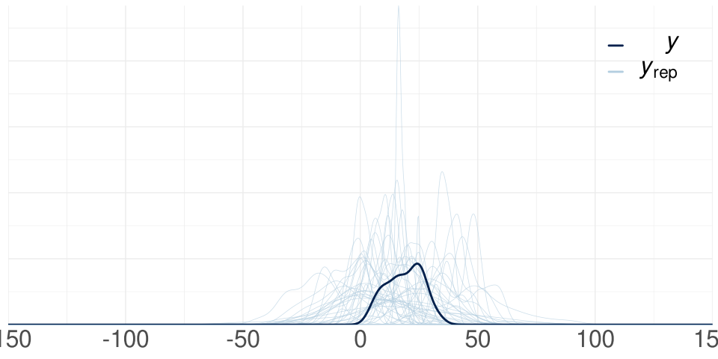
Prior predictive checks
tooth growth (mm)
tooth growth (mm)
rstan’s default priors
custom informative priors

Slide 18
Prior predictive checks
Example with the effect of meditation state on mismatch negativity Fucci, Poublan, Abdoun & Lutz (2022). No effect of FA and OM meditation on EEG auditory MMN [link]
 | rstanarm’s default | informative
Fixed effects : intercept | $$N(-1.3, {4.1}^{2})$$ | $$N(-1.3, 2^{2})$$
Fixed effects : coefficients | $$N(0, {5.8}^{2})$$ to $$N(0, {9.9}^{2})$$ | $$N(0, 2^{2})$$
Random effects : variance of by-subject intercept | $$exp(1)$$ | $$exp(1)$$
Residuals variance | $$exp(0.6)$$ | $$exp(1)$$

Slide 19
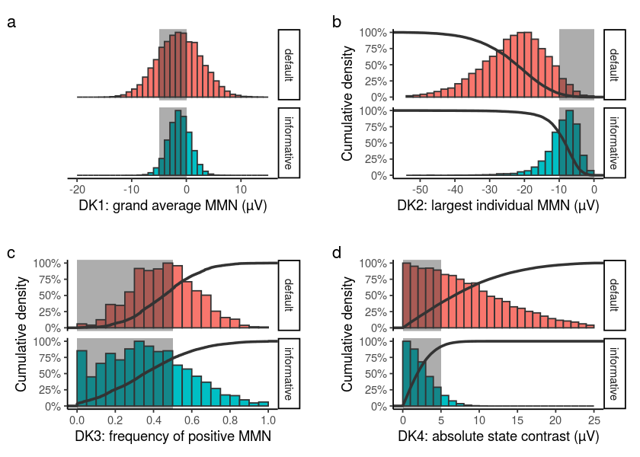
Prior predictive checks
Consistency with domain expertise using summary statistics
“DK1: The grand average MMN amplitude is in the order of -1 to -5µV.”
“DK2: Individual MMN amplitude only rarely exceeds -10µV (see for example figure 3 in Pekkonen et al. 1995, figure 1 in Escera et al. 2000, figure 4 in Näätänen et al. 2012, figure 2 in Kim et al. 2020).”

Slide 20
Prior predictive checks
Consistency with domain expertise using summary statistics
“DK3: (...)”
“DK4: Effects of experimental conditions and differences between populations are in the order of 1µV and rarely exceed 3µv (see for example the studies reported in reviews by Näätänen et al. 2007 and Kujala & Leminen 2017). Importantly, contrasts between experimental conditions and/or populations cannot exceed the magnitude of MMN in absolute value, and therefore are typically smaller than 5µV.”

Slide 21
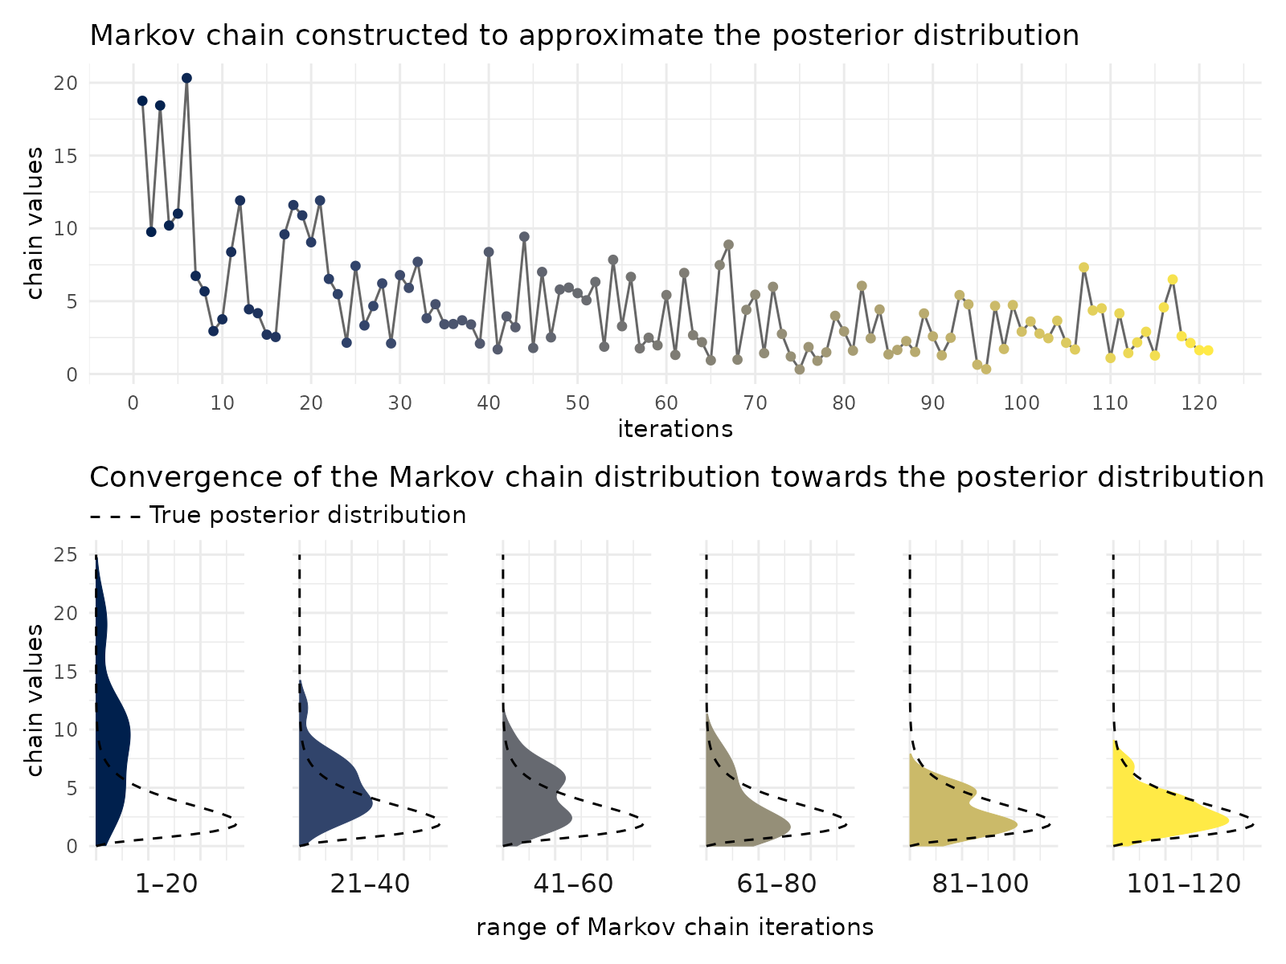
Numerical simulation of the posterior: MCMC
When prior distributions are not conjugate distributions of the likelihood, we don’t have an explicit expression of the posterior distribution anymore and we need to calculate it numerically. We use Markov chain Monte Carlo (MCMC) techniques, a family of algorithms sharing the same basic procedure:
1. A Markov chain (= random process where each sample depends probabilistically on the previous one) is created such that it, in the long run, its distribution converges towards the true posterior distribution.
2. A large number of samples (several to tens of thousands) are generated iteratively from the Markov chain.
3. Initial samples (typically 1000) are considered as not converged yet and rejected (“warm up” phase); the rest of the samples is used as an approximation of the posterior distribution.

Slide 22
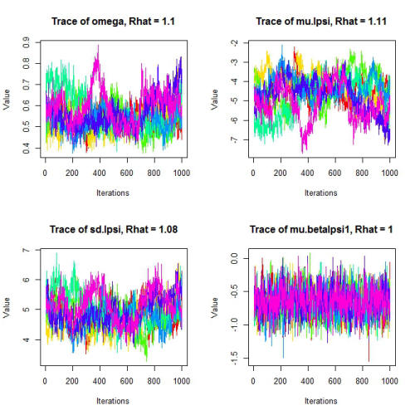
Diagnosis of MCMC convergence
To check whether the MCMC converges properly, we start multiple independent chains (typically 4) and check:
— that they reach stationarity
— that they converge to the same distribution (mean and variance) aka “chain mixing”
⇒ numerical assessment = $$\hat{R}$$ (aka the Gelman-Rubin statistic) ~ between-chain variance / within-chain variance
Recommendation: $$\hat{R}≤1.1$$

Slide 23
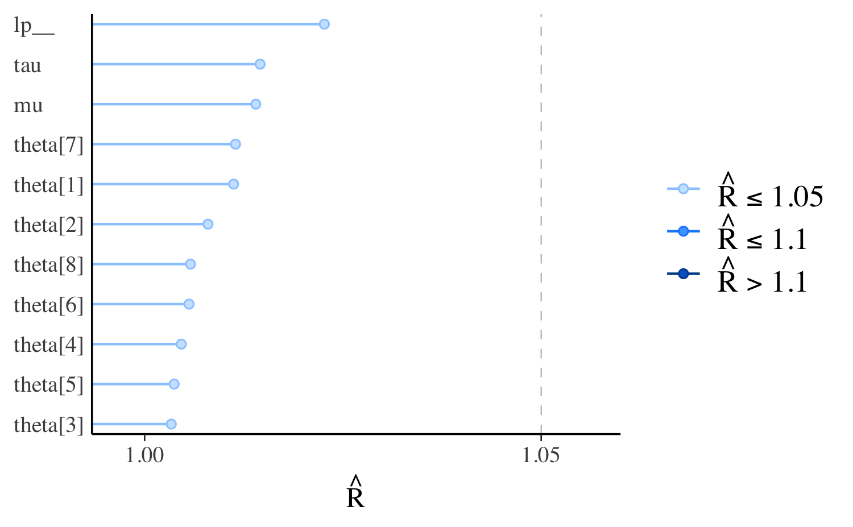
Diagnosis of MCMC convergence
MCMC convergence should be checked for each parameter of the model.
What to do when convergence is poor?
Use more informative priors
2. Collect more data
3. Increase the number of MCMC iterations
4. Simplify the statistical model

Slide 24
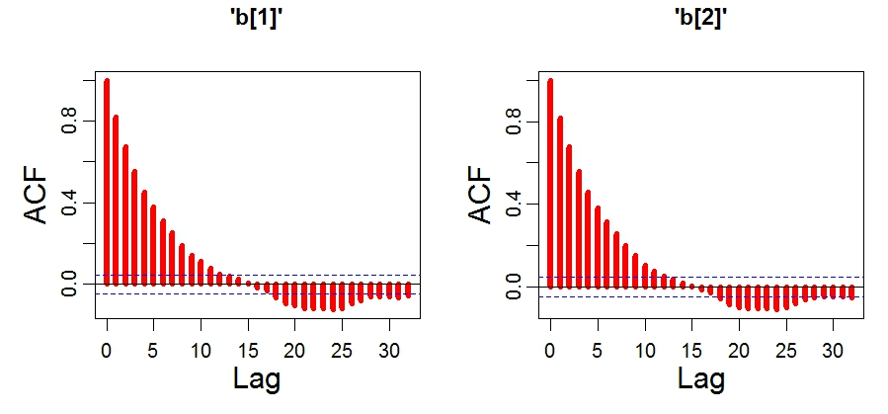
Diagnosis of MCMC convergence
Markov processes have a memory of the previous iteration. Therefore, Markov chains have autocorrelation and some of the information that they contain is “redundant”.
⇒ numerical assessment = effective sample size ($$n_{eff}$$) = number of independent draws from the posterior distribution
Recommendation: $$n_{eff}≥500$$ for parameters of interest
What to do when there are not enough effective samples?
The same as with insufficient mixing, especially increasing the number of MCMC iterations.

Slide 25
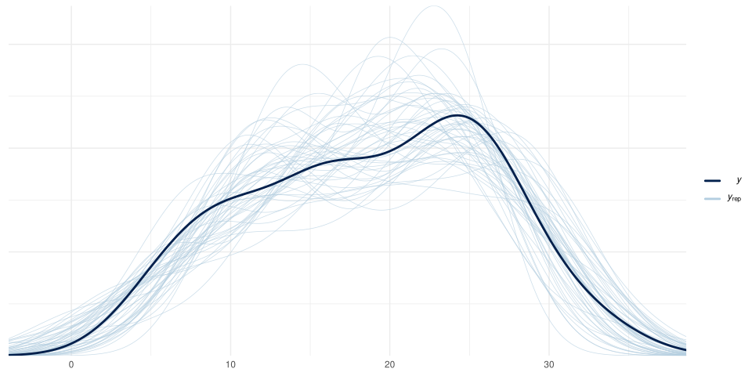
Posterior predictive checks
Similar procedure as the prior predictive check

Slide 26
3.
Reporting

Slide 27
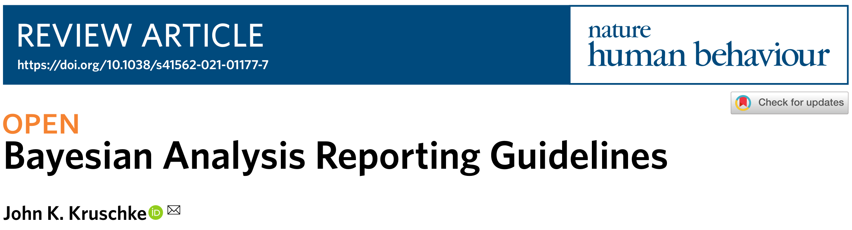
Bayesian Analysis Reporting Guidelines
Kruschke (2021). Bayesian Analysis Reporting Guidelines [link]

Slide 28
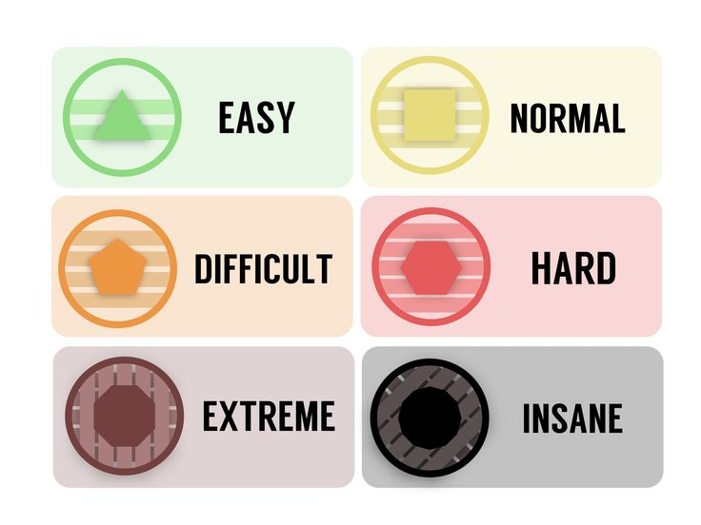
Common mistakes : a test
prevalence in the literature
“Since both the confidence interval (−.09 and .67) and the BF₁₀ (1.2) do not point towards a true difference, this can be considered a very small or non-existent effect.”
<4%
“The Bayesian test showed a positive, but small, effect of Load on tracking pupil size (BF_{incl.}=7.506)”
~4%
“For 6-year-olds, there was no difference between environments (t(52)=1.0, p=.31, d=0.3, BF=0.22)”
35%
“A BF₁₀ = 10 means that the H₁ is ten times more likely to be true than the H₀”
28%
“These analyses revealed a Bayes factor of BF_{1,0} = 0.19 in the attention condition, supporting the null hypothesis.”
62%

Slide 29
Common mistakes
 | Example | Explanation | Correction
1,6—Describing or interpreting the BF as posterior odds | “A BF₁₀ = 10 means that the H₁ is ten times more likely to be true than the H₀” | Not rigorous: BF are likelihood ratios. They are equal to posterior odds only when prior odds equal to 1 | State that prior odds equal to 1.
3a—Missing explanation for the chosen priors | Using default priors without justification. | Not transparent
3b—No mention of the priors used |  | Not reproducible
3c—Incomplete info regarding the priors used | Mentioning using a Cauchy distribution without specifying the value of the scale parameter. | Not reproducible
4—Not referring to the comparison of models | “These analyses revealed a Bayes factor of Bf_{1,0} = 0.19 in the attention condition, supporting the null hypothesis.” | Not rigorous: support for one model depends strongly on the model it is compared to. | Be more verbose, or explain in the Methods once for all how to interpret the BF.
Tendeiro et al. (2024). Diagnosing the Misuse of the Bayes Factor in Applied Research [link]

Slide 30
Common mistakes
 | Example | Explanation | Correction
5—Making absolute statements | “For 6-year-olds, there was no difference between environments (t(52)=1.0, p=.31, d=0.3, BF=0.22)” | Wrong: the BF is a continuous measure of evidence, it can not prove anything with absolute certainty. | “For 6-year-olds, there was weak evidence for an absence of difference ...”
7—Considering the BF as effect size | “The Bayesian test showed only positive, but smaller, effect of Load on tracking pupil size (BF_{incl.}=7.506)” | Wrong: Erroneous association between statistical and practical significance.
9—Inconclusive evidence as evidence of absence | “Since both the confidence interval (−.09 and .67) and the BF₁₀ (1.2) do not point towards a true difference, this can be considered a very small or non-existent effect.” | Wrong: Bayes factors close to 1 imply that the evidence for either model under comparison is about the same. | “Since..., the data is inconclusive with respect to the null or alternative hypotheses.”
10—Interpreting ranges of BF values only | “Evidence for greater disgust in the experimental group was strong (BF₁₀ > 10), but there was only weak evidence for a difference in other emotions (BF₁₀ ’s < 3 )” | Not rigorous: BF is a continuous measure of evidence | Report BF values precisely, and interpret them individually.

