Slide 1
LIBRARY MANAGEMENT SYSTEM
Library Management System
Java • JavaFX • Maven — A hands-on application of Object-Oriented Programming (OOP) principles
CCS2304 — Advanced Programming Applications | Project 12

Slide 2
Project Overview
A desktop application built in Java using JavaFX that manages the book catalog and the library's member list, with a login screen and a main dashboard.
13
4
Classes / Interfaces / Enums
JavaFX Screens
Core goal: a realistic, clear demonstration of the four OOP concepts within a complete, runnable project.
3
4
Main Packages
OOP Principles Applied
01 — Overview
Library Management System — CCS2304

Slide 3
Project Objectives
Build a complete system for managing books and members with an easy-to-use graphical interface.
1
Apply the four OOP principles clearly and document them within the code.
2
Separate the layers — Model, Service, and Controller — to organize the project.
3
Use the Singleton design pattern to manage shared data state.
4
02 — Objectives
Library Management System — CCS2304

Slide 4
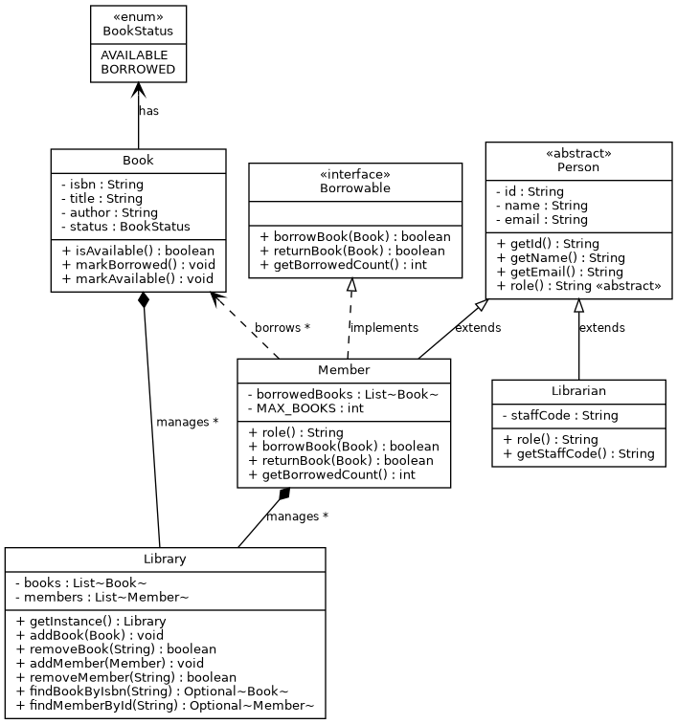
System Design — UML Class Diagram
Person An abstract class — the base for any person in the system.
Member / Librarian inherit from Person (Inheritance).
Borrowable An interface describing borrowing behavior, implemented by Member.
Library aggregates and manages the books and members.
03 — System Design
Library Management System — CCS2304

Slide 5
OOP Concepts Applied
Abstraction
A
Encapsulation
E
Person and Borrowable
Book, Person, Library
role() is declared abstract, and the interface describes behavior without implementation details.
All fields are private with getters/setters, and Library hides its internal Lists.
Inheritance
I
Polymorphism
P
Member, Librarian extends Person
role() in Member and Librarian
Both classes get id, name, and email from the parent Person without duplicating code.
Each class overrides the same role() method differently.
04 — OOP Concepts
Library Management System — CCS2304

Slide 6
Project Structure
Package | Function
model | Person, Member, Librarian, Book, BookStatus, Borrowable
service | Library — the central (Singleton) class for managing books and members
controller | Login, Dashboard, Book, Member — controls the screens
resources | FXML and CSS files for the interfaces
05 — Project Structure
Library Management System — CCS2304

Slide 7
Screens and Functions
1
2
Login
Dashboard
Verifies login credentials before entering the system (admin / admin).
A quick summary of the number of books and members, with links to the other two screens.
3
4
Book Management
Member Management
View/add/delete books, and toggle a book's status (available / borrowed).
View/add/delete members, and borrow/return a book via ISBN.
06 — Screens
Library Management System — CCS2304

Slide 8
How to Run
Requirements: JDK 17 or later, with Maven installed on the machine.
mvn clean javafx:run
Demo Login Credentials
Username: admin
Password: admin
07 — Running
Library Management System — CCS2304

Slide 9
Conclusion
The project delivered a practical, clear demonstration of the four OOP principles by building a complete, runnable JavaFX application. Future ideas include connecting a real database and adding a multi-user permissions system.
Thank You

