Slide 1

Predictive Maintenance
for the Smart Factory
AI FOR INDUSTRY 4.0
A machine-learning system that predicts industrial machine failures before they stop the line.
10,000
0.98
79%
75.8%
sensor records
ROC-AUC
failures caught
cost saved
Yousef Abdallah Khamis | AI & Machine Learning Engineer

Slide 2


From reacting to predicting
01 THE PROBLEM AND THE IDEA
10,000
3.39%
50,000 EGP
machine records analysed
are failures: a needle in a haystack
assumed cost of one unplanned stop
Reactive maintenance (today)
Predictive maintenance (this project)
Fix the machine after it breaks
Unplanned line stoppage
Cost on test set: 3.4M EGP
Sensors feed a model that outputs a risk score
Service only machines at risk
Cost on test set: 0.82M EGP

Slide 3




The AI4I 2020 dataset
02 INPUTS
Sensors (5)
Target: Machine failure
Air temp [K], Process temp [K], Rotational speed [rpm], Torque [Nm], Tool wear [min]
Product type
L (60%), M (30%), H (10%) quality variants
Identifiers
UDI and Product ID: dropped before modelling
Labels
Machine failure plus 5 modes: TWF, HDF, PWF, OSF, RNF
Imbalance ratio about 28 : 1

Slide 4
Six steps from raw data to decisions
03 HOW IT WORKS
1
Load and inspect
2
Explore (EDA)
3
Feature engineering
10,000 rows x 14 columns, 0 missing values, 0 duplicates
Target imbalance, failure modes, correlations, box plots
5 physics-based features + type encoding = 11 inputs
4
Split and SMOTE
5
Train 3 models
6
Explain and value
80/20 stratified split; SMOTE on train only: 8,000 to 15,458
Logistic Regression, Random Forest, XGBoost
SHAP, Isolation Forest, cost-benefit in EGP

Slide 5
Five steps in Google Colab
04 HOW TO RUN IT
1
Upload archive.zip (contains ai4i2020.csv) to Google Drive
$ pip install -r requirements.txt
pandas numpy matplotlib seaborn
2
Open the notebook in Colab and mount Drive
scikit-learn imbalanced-learn
xgboost shap joblib
3
Install the requirements (xgboost, shap, imbalanced-learn)
fastapi uvicorn
Run cells 1 to 10 in order
# training time (CPU)
4
Logistic Reg. 0.18 s
Random Forest 7.69 s
5
Download predictive_maintenance_project.zip
XGBoost 0.55 s

Slide 6



Physics turned into features
05 FEATURE ENGINEERING
Temp_Difference
Process temp - Air temp
Cooling efficiency
Power_W
Torque x RPM x 2pi / 60
Mechanical power in watts
Tool_Stress
Tool wear x Torque
Load on the cutting tool
Wear_per_RPM
Tool wear / (RPM + 1)
Wear per rotation
Thermal_Load
Temp_Difference x Power_W
Heat generated under load
Plus Type_Encoded (H=0, L=1, M=2) = 11 model inputs. Three of the top-5 SHAP features are engineered.

Slide 7
XGBoost wins on balance
06 RESULTS
XGBoost: selected model (best F1)
97.95%
79.4%
Accuracy
Recall
0.725
0.981
F1-Score
ROC-AUC

Slide 8


Where the model is right and wrong
07 ANALYSIS (1/2)
Catches 54 of 68 real failures (79% recall)
1,905
27
True negative: healthy, correct
False positive: false alarm
27 false alarms among 1,932 healthy cases (1.4%)
14 failures missed. Lowering the 0.5 threshold would trade precision for recall
14
54
False negative: missed failure
True positive: failure caught
Isolation Forest flagged 120 samples but found only 34 of 68 failures: a complement, not a replacement

Slide 9
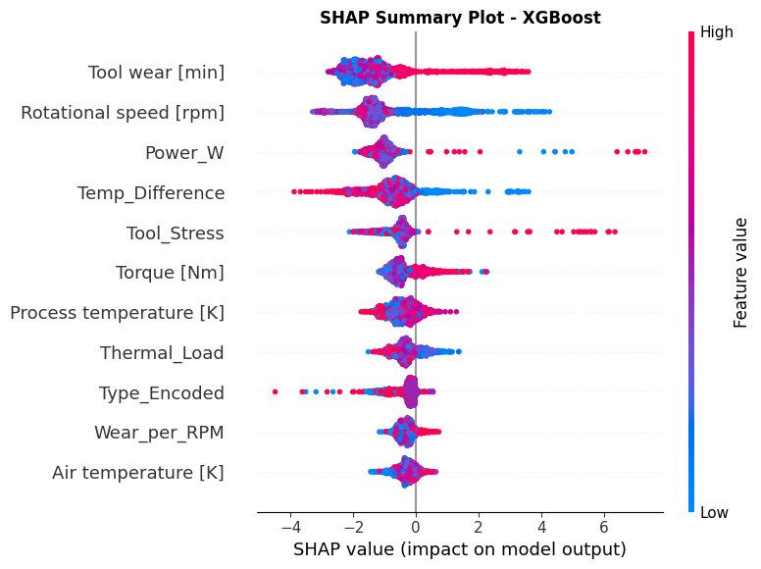
Why the model decides: SHAP
08 ANALYSIS (2/2)
Top-5 drivers (mean |SHAP|)
Tool wear [min]
1.55
Rotational speed
1.32
Power_W *
1.09
Temp_Difference *
0.89
Tool_Stress *
0.65
* engineered feature. Physics-based features rank among the top drivers, so the model learned real mechanics rather than noise.

Slide 10
What the model is worth
09 BUSINESS IMPACT
75.8%
Projected annual cost (million EGP)
maintenance cost reduction
31.4M EGP
saved per year (extrapolated)
Assumptions (editable): 50,000 EGP per unplanned failure, 2,000 EGP preventive fix, 500 EGP per false alarm; the 2,000-sample test set stands for one month.

Slide 11
What the project delivers
10 OUTPUTS
xgboost_model.pkl
scaler.pkl
Real-time risk score
Trained classifier, 440 KB
StandardScaler for new data
Risk > 0.5 triggers an ALERT
features.json
results.json
Sample
Risk
Status
The 11 input features
Metrics of all 3 models
354
0.006
OK
569
0.012
OK
summary.json
requirements.txt
Best model, savings, top features
Python dependencies
1903
0.006
OK
663
0.000
OK
README.md
project .zip
Project documentation
Everything in one download
Examples from the notebook demo (10 random test samples, all healthy and correctly scored).

Slide 12
Honest strengths and limits
11 PROS AND CONS
Strengths
Limitations
Catches 79% of real failures early
98% accuracy, ROC-AUC 0.98 on unseen data
Explainable: SHAP shows why an alert fires
Fast: XGBoost trains in 0.55 s on CPU
Clear ROI: 75.8% lower cost
Precision 0.67: about 1 alert in 3 is false
14 of 68 failures still missed
Synthetic dataset: validate on real plant data
EGP costs are assumptions; one split, no tuning
Isolation Forest is weak (34 of 68)

Slide 13




From notebook to the factory floor
12 HOW TO USE IT
Production lines
Maintenance plans
Spare parts
Safety and quality
Score CNC and milling machines continuously
Service by risk, not by calendar
Stock tools before they wear out
Fewer sudden breakdowns and defects
Phase 1: Pilot
Phase 2: Integrate
Phase 3: Scale
One line, offline scoring, tune the alert threshold
FastAPI service + SCADA/MES feed + dashboard
Retrain on plant data, monitor drift

