Slide 1
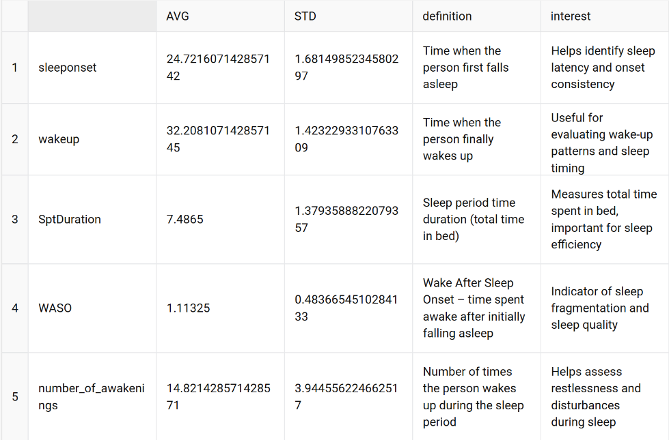
insential variables

Slide 2
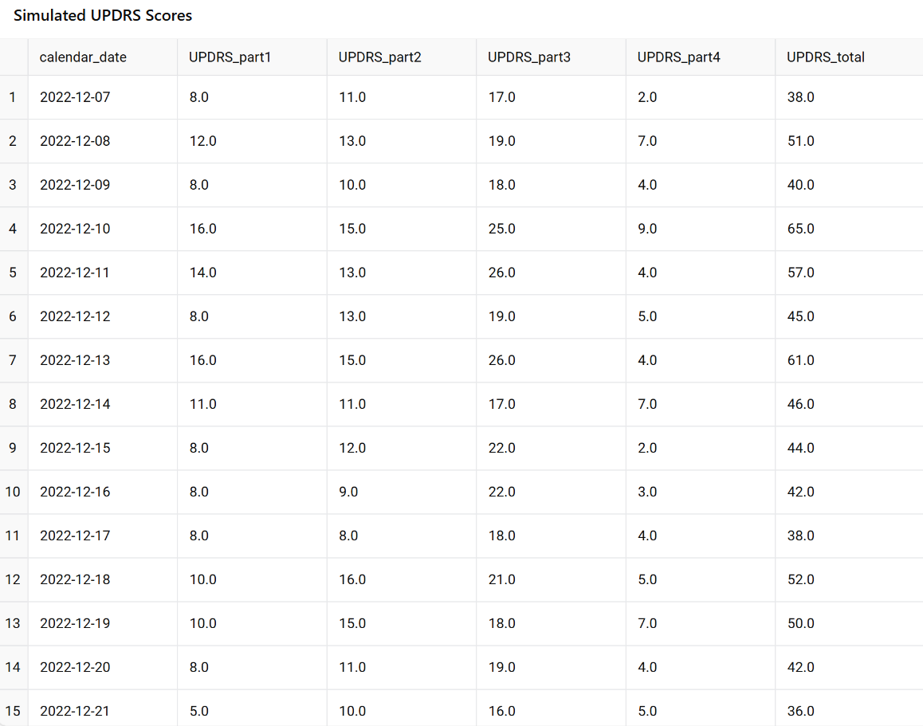
UPDRS

Slide 3
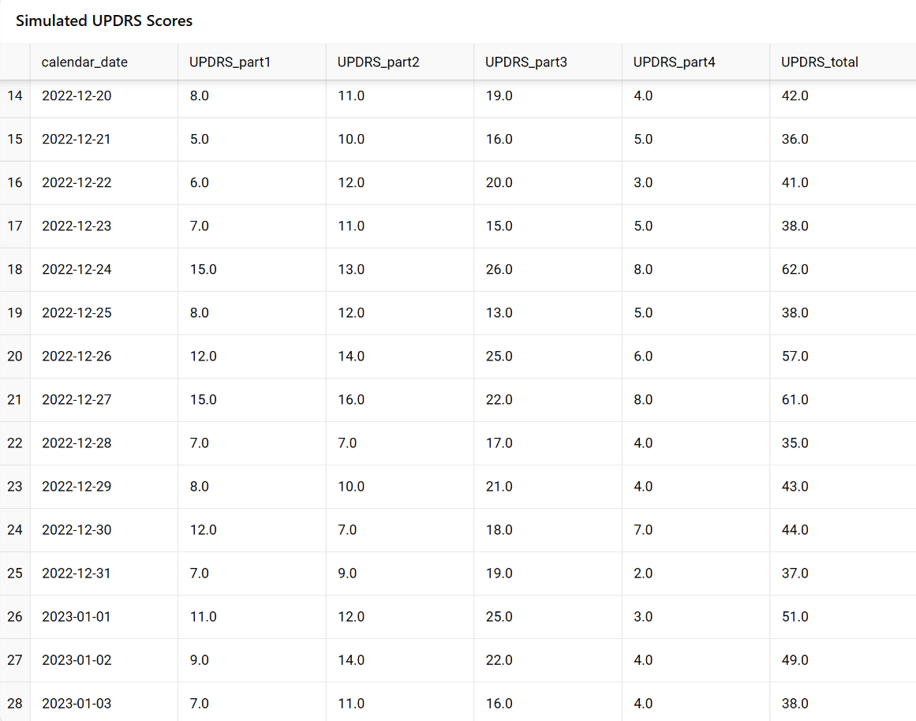
UPDRS

Slide 4
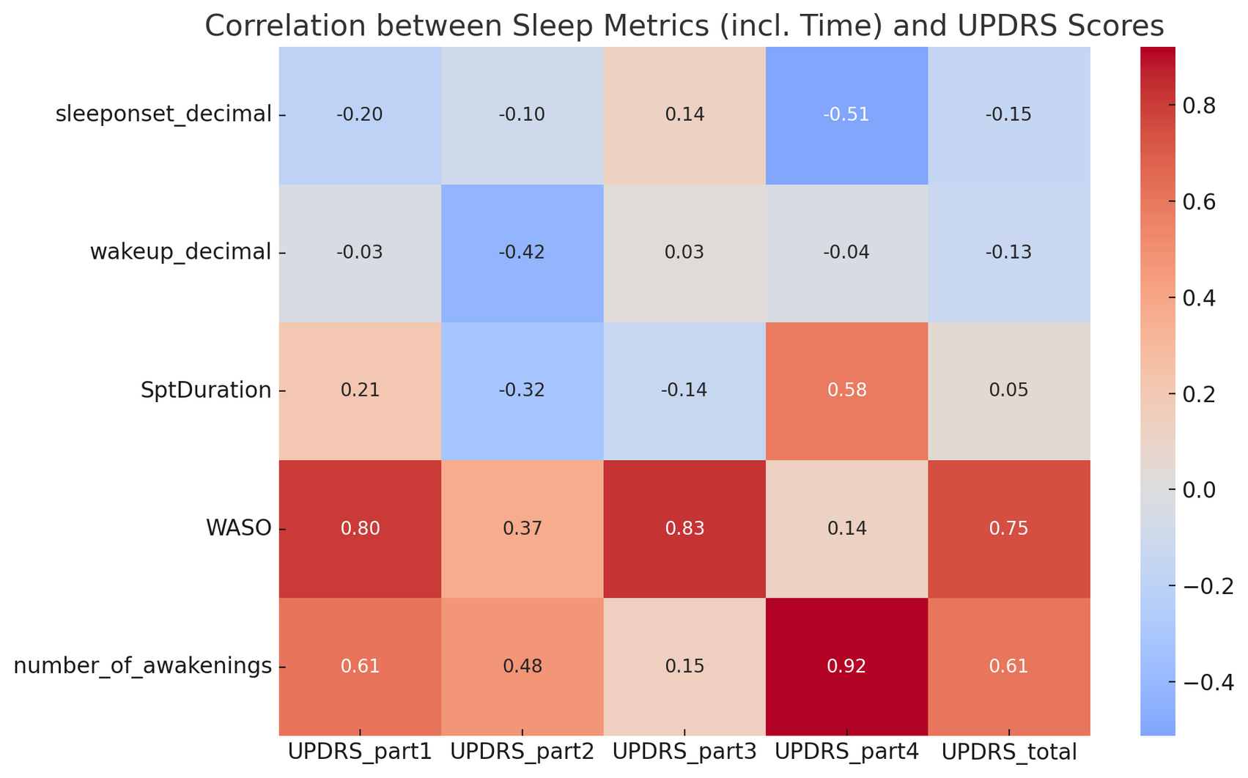
correlations between sleep variables and simulated UPDRS scores

Slide 5
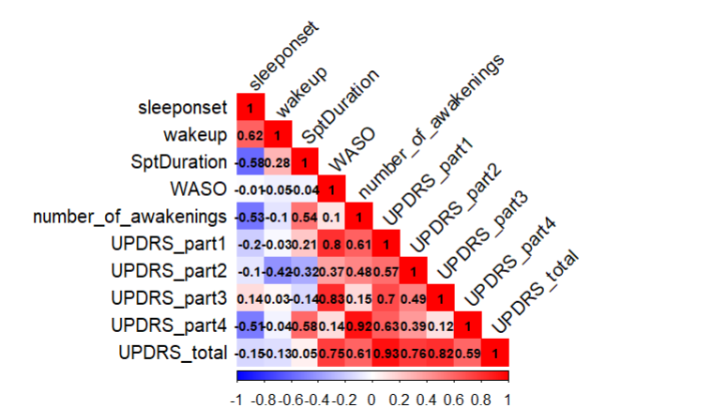

Slide 6
1. Sleep Onset Time (sleeponset_decimal)- Correlation with UPDRS_total: -0.15- Sleep onset time shows a slight negative correlation with total UPDRS score.- Patients who fall asleep later tend to have slightly less severe symptoms, although the relationship is weak.- The strong negative correlation with UPDRS_part4 (-0.51) indicates that motor complications might lead to earlier awakenings, reducing the sleep period.
2. Wake-up Time (wakeup_decimal)- Correlation with UPDRS_total: -0.13- Wake-up time shows a weak negative correlation with UPDRS scores.- Later wake-up time may reflect more consistent or restorative sleep.- Moderate negative correlation with UPDRS_part2 (-0.42) suggests fewer motor difficulties in daily life among patients with regular wake-up times
3. Total Sleep Duration (SptDuration)- Correlation with UPDRS_total: 0.05- Time in bed does not significantly correlate with Parkinson's severity.- Moderate positive correlation with UPDRS_part4 (0.58) suggests patients with more motor complications may stay in bed longer to compensate for sleep disturbances.

Slide 7
4. WASO (Wake After Sleep Onset)- Correlation with UPDRS_total: 0.75- Strongest correlation among all sleep variables.- Strong correlations with UPDRS_part1 (0.80) and UPDRS_part3 (0.83) indicate that frequent awakenings relate to non-motor and motor symptom severity.- WASO is a key marker of poor sleep quality and advanced disease state.
5. Number of Awakenings- Correlation with UPDRS_total: 0.61- Strongly associated with overall disease severity. - Very high correlation with UPDRS_part4 (0.92), reflecting how motor complications during the night disrupt sleep.- Also correlates with UPDRS_part1 (0.61) and part2 (0.48), linking sleep disruption to both non-motor and daily motor functioning challenges

Slide 8
