Slide 1
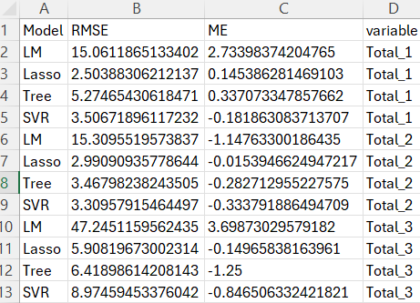
metrics without nparAct values

Slide 2
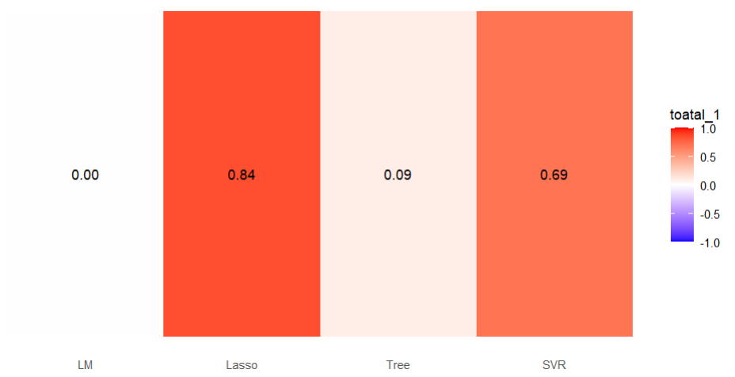
correlation between predicted total_1 and actual total_1 value without nparAct variables

Slide 3
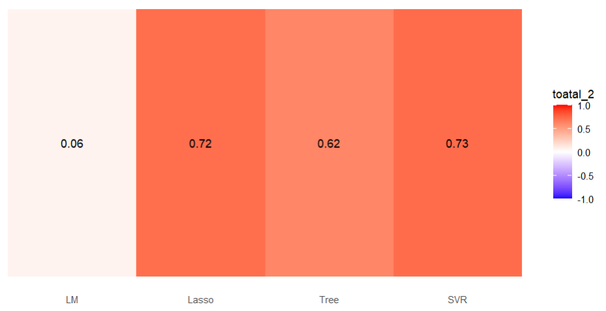
correlation between predicted total_2 and actual total_2 value without nparAct variables

Slide 4
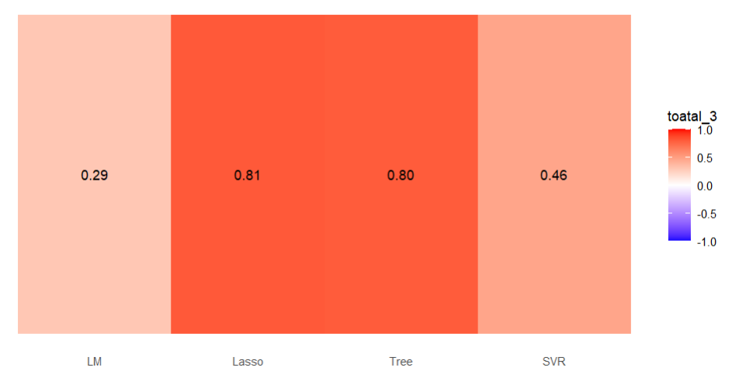
correlation between predicted total_3 and actual total_3 value without nparAct variables

Slide 5
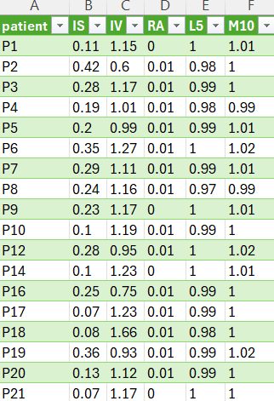
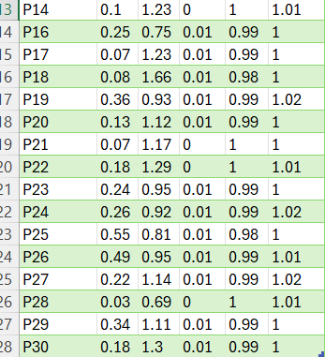
nparAct parametre
IS | IV |RA |L5 | M10

Slide 6
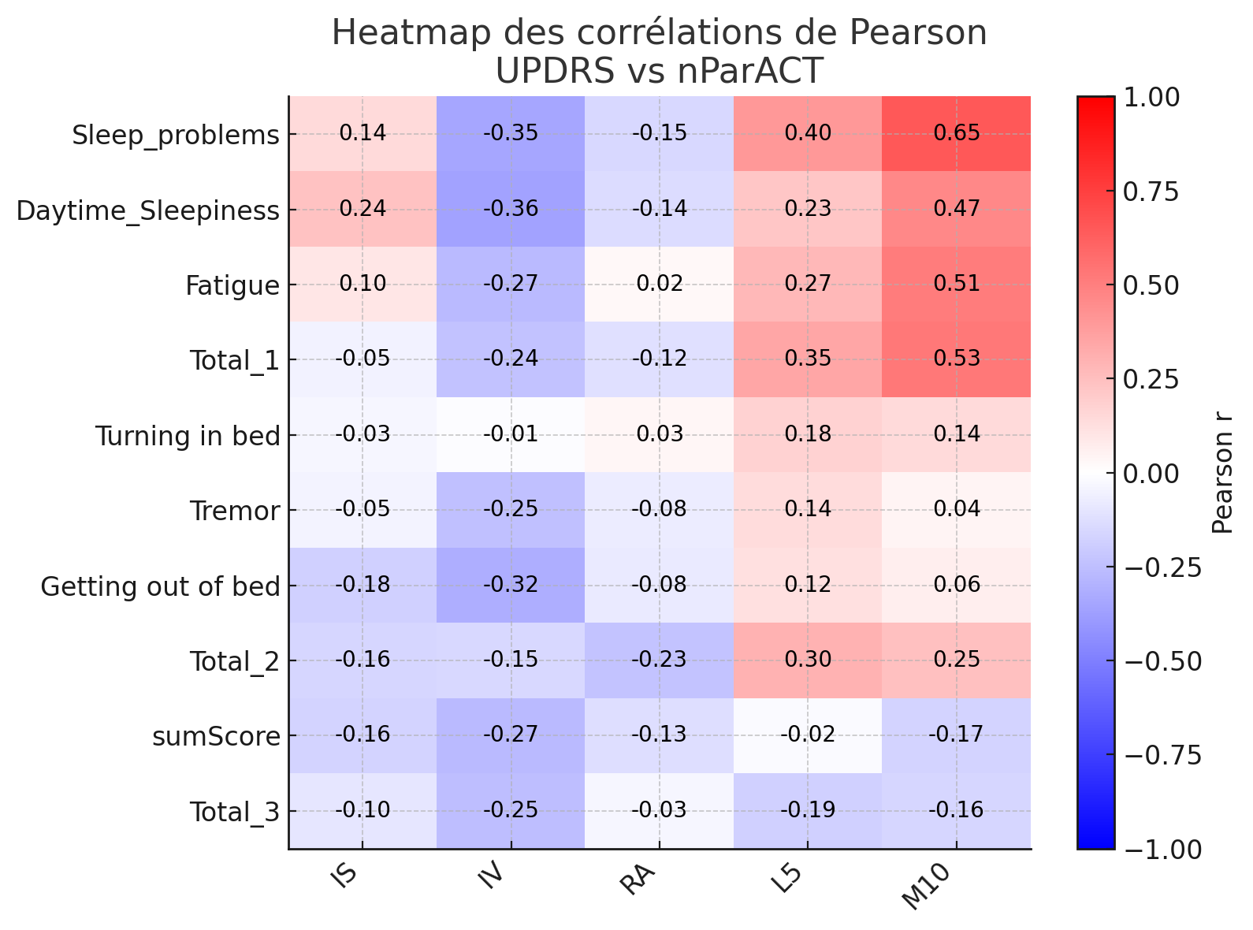
correlation between UPDRS score and nparAct variables

Slide 7
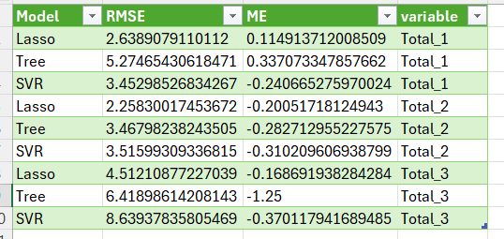
metrics after add nparAct values

Slide 8
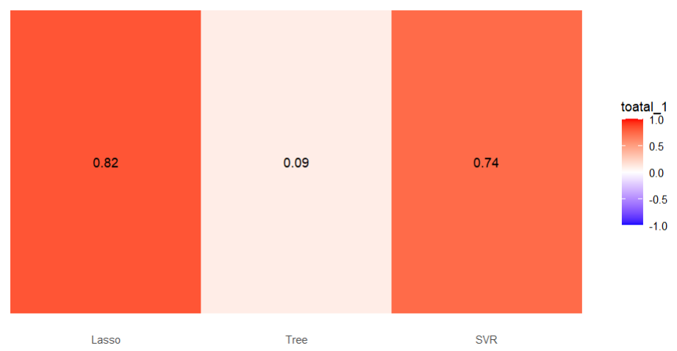
correlation between predicted total_1 and actual total_1 with nparAct variables

Slide 9
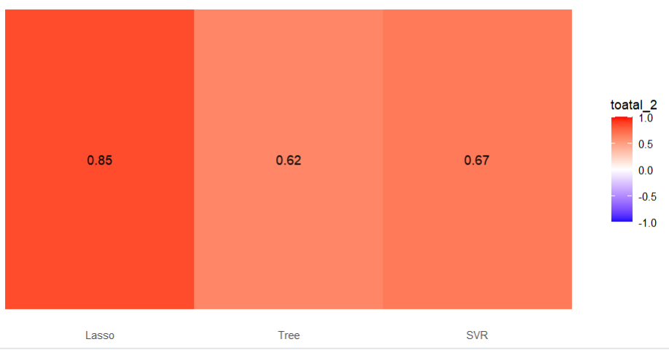
correlation between predicted total_2 and actual total_2 with nparAct variables

Slide 10
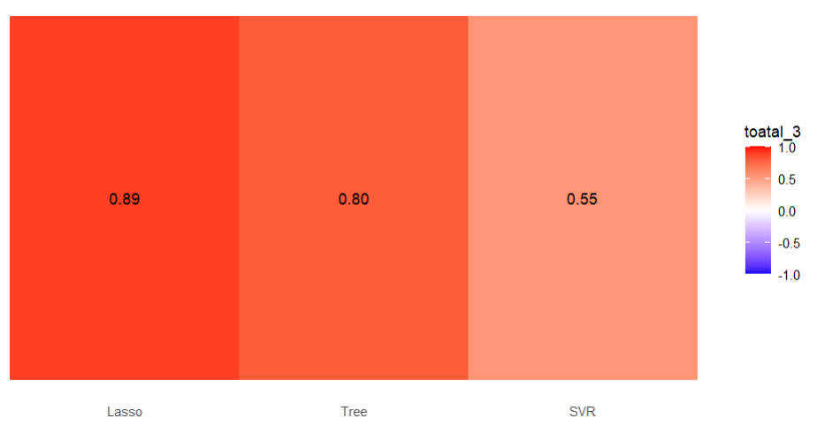
correlation between predicted total_3 and actual total_3 with nparAct variables

Slide 11
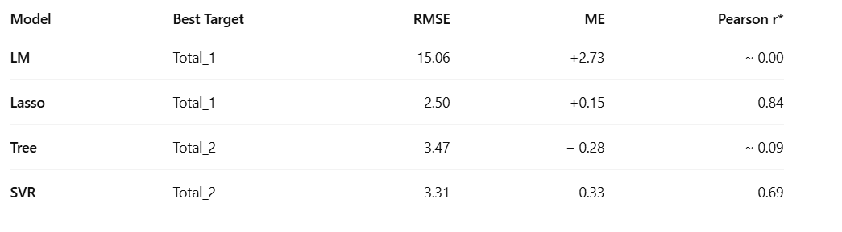
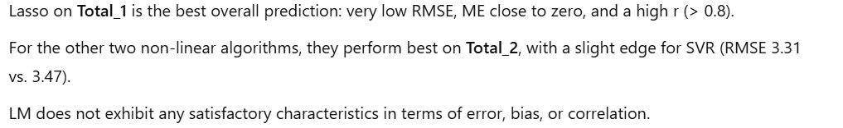
best model

