Slide 1
DATA 205 Capstone
Food Inspections & Median Household Income by ZIP
Ousmane Kandji

Slide 2
Data
- Food inspection dataset (ZIP, results)
- Census median income (ZCTA)
- Merged using ZIP code

Slide 3
Data Challenges
- ZIP vs ZCTA mismatch
- Missing income values
- Cleaning Census format

Slide 4
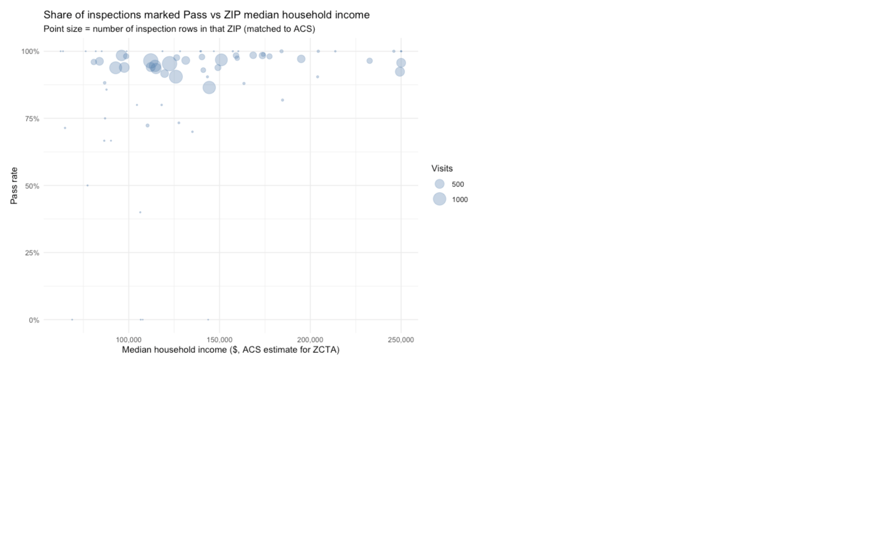
Income vs Pass Rate
- Each point = ZIP
- Size = inspections
- Exploring relationship

Slide 5
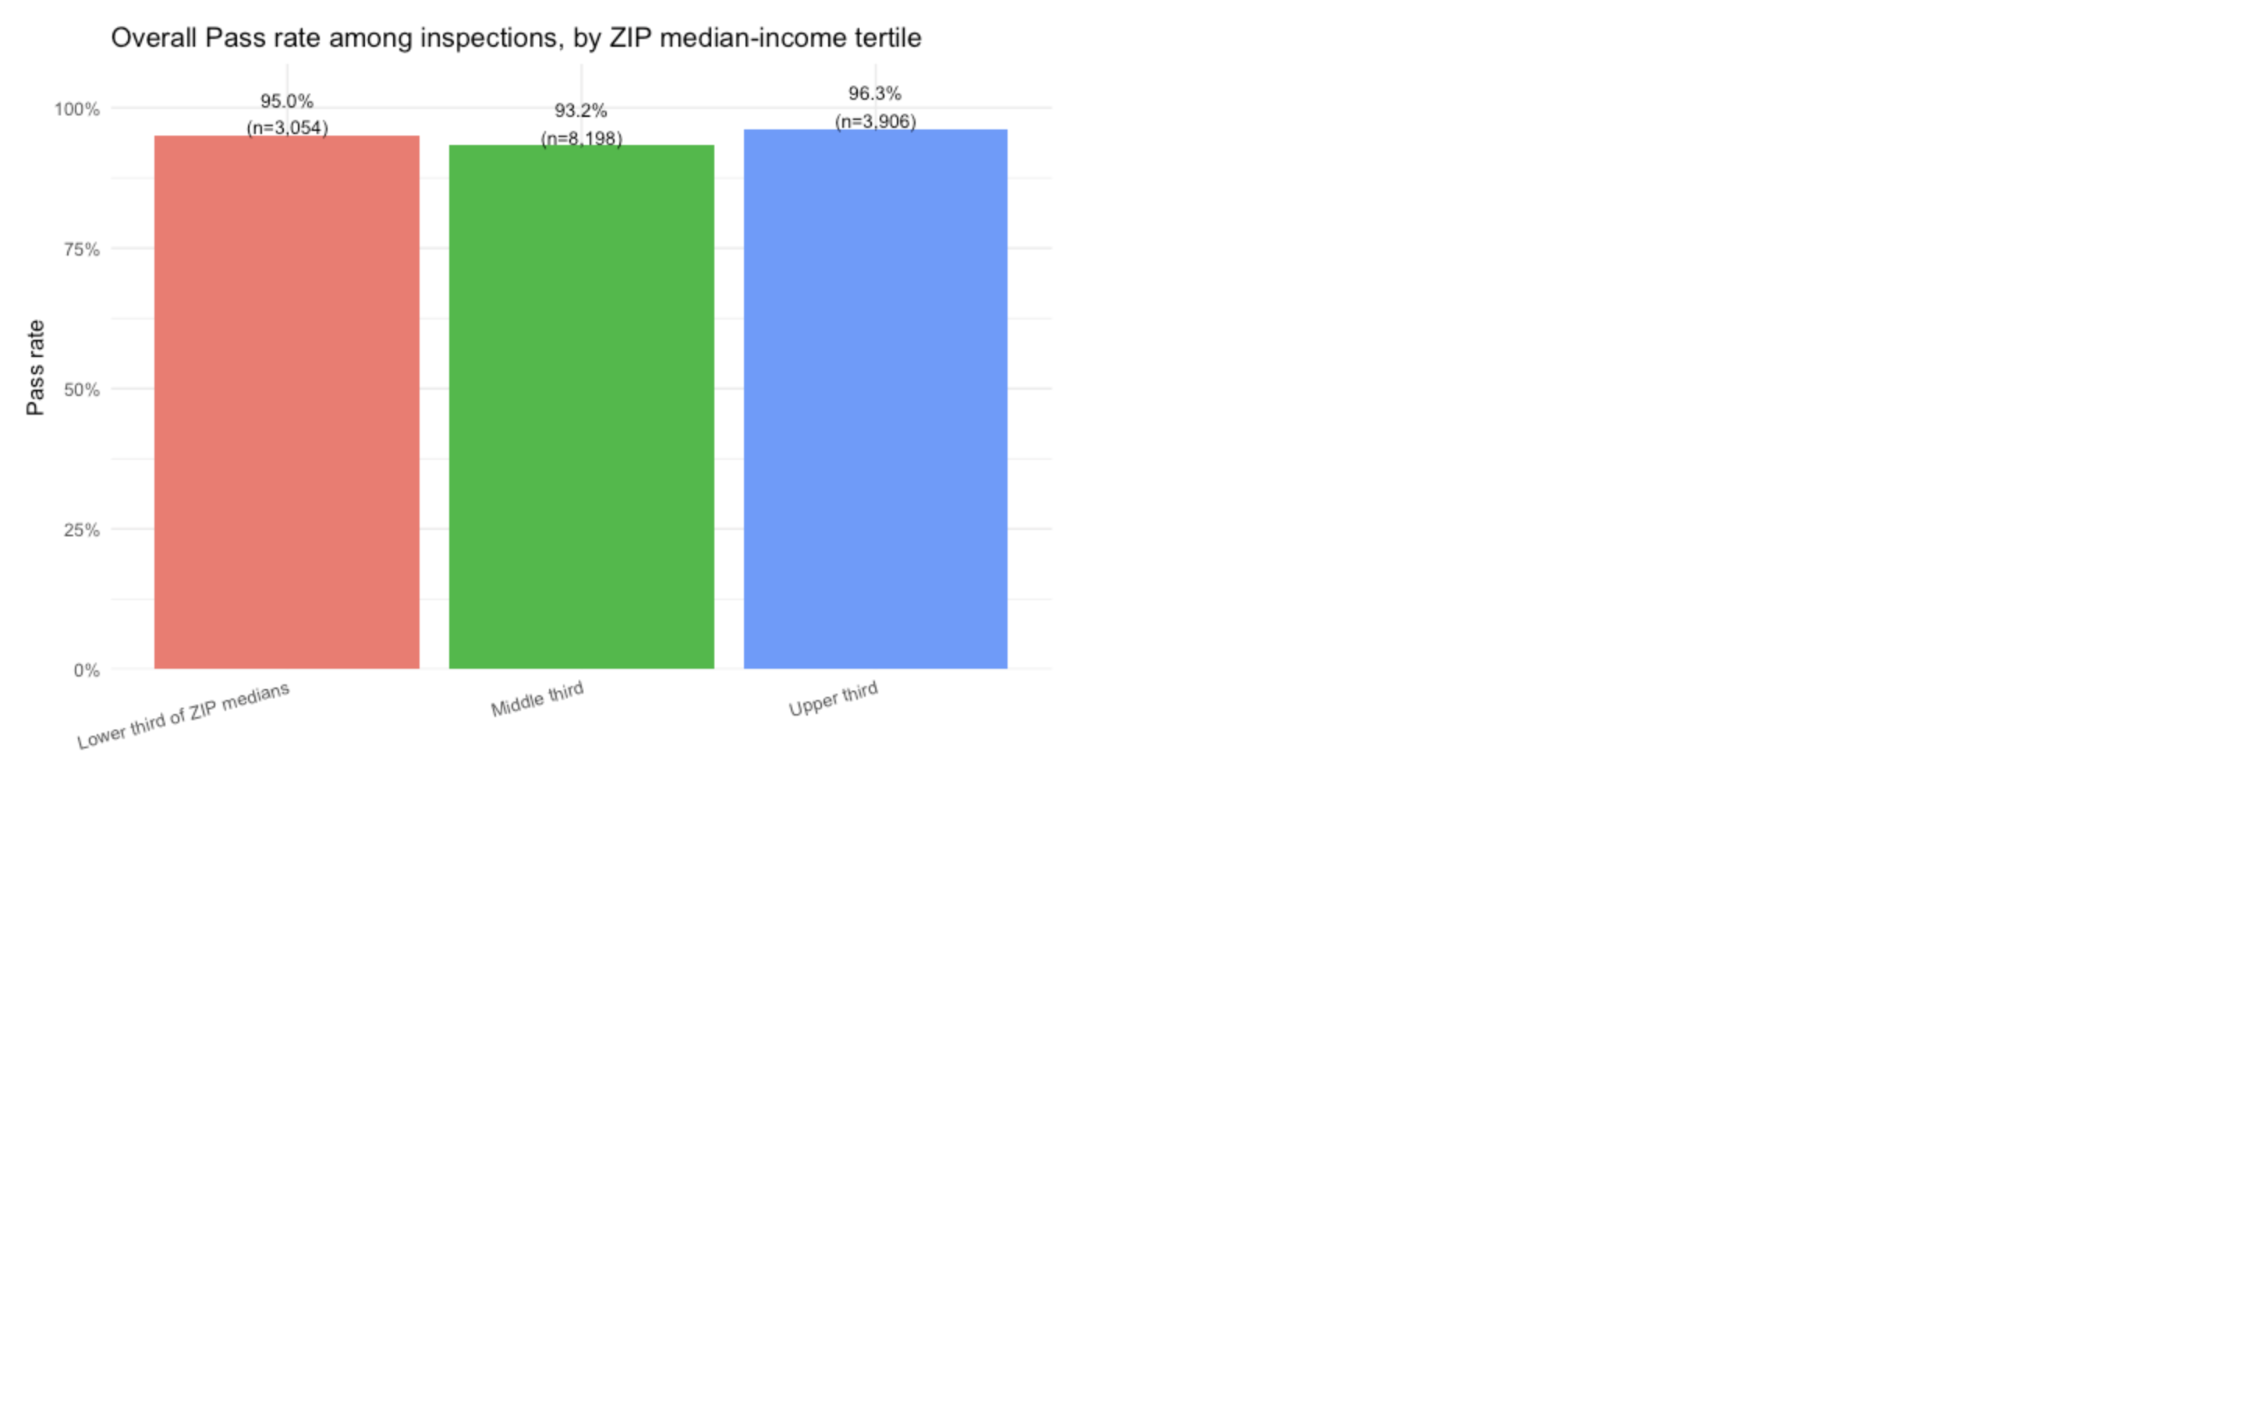
Income Groups Comparison
- Low / Mid / High income
- Compare pass rates

Slide 6
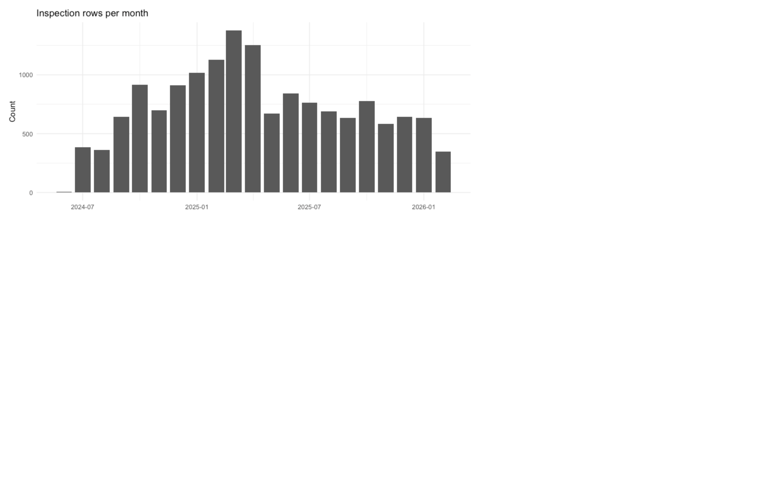
Inspection Trends
- Monthly inspections
- Shows activity patterns

Slide 7
Key Insights
- Pass rates consistent
- Weak income relationship
- ZIP variation

Slide 8
What It Means
- Area-level only
- Not causal
- Context matters

Slide 9
Next Steps
- Analyze violations
- Add variables
- Improve matching

