Slide 1
Food Inspection & Closure Analysis
DATA 205 Capstone
Ousmane Kandji

Slide 2
Project Goal
Analyze food inspection data
Understand closure patterns
Identify common violations
Explore city-level differences

Slide 3
Datasets
FoodInspectionData.csv – all inspections
Closed_Food_Establishments.csv – closures only
Second dataset is smaller and event-focused

Slide 4
Workflow
Ingestion: load + clean data
EDA: visualize patterns
Analysis: city-level risk

Slide 5
Data Cleaning
Removed duplicates
Standardized ZIP codes, city names, dates
Exported cleaned datasets

Slide 6
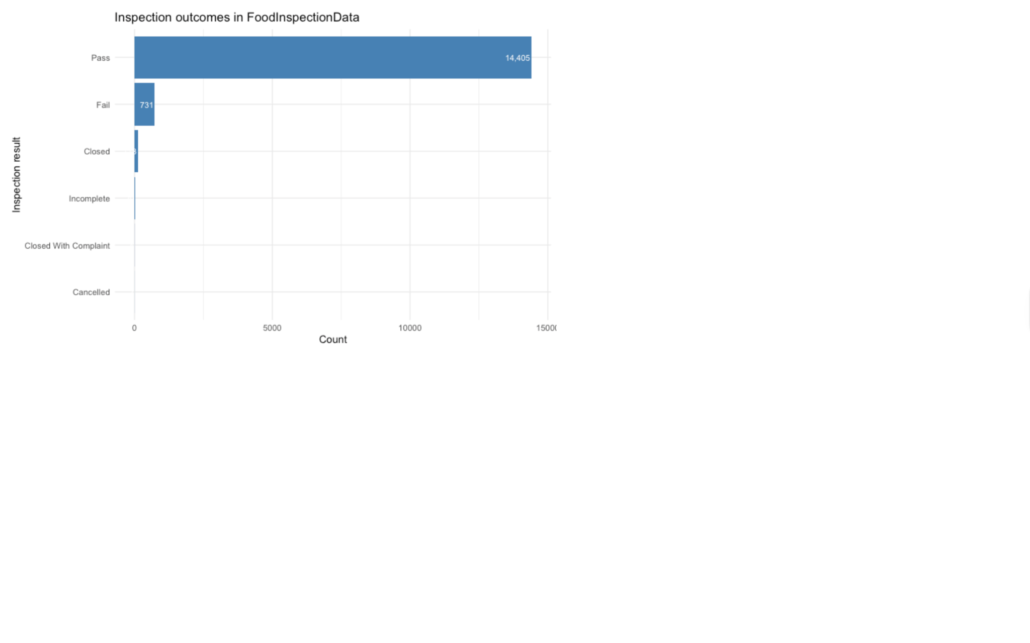
Inspection Outcomes

Slide 7
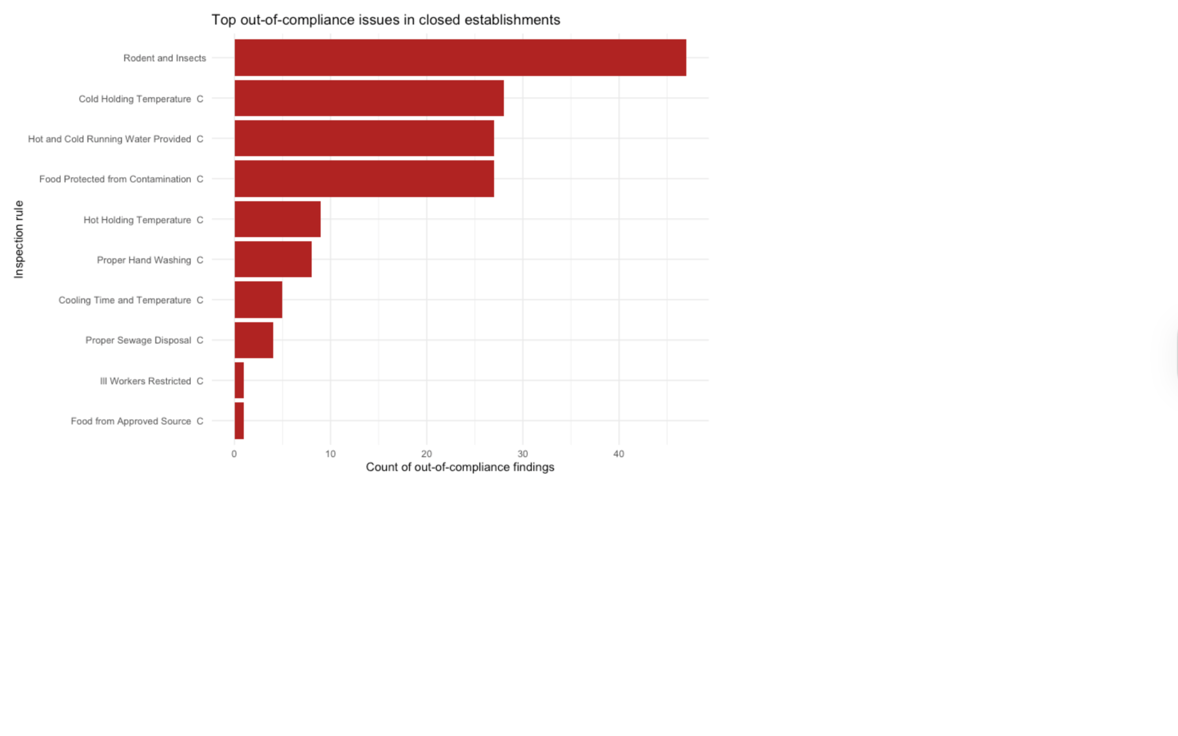
Top Violations

Slide 8
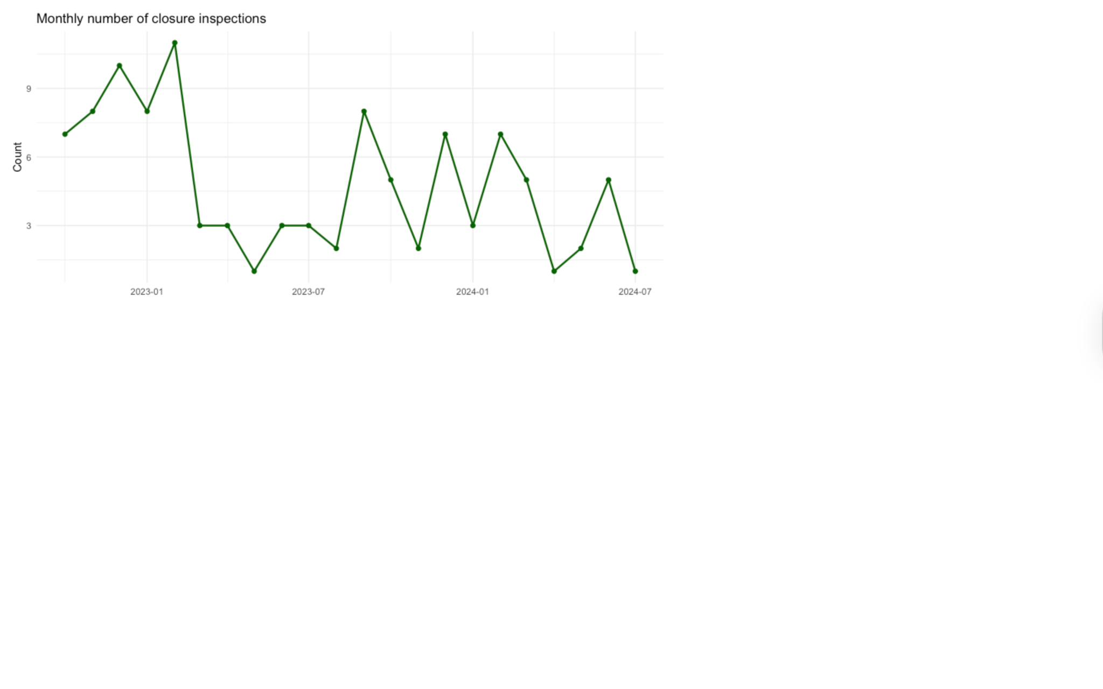
Closure Trend Over Time

Slide 9
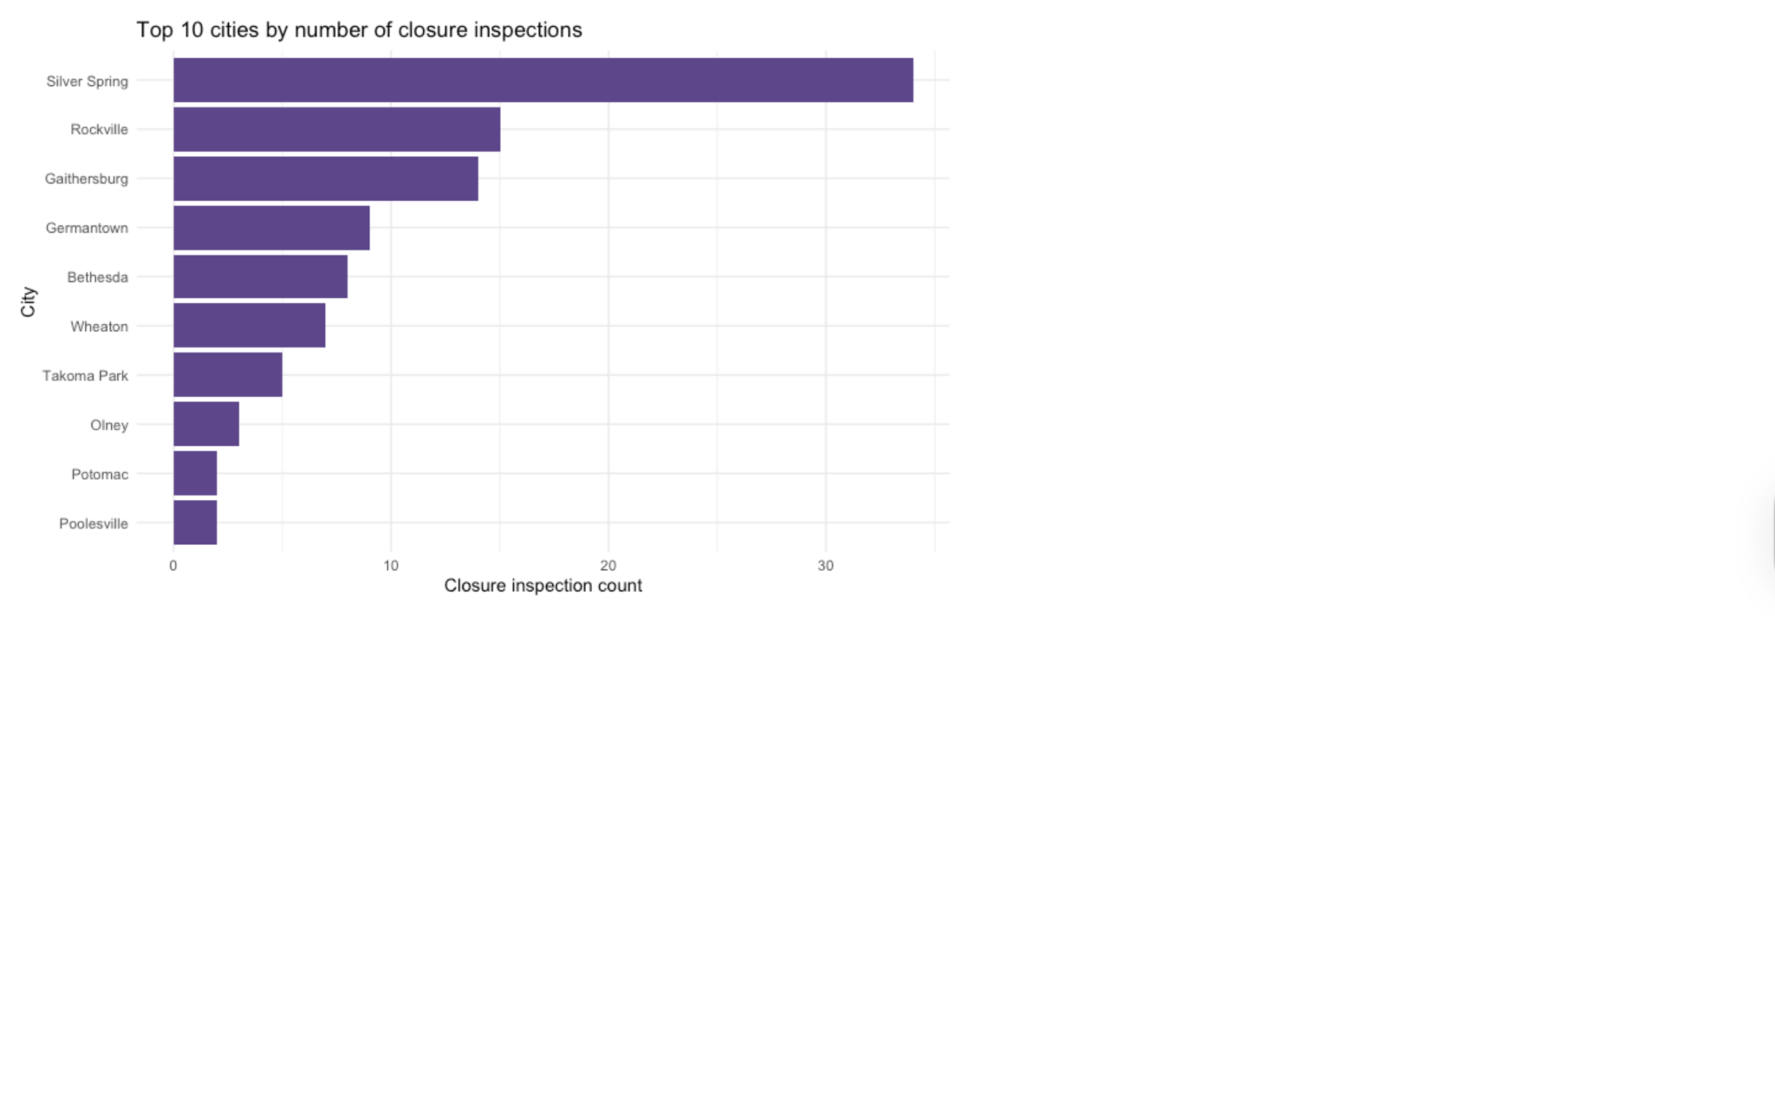
Top Cities

Slide 10
City Closure Rate
closure_rate = closures / inspections
Used to identify high-risk areas

Slide 11
Key Findings
Most inspections pass
Closures occur regularly
Few violations dominate
Risk varies by city

Slide 12
Limitations
Descriptive analysis only
Smaller closure dataset
Possible missing/inconsistent data

Slide 13
Next Steps
Improve merging
Add datasets
Explore deeper analysis

Slide 14
Thank You
Questions?

