Slide 1
Food Inspection Data 205 Capstone Project
Ousmane Kandji
DATA 205 Capstone

Slide 2

Why This Project?
Food safety violations can place customers at risk
Inspection records reveal patterns in violations and closures
Project Question: What patterns are associated with failed inspections and closure events?

Slide 3
Background Information
Datasets: FoodInspectionData.csv and Closed_Food_Establishments.csv
Contains inspection outcomes, dates, locations, and violation indicators
Tools Used: R, tidyverse, ggplot2, lubridate, GitHub

Slide 4
Data Cleaning
Removed duplicate inspection rows
Standardized ZIP codes and city names
Converted inspection dates into date format
Created variables such as critical_count and is_closed
Full details available in GitHub

Slide 5


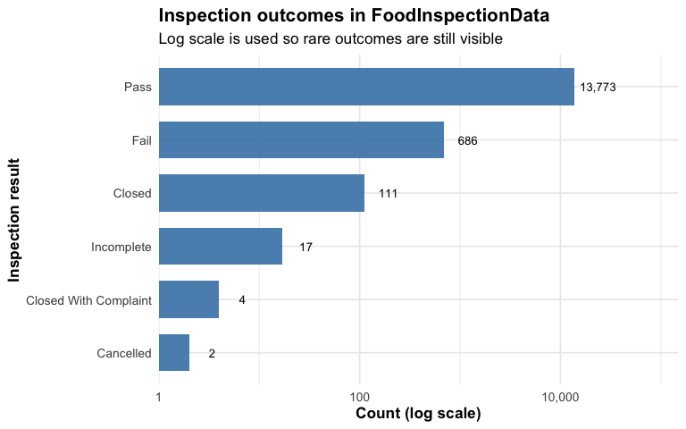
Inspection Outcomes
Most inspections resulted in a pass
Closure outcomes were much less common

Slide 6
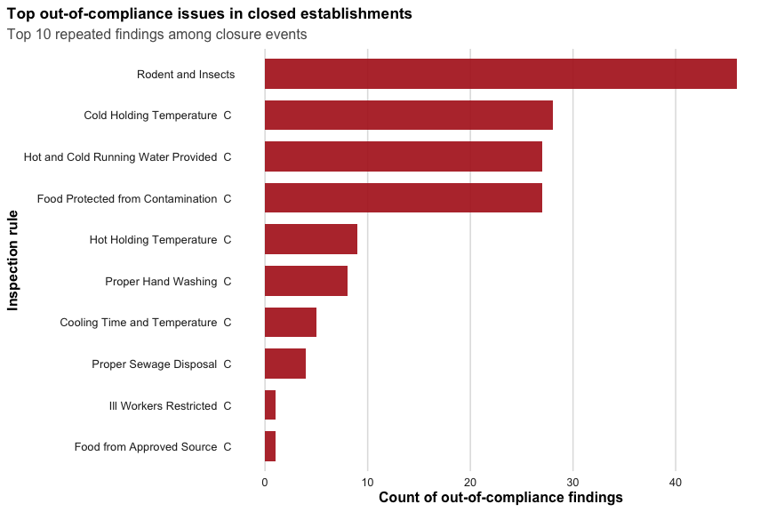
Top Violations
Critical violations repeatedly appeared in closure inspections
Common issues involved contamination, sanitation, and temperature control

Slide 7
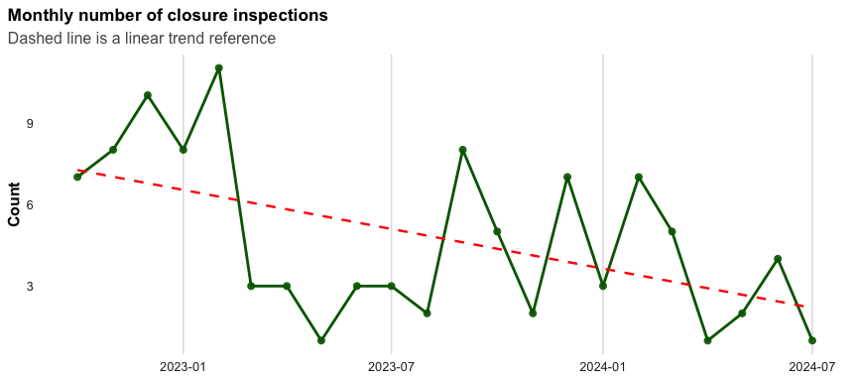
Closure Trends
Closure inspections occurred consistently over time
Trend line helps identify long-term patterns

Slide 8
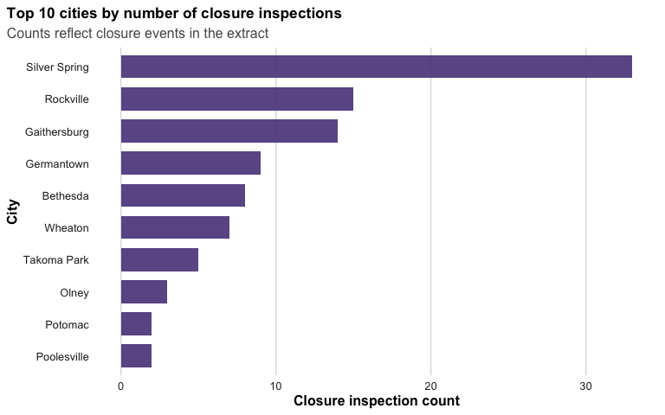
Top Cities
Some cities experienced higher closure activity than others
Closure events were not evenly distributed geographically

Slide 9
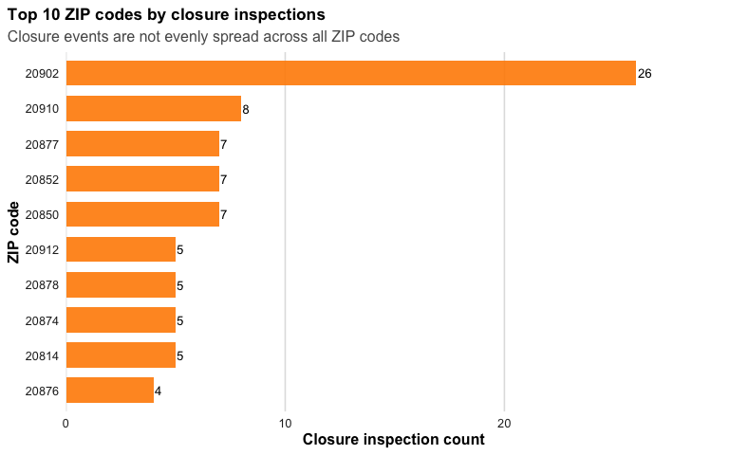
ZIP Code Patterns
Certain ZIP codes had higher closure inspection counts
Geographic closure patterns became easier to interpret using counts

Slide 10
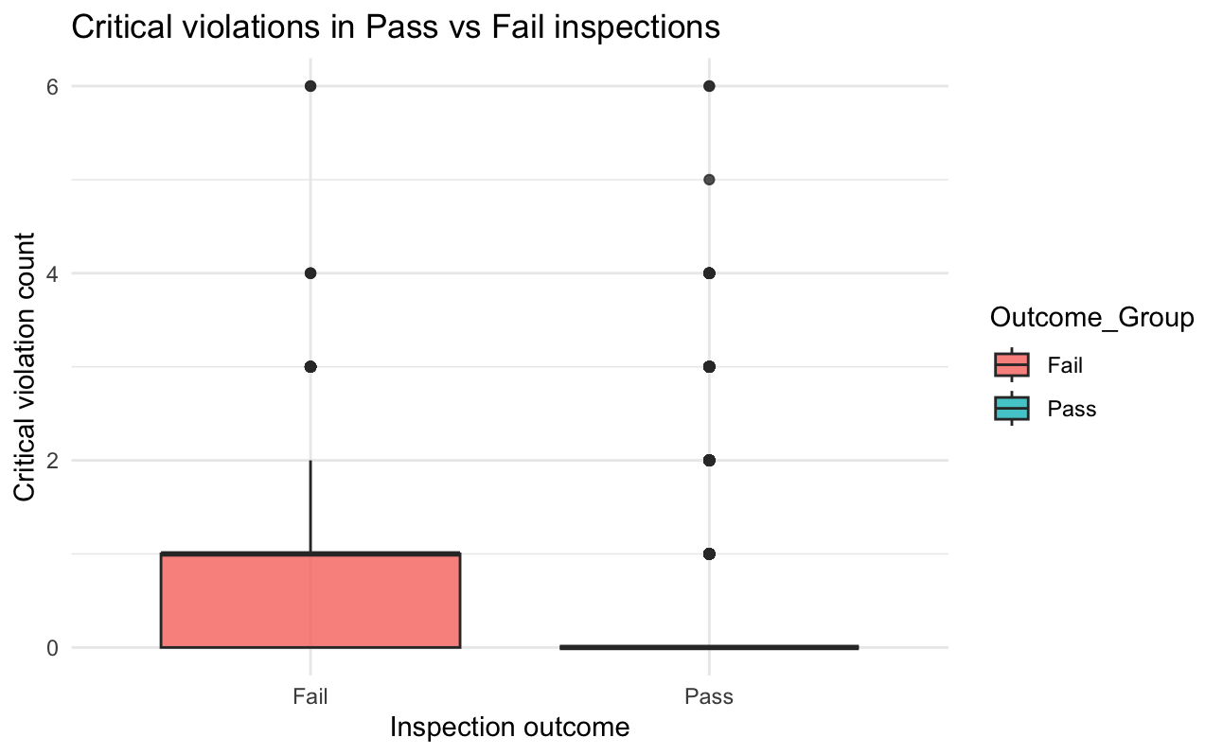
Statistical Analysis
Chi-square testing compared passed vs failed inspections
Failed inspections were more likely to contain critical violations
Logistic regression showed higher critical counts increased closure odds

Slide 11
Key Takeaways
Most inspections passed, but closure events still occurred consistently
Certain critical violations repeatedly appeared in closure inspections
Failed inspections were more likely to contain critical violations
Some cities and ZIP codes experienced higher closure activity

Slide 12
Reflection
Cleaning and standardizing the datasets was challenging
The project evolved throughout the semester
Simplifying the analysis improved the final story
Working with real public datasets was rewarding

Slide 13
Next Steps
Include
Include additional years of inspection data
Incorporate
Incorporate demographic datasets
Build
Build predictive models
Create
Create an interactive dashboard

Slide 14
Acknowledgements
Thank you Professor Alraee
Thank you Professor Saidi and my classmates
Montgomery County Open Data

