Slide 1
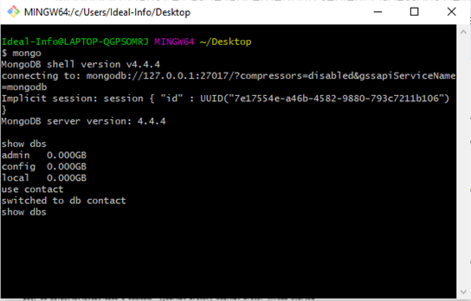
Create a database called "contact"

Slide 2
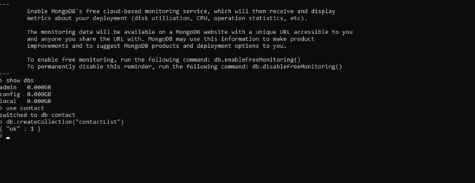
Create a collection called "contactlist"

Slide 3
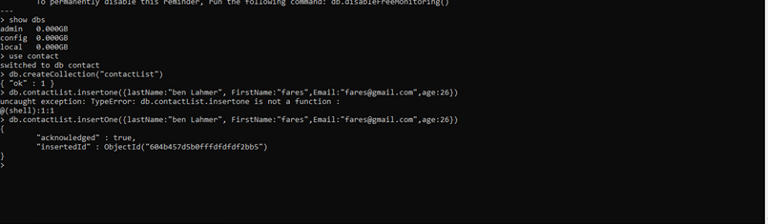
insert : Last name: Ben Lahmer, First name: Fares, Email: fares@gmail.com, age:26 methode : InsertOne

Slide 4
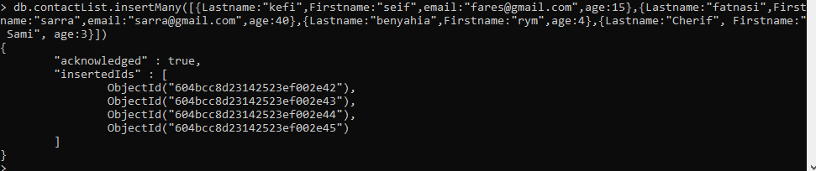
Insert List of user => insertMany

Slide 5
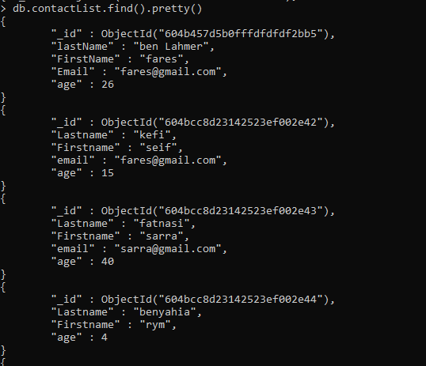
Afficher tout les utilisateurs => db .contactList.find().pretty()

Slide 6
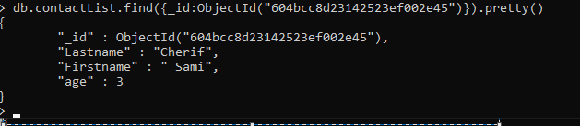
Affichage d’un utilisateur by ID

Slide 7
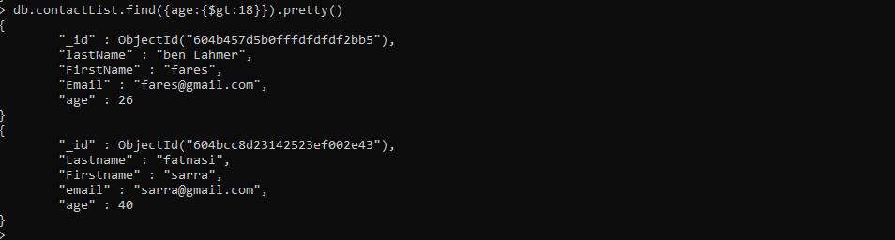
Display all the contact list having age>18

Slide 8
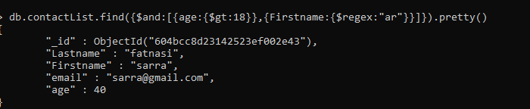
Display all the contact list having age>18 and name containing "ar"

Slide 9
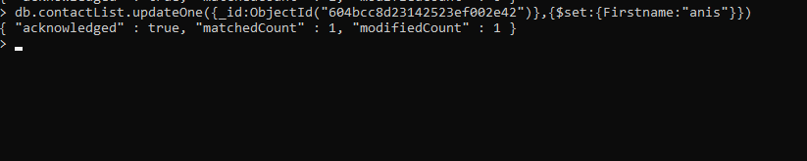
Change the contact first name of "Seif" by " Anis" =>updateOne

Slide 10
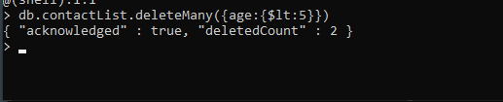
Delete the contact list having age < 5 =>deleteMany

Slide 11
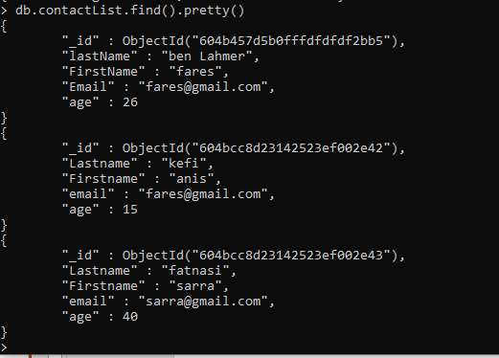
Display all the contact list =>find().pretty()

Slide 12
Merci pour votre attention

