Slide 1

MAKER SKILLS STARTUP PRESENTATION
AeroCommand
A practical drone monitoring service for farms, fields, and cooperatives
Commercial presentation | May 2026

Slide 2
1. INTRODUCTION
Maker Skills builds field technology farmers can actually use
Team
A startup focused on smart agriculture, drones, and mobile IoT
Project
AeroCommand, a web and mobile platform for drone-assisted farm monitoring
Purpose
Show how the product saves time, improves visibility, and becomes a service
Maker Skills | AeroCommand
02

Slide 3
2. PROBLEM / STORYTELLING
A farmer cannot be everywhere at once
Large fields, livestock areas, irrigation lines, and equipment zones are hard to check every day.
Story hook
A broken fence may be noticed only after animals escape
Dry zones or crop stress can spread before anyone sees them
Field checks consume hours of walking, driving, and fuel
The farm owner often has no live view when away from the land
Video idea: morning field check by truck vs. one drone mission visible on the phone.
Maker Skills | AeroCommand
03

Slide 4
2. PROBLEM / STORYTELLING
Delayed detection turns small issues into expensive losses
Most farm problems start small. The cost grows when the information arrives late.
Story hook
Livestock leaves a pasture through a small opening
Irrigation failure creates dry patches before the next visit
Disease or pests spread from one visible area to a whole row
The farmer spends time checking areas that are still normal
Short scene: one missed field problem becomes a repair, treatment, or lost-animal event.
Maker Skills | AeroCommand
04

Slide 5
2. FARMER WORKFLOW
The daily job: inspect more land with less uncertainty
Morning check
Live view
Launch or schedule a route over fields, fences, or livestock zones
See drone status, location, battery, and mission progress from the dashboard
Alert moment
Action
Receive a signal when something needs attention
Send a worker, adjust irrigation, inspect a zone, or repeat the mission
Maker Skills | AeroCommand
05

Slide 6
3. YOUR SOLUTION
AeroCommand turns drones into a farm monitoring service
1
2
3
Drone in the field
Cloud platform
Farmer interface
Collects position, battery, camera, and mission status
Stores history, manages missions, commands, alerts, and live updates
Web dashboard and mobile app for decisions in the office or on-site
Live map
Scheduled routes
Alerts
Mobile access
AI vision
History
Maker Skills | AeroCommand
06

Slide 7
3. MAIN FEATURES
Live farm visibility without a technical control room
Fleet map
Telemetry
Know where each drone is and whether it is ready, flying, or offline
Battery, GPS, speed, altitude, signal, and vehicle health in real time
Web + mobile
History
Use the dashboard from the office and the phone from the field
Review past flights, alerts, and vehicle activity
Maker Skills | AeroCommand
07

Slide 8
3. MAIN FEATURES
Automated missions make farm checks repeatable
Field routes
Fence lines
Plan coverage paths for olive groves, cereals, orchards, or pastures
Repeat perimeter inspection without driving the whole boundary
Irrigation zones
Progress tracking
Check dry areas and water distribution from above
See whether the mission is pending, running, completed, or failed
Maker Skills | AeroCommand
08

Slide 9
3. MAIN FEATURES
Alerts help farmers react before problems grow
Livestock
Security
Flag animals outside an expected area or separated from the herd
Notice people or vehicles in restricted farm zones
Operations
Evidence
Detect low battery, lost connection, or mission interruption
Keep timestamped alert history for follow-up and accountability
Maker Skills | AeroCommand
09

Slide 10
3. MAIN FEATURES
AI vision adds an extra pair of eyes
Detection
Counting
Optional object detection for livestock, people, vehicles, or field objects
Support visual confirmation when checking animals or assets
Zone awareness
Human control
Connect detections to areas that matter on the farm
AI supports decisions; the farmer still confirms what action to take
Maker Skills | AeroCommand
10

Slide 11
4. TARGET MARKET
Primary buyers: farms that lose time in repeated field checks
Small farms
1-2 drones for daily checks, alerts, and basic monitoring
Medium farms
Several zones, multiple missions, livestock and crop monitoring
Cooperatives
Shared drone service across many farmers with centralized support
The customer is practical: they care about fewer unnecessary trips, faster reaction, and a system that does not require a full IT team.
Maker Skills | AeroCommand
11

Slide 12
4. TARGET MARKET
Tunisian agriculture gives us focused first use cases
Olive groves
Tree health, irrigation checks, harvest preparation, perimeter monitoring
Date palms
Large-area inspection, pest spotting, worker coordination
Cereals
Crop stress, dry patches, growth tracking, harvest readiness
The product can sound advanced, but the first value is simple: see more of the farm, more often.
Maker Skills | AeroCommand
12

Slide 13
4. TARGET MARKET
The buyer ecosystem extends beyond one farmer
Direct customer
Farm owners and managers who need visibility over their land
Service provider
Drone operators offering monitoring as a service
Institutional channel
Cooperatives, training centers, smart-agriculture programs
This lets Maker Skills sell both directly and through trusted local organizations.
Maker Skills | AeroCommand
13

Slide 14
5. COMPETITIVE ADVANTAGE
AeroCommand is more farm-ready than generic drone tools
Criterion
Typical ground station
Generic drone app
AeroCommand
Main user
Pilot or technician
Consumer drone owner
Farmer, cooperative, service team
Farm workflow
Manual setup
Limited scheduling
Repeatable routes and alerts
Data access
Local session
Vendor dependent
Cloud history and mobile view
Support model
Technical user
Online help
Local training and deployment
Maker Skills | AeroCommand
14

Slide 15
5. COMPETITIVE ADVANTAGE
Our advantage is simplicity, service, and local adaptation
Need
Current habit
Risk
AeroCommand response
Daily inspection
Walking or driving
Slow and incomplete
Scheduled drone routes
Problem detection
Only after visible damage
Late reaction
Alerts and camera evidence
Farm access
Owner must be present
Low visibility
Mobile dashboard
Adoption
Complex tech setup
Low trust
Training and local support
Maker Skills | AeroCommand
15

Slide 16
6. BUSINESS MODEL
Product-as-a-service keeps the offer simple
Starter
Pro
Cooperative
1-2 drones
3-10 drones
Shared service
Dashboard, mobile access, live map, basic telemetry history
Mission planning, alerts, AI detection, and priority support
Multi-farm organization, training, custom support, SLA
Setup and edge installation
Operator training
Optional AI analytics
Support and maintenance
Maker Skills | AeroCommand
16

Slide 17
6. BUSINESS MODEL
Revenue grows around the service, not only the software
Subscription
Deployment
Add-ons
Recurring
One-time
Optional
Dashboard, mobile app, telemetry history, alerts
Drone connection, edge agent setup, onboarding
AI detection, custom reports, extra users, integrations
This makes pricing understandable for farmers and scalable for Maker Skills.
Maker Skills | AeroCommand
17

Slide 18
7. MARKETING STRATEGY
Sell through trust, demos, and local proof
Field demos
Show a real route over a farm and an alert on the phone
Cooperatives
Use trusted local groups to reach farmers faster
Drone sellers
Bundle AeroCommand as the software layer for farm customers
Events
Agricultural expos, university incubators, smart agriculture programs
Maker Skills | AeroCommand
18

Slide 19
7. MARKETING STRATEGY
Digital marketing should show real farm value fast
Facebook groups
Short clips: field route, live map, alert, result
Before / after
Manual inspection vs. drone-assisted monitoring
Farmer stories
Use simple cases: dry zone found, fence checked, herd located
B2B outreach
LinkedIn and direct visits for cooperatives and service providers
Maker Skills | AeroCommand
19

Slide 20
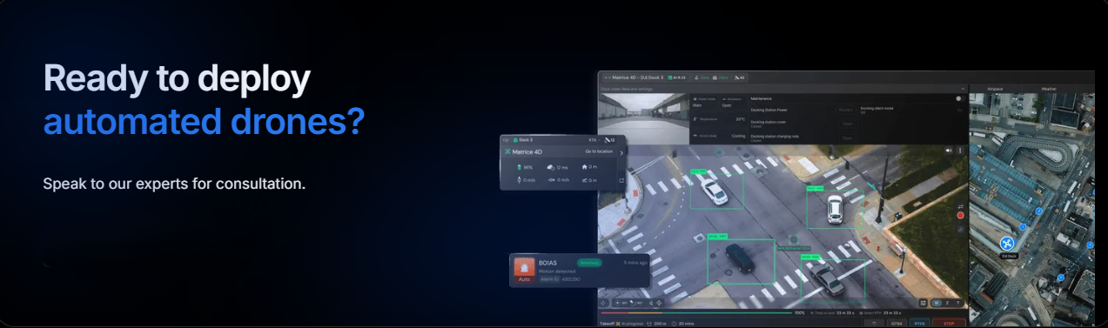
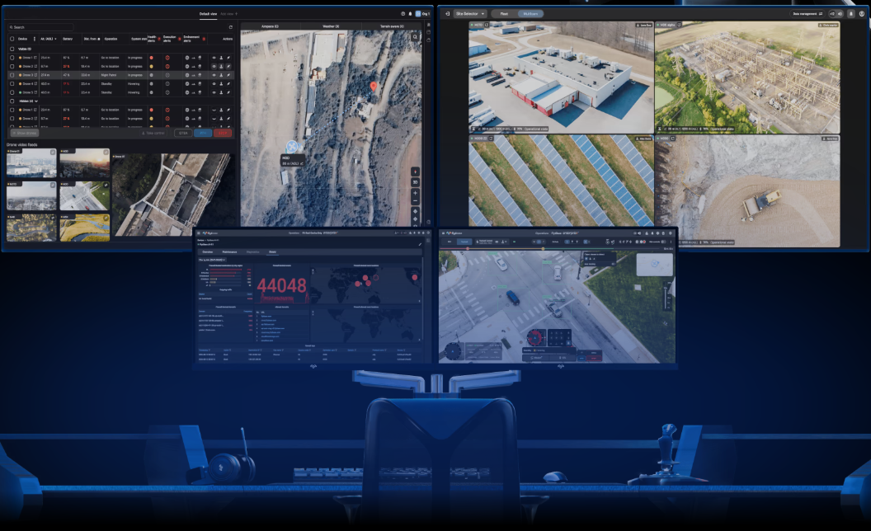
8. DEMO / VISUALS
Demo: from farm map to operational decision
Operations dashboard
Smart farming product page
Live fleet status
Farm route planning
Mobile + web access
Maker Skills | AeroCommand
20

Slide 21
8. DEMO / VISUALS
Demo storyline for the presentation
Step 1
Step 2
Open the dashboard and select the farm vehicle
Show location, battery, and telemetry on the live map
Step 3
Step 4
Launch or review a monitoring mission
Show an alert and explain what action the farmer takes
Maker Skills | AeroCommand
21

Slide 22
9. DEPLOYMENT
What installation looks like for a farm customer
1
2
3
Connect
Configure
Train
Pair drone or robot telemetry with the edge agent
Create farm zones, routes, users, and alert rules
Teach the farmer or operator the daily workflow
Setup
Training
Support
Updates
Maintenance
Reports
Maker Skills | AeroCommand
22

Slide 23
9. IMPACT
The business promise is practical, not futuristic
Less wasted time
Faster reaction
Reduce repeated manual checks across the same routes
Find field problems before they become bigger losses
Better coordination
More confidence
Give workers clearer information before they go on-site
Keep visibility over remote zones even when the owner is away
Maker Skills | AeroCommand
23

Slide 24
9. ROADMAP
Next steps make the farm value stronger
Short term
Polish dashboard demo, mobile alerts, and mission workflows
Pilot
Run controlled farm demonstrations with one or two local partners
Expansion
Add farm reports, AI detection tuning, and cooperative management
The goal is to prove value in the field before scaling the commercial offer.
Maker Skills | AeroCommand
24

Slide 25
10. CONCLUSION
AeroCommand helps farmers see more, sooner
Problem
Solution
Why it matters
Farmers lose time and money when field information arrives late
Drone monitoring with live maps, missions, alerts, and mobile access
More visibility, faster reaction, and a practical path to smart agriculture
Maker Skills | AeroCommand
25

Slide 26
11. Q&A
Thank you for your attention.
Do you have any questions?
AeroCommand by Maker Skills

