Slide 1

MAKER SKILLS STARTUP PRESENTATION
AeroCommand
Cloud-edge drone fleet operations for smart agriculture
Commercial presentation | May 2026

Slide 2
1. INTRODUCTION
Maker Skills turns drone operations into a simple service
Team
A startup building practical MIoT tools for field operators
Project
AeroCommand, a web and mobile platform for drone and robot fleets
Purpose
Show the business value, target customers, and go-to-market path
Maker Skills | AeroCommand
02

Slide 3
2. PROBLEM / STORYTELLING
Farm monitoring is still too manual for modern operations
Large fields, livestock areas, and remote infrastructure are hard to inspect every day.
Story hook
Late detection of crop stress, fence damage, or safety risks
High labor time for repeated inspection routes
Limited visibility when operators are away from the farm
Single-drone tools do not scale to coordinated fleet work
Video idea: before/after clip showing manual inspection vs. live fleet map.
Maker Skills | AeroCommand
03

Slide 4
3. YOUR SOLUTION
AeroCommand connects vehicles, cloud, and operators in one loop
1
2
3
Edge agent
Cloud platform
Operator apps
Reads MAVLink telemetry and sends vehicle state through MQTT
Stores history, manages missions, commands, alerts, and live streams
React dashboard and Flutter mobile app for real-time decisions
Telemetry
Mission planning
Fleet map
Command ACKs
Alerts
AI vision
Maker Skills | AeroCommand
04

Slide 5
3. MAIN FEATURES
What the product does for the customer
Live fleet visibility
Automated missions
Map, battery, GPS, signal, status, and recent telemetry
Plan routes, assign vehicles, upload missions, track progress
Field-ready mobile access
AI-assisted awareness
Monitor vehicles and alerts from the farm, not only the office
Optional YOLOv8 detection for livestock, people, vehicles, or crops
Maker Skills | AeroCommand
05

Slide 6
4. TARGET MARKET
Start local, then expand to fleet-heavy field operations
Primary
Small and medium Tunisian farms using drones for inspection
Channel
Agricultural cooperatives, drone service providers, and training centers
Expansion
Security, infrastructure inspection, disaster response, and logistics
The first buyer is not just a tech fan. It is someone who loses time, visibility, or money when field checks are delayed.
Maker Skills | AeroCommand
06

Slide 7
5. COMPETITIVE ADVANTAGE
AeroCommand is built around local deployment and fleet simplicity
Criterion
Typical ground station
Generic drone app
AeroCommand
Fleet scale
Single operator focus
Limited
Multi-vehicle operations
Real-time data
Local session only
Depends on vendor
Cloud history + live WebSockets
Local adaptation
Technical setup
Global product
Tunisian farming workflows
Cost model
Hardware/software mix
Vendor lock-in
Flexible packages and support
Maker Skills | AeroCommand
07

Slide 8
6. BUSINESS MODEL
Revenue combines software access, deployment, and support
Starter
Pro
Enterprise
1-2 drones
3-10 drones
Cooperatives
Monthly subscription for dashboard, mobile, telemetry history
Mission planning, alerts, AI detection, and priority support
Custom deployment, training, integrations, and SLA
Setup fee for edge installation
Training package for operators
Optional AI analytics add-on
Maker Skills | AeroCommand
08

Slide 9
7. MARKETING STRATEGY
Reach customers where trust already exists
Field demos
Show live drone map, mission planning, and alerts on a real farm
Partnerships
Agricultural cooperatives, drone sellers, telecom/IoT providers
Digital
Facebook groups, short demo videos, LinkedIn for B2B buyers
Events
Agricultural expos, university incubators, smart agriculture programs
Maker Skills | AeroCommand
09

Slide 10
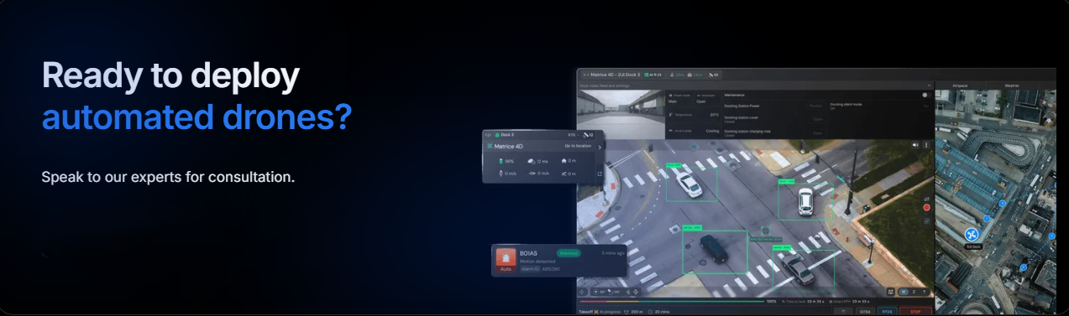
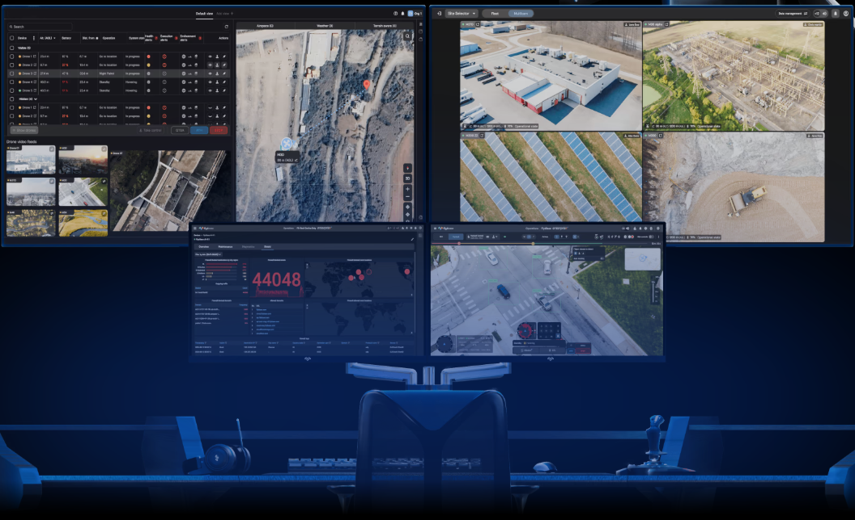
8. DEMO / VISUALS
Prototype screens make the value easy to see
Operations dashboard
Smart farming product page
Live fleet status
Map-first monitoring
Mobile + web access
Maker Skills | AeroCommand
10

Slide 11
10. CONCLUSION
AeroCommand makes smart monitoring accessible to field teams
Problem
Solution
Why it matters
Farmers need faster visibility across large or remote areas
A cloud-edge platform for telemetry, missions, alerts, and AI vision
Less manual inspection, better response time, and safer operations
Maker Skills | AeroCommand
11

Slide 12
11. Q&A
Thank you for your attention.
Do you have any questions?
AeroCommand by Maker Skills

