Slide 1
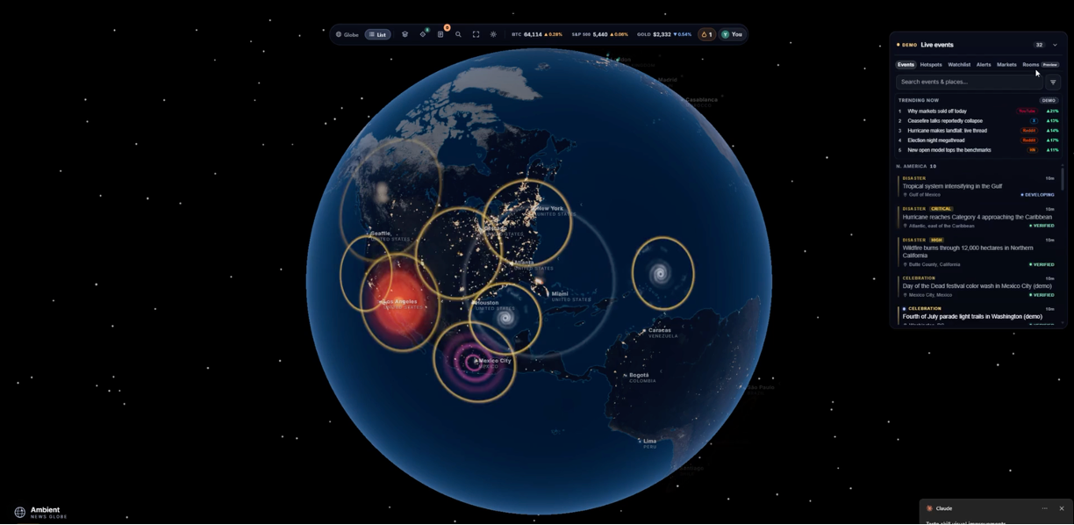
Geopolitical Risk Scoring and Anomaly Detection
Oussama Ennaciri
MS Data Science Practicum
Regis University, Anderson College of Business and Computing
Prof. Ghulam Mujtaba

Slide 2
Introduction
Geopolitical risk is the threat or escalation of wars, terrorism, and tensions between states, which can disrupt international relations.
The leading measure for Geopolitical risk is the GPR index.
Limited coverage: GPR scores only 44 countries.
News-only: GPR relies only on news coverage, it ignores a country’s fundamentals.
This presents an opportunity: score geopolitical risk for every country, based on both news and fundamentals, and monitor it to catch crises early

Slide 3
Methodology : Pipeline
Data collection
Collected 9 datasets, (2015–present)
Collection conducted via APIs/BigQuery/downloads/email request to the providers.
Data preparation
Cleaned each source, selected and engineered features, standardized to a common country-year grid and merge all 9 into one master table.
Modeling
Model 1 (supervised) : trained on the 68 features to predict the GPR index, compared XGBoost, Random Forest, and ElasticNet.
Model 2 (unsupervised) : trained on news signals to learn each country’s baseline and flag anomalies, compared z-score, Isolation Forest, and LOF.
Validation
Model 1: hold out whole countries (GroupKFold) and whole years (expanding window) retrain on the rest, predict the held-out.
Model 2: check flags against a list of known crisis onsets.
Output
Model 1: Geopolitical risk scores for all 247 countries.
Model 2: monthly unrest alerts per country.
3

Slide 4
Data
Source | What it measures | Example features | Features
GPR | Geopolitical risk level : Target | GPRC | 1
WDI | Economy | GDP per capita, inflation, military spending | 15
V-Dem | Governance and democracy | regime type, level of corruption, | 5
GSDB | Sanctions | active sanctions cases | 9
UN GA Voting | Diplomacy | agreement with US / Russia | 4
UNHCR | Forced displacement | Number of refugees | 4
UN Comtrade | Trading | total trade, export concentration (HHI) | 20
SIPRI | Arms transfers | arms imports / exports number of suppliers | 3
GDELT | News events | arms imports / exports (TIV), number of suppliers | 8

Slide 5
Model 1 : Risk Scorer (Supervised)
Approach
Goal : Predict the GPR index for every country.
Target : The GPR index, log-transformed (it’s skewed).
Data :Trained on the 44 labeled countries × 10 years (2015–2024) = 440 rows, with 68 features.
Models : XGBoost regression vs Random Forest vs ElasticNet.
Validation
Model | Spearman (unseen countries) | Spearman (unseen years) | MAE (unseen countries) | MAE (unseen years)
XGBoost | 0.811 | 0.911 | 0.16 | 0.11
RandomForest | 0.743 | 0.906 | 0.178 | 0.119
ElasticNet | 0.639 | 0.845 | 0.241 | 0.139
Baseline (predict mean) | - | - | 0.274 | 0.275

Slide 6
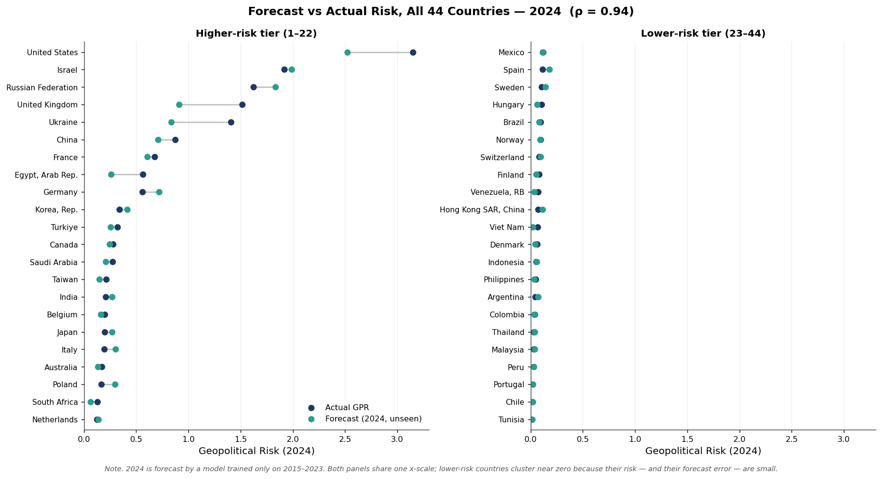
Model 1 : Risk Scorer

Slide 7
Model 2 : Anomaly Detector (Unsupervised)
Approach
Goal: Flag sudden unrest for countries.
Target: None. The model would detect deviations from each country's own baseline.
Data: monthly GDELT, all countries, 32k country-months, 7 signals.
Models: z-score vs Isolation Forest vs LOF.
Validation
Method | Events flagged | Baseline (Random) | P-value
Z-score | 43/50 | 20 | <0.001
Isolation Forest | 43/50 | 21 | <0.001
LOF | 17/50 | 15 | 0.34

Slide 8
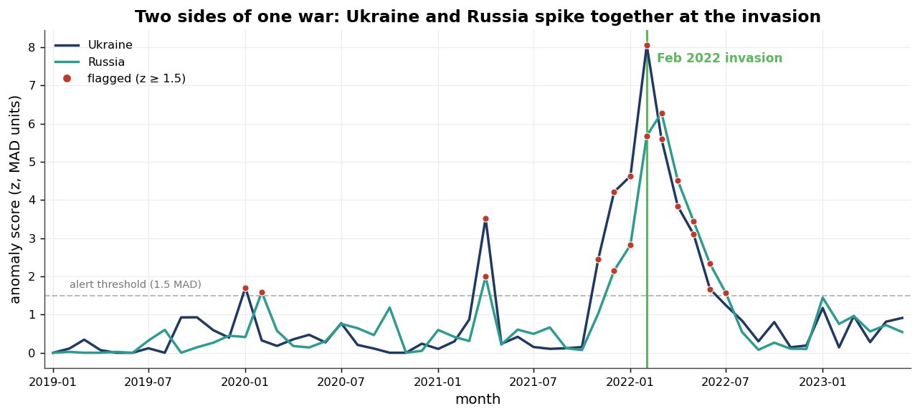
Model 2 : Anomaly Detector

Slide 9
Conclusion and Future Works
Project contributions
Risk scores for all 247 countries
Early-warning monitor for unrest
Future works
Improving data quality (duplicated news, misinformation)
Improving Model 2 precision by reducing false alarms
Deployment

Slide 10
References
Caldara, D., & Iacoviello, M. (2022). Measuring geopolitical risk. American Economic Review, 112(4), 1194–1225.
Chen, T., & Guestrin, C. (2016). XGBoost: A scalable tree boosting system. Proc. 22nd ACM SIGKDD, 785–794.
Hong, D., Fu, Z., Zhang, X., & Pan, Y. (2025). Research on the development and application of the GDELT event database. Data, 10(158).
Iacoviello, M., & Tong, J. (2026). The AI-GPR index: Measuring geopolitical risk using artificial intelligence.
Liu, F. T., Ting, K. M., & Zhou, Z.-H. (2008). Isolation forest. 2008 IEEE ICDM, 413–422.
Murphy, M., Sharpe, E., & Huang, K. (2024). The promise of machine learning in violent conflict forecasting. Data & Policy, 6, e35.
Obukhov, T., & Brovelli, M. A. (2023). Identifying conditioning factors and predictors of conflict likelihood for ML models: A literature review. ISPRS Int. J. of Geo-Information, 12(8), 322.
Ward, M., et al. (2013). Comparing GDELT and ICEWS event data.
Yonamine, J. E. (2013). Predicting future levels of violence in Afghanistan districts using GDELT.

Slide 11
Datasets
GPR : Caldara, D., & Iacoviello, M. (2022). Geopolitical Risk Index (target).
GDELT : The GDELT Project. Global Database of Events, Language, and Tone (Leetaru & Schrodt, 2013).
World Bank WDI : World Bank. World Development Indicators.
V-Dem : Coppedge, M., et al. (2026). V-Dem Dataset v16.
SIPRI : SIPRI Arms Transfers Database.
UN Comtrade : United Nations. UN Comtrade Database.
GSDB : Felbermayr et al. (2020); Yalcin et al. (2025). Global Sanctions Data Base (R4).
UNHCR : UNHCR Refugee Population Statistics Database.
UN GA Voting : Bailey, Strezhnev & Voeten (2017). UN General Assembly Voting Data.

Slide 12
Thank you for your attention

