Slide 1
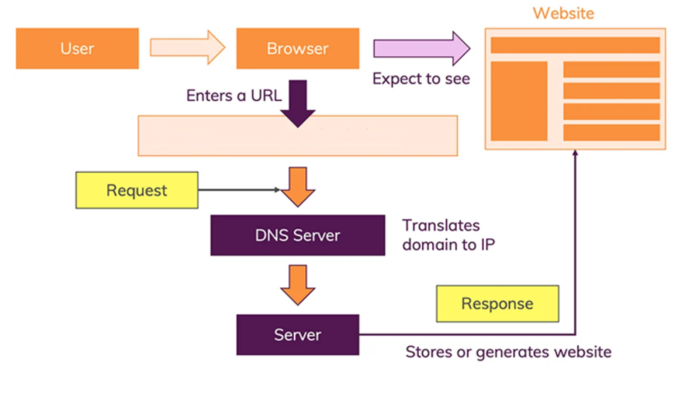
How does the web work?
http//:www.example.com
Notes:
The moment user enter this an address in the browser and you hit ENTER, a lot of different things happen:
The URL gets resolved
A Request is sent to the server of the website
The response of the server is parsed
The page is rendered and displayed

Slide 2
What do you need to be a web developer?
Ten skills required for web developers (Updated 2021)
HTML
CSS
Javascript
Git and Github
At least one JS library
Knowledge of BrowserDev tools
Different Types of APIs
Backend Tech
Problem-solving And Logical Reasoning Skills
Project Management Tools

Slide 3
What is the role of a web developer ?
Web Developer Responsibilities:
Website and software application designing, building, or maintaining.
Using scripting or authoring languages, management tools, content creation tools, applications, and digital media.
Conferring with teams to resolve conflicts, prioritize needs, develop content criteria, or choose solutions.
Directing or performing Website updates.
Developing or validating test routines and schedules to ensure that test cases mimic external interfaces and address all browser and device types.
Editing, writing, or designing Website content, and directing team members who produce content.

Slide 4
Maintaining an understanding of the latest Web applications and programming practices through education, study, and participation in conferences, workshops, and groups.
Back up files from Web sites to local directories for recovery.
Identifying problems uncovered by customer feedback and testing, and correcting or referring problems to appropriate personnel for correction.
Evaluating code to ensure it meets industry standards, is valid, is properly structured, and is compatible with browsers, devices, or operating systems.
Determining user needs by analyzing technical requirements.

