Slide 1
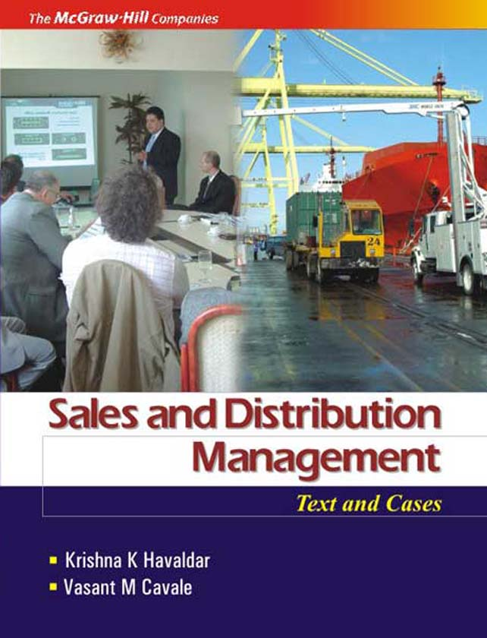
Chapter 1
Introduction to Sales and Distribution Management

Slide 2
Learning Objectives
To understand evolution, nature and importance of sales management
To know role and skills of modern sales managers
To understand types of sales managers
To learn objectives, strategies and tactics of sales management
To know emerging trends in sales management
To understand linkage between sales and distribution management

Slide 3
Evolution, Nature and Importance of Sales Management
Evolution of Sales Management
Situation before industrial revolution in U.K. (1760AD)
Situation after industrial revolutions in U.K., and U.S.A.
Marketing function splits into sales and other functions like market research, advertising, physical distribution

Slide 4
What is Sales Management?
One definition: “The management of the personal selling part of a company’s marketing function.”
Another definition: “The process of planning, directing, and controlling of personal selling, including recruiting, selecting, equipping, assigning, supervising, paying, and motivating the personal sales force.

Slide 5
Nature of Sales Management
Its integration with marketing management
Head-Marketing
Manager-
Promotion
Manager –
Market Research
Manager –
Sales
Manager –
Market Logistics
Manager –
Customer Service
Relationship Selling
Transactional Relationship / Selling | Value – added Relationship / Selling | Collaborative / Partnering Relationship / Selling

Slide 6
Varying Sales Responsibilities / Positions / Jobs
Sales Position | Brief Description | Examples
Delivery salesperson | Delivery of products to business customers or households. Also takes orders. | Milk, newspapers to households Soft drinks, bread to retail stores.
Order taker (Response selling) | Inside order taker • Telemarketing salesperson takes orders over telephone Outside order taker. Also performs other tasks | Behind counter in a garment shop • Pharma products’ orders from nursing homes Food, clothing products’ orders from retailers
Sales support Missionary selling Technical selling | Provide information, build goodwill, introduce new products Technical information, assistance | Medical reps. in pharma industry Steel, Chemical industries
Order-getter (Creative, Problem-solving, Consultative selling) | Getting orders from existing and new household consumers Getting orders from business customers, by solving their business and technology problems | Automobiles, refrigerators, insurance policies Software and business solutions

Slide 7
Importance of Personal Selling and Sales Management
The only function / department in a company that generates revenue / income
The financial results of a firm depend on the performance of the sales department / management
Many salespeople are among the best paid people in business
It is one of the fastest and surest routes to the top management

Slide 8
Roles and Skills of a Modern Sales Manager
Some of the important roles of the modern sales manager are:
  A member of the strategic management team
  A member of the corporate team to achieve objectives
  A team leader, working with salespeople
  Managing multiple sales / marketing channels
  Using latest technologies (like CRM) to build superior buyer-seller relationships
  Continually updating information on changes in marketing environment

Slide 9
Skills of a Successful Sales Manager
People skills include abilities to motivate, lead, communicate, coordinate, team-oriented relationship, and mentoring
Managing skills consist of planning, organizing, controlling and decision making
Technical skills include training, selling, negotiating, problem-solving, and use of computers

Slide 10
Types of Sales Managers / Levels of Sales Management Positions
CEO /
President
V. P. Sales /
V. P. Marketing
Top-Level Sales Managers / Leaders
National Sales Manager
Regional / Zonal / Divisional
Sales Managers
Middle-Level Sales Managers
District / Branch / Area Sales Managers
First / Lower Level Sales Managers
Sales Trainee / Sales Person / Sales Representative

Slide 11
Sales Objectives, Strategies and Tactics
The main components of planning in a company are objectives, strategies and tactics. Their relationship is shown below
Decide / Set
Objectives
Develop Strategies
Evolve Tactics /
Action Plans
E.G. A company wants to increase sales of electric motors by 15 percent, as one of the sales objectives. (see next slide)

Slide 12
To illustrate the relationship between sales objectives, strategies and tactics, consider:
Sales Goals / Objectives | Marketing Strategy | Sales and Distribution Strategy | Tactics / Action plans
Increase sales volume by 15 percent | Enter export markets | Identify the countries Decide distribution channels | Marketing / sales head to get relevant information Negotiate and sign agreements in 3-5 months with intermediaries
 | Penetrate existing domestic markets | Review and improve salesforce training, motivation and compensation Use effective and efficient channels | Add channels and members Train salespeople in deficient areas Train field salesmanagers in effective supervision Link sales volume quotas to the incentive scheme of the compensation plan

Slide 13
Emerging Trends in Sales Management
Global perspective
Revolution in technology
Customer relationship management (CRM)
Salesforce diversity
Team selling approach
Managing multi-channels
Ethical and social issues
Sales professionalism

Slide 14
Linking Sales and Distribution Management
Either sales management or distribution management cannot exist, operate or perform without each other
To achieve the sales goals of sales revenue and growth, the sales management plans the strategy and action plans (tactics), and the distribution management has the role to execute these plans
This will be illustrated by considering some sales management actions and corresponding role of distribution management (in the next slide), as well as by discussing a few integrated cases given at the end of the book

Slide 15
Role of Distribution Management for some of the Sales Management Actions / Tasks
Sales Management Actions / Tasks | Distribution Management Role
Strategy for effective coverage of markets and outlets | Follow call plan / beat plan Make customer call productive Use multi-channel approach
Strategy for handling customer complaints | Prompt action at the customer interface level If the problem persists, involve senior sales and service people
Planning of local advertising and sales promotion | Co-ordination with distribution channels Responsibility of execution with distribution channels Expenses are shared between the company and intermediaries

Slide 16
Key Learnings
Sales management is defined as the management of the personal selling part of a company’s marketing function
Selling includes varying sales jobs like delivery salesperson, order taker, sales support person, and order getter
Sales is the only function or department in an organization that generates revenue / income
Skills of a successful sales manager include managing, technical and people
Main components of sales planning are objectives, strategies, and tactics (or action plan)
Either sales management or distribution management can not exist, operate or perform without each other

