Slide 1
Escape Room location | RDM challenge | Solution | Code word | Aanpassing
Origineel
Address book | What constitutes personal data | All answers are correct. D-B-E-C-A | Good | Linked in profile to partipant data
Wall map | Transferring data across borders | All answers are correct. | Planning | Location based
Notice board | Persistent identifiers | Pablo Colunga-Salas's Orcid is: 0000-0002-1355-0939. This Orcid code identifies the letters on the coded sheet: HELPS. | Helps | Idem, maar dan in print
Filing cabinet | Metadata | 1-2-4-6-8-10-12 | Horrors | Pages from a book, with highlighted letters?
Camera | FAIR | C, D, E, G | Data | Play video on large screen??
Waste paper bin | Preserving data | All answers are correct - all answers are correct - True - True - CE - ABE - False | Avoid | Word seeker

Slide 2

Sectie Noticeboard

Slide 3
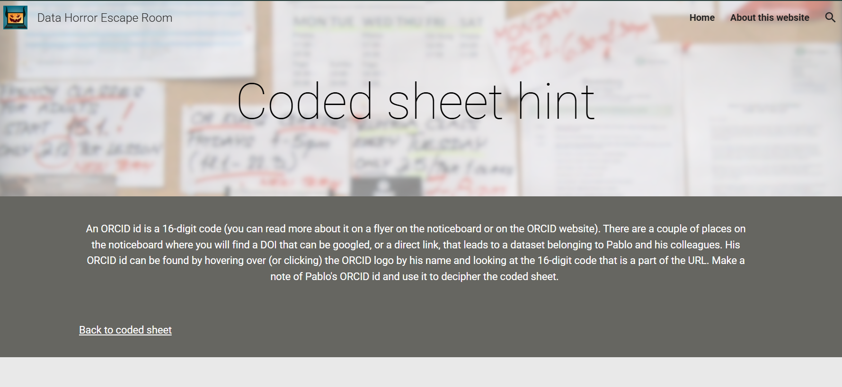

Slide 4


Slide 5
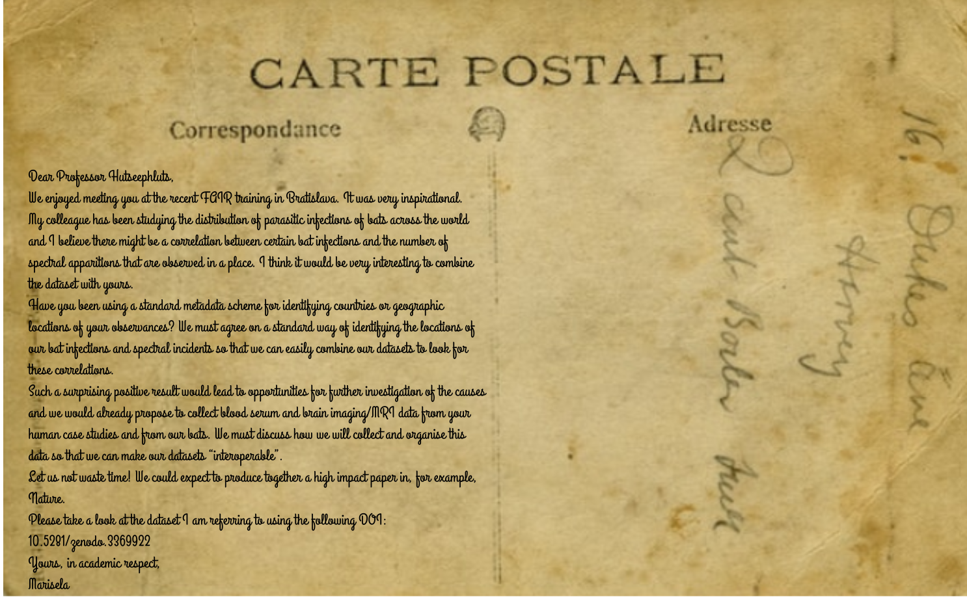

Slide 6


Slide 7
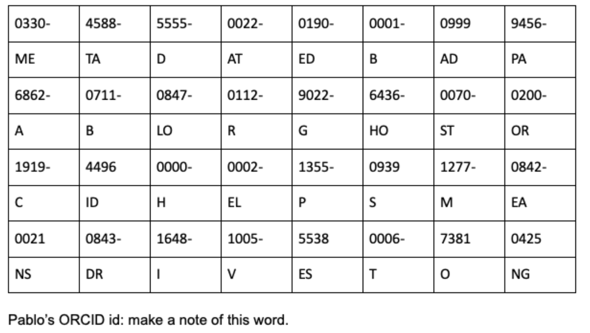

Slide 8
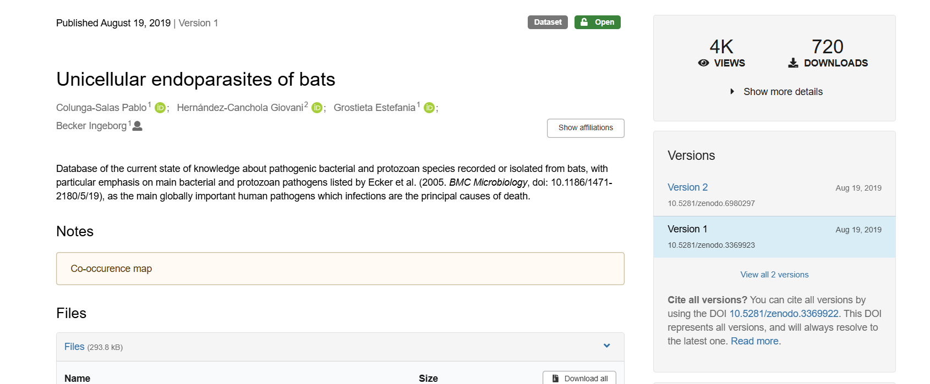

Slide 9
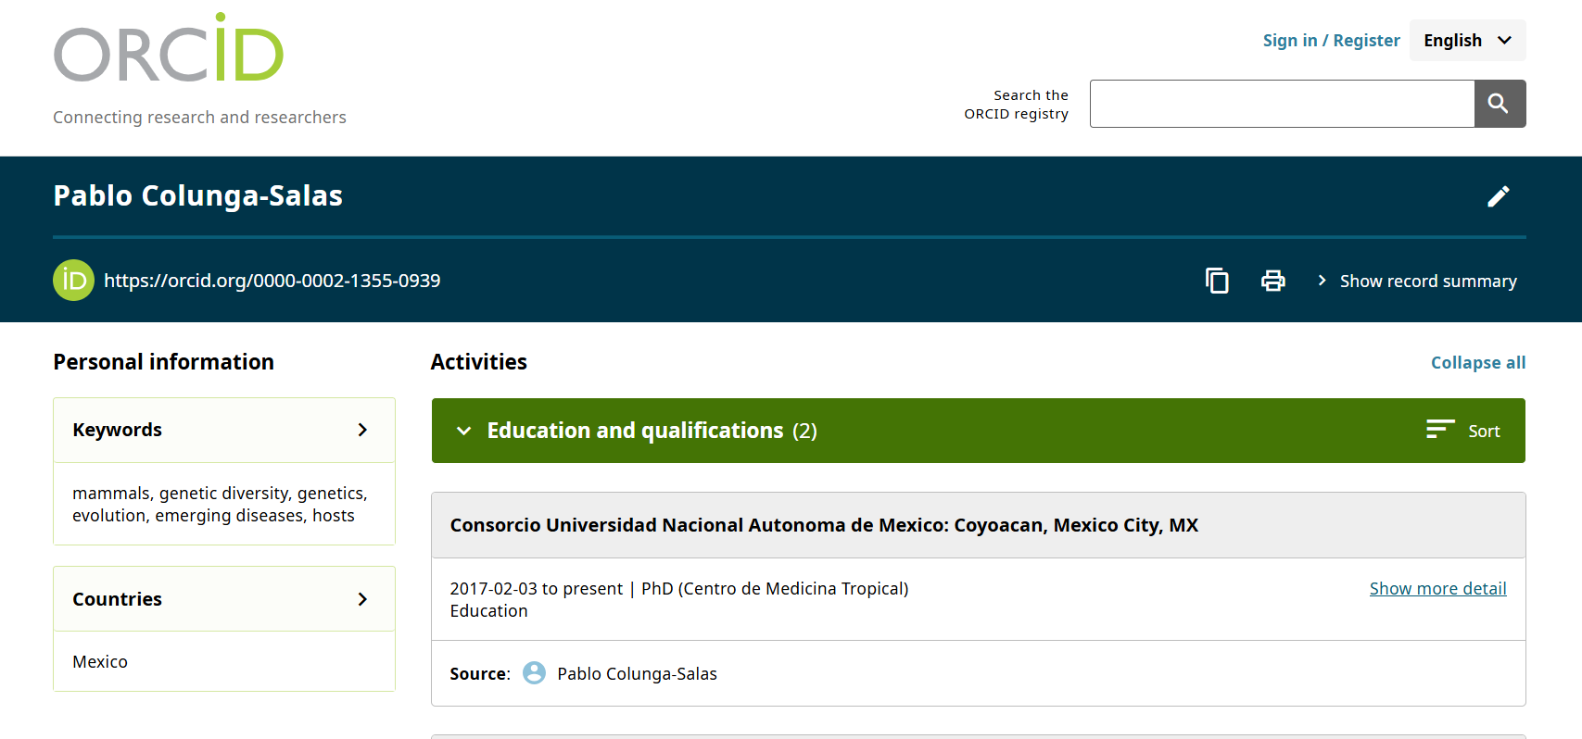

Slide 10
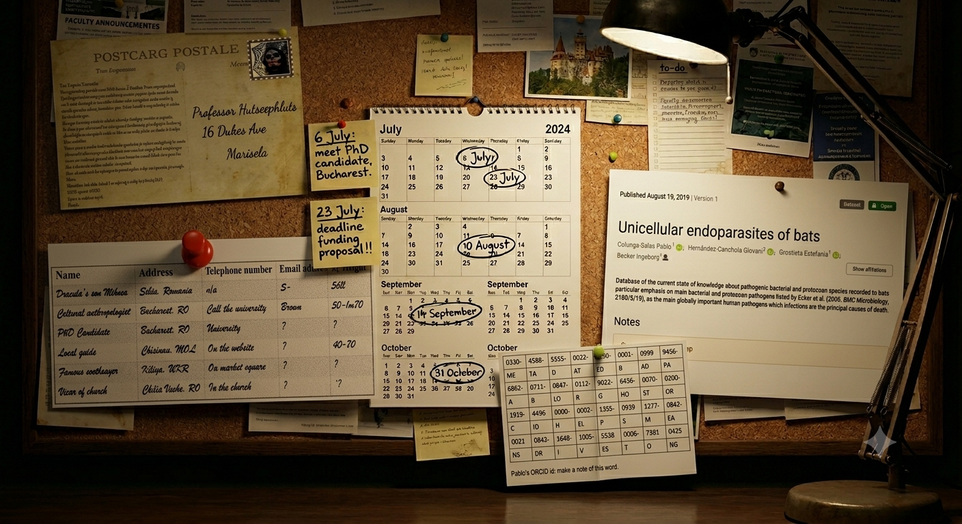

Slide 11
Participant ID | Gender | Age | City of residence | Function | Highest degree | Ergonomic requirements | Pets
Participant 1 | Male | 39 | Utrecht | Not disclosed | Msc | Ergonomic keyboard | Fish
Participant 2 | Male | 45 | Amsterdam | Not disclosed | PhD | Left handed mouse | Allergic
Participant 3 | Male | 60 | Haarlem | Not disclosed | PhD | None | Dog (Rottweiler)
Participant 4 | Female | 30 | Zeist | Not disclosed | Not discolsed | None | Cats (Maine Coon)

Slide 12
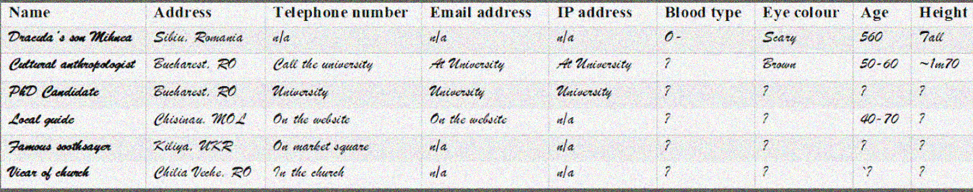

Slide 13
Answer: GOOD
Identificeer personen aan de hand van data vb. leeftijd
Code word “good”
Profiles:

Slide 14

Waste paper bin

Slide 15
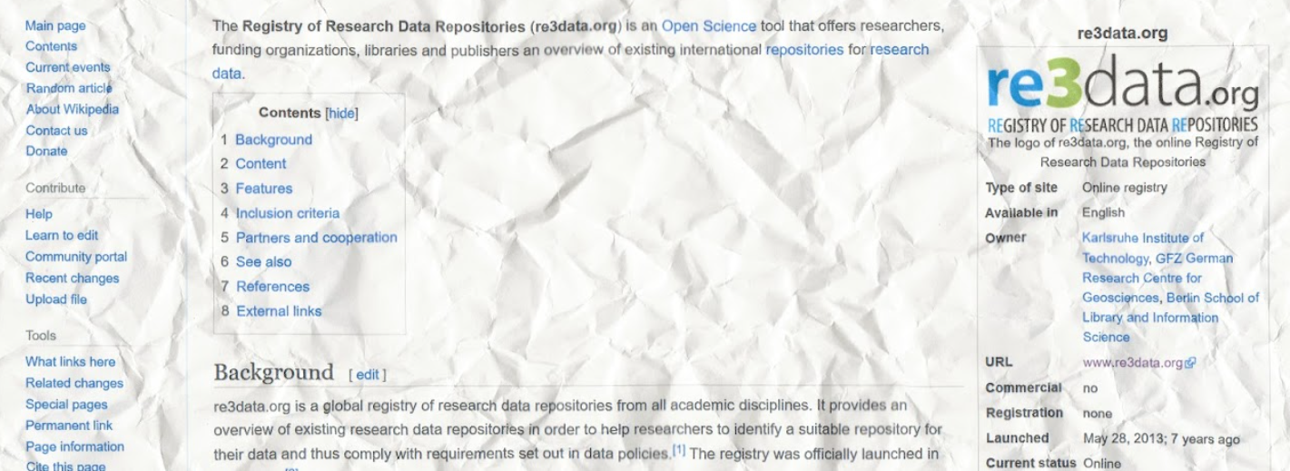

Slide 16
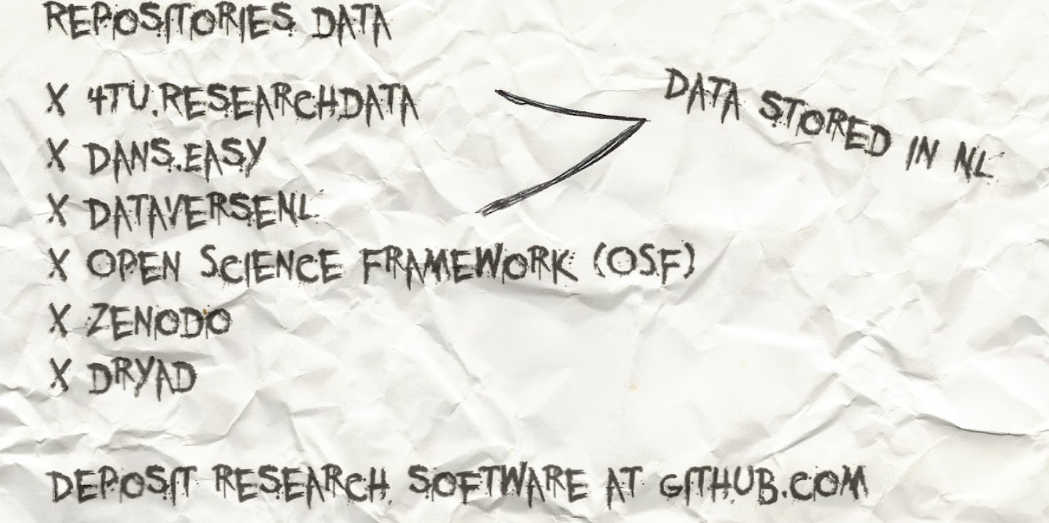

Slide 17
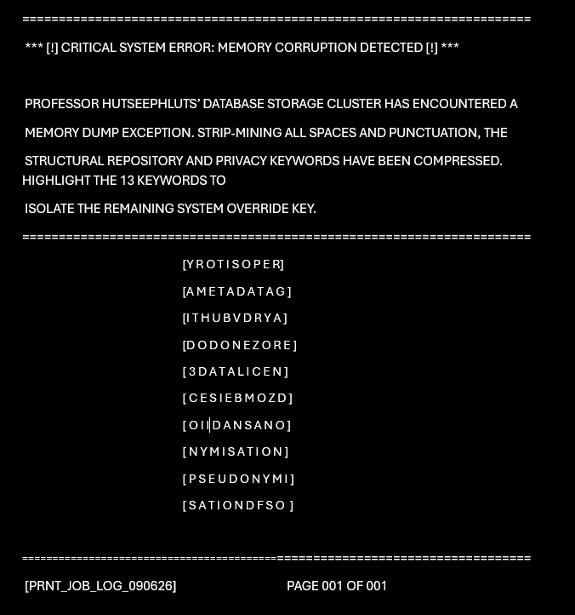

Slide 18
database infrastructure that compiles, manages and gives
access to data and associated metadata and documentation
The European general repository operated by CERN
Open science framework
de-identification procedure
A repository that explicitly stores data locally in the Netherlands
website that can be used find a suitable data repository for your discipline.
What must minimally be added to data to clarify terms of legal re-use
An example of a Persistent Identifier
Data about data
When I say “push” , “pull”, you say…
prevent re-identification of individuals within the dataset
It’s in your head

Slide 19
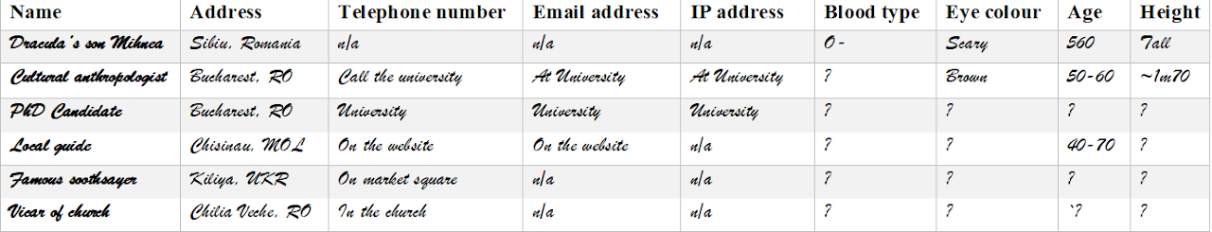
Address Book

Slide 20
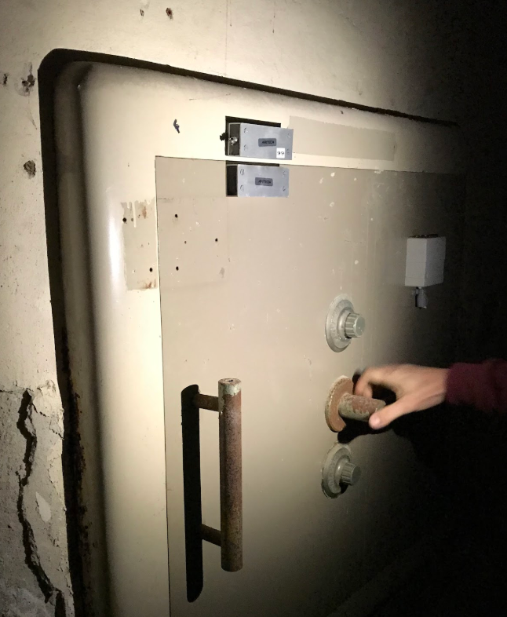
Filing cabinet

Slide 21
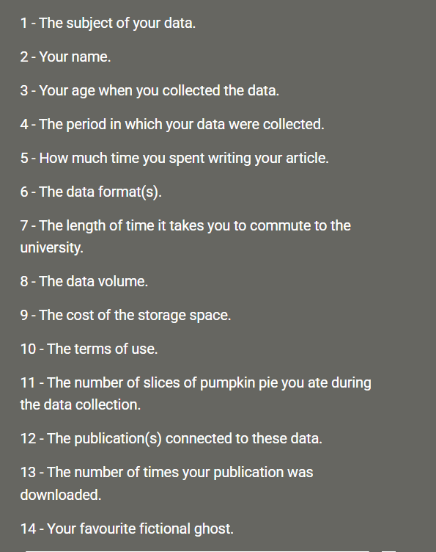
Notes:
Linked to book succesfful presentation skills

Slide 22


