Slide 1
SIGMA-Spoken Dialogue System

Slide 2
Overview
Artificial intelligence (AI) is changing everything, it tries to imitate human intelligence in order to achieve different tasks.
Spoken dialogue systems are a new breed of interfaces that enable humans to communicate with machines naturally and efficiently using a conversational paradigm.
Considerable progress has been made in recent years in the development of dialogue systems that support robust and efficient human-machine interaction using spoken language. Spoken dialogue technology allows various interactive applications to be built and used for practical purposes.
Here we go comprehensive view of state-of-the-art techniques that are used to build SIGMA-spoken dialogue systems. We are working the issues in architectures, dialogue management methods, system evaluation, and also surveys advanced topics (face detection) concerning extensions of the basic model to more conversational setups.
And we focus on problems, and solutions that are used in dialogue system development and evaluation. We are also focus on requirements and challenges for advanced interaction management and future research on this system.

Slide 3
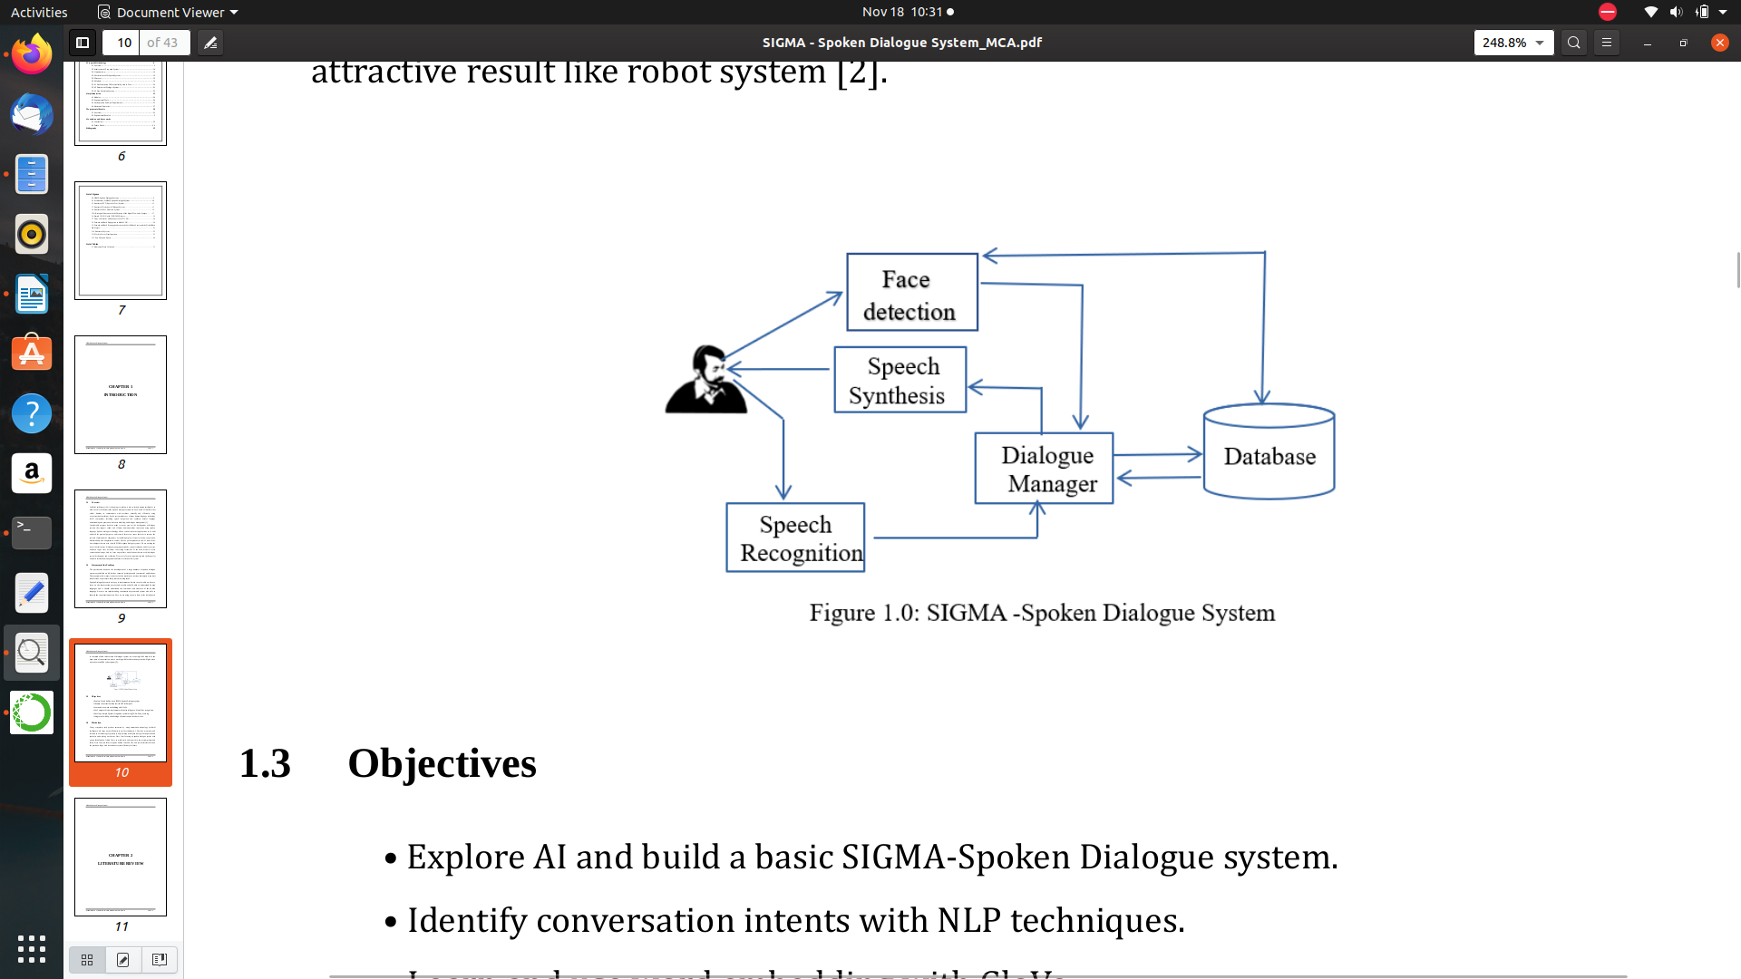
Problem Statements:
The past decade has been the development of a large numbers of spoken dialogue. Systems around the world, both as research prototypes and commercial applications. These systems allow users to interact with a machine to retrieve information, conduct transactions, or perform other problem-solving tasks.
Spoken Dialogue System is not easy to implement and work in real world, we have to focus on the conversation process and machine should able to understand human languages and it should understand the semantics and structure of the human language.
SIGMA-Spoken Dialogue System is a conversation system, and system also able to identify the conversation person.

Slide 4
Challenges:
Data collection
- type of data.
-Volume -----> sample rate and time.

Slide 5
Objectives:
Explore AI and build a basic SIGMA-Spoken Dialogue system.
Identify conversation intents with NLP techniques.
Learn and use word embedding with GloVe.
Use Computer Vision implement artificial intelligence -AI - Face recognition.
Develop a simple Speech recognition system using CNN's -Deep Learning.
Integrate AI with Spoken Dialogue System to enable robot works.

Slide 6
Literature review
James R. Glass, title “challenges of spoken dialogue system”, This system allows user to interact with a machine to retrieve information, conduct transactions, or perform other problem solving tasks. In this paper we cover some of the design issues which confront developers of spoken dialogue systems, provide some examples of research being undertaken in this area, and describe some of the ongoing challenges facing current spoken language technology.
Jensen, Mads Brath; Das, Avishek, title “Technologies and Techniques for Collaborative Robotics in Architecture establishing” a framework for human-robotic design exploration. This study investigates the technological and methodological challenges in establishing an indeterministic approach to robotic fabrication that allows for a collaborative and creative design/fabrication process.
Antonello Rosato, Rodolfo Araneo, Amedeo Andreotti, Federico Succetti and Massimo Panella; title “2-D Convolutional Deep Neural Network for the Multivariate Prediction of Photovoltaic Time Series”, a new deep learning scheme to solve the energy time series prediction problem. The model implementation is based on the use of Long Short-Term Memory networks and Convolutional Neural Networks.
Jianli Han, Tianqi Zhang, Didi Qing; title “Speech Enhancement from Fused Features Based on Deep Neural Network and Gated Recurrent Unit Network” Speech is easily interfered by the external environment in reality, which will lose the important features. Deep learning method has become the mainstream method of speech enhancement because of its superior potential in complex nonlinear mapping problems.

Slide 7
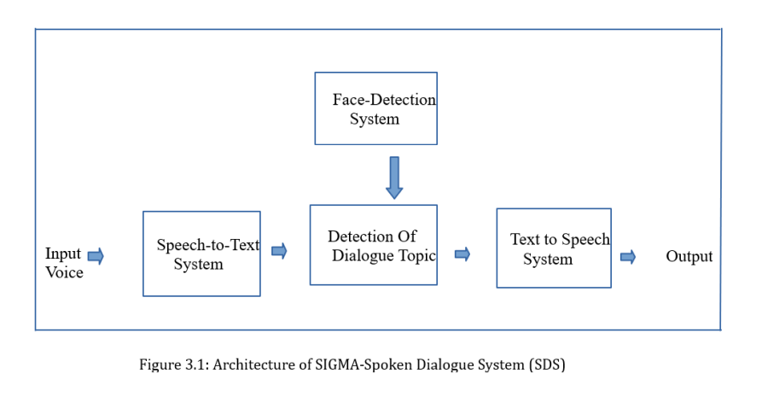
Proposed System
System Architecture is abstract, conceptualization-oriented, global, and focused to achieve the mission and life cycle concepts of the system. It also focuses on high-level structure in systems and system elements. It addresses the architectural principles, concepts, properties, and characteristics of the system-of-interest. It may also be applied to more than one system, in some cases forming the common structure, pattern, and set of requirements for classes or families of similar or related systems.
Figure 3.1 shows the modules of SIGMA- Spoken Dialogue System. In this system there four main sub-systems such are speech-to-text, detection of dialogue, face-detection and text-to- speech detection.

Slide 8
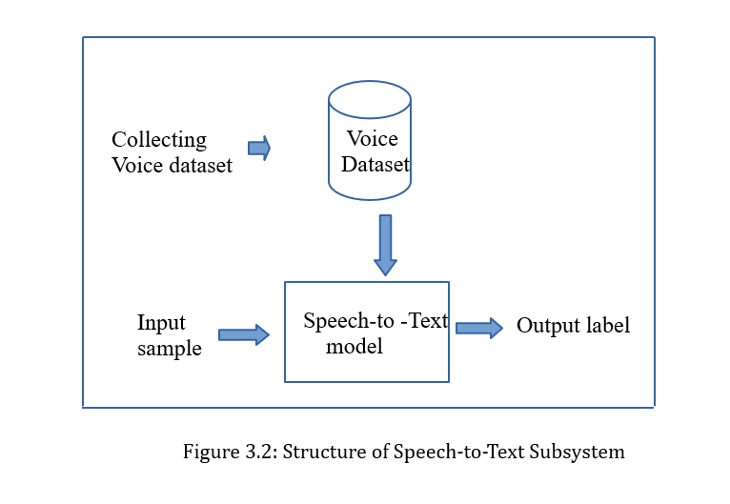
Speech-to-text subsystem
Figure 3.2 speech-to-text subsystem, in this system taking voice signal as input and generating text as output. And we are using same type of audio data-set for train this system. Here speech-to-text model using conv1d. Conv1d is a convolution neural network which performs the convolution along only one dimension.

Slide 9
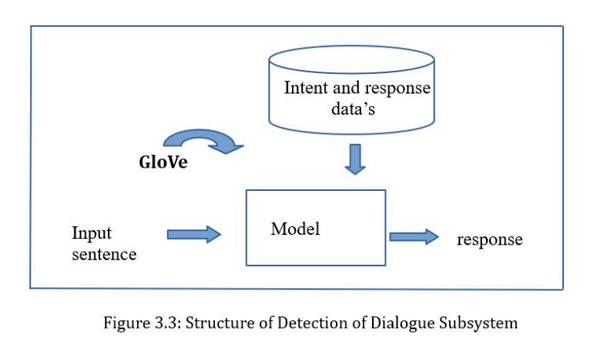
Detection of Dialogue system
Detection of Dialogue topic model (Figure 3.3) used to detect dialogue based on corresponding input from STD model. NLP provides many different approaches to achieve this objective. For example, seq2seq (sequence-to-sequence) models are able to find an answer when given a question. Also, deep language models can generate responses based on a corpus, that is, if a chat bot has a conversational corpus, it can follow a conversation. Here, we are going to build a conversation model using Stanford's GloVe.

Slide 10
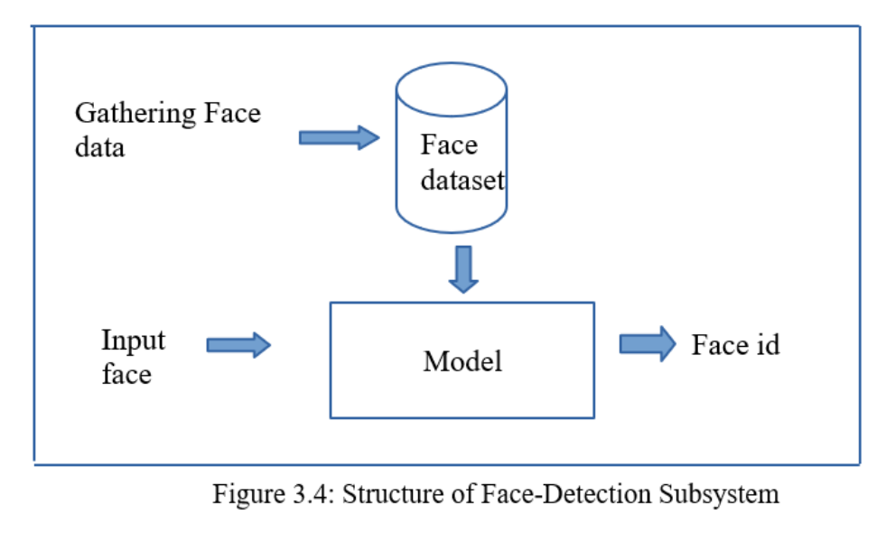
Face Detection System
Face detection system (Figure 3.4), is used to detecting face. Before anything, you must “capture” a face in order to recognize it. The most common way to detect a face is using the “Haar Cascade Classifier” . And In face data-set, where we will store for each id, a group of photos in gray with the portion that was used for face detecting. If SIGMA system known face, then it greets corresponding dialogue and also fetch new face data for future use. Otherwise, it will generate face ID with recognized person name and it will store record in file. And also, it will fetch face data for future , each person face identified with unique generated Face ID and corresponding recognized name.

Slide 11
Speech to Text -Dataset
Dataset Elements | Description
type | Audio data
device | Microphone-collecting data samples
Signal duration | 2 Seconds
Sample Rate | 16000
No. of Classes | 15
No. of Samples in Each Class | 150
Total No. of samples | 2250
Features | Simples commands: Hello ,Hi, Where are you, How are you, Hello sigma, and person name like Akshatha, Bhagyashree.

Slide 12
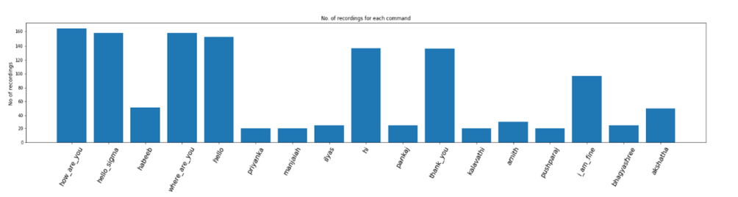
Data Preprocessing and Visualization
Data visualization
Data pre-processing
-Loading audio data and representing array numeric form.
-label encoding
-Splitting

Slide 13
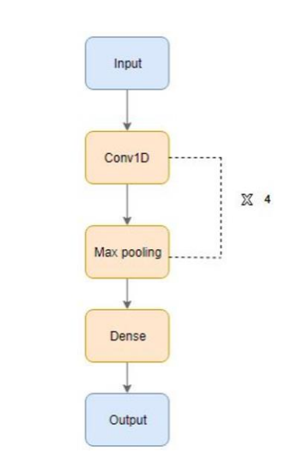
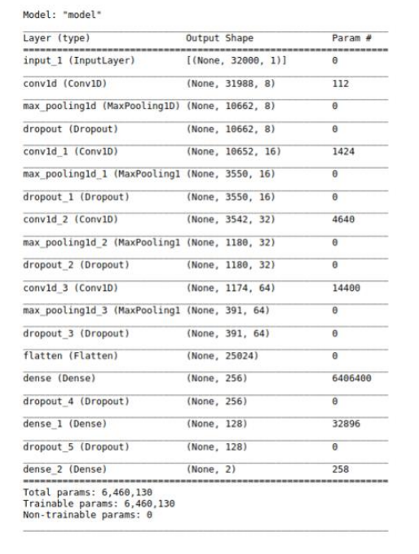
CNN model for Speech to Text
One Dimension Model
1-D CNN Model Architecture Model Summary

Slide 14
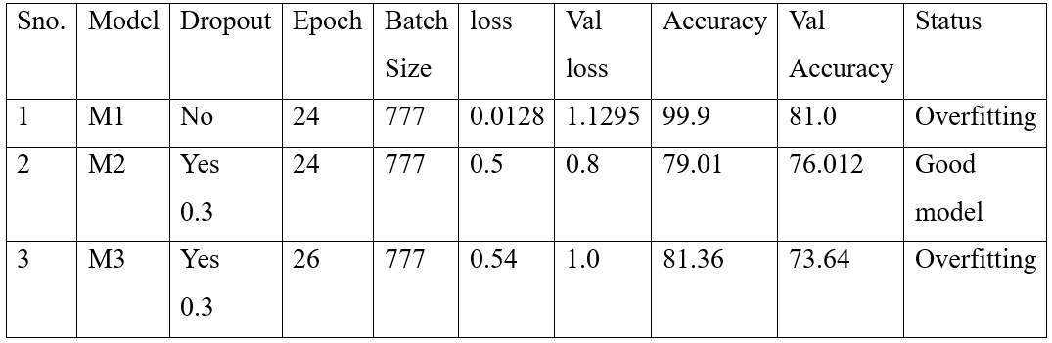
Situation of three models

Slide 15
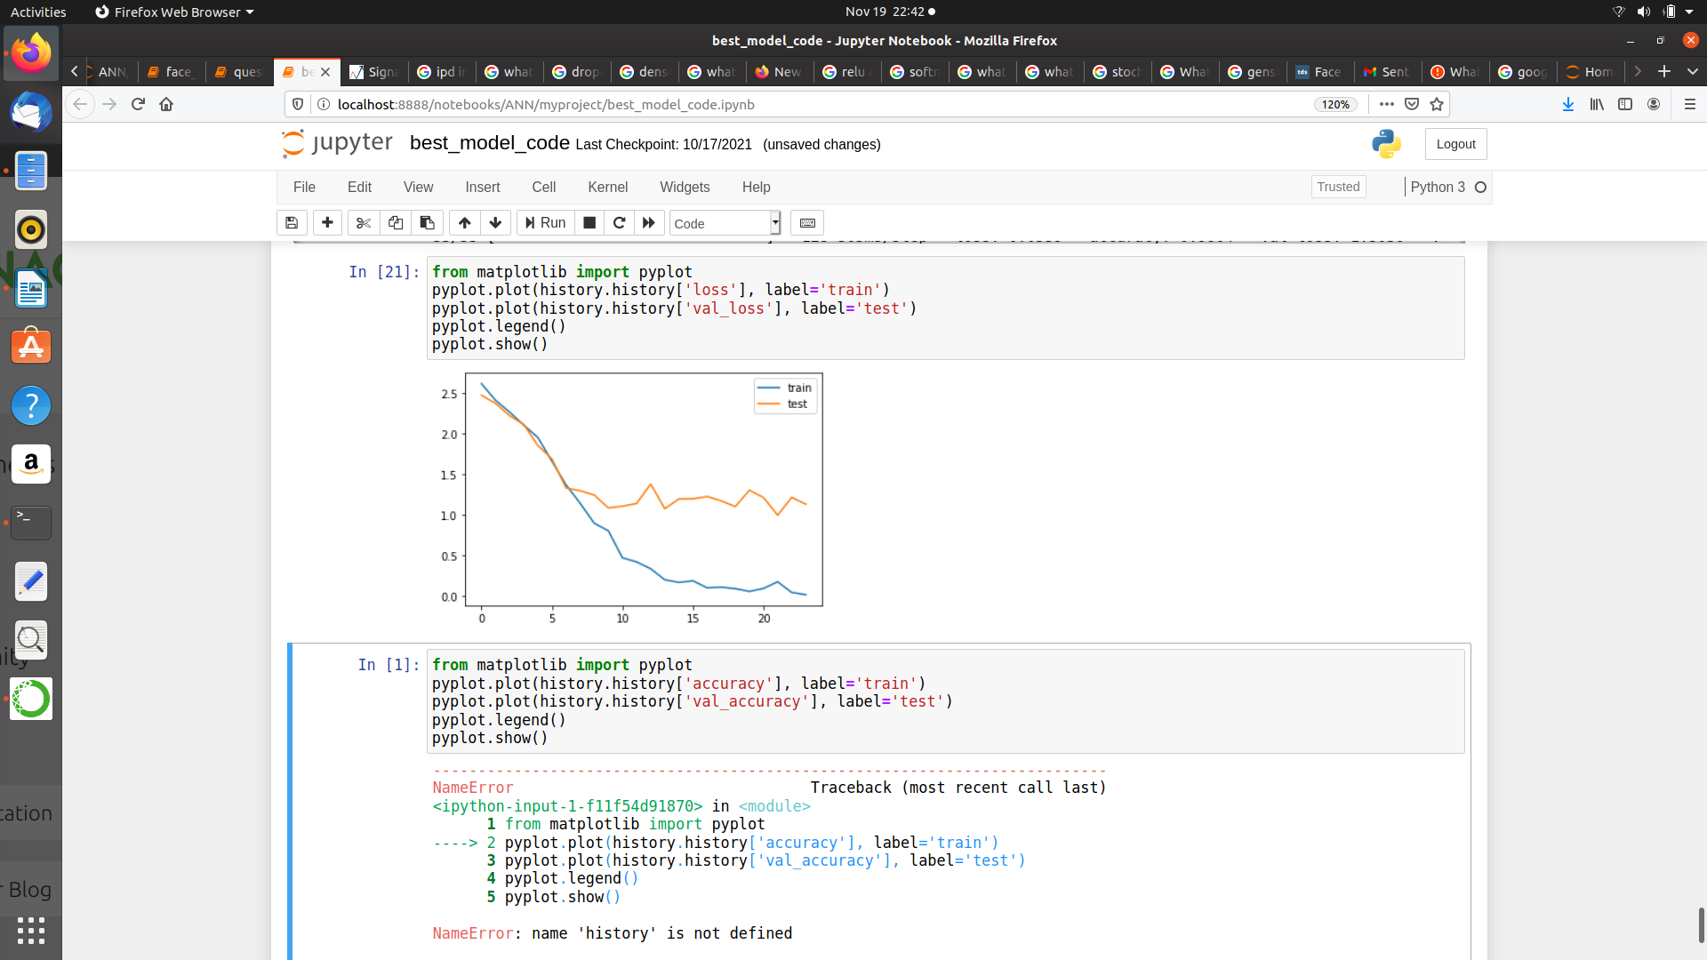
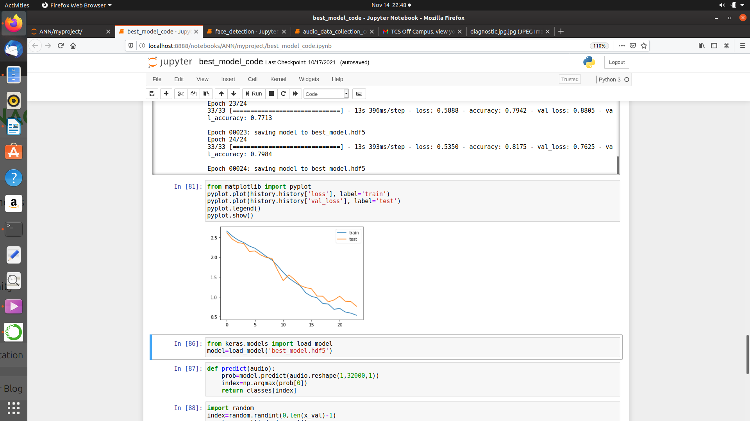
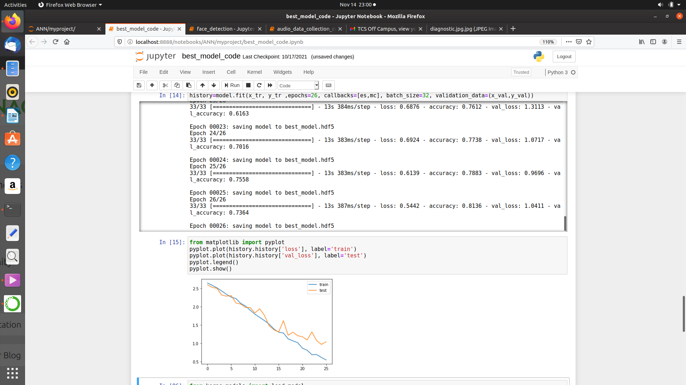
Result
M3 : Overfitting
M1 : Overfitting
M2 : Good model

Slide 16
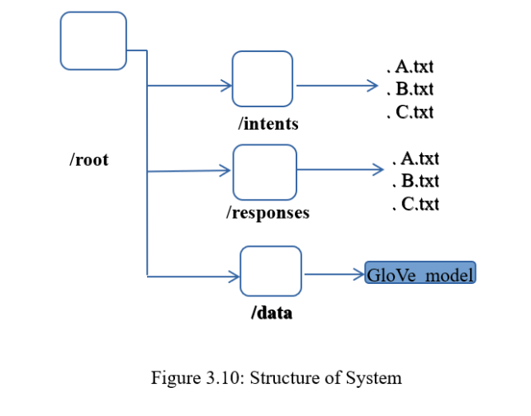
Detection of Dialogue System
There are many other ways to build a conversational agent, and NLP provides many different approaches to achieve this objective. For example, seq2seq (sequence-to-sequence) models are able to find an answer when given a question. Also, deep language models can generate responses based on a corpus, that is, if a system has a conversational corpus, it can follow a conversation. We are going to build a conversation system using Stanford's GloVe.
In figure 3.10, we can see the structure. The extension of the intents and responses files are (.txt) GloVe Model for Intent Detection: GloVe represents each word with a real-valued vector, and these vectors can be used as features in a variety of applications. But for this case – building a conversational agent – we are going to use complete sentences to train our conversation system, not just words.

Slide 17
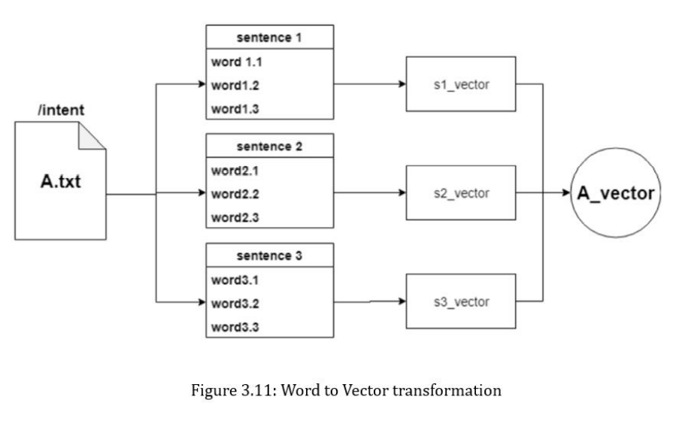
GloVe model located in /data, creating the document vectors to perform the match between the user's sentence and the intent. Figure 3.11 shows the process of transforming a set of sentences in a vector, representing a document. In the example, the A.txt file is an intent with three sentences. Each sentence has three words, so each sentence has three vectors. Combining the vectors, we obtain a representation of each set of words, after which, we get the document vector. The approach of converting sentences into vectors allows a comparison of a sequence of vectors within a document vector without any problem. When the user interacts with the system, the user phrase will be transformed as seq2vec and then it will be compared with each document vector to find the most similar one.

Slide 18
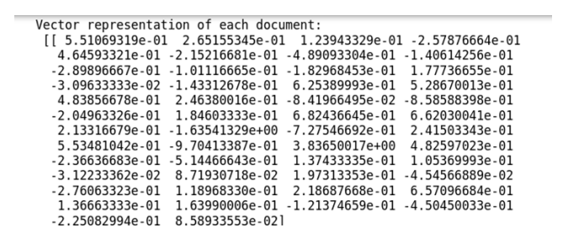
Vector Representation

Slide 19
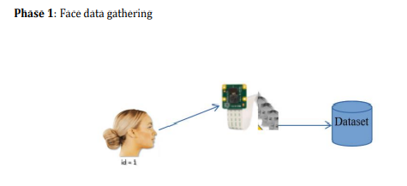
Face Detection
Face Detection System face used to detect face while person talking with sigma system. And each face stored with unique id and sigma will know name of the person through conversation and retain name corresponding to face ID. The most common way to detect a face (or any objects), is using the “Haar Cascade classifier”.
To work on Face Recognition, we must work on 3 very distinct phases show in Figure 3.12 Phase 1: Face data gathering.

Slide 20
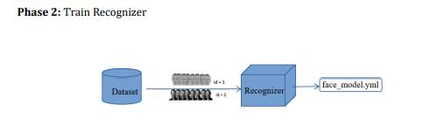
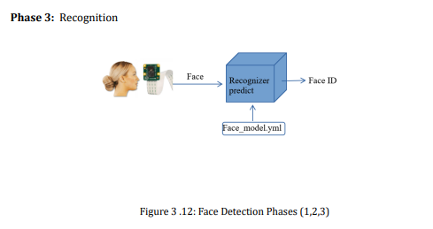

Slide 21
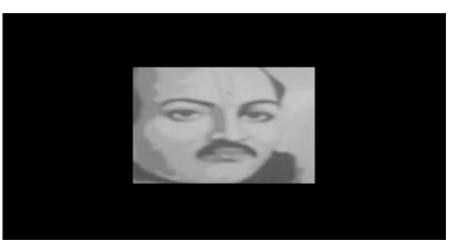
Recognized Face sample:

Slide 22
Modules :
audio_data_collection.py: this file used to collect audio dataset. Here we mentioned the type of collecting samples and their parameters such as audio sample rate, duration and format.
Building_model.py: This file represents the building code of Text to speech system. These are the following task performed in this module:
• Accessing audio dataset.
• Data Visualization and Preprocessing
• building Speech to text model.
Question_and_Answer_model.py: In this we are building dialogue detection system. Perform preprocessing and word to vector transformation.
Face_detection.py: Here we are implementing face detection system.
model_index.py: In this file loading all models and working SIGMA operations.
Text To Speech system implemented by using TTS API.

Slide 23
Experimental Tools and libraries
Glove - For Document Vectorizer
Haar Cascade Classifier - For Face Detection
Librosa - For Audio Processing
IpythonDisplay - For Audio playing and Processing
Gensim - Processing Unstructured text
TensorFlow and Kera's - For model Building.
Scikit-Learn - For Algorithm implementation
CV2 - For Face Detection

Slide 24
Conclusion and Future Scope
In this work, we have described how machine can able to communicate with human and understanding of human languages. Specifically, we described the feature sets and an approach for building SIGMA-Spoken Dialogue System. The technology working based on the automation property, AI is the key of this works. Spoken Dialogue System is hard to implement, we face more challenges and difficulties. Machine cannot understand human languages, obviously structure of this system is more complex. SIGMA understand some simple conversation dialogue and able to response based on the dialogue. And also, able to detect and identify person. This system can’t work continues dialogue; it works just 2 second’s voices .
In future focus on continues signal conversation method, so we can implement better dialogue system. And enhance process of voice signals based on word and sentences. Improvement of system using different filter method to understand noise data and remove noise data for better model. We can move robotics engineering feature like movement of system and actions.

Slide 25
Thank You

