Slide 1
Distributed System & Cloud Computing
SSE USTC
Qing Ding(dingqing@ustc.edu.cn)

Slide 2
Outline
History
Main content in the course

Slide 3
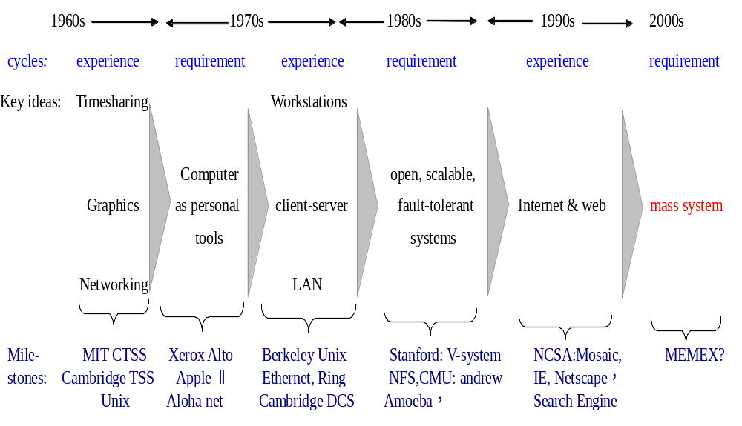
Conceptual developments in system design leading to distributed systems
Notes:
1990 Fernando J. Corbato --- PhD, MIT; Prof, MIT
因在开发大型多功能、可实现时间和资源共享的计算系统，如CTSS ( Compitable time sharing system)
和Multics ( MULTiplexed Information and Computing System ) 方面的贡献而获奖.
Pegasus and Pegasus II from the University of Cambridge, whose purpose is to support applications requiring a constant quality of service.
The MEMEX is "a device in which an individual stores all his books, records, and communications, and which is mechanized so that it may be consulted with exceeding speed and flexibility"

Slide 4
Milestones in Distributed System
System
Organization
Network
Computers
Date
Xerox DFS
Xerox PARC
Ethernet&Internet
Xerox Alto
1977
Cambridge DCS
Cambridge Univ.
Cambidge Ring
LSI-4, M68000
1979
Locus
UCLA
Ethernet
VAX, IBM PC
1980
Apollo Domain
Apollo Computers
Toking Ring
Apollo
1980
Newcastle connection
Newcastle Univ.
various
various
1980
V system
Stanford Univ.
Ethernet
VAX, Sun
1982
Accent
CMU
Ethernet
VAX,Sun
1982
Argus
MIT
-
-
1983
Amoeba
Vrije Univ.
Ethernet
VAX, M68000
1984
Unix
BSD 4.2+
Sun NFS
Sun Microsystems
Ethernet
VAX,Sun+others
1985
Mach
CMU
Ethernet
VAX,Sun+others
1986
NOW
Berkeley
Myrinet
SUN+Solaris
1995
Google
Stanford
Internet
-
1996
Gnutella
AOL
Internet
-
2001

Slide 5
Main content in the course

Slide 6
Distributed Systems: Principles and Paradigms, 2/e, by Andrew S. Tanenbaum, Maarten ven Steen
Principle
  a descriptive comprehensive and fundamental law, doctrine, or assumption;
  a normative rule or code of conduct, and
  a law or fact of nature underlying the working of an artificial device.
Paradigm
  the Oxford English Dictionary defines paradigm as "a pattern or model, an exemplar.“
    How is an experiment to be conducted, and what equipment is available to conduct the experiment.
  how distributed applications should be developed
Notes:
http://en.wikipedia.org/wiki/Principle
http://en.wikipedia.org/wiki/Paradigm

Slide 7
Organization of the book
Principles are discussed in chapters 2-9
  02 Architectures, 03 Processes, 04 Communication
  05 Naming, 06 Synchronization,
  07 Consistency and Replication,
  08 Fault Tolerance,
  09 Security
Paradigms in chapter 10-15
  10 Distributed Object-Based Systems,
  11 Distributed File Systems,
  12 Distributed Web-Based Systems
  13 Distributed Coordination-Based Systems
  14 Grid Computing, 15 Cloud Computing
Cloud Computing
Google
Hadoop
Amzon
Microsoft
BlockChain

Slide 8
Reference
《Distributed Systems: Principles and Paradigms》，Second Edition, Andrew S. Tanenbaum and Marten van Steen，Prentice-Hall, 2008
Distributed Computing: Principles, Algorithms, and Systems, Ajay D. Kshemkalyani, Chicago Mukesh Singhal, Cambridge Press, 2008, ISBN-13: 9780521876346
《Reliable Distributed Systems》，Kenneth P. Birman，2005 Springer Science+Business Media, Inc.
Distributed and Cloud Computing: From Parallel Processing to the Internet of Things (Kai Hwang)
虚拟化与云计算 (IBM)
实战Hadoop——开启通向云计算的捷径 (刘鹏)
开源云计算平台—OpenStack

Slide 9
The Book Description
Virtually every computing system today is part of a distributed system. Programmers, developers, and engineers need to understand the underlying principles and paradigms as well as the real-world application of those principles.
Now, internationally renowned expert Andrew S. Tanenbaum – with colleague Martin van Steen – presents a complete introduction that identifies the seven key principles of distributed systems, with extensive examples of each.
Adds a completely new chapter on architecture to address the principle of organizing distributed systems. Provides extensive new material on peer-to-peer systems, grid computing and Web services, virtualization, and application-level multicasting.
Updates material on clock synchronization, data-centric consistency, object-based distributed systems, and file systems and Web systems coordination.
For all developers, software engineers, and architects who need an in-depth understanding of distributed systems.

Slide 10
Self-learning
如何用Hive访问Hadoop上数据
http://www.cnmooc.org/portal/course/1915/3120.mooc
  课程大纲
  第一课：Hive介绍
  第二课: Hive DDL
  第三课: Hive DML
  第四课：Hive运算符和函数
  第五课：Hive存储格式
  第六课：Hive配置

Slide 11
利用HBase实时管理您的大数据
http://www.cnmooc.org/portal/course/1751/2874.mooc
  课程大纲
  HBase system and architecture
  Use the Client API to perform data operations on HBase
  Describe the various HBase client used to communicate with HBase
  Integrate HBase with a MapReduce job
  Backup and restore data from your HBase

Slide 12
NoSQL和数据库即服务介绍
http://www.cnmooc.org/portal/course/1748/2873.mooc
  课程大纲
  第一课：NoSQL介绍
  第二课：如何定义NoSQL数据库的类型和使用场景
  第三课：如何为应用程序选择合适的数据载体
  第四课：Cloudant介绍-NoSQL的数据库及服务
  第五课：如何开始使用IBM Cloudant-实践练习

Slide 13
Spark 基础课程(一)
http://www.cnmooc.org/portal/course/1749/2872.mooc
  课程大纲
  第一课：Spark简介
  第二课：弹性分布数据集（RDD）
  第三课：Spark应用程序的基本编程
  第四课：Spark库介绍
  第五课：Spark的配置、监控和优化

Slide 14
SQL Access on Hadoop (Big SQL v4)
http://www.cnmooc.org/portal/course/2236/3705.mooc
  课程大纲
  Describe the Big SQL architecture and understand the Big SQL terminologies
  Understand and use different methods for working with Big SQL
  List and explain the Big SQL data types
  Create Big SQL schemas and tables
  Understand and use the file formats supported by Big SQL

Slide 15
基于R语言的大数据分析介绍
(http://www.cnmooc.org/portal/course/1914/3121.mooc)
  课程大纲
  第一课: R语言简介
  第二课: R控制台介绍
  第三课: 数据结构和类型
  第四课: 分析和可视化数据
  第五课: 数据结构，函数以及数据关联的编程开发

