Slide 1
Introduction

Slide 2
01: Introduction
1.1 Definition of A Distributed System
1.2 Goals
  Making Resources Accessible
  Distribution Transparency
  Openness
  Scalability
  Pitfalls
1.3 Types of Distributed Systems
  Distributed Computing Systems
  Distributed Information Systems
  Distributed Pervasive Systems

Slide 3
Computer and Network Evolution
Computer Systems
  10 million dollars and 1 instruction/sec
  1000 dollars and 1 billion instructions/sec
  => a price/performance gain of 10¹³
Computer Networks
  Local-area networks (LANs)
    Small amount of information, a few microseconds
    Large amount of information, at rate of 100 million to 10 billion bits/sec
  Wide-area networks (WANs)
    64 Kbps to gigabits per second
Notes:
The result of these technologies is that it is now not only feasible, but easy, to put together computing systems composed of large numbers of computers connected by a high-speed network.

Slide 4
Distributed System: Definition
A distributed system is a piece of software that ensures that:
  a collection of independent computers appears to its users as a single coherent system
Two aspects
  (1) independent computers and
  (2) single system => middleware.

Slide 5
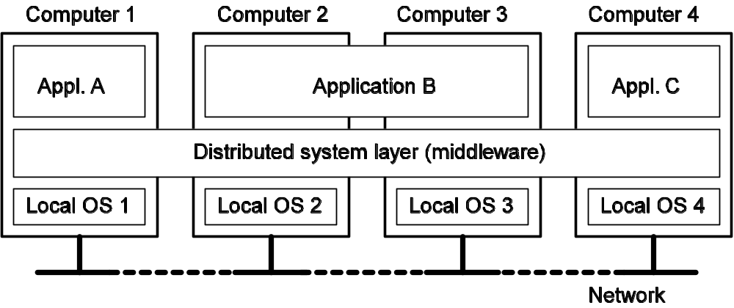
Characters of Distributed System
Differences between the various computers and the ways in which they communicate are mostly hidden from users
Users and applications can interact with a distributed system in a consistent and uniform way, regardless of where and when interaction takes place.
Notes:
Figure 1-1. A distributed system organized as middleware. The middleware layer extends over multiple machines, and offers each application the same interface.

Slide 6
1.2 Goals of Distributed Systems
Making resources available
Distribution transparency
Openness
Scalability

Slide 7
Make Resources Accessible
Access resources and share them in a controlled and efficient way.
  Printers, computers, storage facilities, data, files, Web pages, and networks, …
Connecting users and resources also makes it easier to collaborate and exchange information.
  Internet for exchanging files, mail, documents, audio, and video
Security is becoming increasingly important
  Little protection against eavesdropping or intrusion on communication
  Tracking communication to build up a preference profile of a specific user

Slide 8
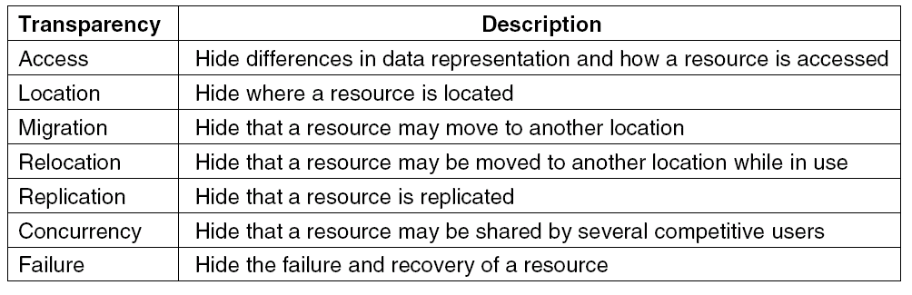
Distribution Transparency
Note: Distribution transparency may be set as a goal, but achieving it is a different story.
Notes:
Figure 1-2. Different forms of transparency in a distributed system (ISO, 1995).
Let us first take a look at what kinds of transparency exist in distributed systems. After that we will address the more general question whether transparency is always required.

Slide 9
Distributed System: Definition
Due to Lesli Lamport
  A distributed system is “You know you have one when the crash of a computer you’ve never heard of stops you from getting any work done.”
This description puts the finger on another important issue of distributed systems design: dealing with failures.

Slide 10

Lesli Lamport
Lamport is best known for his seminal work in distributed systems and as the initial developer of the document preparation system LaTeX.
Lamport’s research contributions have laid the foundations of the theory of distributed systems. Among his most notable papers are
  “Time, Clocks, and the Ordering of Events in a Distributed System”, which received the PODC Influential Paper Award in 2000
  “The Byzantine Generals Problem”
  “Distributed Snapshots: Determining Global States of a Distributed System” and
  “The Part-Time Parliament”.
These papers relate to such concepts as logical clocks (and the happened-before relationship) and Byzantine failures. They are among the most cited papers in the field of computer science and describe algorithms to solve many fundamental problems in distributed systems, including:
  the Paxos algorithm for consensus,
  the bakery algorithm for mutual exclusion of multiple threads in a computer system that require the same resources at the same time and
  the snapshot algorithm for the determination of consistent global states.
Notes:
http://en.wikipedia.org/wiki/Leslie_Lamport

Slide 11
Degree of Transparency
Observation: Aiming at full distribution transparency may be too much:
Users may be located in different continents; distribution is apparent and not something you want to hide
Completely hiding failures of networks and nodes is (theoretically and practically) impossible
  You cannot distinguish a slow computer from a failing one
  You can never be sure that a server actually performed an operation before a crash
Full transparency will cost performance, exposing distribution of the system
  Keeping Web caches exactly up-to-date with the master copy
  Immediately flushing write operations to disk for fault tolerance

Slide 12
Openness
Goal: Open distributed system -- able to interact with services from other open systems, irrespective of the underlying environment:
  System should conform to well-defined interfaces
  Systems should support portability of applications
  Systems should easily interoperate
Achieving openness: At least make the distributed system independent from heterogeneity of the underlying environment:
  Hardware
  Platforms
  Languages
Notes:
Interoperability characterizes the extent by which two implementations of systems or components form different manufactures can co-exist and work together by merely relying on each other's services as specified by a common standard.
Portability characterizes to what extent an application developed for a distributed system A can be executed without modification, on a different distributed system B that implements the same interfaces as A.

Slide 13
Separating policy and mechanism
To achieve flexibility: split the systems in smaller components. Components requires support for different policies specified by applications and users:
Implementing openness requires support for different polices:
  What level of consistency do we require for client-cached data?
  Which operations do we allow downloaded code to perform?
  Which QoS requirements do we adjust in the face of varying bandwidth?
  What level of secrecy do we require for communication?
Implementing openness, ideally, a distributed system provide only mechanisms:
  Allow (dynamic) setting of caching policies
  Support different levels of trust for mobile code
  Provide adjustable QoS parameters per data stream
  Offer different encryption algorithms

Slide 14
Scale in Distributed Systems
Observation: Many developers of modern distributed system easily use the adjective “scalable” without making clear why their system actually scales.
Scalability: At least three components:
  Number of users and/or processes (size scalability)
  Maximum distance between nodes (geographical scalability)
  Number of administrative domains (administrative scalability)
Observation: Most systems account only, to a certain extent, for size scalability. The (non)solution: powerful servers. Today, the challenge lies in geographical and administrative scalability.
Notes:
Scalability of a system can be measured along at least three different dimensions (Neuman, 1994).
First, a system can be scalable with respect to its size, meaning that we can easily add more users and resources to the system.
Second, a geographically scalable system is one in which the users and resources may lie far apart.
Third, a system can be administratively scalable,aming that it can still be easy to manage even if it spans many independent administrative organizations.
Unfortunately, a system that is scalable in one or more of these dimensions often exhibits some loss of performance as the system scales up.

Slide 15
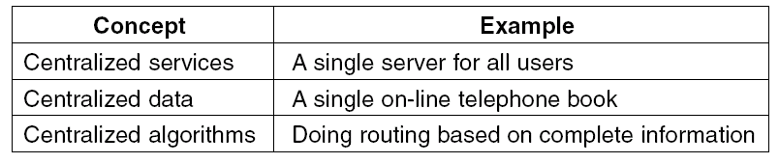
Scalability Problems @ size
Decentralized algorithms:
  No machine has complete information about the system state.
  Machines make decisions based only on local information.
  Failure of one machine does not ruin the algorithm
  There is no implicit assumption that a global clock exists

Slide 16
Scalability Problems @ geography
Synchronous communication
  A party requesting service, generally referred to as a client, blocks until a reply is sent back.
WANs is unreliable and Point-to-point
LANs provide reliable communication facilities based on broadcasting.
Geographical scalability is strongly related to the problems of centralized solutions that hinder size scalability.
  In addition, centralized components now lead to a waste of network resources.

Slide 17
Scalability Problems @ administration
It is a difficult and in many cases open question
  Conflicting polices with respect to resource usage ( and payment), management, and security.
  E.g.,
    Reside within a single domain can often be trusted by users that operate within that same domain.
    Downloading programs such as applets in Web browsers.

Slide 18
Techniques for Scaling
Hide communication latencies: Avoid waiting for responses; do something else:
  Make use of asynchronous communication
  Have separate handler for incoming response
  Problem: not every application fits this model

Slide 19
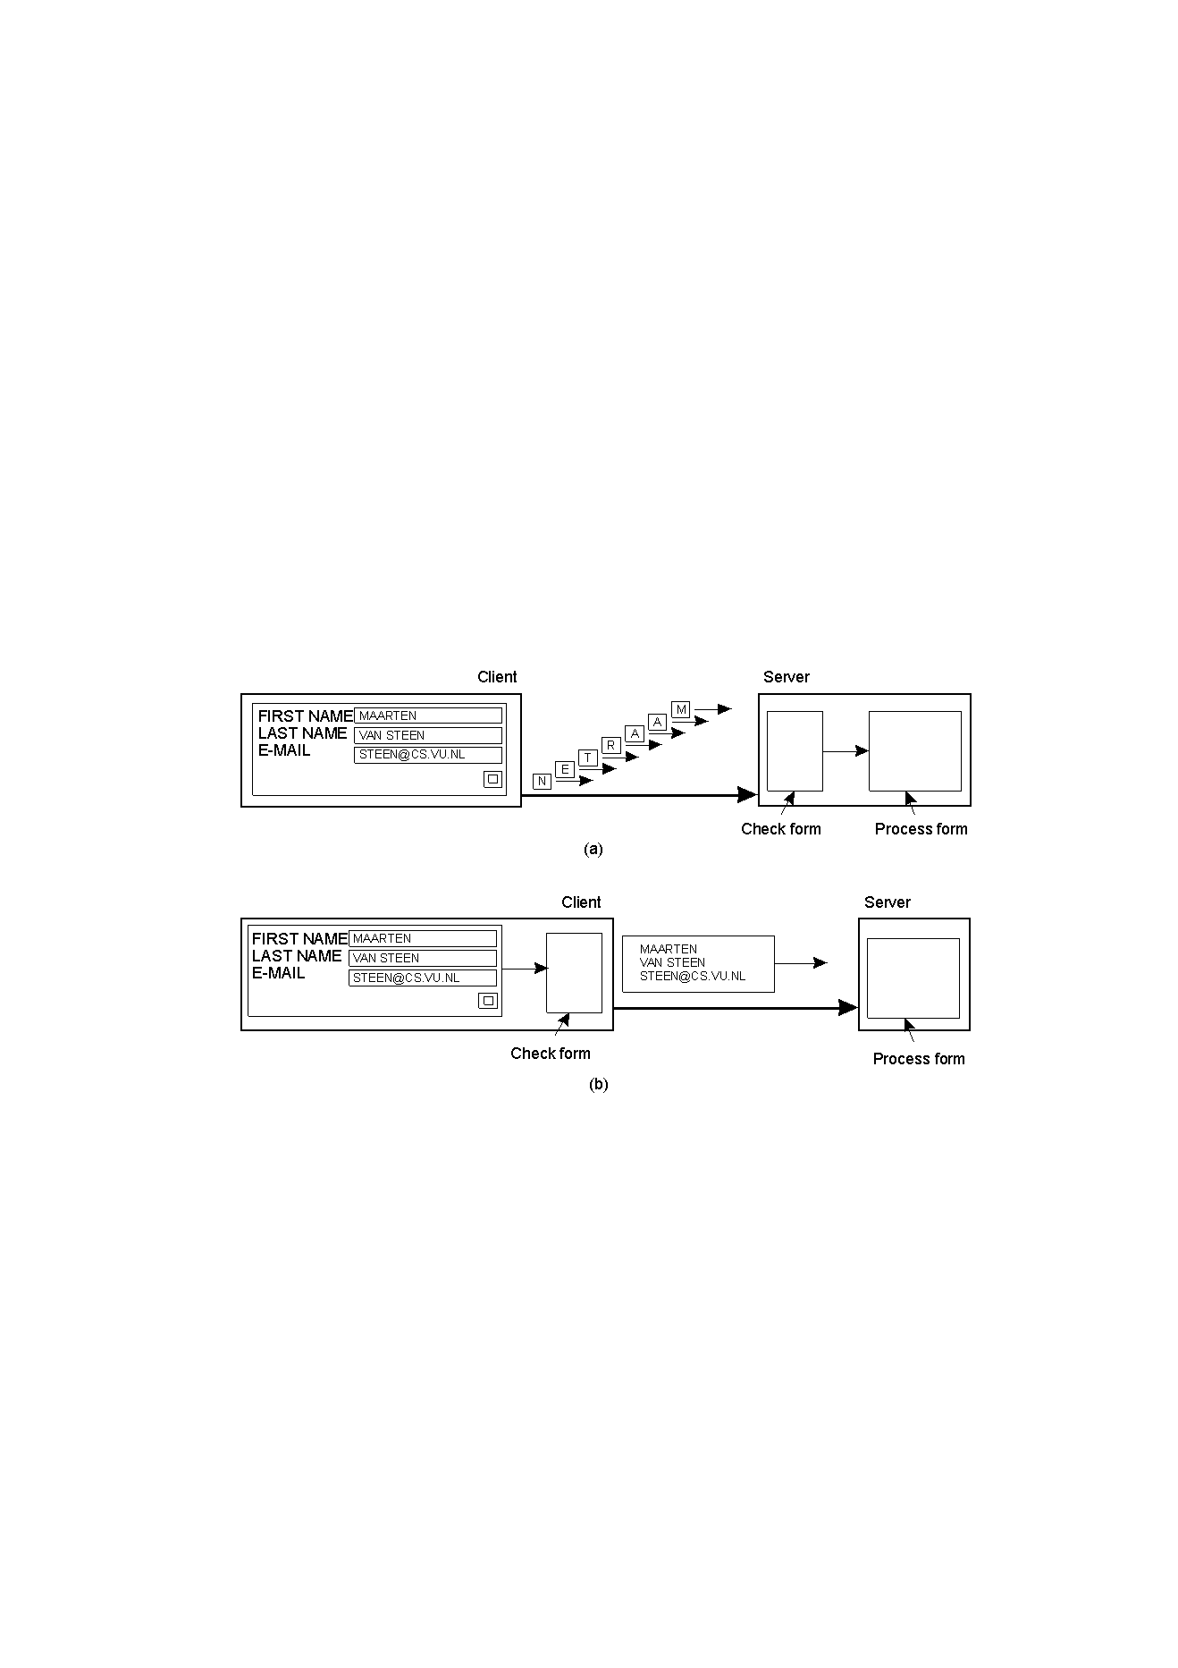
Scaling Techniques Example(1)
Technique: Offload work to clients

Slide 20
Techniques for Scaling
Distribution: Partition data and computations across multiple machines:
  Move computations to clients (Java applets)
  Decentralized naming services (DNS)
  Decentralized information systems (WWW)

Slide 21
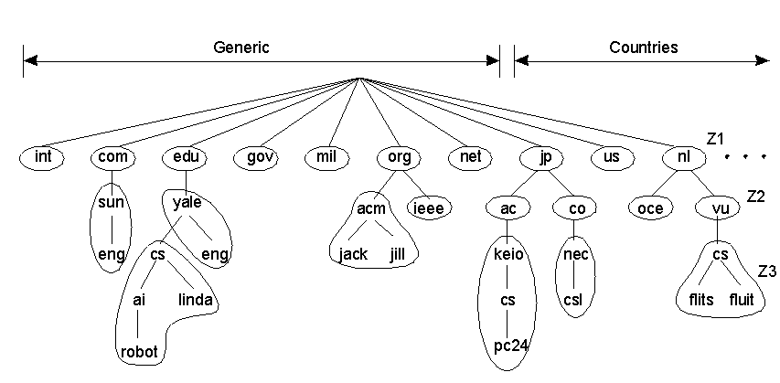
Scaling Techniques Example(2)
Technique: Divide the problem space.
  example: the way DNS divides the name space into zones.
Notes:
An excellent example of distribution is the Internet
Domain Name System (DNS). The DNS name space is hierarchically organized
into a tree of domains, which are divided into nonoverlapping zones, as shown in
Fig. 1-5. The names in each zone are handled by a single name server. Without
going into too many details, one can think of each path name,being the name of a
host in the Internet, and thus associated with a network address of that host. Basically,
resolving a name means returning the network address of the associated
host. Consider, for example, the name nl. vu.cs.flits. To resolve this name, it is
first passed to the server of zone 21 (see Fig. 1-5) which returns the address of the
server for zone 22, to which the rest of name, vu.cs.flits, can be handed. The
server for 22 will return the address of the server for zone 23, which is capable of
handling the last part of the name and will return the address of the associated
host.

Slide 22
Techniques for Scaling
Replication/caching: Make copies of data available at different machines:
  Replicated file servers and databases
  Mirrored Web sites
  Web caches (in browsers and proxies)
  File caching (at server and client)
In contrast to replication
  caching is a decision made by the client of a resource, and not by the owner of a resource.
  Also, caching happens on demand whereas replication is often planned in advance

Slide 23
Scaling – The Problem
Observation: Applying scaling techniques is easy, except for one thing:
  Having multiple copies (cached or replicated), leads to inconsistencies: modifying one copy makes that copy different from the rest.
  Always keeping copies consistent and in a general way requires global synchronization on each modification.
  Global synchronization precludes large-scale solutions.
Observation: If we can tolerate inconsistencies, we may reduce the need for global synchronization, but tolerating inconsistencies is application dependent.

Slide 24
Developing Distributed Systems: Pitfalls
Observation: Many distributed systems are needlessly complex caused by mistakes that required patching later on.
There are many false assumptions:
  The network is reliable
  The network is secure
  The network is homogeneous
  The topology does not change
  Latency is zero
  Bandwidth is infinite
  Transport cost is zero
  There is one administrator

Slide 25
1.3 Types of Distributed Systems
Distributed Computing Systems
Distributed Information Systems
Distributed Pervasive Systems

Slide 26
Distributed Computing Systems (1/4)
Observation: Many distributed systems are configured for High-Performance Computing
Cluster Computing: Essentially a group of high-end systems connected through a LAN:
  Homogeneous: same OS, near-identical hardware
  Single managing node

Slide 27
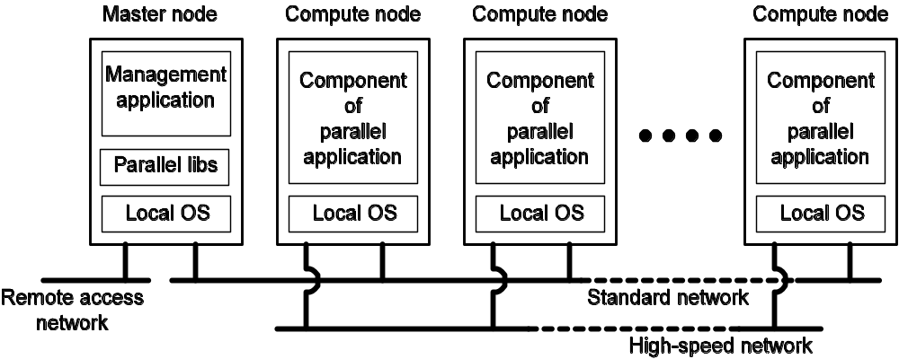
An example of a cluster computing system (2/4)
Notes:
One well-known example of a cluster computer is formed by Linux-based
Beowulf clusters, of which the general configuration is shown in Fig. 1-6. Each
cluster consists of a collection of compute nodes that are controlled and accessed
by means of a single master node. The master typically handles the allocation of
nodes to a particular parallel program, maintains a batch queue of submitted jobs,
and provides an interface for the users of the system. As such, the master actually
runs the middleware needed for the execution of programs and management of the
cluster, while the compute nodes often need nothing else but a standard operating
system.
An important part of this middleware is formed by the libraries for executing
parallel programs. As we will discuss in Chap. 4, many of these libraries effectively
provide only advanced message-based communication facilities, but are not
capable of handling faulty processes, security, etc.
As an alternative to this hierarchical organization, a symmetric approach is
followed in the MOSIX system (Amar et at, 2004). MOSIX attempts to provide
a single-system image of a cluster, meaning that to a process a cluster computer
offers the ultimate distribution transparency by appearing to be a single computer.
As we mentioned, providing such an image under all circumstances is impossible.
In the case of MOSIX, the high degree of transparency is provided by allowing
processes to dynamically and preemptively migrate between the nodes that make
up the cluster. Process migration allows a user to start an application on any node
(referred to as the home node), after which it can transparently move to other
nodes, for example, to make efficient use of resources. We will return to process
migration in Chap. 3.

Slide 28
Distributed Computing Systems (3/4)
Grid Computing: lots of nodes from everywhere:
  Heterogeneous
  Dispersed across several organizations
  Can easily span a wide-area network
Note: To allow for collaborations, grids generally use virtual organizations. In essence, this is a grouping of users (or better: their IDs) that will allow for authorization on resource allocation.

Slide 29
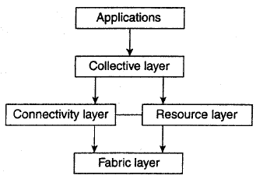
Architecture for grid computing systems (4/4)
fabric layer provides interfaces to local resources at a specific site.
connectivity layer consists of communication protocols for supporting grid transactions that span the usage of multiple resources.
resource layer is responsible for managing a single resource.
collective layer deals with handling access to multiple resources and typically consists of services for resource discovery, allocation and scheduling of tasks onto multiple resources, data replication, and so on.
application layer consists of the applications that operate within a virtual organization and which make use of the grid computing environment.

Slide 30
Distributed Information Systems
Observation:
  organizations that were confronted with a wealth of networked applications, but for which interoperability turned out to be a painful experience.
  Many of the existing middleware solutions are the result of working with an infrastructure in which it was easier to integrate applications into an enterprise-wide information system
We can distinguish several levels at which integration took place.
  Transaction Processing Systems
    In many cases, a networked application simply consisted of a server running that application (often including a database) and making it available to remote programs, called clients.
  Enterprise Application Integration (EAI)
    As applications became more sophisticated and were gradually separated into independent components (notably distinguishing database components from processing components),
    it became clear that integration should also take place by letting applications communicate directly with each other.

Slide 31
Transaction processing systems
Such clients could send a request to the server for executing a specific operation, after which a response would be sent back.
Integration at the lowest level would allow clients to wrap a number of requests, possibly for different servers, into a single larger request and have it executed as a distributed transaction.
Observation : The key idea was that all, or none of the requests would be executed. (Transactions form an atomic operation.)
Notes:
To clarify our discussion, let us concentrate on database applications. In practice, operations on a database are usually carried out in the form of transactions.

Slide 32
Distr. Info. Systems: Transactions
Model: A transaction is a collection of operations on the state of an object (database, object composition, etc.) that satisfies the following properties (ACID):
Atomicity: All operations either succeed, or all of them fail.
  When the transaction fails, the state of the object will remain unaffected by the transaction.
Consistency: A transaction establishes a valid state transition.
  This does not exclude the possibility of invalid, intermediate states during the transaction’s execution.
Isolation: Concurrent transactions do not interfere with each other.
  It appears to each transaction T that other transactions occur either before T, or after T, but never both.
Durability: After the execution of a transaction, its effects are made permanent:
  changes to the state survive failures.
Notes:
BEGIN_ TRANSACTION and END_TRANSACTION are used to delimit the
scope of a transaction. The operations between them form the body of the transaction.
The characteristic feature of a transaction is either all of these operations
are executed or none are executed.

Slide 33
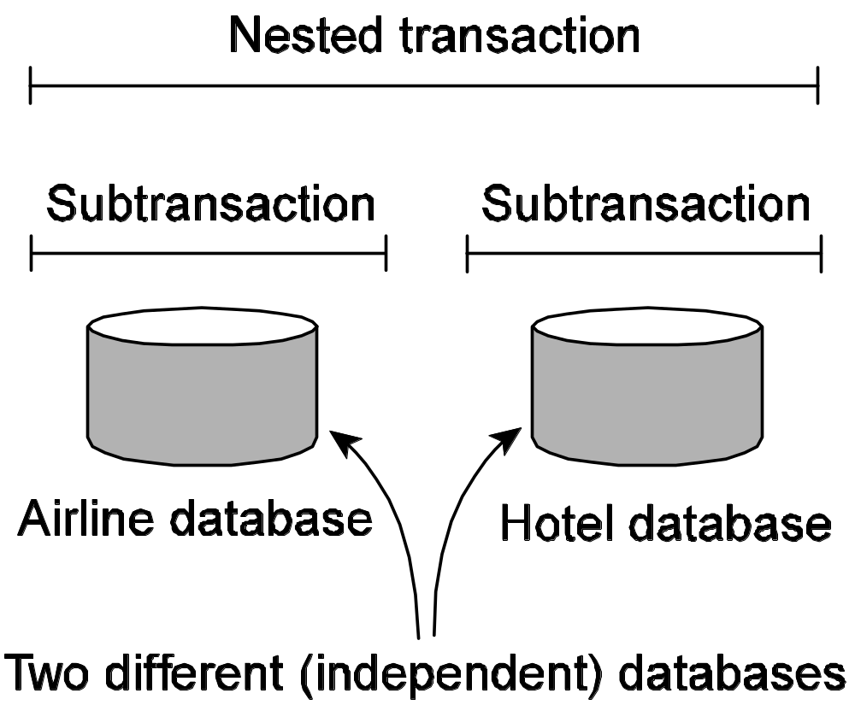
A nested transactions
Is constructed from a number of subtransactions
  Gain performance or simplify programming.
Notes:
So far, transactions have been defined on a single database. A nested transaction is constructed from a number of subtransactions, as shown in Fig. 1-9. The top-level transaction may fork off children that run in parallel with one another,
on different machines, to gain performance or simplify programming. Each of these children may also execute one or more subtransactions, or fork off its own children.
Nested transactions are important in distributed systems, for they provide a
natural way of distributing a transaction across multiple machines.

Slide 34
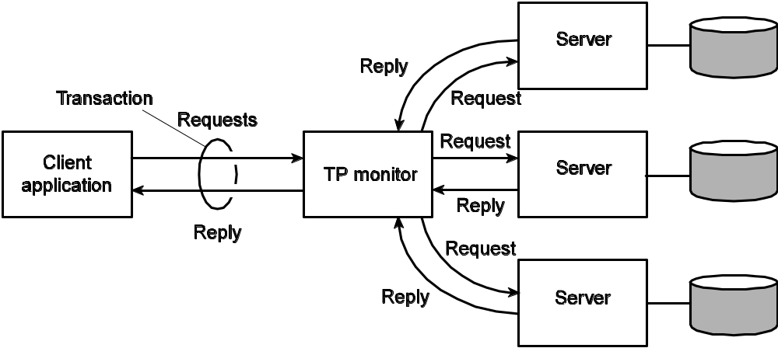
Transaction Processing Monitor
Observation: In many cases, the data involved in a transaction is distributed across several servers. A TP Monitor is responsible for coordinating the execution of a transaction:
Notes:
It is main task was to allow an application to access multiple server/databases by offering it a transactional programming model
Figure 1-10. The role of a TP monitor in distributed systems.

Slide 35
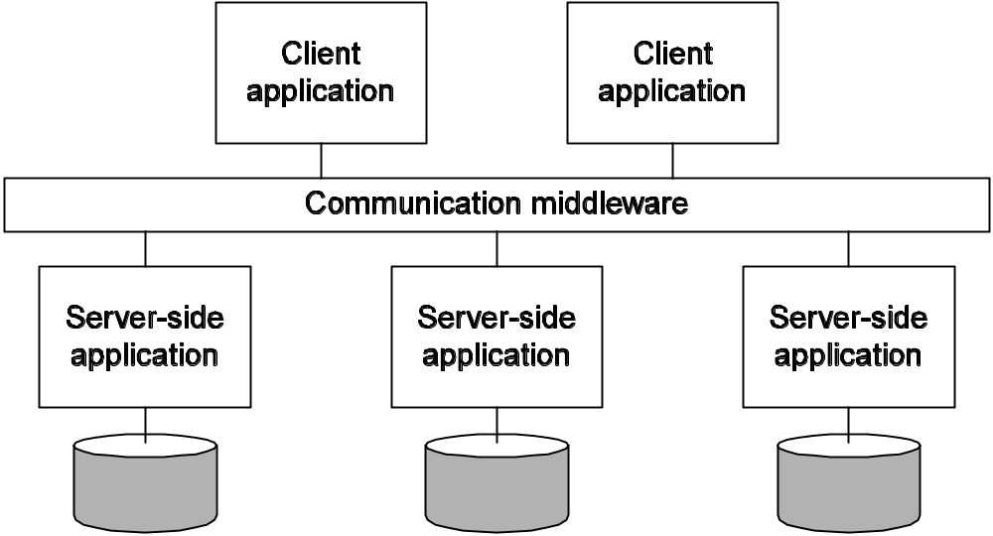
Distr. Info. Systems: Enterprise Application Integration
Problem: A TP monitor works fine for database applications, but in many cases, the apps needed to be separated from the databases they were acting on. Instead, what was needed were facilities for direct communication between applications:
  Remote Procedure Call (RPC)
  Message-Oriented Middleware (MOM)
Notes:
Figure 1-11. Middleware as a communication facilitator in enterprise application integration.

Slide 36
RPC, MOM
With RPC, an application component can effectively send a request to another application component by doing a local procedure call, which results in the request being packaged as a message and sent to the callee. Likewise, the result will be sent back and returned to the application as the result of the procedure call.
RPC and RMI have the disadvantage that the caller and callee both need to be up and running at the time of communication. In addition, they need to know exactly how to refer to each other.
With MOM, applications simply send messages to logical contact points, often described by means of a subject. Likewise, applications can indicate their interest for a specific type of message, after which the communication middleware will take care that those messages are delivered to those applications.
  These so-called publish/subscribe systems form an important and expanding class of distributed systems.

Slide 37
Distributed Pervasive Systems
Observation: There is a next-generation of distributed systems emerging in which the nodes are small, mobile, and often embedded as part of a larger system. Some requirements:
  Contextual change: The system is part of an environment in which changes should be immediately accounted for.
  Ad hoc composition: Each node may be used in a very different ways by different users. Requires ease-of-configuration.
  Sharing is the default: Nodes come and go, providing sharable services and information. Calls again for simplicity.
Observation: Pervasiveness and distribution transparency may not always form a good match.

Slide 38
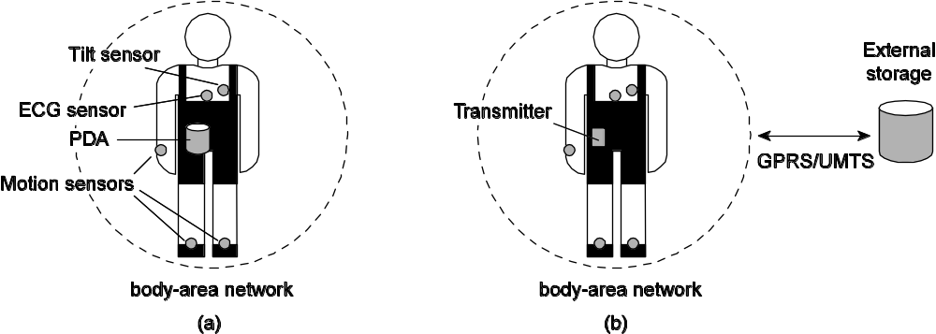
Pervasive Systems: Examples (1/2)
Home Systems: Should be completely self-organizing:
  There should be no system administrator
  Provide a personal space for each of its users
  Simplest solution: a centralized home box?
Electronic health systems: Devices are physically close to a person:
  Where and how should monitored data be stored?
  How can we prevent loss of crucial data?
  What infrastructure is needed to generate and propagate alerts?
  How can security be enforced?
  How can physicians provide online feedback?

Slide 39
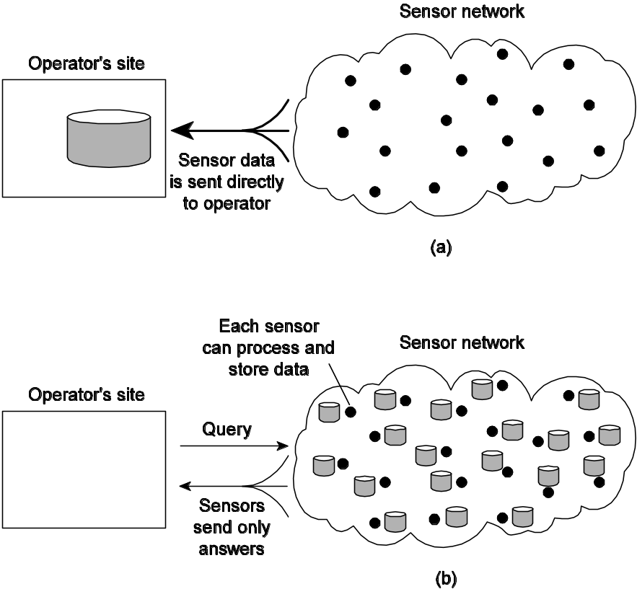
Sensor networks (2/2)
Characteristics: The nodes to which sensors are attached are:
  Many (10s-1000s)
  Simple (i.e., hardly any memory, CPU power, or communication facilities)
  Often battery-powered (or even battery-less)
Sensor networks as distributed systems: consider them from a database perspective:
Notes:
A sensor network typically consists of tens to hundreds or thousands of relatively
small nodes, each equipped with a sensing device. Most sensor networks
use wireless communication, and the nodes are often battery powered. Their limited
resources, restricted communication capabilities, and constrained power consumption
demand that efficiency be high on the list of design criteria.
The relation with distributed systems can be made clear by considering sensor
networks as distributed databases. This view is quite common and easy to understand
when realizing that many sensor networks are deployed for measurement
and surveillance applications (Bonnet et aI., 2002). In these cases, an operator
would like to extract information from (a part of) the network by simply issuing
queries such as "What is the northbound traffic load on Highway I?" Such
queries resemble those of traditional databases. In this case, the answer will probably
need to be provided through collaboration of many sensors located around
Highway 1, while leaving other sensors untouched.
To organize a sensor network as a distributed database, there are essentially
two extremes, as shown in Fig. 1-13. First, sensors do not cooperate but simply
send their data to a centralized database located at the operator's site. The other
extreme is to forward queries to relevant sensors and to let each compute an
answer, requiring the operator to sensibly aggregate the returned answers.

Slide 40
Summary (1/2)
Distributed systems consist of autonomous computers that work together to give the appearance of a single coherent system.
  One important advantage is that they make it easier to integrate different applications running on different computers into a single system.
  Another advantage is that when properly designed, distributed systems scale well with respect to the size of the underlying network.
Distributed systems often aim at hiding many of the intricacies related to the distribution of processes, data, and control.
  However, this distribution transparency not only comes at a performance price, but in practical situations it can never be fully achieved.
  The fact that trade-offs need to be made between achieving various forms of distribution transparency and can easily complicate their understanding.

Slide 41
Summary (2/2)
Matters are further complicated by the fact that many developers initially make assumptions about the underlying network that are fundamentally wrong.
  Later, when assumptions are dropped, it may turn out to be difficult to mask unwanted behavior.
  Other pitfalls include assuming that the network is reliable, static, secure, and homogeneous.
Different types of distributed systems exist which can be classified as being oriented toward supporting computations, information processing, and pervasiveness.
  Distributed computing systems are typically deployed for high-performance applications often originating from the field of parallel computing.
  A huge class of distributed can be found in traditional office environments where we see databases playing an important role. Typically, transaction processing systems are deployed in these environments.
  Finally, an emerging class of distributed systems is where components are small and the system is composed in an ad hoc fashion, but most of all is no longer managed through a system administrator

